Slide 1


PROGETTO di
INFORMATICA INDUSTRIALE
GRUPPO 10:
Silva Edoardo 816560

Slide 2
OUTLINE
Introduction ▪ Specifications
Input/Output Ports&Internal Signals Table
Hierarchical Block
VHDL Design of all stages
Simulation Results
Conclusions

Slide 3
Introduction
The project request is to implement a roadlight with 3 and 3 working modes, with a clock 100Mhz = 1 clock every 10ns.
Red and Yellow in maintenance mode (MOD5) are modulated by 2 different inputs signals.
The resulting output have been put in AND with the °enable° signal, that is accountable as a ON/OFF switch.
Since signals in the modes are independent, the clock-generator have been omitted for 3 ad-hoc signal components.
The 3 modes are: nominal, standby and maintenence; since mode and standby are to be modulated with their own mode-switch input signal and maintenance have to be acted only when the roadlight is turned on or restarted, those 2 execution modes have been jointed with a supercomponent “Normal”.
However, for testing purposes, every second in the fpga has been translated as 100 ns. Since simulating a 1 sec clock with ModelSim was too expensive.

Slide 4
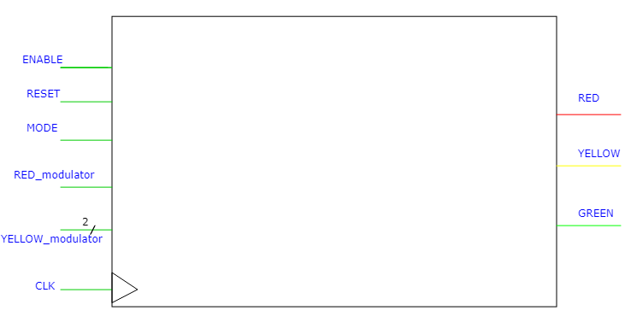
SYMBOL: I/0 diagram

Slide 5
SYMBOL: I/0 TABLE
Name | Size | Direction | Comments
Enable | 1 | input | ON/OFF switch for the circuit
Reset | 1 | input | Simulate a button that, when relased(falling edge), put the light at default function.
Mode | 1 | input | Simulate 2 buttons/switch for functioning mode MOD3:nominal → 0 MOD4:standby → 1
RED_modulator | 1 | input | Modulate the length of red-light during maintenance mode (MOD5) 0→ 0.5s 1→ 6s
Yellow_modulator | 2 | input | Modulate the length of yellow-light respect red-light during maintenance mode (MOD5) 00→ ½ Red 01→ Red 10→2 Red 11→2 Red

Slide 6
SYMBOL: I/0 TABLE
Name | Size | Direction | Comments
Clock | 1 | input | Circuit clock
RED | 1 | output | Red-light
YELLOW | 1 | output | Yellow-light
GREEN | 1 | output | Green-light

Slide 7
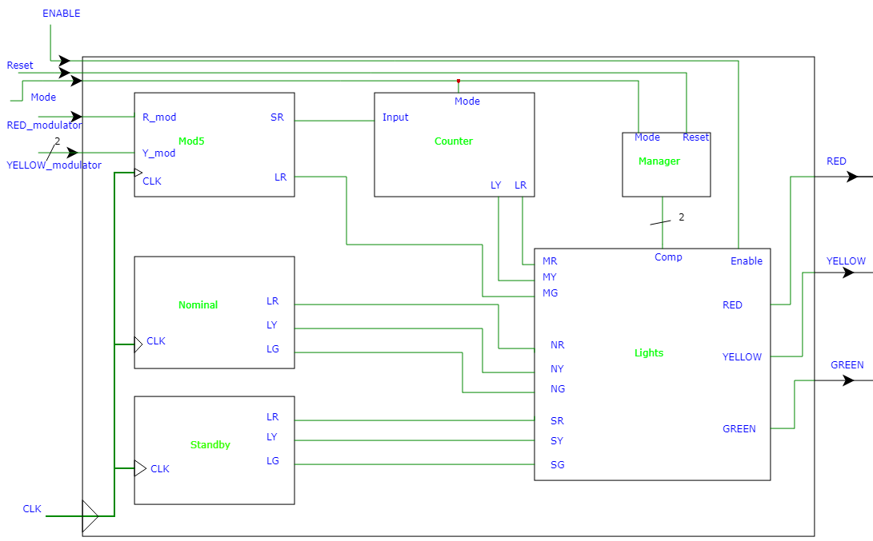
Top-view block scheme

Slide 8
INTERNAL SIGNALS TABLE
Name | Components | Size | Comments
SR-Input | Mod5-Counter | 1 | Signal counting half the interval of a blink of red-light during Maintenance mode.
LR-MG | Mod5-Lights | 1 | Signal of green-light during maintenance mode
LY-MY | Counter-Lights | 1 | Signal of yellow-light during maintenance mode
LR-MR | Counter-Lights | 1 | Signal of red-light during maintenance mode
LR-NR | Nominal-Lights | 1 | Signal of red-light during nominal mode
LY-NY | Nominal-Lights | 1 | Signal of yellow-light during nominal mode
LG-NG | Nominal-Lights | 1 | Signal of green-light during nominal mode
LR-SR | Standby-Lights | 1 | Signal of red-light during Standby mode
LY-SY | Standby-Lights | 1 | Signal of yellow-light during Standby mode
LG-SG | Standby-Lights | 1 | Signal of green-light during Standby mode
Comp | Manager-Lights | 2 | A signal that indicate the possible modality in which to operate

Slide 9
Schema of all Stages

