Slide 1
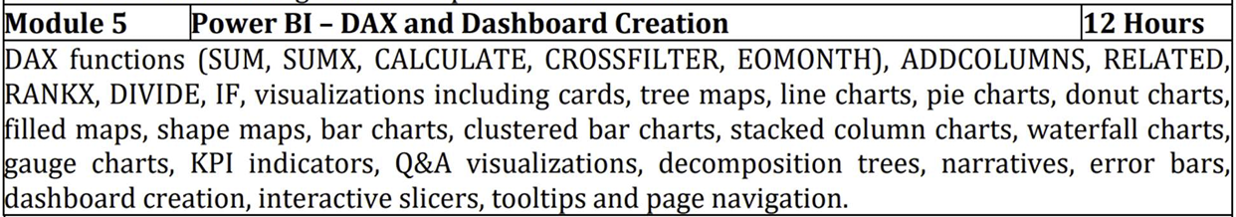

Slide 2
In Power BI, a DAX function refers to a function written in DAX — Data Analysis Expressions. DAX is a formula language used in Power BI, Excel Power Pivot, and SQL Server Analysis Services (SSAS) for creating custom calculations on data models.
What is a DAX Function?
A DAX function is a predefined formula or operation you can use to manipulate data, create new columns, measures, or tables, and build more advanced analytics.
Think of DAX like Excel formulas — but built specifically for data modeling and analytics.

Slide 3
SUM
The SUM() function adds up all the numeric values in a single column.
Syntax:
SUM(<column>)
<column>: The name of the column containing numbers you want to sum.
The column must contain numeric data types like integers or decimals (not text or Boolean).

Slide 4

1. Creating a Measure
You're creating a measure called SUM.
Measures are calculations that aggregate data dynamically based on the filters applied in visuals (tables, charts, slicers, etc.).
2. Using the SUM() Function
The SUM() function is summing the values in the column Orders[Selling Price].
In plain language:
“Add up all the values in the Selling Price column of the Orders table.”

Slide 5
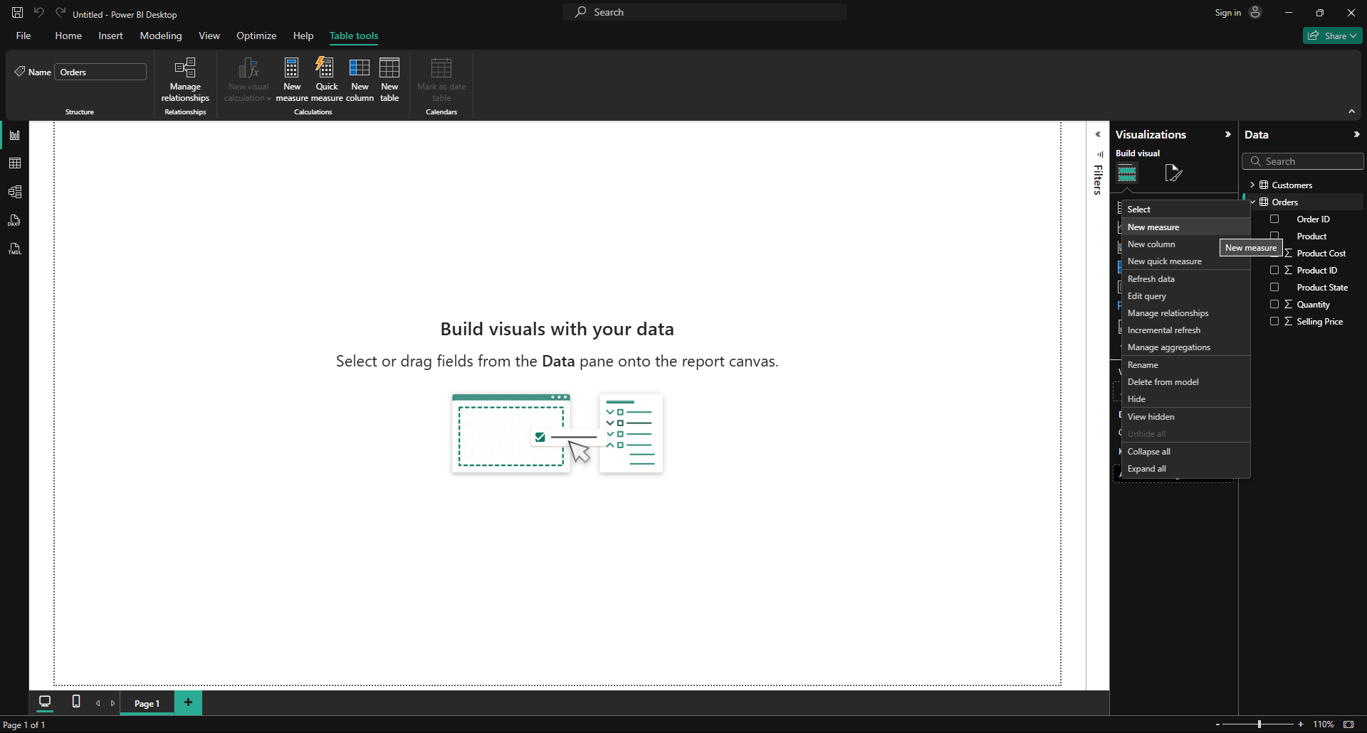




Slide 6
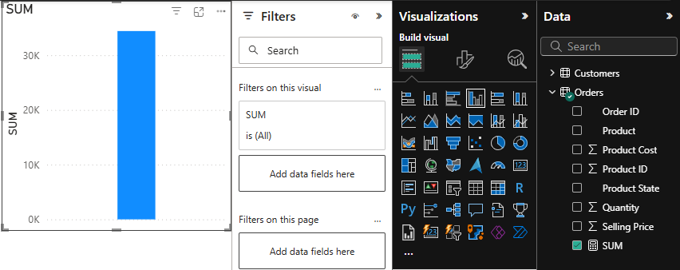

SUM(<Table>[<Column>])

Slide 7
SUMX
What is SUMX in DAX?
SUMX is an iterator function. Unlike SUM() which just adds up a column, SUMX():
Calculates an expression for each row of a table.
Then sums those results.
It’s used when you want to sum a calculated value, not just a plain column.
Syntax
SUMX(<table>, <expression>)
Parameter | Description
<table> | The table to iterate over (usually a table or table expression).
<expression> | The formula to evaluate for each row in the table.

Slide 8
For each row in the Orders table, subtract the Product Cost from the Selling Price, and then sum up all those differences

Slide 9
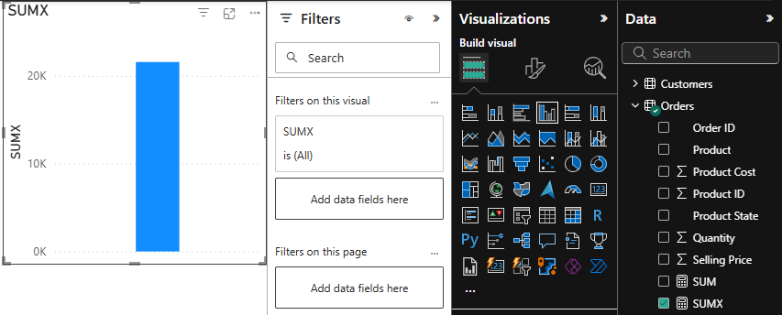
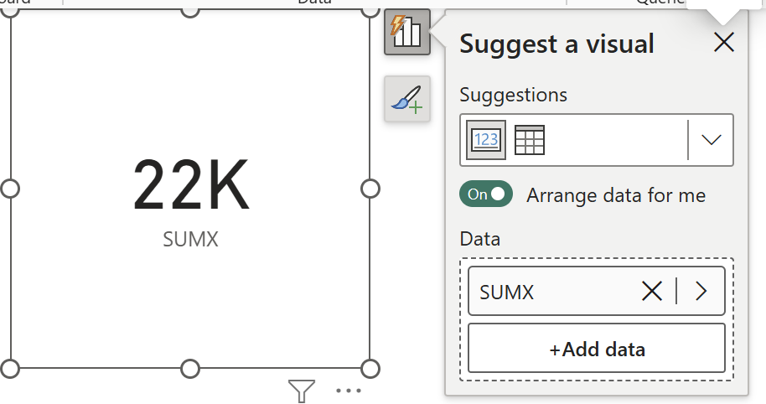



*Measure

Slide 10
Calculate
CALCULATE() evaluates a DAX expression in a customized filter context.
Power BI automatically applies filters based on:
Visuals (like selecting a region or year)
Slicers
But CALCULATE() gives you manual control over those filters:
You can override, add, or remove filters.
You can create calculations independent of user selections.

Slide 11
Calculate
Syntax
CALCULATE(<expression>, <filter1>, <filter2>, ...)
Part | Description
<expression> | A DAX expression that returns a value (often an aggregation like SUM(), AVERAGE(), COUNT(), etc.)
<filter> | One or more filters to apply or modify the current filter context
Eg:
Total Profit West = CALCULATE(
SUMX(Orders, Orders[Selling Price] - Orders[Product Cost]),
Region[Name] = "West"
)

Slide 12
This creates a measure called Calculate By Karnataka, and it does the following:
1. SUM(Orders[Quantity])
This part sums up all the values in the Quantity column from the Orders table.
2. Orders[Product State] = "Karnataka"
This is a filter condition.
It tells Power BI to only include rows where the Product State is "Karnataka".
3. CALCULATE(...)
The CALCULATE function applies the filter (Product State = "Karnataka") before evaluating the SUM(Orders[Quantity]).
This measure returns the total quantity of all orders where the Product State is Karnataka, regardless of what the current filters or slicers on state may be.

Slide 13
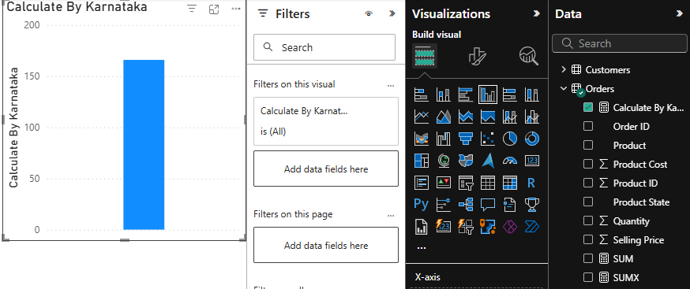








*Measure

Slide 14
Cross Filter
In Power BI and DAX, CROSSFILTER is a function that lets you control the direction of filtering between two related tables — it’s especially useful when dealing with ambiguous relationships or custom calculations that require a specific flow of filter context.
CROSSFILTER() is a DAX function used inside CALCULATE() to override the default direction of a relationship between two tables.
Syntax:
CROSSFILTER(<Table1Column>, <Table2Column>, <Direction>)
Parameter | Description
Table1Column | One side of the relationship (usually from the dimension table)
Table2Column | Other side of the relationship (usually from the fact table)
Direction | One of the following: "None", "OneWay", or "Both"

Slide 15
Example
Let's say you have:
Customers table (CustomerID, Name)
Orders table (CustomerID, Quantity)
Normally, you’d have a one-to-many relationship:
Customers[CustomerID] → Orders[CustomerID]
Now imagine you want to sum quantities for customers, but force filters to flow both ways:
Total Qty With Crossfilter =
CALCULATE(
SUM(Orders[Quantity]),
CROSSFILTER(Customers[CustomerID], Orders[CustomerID], "Both")
)

Slide 16
Example applied here
TotalQuantityByCustomerState =
CALCULATE(
SUM(Orders[Quantity]),
CROSSFILTER(Customers[Order ID], Orders[Order ID], Both)
)
1. SUM(Orders[Quantity])
This sums up the Quantity column from the Orders table.
It calculates the total number of items/orders.
2. CROSSFILTER(Customers[Order ID], Orders[Order ID], Both)
This overrides the default filter direction between the Customers and Orders tables on the Order ID columns.
It forces filters to flow both ways between these two columns/tables.
3. CALCULATE(...)
CALCULATE changes the context in which the sum is evaluated.
Here, it evaluates the sum while applying the bidirectional filter behavior specified by CROSSFILTER.

Slide 17
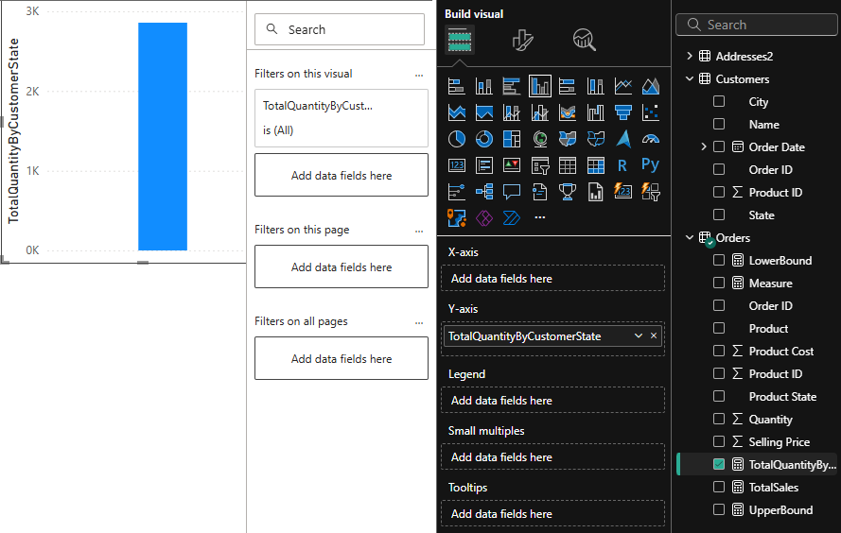



CROSSFILTER(<Column1>, <Column2>, <Direction>)

Slide 18
EOMONTH
EOMONTH stands for End Of Month.
It returns the date of the last day of a month, shifted by a specified number of months from a start date.
Syntax:
EOMONTH(<start_date>, <number_of_months>)
Parameter | Description
<start_date> | A date value or column containing dates
<number_of_months> | Number of months to shift. Can be positive, negative, or zero

Slide 19
How It Works:
If <number_of_months> is 0, it returns the last day of the month of the <start_date>.
If positive, it returns the last day of the month after shifting forward that many months.
Formula | Result Explanation
EOMONTH("2023-09-10", 0) | Returns 2023-09-30 (end of September)
EOMONTH("2023-09-10", 1) | Returns 2023-10-31 (end of October)
EOMONTH("2023-09-10", -1) | Returns 2023-08-31 (end of August)

Slide 20
Example
MonthEndDisplay = EOMONTH(MAX(Customers[Order Date]), 0)
This DAX measure (or calculated column) is calculating the last day of the month for the latest order date found in the Customers[Order Date] column.
1. MAX(Customers[Order Date])
This returns the latest (maximum) order date from the Customers table.
Example: if the column has dates like 2023-05-01, 2023-07-15, and 2023-09-09, this will return 2023-09-09.
2. EOMONTH(..., 0)
Now we pass that latest date (2023-09-09 in our example) into the EOMONTH() function.
The second parameter 0 means:
  "Don't shift the month, just give me the end of the same month."
So EOMONTH("2023-09-09", 0) returns 2023-09-30.

Slide 21
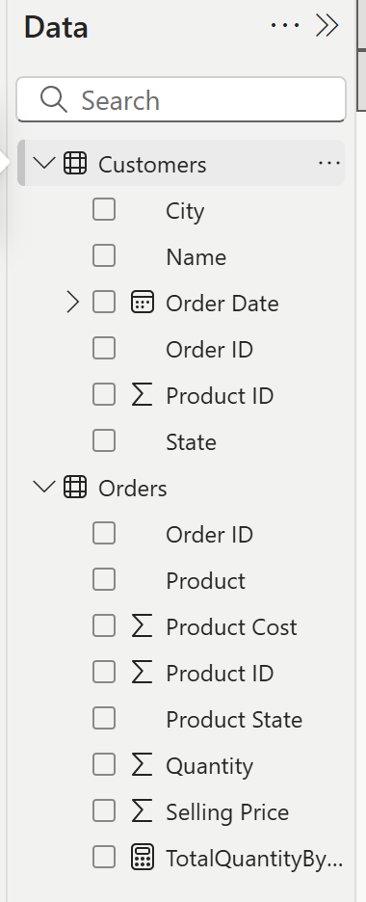
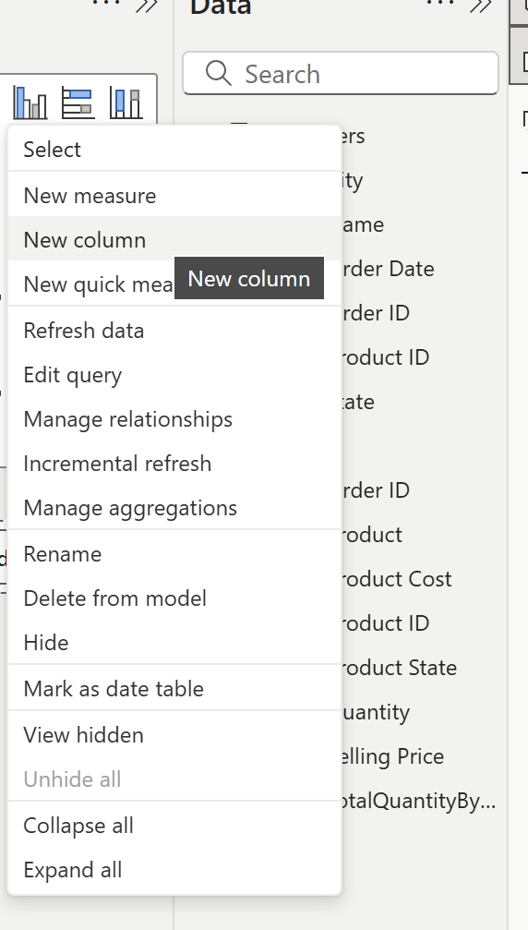




Slide 22
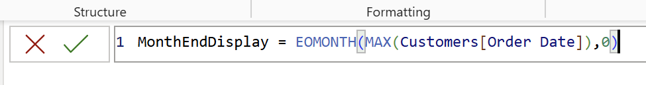
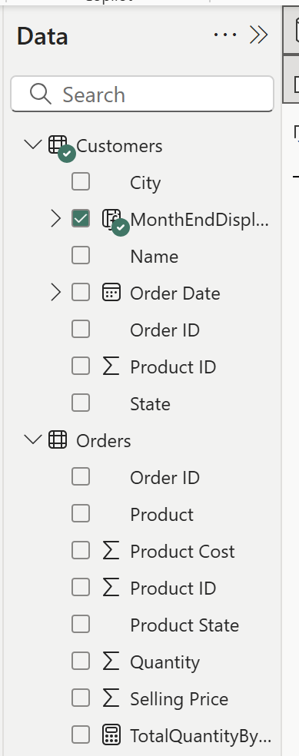
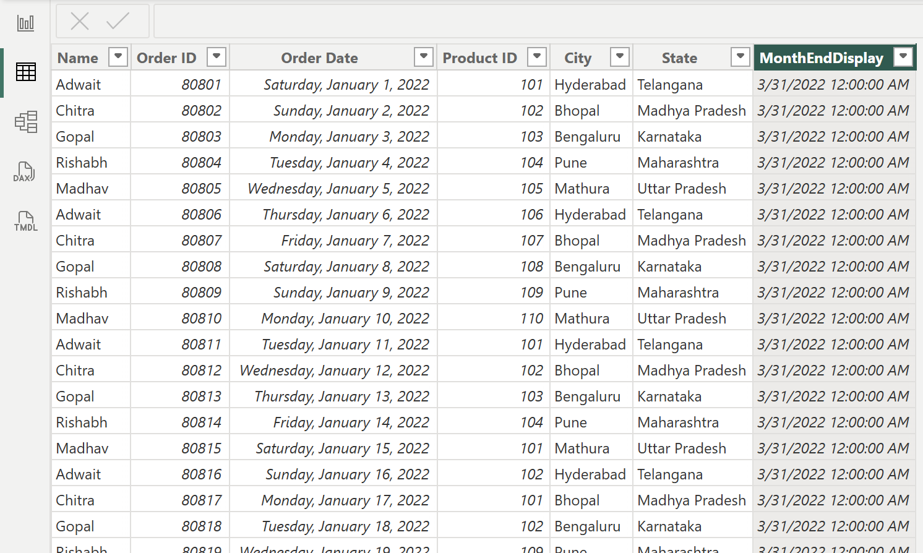





Slide 23
Adding New Column

Slide 24
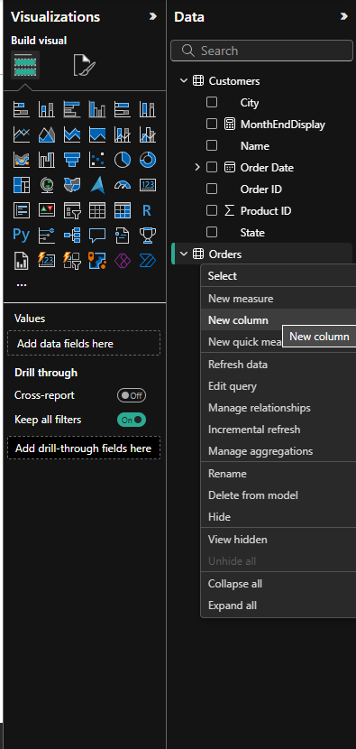
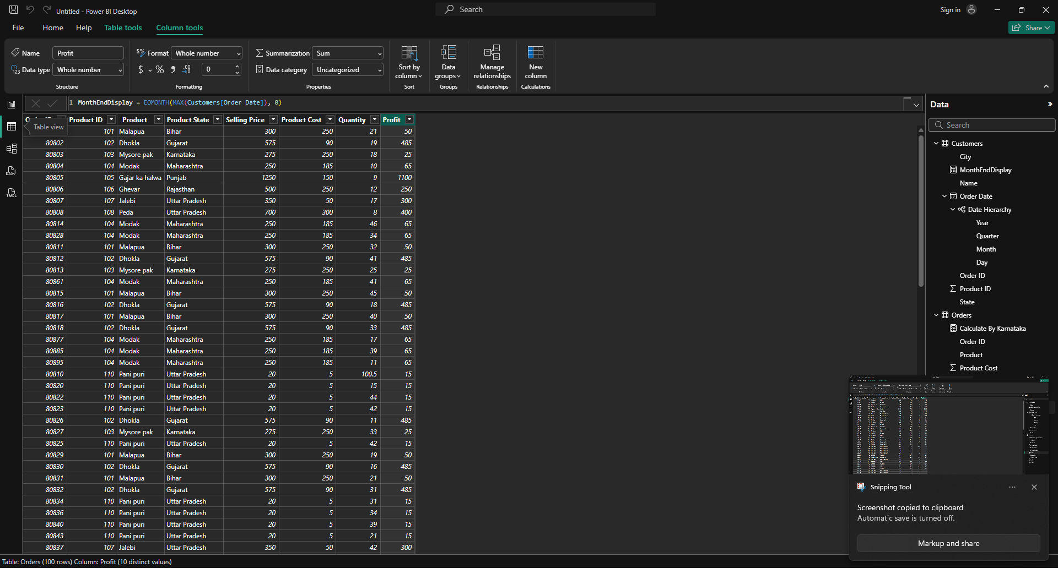




Slide 25
Related
The RELATED() function is used to get a value from another table that is linked to the current table.
When do you use it?
You use RELATED() when:
Two tables are connected (via relationships).
You want to pull data from one table into another.
How does it work?
It works from the many side to the one side of a relationship.
You can only use it if a relationship exists between the tables.
Syntax:
RELATED(<RelatedTable>[<Column>])

Slide 26
Simple example
You have two tables:
Sales table:
SaleID | CustomerID | Amount
1 | 101 | 500
2 | 102 | 300
Customers table:
CustomerID | Name
101 | Alice
102 | Bob
These two tables are linked by CustomerID.
Now, in the Sales table, you want to show the customer's name.

Slide 27
You can write:
CustomerName = RELATED(Customers[Name])
And you’ll get this in the Sales table:
SaleID | CustomerID | Amount | Name
1 | 101 | 500 | Alice
2 | 102 | 300 | Bob

Slide 28

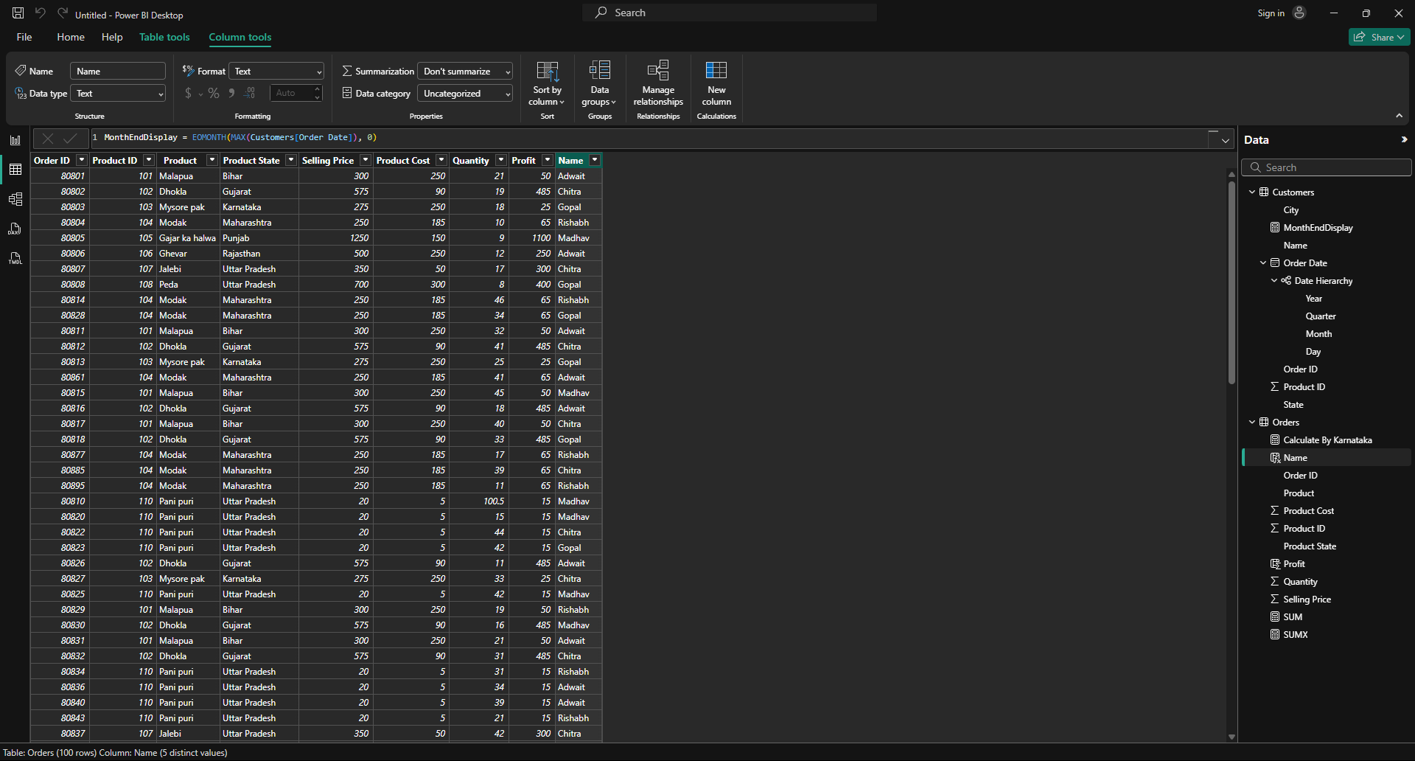

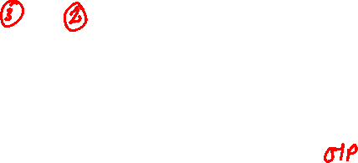
*Column

Slide 29
RANKX
.
RANKX() is a DAX function that gives ranking to items based on a value (like sales, marks, score, etc.).
It answers questions like:
“Who is the top-selling product?”
“What is the rank of each employee based on their performance?”
Basic Syntax:
RANKX(<Table>, <Expression>, [, Value], [, Order])
<Table>: The list of items you want to rank (like products, employees).
<Expression>: The value to rank by (like total sales).
Order: Optional — use DESC for highest to lowest (default), ASC for lowest to highest

Slide 30
Rankx Function Used in this case explained
DAX Code:
ProductRank =
RANKX(
ALL(Orders[Product]),
CALCULATE(SUM(Orders[Quantity])),
,
DESC,
DENSE)
This formula is ranking products based on the total quantity sold, from highest to lowest, using the RANKX() function.
Part | What it does
RANKX(...) | The main function used to rank items
ALL(Orders[Product]) | Returns a list of all products (ignoring any filters), so you can rank across all products
CALCULATE(SUM(Orders[Quantity])) | For each product, calculates the total quantity sold
DESC | Ranks from highest to lowest (e.g., best-selling product gets rank 1)
DENSE | If two products have the same quantity, they’ll share the same rank and the next rank won't be skipped (i.e., 1, 2, 2, 3...)

Slide 31
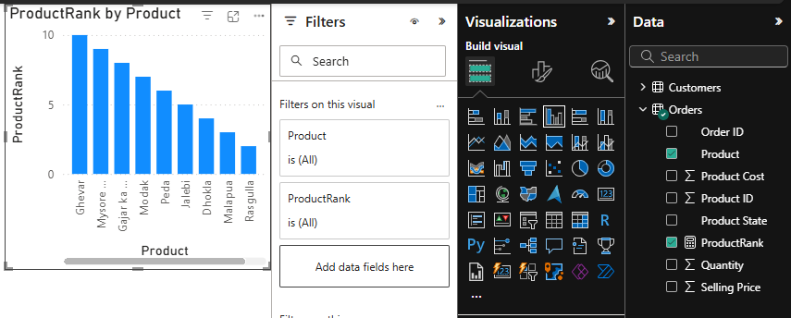








*Measure

Slide 32
Divide
DIVIDE() is a DAX function that safely divides one number by another and avoids errors like "division by zero".
Syntax:
DIVIDE(numerator, denominator, [alternateResult])
Argument | Description
numerator | The number on top (what you want to divide)
denominator | The number on bottom (what you divide by)
alternateResult | (Optional) What to show if the denominator is 0

Slide 33
Example in this case
SalesPerUnit =
DIVIDE(
SUMX(Orders, Orders[Selling Price] * Orders[Quantity]),
SUM(Orders[Quantity])
)
This formula is computing the average selling price per unit.

Slide 34
Step-by-step, using a sample dataset:
Row | Selling Price (Orders[Selling Price]) | Quantity (Orders[Quantity]) | Selling Price * Quantity (Row Total)
1 | 10 | 5 | 10 * 5 = 50
2 | 12 | 3 | 12 * 3 = 36
3 | 8 | 2 | 8 * 2 = 16
Sum | — | 5 + 3 + 2 = 10 | 50 + 36 + 16 = 102
How the formula works:
Step | Result | Explanation
SUMX(Orders, Selling Price * Quantity) | 102 | Calculates the total sales amount by multiplying and summing each row’s price × quantity
SUM(Orders[Quantity]) | 10 | Calculates the total quantity sold by summing all quantities
DIVIDE(102, 10) | 10.2 | Divides total sales amount by total quantity to get average selling price per unit

Slide 35
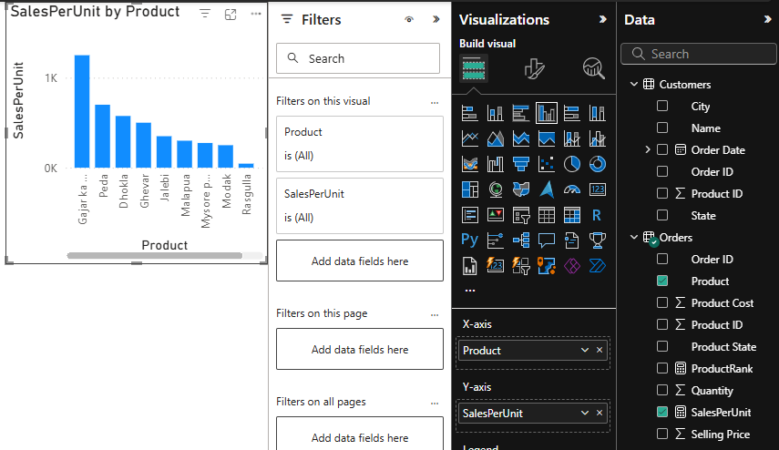







*Measure

Slide 36
If
PriceCategory = IF(
Orders[Selling Price] < 300,
"Low",
IF(
Orders[Selling Price] < 800,
"Medium",
"High"
)
)
This formula creates a new calculated column called PriceCategory in the Orders table.
It categorizes each order’s Selling Price into three groups based on the price value:
Condition | Category
Selling Price less than 300 | "Low"
Selling Price between 300 and 799 | "Medium"
Selling Price 800 or more | "High"

Slide 37
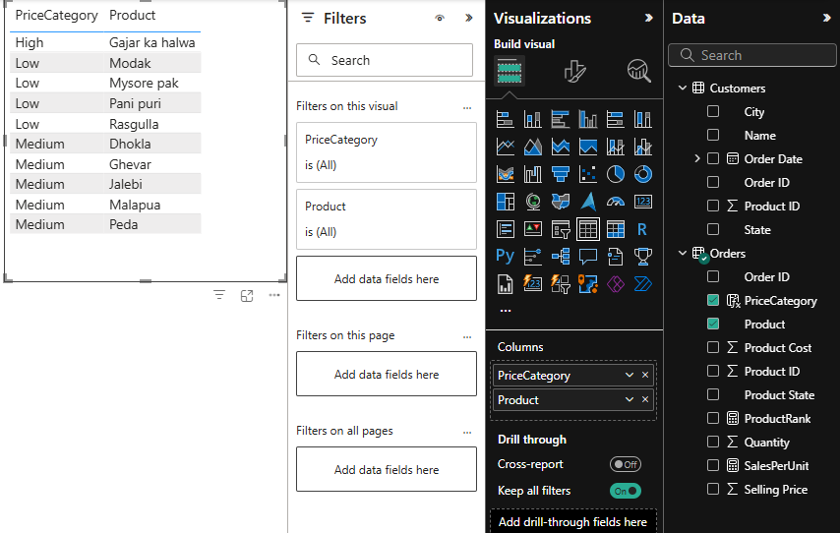








*Column
IF(<logical_test>, <value_if_true>, [<value_if_false>])

Slide 38
A Treemap is a visual chart that displays data as nested rectangles.
Each rectangle represents a category (like Product, Region, etc.).
The size of each box shows a value (like Sales, Quantity, etc.).
You can also use colors to represent another metric (like profit margin).

Slide 39
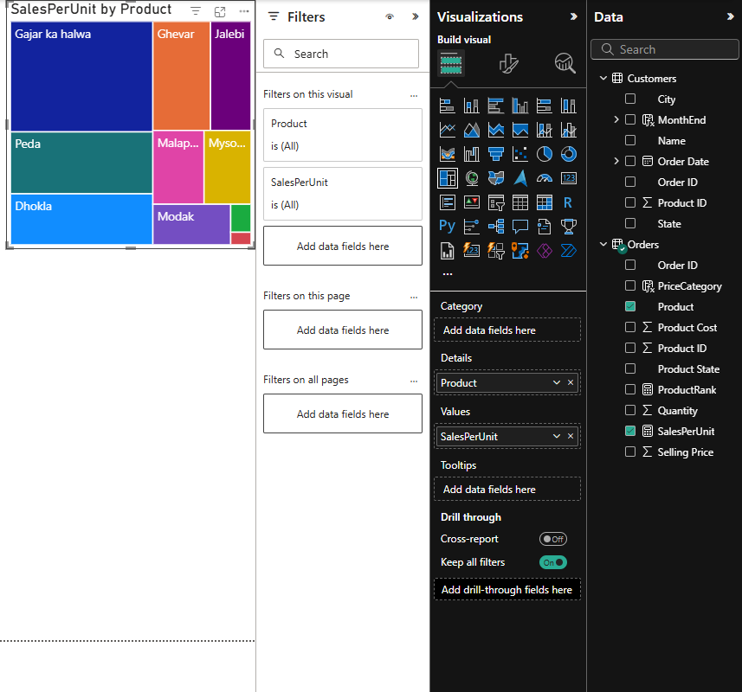



Tree Maps

Slide 40
A Filled Map in Power BI is a visualization that shows geographical data on a map where regions (like countries, states, or districts) are shaded based on values.
Shading (color intensity) = Represents a measure (e.g., sales, population, profit).
The darker or brighter the color, the higher the value.
It’s like a heatmap on a map.

Slide 41
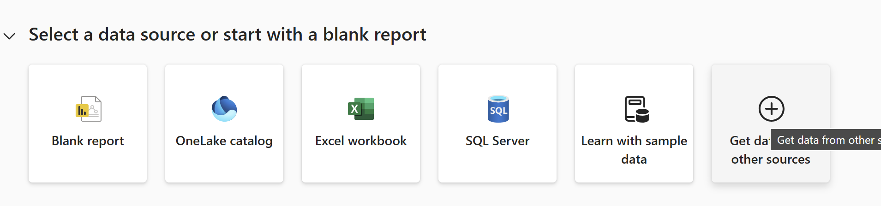
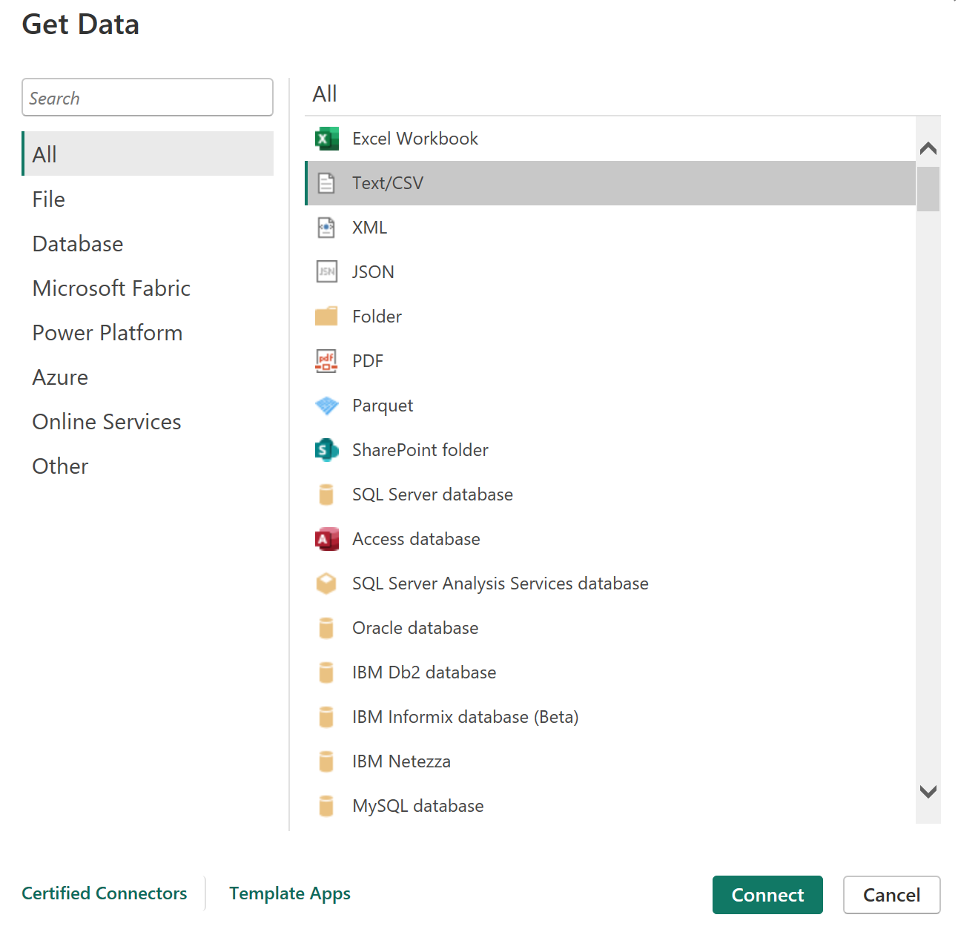
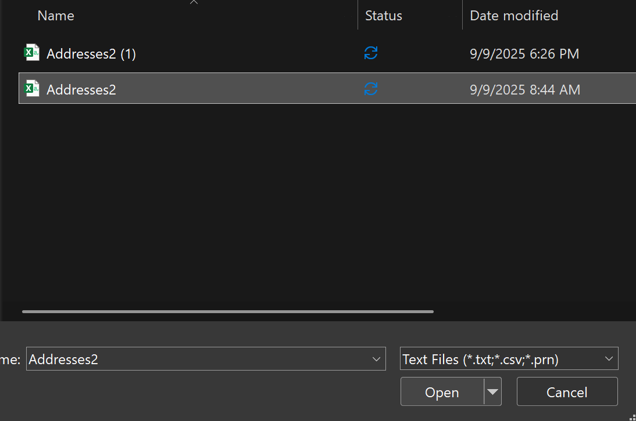



Slide 42
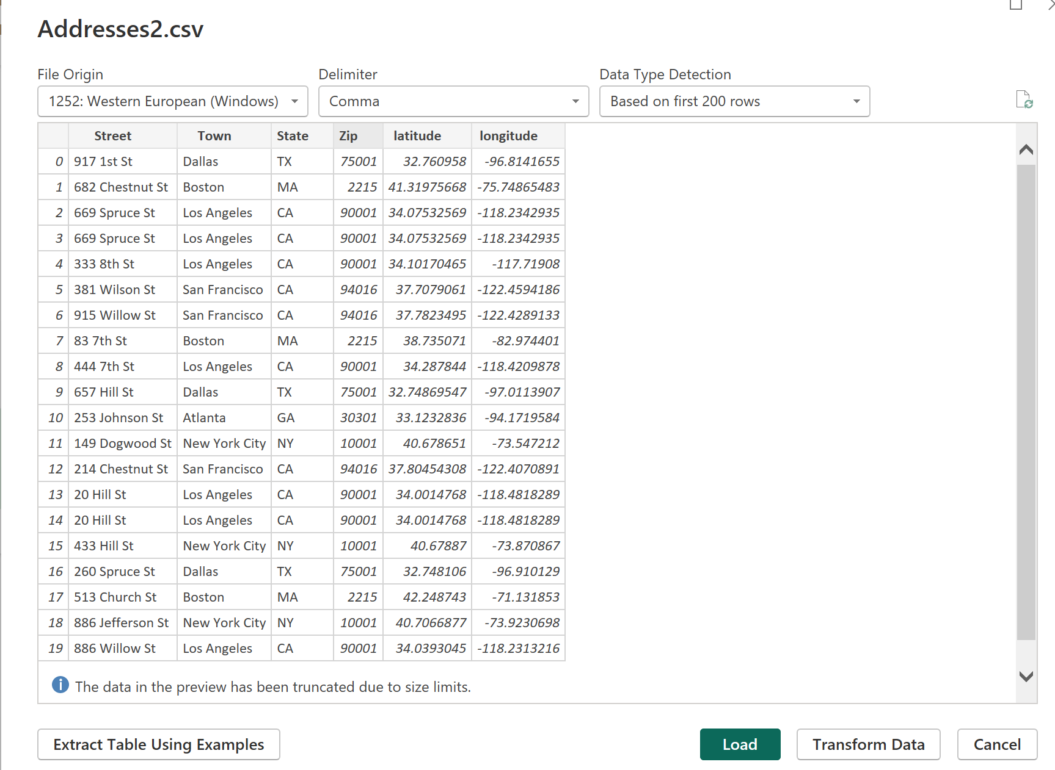

Slide 43
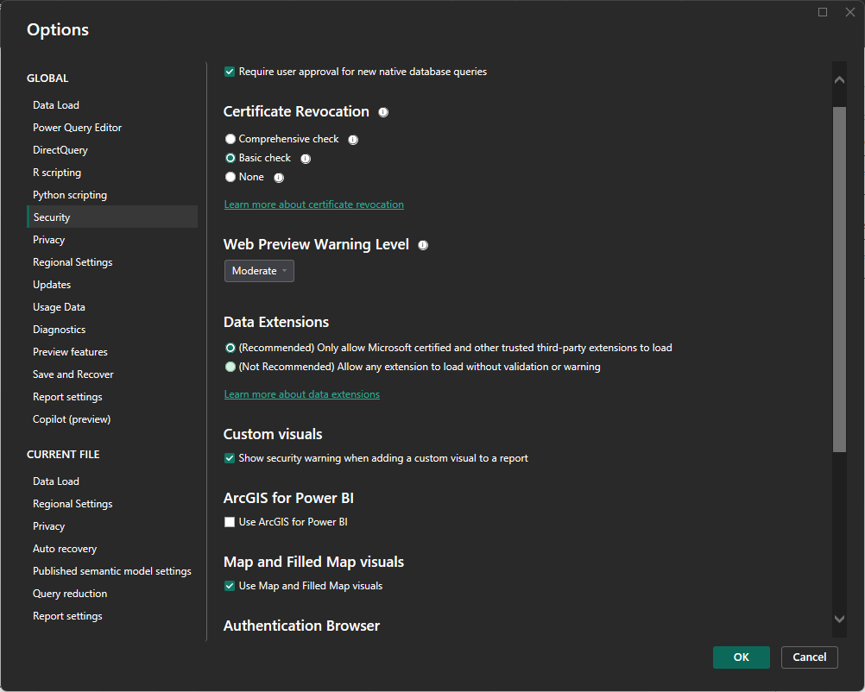




Filled Map

Slide 44
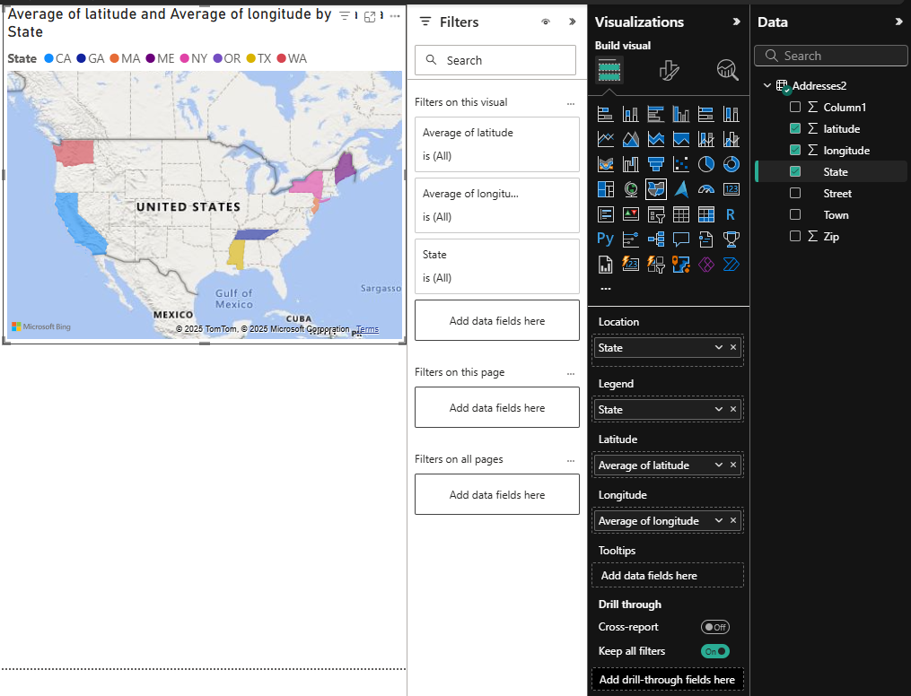









Slide 45
Shape Map
A Shape Map in Power BI is just a map where you control the shapes.
Normal maps (like Filled Map) use Bing Maps to show countries, states, cities.
Shape Map lets you upload your own shapes (like boundaries of states, districts, or even custom zones) using a TopoJSON file.
You can then color each shape based on your data (for example: sales, population, marks, etc.).
Example: If you have sales data for each Indian state, and you use an India states shape file, Power BI will color each state differently based on the sales value.

Slide 46
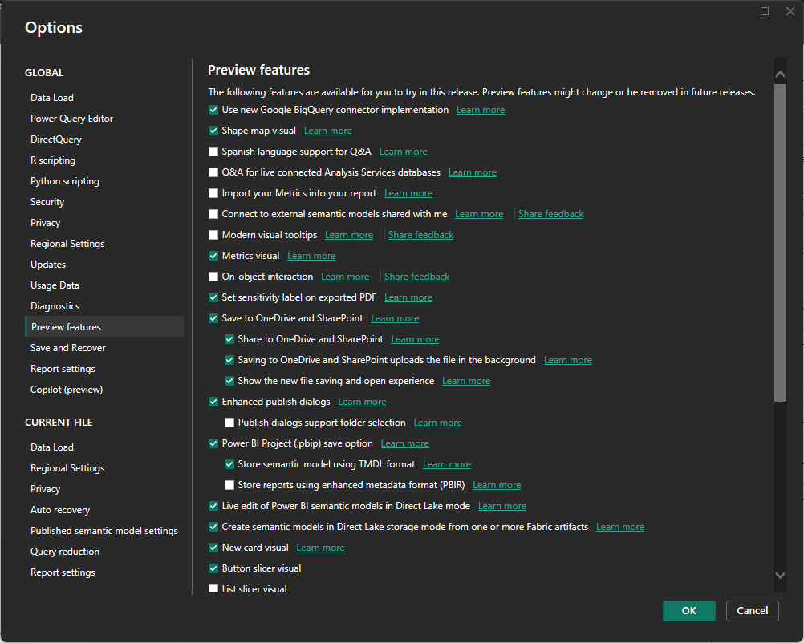

Shape Map

Slide 47
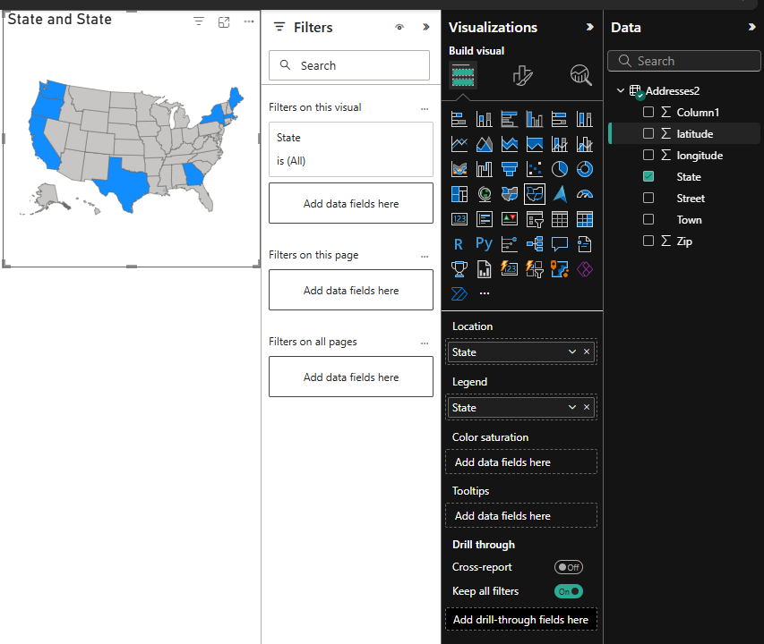







Slide 48
A Waterfall Chart
A Waterfall Chart in Power BI (and Excel) is a type of chart that shows how a starting value changes step by step to reach an ending value.
It’s often used to explain increases and decreases in things like profit, sales, expenses, or budgets.
Key Features:
Starts with an initial value.
Shows increases (bars go up).
Shows decreases (bars go down).
Ends with the final total.

Slide 49
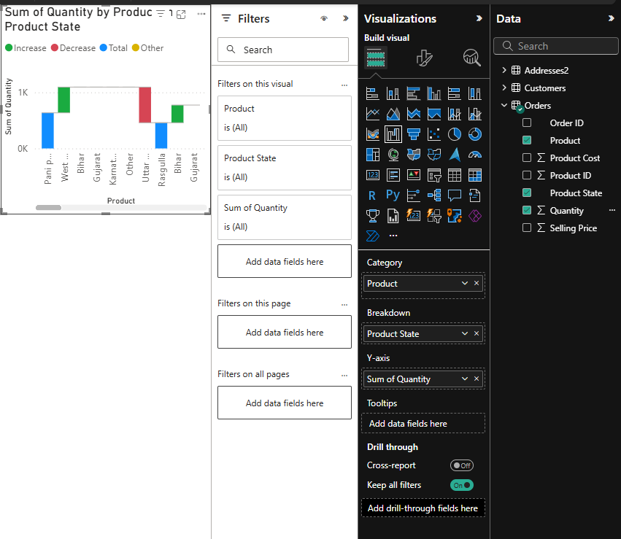









Waterfall Chart

Slide 50
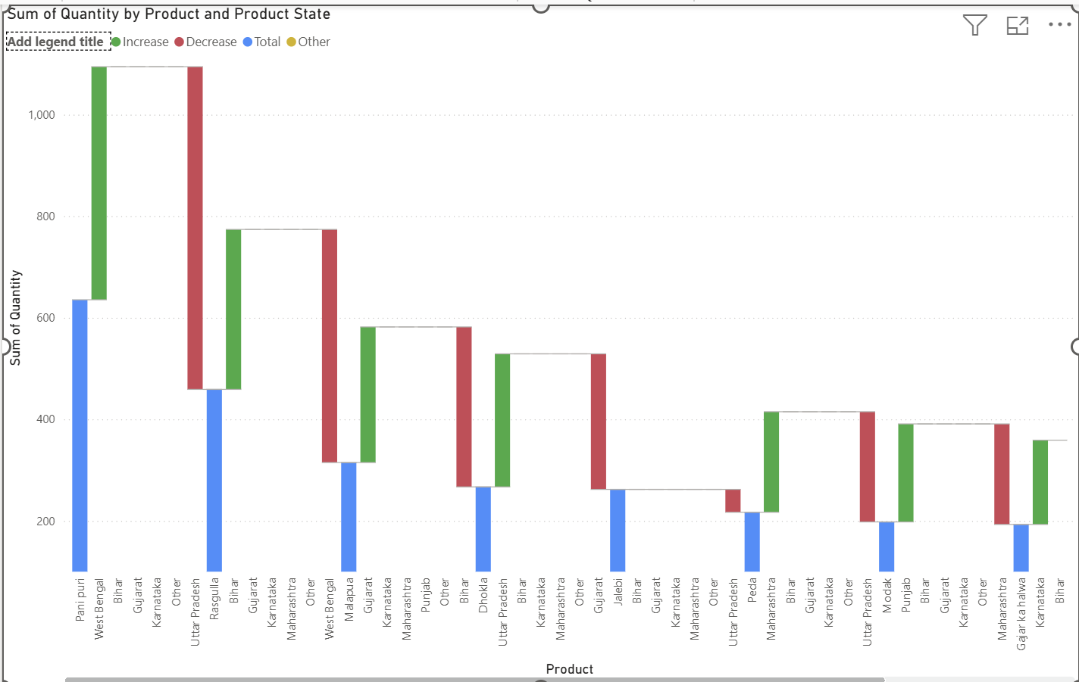

Slide 51
Gauge Chart
A Gauge Chart is a visual in Power BI (and other tools) that looks like a speedometer or dial. It’s mainly used to show progress toward a target.
Example:
Suppose your monthly sales target = ₹1,00,000
Current sales = ₹70,000
The gauge will show a dial from 0 to 1,00,000, and the pointer will stop at 70,000 → meaning you’ve achieved 70% of your goal.

Slide 52
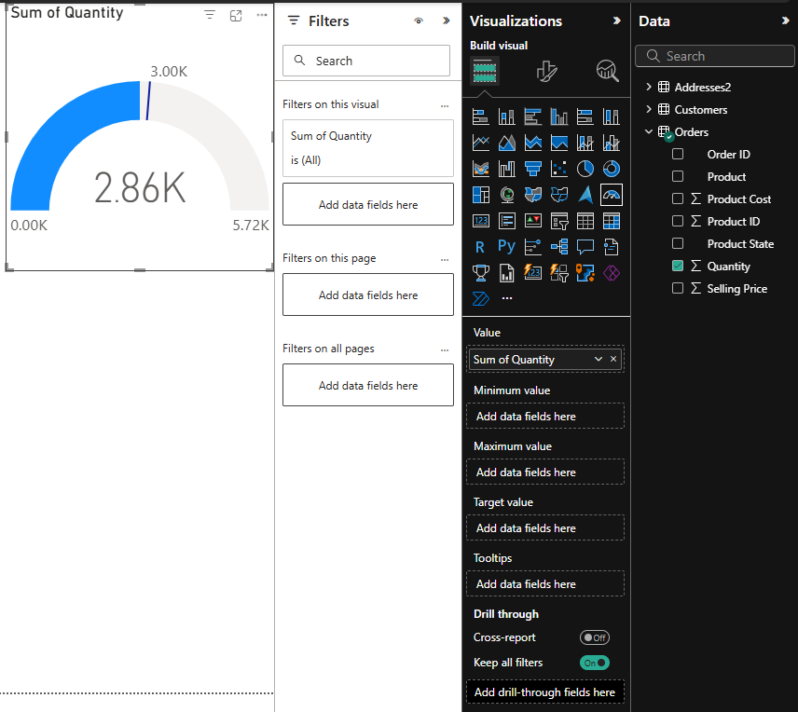
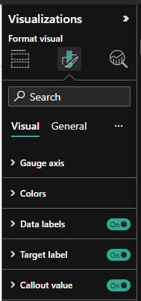





Gauge Chart

Slide 53
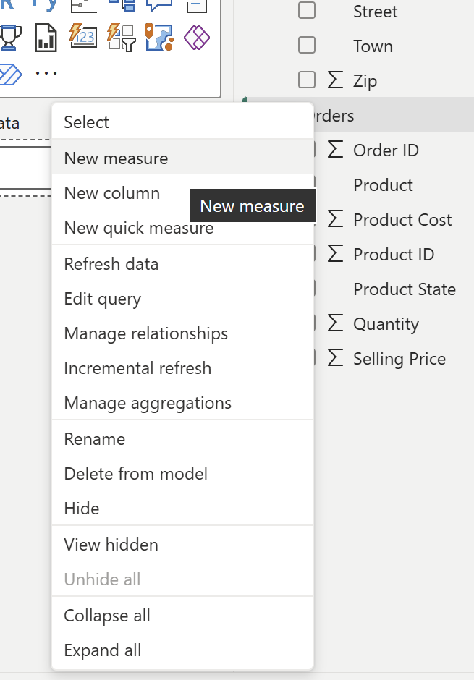
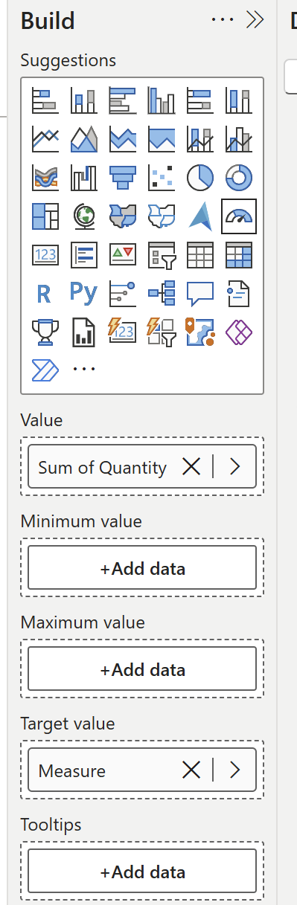
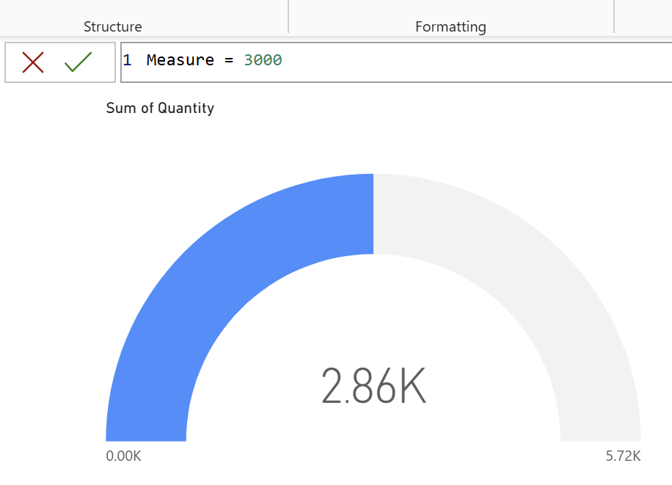



Slide 54
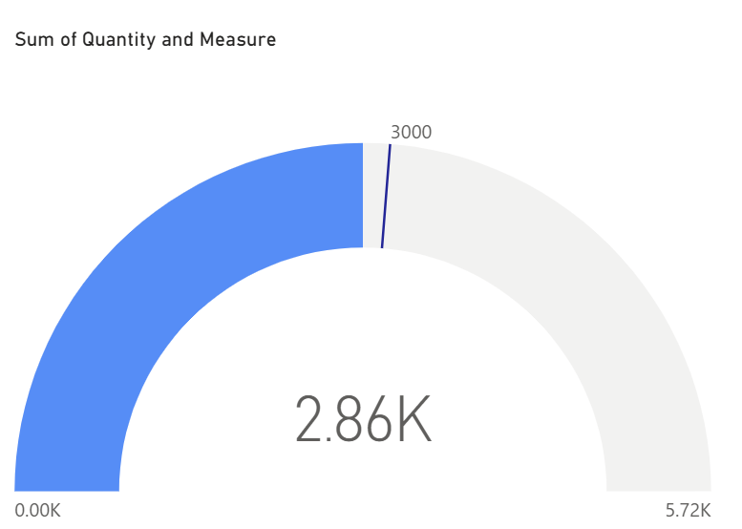

Slide 55
KPI
A KPI (Key Performance Indicator) visual in Power BI is used to track progress toward a goal at a glance.
Shows a main value (like current sales).
Compares it against a target/goal.
Often includes an indicator (arrow, color, trend) to quickly tell if performance is good or bad.

Slide 56


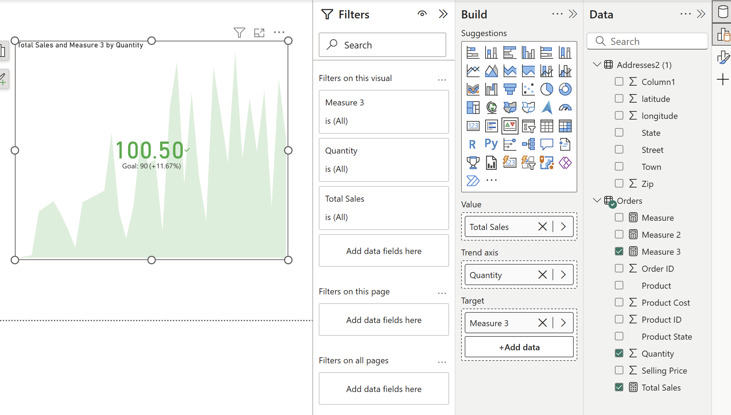
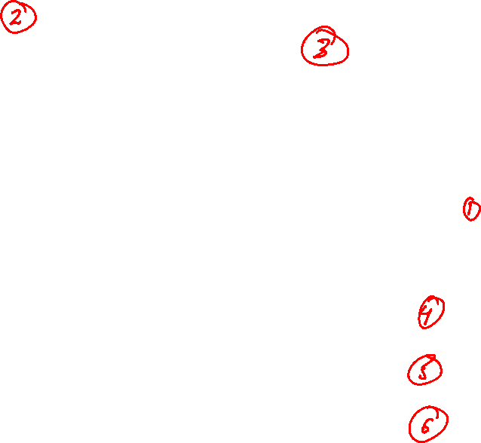

Slide 57
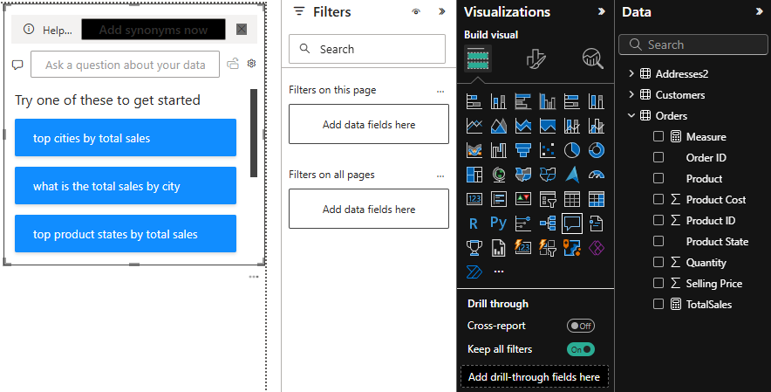
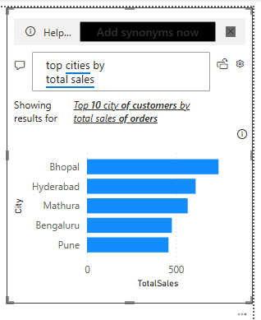




QnA Visualization

Slide 58
Decomposition Tree
A Decomposition Tree in Power BI is a special visual that helps you break down a number step by step into its contributing factors.
Start with a main value (like Total Sales or Profit).
Then drill down into different categories (Region → Product → Sales Rep → etc.).
Power BI shows how much each category contributes to the total.

Slide 59
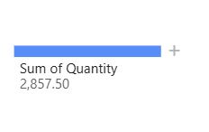
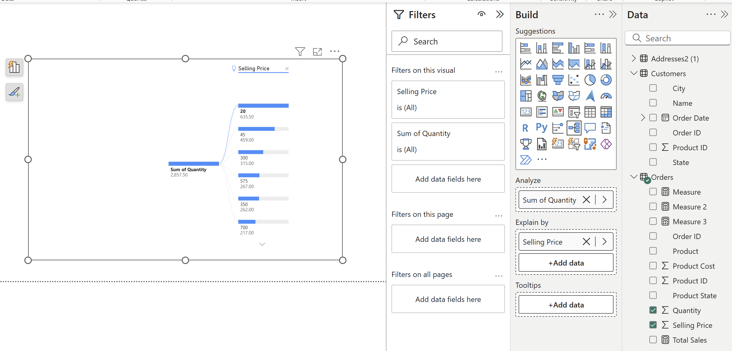
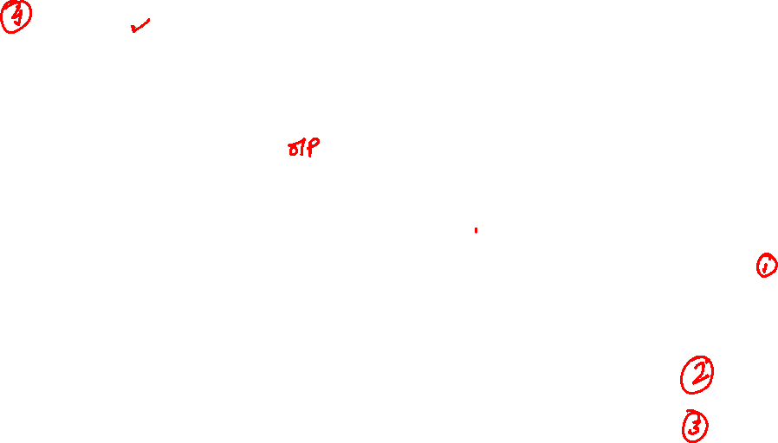

Slide 60
What the visual is doing:
Main Value (Analyze field):
  At the left, we see Sum of Quantity = 2,857.50.
  This is the total value you’re analyzing.
Breakdown (Explain by field):
  You’ve chosen Selling Price as the factor to break down this total.
  Power BI is splitting the total quantity across different selling prices.
Branches (the breakdown):
  For Selling Price = 20, the quantity is 635.50.
  For Selling Price = 45, the quantity is 459.00.
  For Selling Price = 300, the quantity is 315.00.
  For Selling Price = 575, the quantity is 267.00.
  For Selling Price = 350, the quantity is 262.00.

Slide 61
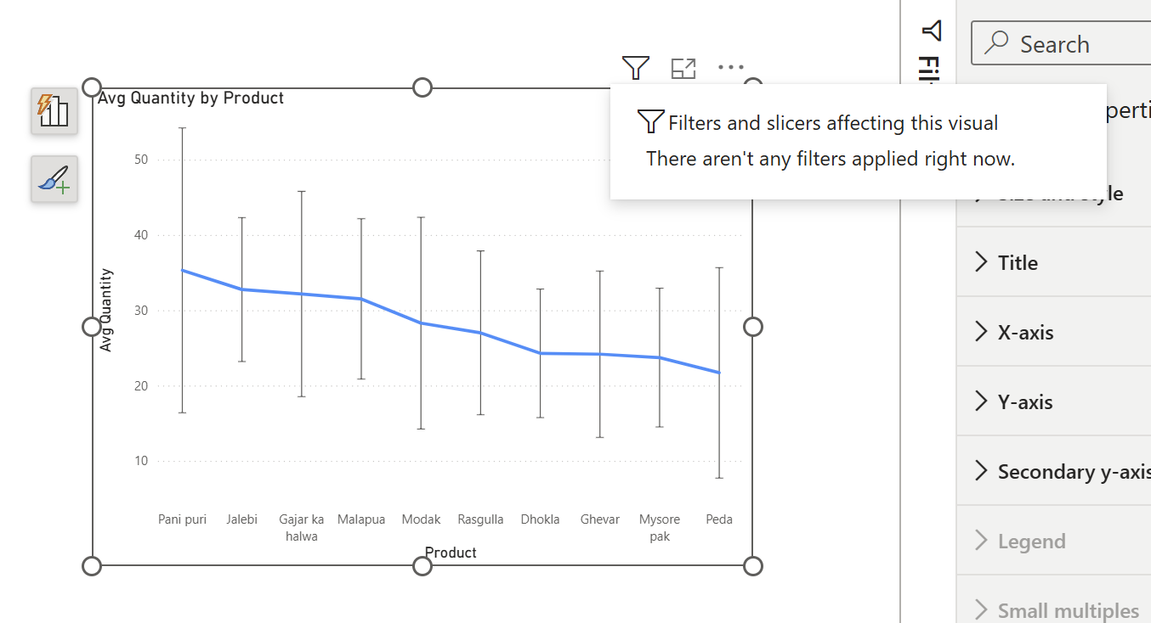
Tooltip

Slide 62
Dashboard Creation
Interactive Slicer
Follow Module 1

Slide 63
Error Bars
Error Bars in Power BI are used to show the uncertainty, variability, or possible error range in your data. They give viewers an idea of how precise a value is. They appear as small lines above and below the data point (like in Excel charts).
They can show:
Standard deviation
Standard error
Percentage error
Or even a custom range you define

Slide 64




Slide 65
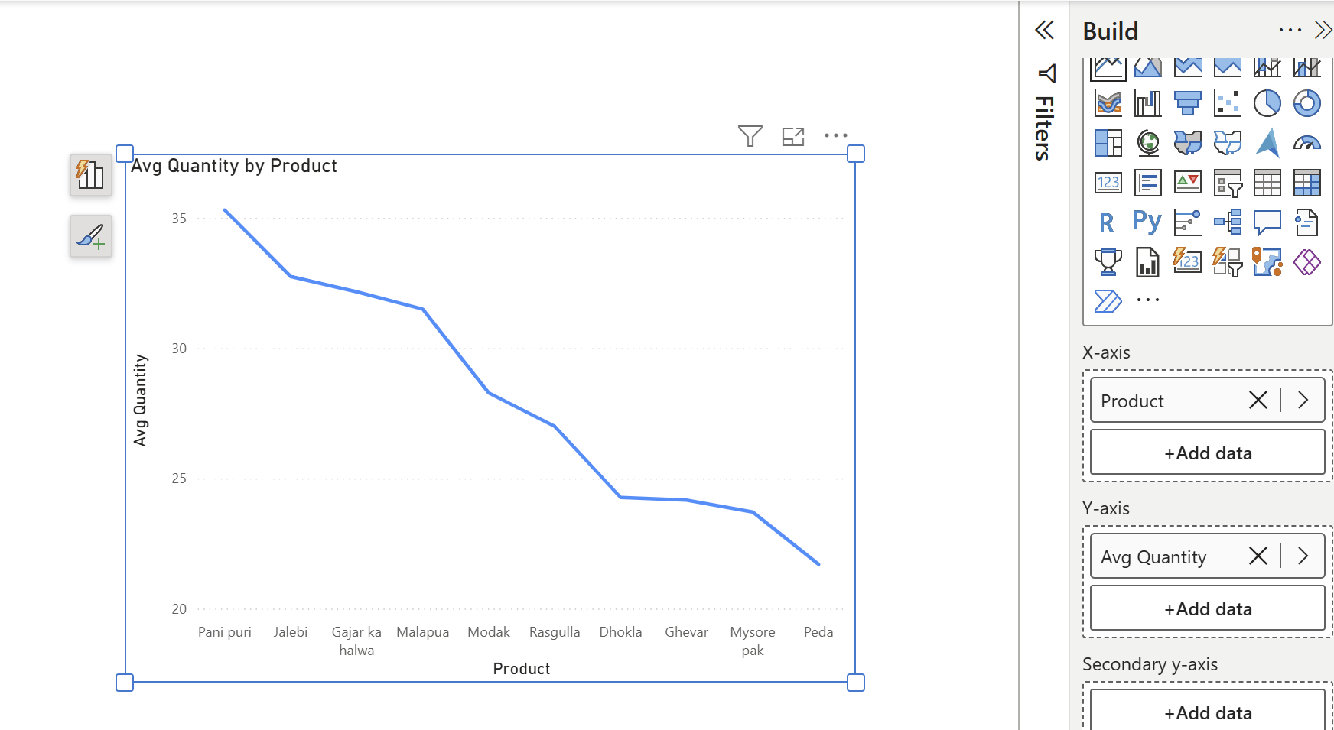





Slide 66
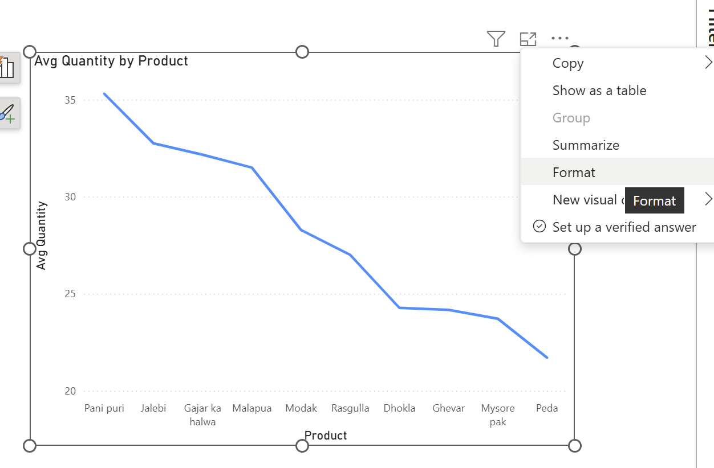


Slide 67
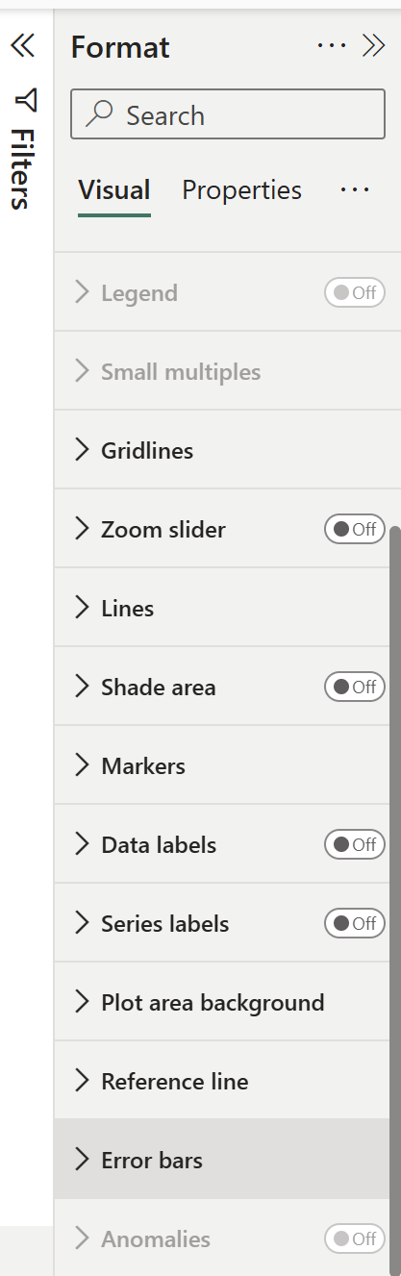
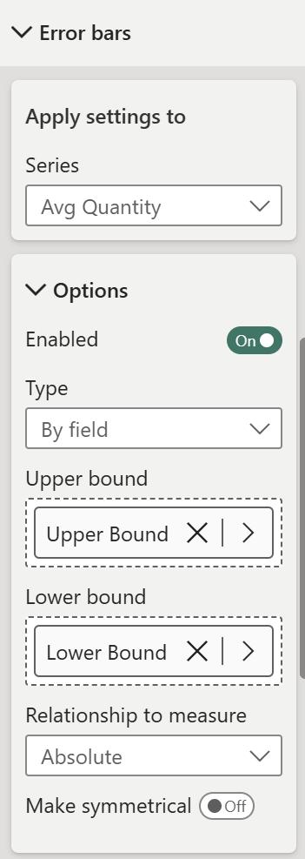





Slide 68
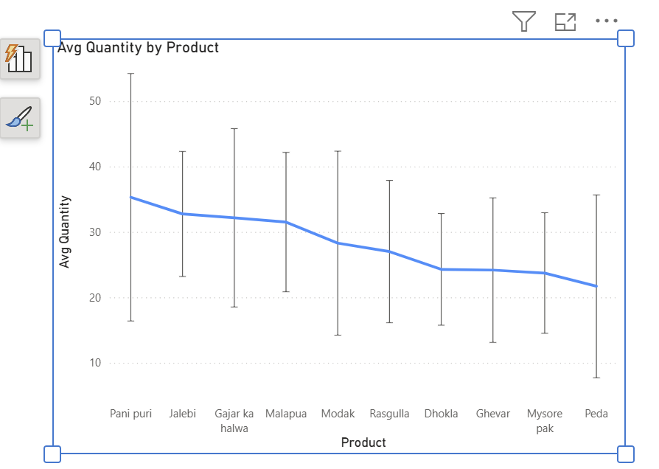


Slide 69
Page Navigation

Slide 70
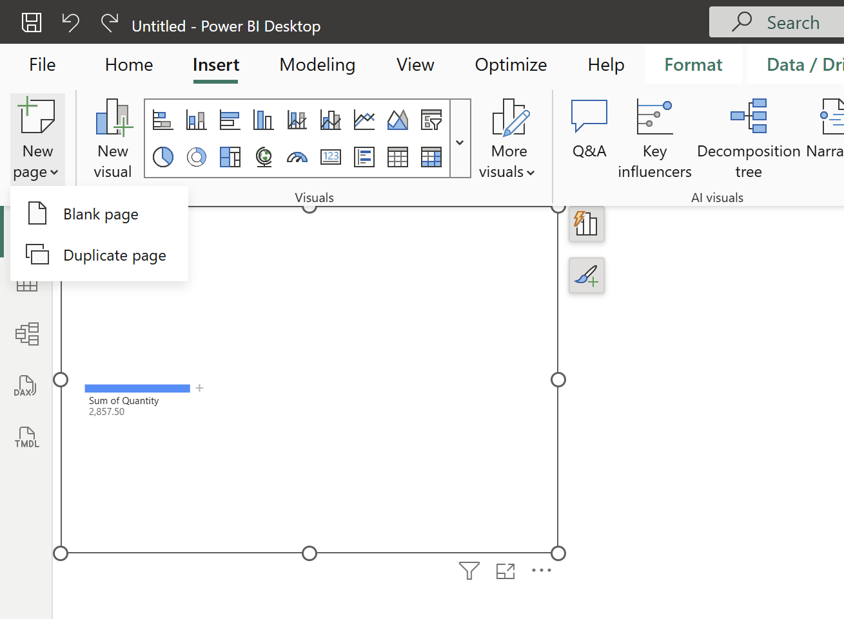




Slide 71




Slide 72










Slide 73


