Slide 1
Handling Absent Data with GRAPE
Anish Khadka
Anush Adhikari

Slide 2
Introduction
GRAPE is a general framework for label prediction and feature imputation in the absence of data.
The method addresses the shortcomings of statistical method for feature imputation.
In machine learning, GRAPE tackles the missing data problem using graphical representation by viewing observation and features as two types of nodes in a bipartite graph.

Slide 3
Motivation
The issue with learning from missing data could impact various field of data analysis like survey research, finance, economics, computational biology etc.
Previously, handling absent data was managed with two methods: feature imputation(using observed values to estimate) and label prediction(learning downstream labels directly from downstream labels).
Previously approached methods faced obstacles(inflexible, strong assumptions, scalability issues etc.)

Slide 4
How it works….
The main innovation is to formulate the problem using a bipartite graph representation.
observations and features are two types of nodes, and the observed feature values are attributed edges between the nodes
we formulate the feature imputation as an edge-level prediction task, and the label prediction as a node-level prediction task

Slide 5
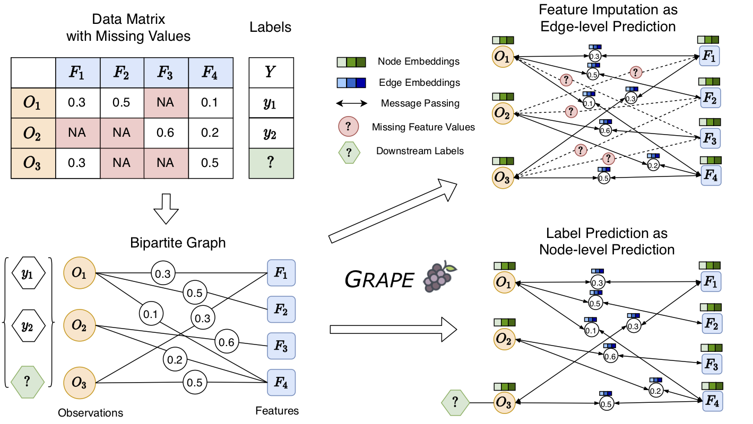
Contd….

Slide 6
Contd…
GRAPE solves both tasks via a Graph Neural Network. GRAPE is inspired by GraphSAGE with three innovations:
It uses augmented node features to initialize observation and feature nodes, which provides greater representation power and maintains inductive learning capabilities.
It employs an edge dropout technique that greatly improves model generalization
It introduces edge embeddings during message passing to fully utilize the rich attribute information.

Slide 7
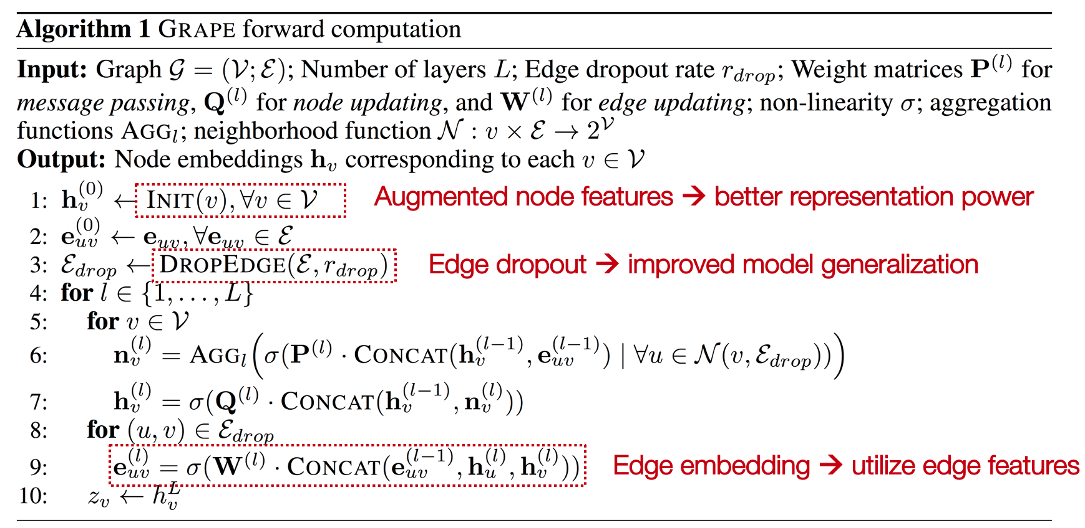
Contd….

Slide 8
Training feature imputations
UCI Datasets:
concrete,
energy,
housing,
kin8nm,
naval,
power,
protein,
wine,
Yacht.
Epochs: 20000
Activation: RELU
Training code:
python train_mdi.py uci --data concrete
Datasets are fully observed
Missing values are randomly introduced

Slide 9
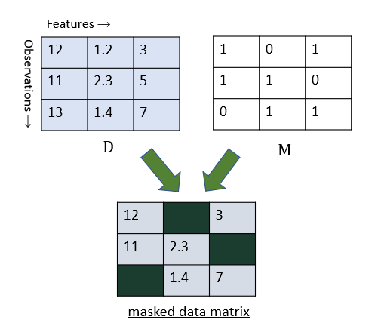
Training datasets
Feature Imputation
  3-layer GNN with 64-hidden units
  Data matrix: D ∈ ℝ^{n × m}
  Mask matrix: M ∈ {0,1}^{n × m}
    Missing rate: P(M_{ij} = 0) = r_{miss}
  Test metric
    root mean square error (rmse)

Slide 10
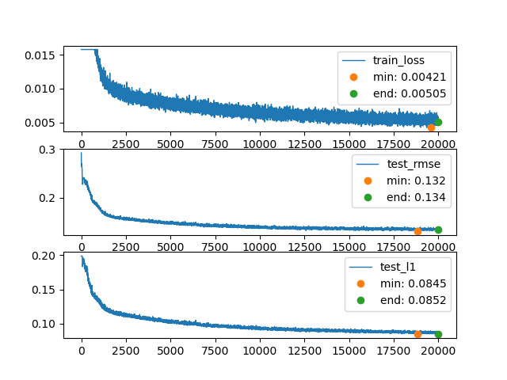
Feature Imputation at missing rate = 0.3
Feature imputation for concrete data set yields test RMSE as low as 0.132
Already a better results than other baseline models like Spectral, mean, KNN etc.

Slide 11
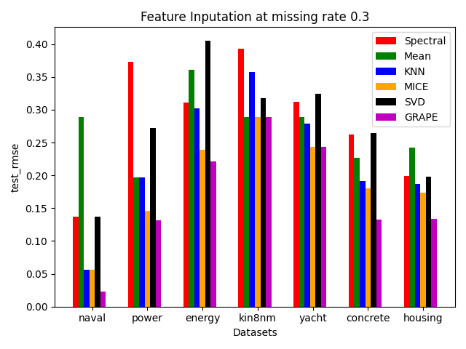
Feature Imputation at missing rate = 0.3
(with baseline models)
Baseline models:
  Spectral Regularization Algorithm
  Mean imputation
  K-Nearest Neighbors
  Multivariate Imputation by Chained Equations (MICE)
  Iterative SVD
GRAPE gives 12% lower average rmse than the best baseline model (MICE)

Slide 12
Label prediction using grape
Label prediction
  2-layer GNN with 16-hidden units
  Labels randomly split into
    70% - training set
    30% - test set
test_rmse
The test metric is calculated based on the RMSE between true Y^{train} and predicted Yˆ^{train}

Slide 13
Feature Imputation For Additional dataset
(with baseline models)
test_rmse

Slide 14
Future Works
Run experiments on additional datasets.
Feature imputation on different missing rates
Specific missing data instead of random missing data

Slide 15
Conclusion
train a Graph Neural Network to solve the tasks end-to-end.
GRAPE yields 20% lower MAE for feature imputation
and 10% lower MAE for label prediction
adapt existing GNN structures to handle continuous edge values

Slide 16
references

