Slide 1
Active travel interventions and walking/cycling uptake
55
13
countlines assessed
pragmatic controls
Data selection, cleaning, contextual matching, exploratory modelling, causal diagnostics, and current limitations.
3
Vivacity sensor data
LSOA + IMD + Census context
Exploratory ITS
schemes modelled
01
Notes:
Today I’m presenting the current progress of my dissertation analysis on active travel interventions and walking/cycling uptake. The focus is on what data I selected, how I cleaned it, how I built the contextual and control comparison, what modelling has been done, and what limitations remain. At this stage, the work supports an exploratory causal analysis rather than a definitive impact estimate.
This presentation summarises where the dissertation analysis currently stands. The project now focuses on Vivacity sensor data as the main evidence base, with LSOA, IMD and Census context used to interpret the socio-economic setting of each sensor.
The key point is that this is not yet a final causal impact evaluation. It is an exploratory workflow that tests how much the available data can support active travel evaluation.

Slide 2
RESEARCH FOCUS
The dissertation question is now operationalised as a trajectory comparison
The work has moved to a reproducible exploratory treated-control time-series workflow.
Study question
Current answer
Do deprived and affluent neighbourhoods exhibit different time-series trajectories in walking and cycling uptake after active travel interventions, compared with matched non-intervention areas?
The current evidence is mixed and uncertain. It supports exploratory comparison of relative trajectories, but not a definitive causal impact claim.
Unit of analysis
Main outcomes
Context lens
Vivacity countline-day data, aggregated to weekly countline-level outcomes for modelling.
Pedestrian counts, cyclist counts, and combined active travel counts per observed countline-day.
LSOA 2021, IMD deciles, income/employment deprivation, car availability, density, and commute mode shares.
02
Notes:
The research question asks whether deprived and affluent neighbourhoods show different walking and cycling trajectories after active travel interventions, compared with matched non-intervention areas. I have operationalised this using Vivacity countline sensor data, linked to LSOA-level deprivation and Census context. The current answer is cautious: the evidence shows mixed relative trajectories, but not a clear causal increase in walking or cycling.
The research question has become more operational. Instead of asking generally whether active travel schemes increase walking and cycling, I am comparing time-series trajectories at treated countlines with matched non-intervention countlines.
The equity element comes from asking whether these trajectories differ across more deprived, middle and more affluent neighbourhood contexts. However, because the sample is small, the equity analysis should be interpreted as contextual rather than a robust deprivation-effect model.

Slide 3
DATA SELECTION
Five treated scheme groups were prepared; modelling should now be rerun with exact dates
Exact scheme dates are now available and certain. These confirmed dates should be used directly as intervention dates in the next model run.
Scheme
Location
Install month
Previous model date
Current output
12b
Cronton / Sandy Lane
Mar 2023
2023-03-01
Descriptive
12d
Aigburth Road
Mar 2023
2023-03-01
Modelled
12e
Park Road / Path off Park Road
Mar 2023
2023-03-01
Descriptive
12f
Leasowe / Wallasey corridor
Jun 2023
2023-06-01
Modelled
13
Astmoor / Warrington Road
Mar 2024
2024-03-01
Modelled
Why 12b and 12e need rechecking: their causal status should be reassessed using the confirmed exact scheme dates and first reliable sensor dates.
03
Notes:
I started with five treated scheme groups: 12b, 12d, 12e, 12f, and 13. The exact scheme dates are now available and certain, so I will use the confirmed dates directly as the model intervention dates. The previous classification modelled 12d, 12f and 13, while keeping 12b and 12e descriptive. This now needs to be rechecked against the confirmed exact dates.
Schemes 12b and 12e were previously retained for descriptive analysis because their reliable treated sensor data appeared to begin after the assumed month-start intervention date. With exact dates now available, their status should be reassessed by comparing each first reliable sensor date against the confirmed scheme date.
Schemes 12d, 12f and 13 remain the strongest current modelling candidates, but their pre/post windows should also be recalculated using the confirmed exact dates.
The date uncertainty limitation has now been reduced because exact scheme dates are available. The next step is to replace month-start assumptions, rebuild the pre/post classifications, and rerun diagnostics.

Slide 4
DATA CLEANING
The cleaning workflow separates sensor absence from real zero flow
The most important cleaning decision was to avoid treating pre-installation or unreliable early sensor periods as true low activity.
Raw exports
Daily aggregation
Full-day cutoff
Reliability gate
Vivacity classified countline CSVs for treated and shortlisted control sensors.
Hourly/directional observations summed to daily pedestrian, cyclist, active travel, and motorised totals.
Data filtered to 2026-05-26 inclusive so every retained day is complete.
Rows must have availability, no data error, at least 80% daily coverage, and fall after first reliable date.
First reliable date
Duplicate check
Output
Defined as the first positive active-travel day with at least 14 reliable days in the following 21-day window.
Duplicate daily countline keys were checked before modelling; duplicate file contains only the header in final outputs.
Cleaned treated/control daily data, QA summaries, inclusion table, and modelling-ready weekly tables.
04
Notes:
The cleaning process was designed to avoid mistaking missing sensor history for real zero flows. I aggregated raw Vivacity exports to daily countline totals, then filtered to complete days up to 26 May 2026. I also identified each countline’s first reliable date, based on positive active travel flow and sufficient reliable days in the following 21-day window. This means early unreliable periods are excluded rather than treated as low activity.
A major risk in the raw data is that early zero counts may not mean no one was walking or cycling. They may mean the sensor was not yet active or was not producing reliable data.
Therefore, the cleaning process identifies the first reliable date for each countline and removes unreliable early periods from analysis. This avoids underestimating pre-intervention activity or creating artificial changes after installation.

Slide 5
INTEGRITY GATE
Controls were not accepted just because they were geographically nearby
The analysis creates an explicit inclusion decision before modelling.
55
21
34
13
2
countlines assessed by integrity gate
treated countlines
control countlines
controls pass pragmatic threshold
controls pass strict seasonal threshold
Pragmatic causal threshold
Strict seasonal threshold
Manual risk remains
First reliable date before confirmed intervention date, at least 90 usable pre-intervention days, and at least 180 usable post-intervention days.
At least 365 usable pre- and post-intervention days. Only two controls meet this stronger standard.
Candidate controls still need local intervention-exposure checks to rule out contamination by other schemes.
05
Notes:
Befor e modelling, I built an integrity gate for all treated and control countlines. In total, 55 countlines were assessed: 21 treated and 34 controls. Thirteen controls met the pragmatic causal threshold, but only two met the stricter seasonal threshold. This is one reason the analysis remains exploratory.
Controls also still need manual checks to make sure they were not affected by other nearby schemes.
The integrity gate is important because it prevents weak control sites from entering the main model. A control countline must have reliable observations before the confirmed intervention date and enough post-intervention coverage.
Controls that fail this rule are treated as descriptive-only. This makes the modelling sample smaller, but it makes the analysis more transparent.

Slide 6
CONTEXT JOINING
The socio-economic comparison is anchored at LSOA 2021
A single spatial unit was used to synchronise sensor locations, deprivation, Census context, and matching.
Sensor points
LSOA 2021 join
Context variables
Control shortlist
Vivacity countline latitude/longitude and countline names.
Spatial join from countline location to LSOA boundary.
IMD, income, employment, density, car availability, walk/cycle commute shares.
Candidate control countlines ranked by LSOA similarity to treated areas.
What this explains
What it cannot prove alone
Whether observed trajectories differ by deprivation context, car availability, density, and baseline commute mode structure.
Spatial similarity does not guarantee behavioural equivalence or absence of unobserved local interventions.
06
Notes:
For the contextual analysis, I used LSOA 2021 as the common spatial unit. Sensor points were spatially joined to LSOA boundaries, then linked to IMD, income and employment deprivation, population density, car availability, and Census commute variables. This allowed me to compare treated and control areas socio-economically, and to shortlist controls based on contextual similarity rather than only geographic closeness.
The LSOA 2021 join allows each sensor to be linked to deprivation and Census variables. This does not tell us the income or deprivation status of individual people passing the sensor.
Instead, it describes the neighbourhood context around the sensor. So the analysis is about area-level equity context, not individual-level behaviour.

Slide 7
METHODOLOGY
The model remains exploratory and needs an exact-date rerun
Current outputs are provisional; the next run should use confirmed exact scheme dates and separated outcomes.
Weekly model form
Immediate level term
log1p(outcome per observed day) ~ time + post + post-time + treated-post + treated-post-time + seasonality + countline fixed effects
`treated_post` will estimate treated-control level change after the confirmed exact intervention date in the rerun.
Slope term
`treated_post_time_weeks` will estimate additional weekly treated-control trajectory change in the rerun.
Weighting
Seasonality
Uncertainty
Weighted by observed days so partial weekly data contribute proportionally.
Sine and cosine terms capture annual seasonal cycling/walking patterns.
Cluster-robust standard errors by countline.
07
Notes:
The modelling approach is an exploratory matched-control interrupted time-series.
The key outcomes are pedestrian counts, cyclist counts, and total active travel per observed countline-day. The model includes time, post-intervention level change, post-intervention slope change, seasonality, and countline fixed effects, with cluster-robust standard errors by countline.
The exact-date rerun will estimate whether treated countlines changed differently from valid controls after the confirmed intervention date.
The immediate level term will capture whether there is a step change after the confirmed intervention date, while the slope term will capture whether the trajectory changes over time. I use weekly aggregation to reduce daily noise, and seasonality controls are included because walking and cycling naturally vary across the year.

Slide 8
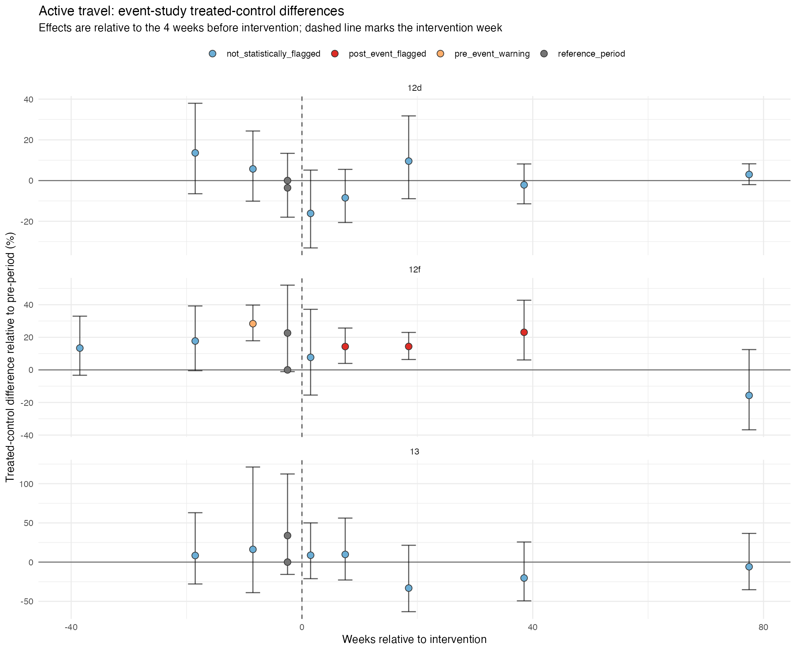
CAUSAL DIAGNOSTICS
Diagnostics explain why current causal language must stay cautious
Existing diagnostics show weak support and should be recalculated after the exact-date rerun.
Scheme
Pretrend
Pre-event
Post flags
Readiness
12d
2
0
2
weak
12f
0
1
4
weak
13
0
1
0
weak
Interpretation
Pre-trend and event-study checks are useful, but current diagnostics do not justify a strong causal impact estimate and must be rerun with exact dates.
Defensible label
Exploratory matched-control interrupted time-series analysis with diagnostics.
08
Notes:
The causal diagnostics explain why the claims need to stay cautious. The current diagnostics were produced from the existing model run and should be recalculated after confirmed exact scheme dates are incorporated. At present, all three modelled schemes show weak causal readiness: 12d has two pre-trend warnings, while 12f and 13 have pre-event warnings in the event-study checks.
The diagnostics are used to test whether stronger causal interpretation is credible. For scheme 12d, treated and control trends were already different before the intervention, which weakens causal interpretation.
For 12f and 13, the linear pre-trend tests are better, but the event-study checks still show pre-period warnings. Therefore, all three schemes remain exploratory rather than definitive causal evidence, pending the exact-date rerun and separated outcome checks.

Slide 9
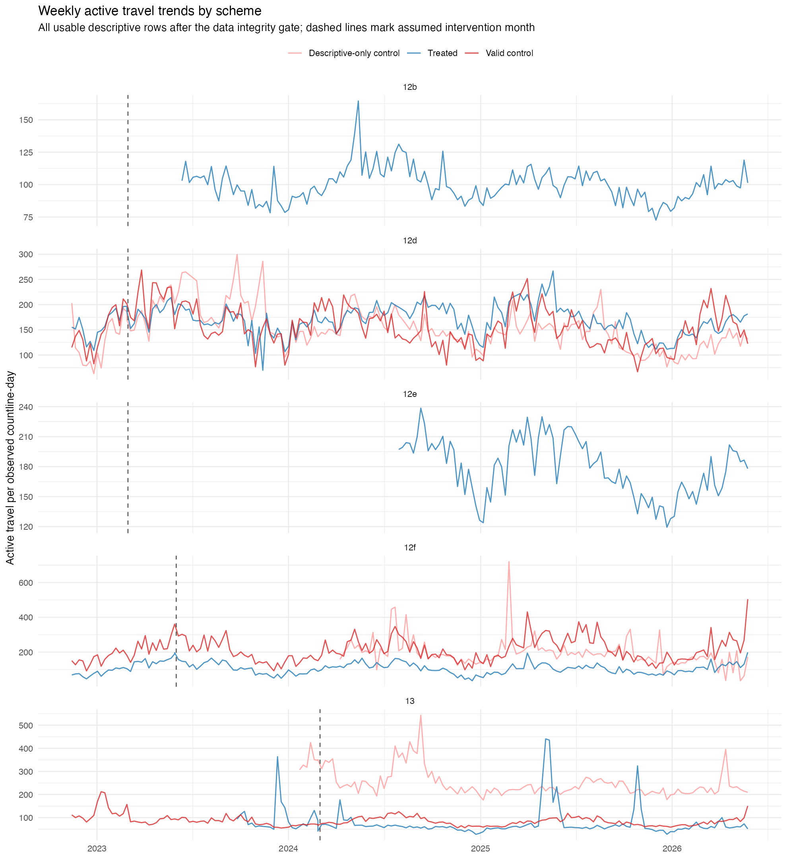
DESCRIPTIVE ANALYSIS
Observed trends should be split by mode and route type
Descriptive analysis supports interpretation even where causal modelling is not defensible.
Trend plots
Weekly and monthly trends by scheme, role, pedestrian/cyclist mode, and road/path route type.
Route-type checks
Road versus path/cycle-facility patterns should be analysed separately to identify redistribution or facility-specific differences.
Seasonality
Monthly profiles separate seasonal cycling/walking variation from possible scheme timing.
Pre/post summaries
Sensitivity-ready tables should compare confirmed-date, transition-exclusion, pedestrian-only, cyclist-only, road-only, and path-only scenarios.
09
Notes:
The descriptive analysis covers all five schemes, including those not suitable for causal modelling. I produced weekly and monthly trend plots, mode-specific summaries, route-type comparisons, seasonality profiles, pre/post summaries, and sensitivity-ready scenarios. The next version should update these around the confirmed exact scheme dates. This part is valuable for describing observed patterns, especially for 12b and 12e, even though it does not solve the causal identification problem.
The descriptive analysis is still useful because it includes all five schemes, including those that cannot enter the causal model. The next version should explicitly separate pedestrian from cyclist trends, and road countlines from path or cycle-facility countlines.
This matters because combined active travel totals can hide different walking and cycling responses, and mixed road/path countlines can hide whether change is happening on the dedicated facility or the carriageway.

Slide 10
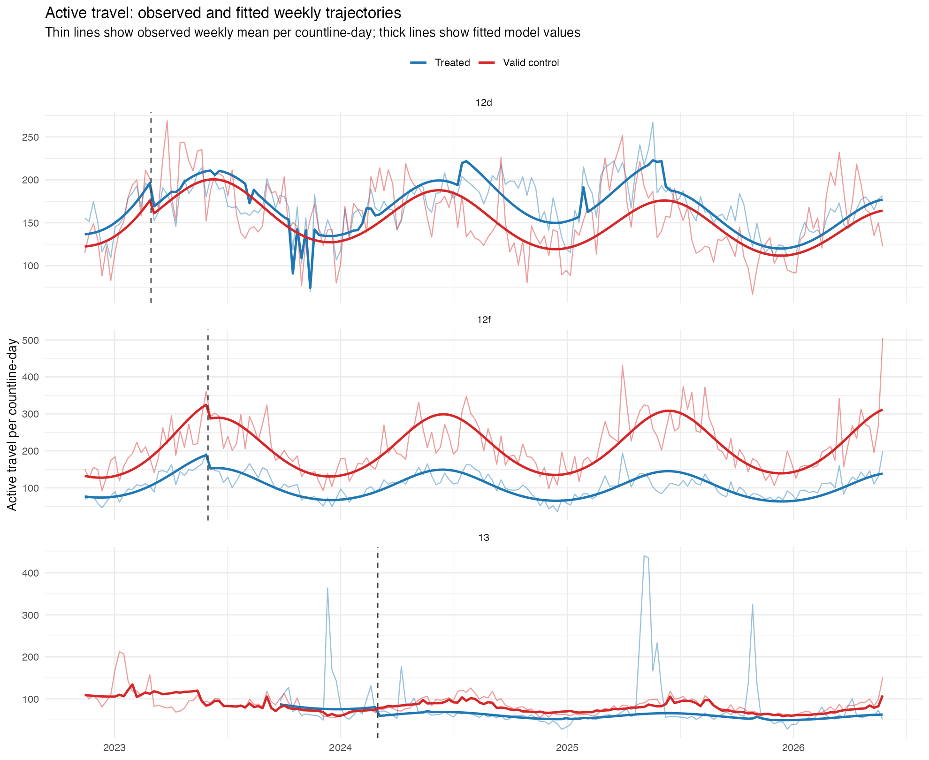
EXPLORATORY MODEL RESULTS
Current model results are provisional before the exact-date rerun
The current combined results are mixed; the next run should use confirmed exact dates and separate mode and route type.
12d
Cyclist slope is negative and statistically flagged: about -0.15% per week relative to controls. Active travel and pedestrian terms are unclear.
12f
Active travel slope is negative and statistically flagged: about -0.11% per week. Pedestrian and cyclist terms are negative but uncertain.
13
Immediate level changes are negative but uncertain. Post-intervention slope terms are not statistically clear.
Writing implication
Use 'relative trajectory differences' and 'evidence consistent with', not direct causal claims.
10
Notes:
The exploratory model results are mixed and should be treated as provisional. There is no clear positive uptake signal across the modelled schemes in the current output. For 12d, cyclist counts show a negative statistically flagged slope relative to controls, around minus 0.15 percent per week. For 12f, active travel shows a negative statistically flagged slope of around minus 0.11 percent per week. For 13, the results are mostly uncertain. I would describe these as relative trajectory differences, not direct scheme effects.
The model results do not show a clear positive uptake signal relative to controls. The next modelling step should separate pedestrian and cyclist outcomes, and where sample size allows, separate road countlines from path or cycle-facility countlines. This should not be written as proof that the schemes reduced active travel. A safer interpretation is that, in the current provisional output, combined treated countlines did not clearly outperform controls. Mode-specific, route-type-specific, and exact-date reruns are needed before making scheme-level claims.

Slide 11
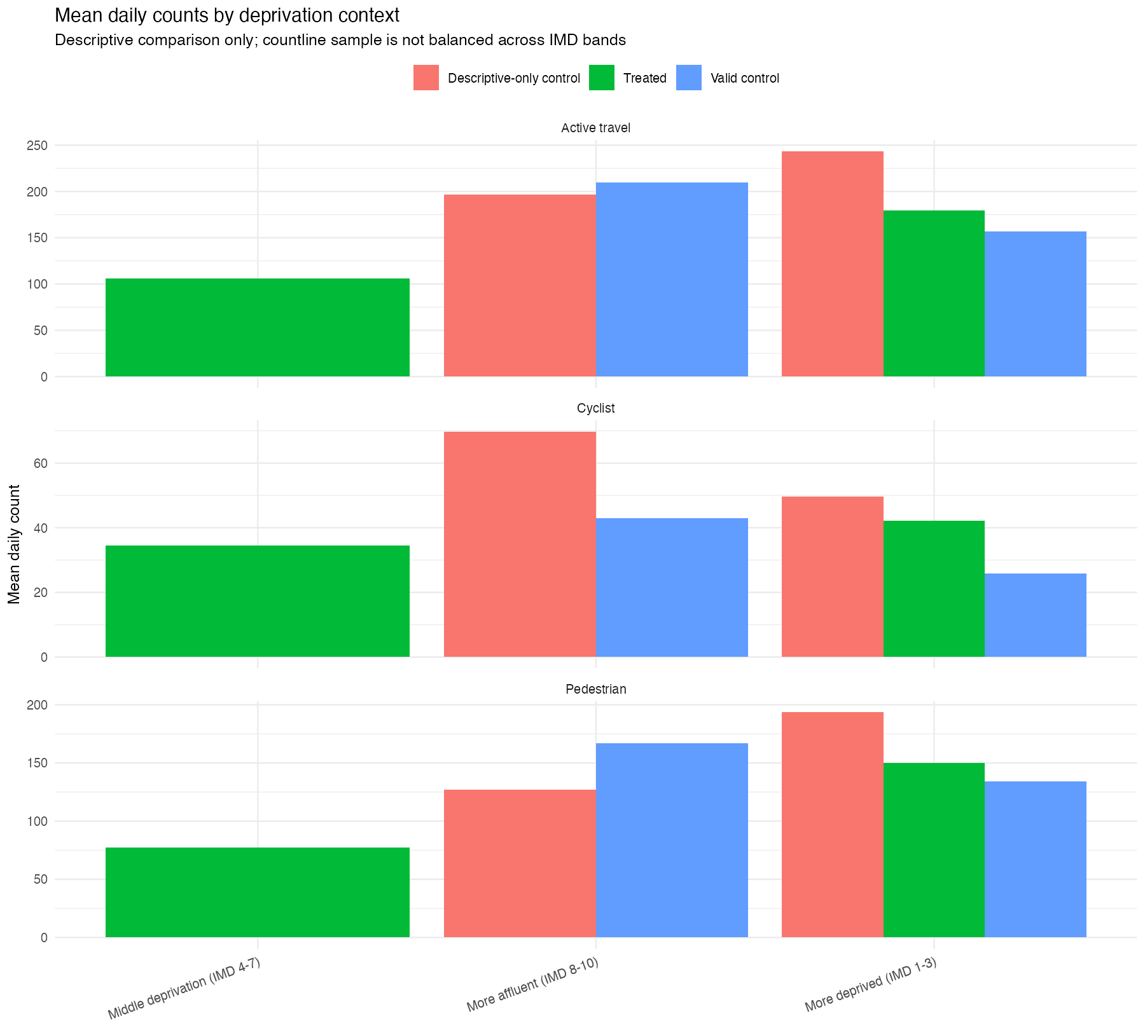
EQUITY AND DEPRIVATION LENS
The analysis links trajectories to local socio-economic context, but the sample is not balanced
This section should be framed as contextual interpretation rather than a clean deprivation effect estimate.
Context variables used
IMD decile/band, income and employment deprivation, population density, no-car households, walk/cycle commute share, car-driver commute share, work-from-home share.
Analytical use
Explain where interventions and controls sit within deprived or affluent urban contexts, and whether observed count trajectories align with those contexts.
Key caution
Countline sample is small and uneven across IMD bands, so this is not yet a robust deprivation gradient model.
11
Notes:
The equity and deprivation component links each countline to local socio-economic context. This lets me discuss whether schemes and controls sit in more deprived or more affluent neighbourhoods, and whether observed walking and cycling patterns differ across those contexts. However, the sample is small and not balanced across IMD bands, so this should be treated as contextual interpretation rather than a robust deprivation-effect model.
The equity analysis is limited by sample balance. More deprived areas are well represented, especially in schemes 12d and 13, but more affluent contexts are limited.
Therefore, the dissertation can discuss whether the usable evidence base is uneven across deprivation contexts, but it should not claim a strong deprived-versus-affluent causal difference.

Slide 12
LIMITATIONS AND SUPERVISOR DECISIONS
The project is on track, but the claims need a carefully bounded frame
The strongest dissertation route is to treat this as transparent exploratory causal evaluation, not final impact attribution.
Confirmed scheme dates
Control contamination
Baseline coverage
Exact scheme dates are now available and certain; update intervention-date fields and rerun the gate, models, and diagnostics.
Shortlisted controls need manual checks against other local interventions.
Recheck 12b and 12e against confirmed exact scheme dates and first reliable sensor dates.
Small control pool
Sensor measurement
Next analysis choices
Only 13 controls meet the pragmatic threshold; only 2 meet the strict seasonal threshold.
Automated counts are useful but remain sensitive to sensor coverage, classification, and local conditions.
Separate pedestrian/cyclist and road/path outcomes, try weather sensitivity controls, then prioritise manual control verification.
12
Notes:
The main limitations are now possible control contamination, limited pre-intervention coverage for some schemes after exact-date recalculation, a small pool of valid controls, and sensor measurement issues. My recommended framing is: this is exploratory matched-control interrupted time-series evidence of relative trajectory differences after confirmed intervention dates. The next are to separate pedestrian/cyclist and road/path outcomes, consider weather controls such as rainfall, temperature and wind, and then prioritise manual verification of control sites.
The main limitations are not just technical; they affect the strength of the dissertation claims. The exact scheme dates are now available, but some schemes may still lack pre-intervention baselines after recalculation, and the control sites still need manual checking.
The results chapter should report pedestrian and cyclist outcomes separately first, and should also separate road and path/cycle-facility countlines where the sample supports it. Active travel total should be used only as a summary measure after these disaggregated results. Weather controls can be introduced as a sensitivity layer, especially for rainfall, temperature and wind effects on walking and cycling counts.

