Slide 1


PixelProbe – AI Image detection system
Naoise O’loughlin
Software & Electronic Engineering
Atlantic Technological University, Galway

Slide 2
Intro
Huge advancements in image generators like Dall-E and Midjourney over the past 3 years.
Increasingly Difficult to distinguish between real and synthetic media.
PixelProbe allows users to upload image and receive real time classification of real or fake images.
Huge needs with the increase in miss-use of image generators such as the Grok controversy in December 2025.

Slide 3

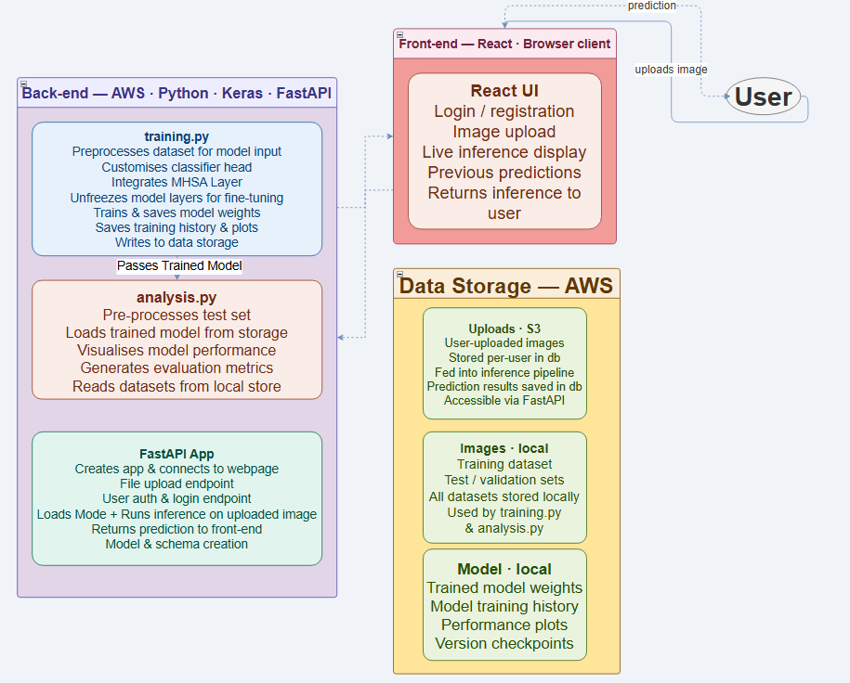
System Architecture
React Frontend provides a reactive user interface
FastAPI backend handles model loading, predictions, user authentication. Hosted on AWS.
User information & Prediction information stored in SQLite database.
Image uploads stored in amazon S3.

Slide 4
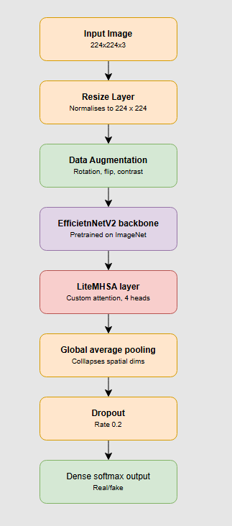
Model Pipeline
Input image: 224 x 224 x 3
Resize Layer: Resize + normalization for consistent model behavior.
Data Augmentation: Introduces Random augmentations such as rotations, contrast change etc. to help improve generalisation.
EfficientNetV2 Backbone: Pretrained on ImageNet, provides hierarchal feature representations
LiteMHSA: Multi-Head Self Attention Layer that aids in detection of subtle, fine-grained artifacts
Global Average Pooling: Compresses spatial features
Dropout: 0.2 for regularisation
Dense softmax output: Outputs final class probabilities (real vs fake)

Slide 5
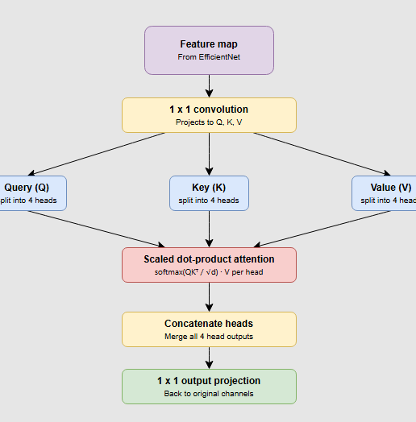
Lite MHSA
Purpose
Adds global context so the model can detect subtle, long‑range artifacts that CNNs miss.
How It Works
1×1 Conv → Q, K, V: Projects features into attention space
4 Heads: Each head focuses on different patterns
Scaled Dot‑Product Attention: Computes similarity across all spatial positions
Concat + 1×1 Output: Merges heads and restores channel depth
Why It Helps
Captures non‑local relationships
Improves detection of fine‑grained inconsistencies
Lightweight and computationally efficient

Slide 6
Results
Mode | Train Set | ZHANG | CIFAKE | GEN/P365 | GHAI
PixelProbeB0 | ZHANG | 86 | 50 | 58 | 70
PixelProbeB1 V3 | ZHANG | 94 | 51 | 57 | 78
PixelProbeB1CFV2 | CIFAKE | 44 | 95 | 51 | 26
PixelProbeB1GI | GenImage | 52 | 61 | 80 | 77
PixelProbeB2GI | GenImage | 50 | 56 | 79 | 75
PixelProbeB2GIV3 | GenImage/Places365 | 56 | 54 | 78 | 73
Image Classification Cross-Dataset Accuracy Results (%)

Slide 7
Conclusion
All planned features fully implemented and validated across the system.
Provides reliable detection of AI‑generated content in real‑world scenarios.
PixelProbe is now a complete and scalable AI-Image Detection system.

Slide 8
Future Work
Video Frame-by-frame detection Integrate real-time frame-by-frame detection showing users sections of video that may be tampered with.
Mobile App Deployment
A mobile app would make PixelProbe more accessible to users and easier way to verify images on social media.
Plugins
Introducing PixelProbe as a web or mobile plugin would remove the need for users to download images to their device for inference.

Slide 9
AI Usage
Over the course of the project, AI assistants Claude and Copilot have been used.
The use of the AI assistants have been for research purposes and Bug fixes predominantly.
Additional usage has been to gain deeper understanding of source code referenced throughout the development of this system.

Slide 10
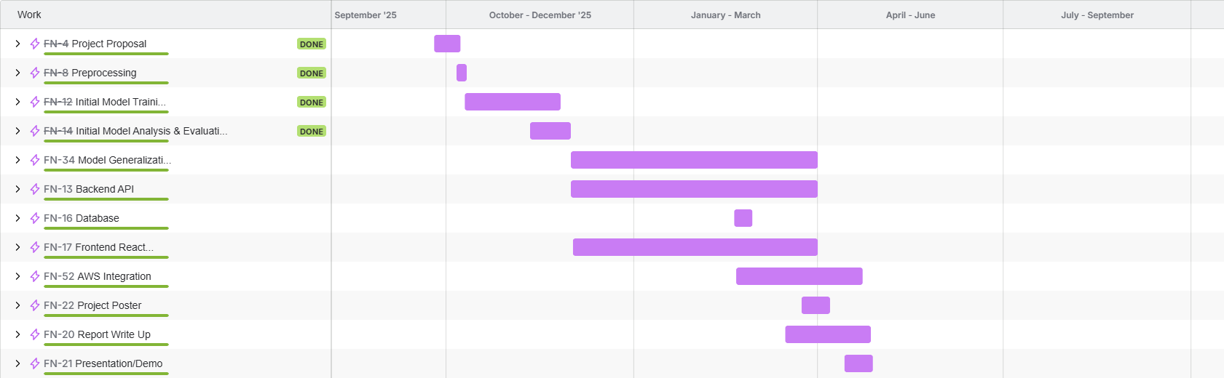
Project Timeline

Slide 11
Thank you for listening!
https://github.com/NaoiseOL/FYP2025-26

