Slide 1
High-Level Synthesis of Side Channel Attack Resistant RSA Decryption Circuit
R2-13
◎Naoki Osako, Sayuri Ota, Suguru Yura, Nagisa Ishiura
(Kwansei Gakuin University, Japan)
Notes:
Thank you chairman.
I'm Naoki Osako of Kwansei Gakuin University, Japan.
The title of my presentation is High-Level Synthesis of Side Channel Attack Resistant RSA Decryption Circuit.

Slide 2


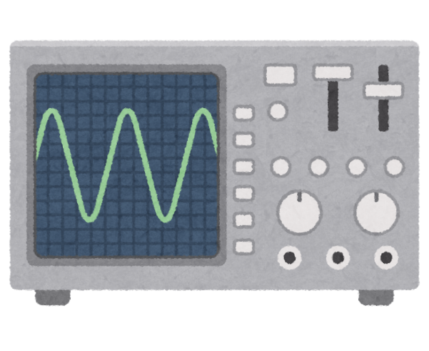

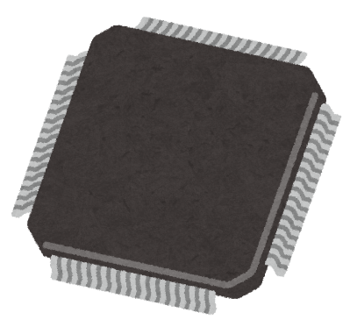

R2-13
Security for IoT devices
AES, RSA, ECC, etc.
HW implementation to ensure performance
Side Chanel Attacks
Key bits are inferred by:
power analysis
fault injection
Measures against side channel attacks are must
Notes:
The number of devices connected to the Internet has increased.
The IoT devices use to ensure security encryption function such as AES, RSA, ECC.
HW implementation is one of the options to ensure performance.
side channel attack is against the vulnerability of the encryption device.
For example, There are power analysis attacks that infer key from the power consumption, and fault injection that insert faults and infer keys.
You must take measures against side-channel attacks on both SW and HW.

Slide 3
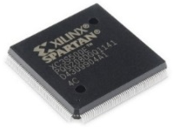
R2-13
Side Channel Attack Resistant RSA Decoder
C program
① Resistance
Fournaris’ algorithm
③ Acceleration
② Arithmetic
Montgomery reduction
Parallelization
GNU Multi-Precision library
3.3
ACAP
(Binary synthesizer)
29.2
89% reduction
Hardware
(Verilog HDL)
8.1
Faster responses
MIPS
HW
HW+③
Notes:
To solve this problem, we made Side Channel Attack Resistant RSA Decoder.
We append RSA to side channel attack resistance based on the founaris’ algorithm.
The program is create by the C program.
In normal C program, it is impossible to conduct multiple lengths computation, so we linked GNU Multi-Precision Library.
We realize Acceleration by Montgomery Reduction and parallelization.
We synthesize by the binary synthesizer ACAP.
This graph shows the reduction of execution time.
We reduced execution time by making it HW.
Furthermore, we reduced execution time with Montgomery Reduction and parallelization.
As a result, Execution times were reduced by 89%.

