Slide 1


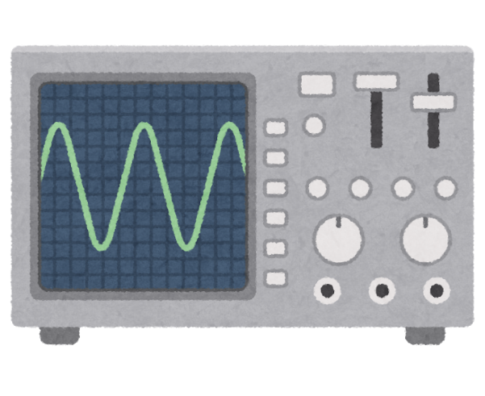
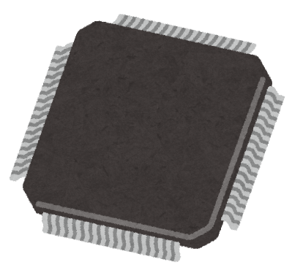
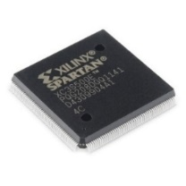




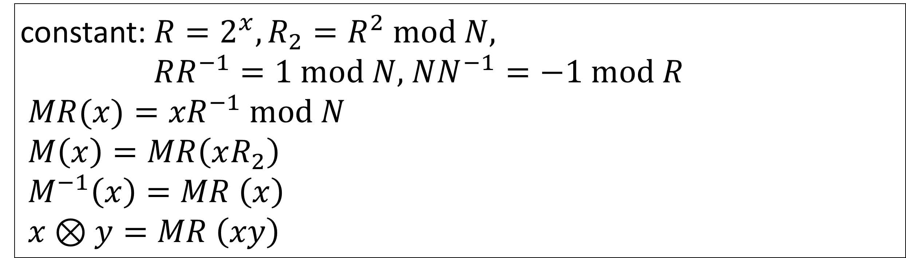


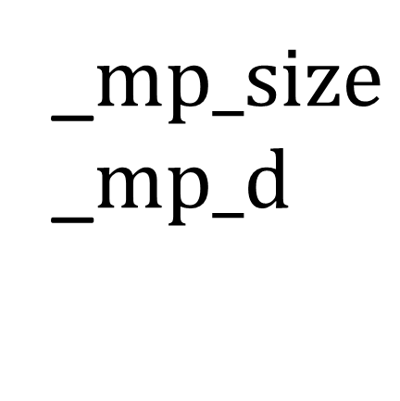






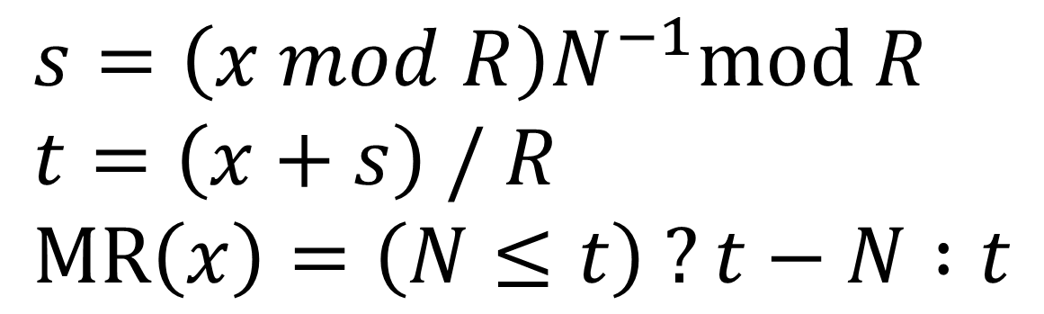
R2-13
High-Level Synthesis of Side Channel Attack Resistant RSA Decryption Circuit
*Naoki Osako, Sayuri Ota, Suguru Yura, Nagisa Ishiura
(Kwansei Gakuin University, Japan)
Introduction
Side Channel Attack RSA Resistant Decoder
Security for IoT devices
AES, RSA, ECC, etc.
HW implementation to ensure performance
Side Chanel Attacks
Key bits are inferred by:
① Resistance
C program
Fournaris’ algorithm
③ Acceleration
② Arithmetic
Montgomery reduction
Parallelization
GNU Multi-Precision library
power analysis
fault injection
ACAP
(Binary synthesizer)
3.3
Hardware
(Verilog HDL)
Faster responses
② GNU Multi-Precision library
Measures against side channel attacks are must
44
$$c=ab mod N$$
$$mpz_t a, b, c, tmp, N$$
$$mpz_mul(tmp, a, b)$$
$$mpz_mod(c, tmp, N)$$
_$mp_size$
_$mp_d$
4
#words
① Founaris’ algorithm
static allocation
RSA decryption with side channel attack resistance
③ Acceleration
$Input:p, q, c, b,b^{−1},d_{p}$ =d mod (p -1), $d_{q},i_{q}$ = $q^{−1}$ mod p
Output: $c^{d} mod p∙q$
${ (s}_{0}^{p}$, ${ s}_{1}^{p}$, ${ s}_{2}^{p}$, ${ s}_{4}^{p}$) = FSCAME ($c, b,b^{−1},d_{p}$, p );
${ (s}_{0}^{q}$, ${ s}_{1}^{q}$, ${ s}_{2}^{q}$, ${ s}_{4}^{q}$) = FSCAME ($c, b,b^{−1},d_{q}$, q );
$S_{0}$ = ${ s}_{0}^{q}+q∙(({ s}_{0}^{p}−{ s}_{0}^{q})∙i_{q}$mod p);
$S_{1}$ = ${ s}_{1}^{q}+q∙(({ s}_{1}^{p}−{ s}_{1}^{q})∙i_{q}$mod p);
$S_{2}$ = ${ s}_{2}^{q}+q∙(({ s}_{2}^{p}−{ s}_{2}^{q})∙i_{q}$mod p);
$S_{4}$ = ${ s}_{4}^{q}+q∙(({ s}_{4}^{p}−{ s}_{4}^{q})∙i_{q}$mod p);
if ($S_{0}$ $∙S_{1 }$mod $p∙q$= $S_{2}$ and p, q not modified)
{return ($S_{0}$ $∙S_{4 }$mod $p∙q$);} else {return error;}
Montgomery reduction
Eliminate division from modular multiplication
$${ c}^{d_{q}} mod p$$
$$a$$
$$b$$
$$c=ab mod N$$
$M (a)$, ${M\left(b\right)}^{}$
$$A$$
$$B$$
$$A⊗B$$
$${ c}^{d_{q}} mod q$$
$M^{−1} (A⊗B$)
CRT
constant: ${R=2^{x},R_{2}=R}^{2} mod N$,
$RR^{−1}=1 mod N$, $NN^{−1}=−1 mod R$
${MR(x)=xR}^{−1} mod N$
$M\left(x\right)=MR\left(xR_{2}\right)$
$M^{−1}\left(x\right)=MR \left(x\right)$
$x⊗y=MR \left(xy\right)$
detect fault injection
and
and
$s=\left(x mod R\right)N^{−1}mod R$
$t=\left(x+s\right) / R$
$MR\left(x\right)=\left(N≤t\right) ?t−N :t$
FSCAME
shift
$Input:c, b,b^{−1},\text{d} \text{=} \text{(}\text{1}\text{,}{ d}_{t−2}$, …$d_{0}), M$
Output: ($s_{0}, s_{1}, s_{2},s_{4}$)
R = $2_{}^{n+2}$; T = $R_{}^{2}$ mod M;
$b_{R}$ = b $∙$R mod M; $b_{R−1}$ = $b^{−1}$ $∙$R mod M;
$s_{0}$= $s_{1}$ = $b_{R}$;
$T_{R}$ = T $∙$c $∙R^{−1}$mod M;
$s_{2}$ = $b_{R}$ $∙T_{R}∙R^{−1}$mod M;
$s_{3}$ = $s_{4}$ = $s_{5}$ = $b_{R−1}$;
for (i = 0 to t -1) {
if (${ d}_{i}$= 1) {
${ s}_{0}$ = $s_{0}$ $∙s_{2}∙R^{−1}$mod M; ${ s}_{4}$ = $s_{4}$ $∙s_{3}∙R^{−1}$mod M;
} else {
${ s}_{1}$ = $s_{1}$ $∙s_{2}∙R^{−1}$mod M; ${ s}_{5}$ = $s_{5}$ $∙s_{3}∙R^{−1}$mod M;
}
${ s}_{2}$ = $s_{2}^{2}$ $∙R^{−1}$mod M; ${ s}_{3}$ = $s_{3}^{2}$ $∙R^{−1}$mod M;
}
$s_{0}$ = $s_{0}$ $∙b^{−1}∙R^{−1}$mod M; $s_{1}$ = $s_{1}$ $∙$c $∙R^{−1}$mod M;
$s_{2}$ = $s_{2}$ $∙$1 $∙R^{−1}$mod M; $s_{4}$ = $s_{4}$ $∙$b $∙R^{−1}$mod M;
if (i and d are not modified and
$s_{0}$ $∙s_{1}∙R^{−1}$mod M = $s_{2}∙$1 $∙R^{−1}$mod M){
return ($s_{0},$ $s_{1},$ $s_{2},$ $s_{4}$);
} else {return error;}
Parallelization
Masking
FSCAME
FSCAME
CRT
FSCAME
CRT
FSCAME
Synthesis Result
hiding
Code |  | #cycles | freq. [MHz] | #LUT
RSA | SW | 431,256 | 121.7 | 3,180
 | HW | 68,261 | 107.8 | 11,721
SRR | MIPS | 3,554,185 | 121.7 | 3,180
 | HW | 627,615 | 77.5 | 16,801
 | HW+M | 680,284 | 105.5 | 11,464
 | HW+M+P | 353,489 | 105.6 | 22,590
Execution times are reduced by 89%
Circuit scale is increased 7.1 times
detect fault injection
M: Montgomery reduction
P: Parallelization
key: 128bits
Xilinx vivado (2016.4)
FPGA (kintex -7 xc7k70)
MIPS ×10.2 faster
(with ×7.1 LUTs)

