Slide 1
Operating Systems: CSE 3204
Chapter Two
Process Management
Lecture 4: Process Scheduling
ASTU
Department of CSE

Slide 2
Basic Concepts
In a single process/single processor system, only one process can run at a time
If there are multiple processes in the system, some processes must wait until the CPU is free and can be allocated to them.
At an instance of time, multiple processes may be willing to occupy the CPU (just after the currently running process yields the control of CPU).
Now, which process is going to get the CPU next to the current process finish its turn is very important question form the point of view of not only keeping system functioning, but we will see that the decision regarding selection of next process can be made in many ways and can affect performance of the system.

Slide 3
Process scheduling
The particular way in which a process is selected from a queue of processes in order to assign the CPU is called a CPU scheduling algorithm.
While a CPU scheduling algorithm assigns the processor(s) to process(es), the general problem of process scheduling is little bit broader, in which we study about keeping processes in different queues, in memory, in swap area or at CPU, keeping eye on system performance.

Slide 4
CPU Scheduling
Almost all resources are scheduled before use
CPU is one of the primary resource of a computer
CPU scheduling is the basis of multiprogrammed operating systems
By switching the CPU among processes, the operating systems can be made more productive
Scheduling refers to the way processes are assigned to run on the available CPUs. since there are typically many more processes running than there are available CPUs.
This assignment is carried out by software known as a scheduler and dispatcher.

Slide 5
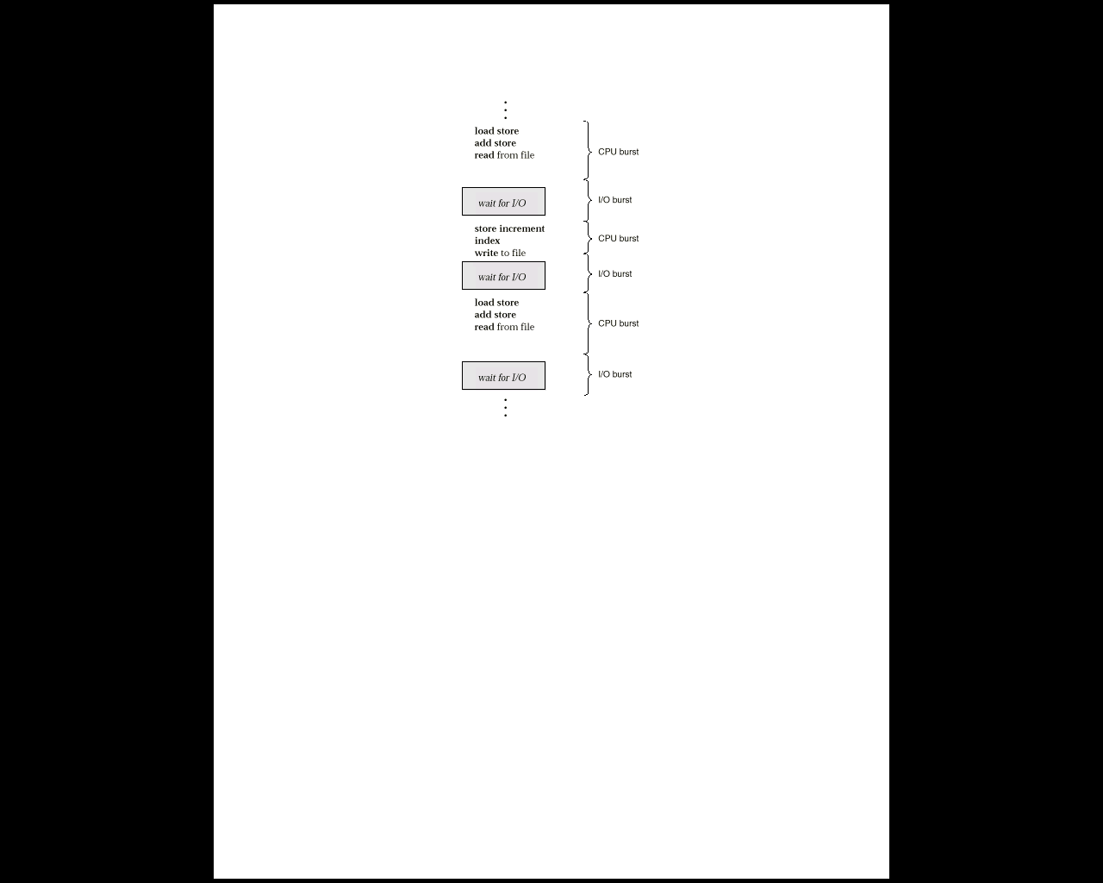
CPU - I/O burst
Each process is assigned a fixed number of time slices to perform its execution at the processor or to complete its I/O operation. There are two types of “Bursts” on the timeline:
CPU burst
CPU burst is the time allocated to a process or required by a process to execute on CPU.
I/O Burst
I/O burst is the time allocated or required by a process to perform its I/O operation.
CPU - I/O burst cycle: If we carefully see the timeline of execution of all processes in the system, most processes will be alternating between CPU and I/O operations. i.e. on timeline we can observe CPU burst followed by I/O burst. In this alternating burst sequence, CPU intensive process have larger CPU burst while I/O intensive processes have larger I/O burst requirement.
CPU-I/O burst

Slide 6
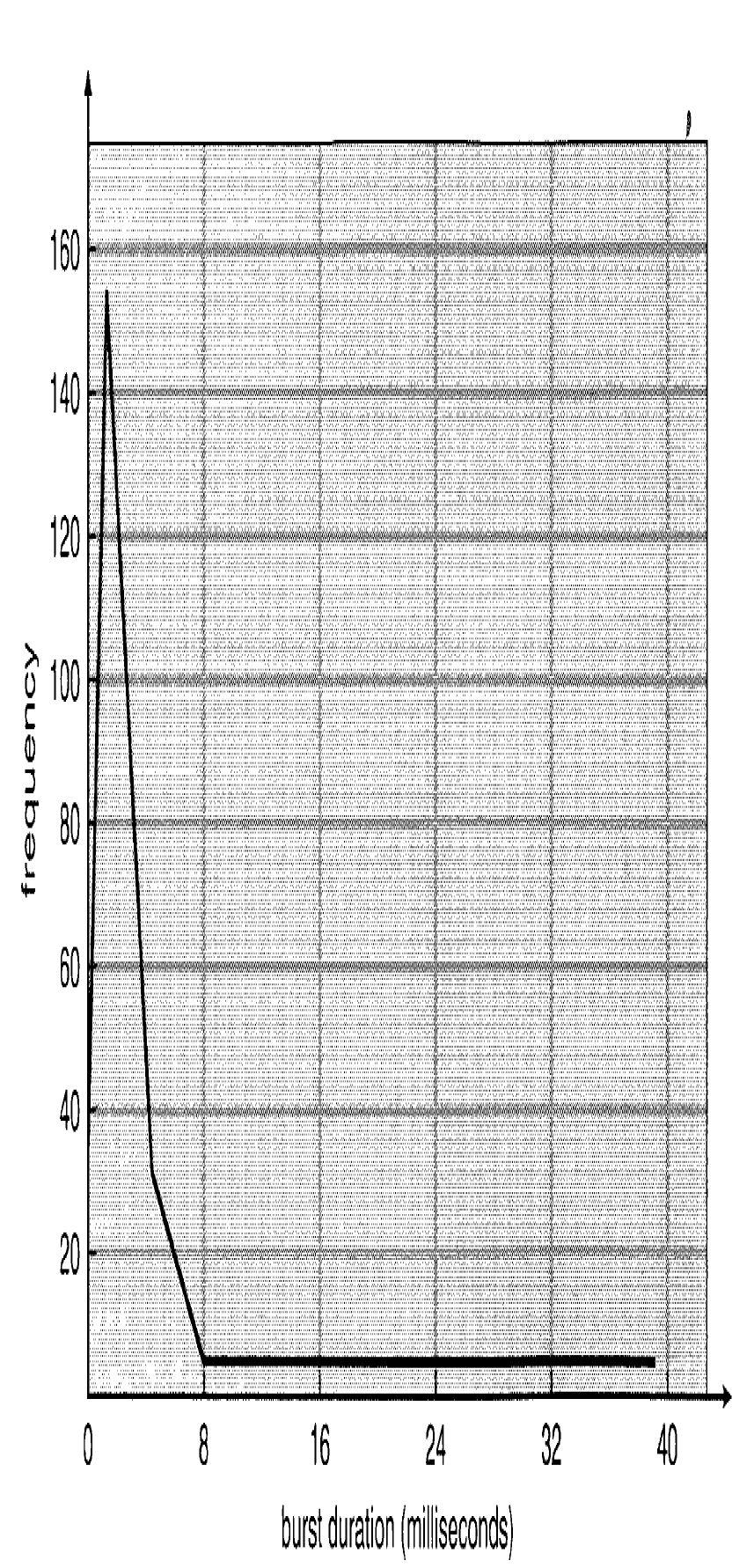
CPU Scheduling
Whenever the CPU finishes executing a process, the operating system must select another process in the ready queue (A process must be in ready/waiting queue and not in any other state as per state transition diagram to be scheduled next on the CPU)
This selection of next process from ready queue is done by the scheduler
The selection process is carried out by the short-term scheduler (CPU scheduler)
The scheduler selects a process from the list of processes in memory ready for execution and allocates the CPU
Although CPU bursts differ from computer to computer & from process to process, they tend to have a frequency curve shown in the diagram below, with a large number of short CPU bursts and a small number of long CPU bursts.
CPU burst durations

Slide 7
Types of CPU Schedulers
There are three types of process schedulers based on the source and destination location of the process being scheduled
Short term Scheduler(CPU scheduler)
Medium term Scheduler
Long term Scheduler

Slide 8
Short term scheduler(CPU scheduler)
A short term scheduler, also called CPU scheduler is responsible for selecting the jobs from ready queue and dispatch the selected job for execution at CPU.
This scheduler is invoked frequently and should be implemented in a very efficient manner with minimum scheduling overhead.
How much time will be allowed to a process on CPU is dependent on the CPU scheduling algorithm used.

Slide 9
Types of CPU schedulers
There are two types of CPU schedulers:
a)Preemptive Scheduler:
Preemptive scheduling is used when a process switches from running state to ready state or from waiting state to ready state. The resources (mainly CPU cycles) are allocated to the process for the limited amount of time and then is taken away, and the process is again placed back in the ready queue if that process still has CPU burst time remaining. That process stays in ready queue till it gets next chance to execute.

Slide 10
b)Non-preemptive Scheduler: Non-preemptive Scheduling is used when a process terminates, or a process switches from running to waiting state. In this scheduling, once the resources (CPU cycles) is allocated to a process, the process holds the CPU till it gets terminated or it reaches a waiting state. In case of non-preemptive scheduling does not interrupt a process running CPU in middle of the execution. Instead, it waits till the process complete its CPU burst time and then it can allocate the CPU to another process. .

Slide 11
When preemptive and non-preemptive are used
CPU Scheduling decisions may take place when a process:
switches from running to waiting state
switches from running to ready state
switches from waiting to ready
Terminates/exits
When scheduling occurs in either 1st or 4th way, then the scheduling scheme is called non-preemptive or cooperative, all other scheduling scheme is termed as preemptive(eg. scheduling 2 and 3)
In non-preemptive scheduling, once the CPU is allocated to a process, the process keeps using the CPU until it either finishes its execution or it enters in to a waiting state
It is used on certain/ most hardware since it does not require special hardware needed by preemptive scheduling
In preemptive scheduling, An interrupt causes currently running process to give up the CPU and be replaced by another process( the situations 2nd and 3rd )
The design of the operating system kernel is affected
it incur cost associated with access to shared data

Slide 12
Dispatcher
The dispatcher is the module that gives control of the CPU to the process selected by the short-term scheduler.
This function involves the following:
switching context
switching to user mode
jumping to the proper location in the user program to restart that program
The dispatcher should be as fast as possible, since it is invoked during every process switch. The time it takes for the dispatcher to stop one process and start another running is known as the dispatch latency.

Slide 13
Medium-term: which process to swap in or out?
Controls the process remains resident in memory and which jobs must be swapped out to reduce degree of multiprogramming
Long-term: which process to admit?
Determines which programs are admitted to the system for processing & it Controls the degree of multiprogramming
Attempts to keep a balanced mix of processor-bound and I/O-bound processes

Slide 14
CPU Scheduling Criteria
The most common criteria used to compare scheduling algorithms:
CPU Utilization
The fraction of time a device is in use. ( ratio of in-use time / total observation time )
Throughput
The number of job completions in a period of time. (jobs / second )
Turnaround time
The interval between the submission of a process to its execution
It is the sum of the periods spent waiting to get the memory, waiting in the ready queue, executing on the CPU an doing and I/O
Waiting time
The sum of the periods spent waiting in the ready queue
Service time
The time required by a device to handle a request.
Response time
Amount of time it takes from the submission of a request till the first response is produced

Slide 15
CPU Scheduling Optimization criteria
Maximum CPU utilization
Maximum throughput time
Minimize turnaround time
Minimize waiting time
Minimize response time
Note that:
It’s desirable to maximize CPU utilization and throughput and minimize turnaround time, waiting time and response time.

Slide 16
CPU Scheduling Algorithms
Scheduling deals with the problem of deciding which of the outstanding requests is to be allocated resources.
Scheduling algorithms are used for distributing resources among parties which simultaneously and asynchronously request them. In OS (to share CPU time among both threads and processes )
The main purposes of scheduling algorithms are to minimize resource starvation and to ensure fairness amongst the parties utilizing the resources.
There are many different scheduling algorithms:
First-Come, First Served(FCFS)
Shortest Job First(SJF)
Priority Based Scheduling
Round Robin Scheduling
Multi-Level Queues
Multi-Level Feedback Queues

Slide 17
1.First-Come, First Served(FCFS)
In this algorithm, that process the requests the CPU first is allocated the CPU first
The implementation of this algorithm is handled by FIFO queue
Arriving jobs are inserted in to the tail(rear) of the ready queue and the process to be executed next is removed from the front (head) of the ready queue
Relative importance of jobs is measured by arrival time
The average waiting time is quite too long
Throughput can be low, since long processes can hog the CPU
Turnaround time, waiting time and response time can be high
A long CPU-bound process may hog the CPU and may force shorter processes to wait for a prolonged period.
This may lead to a long queue of ready jobs in the ready queue
(convoy effect)

Slide 18
1.First-Come, First Served(FCFS) (cont.)
The convoy effect results in a lower CPU and device utilization
It’s a non-preemptive algorithm
A process runs until it blocks for an I/O or it terminates
Favors CPU-bound processes
A CPU-bound process monopolizes the processor
I/O-bound processes have to wait until completion of CPU-bound process
I/O-bound processes may have to wait even after their I/Os are completed (poor device utilization)
Better I/O device utilization could be achieved if I/O bound processes had higher priority

Slide 19
1.First-Come, First Served(FCFS) (cont.)
Example 1:
Consider the following processes that arrive at time zero, with the length of the CPU burst given in milliseconds
If the processes arrive in the order of P1, P2 and P3 and are served in the FCFS order, then the waiting time for each of the processes will be as follows:
Process | Burst Time
P1 | 27
P2 | 9
P3 | 3
P1 P2 P3
0
27
36
39
Waiting time for P1 is 0 ms, meaning it starts immediately
Waiting time for P2 is 27 ms, before starting
Waiting time for P3 is 36 ms
Average waiting time = (0+27+36)/3=21 ms

Slide 20
1.First-Come, First Served (FCFS) (cont.)
* What if the order of the processes was P2, P3, P1? What will be the average waiting time? Check [avg. waiting time= 7 ms] what do you notice from this?
Example 2:
Average wait =((0) + (8-1) + (12-2) + (21-3) )/4 = 35/4 = 8.75
Process | Arrival time | Service time
1 | 0 | 8
2 | 1 | 4
3 | 2 | 9
4 | 3 | 5
Waiting time for P₁ = 0; P₂ = 8-1; P₃ = 12-2; P₄=21-3
P1
P2
P3
P4
0
8
12
21
26

Slide 21
2. Shortest Job First (SJF), Shortest Job Next (SJN)
SJF policy selects the job with the shortest (expected) processing time first.
With this strategy the scheduler arranges processes with the least estimated processing time remaining to be next in the queue. This requires advance knowledge or estimations about the time required for a process to complete
Two schemes:
Non-preemptive – once CPU is given to a process, it cannot be preempted in the current CPU burst
Preemptive – if a new process arrives with CPU burst length less than the remaining time of current process, preempt.
One major difficulty with SJF is the need to know or estimate the processing time of each job (can only predict the future!)
This scheme is know as the Shortest-Remaining-Time-First (SRTF)
SJF is optimal – gives minimum average waiting time for a given set of processes
Starvation is possible, especially in a busy system with many small processes being run.

Slide 22
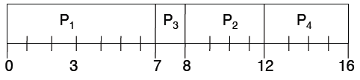
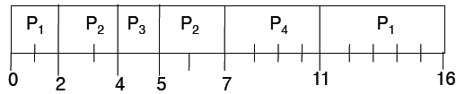
2. Shortest Job First (SJF), Shortest Job Next (SJN)
Example: SJF
a. NonPreemptive
Process | Arrival time | Service time
1 | 0 | 7
2 | 2 | 4
3 | 4 | 1
4 | 5 | 4
Average waiting time=(0+(8-2)+(7-4)+(12-5))/4 = 4
b. preemptive
Average waiting time= ((11-2) + (5-4) + (4-4) +(7-5))/4 = 3

Slide 23
3. Priority Based Scheduling
Assign each process a priority. Schedule highest priority first. All processes within same priority are FCFS
Priority may be determined by user or by some default mechanism
The system may determine the priority based on memory requirements, time limits, or other resource usage
CPU allocated to process with highest priority
Preemptive or non-preemptive
Problem → Starvation – low priority processes may never execute.
Solution → Aging – as time progresses increase the priority of the process
Delicate balance between giving favorable response for interactive jobs, but not starving batch jobs

Slide 24
3. Priority Based Scheduling(cont…)
EXAMPLE :Consider the following processes that arrive at time zero, with the length of the CPU burst and priorities given.
Process Burst Time Priority
1 10 3
2 1 1
3 2 4
4 1 5
5 5 2
Using Priority scheduling, we would schedule these processes according to the following Gant chart:
Average waiting time = (6+0+16+18+1)/5 = 8.2
P₂ P₅ P₁ P₃ P₄
0
1
6
16
18
19

Slide 25
4. Round Robin (RR)
Each process gets a small unit of CPU time (time quantum), usually 10-100 milliseconds. After this time has elapsed, the process is preempted and added to the end of the ready queue
The name of the algorithm comes from the round- robin principle known from other fields, where each person takes an equal share of something in turn
If there are n processes in the ready queue and the time quantum is q, then each process gets 1/n of the CPU time in chunks of at most q time units at once. No process waits more than (n-1)q time units
Performance: Choosing a time quantum q:
q large ⇒ FIFO
q small ⇒ q must be large with respect to context switch, otherwise overhead is too high

Slide 26
4. Round Robin (RR) (cont.)
Example 1: RR with time quantum =20
Process | Burst time
P1 | 53
P2 | 17
P3 | 68
P4 | 24
P₁
P₂
P₃
P₄
P₁
P₃
P₄
P₁
P₃
P₃
0
20
37
57
77
97
117
121
134
154
162
Typically, higher average turnaround than SJF, but better response

Slide 27
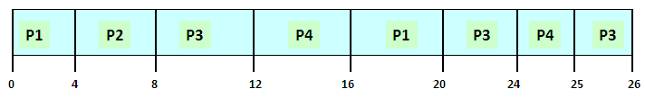
4. Round Robin (RR) (cont.)
Example 2: RR with time quantum =4, no priority-based preemption
Process Arrival Service
Time Time
1 0 8
2 1 4
3 2 9
4 3 5
Average wait = ( (20-0) + (8-1) + (26-2) + (25-3) )/4 = 74/4 = 18.5

Slide 28
5.Multilevel Queue Scheduling
Ready queue is partitioned into separate queues: foreground (interactive) background (batch)
Each queue has its own scheduling algorithm
foreground – RR
background – FCFS
Scheduling must be done between the queues
Fixed priority scheduling; (i.e., serve all from foreground then from background). Possibility of starvation.
Time slice – each queue gets a certain amount of CPU time which it can schedule amongst its processes; i.e., 80% to foreground in RR
20% to background in FCFS

Slide 29
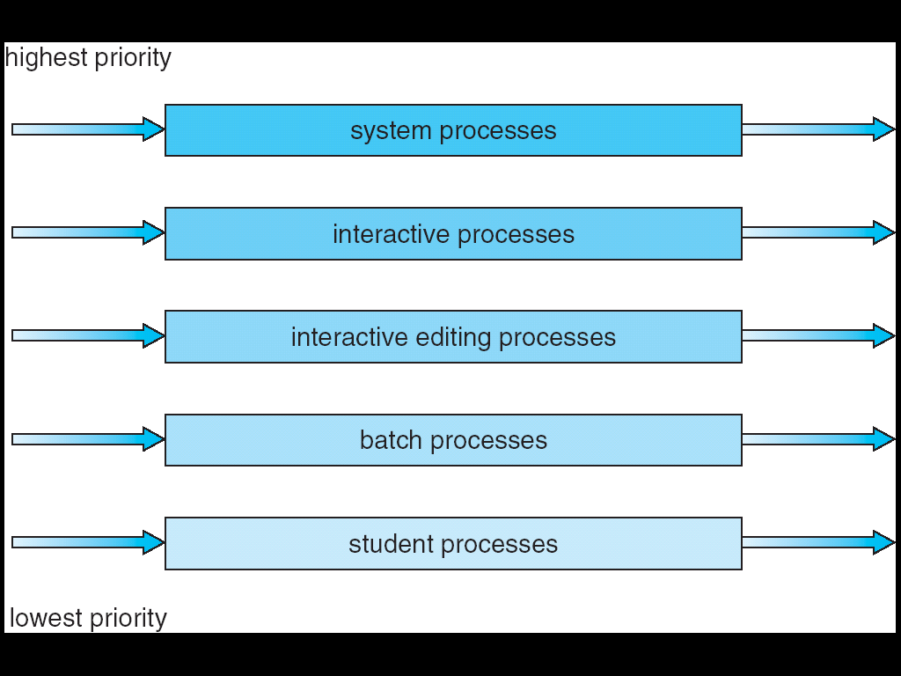
5.Multilevel Queue Scheduling
For example, could separate system processes, interactive, batch, favored, unfavored processes.

Slide 30
6. Multilevel Feedback Queue Scheduling
A process can move between the various queues
aging can be implemented this way
Multilevel-feedback-queue scheduler defined by the following parameters:
number of queues
scheduling algorithms for each queue
method to determine when to upgrade a process
method to determine when to demote a process
method used to determine which queue a process will enter when that process needs service

Slide 31
6. Multilevel Feedback Queue
Example:
Three queues:
– Q0 – RR with time quantum 8 milliseconds
– Q1 – RR time quantum 16 milliseconds
– Q2 – FCFS
• Scheduling
– A new job enters queue Q0: when it gains CPU, job receives 8 milliseconds. If it does not finish in 8 milliseconds, job is moved to queue Q1
– At Q1 job: it receives 16 additional milliseconds. If it still does not complete, it is preempted and moved to queue Q2

Slide 32
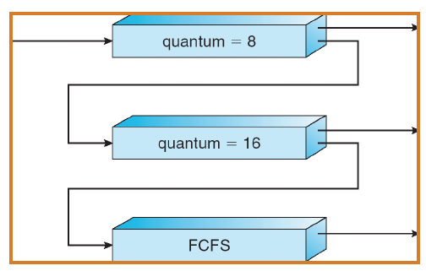
6. Multilevel Feedback Queue (cont.)

Slide 33
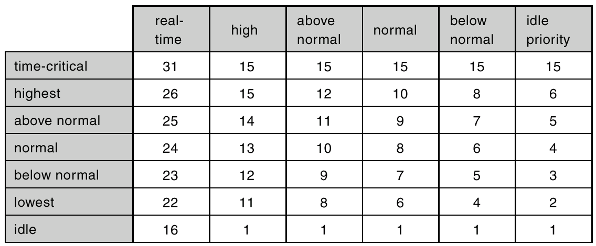
CPU Scheduling: using priorities
Here’s how the priorities are used in Windows systems

Slide 34
Scheduling Algorithms
Real-time systems
Hard real-time systems – required to complete a critical task within a guaranteed amount of time
Soft real-time computing – requires that critical processes receive priority over less fortunate ones
Multiple Processor Scheduling
Different rules for homogeneous or heterogeneous processors
Load sharing in the distribution of work, such that all processors have an equal amount to do.
Each processor can schedule from a common ready queue (equal machines) OR can use a master slave arrangement
Thread Scheduling
Local Scheduling – How the user threads library decides which thread to put onto an available LWP (Light Weight Process)--- process contention scope
Global Scheduling – How the kernel decides which kernel thread to run next

Slide 35
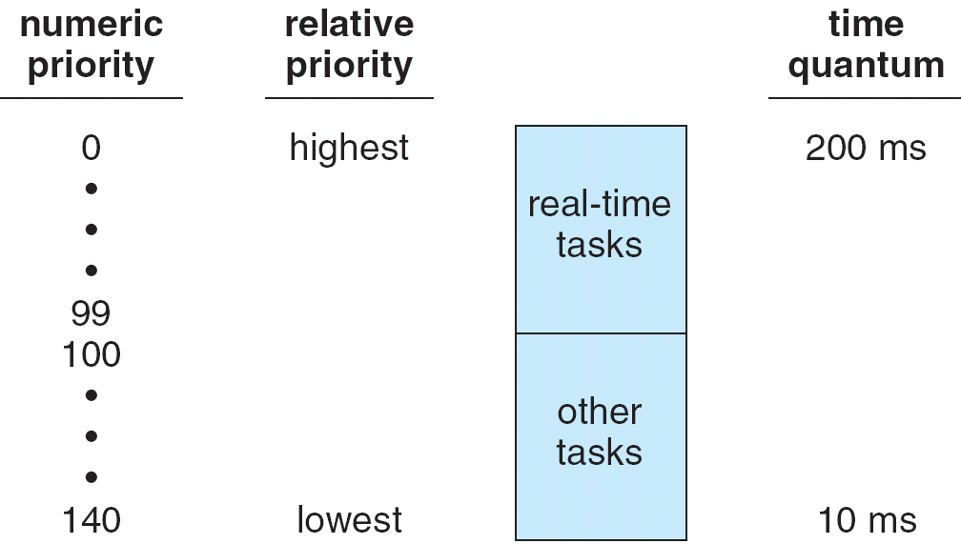
Linux Scheduling
Two algorithms:
time-sharing and real-time
Time-sharing
Prioritized credit-based – process with most credits is scheduled next
Credit subtracted when timer interrupt occurs
When credit = 0, another process chosen
When all processes have credit = 0, recrediting occurs
Based on factors including priority and history
Real-time
Soft real-time
Posix.1b compliant – two classes
FCFS and RR
Highest priority process runs first

Slide 36
Algorithm Evaluation Summary
Which algorithm is the best?
The answer depends on many factors:
the system workload (extremely variable)
hardware support for the dispatcher
relative importance of performance criteria (response time, CPU utilization, throughput...)
The evaluation method used (each has its limitations...)
Which one works the best is application dependent
General purpose OS will use priority based, round robin, preemptive
Real Time OS will use priority, no preemption

Slide 37
Terminology for Examples
AT: Arrival time of a process
BT: Burst time of a process
CT: completion time of a process
WT: waiting time of a process
TAT: turn around time
ST: Scheduled time of a process

Slide 38
Formulas
Turn around time is the total time in which a process is present in the system, irrespective to the fact that process was waiting, doing I/O or executing.
TAT=CT-AT=BT+WT
Weighted TAT= (CT-AT)/BT
Wait Time of a process
WT=TAT-BT=CT-AT-BT

Slide 39
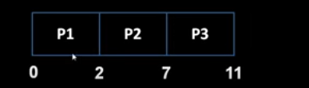
Gantt Chart
A graphical representation of process scheduling information
A timeline represented by rectangular blocks, each block has a process Id,
At time 0 P1 was scheduled for execution, at time 2 P2 was scheduled
Schedule length is 11 unit of time
Timeline

Slide 40
Schedule length is the difference between maximum completion time of any process and the minimum arrival time of any process.
**(!3 number of schedules are possible with 3 processes)
SL= Max(CT)-Min(AT)
=11-0
=11
Throughput is the number of processes competed per unit time
Th=No. of process completed/Shedule length
Th=3/11=.27

Slide 41
FCFS example
Selection Criteria: Basic criteria of selection of process is AT(Arrival Time)
Mode: It is Non-preemptive mode
Assumptions: context switch time is negligible, each process have only CPU burst time and zero I/O burst time.
Example: Given following processes, compute TAT, WT for each process using FCFS
SN | PID | AT | BT
1 | P1 | 0 | 2
2 | P2 | 1 | 3
3 | P3 | 2 | 5
4 | P4 | 3 | 4
5 | P5 | 4 | 1

Slide 42
solution
First compute sum of all Burst times
ℇBT= 2+3+5+4+1
=15
So, on Gantt chart we need to make a timeline of length 15, because in this amount of time all the processes will finish their burst time.
So let us make Gantt chart for schedule using FCFS:
Step 1: Select the process whose AT is smallest: here P1 is arrived on time=0, so we select the P1 and schedule it on the processor.

Slide 43
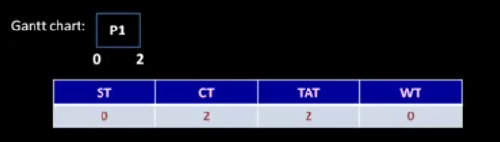
Gantt chart for P1
For process P1, Scheduled time is 0, because it was given processor at time 0, its Burst time is 2 units, so after completing its BT, it was completed, so CT of P1 is 2. its WT is zero because it was immediately scheduled. Also TAT=CT-AT=2-0=2

Slide 44
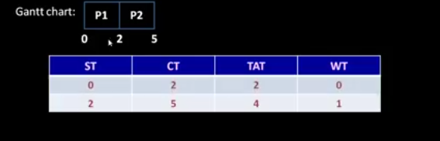
Gantt Chart for P2
P2 was arrived at AT=1, but at that time CPU was held by P1. In, non-preemptive settings P2 will wait for P1. On time 2, it is Schedule time for P2. its BT is 3 so its completion time is CT=BT+ST=3+2=5
TAT(P2)=CT(P2)-AT(P2)
=5-1=4
WT(P2)=TAT(P2)-BT(P2)
=4-3=1

Slide 45
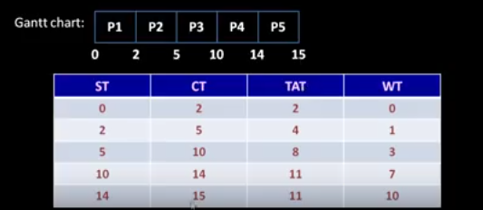
Complete Gantt Chart
Important to see AT and Scheduled times of processes in the Gantt chart.
Here schedule length is
SL=15-0=15

Slide 46
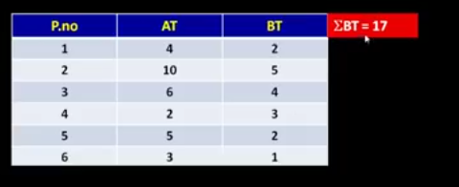
Assignment question:FCFS
Compute ST, CT, TAT and WT for each process
Compute SL
Compute TH

Slide 47
Non preemptive Shortest Job First algorithm
Criteria
The next process will be selected for execution whose Burst time is least.
Non preemptive SJF allow a process to finish its BT once scheduled and do not allow forceful yield of processor
In case of preemptive version of SJF, if another process of shorter BT arrives during schedule of a process, we prefer to force the previous process to leave the CPU and execute shorter BT process first.

Slide 48
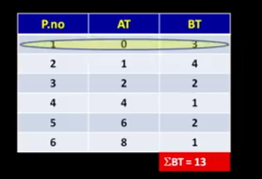
Example: SJF-NP
Question:
Compute:
WT, TAT, ST etc.
TH
SL

Slide 49
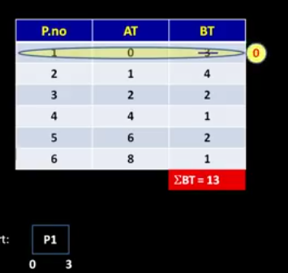
Since at time 0, only P1 was in system so w e have to schedule it.
However process P4 and P6 have shorter burst time but they have not arrived at time 0,
P1 will execute upto time =3, in the mean time P2 and P3 will arrive.
However AT(P2)<AT(P3)
But BT(P3)<BT(P2)
So after completion of P1, P3 will be selected.
Schedule First process

Slide 50
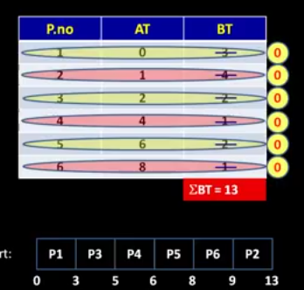
Full solution
Here the SL is 13
Each process is selected and scheduled based on BT
You can compute individual
TAT, WT and ST, CT etc.

Slide 51
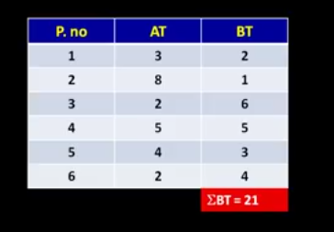
Assignment: SJF-NP
Solve following using NP-SJF and compute TAT, CT, WT, ST for each process
Use preemptive SJF
Question

