Slide 1
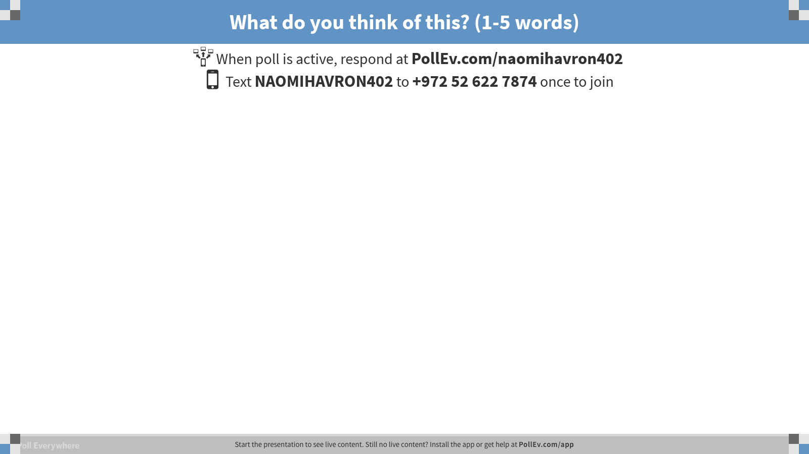
Notes:
Poll Title: What do you think of this? (1-5 words) https://www.polleverywhere.com/free_text_polls/qTZ4s7GzGiw5o0N

