Slide 1

Driving User-Centered Design with AI
PAB All-staff
Nov 13 , 2024

Slide 2
"The future is not about replacing creativity with machines, but about leveraging technology to augment human potential and creativity.”
Satya Nadella, Microsoft CEO

Slide 3
DDPD GenAI use cases
Improve content usability
Accelerate content design
Template web designs
Apply templates, components and other patterns to content structures
Generate metadata
Bulk generate missing metadata to improve search results
Assess accessibility
Review HTML code for opportunities to improve accessibility of content
Summarize site feedback
Review large amounts of user feedback to identify key themes and analyze data patterns
Create IA diagrams
Output editable charts and diagrams for website navigation, user journeys or other logic maps
Draft UX scenarios
Automate drafting of tasks and scenarios as well as categorization of tasks
Notes:
This deck provides an overview of 3 project cases that have come out of the opportunities we have identified.

Slide 4

Project: Summarize site feedback
Leveraging AI to Transform User Feedback into Actionable Insights at CRA
Notes:
Speaking Notes: The significance of using technology as a tool to unlock human potential.
AI is enhancing our capacity to respond to user needs more effectively.

Slide 5


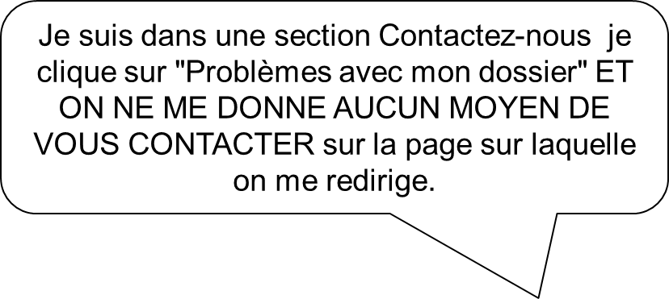
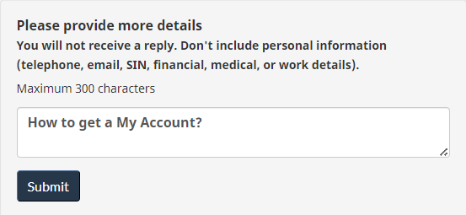
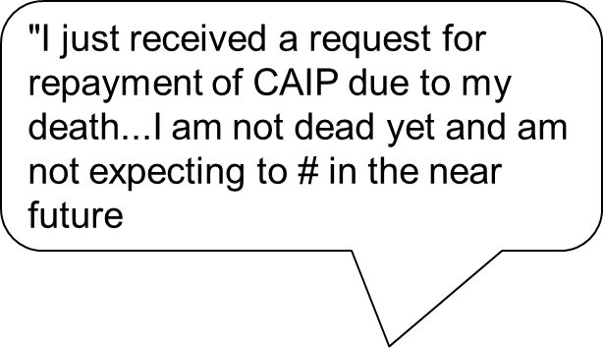

Site feedback on Canada.ca
On each CRA web page, users can answer: “Did you find what you were looking for?” If they say “no,” they can leave details to explain their challenges.
This feedback gives CRA the direct “voice of the user,” capturing specific issues that users experience. It’s foundational to making user-centered improvements
The voice of the user

Slide 6
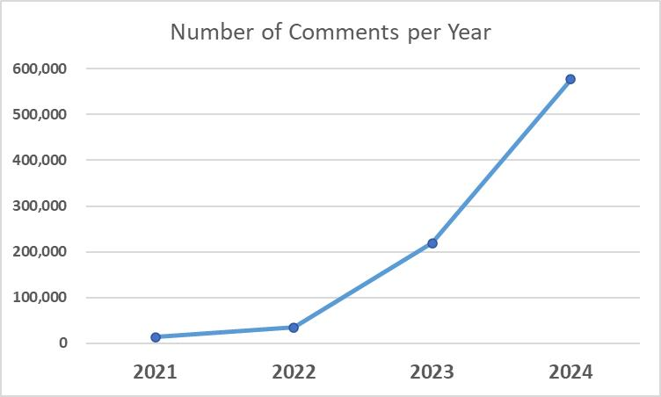
The Challenge – Overwhelmed by Volume
With half a million comments over six months, We faced a significant problem: how to analyze this vast volume of feedback and prioritize issues effectively.
Traditional analysis methods weren’t feasible given the time and resources required, meaning we risked missing out on critical insights.
62,000
Comments in May 2024
500,000 Comments in 6 months
Notes:
AI is helping us actively use the comments people send, turning feedback into valuable insights rather than letting it sit unused.

Slide 7





GenAI to analyze feedback
Empowering design and program teams with summarized insights into challenges taxpayers face.
Generative AI, like ChatGPT, helps us accelerate feedback analysis, quickly sorting, clustering, and prioritizing comments.
It's not just saving time but unlocking insights that were previously out of reach. AI turns feedback data into structured, actionable information.
Generative AI allows us to:
Quickly identify trends and patterns​
Cluster related data for in-depth analysis​
Summarize insights into user problems​
Propose actionable solutions​
Monitor user reaction to design updates

Slide 8
Integration into User-Centered Design
AI-empowered feedback analysis is now embedded in our user-centered design (UCD) process.
Using generative AI in the discovery phase provides us with insights that shape decision-making early on, enabling evidence-based, user-centered design.
By monitoring feedback after changes, we can continually refine and improve user experiences.
Initiate phase
Discover phase
Design phase
Deliver phase
Monitor & refine phase

Slide 9
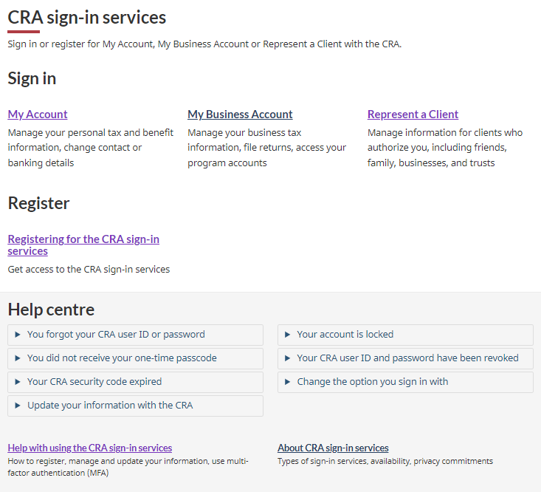

Case Study – My Account Optimization
In November 2023, over 93,000 comments were collected on My Account login and access issues.
Prompted a GENAI tool to "review the comments, classify them and provide a summary along with actionable insights
This level of detailed analysis helped the team prioritize and address issues impacting user experience.
Based on AI-driven insights, we improved the clarity of answers to key issues faced by users and placed this help at the point of need.
Notes:
This targeted improvement illustrates how GenAI analysis drives actionable changes, making My Account more accessible and user-friendly.

Slide 10
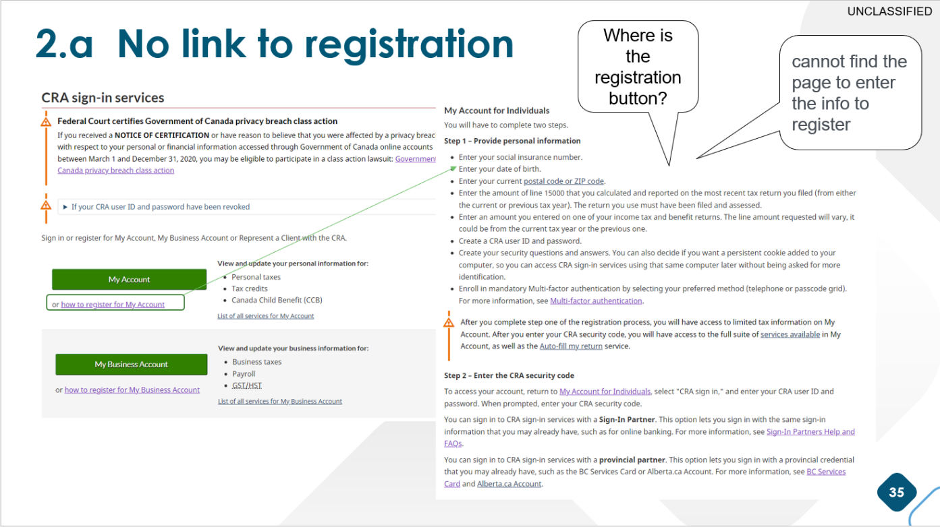
Case Study – My Account Optimization
Users frequently mentioned difficulties in finding a clear and direct link or button to start the registration process. They expressed frustration about not being able to locate the actual registration form.
AI Feedback Summary
Problem: The registration instructions described in detail the registration process, but didn’t have a link or button to start the registration process.
Solution: The redesigned registration page has clear buttons to start the registration process.
Result: Negative feedback for this task decreased by 51% and calls per 100 visits decreased by 42%.

Slide 11
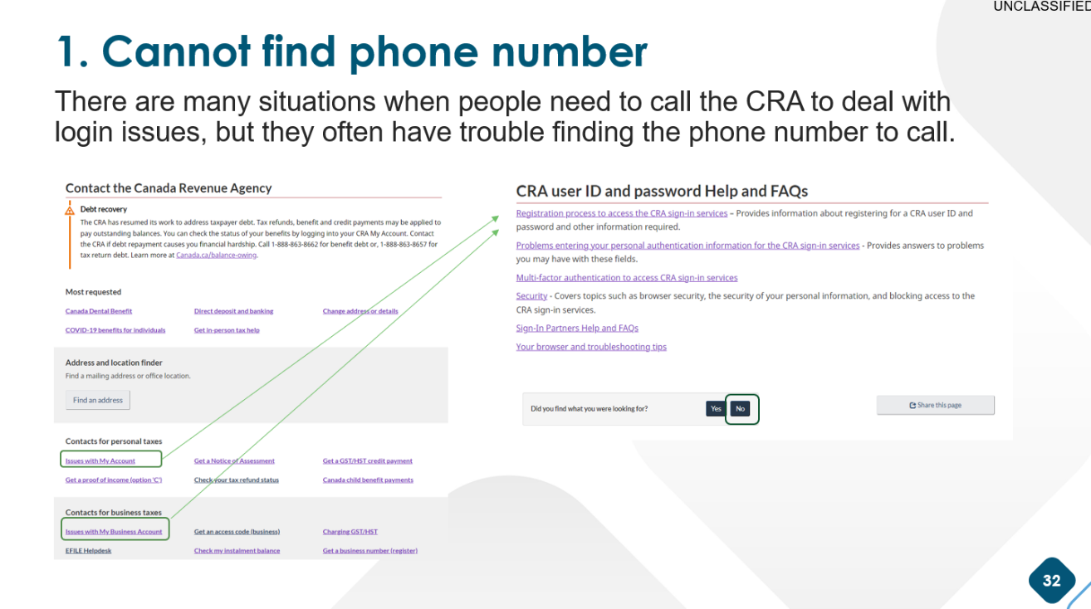
Case Study – My Account Optimization / Call Mitigation Project
Users face obstacles when trying to reach CRA for assistance, whether through phone calls or the website's communication channels.
AI Feedback Summary
Problem: Users on the "Contact the CRA" page clicked a link for “Issues with My Account” that led them to an FAQ section without a phone number.
Solution: We removed the misleading link and launched a redesigned contact page in May 2024.
Result: Observed an immediate drop in negative feedback following the changes.

Slide 12

Key Takeaways
With the success of this pilot, generative AI feedback analysis has become an operationalized step in the user centered design process.
Scalable Analysis
Evidence-Based Design
Improved User Experience
"The future is not about replacing creativity with machines, but about leveraging technology to augment human potential and creativity.” - Satya Nadella, Microsoft CEO
Using AI to analyze feedback doesn’t replace human insight—it augments it.
AI helps us quickly find patterns and understand user needs, so we can make smarter, faster improvements to the user experience.
Notes:
Scalable Analysis: Generative AI allows us to analyze feedback at an unprecedented scale, turning vast amounts of data into actionable insights. Evidence-Based Design: Insights derived from feedback analysis empower CRA’s design and program teams to make user-centered, data-driven improvements. Improved User Experience: The AI-based analysis has already led to reduced user frustrations in targeted areas and will continue to enhance CRA services.

Slide 13
Thank you
Notes:
Blank new section title slide

