Slide 1
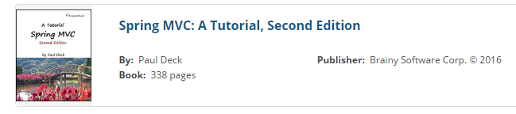
Spring @MVC
http://books.brainysoftware.com/download
Internal Use - Confidential

Slide 2
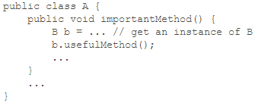
Dependency Injection
Many people use the terms dependency injection and Inversion of Control (IoC) interchangeably, even though Martin Fowler argues that they are not the same in his excellent article on the subject.
http://martinfowler.com/articles/injection.html
short explanation of dependency injection :
If you have two components, A and B, and A depends on B, you can say A is dependent on B or B is a dependency of A.
Suppose A is a class that has a method called importantMethod that uses B, as defined in the following code fragment.

Slide 3
A must obtain an instance of B before it can use B.
While it is as straightforward as using the new operator if B is a concrete class, it can be problematic if B is an interface with many implementations.
You will have to choose an implementation of B and by doing so you reduce the reusability of A because you cannot use A with the implementations of B that you did not choose.
Dependency injection framework like Spring would create an instance of A and an instance of B and inject the latter to the former.

Slide 4
Spring supports both setter-based and constructor-based dependency injection since version 1.
Starting from Spring 2.5, field-based dependency injection is also made possible via the use of the Autowired annotation type.
With Spring, you practically hand over the creation of all important objects to it. You configure Spring, either through XML files or annotations, to tell it how it should inject dependencies.
You would then create an ApplicationContext, which essentially represents a Spring IoC container. The ApplicationContext interface comes with several implementations, including
ClassPathXmlApplicationContext -- will try to find the configuration files in the class path
FileSystemXmlApplicationContext -- will try to find them in the file system.
WebApplicationContext -- by default will look in the web application directory
All expect an XML document or multiple XML documents that contain information on the beans that it will manage.

Slide 5
XML-Based Spring Configuration
Spring supports XML-based configuration since version 1.0 as well as annotation-based configuration starting version 2.5.
The root element of a Spring configuration file is always beans.
You can add more schemas to the schemaLocation attribute if you need more Spring functionality in your application.
You can even use a version-specific schema like this rather than the default schema:
http://www.springframework.org/schema/beans/spring-beans-4.2.xsd

Slide 6
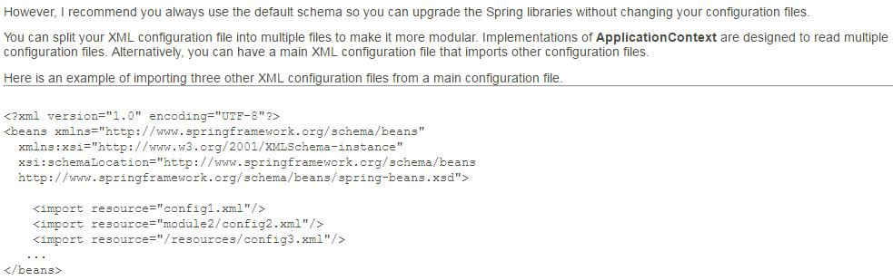

Slide 7
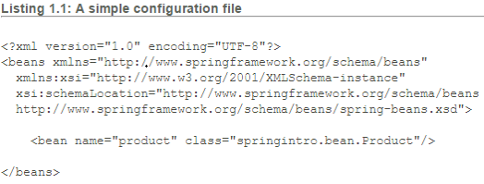
Using Spring to Manage Dependencies

Slide 8
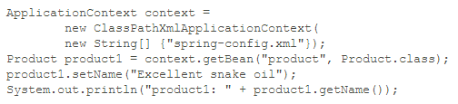
Notes:
Ca

Slide 9
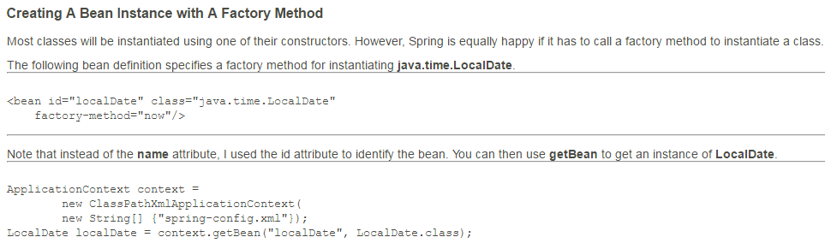
Notes:
<bean id=“localDate” class=“java.time.LocalDate” factory-method=“now”/>
ApplicationContext context = new ClassPathXmlApplicationContext(new String[] {“spring-config.xml”});
LocaDate localDate = context.getBean(“localDate”,LocalDate.class);

Slide 10
Using A Destroy Method
Some classes come with methods that should be called before instances of the classes are put for garbage collection.
Spring supports this notion too. In your bean declaration, you can use the destroy-method attribute to name a method that should be invoked before the object is decommissioned.
For example, the following bean element instructs Spring to create an instance of java.util.concurrent.ExecutorService by calling the static method newCachedThreadPool on the java.util.concurrent.Executors class.

Slide 11

The bean definition defines the shutdown method as the value of its destroy-method attribute.
As a result, Spring will call shutdown before destroying the ExecutorService instance.
Notes:
<bean id=“executorService” class=“java.util.concurrent.Executors”
factory-method=“newCachedThreadPool”
destroy-method=“shutdown”/>

Slide 12
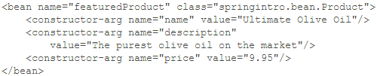

Passing Arguments to a Constructor
Spring can pass arguments to a class constructor if using the constructor is how it is intended to instantiate the class.
The following bean definition passes arguments to the Product class by name.
In this case, Spring will use the following constructor of the Product class.

Slide 13
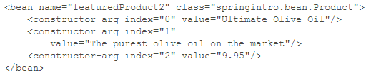
Passing arguments by name is not the only way to do business in Spring.
Spring allows you to pass argument by index. Here is how the featuredProduct bean can be rewritten.
If you choose to pass arguments to a constructor, you must pass all the arguments required by the constructor.
An incomplete list of arguments will not be accepted.

Slide 14
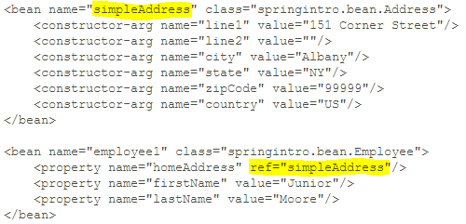
Setter-based Dependency Injection

Slide 15
Chapter2 – Model2 & MVC Pattern

Slide 16
Highlights
There are two models used in Java web application design, conveniently called Model 1 and Model 2.
Model 1 is page-centric and suitable for very small applications only.
Model 2 is the recommended architecture for all but the simplest Java web applications.
This chapter discusses Model 2 in minute detail and provides four Model 2 sample applications.
The first example features a basic Model 2 application with a servlet as the controller.
The second example is also a simple Model 2 application, however it uses a filter as the controller.
The third example introduces a validator component for validating user input.
The fourth application illustrates the use of a home-grown dependency injector. In real-world applications, you should use Spring instead.
Note : At the time of writing, an effort is being made to standardize MVC web frameworks through JSR 371.

Slide 17
Model 1 Overview
When you first learn JSP, your sample applications would normally enable navigation from one page to another by providing a clickable link to the latter.
While this navigation method is straightforward, in medium-sized or large applications with significant numbers of pages this approach can cause a maintenance headache.
Changing the name of a JSP page, for instance, could force you to rename the links to the page in many other pages.
As such, Model 1 is not recommended unless your application will only have two or three pages.

Slide 18
Model 2 Overview
In Model 2, you have a servlet or a filter acting as the controller.
All modern web frameworks are Model 2 implementations. Frameworks such as Struts 1, JavaServer Faces and Spring MVC employ a servlet controller in their MVC architectures, whereas Struts 2, another popular framework, uses a filter.
Generally JSP pages are employed as the views of the application, even though other view technologies are supported.
As the models, you use POJOs (Plain Old Java Object). POJOs are ordinary objects, as opposed to Enterprise JavaBeans (EJB) or other special objects.
Many people choose to use JavaBeans to store the states of model objects and move business logic to action classes.

Slide 19
In a Model 2 application, every HTTP request must be directed to the controller. The request's Uniform Request Identifier (URI) tells the controller what action to invoke. The term "action" refers to an operation that the application is able to perform. The Java object associated with an action is called an action object. A single action class may be used to serve different actions (as in Struts 2 and Spring MVC) or a single action (as in Struts 1).
A seemingly trivial operation may take more than one action. For instance, adding a product to a database would require two actions:
Display an "Add Product" form for the user to enter product information.
Save the product information in the database.

Slide 20
As mentioned above, you use the URI to tell the controller which action to invoke. For instance, to get the application to send the "Add Product" form, you would use a URI like this:
http://domain/appName/input-product
To get the application to save a product, the URI would be:
http://domain/appName/save-product
The controller examines the URI to decide what action to invoke.
It also stores the model object in a place that can be accessed from the view, so that server-side values can be displayed on the browser. Finally, the controller uses a RequestDispatcher or HttpServletResponse.sendRedirect() to forward/redirect to a view (a JSP page or another resource).
In the JSP page, you use the Expression Language expressions and custom tags to display values.

Slide 21
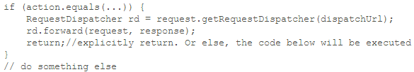
Note that calling RequestDispatcher.forward() or HttpServletResponse.sendRedirect() does not prevent the code below it from being executed. Therefore, unless the call is the last line in a method, you need to return explicitly.

Slide 22
Most of the time, you would use a RequestDispatcher to forward to a view because it is faster than sendRedirect.
This is due to the fact that a redirect causes the server to send the HTTP response status code 302 with a Location header containing a new URL to the browser.
Upon receiving the status code 302, the browser makes a new HTTP request to the URL found in the Location header.
In other words, a redirect requires a round-trip that makes it slower than a forward.

Slide 23
What is the advantage of using a redirect over a forward?
With a redirect, you can direct the browser to a different application.
You cannot do this with a forward.
If a redirect is used to hit a different resource in the same application, it is because it yields a different URL than the original request URL.
As such, if the user accidentally presses the browser Reload/Refresh button after a response is rendered, the code associated with the original request URL will not be executed again.
For instance, you would not want the same code that makes a credit card payment re-executed just because the user accidentally pressed the Reload or Refresh button of her browser.
The last example in this chapter, the appdesign4 application, shows an example of a redirect and demonstrates how it can be done.

Slide 24
Model 2 with A Servlet Controller
The application is capable of performing these two actions:
Display the "Add Product" form. This action sends the entry form in Figure 2.2 to the browser. The URI to invoke this action must contain the string input-product.
Save the product and returns the confirmation page in Figure 2.3. The URI to invoke this action must contain the string save-product.
The application consists of the following components:
A Product class that is the template for the model objects. An instance of this class contains product information.
A ProductForm class, which encapsulates the fields of the HTML form for inputting a product. The properties of a ProductForm are used to populate a Product.
A ControllerServlet class, which is the controller of this Model 2 application.
An action class named SaveProductAction.
Two JSP pages (ProductForm.jsp and ProductDetails.jsp) as the views.
A CSS file that defines the styles of the views. This is a static resource.

Slide 25
Let's take a closer look at each component in appdesign1.
The Product Class
A Product instance is a JavaBean that encapsulates product information. The Product class (shown in Listing 2.1) has three properties: productName, description, and price.
The Product class implements java.io.Serializable so that its instances can be stored safely in HttpSession objects. As an implementation of Serializable, Product should have a serialVersionUID field.
The ProductForm Class
A form class is mapped to an HTML form. It is the representation of the HTML form on the server. At a glance the ProductForm class is similar to the Product class and you might question why ProductForm needs to exist at all. A form object, as you can see in the section "Validators" later in this chapter, saves passing the ServletRequest to other components, such as validators. ServletRequest is a servlet-specific type and should not be exposed to other layers of the applications.

Slide 26
The ControllerServlet Class
The ControllerServlet class (presented in Listing 2.3) extends the javax.servlet.http.HttpServlet class. Both its doGet and doPost methods call the process method, which is the brain of the servlet controller.
I am probably raising a few eyebrows here by naming the servlet controller ControllerServlet, but I'm following the convention that says all servlet classes should be suffixed with Servlet.
The Action Class
There is only one action class in the application, which is responsible for saving a product to some storage, such as a database. The action class is named SaveProductAction and is given in Listing 2.4.
The Views
The application utilizes two JSP pages for the views of the application. The first page, ProductForm.jsp, is displayed if the action is input-product. The second page, ProductDetails.jsp, is shown for save-product. ProductForm.jsp is given in Listing 2.5 and ProductDetails.jsp in Listing 2.6.

Slide 27
Model 2 with A Filter Dispatcher
While a servlet is the most common controller in a Model 2 application, a filter can act as a controller too.
Note, however, that a filter does not have the privilege to act as a welcome page.
Simply typing the domain name won't invoke a filter dispatcher.
Struts 2 uses a filter as a controller because the filter is used to serve static contents too.
The JSP pages and the Product class are the same as the ones in appdesign1. However, instead of a servlet as controller, you have a filter called FilterDispatcher (given in Listing 2.7).
doFilter method performs what the process method in appdesign1 did.
http://localhost:8080/appdesign2/input-product

Slide 28
Validators
Input validation is an important step in performing an action.
Validation ranges from simple tasks like checking if an input field has a value to more complex ones like verifying a credit card number.
In fact, validation play such an important role that the Java community has published JSR 303, "Bean Validation" to standardize input validation in Java.
Modern MVC frameworks often offer both programmatic and declarative validation methods.
In programmatic validation, you write code to validate user input.
In declarative validation, you provide validation rules in XML documents or properties files.
Note : don't rely on client-side validation because the savvy user can bypass it easily. Always perform server-side input validation!
Look into appdesign3 for validation example.
Notes:
Run the appdesign3 application.

Slide 29

Dependency Injection
http://martinfowler.com/articles/injection.html
If you have two components, A and B, and A depends on B, you can say A is dependent on B or B is a dependency of A. Suppose A has a method, importantMethod, that uses B as defined in the following code fragment:
A must obtain an instance of B before it can use B.
While it is as straightforward as using the new keyword if B is a Java concrete class, it can be problematic if B is not and there are various implementations of B.
You will have to choose an implementation of B and by doing so you reduce the reusability of A because you cannot use A with implementations of B that you did not choose.

Slide 30
appdesign4
The sample application is used to generate PDFs.
It has two actions, form and pdf.
The first does not have an action class and simply forwards to a form that can be used to enter some text.
The second generates a PDF file and uses a PDFAction class.
The action class itself relies on a service class that generates the PDF.
Dependency injection in Java is specified in JSR 330 and JSR 299.

Slide 31
MVC
Model-view-controller (MVC) is a common design pattern in UI design.
It decouples business logic from UIs by separating the roles of model, view, and controller in an application.
Models are responsible for encapsulating application data for views to present.
Views should only present this data, without including any business logic.
Controllers are responsible for receiving requests from users and invoking back-end services for business processing.
After processing, back-end services may return some data for views to present.
Controllers collect this data and prepare models for views to present.
Core idea here is to separate business logic from UIs to allow them to change independently without affecting each other.

Slide 32
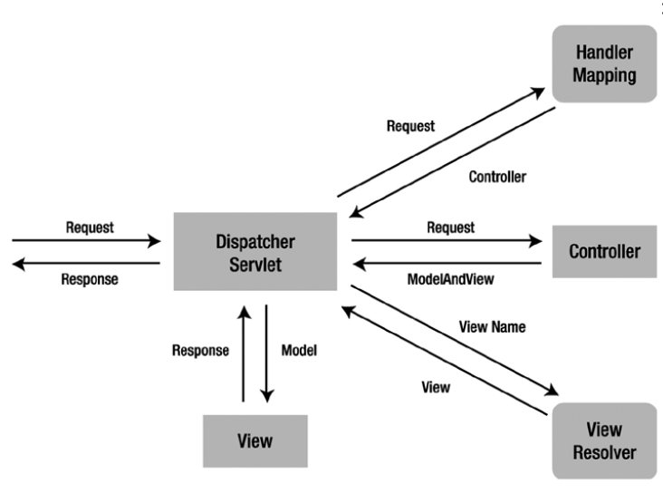
MVC Structure

Slide 33
Chapter 3: Introduction to Spring MVC

Slide 34
The Benefits of Spring MVC
When writing a Model 2 application without a framework, it is your responsibility to write a dispatcher servlet and controller classes.
Your dispatcher servlet must be capable of doing these things:
Determine from the URI what action to invoke.
Instantiate the correct controller class.
Populate a form bean with request parameter values.
Call the correct method in the controller object.
Forward control to a view (JSP page).

Slide 35
List of features provided in Spring MVC
Spring MVC provides a dispatcher servlet, saving your writing one.
Spring MVC employs an XML-based configuration file that you can edit without recompiling the application.
Spring MVC instantiates controller classes and populates beans with user inputs.
Spring MVC automatically binds user input with the correct type. For example, Spring MVC can automatically parse a string and sets a property of type float or decimal.
Spring MVC validates user input and redirects the user back to the input form if validation failed.
Input validation is optional and can be done programmatically or declaratively.
On top of that, Spring MVC provides built-in validators for most of the tasks you may encounter when building a web application.

Slide 36
List of features provided in Spring MVC(cont..)
Spring MVC is part of the Spring framework. You get everything Spring has to offer.
Spring MVC supports internationalization and localization.
This means, you can display messages in multiple languages depending on the user locale.
Spring MVC supports multiple view technologies.
Most of the time you'll be using JSP, but other technologies are supported, including Velocity and FreeMarker.

Slide 37
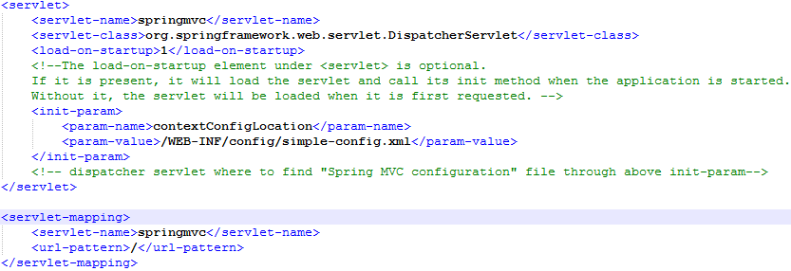
Spring MVC DispatcherServlet
Spring MVC comes with a dispatcher servlet that you can instantly use.
Configure it in your deployment descriptor (web.xml file) using the servlet and servlet-mapping elements

Slide 38
The Controller Interface
Prior to Spring 2.5, the only way to write a controller was by implementing the org.springframework.web.servlet.mvc.Controller interface.
This interface exposes a handleRequest method that must be overidden by implementing classes.
An implementation has access to the HttpServletRequest and HttpServletResponse of the corresponding request.
The implementation must also return a ModelAndView that contains a view path or a view path and a model.
A controller implementing the Controller interface can only handle one single action.
An annotation-based controller can house many request-handling methods and do not have to implement any interface.

Slide 39
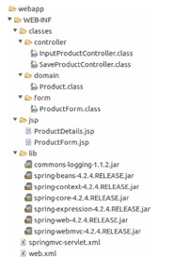
Your First Spring MVC Application
Go through springmvc-intro1 sample application in Chapter3.
The Directory Structure

Slide 40
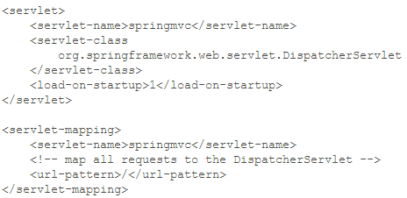
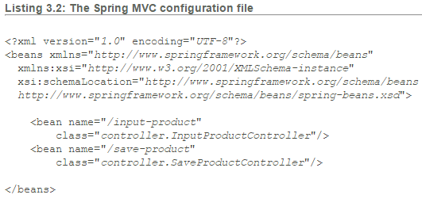
The Deployment Descriptor and Spring MVC Configuration File
Notes:
Nothing spectacular here. You're just telling the servlet/JSP container that you want to use the Spring MVC dispatcher servlet and map it to all URLs by using / in the urlpattern element. Since there is no init-param element under the servlet element, the Spring MVC configuration file is assumed to be under /WEB-INF and follow the usual naming convention.

Slide 41
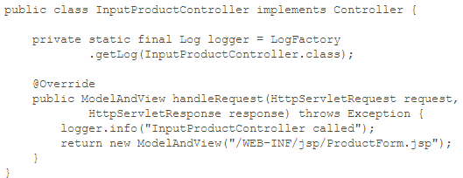
The Controllers

Slide 42
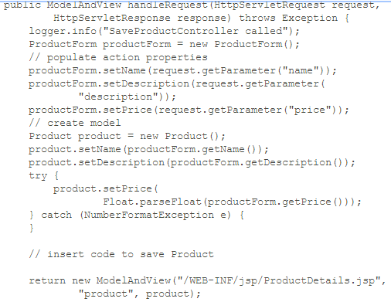

Slide 43
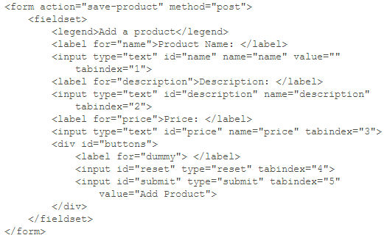
The View
Listing 3.5: The ProductForm.jsp page

Slide 44
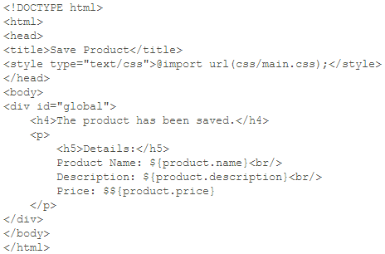
Listing 3.6: The ProductDetails.jsp page

Slide 45

The View Resolver
The view resolver in Spring MVC is responsible for resolving views.
To use and configure the view resolver, declare a viewResolver bean in your configuration file, such as this one.
The viewResolver bean above configures two properties, prefix and suffix.
As a result, your view paths will be shorter. Instead of setting the view path to/WEBINF/jsp/myPage.jsp, for example, you just write myPage and the view resolver will prefix and suffix the string.

Slide 46
Chapter 4: Annotation-Based Controllers

Slide 47
Spring MVC Annotation Types
There are several advantages of using annotation-based controllers. For one, a controller class can handle multiple actions. This means, related actions can be written in the same controller class, thus reducing the number of classes in your application.
Secondly, with annotation-based controllers request mappings do not need to be stored in a configuration file. Using the RequestMapping annotation type, a method can be annotated to make it a request-handling method.
Controller and RequestMapping annotation types are two most important annotation types in the Spring MVC API. This chapter focuses on these two and briefly touches on some other less popular annotation types.

Slide 48
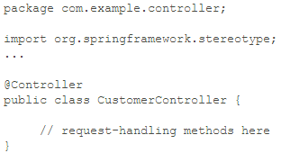
The Controller Annotation Type
The org.springframework.stereotype.Controller annotation type is used to annotate a Java class to indicate to Spring that instances of the class are controllers.
Spring uses a scanning mechanism to find all annotation-based controller classes in an application.

Slide 49
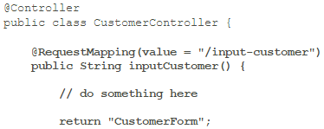
The RequestMapping Annotation Type
Inside a controller class you write request handling methods that each will handle an action. To tell Spring which method handles which action, you need to map URIs with methods using the org.springframework.web.bind.annotation.RequestMapping annotation type.
The RequestMapping annotation type does what its name implies: map a request and a method. You can use @RequestMapping to annotate a method or a class.
A method annotated with @RequestMapping becomes a request-handling method and will be invoked when the dispatcher servlet receives a request with a matching URI.

Slide 50
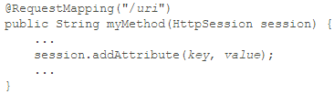
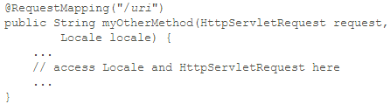
Writing Request-Handling Methods
A request-handling method can have a mix of argument types as well as one of a variety of return types. For example, if you need access to the HttpSession object in your method, you can add HttpSession as an argument and Spring will pass the correct object for you:
Or, if you need the client locale and the HttpServletRequest, you can include both as method arguments like this.

Slide 51
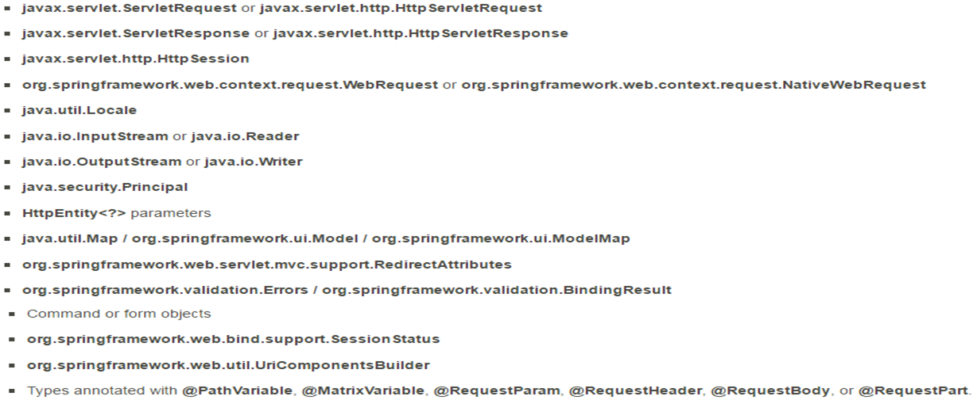
List of argument types that can appear in a request-handling method.

Slide 52
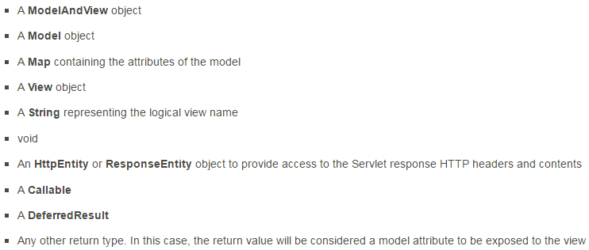
Of special importance is the org.springframework.ui.Model type. This is not a Servlet API type, but rather a Spring MVC type that contains a Map. Every time a request handling method is invoked, Spring MVC creates a Model object and populates its Map with potentially various objects.
A request-handling method can return one of these objects.

Slide 53
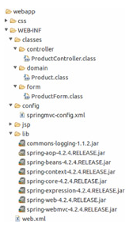
Using An Annotation-Based Controller
annotated1 application Directory Structure

Slide 54
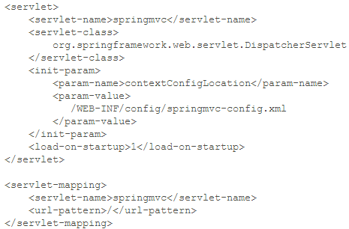
Listing 4.1: The deployment descriptor for annotated1 (web.xml)
Notes:
Note that in the <servlet-mapping/> element in the deployment descriptor, the URL pattern for the Spring MVC dispatcher servlet is set to /. Setting the URL pattern to / means that all requests, including those for static resources, are directed to the dispatcher servlet. In order for static resources to be handled properly, you need to add some elements in the Spring MVC configuration file.

Slide 55
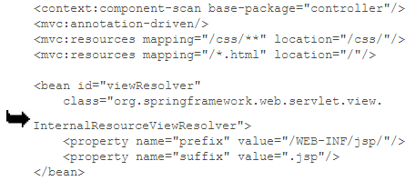
Listing 4.2: The springmvc-config.xml file
Notes:
The main thing in the Spring MVC configuration file in Listing 4.2 is the presence of a <component-scan/> element.
It is to tell Spring MVC to scan classes under a certain package, in this case the controller package.
On top of that, there are also an <annotation-driven/> element and two <resources/> elements.
The<annotationdriven/> element does several things, including registering beans to support request processing with annotated controller methods. The<resources/> element tells Spring MVC which static resources need to be served independently from the dispatcher servlet.
In the configuration file in Listing 4.2 there are two <resources/> elements. The first makes sure that all files in the /css directory will be visible. The second allows displaying of all .html files in the application directory.
Note Without <annotation-driven/>, the <resources/> elements will prevent any controller from being invoked. You don't need an <annotation-driven/>element if you are not using resources elements.

Slide 56
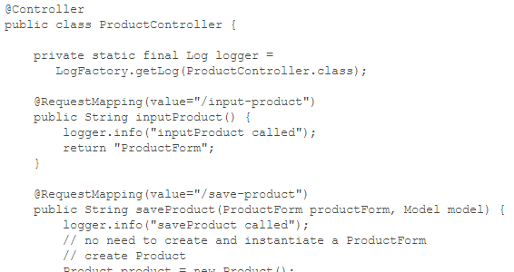
The Controller Class
One of the advantages of using the Controller annotation type is that a controller class can contain multiple request-handling methods. As can be seen in the ProductController class in Listing 4.3, there are two methods in it, inputProduct and saveProduct.

Slide 57
Note that the second argument to saveProduct in the ProductController class is of type org.springframework.ui.Model. Spring MVC creates a Model instance every time a request-handling method is invoked, whether or not you'll use the instance in your method. The main purpose of having a Model is for adding attributes that will be displayed in the view. In this example, you added a Product instance by calling model.addAttribute:
model.addAttribute("product", product);
The Product instance can then be accessed as if you had added it to the HttpServletRequest.

Slide 58
The View
Listing 4.4: The ProductForm.jsp page

Slide 59
Listing 4.5: The ProductDetails.jsp page

Slide 60
Dependency Injection with @Autowired and @Service
One of the benefits of using the Spring Framework is that you get dependency injection for free. After all, Spring started as a dependency injection container. The easiest way to get a dependency injected to a Spring MVC controller is by annotating a field or a method with @Autowired. The Autowired annotation type belongs to the org.springframework.beans.factory.annotation package.
In order for a dependency to be found, its class must be annotated with @Service. A member of the org.springframework.stereotype package, the Service annotation type indicates that the annotated class is a service. In addition, in your configuration file you need to add a <component-scan/> element to scan the base package for your dependencies.
As an example of dependency injection in a Spring MVC application, consider another example, the annotated2 application. The ProductController class in the annotated2 application (See Listing 4.6) has been modified from the identically named class in annotated1.

Slide 61
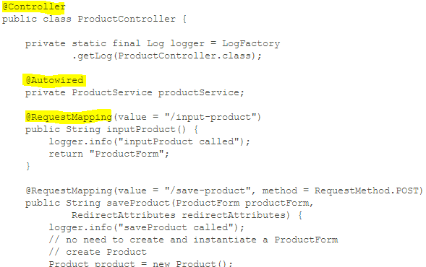
Listing 4.6: The ProductController class in annotated2
Notes:
A couple of things make the ProductController class in annotated2 different from its counterpart in annotated1.
The first thing is the addition of the following private field that is annotated with @Autowired:
Here, ProductService is an interface that provides various methods for handling products.
Annotating productService with @Autowired causes an instance of ProductService to be injected to the ProductController instance.
Listing 4.7 shows the ProductService interface and Listing 4.8 its implementation ProductServiceImpl.
Note that for the implementation to be scannable, you must annotate its class definition with @Service.

Slide 62
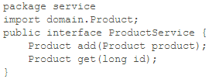
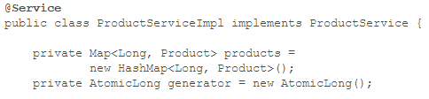
Listing 4.7: The ProductService interface
Listing 4.8: The ProductServiceImpl class

Slide 63
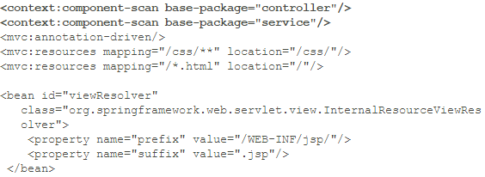
Listing 4.9: The Spring MVC configuration file for annotated2

Slide 64
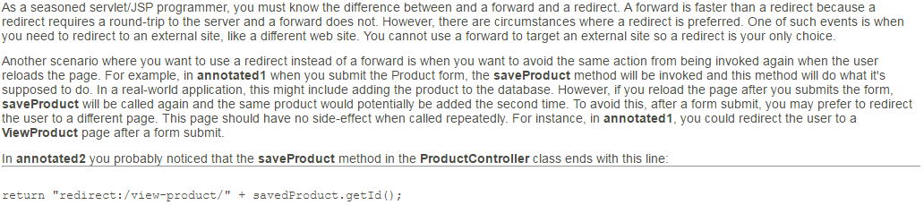
Redirect and Flash Attributes

Slide 65
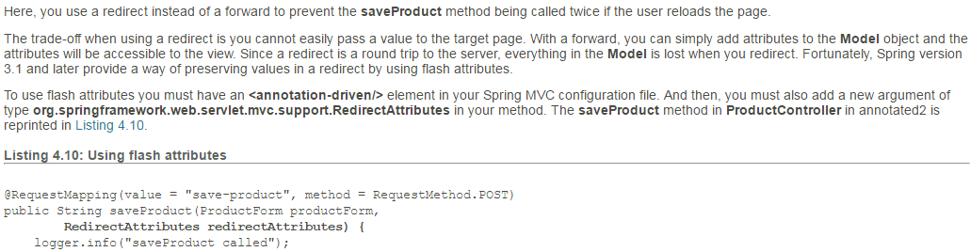

Slide 66
Request Parameters and Path Variables
Both request parameters and path variables are used to send values to the server. Both are also part of a URL. The request parameter takes the form of key=value pairs separated by an ampersand. For instance, this URL carries a productId request parameter with a value of 3.
http://localhost:8080/annotated2/view-product?productId=3
In servlet programming, you can retrieve a request parameter value by using the getParameter method on the HttpServletRequest:

Slide 67
In Spring MVC there is an easier way to retrieve a request parameter value: by using the org.springframework.web.bind.annotation.RequestParam annotation type to annotate an argument to which the value of the request parameter will be copied. For example, the following method contains an argument that captures request parameter productId.
As you can see, the type of argument annotated with @RequestParam does not need to be String.
A path variable is similar to a request parameter, except that there is no key part, just a value. For example, the view-product action in annotated2 is mapped to a URL with this format.

Slide 68
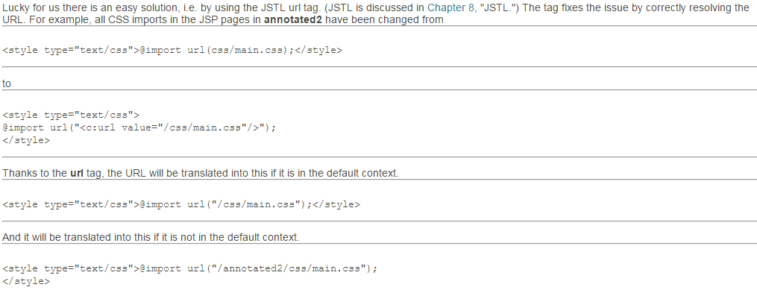

Slide 69
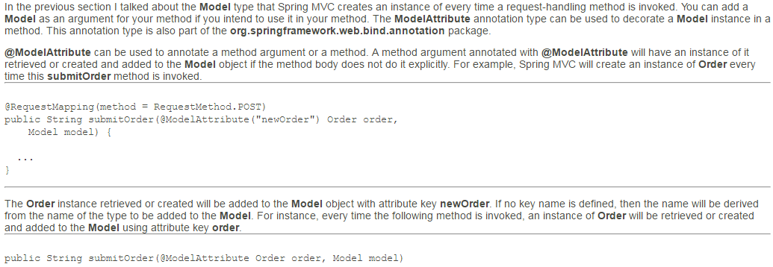
@ModelAttribute

Slide 70
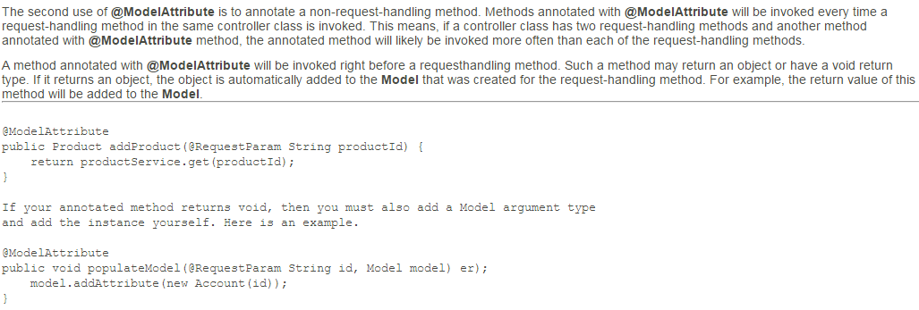

Slide 71
Chapter 5: Data Binding and the Form Tag Library

Slide 72
Highlights
Data binding is a feature that binds user input to the domain model.
Thanks to data binding, HTTP request parameters, which are always of type String, can be used to populate object properties of various types.
Data binding also makes form beans (e.g. instances of ProductForm in the previous chapters) redundant.
To use data binding effectively, you need the Spring form tag library.
This chapter explains data binding and the form tag library and provides examples that highlight the use of the tags in the form tag library.

Slide 73
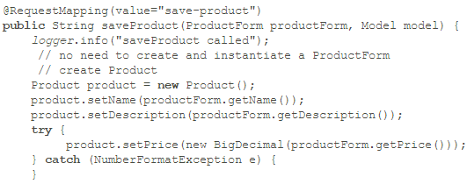
Data Binding Overview
Due to the nature of HTTP, all HTTP request parameters are strings. Recall that in the previous chapters you had to parse a string to a BigDeciimal in order to get the correct product price. To refresh your memory, here is some code from the ProductController class's saveProduct method in the sample applications in Chapter 4.
You had to parse the price property in the ProductForm because it was a String and you needed a BigDecimal to populate the Product's price property. With data binding you can replace the saveProduct method fragment above with this.
Notes:
Thanks to data binding, you don't need the ProductForm class anymore and no parsing is necessary for the price property of the Product object.
Another benefit of data binding is for repopulating an HTML form when input validation fails. With manual HTML coding, you have to worry about repopulating the input fields with the values the user previously entered. With Spring data binding and the form tag library, this is taken care of for you.

Slide 74
The Form Tag Library
The form tag library contains tags you can use to render HTML elements in your JSP pages. To use the tags, declare this taglib directive at the top of your JSP pages

Slide 75
Tag | Description
form | Renders a form element.
input | Renders an <input type="text"/> element
password | Renders an <input type="password"/> element
hidden | Renders an <input type="hidden"/> element
textarea | Renders a textarea element
checkbox | Renders an <input type="checkbox"/> element
checkboxes | Renders multiple <input type="checkbox"/> elements
radiobutton | Renders an <input type="radio"/> element
radiobuttons | Renders multiple <input type="checkbox"/> elements
select | Renders a select element
option | Renders an option element.
options | Renders a list of option elements.
errors | Renders field errors in a span element.
Notes:
Each of the tags will be explained in the following subsections.
A sample application presented in the section, "Data Binding Example" demonstrates the use of data binding with the form tag library.

Slide 76
The form Tag
The form tag renders an HTML form. You must have a form tag to use any of the other tags that render a form input field. The attributes of the form tag are given in Table 5.2. All attributes in Table 5.2 are optional. The table does not include HTML attributes, such as method and action.
Attribute | Description
acceptCharset | Specifies the list of character encodings accepted by the server.
commandName | The name of the model attribute under which the form object is exposed. The default is 'command.'
cssClass | Specifies the CSS class to be applied to the rendered form element.
cssStyle | Specifies the CSS style to be applied to the rendered form element
htmlEscape | Accepts true or false indicating whether or not the rendered value(s) should be HTML-escaped.
modelAttribute | The name of the model attribute under which the form-backing object is exposed. The default is 'command'.

Slide 77

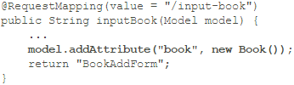
The commandName attribute is probably the most important attribute as it specifies the name of the model attribute that contains a backing object whose properties will be used to populate the generated form. If this attribute is present, you must add the corresponding model attribute in the request-handling method that returns the view containing this form. For instance, in the tags-demo application that accompanies this chapter, the following form tag is specified in the BookAddForm.jsp
The inputBook method in the BookController class is the request-handling method that returns BookAddForm.jsp. Here is the inputBook method.
Notes:
As you can see, a Book object is created and added to the Model with attribute name book. Without the model attribute, the BookAddForm.jsp page will throw an exception because the form tag cannot find a form-backing object specified in its commandName attribute.
In addition, you will still normally use the action and method attributes. Both are HTML attributes and therefore not included in Table 5.2.

Slide 78
The input Tag
The input tag renders an <input type="text"/> element.
The most important attribute of this tag, the path attribute, binds this input field to a property of the form-backing object.
For example, if the commandName attribute of the enclosing <form/> tag is assigned book and the path attribute of the input tag is given the value isbn, the input tag will be bound to the isbn property of the Book object.
Table 5.3 shows all the attributes in the input tag. All attributes in Table 5.3 are optional and the table does not include HTML attributes.

Slide 79
Table 5.3: The input tag's attributes
Attribute | Description
cssClass | Specifies the CSS class to be applied to the rendered input element.
cssStyle | Specifies the CSS style to be applied to the rendered input element
CssErrorClass | Specifies the CSS class to be applied to the rendered input element if the bound property contains errors, overriding the value of the cssClass attribute.
htmlEscape | Accepts true or false indicating whether or not the rendered value(s) should be HTML-escaped.
path | The path to the property to bind.

Slide 80
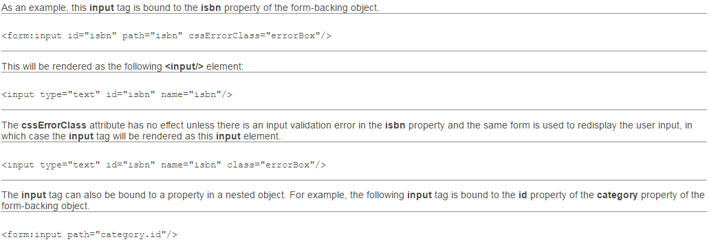

Slide 81
The password Tag
The password tag renders an <input type="password"/> element and its attributes are given in Table 5.4. The password tag is similar to the input tag except that it has a showPassword attribute.
Table 5.4: The password tag's attributes
Attribute | Description
cssClass | Specifies the CSS class to be applied to the rendered input element.
cssStyle | Specifies the CSS style to be applied to the rendered input element
cssErrorClass | Specifies the CSS class to be applied to the rendered input element if the bound property contains errors, overriding the value of the cssClass attribute.
htmlEscape | Accepts true or false indicating whether or not the rendered value(s) should be HTML-escaped.
path | The path to the property to bind.
showPassword | Indicates whether the password should be shown rather than masked. The default is false.
Notes:
All attributes in Table 5.4 are optional and the table does not include HTML attributes. Here is an example of the password tag
<form:password id="pwd" path="password" cssClass="normal"/>

Slide 82
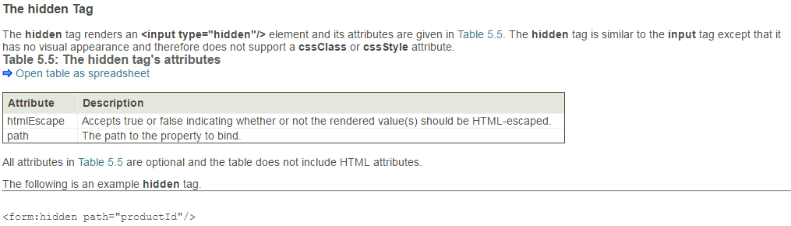

Slide 83
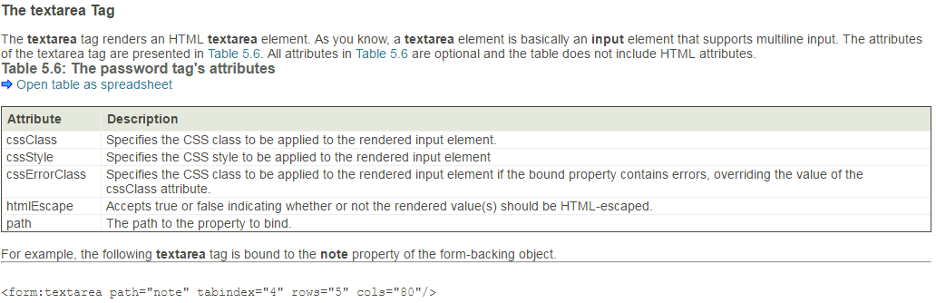

Slide 84
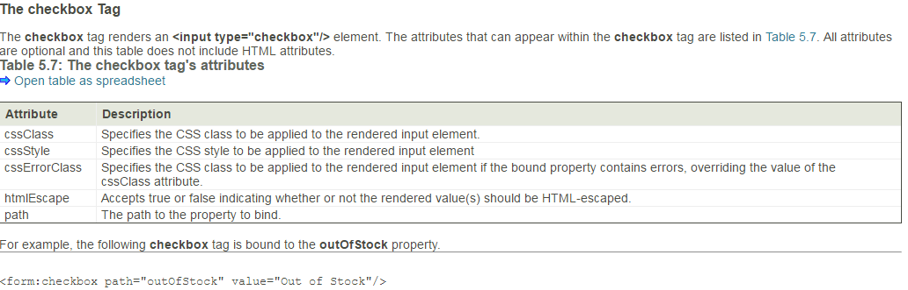

Slide 85
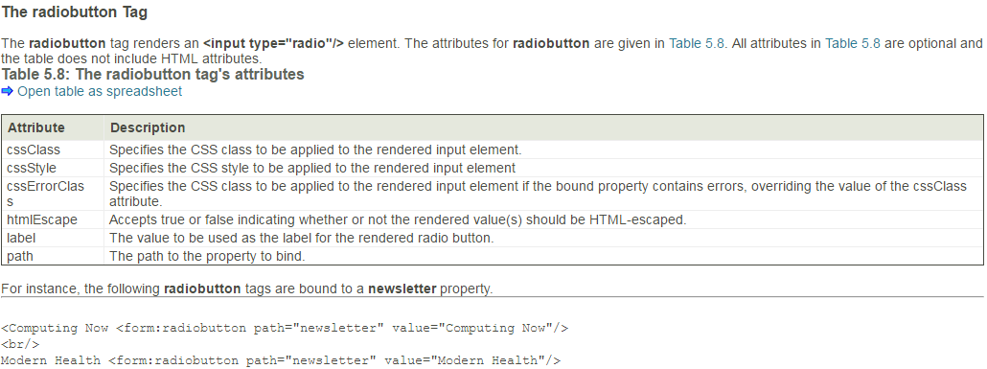

Slide 86
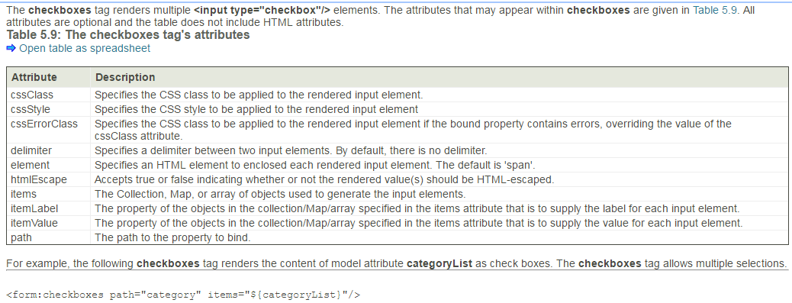

Slide 87
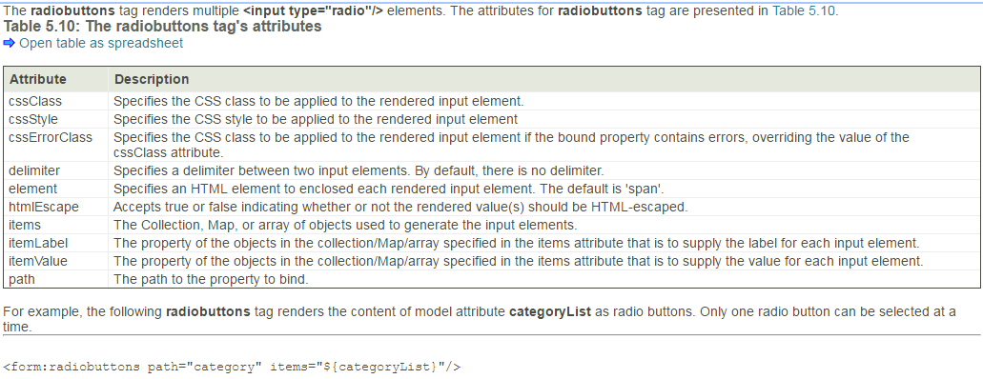

Slide 88
The select Tag
The select tag renders a HTML select element. The options for the rendered element may come from a collection or a map or an array assigned to its items attribute or from a nested option or options tag. The properties of the select tag are given in Table 5.11. All attributes are optional and none of the HTML attributes is included in the table.
Attribute | Description
cssClass | Specifies the CSS class to be applied to the rendered input element.
cssStyle | Specifies the CSS style to be applied to the rendered input element
cssErrorClass | Specifies the CSS class to be applied to the rendered input element if the bound property contains errors, overriding the value of the cssClass attribute.
htmlEscape | Accepts true or false indicating whether or not the rendered value(s) should be HTML-escaped.
items | The Collection, Map, or array of objects used to generate the input elements.
itemLabel | The property of the objects in the collection/Map/array specified in the items attribute that is to supply the label for each input element.
itemValue | The property of the objects in the collection/Map/array specified in the items attribute that is to supply the value for each input element.
path | The path to the property to bind.
Notes:
The items attribute is particularly useful as it may be bound to a collection, a map, or an array of objects to generate the options for the select element.
For example, the following select tag is bound to the id property of the category property of the form-backing object. Its options come from a categories model attribute. The value for each option comes from the id property of the objects in the categories collection/map/array, and its label comes from the name property.
<form:select id="category" path="category.id" items="${categories}" itemLabel="name“ itemValue="id"/>

Slide 89
The option Tag
The option tag renders an HTML option element to be used within a select element. Its attributes are given in Table 5.12. All attributes are optional and the table does not include HTML attributes.
Attribute | Description
cssClass | Specifies the CSS class to be applied to the rendered input element.
cssStyle | Specifies the CSS style to be applied to the rendered input element
cssErrorClass | Specifies the CSS class to be applied to the rendered input element if the bound property contains errors, overriding the value of the cssClass attribute.
htmlEscape | Accepts true or false indicating whether or not the rendered value(s) should be HTML-escaped.
Notes:
For example, here is an example option tag.
<form:select id="category" path="category.id“
items="${categories}" itemLabel="name"
itemValue="id">
<option value="0">-- Please select --</option>
</form:select>
This code snippet renders a select element whose options come from a categories model attribute as well as from the option tag.

Slide 90
The options Tag
The options tag generates a list of HTML option elements. Table 5.13 shows the attributes that may appear in the options tag. It does not include HTML attributes.
The tags-demo application provides an example of the options tag.
Attrioute | Description
cssClass | Specifies the CSS class to be applied to the rendered input element.
cssStyle | Specifies the CSS style to be applied to the rendered input element
cssErrorClass | Specifies the CSS class to be applied to the rendered input element if the bound property contains errors, overriding the value of the cssClass attribute.
htmlEscape | Accepts true or false indicating whether or not the rendered value(s) should be HTML-escaped.
items | The Collection, Map, or array of objects used to generate the input elements.
itemLabel | The property of the objects in the collection/Map/array specified in the items attribute that is to supply the label for each input element.
itemValue | The property of the objects in the collection/Map/array specified in the items attribute that is to supply the value for each input element.

Slide 91
The errors Tag
The errors tag renders one or more HTML span element that each contains a field error message. This tag can be used to display a specific field error or all field errors.
The attributes of the errors tag are listed in Table 5.14. All attributes are optional and the table does not include HTML attributes that may appear in the HTML
Attribute | Description
cssClass | Specifies the CSS class to be applied to the rendered input element.
cssStyle | Specifies the CSS style to be applied to the rendered input element
delimiter | Delimiter for separating multiple error messages.
element | Specifies an HTML element to enclose the error messages.
htmlEscape | Accepts true or false indicating whether or not the rendered value(s) should be HTML-escaped.
path | The path to the errors object to bind.
Notes:
For example, this errors tag displays all field errors.
<form:errors path="*"/>
The following errors tag displays a field error associated with the author property of the form-backing object.
<form:errors path="author"/>

Slide 92
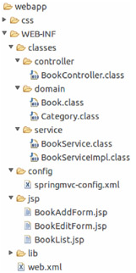
Data Binding Example
As an example of using the tags in the form tag library to take advantage of data binding, consider the tags-demo application. This example centers around the Book domain class. The class has several properties, including a category property of type Category. Category has two properties, id and name.
The application allows you to list books, add a new book, and edit a book.
The Directory Structure of tags-demo

