Slide 1
Pro-Spring

Slide 2
Chapter 3 - Introducing IoC and DI in Spring

Slide 3
Introducing IoC and DI in Spring
In Chapter 2, we covered the basic principles of Inversion of Control (IoC Dependency Injection (DI. Practically, DI is a specialized form of IoC, although you will often find that the two terms are used interchangeably. In this chapter, we take a much more detailed look at IoC and DI, formalizing the relationship between the two concepts and looking in great detail at how Spring fits into the picture.
After defining both and looking at Spring's relationship with them, we will explore the concepts that are essential to Spring's implementation of DI. This chapter covers only the basics of Spring's DI implementation; we discuss more-advanced DI features in Chapter 4. More specifically, this chapter covers the following topics:

Slide 4
Overview
Inversion of Control concepts: In this section, we discuss the various kinds of IoC, including Dependency Injection and Dependency Lookup. This section presents the differences between the various IoC approaches as well as the pros and cons of each.
Inversion of Control in Spring: This section looks at IoC capabilities available in Spring and how they are implemented. In particular, you'll see the Dependency Injection services that Spring offers, including Setter, Constructor, and Method Injection.
Dependency Injection in Spring This section covers Spring's implementation of the IoC container. For bean definition and DI requirements, BeanFactory is the main interface an application interacts with. However, other than the first few, the remainder of the sample code provided in this chapter focuses on using Spring's ApplicationContext interface, which is an extension of BeanFactory and provides much more powerful features. We cover the difference between BeanFactory and ApplicationContext in later sections.
Configuring the Spring application context: The final part of this chapter focuses on using the XML and annotation approaches for ApplicationContext configuration. Groovy and Java configuration are further discussed in Chapter 4. This section starts with a discussion of DI configuration and moves on to present additional services provided by the BeanFactory such as bean inheritance, life-cycle management, and autowiring.

Slide 5
Inversion of Control and Dependency Injection
At its core, IoC, and therefore DI, aims to offer a simpler mechanism for provisioning component dependencies (often referred to as an object's collaborators) and managing these dependencies throughout their life cycles.
A component that requires certain dependencies is often referred to as the dependent object or, in the case of IoC, the target.
In general, IoC can be decomposed into two subtypes: Dependency Injection and Dependency Lookup.
These subtypes are further decomposed into concrete implementations of the IoC services.
From this definition, you can clearly see that when we are talking about DI, we are always talking about IoC, but when we are talking about IoC, we are not always talking about DI (for example, Dependency Lookup is also a form of IoC).

Slide 6
Types of Inversion of Control
There are two types of IoC.
Dependency Lookup is a much more traditional approach, and at first glance, it seems more familiar to Java programmers.
Dependency Injection, although it appears counterintuitive at first, is actually much more flexible and usable than Dependency Lookup.
With Dependency Lookup-style IoC, a component must acquire a reference to a dependency, whereas with Dependency Injection, the dependencies are injected into the component by the IoC container.
Dependency Lookup comes in two types: Dependency Pull and Contextualized Dependency Lookup (CDL).
Dependency Injection also has two common flavors: Constructor and Setter Dependency Injection.
Notes:
Note For the discussions in this section, we are not concerned with how the fictional IoC container comes to know about all the different dependencies, just that at some point, it performs the actions described for each mechanism.

Slide 7
Dependency Pull
To a Java developer, Dependency Pull is the most familiar type of IoC.
In Dependency Pull, dependencies are pulled from a registry as required.
Anyone who has ever written code to access an EJB (2.1 or prior versions) has used Dependency Pull (that is, via the JNDI API to look up an EJB component). Figure 3-1 shows the scenario of Dependency Pull via the lookup mechanism.
Spring also offers Dependency Pull as a mechanism for retrieving the components that the framework manages; you saw this in action in Chapter 2. Listing 3-1 shows a typical Dependency Pull lookup in a Spring-based application.

Slide 8
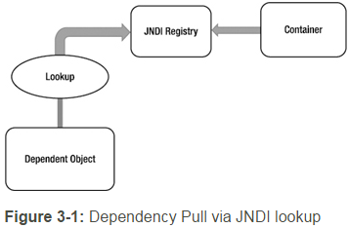
Dependency Pull

Slide 9
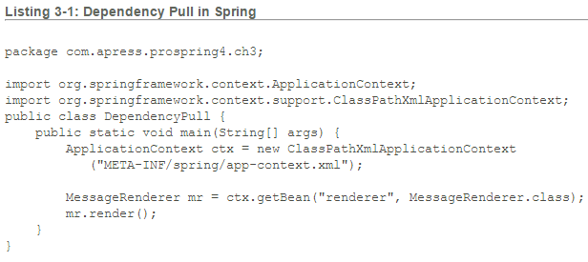
Dependency Pull
Notes:
This kind of IoC is not only prevalent in JEE-based applications (using EJB 2.1 or prior versions), which make extensive use of JNDI lookups to obtain dependencies from a registry, but also pivotal to working with Spring in many environments.

Slide 10
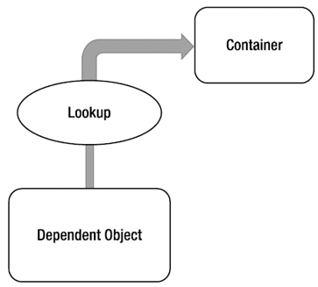
Contextualized Dependency Lookup
Contextualized Dependency Lookup (CDL) is similar, in some respects, to Dependency Pull, but in CDL, lookup is performed against the container that is managing the resource, not from some central registry, and it is usually performed at some set point. Below Figure 3-2 shows the CDL mechanism.

Slide 11

CDL works by having the component implement an interface similar to that in Listing 3-2.
Listing 3-2. Component Interface for CDL
By implementing this interface, a component is signaling to the container that it wants to obtain a dependency. The container is usually provided by the underlying application server or framework (for example, Tomcat or JBoss) or framework (for example, Spring). Listing 3-3 shows a simple Container interface that provides a Dependency Lookup service.

Slide 12
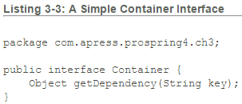
When the container is ready to pass dependencies to a component, it calls performLookup() on each component in turn.
The component can then look up its dependencies by using the Container interface, as shown in Listing 3-4.

Slide 13
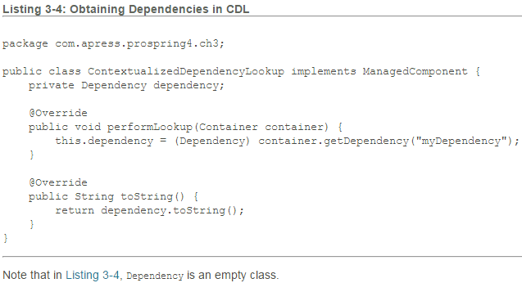

Slide 14
Constructor Dependency Injection
Constructor Dependency Injection occurs when a component's dependencies are provided to it in its constructor(s).
The component declares a constructor or a set of constructors, taking as arguments its dependencies, and the IoC container passes the dependencies to the component when instantiation occurs, as shown in Listing 3-5.

Slide 15
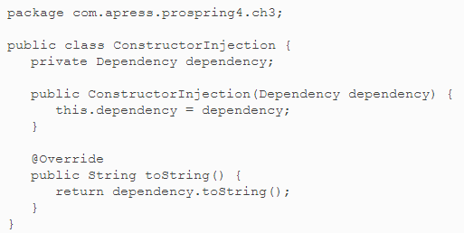
Listing 3-5. Constructor Dependency Injection

Slide 16
Setter Dependency Injection
In Setter Dependency Injection, the IoC container injects a component's dependencies via JavaBean-style setter methods.
A component's setters expose the dependencies the IoC container can manage. Listing 3-6 shows a typical Setter Dependency Injection-based component.
Within the container, the dependency requirement exposed by the setDependency() method is referred to by the JavaBeans-style name, dependency.
In practice, Setter Injection is the most widely used injection mechanism, and it is one of the simplest IoC mechanisms to implement.

Slide 17
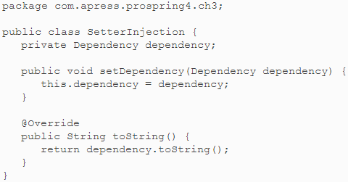
Listing 3-6. Setter Dependency Injection

Slide 18
Injection vs. Lookup
Choosing which style of IoC to use—injection or lookup—is not usually a difficult decision. In many cases, the type of IoC you use is mandated by the container you are using.
For instance, if you are using EJB 2.1 or prior versions, you must use lookup-style IoC (via JNDI) to obtain an EJB from the JEE container.
In Spring, aside from initial bean lookups, your components and their dependencies are always wired together using injection-style IoC.
Note When you are using Spring, you can access EJB resources without needing to perform an explicit lookup. Spring can act as an adapter between lookup and injection-style IoC systems, thus allowing you to manage all resources by using injection.

Slide 19
The real question is this: given the choice, which method should you use, injection or lookup? The answer is most definitely injection. If you look at the code in Listings 3-4 and 3-5, you can clearly see that using injection has zero impact on your components’ code.
The Dependency Pull code, on the other hand, must actively obtain a reference to the registry and interact with it to obtain the dependencies, and using CDL requires your classes to implement a specific interface and look up all dependencies manually.
When you are using injection, the most your classes have to do is allow dependencies to be injected by using either constructors or setters.

Slide 20
Using injection, you are free to use your classes completely decoupled from the IoC container that is supplying dependent objects with their collaborators manually, whereas with lookup, your classes are always dependent on the classes and interfaces defined by the container.
Another drawback with lookup is that it becomes very difficult to test your classes in isolation from the container.
Using injection, testing your components is trivial, because you can simply provide the dependencies yourself by using the appropriate constructor or setter.
Note For a more complete discussion of testing by using Dependency Injection and Spring, refer to Chapter 13.

Slide 21
Lookup-based solutions are, by necessity, more complex than injection-based ones. Although complexity is nothing to be afraid of, we question the validity of adding unneeded complexity to a process as central to your application as dependency management.
All of these reasons aside, the biggest reason to choose injection over lookup is that it makes your life easier. You write substantially less code when you are using injection, and the code that you do write is simple and can, in general, be automated by a good IDE. You will notice that all of the code in the injection samples is passive, in that it doesn’t actively try to accomplish a task. The most exciting thing you see in injection code is that objects get stored in a field only; no other code is involved in pulling the dependency from any registry or container. Therefore, the code is much simpler and less error prone. Passive code is much simpler to maintain than active code, because there is very little that can go wrong. Consider the following code taken from Listing 3-4:

Slide 22
In this code, plenty could go wrong: the dependency key could change, the container instance could be null, or the returned dependency might be the incorrect type. We refer to this code as having a lot of moving parts, because plenty of things can break. Using Dependency Lookup might decouple the components of your application, but it adds complexity in the additional code required to couple these components back together in order to perform any useful tasks.

Slide 23
Difference between constructor and setter injection
There are many key differences between constructor injection and setter injection.
Partial dependency: can be injected using setter injection but it is not possible by constructor. Suppose there are 3 properties in a class, having 3 arg constructor and setters methods. In such case, if you want to pass information for only one property, it is possible by setter method only.
Overriding: Setter injection overrides the constructor injection. If we use both constructor and setter injection, IOC container will use the setter injection.(How to do?)
Changes: We can easily change the value by setter injection. It doesn't create a new bean instance always like constructor. So setter injection is flexible than constructor injection.
Notes:
http://www.javatpoint.com/difference-between-constructor-and-setter-injection
http://javarevisited.blogspot.in/2012/11/difference-between-setter-injection-vs-constructor-injection-spring-framework.html
http://www.java4s.com/spring/difference-between-setter-injection-and-constructor-injection/

Slide 24
Setter Injection vs. Constructor Injection
Now that we have established which method of IoC is preferable, you still need to choose whether to use Setter Injection or Constructor Injection.
Constructor Injection is particularly useful when you absolutely must have an instance of the dependency class before your component is used.
Many containers, Spring included, provide a mechanism for when you use Setter Injection, but by using Constructor Injection, you assert the requirement for the dependency in a container-agnostic manner.
Constructor Injection also helps achieve the use of immutable objects.

Slide 25
Setter Injection is useful in a variety of cases. If the component is exposing its dependencies to the container but is happy to provide its own defaults, Setter Injection is usually the best way to accomplish this.
Another benefit of Setter Injection is that it allows dependencies to be declared on an interface, although this is not as useful as you might first think.
Consider a typical business interface with one business method, defineMeaningOfLife().
If, in addition to this method, you define a setter for injection such as setEncylopedia(), you are mandating that all implementations must use or at least be aware of the encyclopedia dependency.
However, you don’t need to define setEncylopedia() in the business interface. Instead, you can define the method in the classes implementing the business interface.
While programming in this way, all recent IoC containers, Spring included, can work with the component in terms of the business interface but still provide the dependencies of the implementing class. An example of this may clarify this matter slightly. Consider the business interface in Listing 3-7.

Slide 26

Listing 3-7. The Oracle Interface
Notes:
Notice that the business interface does not define any setters for Dependency Injection. This interface could be implemented as shown in Listing 3-8.

Slide 27
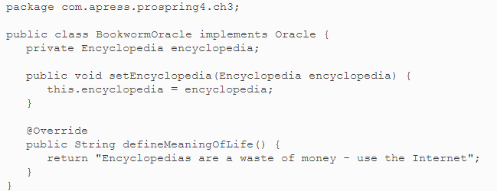
Listing 3-8. Implementing the Oracle Interface

Slide 28
As you can see, the BookwormOracle class not only implements the Oracle interface, but also defines the setter for Dependency Injection.
Spring is more than comfortable dealing with a structure like this—there is absolutely no need to define the dependencies on the business interface.
The ability to use interfaces to define dependencies is an often-touted benefit of Setter Injection, but in actuality, you should strive to keep setters used solely for injection out of your interfaces.
Unless you are absolutely sure that all implementations of a particular business interface require a particular dependency, let each implementation class define its own dependencies and keep the business interface for business methods.

Slide 29
Although you shouldn’t always place setters for dependencies in a business interface, placing setters and getters for configuration parameters in the business interface is a good idea and makes Setter Injection a valuable tool.
We consider configuration parameters to be a special case for dependencies.
Certainly your components depend on the configuration data, but configuration data is significantly different from the types of dependency you have seen so far.
We will discuss the differences shortly, but for now, consider the business interface shown in Listing 3-9.

Slide 30
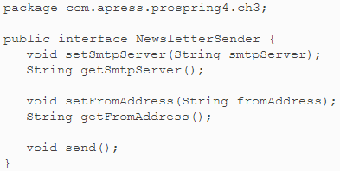
Listing 3-9. The NewsletterSender Interface

Slide 31
Classes that send a set of newsletters via e-mail implement the NewsletterSenderinterface. The send() method is the only business method, but notice that we have defined two JavaBean properties on the interface. Why are we doing this when we just said that you shouldn’t define dependencies in the business interface? The reason is that these values, the SMTP server address and the address the e-mails are sent from, are not dependencies in the practical sense; rather, they are configuration details that affect how all implementations of the NewsletterSender interface function. The question here then is this: what is the difference between a configuration parameter and any other kind of dependency? In most cases, you can clearly see whether a dependency should be classified as a configuration parameter, but if you are not sure, look for the following three characteristics that point to a configuration parameter:

Slide 32
Configuration parameters are passive. In the NewsletterSender example shown in Listing 3-8, the SMTP server parameter is an example of a passive dependency. Passive dependencies are not used directly to perform an action; instead, they are used internally or by another dependency to perform their actions. In the MessageRenderer example from Chapter 2, the MessageProvider dependency was not passive—it performed a function that was necessary for the MessageRenderer to complete its task.
Configuration parameters are usually information, not other components. By this we mean that a configuration parameter is usually some piece of information that a component needs to complete its work. Clearly, the SMTP server is a piece of information required by the NewsletterSender, but the MessageProvider is really another component that the MessageRenderer needs to function correctly.

Slide 33
Configuration parameters are usually simple values or collections of simple values.
This is really a by-product of the previous two points, but configuration parameters are usually simple values.
In Java this means they are a primitive (or the corresponding wrapper class) or a String or collections of these values.
Simple values are generally passive.
This means you can’t do much with a String other than manipulate the data it represents; and you almost always use these values for information purposes—for example, an int value that represents the port number that a network socket should listen on, or a String that represents the SMTP server through which an e-mail program should send messages.

Slide 34
When considering whether to define configuration options in the business interface, also consider whether the configuration parameter is applicable to all implementations of the business interface or just one.
For instance, in the case of implementations of NewsletterSender, it is obvious that all implementations need to know which SMTP server to use when sending e-mails. However, we would probably choose to leave the configuration option that flags whether to send secure e-mail off the business interface, because not all e-mail APIs are capable of this, and it is correct to assume that many implementations will not take security into consideration at all.
Note Recall that in Chapter 2, we chose to define the dependencies in the business purposes. This was for illustration purposes and should not be treated in any way as a best practice.

Slide 35
Setter injection also allows you to swap dependencies for a different implementation on the fly without creating a new instance of the parent component. Spring’s JMX support makes this possible. Perhaps the biggest benefit of Setter Injection is that it is the least intrusive of the injection mechanisms.
In general, you should choose an injection type based on your use case. Setter-based injection allows dependencies to be swapped out without creating new objects and also lets your class choose appropriate defaults without the need to explicitly inject an object. Constructor injection is a good choice when you want to ensure that dependencies are being passed to a component, and when designing for immutable objects. Do keep in mind that while constructor injection ensures that all dependencies are provided to a component, most containers provide a mechanism to ensure this as well but may incur a cost of coupling your code to the framework.

Slide 36
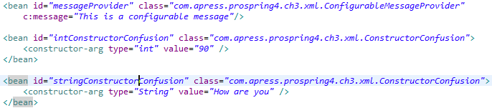
Xml and Annotation – Constructor Injection
Notes:
<bean id=“messageProvider”

Slide 37


Slide 38
Setter Injection vs. Constructor Injection
In general, you should choose an injection type based on your use case.
Setter-based injection allows dependencies to be swapped out without creating new objects and also lets your class choose appropriate defaults without the need to explicitly inject an object.
Constructor injection is a good choice when you want to ensure that dependencies are being passed to a component, and when designing for immutable objects.
Do keep in mind that while constructor injection ensures that all dependencies are provided to a component, most containers provide a mechanism to ensure this as well but may incur a cost of coupling your code to the framework.
Notes:
Read about Setter Injection vs. Constructor Injection again from Pro Spring book.

Slide 39
Inversion of Control in Spring
As we mentioned earlier, Inversion of Control is a big part of what Spring does.
The core of Spring's implementation is based on Dependency Injection, although Dependency Lookup features are provided as well.
When Spring provides collaborators to a dependent object automatically, it does so using Dependency Injection.
In a Spring-based application, it is always preferable to use Dependency Injection to pass collaborators to dependent objects rather than have the dependent objects obtain the collaborators via lookup.

Slide 40
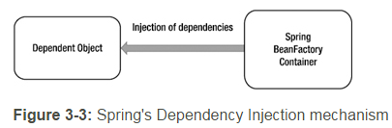

Slide 41
Although Dependency Injection is the preferred mechanism for wiring together collaborators and dependent objects, you need Dependency Lookup to access the dependent objects.
In many environments, Spring cannot automatically wire up all of your application components by using Dependency Injection, and you must use Dependency Lookup to access the initial set of components.
For example, in stand-alone Java applications, you need to bootstrap Spring's container in the main() method and obtain the dependencies (via the ApplicationContext interface) for processing programmatically.
However, when you are building web applications by using Spring's MVC support, Spring can avoid this by gluing your entire application together automatically.
Wherever it is possible to use Dependency Injection with Spring, you should do so; otherwise, you can fall back on the Dependency Lookup capabilities.
Spring's IoC container has the ability to act as an adaptor between its own Dependency Injection container and external Dependency Lookup containers.

Slide 42
You will see examples of both in action during the course of this chapter, and we will point them out when they first arise.
An interesting feature of Spring’s IoC container is that it has the ability to act as an adaptor between its own Dependency Injection container and external Dependency Lookup containers. We discuss this feature later in this chapter.
Spring supports both Constructor and Setter Injection and bolsters the standard IoC feature set with a whole host of useful additions to make your life easier.
The rest of this chapter introduces the basics of Spring’s DI container, complete with plenty of examples.

Slide 43
Dependency Injection in Spring
Spring’s support for Dependency Injection is comprehensive and, as you will see in Chapter 4, goes beyond the standard IoC feature set we have discussed so far.
The rest of this chapter addresses the basics of Spring’s Dependency Injection container, looking at Setter, Constructor, and Method Injection, along with a detailed look at how Dependency Injection is configured in Spring.

Slide 44
Beans and BeanFactories
The core of Spring’s Dependency Injection container is the BeanFactory interface. BeanFactory is responsible for managing components, including their dependencies as well as their life cycles. In Spring, the term bean is used to refer to any component managed by the container. Typically, your beans adhere, at some level, to the JavaBeans specification, but this is not required, especially if you plan to use Constructor Injection to wire your beans together.
If your application needs only DI support, you can interact with the Spring DI container via the BeanFactory interface. In this case, your application must create an instance of a class that implements the BeanFactory interface and configures it with bean and dependency information. After this is complete, your application can access the beans via BeanFactory and get on with its processing. In some cases, all of this setup is handled automatically (for example, in a web application, Spring’s ApplicationContext will be bootstrapped by the web container during application startup via a Spring-provided ContextLoaderListener class declared in the web.xml descriptor file). But in many cases, you need to code the setup yourself. All of the examples in this chapter require manual setup of the BeanFactory implementation.

Slide 45
Although the BeanFactory can be configured programmatically, it is more common to see it configured externally using some kind of configuration file. Internally, bean configuration is represented by instances of classes that implement the BeanDefinition interface. The bean configuration stores information not only about a bean itself but also about the beans that it depends on.
For any BeanFactory implementation classes that also implement the BeanDefinitionReader interface, you can read the BeanDefinition data from a configuration file, using either PropertiesBeanDefinitionReader or XmlBeanDefinitionReader. PropertiesBeanDefinitionReader reads the bean definition from properties files, while XmlBeanDefinitionReader reads from XML files.

Slide 46
So you can identify your beans within BeanFactory, each bean can be assigned an ID, a name, or both. A bean can also be instantiated without any ID or name (known as an anonymous bean) or as an inner bean within another bean.
Each bean has at least one name but can have any number of names (additional names are separated by commas). Any names after the first are considered aliases for the same bean. You use bean IDs or names to retrieve a bean from BeanFactory and also to establish dependency relationships—that is, bean X depends on bean Y.
Notes:
Doubt : Can we declare a bean without ID in Spring config file.

Slide 47
BeanFactory Implementations
The description of the BeanFactory interface may appear overly complex, but in practice, this is not the case. Take a look at a simple example.
Let’s say you have an implementation that mimics an oracle that can tell you the meaning of life. Listings 3-10 and 3-11 define the interface and a simple implementation, respectively.

Slide 48

Listing 3-10. The Oracle Interface

Slide 49
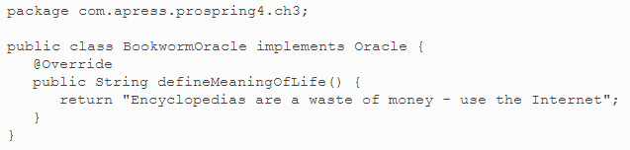
Listing 3-11. A Simple Oracle Interface Implementation
Notes:
Now let’s see, in a stand-alone Java program, how we can initialize Spring’s BeanFactoryand obtain the oracle bean for processing (see Listing 3-12).

Slide 50
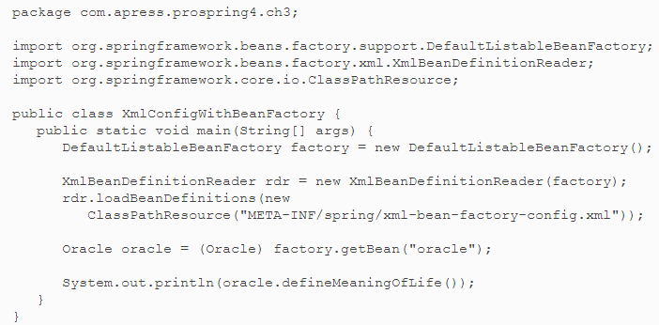
Listing 3-12. Using BeanFactory

Slide 51
In Listing 3-12, you can see that we are using DefaultListableBeanFactory—one of the two main BeanFactory implementations supplied with Spring—and that we are reading in the BeanDefinition information from an XML file by using XmlBeanDefinitionReader.
Once the BeanFactory implementation is created and configured, we retrieve the Oracle bean by using its name, oracle, which is configured in the XML configuration file.
Listing 3-13 is the content of the XML for bootstrapping Spring’s BeanFactory (xml-bean-factory-config.xml).

Slide 52
Listing 3-13. Simple Spring XML Configuration
<?xml version="1.0" encoding="UTF-8"?> <beans xmlns="http://www.springframework.org/schema/beans" xmlns:xsi="http://www.w3.org/2001/XMLSchema-instance" xsi:schemaLocation="http://www.springframework.org/schema/beans http://www.springframework.org/schema/beans/spring-beans.xsd"> <bean id="oracle" name="wiseworm" class="com.apress.prospring4.ch3.BookwormOracle"/> </beans>
Notes:
Note When declaring a Spring XSD location, it’s a best practice to not include the version number. This resolution is already handled for you by Spring as the versioned XSD file is configured through a pointer in the spring.schemas file. This file resides in the spring-beans module defined as a dependency in your project. This also prevents you from having to modify all of your bean files when upgrading to a new version of Spring.

Slide 53
The previous file declares a Spring bean, gives it an ID of oracle and a name of wiseworm, and tells Spring that the underlying implementation class is com.apress.prospring4.ch3.BookwormOracle. Don’t worry too much about the configuration at the moment; we discuss the details in later sections.
Having the configuration defined, run the program in Listing 3-12, and you will see the phrase returned by the defineMeaningOfLife() method in the console output.
In addition to XmlBeanDefinitionReader, Spring also provides PropertiesBeanDefinitionReader, which allows you to manage your bean configuration by using properties rather than XML. Although properties are ideal for small, simple applications, they can quickly become cumbersome when you are dealing with a large number of beans. For this reason, it is preferable to use the XML configuration format for all but the most trivial of applications.

Slide 54
Of course, you are free to define your own BeanFactory implementations, although be aware that doing so is quite involved; you need to implement a lot more interfaces than just BeanFactory to get the same level of functionality you have with the supplied BeanFactory implementations.
If all you want to do is define a new configuration mechanism, create your definition reader by developing a class that extends the DefaultListableBeanFactory class, which has the BeanFactory interface implemented.

Slide 55
ApplicationContext
In Spring, the ApplicationContext interface is an extension to BeanFactory. In addition to DI services, ApplicationContext provides other services, such as transaction and AOP service, message source for internationalization (i18n), and application event handling, to name a few.
In developing Spring-based applications, it’s recommended that you interact with Spring via the ApplicationContext interface. Spring supports the bootstrapping of ApplicationContext by manual coding (instantiate it manually and load the appropriate configuration) or in a web container environment via the ContextLoaderListener. From this point onward, all the sample code in this book uses ApplicationContext.

Slide 56
Configuring ApplicationContext
Having discussed the basic concepts of IoC and DI and gone through a simple example of using Spring’s BeanFactory interface, let’s dive into the details on how to configure a Spring application.
In the following sections, we go through various aspects of configuring Spring applications. Specifically, we focus our attention on the ApplicationContext interface, which provides many more configuration options than the traditional BeanFactory interface.

Slide 57
Setting Spring Configuration Options
Originally, Spring supported defining beans either through properties or an XML file.
Since the release of JDK 5 and Spring's support of Java annotations, Spring (starting from Spring 2.5) also supports using Java annotations when configuring ApplicationContext.
So, which one is better, XML or annotations? There have been lots of debates on this topic, and you can find numerous discussions on the Internet (for example, try the Spring Community Forums at http://forum.spring.io/). There is no definite answer, and each approach has its pros and cons.
Using an XML file can externalize all configuration from Java code, while annotations allow the developer to define and view the DI setup from within the code.
Spring also supports a mix of the two approaches in a single ApplicationContext.
One common approach is to define the application infrastructure (for example, data source, transaction manager, JMS connection factory, or JMX) in an XML file, while defining the DI configuration (injectable beans and beans' dependencies) in annotations.
However, no matter which option you choose, stick to it and deliver the message clearly across the entire development team.

Slide 58
Basic Configuration Overview
For XML configuration, you need to declare the required namespace base provided by Spring that your application requires.
Listing 3-14 shows the most basic sample, which declares only the beans namespace for you to define the Spring beans.
We refer to this configuration file as app-context-xml.xml for XML-style configuration throughout the samples.
Besides beans, Spring provides a large number of other namespaces for different purposes. Some examples include context for ApplicationContext configuration, aop for AOP support, and tx for transactional support.

Slide 59
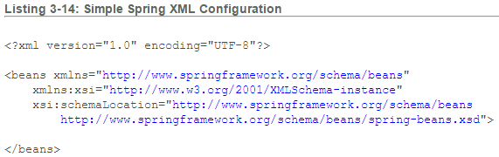

Slide 60
Besides beans, Spring provides a large number of other namespaces for different purposes. Some examples include context for ApplicationContext configuration, aop for AOP support, and tx for transactional support. Namespaces are covered in the appropriate chapters.
To use Spring’s annotation support in your application, you need to declare the tags shown in Listing 3-15 in your XML configuration. We refer to this configuration file as app-context-annotation.xml for XML configuration with annotation support throughout the samples.

Slide 61
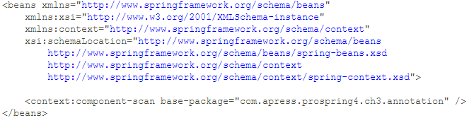
Listing 3-15. Spring XML Configuration with Annotation Support

Slide 62
The <context:component-scan> tag tells Spring to scan the code for injectable beans annotated with @Component, @Controller, @Repository, and @Service as well as supporting the @Autowired and @Inject annotations under the package (and all its subpackages) specified.
In the <context:component-scan> tag, multiple packages can be defined by using either a comma, a semicolon, or a space as the delimiter.
Moreover, the tag supports inclusion and exclusion of a components scan for more fine-grained control. For example, consider the configuration in Listing 3-16.
Listing 3-16. Spring XML Configuration Component Scan

Slide 63
The previous tag tells Spring to scan the package as specified but omit the classes that were assignable to the type as specified in the expression (can be either a class or an interface).
Besides the exclude filter, you can also use an include filter. And for the type, you can use annotation, regex, assignable, AspectJ, or custom (with your own filter class that implements org.springframework.core.type.filter.TypeFilter) as the filter criteria. The expression format depends on the type you specified.

Slide 64
Declaring Spring Components
After you develop some kind of service class and want to use it in a Spring-base application, you need to tell Spring that those beans are eligible for injection to other beans and have Spring manage them for you. Consider the sample in Chapter 2, where MessageRenderoutputs the message and depends on MessageProvider to provide the message to render. Listing 3-17 recaps the interfaces and implementations of the two services.

Slide 65
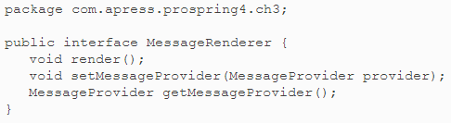
Listing 3-17. MessageRenderer and MessageProvider

Slide 66
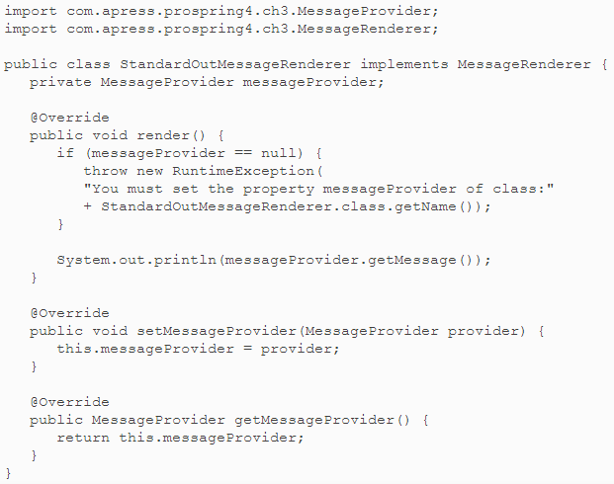

Slide 67
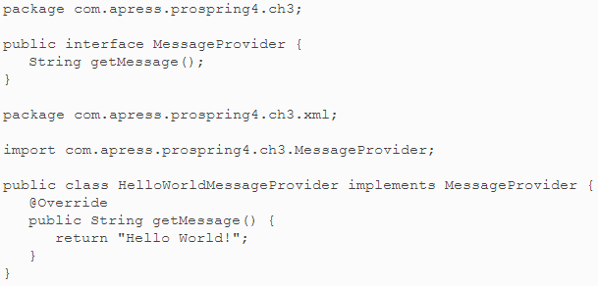

Slide 68
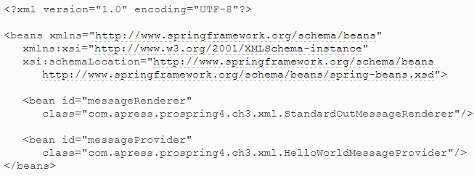
To declare the beans in an XML file, on top of the basic configuration (as stated earlier in Listing 3-14), you add the <bean> tags in Listing 3-18 to the file app-context-xml.xml.
Listing 3-18. Declare Spring Beans (XML)

Slide 69
The previous tags declare two beans, one with an ID of messageProvider with the HelloWorldMessageProvider implementation, and the other with an ID of messageRenderer with the StandardOutMessageRenderer implementation.
To define the Spring beans via annotation, you don’t need to modify the XML configuration file (app-context-annotation.xml) anymore; you just need to add the corresponding annotation to the service implementation classes under package com.apress.prospring4.ch3.annotation (see Listing 3-19).

Slide 70
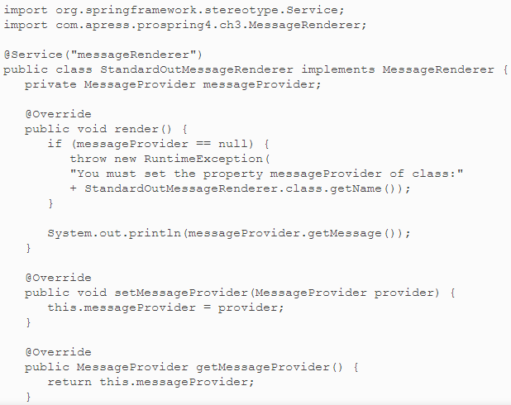
Listing 3-19. Declare Spring Beans (Annotation)

Slide 71
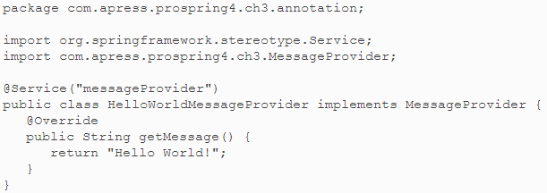

Slide 72
From the previous code sample, you use Spring’s @Service annotation to specify that the bean provides services that other beans may require, passing in the bean name as the parameter. When bootstrapping Spring’s ApplicationContext with the XML configuration in Listing 3-15, Spring will seek out those components and instantiate the beans with the specified names.
Using either approach doesn’t affect the way you obtain the beans from ApplicationContext. Listing 3-20 shows the example code to obtain the message provider.

Slide 73
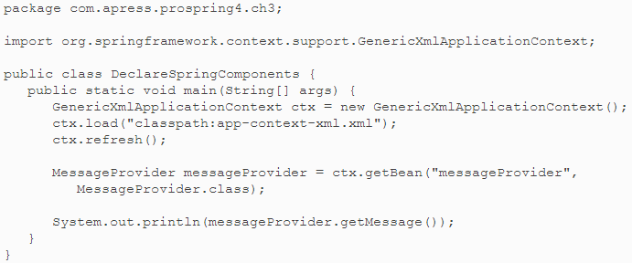
Listing 3-20. Declare Spring Beans (Testing)

Slide 74
Instead of DefaultListableBeanFactory, an instance of GenericXmlApplicationContext is instantiated. The GenericXmlApplicationContext class implements the ApplicationContext interface and is able to bootstrap Spring’s ApplicationContext from the configurations defined in XML files.
You can swap the app-context-xml.xml file with app-context-annotation.xml in the provided source code for this chapter, and you will find that both cases produce the same result: “Hello World!” is printed.
Listing 3-21 (app-context-xml.xml) and Listing 3-22 (app-context-annotation.xml) recap the configuration file content for both XML and annotation-style configuration that we have discussed so far.

Slide 75
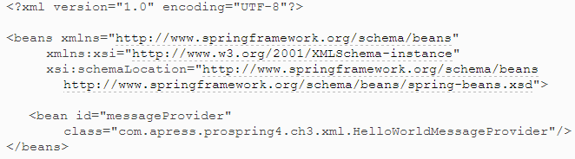
Listing 3-21. XML Configuration (app-context-xml.xml)

Slide 76
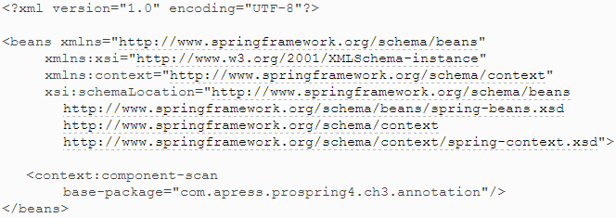
Listing 3-22. Annotation Configuration (app-context-annotation.xml)

Slide 77
Using Setter Injection
To configure Setter Injection by using XML configuration, you need to specify <property>tags under the <bean> tag for each <property> into which you want to inject a dependency.
For example, to assign the message provider bean to the messageProvider property of the messageRenderer bean, you simply change the <bean> tag for the messageRenderer bean, as shown in Listing 3-23.

Slide 78
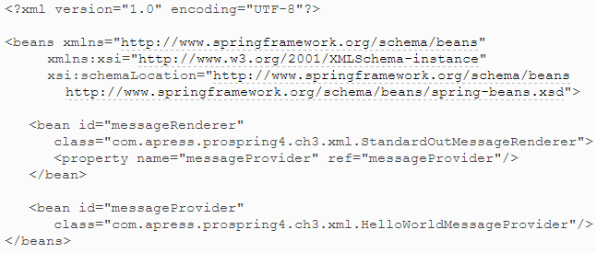
Listing 3-23. Setter Injection (XML)

Slide 79
From this code, you can see that we are assigning the messageProvider bean to the messageProvider property. You can use the ref attribute to assign a bean reference to a property (discussed in more detail shortly).
If you are using Spring 2.5 or later and have the p namespace declared in your XML configuration file, you can declare the injection as shown in Listing 3-24.

Slide 80
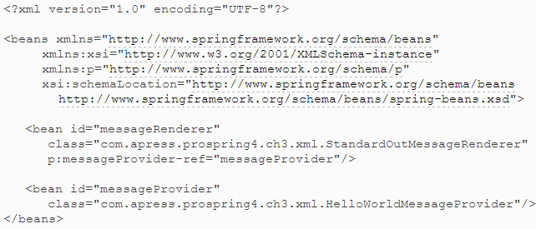
Listing 3-24. Setter Injection (XML)
Notes:
The p namespace provides a simplified way for defining Setter Injection.
Note The p namespace is not defined in an XSD file and exists only in Spring core; therefore, no XSD is declared in the schemaLocation attribute.
For annotation, it’s even simpler. You just need to add an @Autowired annotation to the setter method, as shown in Listing 3-25.

Slide 81
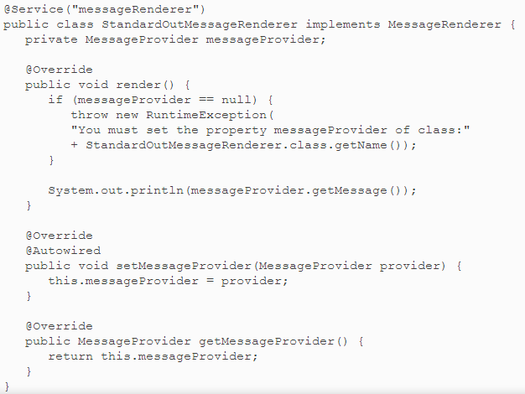
Listing 3-25. Setter Injection (Annotation)
Notes:
Since we declared the <context:component-scan> tag in the XML configuration file, during the initialization of Spring’s ApplicationContext, Spring will discover those @Autowired annotations and inject the dependency as required.

Slide 82
Instead of @Autowired, you can also use @Resource(name="messageProvider") to achieve the same result.
@Resource is one of the annotations in the JSR-250 standard that defines a common set of Java annotations for use on both JSE and JEE platforms.
Different from @Autowired, the @Resource annotation supports the name parameter for more fine-grained DI requirements.
Additionally, Spring supports use of the @Inject annotation introduced as part of JSR-299, "Contexts and Dependency Injection for the Java EE platform" (CDI).
@Inject is equivalent in behavior to Spring's @Autowired annotation.
The @Autowired annotation can be applied to only one of the constructor methods. If you apply the annotation to more than one constructor method, Spring will complain during bootstrapping ApplicationContext.
Notes:
Doubt : Last point in above slide.
@Autowired annotation can be applied to only one of the constructor methods.
If you apply the annotation to more than one constructor method, Spring will complain during bootstrapping ApplicationContext.

Slide 83
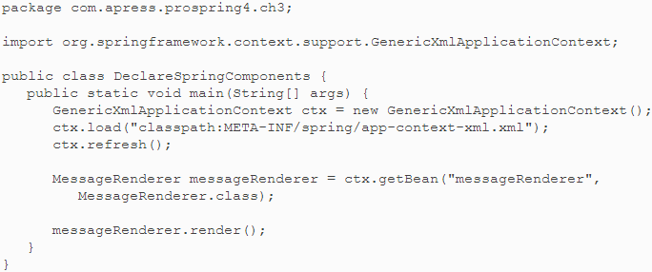
Listing 3-26. Using Setter Injection (Testing)

Slide 84
As in the previous section, you can swap the app-context-xml.xml file with app-context-annotation.xml in the provided source code for this chapter, and you will find that both cases produce the same result: “Hello World!” is printed.

Slide 85
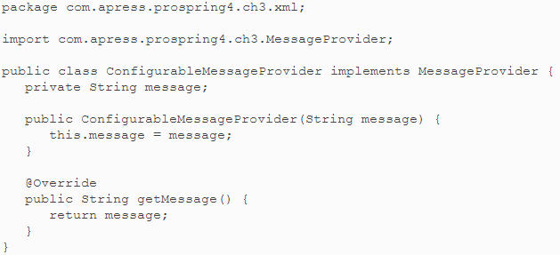
Listing 3-27. The ConfigurableMessageProvider Class (XML)

Slide 86
As you can see, it is impossible to create an instance of ConfigurableMessageProvider without providing a value for the message (unless you supply null). This is exactly what we want, and this class is ideally suited for use with Constructor Injection.
Listing 3-28 shows how you can redefine the messageProvider bean definition to create an instance of ConfigurableMessageProvider, injecting the message by using Constructor Injection.

Slide 87
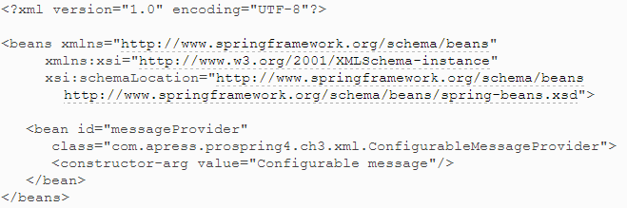
Listing 3-28. Using Constructor Injection (XML)

Slide 88
In this code, instead of using a <property> tag, we used a <constructor-arg> tag. Because we are not passing in another bean this time, just a String literal, we use the value attribute instead of ref to specify the value for the constructor argument.
When you have more than one constructor argument or your class has more than one constructor, you need to give each <constructor-arg> tag an index attribute to specify the index of the argument, starting at 0, in the constructor signature.
It is always best to use the index attribute whenever you are dealing with constructors that have multiple arguments, to avoid confusion between the parameters and ensure that Spring picks the correct constructor.
In addition to the p namespace, as of Spring 3.1, you can also use the c namespace, as shown here:

Slide 89
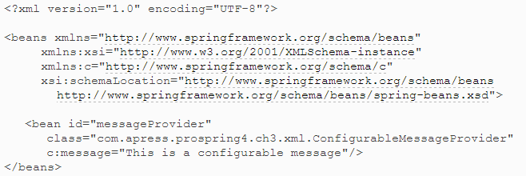

Slide 90
Note The c namespace is not defined in an XSD file and exists only in Spring core; therefore, no XSD is declared in the schemaLocation attribute.
To use an annotation for Constructor Injection, we also use the @Autowired annotation in the target bean’s constructor method, as shown in Listing 3-29, which is an alternative option to the one using Setter Injection, as shown in Listing 3-24.

Slide 91
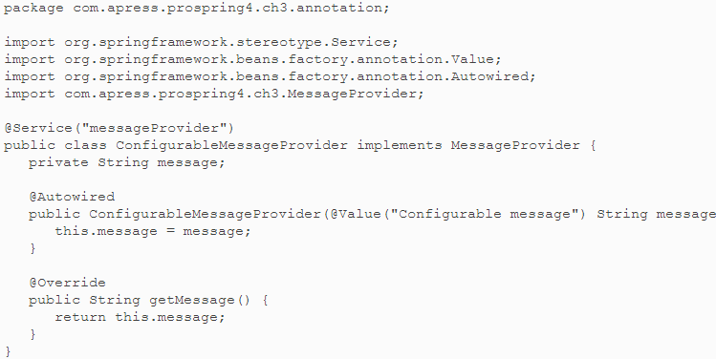
Listing 3-29. Using Constructor Injection (Annotation)

Slide 92
From the previous listing, you can see that we use another annotation, @Value, to define the value to be injected into the constructor. This is the way in Spring you inject values into a bean.
Besides simple strings, you can also use the powerful SpEL for dynamic value injection (more on this later in this chapter).
However, hard-coding the value in the code is not a good idea, since to change it, you would need to recompile the program.
Even if you choose annotation-style DI, a good practice is to externalize those values for injection.
To externalize the message, let’s define the message as a Spring bean in the annotation configuration file, as in Listing 3-30.

Slide 93
Listing 3-30. Using Constructor Injection (Annotation)
<?xml version="1.0" encoding="UTF-8"?> <beans xmlns="http://www.springframework.org/schema/beans" xmlns:xsi="http://www.w3.org/2001/XMLSchema-instance" xmlns:context="http://www.springframework.org/schema/context" xmlns:c="http://www.springframework.org/schema/c" xsi:schemaLocation="http://www.springframework.org/schema/beans http://www.springframework.org/schema/beans/spring-beans.xsd http://www.springframework.org/schema/context http://www.springframework.org/schema/context/spring-context.xsd"> <context:component-scan base-package="com.apress.prospring4.ch3.annotation"/> <bean id="message"
class="java.lang.String" c:_0="This is a configurable message"/> </beans>

Slide 94
Here we define a bean with an ID of message and type of java.lang.String.
Notice that we also use the c namespace for Constructor Injection to set the string value, and _0 indicates the index for the constructor argument.
Have the bean declared; we can take away the @Value annotation from the target bean, as in Listing 3-31.

Slide 95
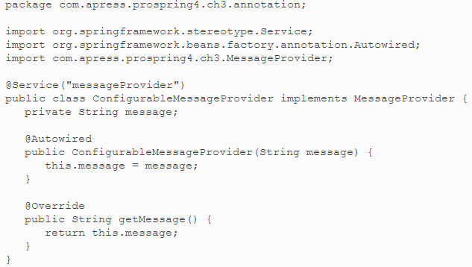
Listing 3-31. Using Constructor Injection (Annotation)

Slide 96
Since we declare that the message bean and its ID are the same as the name of the argument specified in the constructor, Spring will detect the annotation and inject the value into the constructor method.
Now run the test by using the code in Listing 3-32 against both the XML (app-context.xml.xml) and annotation configurations (app-context-annotation.xml), and the configured message will be displayed in both cases.
The following is the sample output:
This is a configurable message

Slide 97
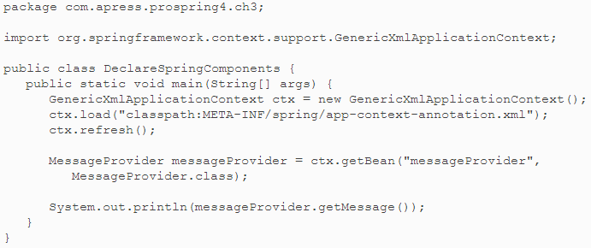
Listing 3-32. Constructor Confusion

Slide 98
In some cases, Spring finds it impossible to tell which constructor you want it to use for Constructor Injection.
This usually arises when you have two constructors with the same number of arguments and the types used in the arguments are represented in exactly the same way.
Consider the code in Listing 3-33.

Slide 99
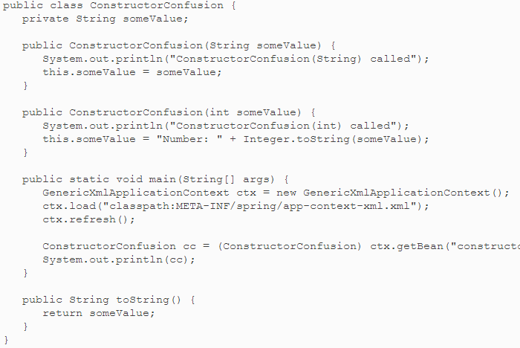
Listing 3-33. Constructor Confusion

Slide 100
Here, you can clearly see what this code does—it simply retrieves a bean of type ConstructorConfusion from ApplicationContext and writes the value to console output.
Now look at the configuration code in Listing 3-34 (app-context-xml.xml).

Slide 101
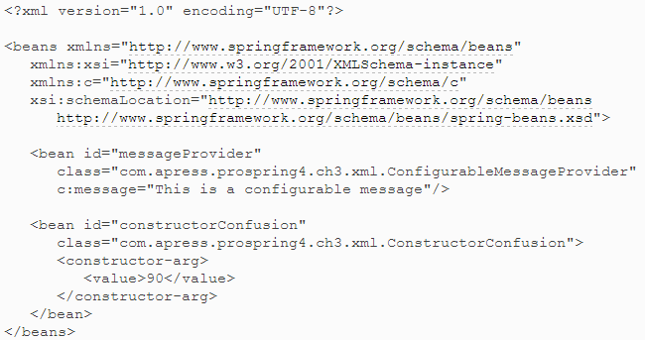
Listing 3-34. Confused Constructors

Slide 102
Which of the constructors is called in this case? Running the example yields the following output:
ConstructorConfusion(String) called 90, This shows that the constructor with the String argument is called.
This is not the desired effect, since we want to prefix any integer values passed in by using Constructor Injection with Number:, as shown in the int constructor.
To get around this, we need to make a small modification to the configuration, shown in Listing 3-35 (app-context-xml.xml).

Slide 103
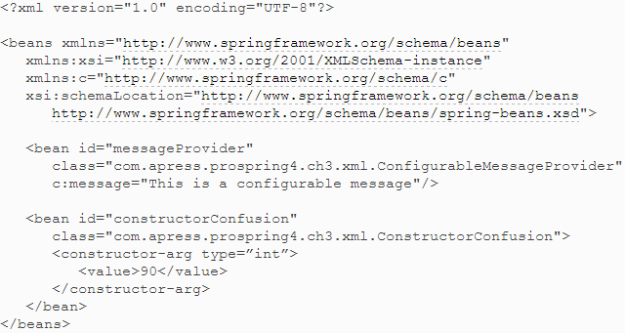
Listing 3-35. Overcoming Constructor Confusion

Slide 104
Notice now that the <constructor-arg> tag has an additional attribute, type, that specifies the type of argument Spring should look for. Running the example again with the corrected configuration yields the correct output:
ConstructorConfusion(int) called Number: 90
For annotation-style Construction Injection, the confusion can be avoided by applying the annotation directly to the target constructor method, as we’ve done in Listing 3-36.

Slide 105
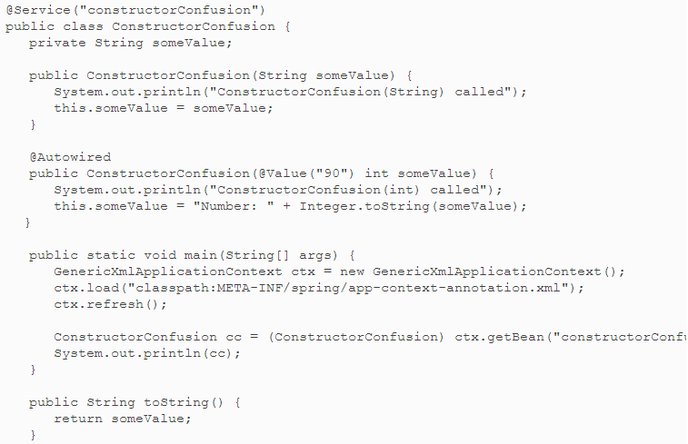
Listing 3-36. Constructor Confusion (Annotation)

Slide 106
By applying the @Autowired annotation to the desired constructor method, Spring will use that method to instantiate the bean and inject the value as specified. As before, you should externalize the value from the configuration.
Note The @Autowired annotation can be applied to only one of the constructor methods. If you apply the annotation to more than one constructor method, Spring will complain during bootstrapping ApplicationContext.

Slide 107
Using Injection Parameters
In the two previous examples, you saw how to inject other components and values into a bean by using both Setter Injection and Constructor Injection.
Spring supports a myriad of options for injection parameters, allowing you to inject not only other components and simple values, but also Java collections, externally defined properties, and even beans in another factory.
You can use all of these injection parameter types for both Setter Injection and Constructor Injection by using the corresponding tag under the <property> and <constructor-args> tags, respectively.

Slide 108
Injecting Simple Values
Injecting simple values into your beans is easy. To do so, simply specify the value in the configuration tag, wrapped inside a <value> tag.
By default, not only can the <value> tag read String values, but it can also convert these values to any primitive or primitive wrapper class.
Listing 3-37 shows a simple bean that has a variety of properties exposed for injection.
For annotation-style simple value injection, we can apply the @Value annotation to the bean properties.
This time, instead of the setter method, we apply the annotation to the property declaration statement, as you can see in Listing 3-39. (Spring supports the annotation either at the setter method or in the properties.)

Slide 109
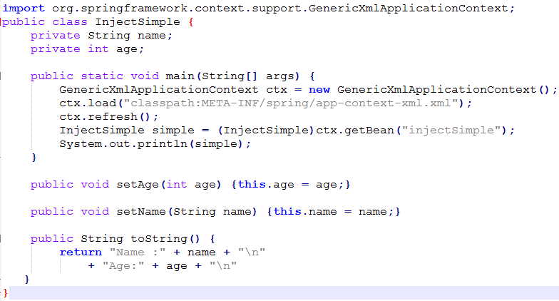
Listing 3-37. Injecting Simple Values (XML)
Notes:
In addition to the properties, the InjectSimple class also defines the main() method that creates an ApplicationContext and then retrieves an InjectSimple bean from Spring. The property values of this bean are then written to the console output. Listing 3-38 shows the configuration (app-context-xml.xml) for this bean.

Slide 110
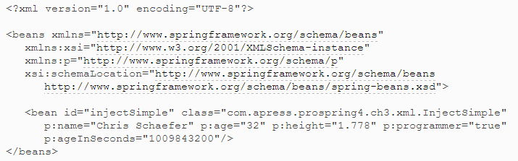
Listing 3-38. Configuring Simple Value Injection
Notes:
You can see from Listings 3-37 and 3-38 that it is possible to define properties on your bean that accept String values, primitive values, or primitive wrapper values and then inject values for these properties by using the <value> tag. Here is the output created by running this example as expected:
Name: Chris Schaefer Age: 32 Age in Seconds: 1009843200 Height: 1.778 Is Programmer?: true
For annotation-style simple value injection, we can apply the @Value annotation to the bean properties. This time, instead of the setter method, we apply the annotation to the property declaration statement, as you can see in Listing 3-39. (Spring supports the annotation either at the setter method or in the properties.)

Slide 111
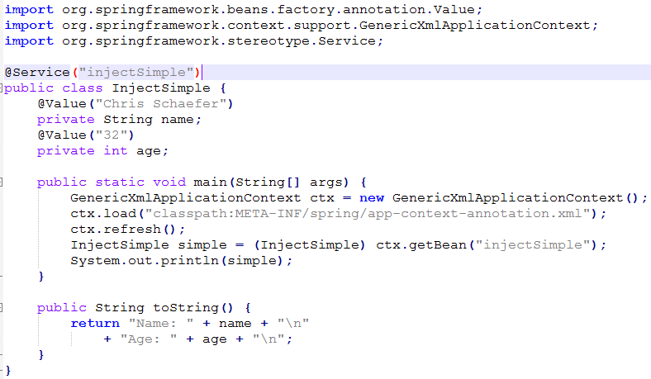
Listing 3-39. Injecting Simple Values (Annotation)

Slide 112
Injecting Values by Using SpEL
One powerful feature introduced into Spring 3 is the Spring Expression Language (SpEL enables you to evaluate an expression dynamically and then use it in Spring's ApplicationContext.
You can use the result for injection into Spring beans. In this section, we take a look at how to use SpEL to inject properties from other beans, by using the example in the preceding section.
Suppose now we want to externalize the values to be injected into a Spring bean in a configuration class, as in Listing 3-40.
We can then define the bean in the XML configuration and use SpEL to inject the bean's properties into the dependent bean, as we have done in Listing 3-41(app-context-xml.xml).

Slide 113
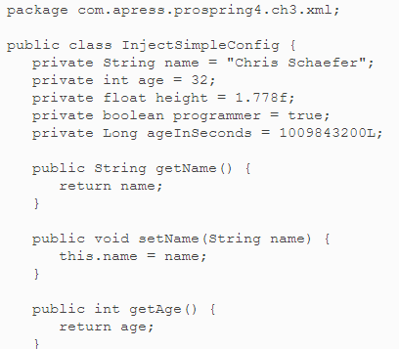
Listing 3-40. Injecting Values by Using SpEL (XML)
Notes:
We can then define the bean in the XML configuration and use SpEL to inject the bean’s properties into the dependent bean, as we have done in Listing 3-41 (app-context-xml.xml).

Slide 114
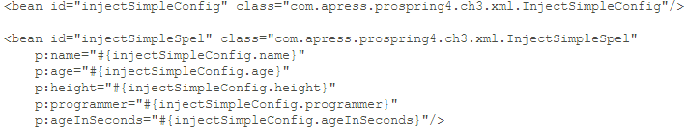
Listing 3-41(app-context-xml.xml)
Notes:
Notice that we use the SpEL #{injectSimpleConfig.name} in referencing the property of the other bean. For the age, we add 1 to the value of the bean to indicate that we can use SpEL to manipulate the property as we see fit and inject it into the dependent bean. Now we can test the configuration with the program in Listing 3-42.

Slide 115
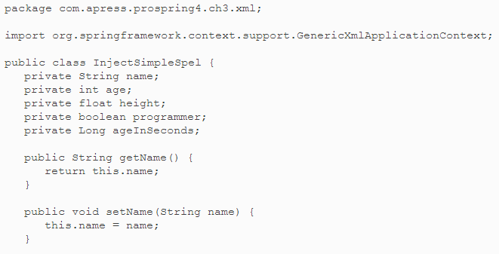
Listing 3-42. Injecting Values by Using SpEL (XML)

Slide 116
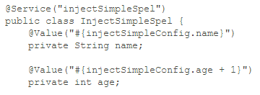
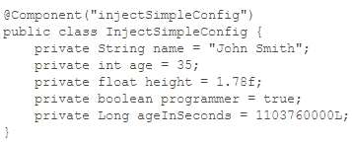
When using annotation-style value injection, we just need to substitute the value annotations with the SpEL expressions (see Listing 3-43).

Slide 117
In Listing 3-44, instead of the @Service annotation, @Component was used. Basically, using @Component has the same effect as @Service.
Both annotations are instructing Spring that the annotated class is a candidate for auto detection using annotation-based configuration and classpath scanning.
However, since the InjectSimpleConfig class is storing the application configuration, rather than providing a business service, using @Component makes more sense.
Practically, @Service is a specialization of @Component, which indicates that the annotated class is providing a business service to other layers within the application.
Testing the program will produce the same result.
Using SpEL, you can access any Spring-managed beans and properties and manipulate them for application use by Spring's support of sophisticated language features and syntax.

Slide 118
Injection and ApplicationContext Nesting
So far, the beans we have been injecting have been located in the same ApplicationContext (and hence the same BeanFactory) as the beans they are injected into. However, Spring supports a hierarchical structure for ApplicationContext so that one context (and hence the associating BeanFactory) is considered the parent of another. By allowing ApplicationContexts to be nested, Spring allows you to split your configuration into different files—a godsend on larger projects with lots of beans.
When nesting ApplicationContexts, Spring allows beans in what is considered the child context to reference beans in the parent context. ApplicationContext nesting using GenericXmlApplicationContext is very simple to get a grip on. To nest one GenericXmlApplicationContext inside another, simply call the setParent() method in the child ApplicationContext, as shown in Listing 3-48.
Inside the configuration file for the child ApplicationContext, referencing a bean in the parent ApplicationContext works exactly like referencing a bean in the child ApplicationContext, unless you have a bean in the child ApplicationContext that shares the same name. In that case, you simply replace the bean attribute of the ref attribute with parent, and you are on your way. Listing 3-50 shows a sample configuration file for the parent BeanFactory (parent.xml).

Slide 119
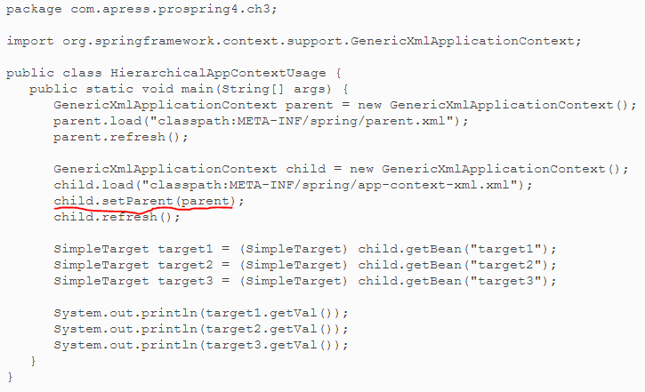
Listing 3-48. Nesting GenericXmlApplicationContext

Slide 120
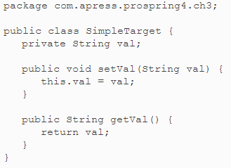
Listing 3-49. The SimpleTarget Class

Slide 121
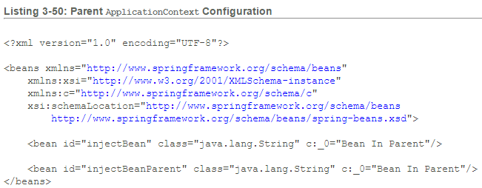

Slide 122
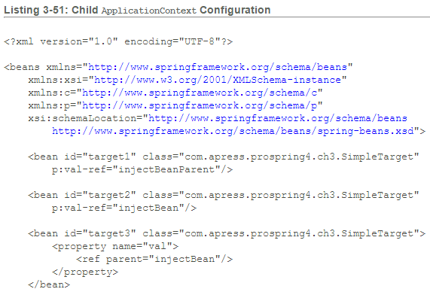

Slide 123
From Listing 3-51, we Notice that we have defined four beans here. The injectBean in this listing is similar to the injectBean in the parent except that the String it represents has a different value, indicating that it is located in the child ApplicationContext.
The target1 bean is using the bean ref attribute to reference the bean named injectBeanParent. Because this bean exists only in the parent BeanFactory, target1 receives a reference to that bean. There are two points of interest here. First, you can use the bean attribute to reference beans in both the child and the parent ApplicationContexts. This makes it easy to reference the beans transparently, allowing you to move beans between configuration files as your application grows. The second point of interest is that you can't use the local attribute to refer to beans in the parent ApplicationContext. The XML parser checks to see that the value of the local attribute exists as a valid element in the same file, preventing it from being used to reference beans in the parent context.
The target2 bean is using the bean ref attribute to reference the injectBean. Because that bean is defined in both ApplicationContexts, the target2 bean receives a reference to the injectBean in its own ApplicationContext.
The target3 bean is using the <ref> tag to reference the injectBean directly in the parent ApplicationContext. Because target3 is using the parent attribute of the <ref> tag, the injectBean declared in the child ApplicationContext is ignored completely.

Slide 124
Note You may have noticed that, unlike target1 and target2, the target3 bean is not using the p namespace. While the p namespace provides handy shortcuts, it does not provide all the capabilities as when using property tags, such as referencing a parent bean. While we show it as an example, its best to pick either the p namespace or property tags to define your beans, rather than mixing styles (unless absolutely necessary).
Here is the output from running the HierarchicalAppContextUsage class (Listing 3-48):
Bean In Parent (<br/>)Bean In Child (<br/>)Bean In Parent
As expected, the target1 and target3 beans both get a reference to beans in the parent ApplicationContext, whereas the target2 bean gets a reference to a bean in the child ApplicationContext.

Slide 125
Using Collections for Injection
Often your beans need access to collections of objects rather than just individual beans or values.
Therefore, it should come as no surprise that Spring allows you to inject a collection of objects into one of your beans.
Using the collection is simple: you choose either <list>, <map>, <set>, or <props> to represent a List, Map, Set, or Properties instance, and then you pass in the individual items just as you would with any other injection.
The <props> tag allows for only Strings to be passed in as the value, because the Properties class allows only for property values to be Strings.
When using <list>, <map>, or <set>, you can use any tag you want when injecting into a property, even another collection tag.
This allows you to pass in a List of Maps, a Map of Sets, or even a List of Maps of Sets of Lists! Listing 3-52 shows a class that can have all four of the collection types injected into it.

Slide 126

Listing 3-52. Collection Injection (XML)
Notes:
That is quite a lot of code, but it actually does very little. The main() method retrieves a CollectionInjection bean from Spring and then calls the displayInfo() method. This method just outputs the contents of the Map, Properties, Set, and List instances that will be injected from Spring. In Listing 3-53, you can see the configuration required to inject values for each of the properties on the CollectionInjection class.

Slide 127

Listing 3-52. Collection Injection (XML)(cont…)

Slide 128

Listing 3-53. Configuring Collection Injection (XML)
Notes:
Also notice the declaration of the Map<String,Object> property. For JDK 5 and newer versions, Spring also supports the strongly typed Collection declaration and will perform the conversion from the XML configuration to the corresponding type specified accordingly (app-context-xml.xml).
In this code, you can see that we have injected values into all four setters exposed on the CollectionInjection class. For the map property, we have injected a Map instance by using the <map> tag. Notice that each entry is specified using an <entry> tag, and each has a String key and then an entry value. This entry value can be any value you can inject into a property separately; this example shows the use of the <value> and <ref> tags to add a String value and a bean reference to the Map. For the props property, we use the <props>tag to create an instance of java.util.Properties and populate it using <prop> tags. Notice that although the <prop> tag is keyed in a similar manner to the <entry> tag, you can specify a String value only for each property that goes in the Properties instance.
Both the <list> and <set> tags work in exactly the same way: you specify each element by using any of the individual value tags such as <value> and <ref> that are used to inject a single value into a property. In Listing 3-52, you can see that we have added a String value and a bean reference to both the List and the Set instances.
Here is the output generated by Listing 3-52. As expected, it simply lists the elements added to the collections in the configuration file.

Slide 129


Slide 130
Remember, with the <list>, <map>, and <set> elements, you can employ any of the tags used to set the value of noncollection properties to specify the value of one of the entries in the collection. This is quite a powerful concept, because you are not limited just to injecting collections of primitive values; you can also inject collections of beans or other collections.
Using this functionality, it is much easier to modularize your application and provide different, user-selectable implementations of key pieces of application logic. Consider a system that allows corporate staff to create, proofread, and order their personalized business stationery online. In this system, the finished artwork for each order is sent to the appropriate printer when it is ready for production. The only complication is that some printers want to receive the artwork via e-mail, some via FTP, and others using Secure Copy Protocol (SCP). Using Spring’s collection injection, you can create a standard interface for this functionality, as shown in Listing 3-54.

Slide 131

Listing 3-54. The ArtworkSender Interface
Notes:
In Listing 3-54, the Recipient class is an empty class. From this interface, you can create multiple implementations, each of which is capable of describing itself to a human, such as the ones shown in Listing 3-55.

Slide 132

Listing 3-55. The FtpArtworkSender Class

Slide 133
Imagine that you then develop an ArtworkManager class that supports all available implementations of the ArtworkSender interface. With the implementations in place, you simply pass a List to your ArtworkManager class, and you are on your way. Using the getFriendlyName() method, you can display a list of delivery options for the system administrator to choose from when you are configuring each stationery template. In addition, your application can remain fully decoupled from the individual implementations if you just code to the ArtworkSender interface. We will leave the implementation of the ArtworkManager class as an exercise for you.
Besides the XML configuration, we can use annotations for collection injection. However, we would also like to externalize the values of the collections into the configuration file for easy maintenance. Listing 3-56 is the configuration of four different Spring beans that mimic the same collection properties of the previous sample (app-context-annotation.xml).

Slide 134

Listing 3-56. Configuring Collection Injection (Annotation)

Slide 135

Listing 3-56. Configuring Collection Injection (Annotation)(cont..)

Slide 136

Listing 3-57. The BookwormOracle Class (Annotation)

Slide 137

Listing 3-58. Configuring Collection Injection (Annotation) ";

Slide 138

Listing 3-58. Configuring Collection Injection (Annotation) (cont..)

Slide 139
Note You may wonder why the annotation @Resource is used instead of @Autowired. It’s because the @Autowired annotation is semantically defined in a way that it always treats arrays, collections, and maps as sets of corresponding beans, with the target bean type derived from the declared collection value type. So, for example, if a class has an attribute of type List<Oracle> and has the @Autowired annotation defined, Spring will try to inject all beans of type Oracle within the current ApplicationContext into that attribute (instead of the <util:list> declared in the configuration file), which will result in either the unexpected dependencies being injected or Spring throwing an exception if no bean of type Oracle was defined. So, for collection type injection, we have to explicitly instruct Spring to perform injection by specifying the bean name, which the @Resource annotation supports.

Slide 140
Using Method Injection
Besides Constructor and Setter Injection, another less frequently used DI feature that Spring provides is Method Injection.
Spring's Method Injection capabilities come in two loosely related forms, Lookup Method Injection and Method Replacement.
Lookup Method Injection provides another mechanism by which a bean can obtain one of its dependencies.
Method Replacement allows you to replace the implementation of any method on a bean arbitrarily, without having to change the original source code.
To provide these two features, Spring uses the dynamic bytecode enhancement capabilities of CGLIB.

Slide 141
Lookup Method Injection
Lookup Method Injection was added to Spring since version 1.1 to overcome the problems encountered when a bean depends on another bean with a different life cycle—specifically, when a singleton depends on a nonsingleton. In this situation, both Setter and Constructor Injection result in the singleton maintaining a single instance of what should be a nonsingleton bean. In some cases, you will want to have the singleton bean obtain a new instance of the nonsingleton every time it requires the bean in question.
Consider a scenario in which a LockOpener class provides the service of opening any locker. The LockOpener class relies on a KeyHelper class for opening the locker, which was injected into LockOpener. However, the design of the KeyHelper class involves some internal states that make it not suitable for reuse. Every time the openLock() method is called, a new KeyHelper instance is required. In this case, LockOpener will be a singleton. However, if we inject the KeyHelper class by using the normal mechanism, the same instance of the KeyHelper class (which was instantiated when Spring performed the injection the first time) will be reused. To make sure that a new instance of the KeyHelper instance is passed into the openLock() method every time it is invoked, we need to use Lookup Method Injection.

Slide 142
Typically, you can achieve this by having the singleton bean implement the ApplicationContextAware interface (we discuss this interface in next chapter). Then, using the ApplicationContext instance, the singleton bean can look up a new instance of the nonsingleton dependency every time it needs it. Lookup Method Injection allows the singleton bean to declare that it requires a nonsingleton dependency and that it will receive a new instance of the nonsingleton bean each time it needs to interact with it, without needing to implement any Spring-specific interfaces.
Lookup Method Injection works by having your singleton declare a method, the lookup method, which returns an instance of the nonsingleton bean. When you obtain a reference to the singleton in your application, you are actually receiving a reference to a dynamically created subclass on which Spring has implemented the lookup method. A typical implementation involves defining the lookup method, and thus the bean class, as abstract. This prevents any strange errors from creeping in when you forget to configure the Method Injection and you are working directly against the bean class with the empty method implementation instead of the Spring-enhanced subclass. This topic is quite complex and is best shown by example.
In this example, we create one nonsingleton bean and two singleton beans that both implement the same interface. One of the singletons obtains an instance of the nonsingleton bean by using "traditional" Setter Injection; the other uses Method Injection. Listing 3-59 shows the MyHelper bean, which in our example is the nonsingleton bean.

Slide 143


Slide 144


Slide 145



Slide 146
Considerations for Lookup Method Injection
Lookup Method Injection is intended for use when you want to work with two beans of different life cycles. Avoid the temptation to use Lookup Method Injection when the beans share the same life cycle, especially if they are singletons. Listing 3-64 shows a noticeable difference in performance between using Method Injection to obtain new instances of a dependency and using standard DI to obtain a single instance of a dependency. Also, make sure you don't use Lookup Method Injection needlessly, even when you have beans of different life cycles.
Consider a situation in which you have three singletons that share a dependency in common. You want each singleton to have its own instance of the dependency, so you create the dependency as a nonsingleton, but you are happy with each singleton using the same instance of the collaborator throughout its life. In this case, Setter Injection is the ideal solution; Lookup Method Injection just adds unnecessary overhead.
When you are using Lookup Method Injection, there are a few design guidelines that you should bear in mind when building your classes. In the earlier examples, we declared the lookup method in an interface. The only reason we did this was we did not have to duplicate the displayInfo() method twice for two different bean types. As we mentioned earlier, generally you do not need to pollute a business interface with unnecessary definitions that are used solely for IoC purposes. Another point to bear in mind is that although you don't have to make your lookup method abstract, doing so prevents you from forgetting to configure the lookup method and then using a blank implementation by accident.

Slide 147
Method Replacement
Although the Spring documentation classifies method replacement as a form of injection, it is very different from what you have seen so far. So far, we have used injection purely to supply beans with their collaborators. Using method replacement, you can replace the implementation of any method on any beans arbitrarily without having to change the source of the bean you are modifying. For example, you have a third-party library that you use in your Spring application, and you need to change the logic of a certain method. However, you are not able to change the source code because it was provided by a third party, so one solution is to use method replacement to just replace the logic for that method with your own implementation.
Internally, you achieve this by creating a subclass of the bean class dynamically. You use CGLIB and redirect calls to the method you want to replace to another bean that implements the MethodReplacer interface.
In Listing 3-65, you can see a simple bean that declares two overloads of the formatMessage() method.

Slide 148
Listing 3-65. The ReplacementTarget Class
package com.apress.prospring4.ch3; public class ReplacementTarget { public String formatMessage(String msg) { return "<h1>" + msg + "</h1>"; } public String formatMessage(Object msg) { return "<h1>" + msg + "</h1>"; } }

Slide 149

Listing 3-66. Implementing MethodReplacer

Slide 150

Listing 3-67. Configuring Method Replacement

Slide 151

Listing 3-68. Method Replacement in Action

Slide 152
You should be very familiar with this code by now, so we won’t go into detail. On our machine, running this example yields the following output:
Hello World!</h2> 1000000 invocations took: 396 ms Hello World!</h1> 1000000 invocations took: 18 ms
As expected, the output from the replacementTarget bean reflects the overridden implementation that the MethodReplacer provides. Interestingly, though, the dynamically replaced method is many times slower than the statically defined method. Removing the check for a valid method in MethodReplacer made a negligible difference across a number of executions, so we can conclude that most of the overhead is in the CGLIB subclass.

Slide 153
When to Use Method Replacement
Method replacement can prove quite useful in a variety of circumstances, especially when you want to override only a particular method for a single bean rather than all beans of the same type. With that said, we still prefer using standard Java mechanisms for overriding methods rather than depending on runtime bytecode enhancement.
If you are going to use method replacement as part of your application, we recommend you use one MethodReplacer per method or group of overloaded methods. Avoid the temptation to use a single MethodReplacer for lots of unrelated methods; this results in extra unnecessary String comparisons while your code works out which method it should reimplement. We have found that performing simple checks to ensure that MethodReplacer is working with the correct method is useful and doesn't add too much overhead to your code. If you are really concerned about performance, you can simply add a Boolean property to your MethodReplacer, which allows you to turn the check on and off using Dependency Injection.

Slide 154
Understanding Bean Naming
Spring supports quite a complex bean-naming structure that allows you the flexibility to handle many situations. Every bean must have at least one name that is unique within the containing ApplicationContext. Spring follows a simple resolution process to determine what name is used for the bean. If you give the <bean>tag an id attribute, the value of that attribute is used as the name. If no id attribute is specified, Spring looks for a name attribute, and if one is defined, it uses the first name defined in the name attribute. (We say the first name because it is possible to define multiple names within the name attribute; this is covered in more detail shortly.) If neither the id nor the name attribute is specified, Spring uses the bean's class name as the name, provided, of course, that no other bean is using the same class name. In case multiple beans without an ID or the name defined are using the same class name, Spring will throw an exception(of type org.springframework.beans.factory.NoSuchBeanDefinitionException) on injection during ApplicationContext initialization. Listing 3-69 shows a sample configuration that uses all three naming schemes.

Slide 155

Each of these approaches is equally valid from a technical point of view, but which is the best choice for your application? To start with, avoid using the automatic name by class behavior. This doesn't allow you much flexibility to define multiple beans of the same type, and it is much better to define your own names. That way, if Spring changes the default behavior in the future, your application continues to work. When choosing whether to use id or name, always use id to specify the bean's default name. Prior to Spring 3.1, the id attribute is the same as the XML identity (that is, xsd:ID), which places a restriction in the characters that you can use. As of Spring 3.1, Spring uses xsd:String for the id attribute, so the previous restriction on the characters that you can use is gone. However, Spring will continue to ensure that the id is unique across the entire ApplicationContext. As a general practice, you should give your bean a name by using the id attribute and then associate the bean with other names by using name aliasing, as discussed in the next section.

Slide 156
Bean Name Aliasing
Spring allows a bean to have more than one name. You can achieve this by specifying a space-, comma-, or semicolon-separated list of names in the nameattribute of the bean's <bean> tag. You can do this in place of, or in conjunction with, using the id attribute.
Besides using the name attribute, you can use the <alias> tag for defining aliases for Spring bean names. Listing 3-70 shows a simple <bean> configuration that defines multiple names for a single bean (app-context-xml.xml).
As you can see, we have defined six names: one using the id attribute and the other four as a list using all allowed bean name delimiters in the name attribute (this is just for demonstration purposes and is not recommended for real-life development). In real-life development, it's recommended you standardize on the delimiter to use for separating bean names' declarations within your application. One more alias was defined using the <alias> tag. Listing 3-71 shows a sample Java routine that grabs the same bean from the ApplicationContext six times using different names and verifies that they are the same bean.

Slide 157

Listing 3-70. Configuring Multiple Bean Name

Slide 158

Listing 3-71. Accessing Beans by Using Aliases

Slide 159

Output of earlier application

Slide 160
This code prints false five times to the console output for the configuration contained in Listing 3-70, verifying that the beans accessed using different names are, in fact, the same bean.
You can retrieve a list of the bean aliases by calling ApplicationContext.getAliases(String) and passing in any one of the bean's names or ID. The list of aliases, other than the one you specified, will then be returned as a String array.
Bean name aliasing is a strange beast because it is not something you tend to use when you are building a new application. If you are going to have many other beans inject another bean, they may as well use the same name to access that bean. However, as your application goes into production and maintenance work gets carried out, modifications are made, and so on, bean name aliasing becomes more useful.
Consider the following scenario: you have an application in which 50 beans, configured using Spring, all require an implementation of the Foo interface. Twenty-five of the beans use the StandardFoo implementation with the bean name standardFoo, and the other 25 use the SuperFoo implementation with the superFoo bean name.

Slide 161
Six months after you put the application into production, you decide to move the first 25 beans to the SuperFoo implementation.
To do this, you have three options:
The first is to change the implementation class of the standardFoo bean to SuperFoo. The drawback of this approach is that you have two instances of the SuperFoo class lying around when you really need only one. In addition, you now have two beans to make changes to when the configuration changes.
The second option is to update the injection configuration for the 25 beans that are changing, which changes the beans' names from standardFoo to superFoo. This approach is not the most elegant way to proceed—you could perform a find and replace, but then rolling back your changes when management isn't happy means retrieving an old version of your configuration from your version control system.
The third, and most ideal, approach is to remove (or comment out) the definition for the standardFoo bean and make standardFoo an alias to superFoo. This change requires minimal effort, and restoring the system to its previous configuration is just as simple.

Slide 162
Understanding Bean Instantiation Mode
By default, all beans in Spring are singletons. This means Spring maintains a single instance of the bean, all dependent objects use the same instance, and all calls to ApplicationContext.getBean() return the same instance. We demonstrated this previously in Listing 3-71, where we were able to use identity comparison (==) rather than the equals() comparison to check whether the beans were the same.
The term singleton is used interchangeably in Java to refer to two distinct concepts: an object that has a single instance within the application, and the Singleton design pattern. We refer to the first concept as singleton and to the Singleton pattern as Singleton. The Singleton design pattern was popularized in the seminal Design Patterns: Elements of Reusable Object-Oriented Software by Erich Gamma, et al. (Addison-Wesley, 1994). The problem arises when people confuse the need for singleton instances with the need to apply the Singleton pattern. Listing 3-72 shows a typical implementation of the Singleton pattern in Java.

Slide 163


Slide 164
This pattern achieves its goal of allowing you to maintain and access a single instance of a class throughout your application, but it does so at the expense of increased coupling. Your application code must always have explicit knowledge of the Singleton class in order to obtain the instance—completely removing the ability to code to interfaces. In reality, the Singleton pattern is actually two patterns in one. The first, and desired, pattern involves maintenance of a single instance of an object. The second, and less desirable, is a pattern for object lookup that completely removes the possibility of using interfaces. Using the Singleton pattern also makes it very difficult to swap out implementations arbitrarily, because most objects that require the Singleton instance access the Singleton object directly. This can cause all kinds of headaches when you are trying to unit test your application because you are unable to replace the Singleton with a mock for testing purposes.
Fortunately, with Spring you can take advantage of the singleton instantiation model without having to work around the Singleton design pattern. All beans in Spring are, by default, created as Singleton instances, and Spring uses the same instances to fulfill all requests for that bean. Of course, Spring is not just limited to use of the Singleton instance; it can still create a new instance of the bean to satisfy every dependency and every call to getBean(). It does all of this without any impact on your application code, and for this reason, we like to refer to Spring as being instantiation mode agnostic. This is a very powerful concept. If you start off with an object that is a singleton but then discover it is not really suited to multithread access, you can change it to a nonsingleton (prototype) without affecting any of your application code.
Note Although changing the instantiation mode of your bean won't affect your application code, it does cause some problems if you rely on Spring's life-cycle interfaces. We cover this in more detail in Chapter 4.

Slide 165
Choosing an Instantiation Mode
We find that singleton is the default mode for our beans. singletons should be used in the following scenarios:
Shared objects with no state: You have an object that maintains no state and has many dependent objects. Because you do not need synchronization if there is no state, you do not need to create a new instance of the bean each time a dependent object needs to use it for some processing.
Shared object with read-only state: This is similar to the previous point, but you have some read-only state. In this case, you still do not need synchronization, so creating an instance to satisfy each request for the bean is just adding overhead.
Shared object with shared state: If you have a bean that has state that must be shared, singleton is the ideal choice. In this case, ensure that your synchronization for state writes is as granular as possible.
High-throughput objects with writable state: If you have a bean that is used a great deal in your application, you may find that keeping a singleton and synchronizing all write access to the bean state allows for better performance than constantly creating hundreds of instances of the bean. When using this approach, try to keep the synchronization as granular as possible without sacrificing consistency. You will find that this approach is particularly useful when your application creates a large number of instances over a long period of time, when your shared object has only a small amount of writable state, or when the instantiation of a new instance is expensive.

Slide 166
You should consider using nonsingletons in the following scenarios:
Objects with writable state: If you have a bean that has a lot of writable state, you may find that the cost of synchronization is greater than the cost of creating a new instance to handle each request from a dependent object.
Objects with private state: In some cases, your dependent objects need a bean that has private state so that they can conduct their processing separately from other objects that depend on that bean. In this case, singleton is clearly not suitable, and you should use nonsingleton.
The main positive you gain from Spring's instantiation management is that your applications can immediately benefit from the lower memory usage associated with singletons, with very little effort on your part.
Then, if you find that singleton mode does not meet the needs of your application, it is a trivial task to modify your configuration to use nonsingleton mode.

Slide 167
Implementing Bean Scopes
Singleton: The default singleton scope. Only one will be created per Spring IoC container.
Prototype: A new instance will be created by Spring when requested by the application.
Request: For web application use. When using Spring MVC for web applications, beans with request scope will be instantiated for every HTTP request and then destroyed when the request is completed.
Session: For web application use. When using Spring MVC for web applications, beans with session scope will be instantiated for every HTTP session and then destroyed when the session is over.
Global session: For portlet-based web applications. The global session scope beans can be shared among all portlets within the same Spring MVC-powered portal application.
Thread: A new bean instance will be created by Spring when requested by a new thread, while for the same thread, the same bean instance will be returned. Note that this scope is not registered by default.
Custom: Custom bean scope that can be created by implementing the interface org.springframework.beans.factory.config.Scope and registering the custom scope in Spring's configuration (for XML, use the class org.springframework.beans.factory.config.CustomScopeConfigurer).

Slide 168
Resolving Dependencies
During normal operation, Spring is able to resolve dependencies by simply looking at your configuration file or annotations in your classes.
Spring is not aware of any dependencies that exist between beans in your code.
For example, in the constructor of beanA, you get an instance of beanB by calling ctx.getBean("beanB"), without asking Spring to inject the dependency for you.
In this case, Spring is unaware that beanA depends on beanB, and, as a result, it may instantiate beanA before beanB.
Listing 3-75: Manually Defining Dependencies
<bean id="beanA" class="com.apress.prospring4.ch3.BeanA" depends-on="beanB"/>
<bean id="beanB" class="com.apress.prospring4.ch3.BeanB"/>

Slide 169
Autowiring Your Bean
In all the examples so far, we have had to define explicitly, via the configuration file, how the individual beans are wired together.
If you don't like having to wire all your components together, you can have Spring attempt to do so automatically.
By default, autowiring is disabled.
To enable it, you specify which method of autowiring you want to use by using the autowire attribute of the bean you want to autowire.

Slide 170
Modes of Autowiring
Spring supports five modes for autowiring:
byName, byType, constructor, default, and no (which is the default).
When using byName autowiring, Spring attempts to wire each property to a bean of the same name.
So, if the target bean has a property named foo and a foo bean is defined in the ApplicationContext, the foo bean is assigned to the foo property of the target.

Slide 171
When using byType autowiring, Spring attempts to wire each of the properties on the target bean by automatically using a bean of the same type in ApplicationContext.
So, if you have a property of type String on the target bean, and a bean of type String in ApplicationContext, then Spring wires the String bean to the target bean's String property.
If you have more than one bean of the same type, in this case String, in the same ApplicationContext, then Spring is unable to decide which one to use for the autowiring and throws an exception (of type org.springframework.beans.factory.NoSuchBeanDefinitionException).

Slide 172
The constructor autowiring mode functions just like byType wiring, except that it uses constructors rather than setters to perform the injection.
Spring attempts to match the greatest numbers of arguments it can in the constructor.
So, if your bean has two constructors, one that accepts a String and one that accepts a String and an Integer, and you have both a String and an Integer bean in your ApplicationContext, Spring uses the two-argument constructor.
In default mode, Spring will choose between constructor and byType modes automatically.
If your bean has a default (no-arguments) constructor, Spring uses byType; otherwise, it uses constructor.

Slide 173
Configuration shown in Listing 3-76, Foo and Bar are empty classes.
Notice that each of the Target beans has a different value for the autowire attribute.
Moreover, the lazy-init attribute is set to true to inform Spring to instantiate the bean only when it is first requested, rather than at startup, so that we can output the result in the correct place in the testing program.

Slide 174

Listing 3-76. Configuring Autowiring

Slide 175




Slide 176
In this code, you can see that the Target class has three constructors:
a no-argument constructor,
a constructor that accepts a Foo instance,
and a constructor that accepts a Foo and a Bar instance.
In addition to these constructors, the Target bean has three properties:
two of type Foo and one of type Bar.
Each of these properties and constructors writes a message to console output when it is called.
The main() method simply retrieves each of the Target beans declared in ApplicationContext, triggering the autowire process. Here is the output from running this example:

Slide 177

From the output, you can see that when Spring uses byName, the only property that is set is foo, because this is the only property with a corresponding bean entry in the configuration file.
When using byType, Spring sets the value of all three properties. The foo and foo2 properties are set by the foo bean, and the bar property is set by the bar1 bean.
When using constructor, Spring uses the two-argument constructor, because Spring can provide beans for both arguments and does not need to fall back to another constructor.

Slide 178
When to Use Autowiring
In most cases, the answer to the question of whether you should use autowiring is definitely no!
Autowiring can save you time in small applications, but in many cases, it leads to bad practices and is inflexible in large applications.
Using byName seems like a good idea, but it may lead you to give your classes artificial property names so that you can take advantage of the autowiring functionality.
The whole idea behind Spring is that you can create your classes as you like and have Spring work for you, not the other way around.
You may be tempted to use byType until you realize that you can have only one bean for each type in your ApplicationContext—a restriction that is problematic when you need to maintain beans with different configurations of the same type.
The same argument applies to the use of constructor autowiring.
In some cases, autowiring can save you time, but it does not really take that much extra effort to define your wiring explicitly, and you benefit from explicit semantics and full flexibility on property naming and on how many instances of the same type you manage.

Slide 179

Setting Bean Inheritance
In some cases, you many need multiple definitions of beans that are the same type or implement a shared interface.
This can become problematic if you want these beans to share some configuration settings but not others.
The process of keeping the shared configuration settings in sync is quite error-prone, and on large projects, doing so can be quite time-consuming.
To get around this, Spring allows you to provide a <bean> definition that inherits its property settings from another bean in the same ApplicationContext.
You can override the values of any properties on the child bean as required, which allows you to have full control, but the parent bean can provide each of your beans with a base configuration.

Slide 180
Summary
In this chapter, we covered a lot of ground with both the Spring core and IoC in general.
We showed you examples of the types of IoC and presented the pros and cons of using each mechanism in your applications.
We looked at which IoC mechanisms Spring provides and when (and when not) to use each within your applications.
While exploring IoC, we introduced the Spring BeanFactory, which is the core component for Spring's IoC capabilities, and then ApplicationContext, which extends BeanFactory and provides additional functionalities.
For ApplicationContext, we focused on GenericXmlApplicationContext, which allows external configuration of Spring by using XML.
Another method to declare DI requirements for ApplicationContext, that is, using Java annotations, was also discussed.
This chapter also introduced you to the basics of Spring's IoC feature set including Setter Injection, Constructor Injection, Method Injection, autowiring, and bean inheritance.
In the discussion of configuration, we demonstrated how you can configure your bean properties with a wide variety of values, including other beans, using both XML and annotation type configurations and GenericXmlApplicationContext.

Slide 181
Chapter 4: Spring Configuration in Detail

Slide 182
Overview
Managing the bean life cycle: So far, all the beans you have seen have been fairly simple and completely decoupled from the Spring container. In this section, we present some strategies you can employ to enable your beans to receive notifications from the Spring container at various points throughout their life cycle. You can do this either by implementing specific interfaces laid out by Spring, by specifying methods that Spring can call via reflection, or by using JSR-250 JavaBeans life-cycle annotations.
Making your beans "Spring aware": In some cases, you want a bean to be able to interact with the ApplicationContext that configured it. For this reason, Spring offers two interfaces, BeanNameAware and ApplicationContextAware, that allow your bean to obtain its assigned name and reference its ApplicationContext, respectively.
Using FactoryBeans: As its name implies, the FactoryBean interface is meant to be implemented by any bean that acts as a factory for other beans. The FactoryBean interface provides a mechanism by which you can easily integrate your own factories with the Spring BeanFactory.

Slide 183
Working with JavaBeans PropertyEditors: The PropertyEditor interface is a standard interface provided in the java.beans package. PropertyEditors are used to convert property values to and from String representations. Spring uses PropertyEditors extensively, mainly to read values specified in the BeanFactory configuration and convert them into the correct types. In this section, we discuss the set of PropertyEditors supplied with Spring and how you can use them within your application.We also take a look at implementing custom PropertyEditors.
Learning more about the Spring ApplicationContext: As we know, ApplicationContext is an extension of BeanFactory intended for use in full applications. The ApplicationContext interface provides a useful set of additional functionality, including internationalized message support, resource loading, and event publishing. In this section, we present a detailed look at the features in addition to IoC that ApplicationContext offers. We also jump ahead of ourselves a little to show you how ApplicationContext simplifies the use of Spring when you are building web applications.
Using Java classes for configuration: Starting with 3.0, Spring offers another option for developers to configure the Spring ApplicationContext using Java classes.
Using configuration enhancements: We present features that make application configuration easier, such as profile management, environment and property source abstraction, and so on.
Using Groovy for configuration: New to Spring 4.0 is the ability to configure bean definitions in the Groovy language, which can be used as an alternative or supplement to the existing XML and Java configuration methods.

Slide 184
Bean Life-Cycle Management
An important part of any IoC container, Spring included, is that beans can be constructed in such a way that they receive notifications at certain points in their life cycle.
This enables your beans to perform relevant processing at certain points throughout their life.
In general, two life-cycle events are particularly relevant to a bean: post-initialization and pre-destruction.
In the context of Spring, the post-initialization event is raised as soon as Spring finishes setting all the property values on the bean and finishes any dependency checks that you configured it to perform.
The pre-destruction event is fired just before Spring destroys the bean instance.
However, for beans with prototype scope, the pre-destruction event will not be fired by Spring.
The design of Spring is that the initialization life-cycle callback methods will be called on objects regardless of bean scope, while for beans with prototype scope, the destruction life-cycle callback methods will not be called.
Spring provides three mechanisms a bean can use to hook into each of these events and perform some additional processing: interface-based, method-based, and annotation-based mechanisms.

Slide 185
Using the interface-based mechanism, your bean implements an interface specific to the type of notification it wants to receive, and Spring notifies the bean via a callback method defined in the interface.
For the method-based mechanism, Spring allows you to specify, in your ApplicationContext configuration, the name of a method to call when the bean is initialized and the name of a method to call when the bean is destroyed.
For the annotation mechanism, you can use JSR-250 annotations to specify the method that Spring should call after construction or before destruction.

Slide 186
In the case of both events, the mechanisms achieve exactly the same goal.
The interface mechanism is used extensively throughout Spring so that you don't have to remember to specify the initialization or destruction each time you use one of Spring's components.
However, in your own beans, you may be better served using the method-based or annotation mechanism because your beans do not need to implement any Spring-specific interfaces.
Although we stated that portability often isn't as important a requirement as many books lead you to believe, this does not mean you should sacrifice portability when a perfectly good alternative exists.
That said, if you are coupling your application to Spring in other ways, using the interface method allows you to specify the callback once and then forget about it.
If you are defining a lot of beans of the same type that need to take advantage of the life-cycle notifications, then using the interface mechanism can avoid the need for specifying the life-cycle callback methods for every bean in the XML configuration file.
Using JSR-250 annotations is also another viable option, since it's a standard defined by the JCP and you are also not coupled to Spring's specific annotations.
Just make sure that the IoC container you are running your application on supports the JSR-250 standard.

Slide 187
Overall, the choice of which mechanism you use for receiving life-cycle notifications depends on your application requirements.
If you are concerned about portability or you are just defining one or two beans of a particular type that need the callbacks, use the method-based mechanism.
If you use annotation-type configuration and are certain that you are using an IoC container that supports JSR-250, use the annotation mechanism.
If you are not too concerned about portability or you are defining many beans of the same type that need the life-cycle notifications, using the interface-based mechanism is the best way to ensure that your beans always receive the notifications they are expecting.
If you plan to use a bean across many different Spring projects, you almost certainly want the functionality of that bean to be as self-contained as possible, so you should definitely use the interface-based mechanism.

Slide 188

Spring beans life cycle

Slide 189
Hooking into Bean Creation
By being aware of when it is initialized, a bean can check whether all its required dependencies are satisfied.
Although Spring can check dependencies for you, it is pretty much an all-or-nothing approach, and it doesn't offer any opportunities for applying additional logic to the dependency resolution procedure.
Consider a bean that has four dependencies declared as setters, two of which are required and one of which has a suitable default in the event that no dependency is provided.
Using an initialization callback, your bean can check for the dependencies it requires, throwing an exception or providing a default as needed.
A bean cannot perform these checks in its constructor because at this point, Spring has not had an opportunity to provide values for the dependencies it can satisfy.
The initialization callback in Spring is called after Spring finishes providing the dependencies that it can and performs any dependency checks that you ask of it.
You are not limited to using the initialization callback just to check dependencies; you can do anything you want in the callback, but it is most useful for the purpose we have described.
In many cases, the initialization callback is also the place to trigger any actions that your bean must take automatically in response to its configuration.
For instance, if you build a bean to run scheduled tasks, the initialization callback provides the ideal place to start the scheduler—after all, the configuration data is set on the bean.

Slide 190
Executing a Method When a Bean Is Created
As we mentioned previously, one way to receive the initialization callback is to designate a method on your bean as an initialization method and tell Spring to use this method as an initialization method.
As discussed, this callback mechanism is useful when you have only a few beans of the same type or when you want to keep your application decoupled from Spring.
Another reason for using this mechanism is to enable your Spring application to work with beans that were built previously or were provided by third-party vendors.
Specifying a callback method is simply a case of specifying the name in the init-method attribute of a bean's <bean> tag.
Listing 4-1 shows a basic bean with two dependencies.

Slide 191
Implementing the InitializingBean Interface
The InitializingBean interface defined in Spring allows you to define inside your bean code that you want the bean to receive notification that Spring has finished configuring it.
In the same way as when you are using an initialization method, this gives you the opportunity to check the bean configuration to ensure that it is valid, providing any default values along the way.
The InitializingBean interface defines a single method, afterPropertiesSet(), that serves the same purpose as the init() method in Listing 4-1.
Listing 4-3 shows a reimplementation of the previous example using the InitializingBean interface in place of the initialization method.

Slide 192
Using JSR-250 @PostConstruct Annotation
Another method that can achieve the same purpose is to use the JSR-250 life-cycle annotation, @PostConstruct.
Starting from Spring 2.5, JSR-250 annotations are also supported to specify the method that Spring should call if the corresponding annotation relating to the bean's life cycle exists in the class.
Listing 4-5 shows the program with the @PostConstruct annotation applied.

Slide 193
Understanding Order of Resolution
You can use all initialization mechanisms on the same bean instance. In this case, Spring invokes the method annotated with @PostConstruct first and then InitializingBean.afterPropertiesSet(), followed by your initialization method specified in the configuration file.
This can be useful if you have an existing bean that performs some initialization in a specific method but you need to add some more initialization code when you use Spring.

Slide 194
Hooking into Bean Destruction
When using an ApplicationContext implementation that wraps the DefaultListableBeanFactory interface (such as GenericXmlApplicationContext, via the getDefaultListableBeanFactory() method), you can signal to BeanFactory that you want to destroy all singleton instances with a call to ConfigurableBeanFactory.destroySingletons().
Typically, you do this when your application shuts down, and it allows you to clean up any resources that your beans might be holding open, thus allowing your application to shut down gracefully.
This callback also provides the perfect place to flush any data you are storing in memory to persistent storage and to allow your beans to end any long-running processes they may have started.
To allow your beans to receive notification that destroySingletons() has been called, you have three options, all similar to the mechanisms available for receiving an initialization callback.
The destruction callback is often used in conjunction with the initialization callback.
In many cases, you create and configure a resource in the initialization callback and then release the resource in the destruction callback.

Slide 195
Executing a Method When a Bean Is Destroyed
To designate a method to be called when a bean is destroyed, you simply specify the name of the method in the destroy-method attribute of the bean's <bean> tag.
Spring calls it just before it destroys the singleton instance of the bean (Spring will not call this method for those beans with prototype scope).
Listing 4-6 provides an example of using a destroy-method callback.

Slide 196
Implementing the DisposableBean Interface
As with initialization callbacks, Spring provides an interface, in this case DisposableBean, that can be implemented by your beans as a mechanism for receiving destruction callbacks.
The DisposableBean interface defines a single method, destroy(), which is called just before the bean is destroyed.
Using this mechanism is orthogonal to using the InitializingBean interface to receive initialization callbacks.
Listing 4-8 shows a modified implementation of the DestructiveBean class that implements the DisposableBean interface.

Slide 197
Using JSR-250 @PreDestroy Annotation
The third way is to use the JSR-250 life-cycle @PreDestroy annotation, which is the inverse of the @PostConstruct annotation.
Listing 4-10 is a version of DestructiveBean that uses both @PostConstruct and @PreDestroy in the same class to perform program initialization and destroy actions.
Understanding Order of Resolution
As with the case of bean creation, you can use all mechanisms on the same bean instance for bean destruction.
In this case, Spring invokes the method annotated with @PreDestroy first and then DisposableBean.destroy(), followed by your destroy method configured in your XML definition.

Slide 198
Using a Shutdown Hook
The only drawback of the destruction callbacks in Spring is that they are not fired automatically; you need to remember to call AbstractApplicationContext.destroy() before your application is closed.
When your application runs as a servlet, you can simply call destroy() in the servlet's destroy() method.
However, in a stand-alone application, things are not quite so simple, especially if you have multiple exit points out of your application.
Fortunately, there is a solution.
Java allows you to create a shutdown hook, a thread that is executed just before the application shuts down.
This is the perfect way to invoke the destroy() method of your AbstractApplicationContext (which was being extended by all concrete ApplicationContext implementations).
The easiest way to take advantage of this mechanism is to use the AbstractApplicationContext's registerShutdownHook() method.
The method automatically instructs Spring to register a shutdown hook of the underlying JVM runtime. This is shown in Listing 4-12.

Slide 199
Making Your Beans "Spring Aware"
One of the biggest selling points of Dependency Injection over Dependency Lookup as a mechanism for achieving Inversion of Control is that your beans do not need to be aware of the implementation of the container that is managing them.
To a bean that uses constructor or setter injection, the Spring container is the same as the container provided by Google Guice or PicoContainer.
However, in certain circumstances, you may need a bean that is using Dependency Injection to obtain its dependencies so it can interact with the container for some other reason.
An example of this may be a bean that automatically configures a shutdown hook for you, and thus it needs access to ApplicationContext.
In other cases, a bean may want to know what its name is (that is, the bean name that was assigned within the current ApplicationContext) so it can perform some additional processing based on this name.
That said, this feature is really intended for internal Spring use.
Giving the bean name some kind of business meaning is generally a bad idea and can lead to configuration problems as bean names have to be artificially manipulated to support their business meaning.
However, we have found that being able to have a bean find out its name at runtime is really useful for logging.
Say you have many beans of the same type running under different configurations.
The bean name can be included in log messages to help you differentiate between the one that is generating errors and the ones that are working fine when something goes wrong.

Slide 200
Using the BeanNameAware Interface
The BeanNameAware interface, which can be implemented by a bean that wants to obtain its own name, has a single method: setBeanName(String).
Spring calls the setBeanName() method after it has finished configuring your bean but before any life-cycle callbacks (initialization or destroy) are called (refer to Figure 4-1).
In most cases, the implementation of the setBeanName() interface is just a single line that stores the value passed in by the container in a field for use later.
Listing 4-13 shows a simple bean that obtains its name by using BeanNameAware and then later uses this bean name to print to the console.
Using the BeanNameAware interface is really quite simple, and it is put to good use when you are improving the quality of your log messages.
Avoid being tempted to give your bean names business meaning just because you can access them; by doing so, you are coupling your classes to Spring for a feature that brings negligible benefit.
If your beans need some kind of name internally, have them implement an interface such as Nameable (which is specific to your application) with a method setName() and then give each bean a name by using Dependency Injection.
This way, you can keep the names you use for configuration concise, and you won't need to manipulate your configuration unnecessarily to give your beans names with business meaning.

Slide 201
Using the ApplicationContextAware Interface
Using the ApplicationContextAware interface, it is possible for your beans to get a reference to the ApplicationContext that configured them.
The main reason this interface was created was to allow a bean to access Spring's ApplicationContext in your application—for example, to acquire other Spring beans programmatically, using getBean().
You should, however, avoid this practice and use Dependency Injection to provide your beans with their collaborators.
If you use the lookup-based getBean() approach to obtain dependencies when you can use Dependency Injection, you are adding unnecessary complexity to your beans and coupling them to the Spring Framework without good reason.
Of course, ApplicationContext isn't used just to look up beans; it performs a great many other tasks.
As you saw previously, one of these tasks is to destroy all singletons, notifying each of them in turn before doing so.
In the previous section, you saw how to create a shutdown hook to ensure that ApplicationContext is instructed to destroy all singletons before the application shuts down.
By using the ApplicationContextAware interface, you can build a bean that can be configured in ApplicationContext to create and configure a shutdown hook bean automatically.
Listing 4-16 shows the code for this bean.

Slide 202
Use of FactoryBeans
One of the problems that you will face when using Spring is how to create and then inject dependencies that cannot be created simply by using the new operator.
To overcome this problem, Spring provides the FactoryBean interface that acts as an adaptor for objects that cannot be created and managed using the standard Spring semantics.
Typically, you use FactoryBeans to create beans that you cannot create by using the new operator, such as those you access through static factory methods, although this is not always the case.
Simply put, a FactoryBean is a bean that acts as a factory for other beans.
FactoryBeans are configured within your ApplicationContext like any normal bean, but when Spring uses the FactoryBean interface to satisfy a dependency or lookup request, it does not return FactoryBean; instead, it invokes the FactoryBean.getObject() method and returns the result of that invocation.
FactoryBeans are used to great effect in Spring; the most noticeable uses are the creation of transactional proxies, which we cover in Chapter 9, and the automatic retrieval of resources from a JNDI context.
However, FactoryBeans are useful not just for building the internals of Spring; you'll find them really useful when you build your own applications, because they allow you to manage many more resources by using IoC than would otherwise be available.

Slide 203
FactoryBean Example: The MessageDigestFactoryBean
Often the projects that we work on require some kind of cryptographic processing; typically, this involves generating a message digest or hash of a user's password to be stored in a database.
In Java, the MessageDigest class provides functionality for creating a digest of any arbitrary data.
MessageDigest itself is abstract, and you obtain concrete implementations by calling MessageDigest.getInstance() and passing in the name of the digest algorithm you want to use.
For instance, if we want to use the MD5 algorithm to create a digest, we use the following code to create the MessageDigest instance:
MessageDigest md5 = MessageDigest.getInstance("MD5");
If we want to use Spring to manage the creation of the MessageDigest object, the best we can do without a FactoryBean is have a property, algorithmName, on our bean and then use an initialization callback to call MessageDigest.getInstance().
Using a FactoryBean, we can encapsulate this logic inside a bean.
Then any beans that require a MessageDigest instance can simply declare a property, messageDigest, and use the FactoryBean to obtain the instance.
Listing 4-19 shows an implementation of FactoryBean that does just this.

Slide 204
Using the factory-bean and factory-method Attributes
Sometimes you need to instantiate JavaBeans that were provided by a non-Spring-powered third-party application.
You don't know how to instantiate that class, but you know that the third-party application provides a class that can be used to get an instance of the JavaBean that your Spring application needs.
In this case, Spring bean's factory-bean and factory-method attributes in the <bean> tag can be used.
To take a look at how it works, Listing 4-24 shows another version of the MessageDigestFactory that provides a method to return a MessageDigest bean.

Slide 205
JavaBeans PropertyEditors
If you are not entirely familiar with JavaBeans concepts, a PropertyEditor is an interface that converts a property's value to and from its native type representation into a String.
Originally, this was conceived as a way to allow property values to be entered, as String values, into an editor and have them transformed into the correct type.
However, because PropertyEditors are inherently lightweight classes, they have found uses in many settings, including Spring.
Because a good portion of property values in a Spring-based application start life in the BeanFactory configuration file, they are essentially Strings.
However, the property that these values are set on may not be String-typed.
So, to save you from having to create a load of String-typed properties artificially, Spring allows you to define PropertyEditors to manage the conversion of String-based property values into the correct types.

Slide 206
Using the Built-in PropertyEditors
As of version 4, Spring comes with 13 built-in PropertyEditor implementations that are preregistered with BeanFactory.
Listing 4-27 shows a simple bean that declares 13 properties, one for each of the types supported by the built-in PropertyEditors.
Using the Built-in PropertyEditors
As of version 4, Spring comes with 13 built-in PropertyEditor implementations that are preregistered with BeanFactory.
Listing 4-27 shows a simple bean that declares 13 properties, one for each of the types supported by the built-in PropertyEditors.

Slide 207
More Spring ApplicationContext Configuration
So far, although we are discussing Spring's ApplicationContext, most of the features that we covered mainly surround the BeanFactory interface wrapped by ApplicationContext. In Spring, various implementations of the BeanFactory interface are responsible for bean instantiation, providing Dependency Injection and life-cycle support for beans managed by Spring. However, as stated earlier, being an extension of the BeanFactory, ApplicationContext provides other useful functionalities as well.
The main function of ApplicationContext is to provide a much richer framework on which to build your applications. ApplicationContext is much more aware of the beans (compared to BeanFactory) that you configure within it, and in the case of many of the Spring infrastructure classes and interfaces, such as BeanFactoryPostProcessor, it interacts with them on your behalf, reducing the amount of code you need to write in order to use Spring.
The biggest benefit of using ApplicationContext is that it allows you to configure and manage Spring and Spring-managed resources in a completely declarative way. This means that wherever possible, Spring provides support classes to load ApplicationContext into your application automatically, thus removing the need for you to write any code to access ApplicationContext. In practice, this feature is currently available only when you are building web applications with Spring, which allows you to initialize Spring's ApplicationContext in the web application deployment descriptor. When using a stand-alone application, you can also initialize Spring's ApplicationContext by simple coding.

Slide 208
In the following sections, we discuss some of the most important features in ApplicationContext besides DI.
In addition to providing a model that is focused more on declarative configuration, ApplicationContext supports the following features:
Internationalization
Event publication
Resource management and access
Additional life-cycle interfaces
Improved automatic configuration of infrastructure components

Slide 209
Internationalization with the MessageSource
One area where Spring really excels is in support for internationalization (i18n). Using the MessageSource interface, your application can access String resources, called messages, stored in a variety of languages. For each language you want to support in your application, you maintain a list of messages that are keyed to correspond to messages in other languages. For instance, if I wanted to display "The quick brown fox jumped over the lazy dog" in English and in Czech, I would create two messages, both keyed as msg; the one for English would read, "The quick brown fox jumped over the lazy dog," and the one for Czech would read, "Príšerne žlutoucký kun úpel dábelské ódy."
Although you don't need to use ApplicationContext to use MessageSource, the ApplicationContext interface extends MessageSource and provides special support for loading messages and for making them available in your environment. The automatic loading of messages is available in any environment, but automatic access is provided only in certain Spring-managed scenarios, such as when you are using Spring's MVC framework to build a web application. Although any class can implement ApplicationContextAware and thus access the automatically loaded messages, we suggest a better solution later in this chapter, in the section "Using MessageSource in Stand-Alone Applications."
Before we continue, if you are unfamiliar with i18n support in Java, we suggest that you at least check out the Javadocs (http://download.java.net/jdk8/docs/api/index.html).

Slide 210
Using ApplicationContext and MessageSource
Aside from ApplicationContext, Spring provides three MessageSource implementations: ResourceBundleMessageSource, ReloadableResourceBundleMessageSource, and StaticMessageSource. The StaticMessageSource implementation should not be used in a production application because you can't configure it externally, and this is generally one of the main requirements when you are adding i18n capabilities to your application. ResourceBundleMessageSource loads messages by using a Java ResourceBundle. ReloadableResourceBundleMessageSource is essentially the same, except it supports scheduled reloading of the underlying source files.
All three MessageSource implementations also implement another interface called HierarchicalMessageSource, which allows for many MessageSource instances to be nested. This is key to the way ApplicationContext works with MessageSources.
To take advantage of ApplicationContext's support for MessageSource, you must define a bean in your configuration of type MessageSource and with the namemessageSource. ApplicationContext takes this MessageSource and nests it within itself, allowing you to access the messages by using ApplicationContext. This can be hard to visualize, so take a look at the following example.
Listing 4-33 shows a simple application that accesses a set of messages for both the English and Czech locales.

Slide 211
Using the getMessage( ) Method
The MessageSource interface defines three overloads for the getMessage() method.
Method Signature | Description
getMessage (String, Object[],Locale) | This is the standard getMessage() method. The String argument is the key of the message corresponding to the key in the properties file. In Listing 4-33, the first call to getMessage() used msg as the key, and this corresponded to the following entry in the properties file for the en locale: msg=The quick brown fox jumped over the lazy dog. The Object[] array argument is used for replacements in the message. In the third call to getMessage() in Listing 4-33, we passed in an array of two Strings. The message keyed as nameMsg was My name is {0} {1}. The numbers in braces are placeholders, and each one is replaced with the corresponding entry in the argument array. The final argument, Locale, tells ResourceBundleMessageSource which properties file to look in. Even though the first and second calls to getMessage() in the example used the same key, they returned different messages that correspond to the Locale that was passed in to getMessage().
getMessage (String, Object[], String, Locale) | This overload works in the same way as getMessage(String, Object[], Locale), other than the second String argument, which allows you to pass in a default value in case a message for the supplied key is not available for the supplied Locale.
getMessage (MessageSourceResolvable, Locale | This overload is a special case. We discuss it in further detail in the section "The MessageSourceResolvable Interface."

Slide 212
Why Use ApplicationContext As a MessageSource?
To answer this question, we need to jump a little ahead of ourselves and look at the web application support in Spring. The answer, in general, is that you shouldn't use ApplicationContext as a MessageSource because doing so couples your bean to ApplicationContext unnecessarily (this is discussed in more detail in the next section). You should use ApplicationContext when you are building a web application by using Spring's MVC framework.
The core interface in Spring MVC is Controller. Unlike frameworks such as Struts that require you to implement your controllers by inheriting from a concrete class, Spring simply requires that you implement the Controller interface (or annotate your controller class with the @Controller annotation). Having said that, Spring provides a collection of useful base classes that you will use to implement your own controllers. Each of these base classes are themselves subclasses (directly or indirectly) of the ApplicationObjectSupport class, which is a convenient superclass for any application objects that want to be aware of ApplicationContext.
Remember that in a web application setting, ApplicationContext is loaded automatically. ApplicationObjectSupport accesses this ApplicationContext, wraps it in a MessageSourceAccessor object, and makes that available to your controller via the protected getMessageSourceAccessor() method. MessageSourceAccessorprovides a wide array of convenient methods for working with MessageSources. This form of autoinjection is quite beneficial; it removes the need for all of your controllers to expose a MessageSource property.
However, this is not the best reason for using ApplicationContext as a MessageSource in your web application. The main reason to use ApplicationContext rather than a manually defined MessageSource bean is that Spring does, where possible, expose ApplicationContext, as a MessageSource, to the view tier. This means that when you are using Spring's JSP tag library, the <spring:message> tag automatically reads messages from ApplicationContext, and when you are using JSTL, the <fmt:message> tag does the same.
All of these benefits mean that it is better to use the MessageSource support in ApplicationContext when you are building a web application, rather than manage an instance of MessageSource separately. This is especially true when you consider that all you need to do to take advantage of this feature is configure a MessageSource bean with the name messageSource.

Slide 213
Using MessageSource in Stand-Alone Applications
When you are using MessageSource in stand-alone applications, where Spring offers no additional support other than to nest the MessageSource bean automatically in ApplicationContext, it is best to make the MessageSource available by using Dependency Injection.
You can opt to make your bean ApplicationContextAware, but doing so precludes its use in a BeanFactory context.
Add to this that you complicate testing without any discernible benefit, and it is clear that you should stick to using Dependency Injection to access MessageSource objects in a stand-alone setting.

Slide 214
The MessageSourceResolvable Interface
You can use an object that implements MessageSourceResolvable in place of a key and a set of arguments when you are looking up a message from a MessageSource. This interface is most widely used in the Spring validation libraries to link Error objects to their internationalized error messages.
Application Events
Another feature of ApplicationContext not present in BeanFactory is the ability to publish and receive events by using ApplicationContext as a broker. In this section, you will take a look at its usage.

Slide 215
Using Application Events
An event is class-derived from ApplicationEvent, which itself derives from java.util.EventObject.
Any bean can listen for events by implementing the ApplicationListener<T> interface; ApplicationContext automatically registers any bean that implements this interface as a listener when it is configured.
Events are published using the ApplicationEventPublisher.publishEvent() method, so the publishing class must have knowledge of ApplicationContext (which extends the ApplicationEventPublisher interface).
In a web application, this is simple because many of your classes are derived from Spring Framework classes that allow access to ApplicationContext through a protected method.
In a stand-alone application, you can have your publishing bean implement ApplicationContextAware to enable it to publish events.
Listing 4-37 shows an example of a basic event class.
Notes:
C:\Raghava\Development\Spring\ProSpring\Chapter4\events

Slide 216
Considerations for Event Usage
In many cases in an application, certain components need to be notified of certain events. Often you do this by writing code to notify each component explicitly or by using a messaging technology such as JMS. The drawback of writing code to notify each component in turn is that you are coupling those components to the publisher, in many cases unnecessarily.
Consider a situation whereby you cache product details in your application to avoid trips to the database. Another component allows product details to be modified and persisted to the database. To avoid making the cache invalid, the update component explicitly notifies the cache that the user details have changed. In this example, the update component is coupled to a component that, really, has nothing to do with its business responsibility. A better solution would be to have the update component publish an event every time a product's details are modified and then have interested components, such as the cache, listen for that event. This has the benefit of keeping the components decoupled, which makes it simple to remove the cache if needed, or to add another listener that is interested in knowing when a product's details change.
Using JMS in this case would be overkill, because the process of invalidating the product's entry in the cache is quick and is not business critical. The use of the Spring event infrastructure adds very little overhead to your application.
Typically, we use events for reactionary logic that executes quickly and is not part of the main application logic. In the previous example, the invalidation of a product in cache happens in reaction to the updating of product details, it executes quickly (or it should), and it is not part of the main function of the application. For processes that are long running and form part of the main business logic, it is recommended to use JMS or similar messaging systems such as RabbitMQ. The main benefits of using JMS are that it is more suited to long-running processes, and as the system grows, you can, if necessary, factor the JMS-driven processing of messages containing business information onto a separate machine.

Slide 217
Accessing Resources
Often an application needs to access a variety of resources in different forms. You might need to access some configuration data stored in a file in the file system, some image data stored in a JAR file on the classpath, or maybe some data on a server elsewhere. Spring provides a unified mechanism for accessing resources in a protocol-independent way. This means your application can access a file resource in the same way, whether it is stored in the file system, in the classpath, or on a remote server.
At the core of Spring's resource support is the org.springframework.core.io.Resource interface. The Resource interface defines ten self-explanatory methods:contentLength(), exists(), getDescription(), getFile(), getFileName(), getURI(), getURL(), isOpen(), isReadable(), and lastModified(). In addition to these ten methods, there is one that is not quite so self-explanatory: createRelative(). The createRelative() method creates a new Resource instance by using a path that is relative to the instance on which it is invoked. You can provide your own Resource implementations, although that is outside the scope of this chapter, but in most cases, you use one of the built-in implementations for accessing a file (the FileSystemResource class), a classpath (the ClassPathResource class), or URL resources (the UrlResource class).
Internally, Spring uses another interface, ResourceLoader, and the default implementation, DefaultResourceLoader, to locate and create Resource instances. However, you generally won't interact with DefaultResourceLoader, instead using another ResourceLoader implementation—ApplicationContext.
Listing 4-41 shows a sample application that accesses three resources by using ApplicationContext.
Notes:
C:\Raghava\Development\Spring\ProSpring\Chapter4\resource

Slide 218
Configuration Using Java Classes
Besides XML and property file configuration, you can use Java classes to configure Spring's ApplicationContext.
Spring JavaConfig used to be a separate project, but starting with Spring 3.0, its major features for configuration using Java classes was merged into the core Spring Framework.
In this section, we show how to use Java classes to configure Spring's ApplicationContext and its equivalent when using XML configuration.

Slide 219
ApplicationContext Configuration in Java
Let's see how we can configure Spring's ApplicationContext by using Java classes, by referring to the same example for message provider and renderer that we presented in Chapter 3.
Listing 4-42 recaps the message provider interface and a configurable message provider.
C:\Raghava\Development\Spring\ProSpring\Chapter4\java-config
C:\Raghava\Development\Spring\ProSpring\Chapter4\java-config-message-provider

Slide 220
Common annotations for configuration in Java classes :
The @PropertySource annotation is used to load properties files into the Spring ApplicationContext, which accepts the location as the argument (more than one location can be provided). For XML, <context:property-placeholder> serves the same purpose.
@ImportResource can also be used to import configuration from XML files, which means you can use XML and Java configuration classes in a mix-and-match way, although we do not recommend doing that. Mixing XML and Java configurations will make your application harder to maintain, because you need to scan through both XML files and Java classes to search for a specific bean.
Besides @ImportResource, the @Import annotation can import other configuration classes, which means you can also have multiple Java configuration classes for various configurations (for example, one class can be dedicated to DAO beans declaration, one for the Service beans declaration, and so forth).

Slide 221
Common annotations for configuration in Java classes :
@ComponentScan defines the packages that Spring should scan for annotations for bean definitions. It's the same as the <context:component-scan> tag in the XML configuration.
The other annotations are quite self-explanatory. The @Lazy annotation instructs Spring to instantiate the bean only when requested (same as lazy-init="true" in XML), and @DependsOn tells Spring that a certain bean depends on some other beans, so Spring will make sure that those beans are instantiated first. The @Scope annotation is to define the bean's scope.
Application infrastructure services can also be defined in Java classes. For example, @EnableTransactionManagement defines that we will use Spring's transaction management feature, which is discussed further in Chapter 9.
You may also notice the @Autowired property of the env variable, which is of the Environment type. This is the Environment abstraction feature that Spring provides. We discuss it later in this chapter.

Slide 222
Java or XML Configuration?
As you already saw, using Java classes can achieve the same level of ApplicationContext configuration as XML.
So, which one should you use? The consideration is quite like the one of whether to use XML or Java annotations for DI configuration.
Each approach has its own pros and cons.
However, the recommendation is the same; that is, when you and your team decide on the approach to use, stick to it and keep the configuration style persistent, instead of scattered around between Java class and XML files.
Using one approach will make the maintenance work much easier.

Slide 223
Profiles
Another interesting feature that Spring provides is the concept of configuration profiles.
Basically, a profile instructs Spring to configure only the ApplicationContext that was defined when the specified profile was active.
In this section, we demonstrate the usage of profiles in a simple program.
An Example of Using the Spring Profiles Feature
Let's say there is a service called FoodProviderService that is responsible for providing food to schools, including kindergarten and high school.
The FoodProviderService interface has only one method called provideLunchSet(), which produces the lunch set to each student for the calling school.
A lunch set is a list of Food objects, which is a very simple class that has only a name attribute. Listing 4-49 shows the Food class.
C:\Raghava\Development\Spring\ProSpring\Chapter4\profiles

Slide 224
Considerations for Using Profiles
The profiles feature in Spring creates another way for developers to manage the application's running configuration, which used to be done in build tools (for example, Maven's profile support). Build tools rely on the arguments passed into the tool to pack the correct configuration/property files into the Java archive (JAR or WAR, depending on the application type) and then deploy to the target environment. Spring's profile feature lets us as application developers define the profiles by ourselves and activate them either programmatically or by passing in the JVM argument. By using Spring's profile support, you can now use the same application archive and deploy to all environments, by passing in the correct profiles as an argument during JVM startup. For example, you can have applications with different profiles such as (dev, hibernate), (prd, jdbc), and so on, with each combination representing the running environment (development or production) and the data access library to use (Hibernate or JDBC). It brings application profile management into the programming side.
But this approach also has its drawbacks. For example, some may argue that putting all the configuration for different environments into application configuration files or Java classes and bundling them together will be error prone if not handled carefully (for example, the administrator may forget to set the correct JVM argument in the application server environment). Packing files for all profiles together will also make the package a bit larger than usual. Again, let the application and configuration requirements drive you to select the approach that best fits your project.

Slide 225
Environment and PropertySource Abstraction
To set the active profile, we need to access the Environment interface. The Environment interface is an abstraction layer that serves to encapsulate the environment of the running Spring application.
Besides the profile, other key pieces of information encapsulated by the Environment interface are properties. Properties are used to store the application's underlying environment configuration, such as the location of the application folder, database connection information, and so on.
The Environment and PropertySource abstraction features in Spring assist us as developers in accessing various configuration information from the running platform. Under the abstraction, all system properties, environment variables, and application properties are served by the Environment interface, which Spring populates when bootstrapping ApplicationContext. Listing 4-56 shows a simple example.

Slide 226
Configuration Using JSR-330 Annotations
As we discussed in Chapter 1, JEE 6 provides support for JSR-330 ("Dependency Injection for Java"), which is a collection of annotations for expressing an application's DI configuration within a JEE container or other compatible IoC framework.
Spring also supports and recognizes those annotations, so although you may not be running your application in a JEE 6 container, you can still use JSR-330 annotations within Spring.
Using JSR-330 annotations can help you ease the migration to the JEE 6 container or other compatible IoC container (for example, Google Guice) away from Spring.
Again, let's take the message renderer and message provider as an example and implement it using JSR-330 annotations.
To support JSR-330 annotations, you need to add “javax.inject” dependency to the project, as shown in below table.
Listing 4-62 shows the MessageProvider and ConfigurableMessageProvider implementation.

Slide 227
By using JSR-330, you can ease the migration into other JSR-330-compatible IoC containers (for example, JEE 6-compatible application servers or other DI containers such as Google Guice). However, Spring's annotations are much more feature rich and flexible than JSR-330 annotations. Some main differences are highlighted here:
When using Spring's @Autowired annotation, you can specify a required attribute to indicate that the DI must be fulfilled (you can also use Spring's @Required annotation to declare this requirement), while for JSR-330's @Inject annotation, there is no such equivalent. Moreover, Spring provides the @Qualifier annotation, which allows more fine-grained control for Spring to perform autowiring of dependencies based on qualifier name.
JSR-330 supports only singleton and nonsingleton bean scopes, while Spring supports more scopes, which is very useful for web applications.
In Spring, you can use the @Lazy annotation to instruct Spring to instantiate the bean only when requested by the application. There's no such equivalent in JSR-330.
Spring's annotations approach is recommended over JSR-330 annotations, because Spring's annotations are much more powerful, unless there is a requirement that your application should be IoC container independent.

Slide 228
Configuration Using Groovy
New to Spring Framework 4.0 is the ability to configure your bean definitions and ApplicationContext by using the Groovy language. This provides developers another choice in configuration to either replace or supplement XML- and/or annotation-based bean configuration. A Spring ApplicationContext can be created directly in a Groovy script or loaded from Java, both by way of the GenericGroovyApplicationContext class.
First let's dive into the details by showing how to create bean definitions from an external Groovy script and loading them from Java. Listing 4-66 shows our sample Contact POJO.

Slide 229
Summary
In this chapter, you saw a wide range of Spring-specific features that complement the core IoC capabilities. You saw how to hook into the life cycle of a bean and to make it aware of the Spring environment. We introduced FactoryBeans as a solution for IoC, enabling a wider set of classes. We also showed how you can use PropertyEditors to simplify application configuration and to remove the need for artificial String-typed properties. Moreover, we finished with an in-depth look at some additional features offered by ApplicationContext, including i18n, event publication, and resource access.
We also covered features such as using Java classes and the new Groovy syntax instead of XML configuration, profiles support, and the environment and property source abstraction layer. Finally, we discussed using JSR-330 standard annotations in Spring.
So far, we have covered the main concepts of the Spring Framework and its features as a DI container as well as other services that the core Spring Framework provides. In the next chapter and onward, we discuss using Spring in specific areas such as AOP, data access, transaction support, and web application support.

Slide 230
Chapter 5: Introducing Spring AOP

