Slide 1
Spring Boot

Slide 2
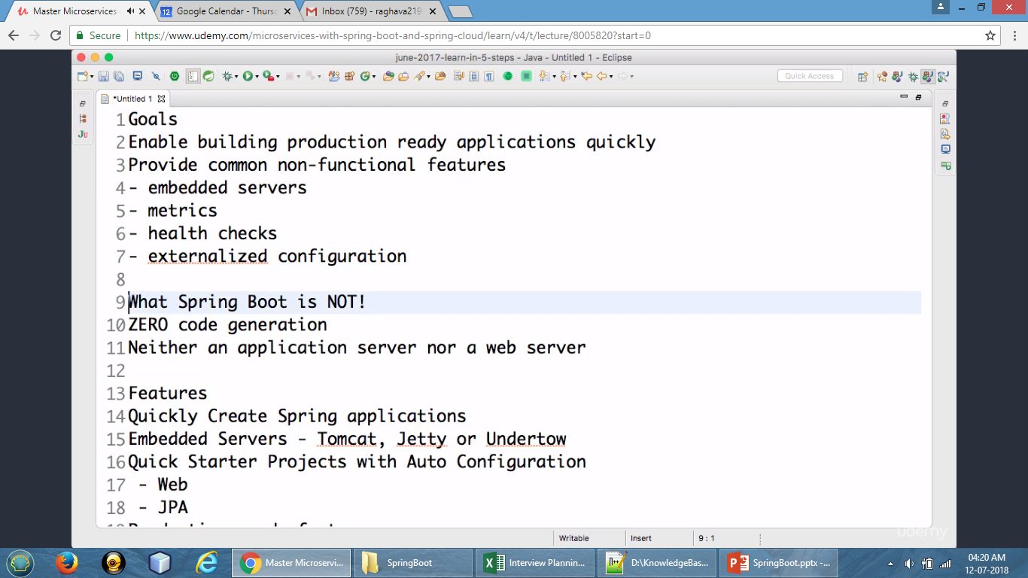
Goals

Slide 3
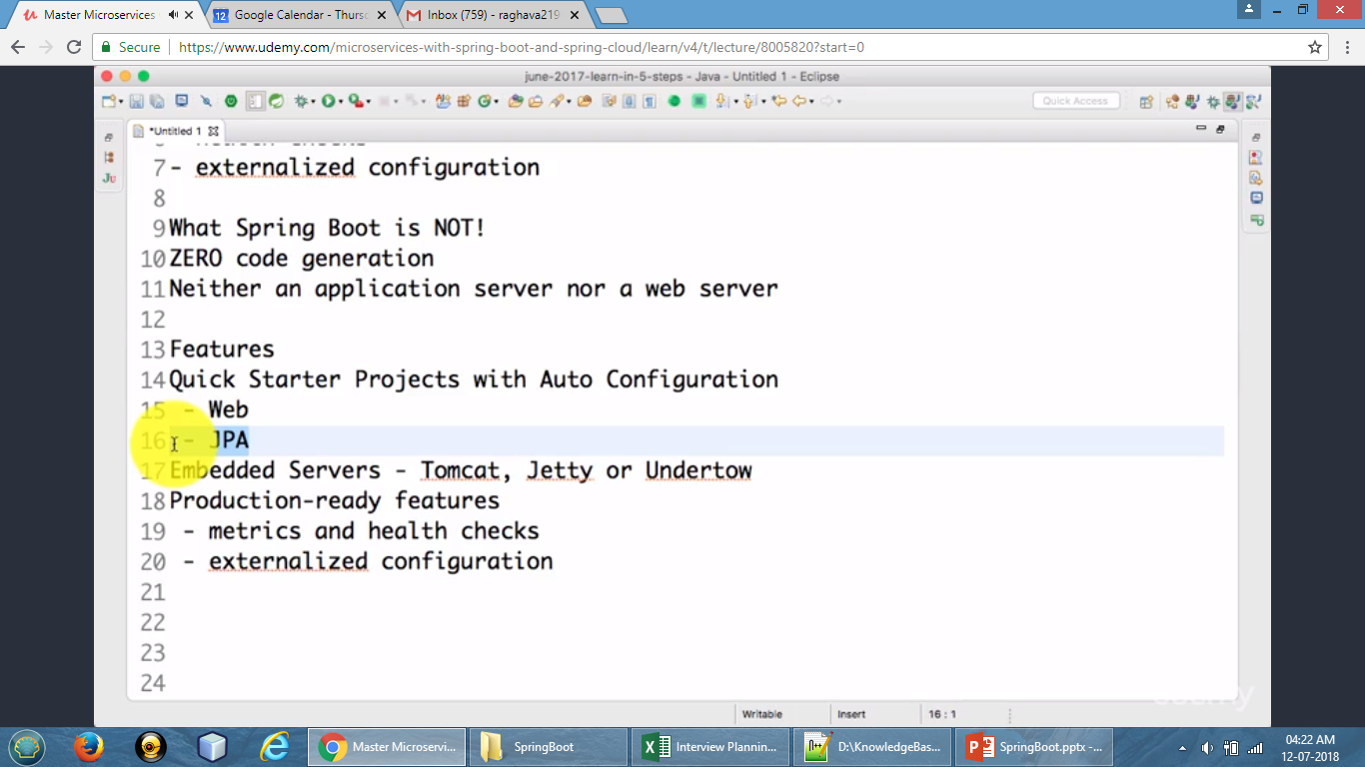
Notes:
Spring Actuator

Slide 4
https://github.com/in28minutes/SpringMvcStepByStep
https://start.spring.io/
www.springboottutorial.com

Slide 5
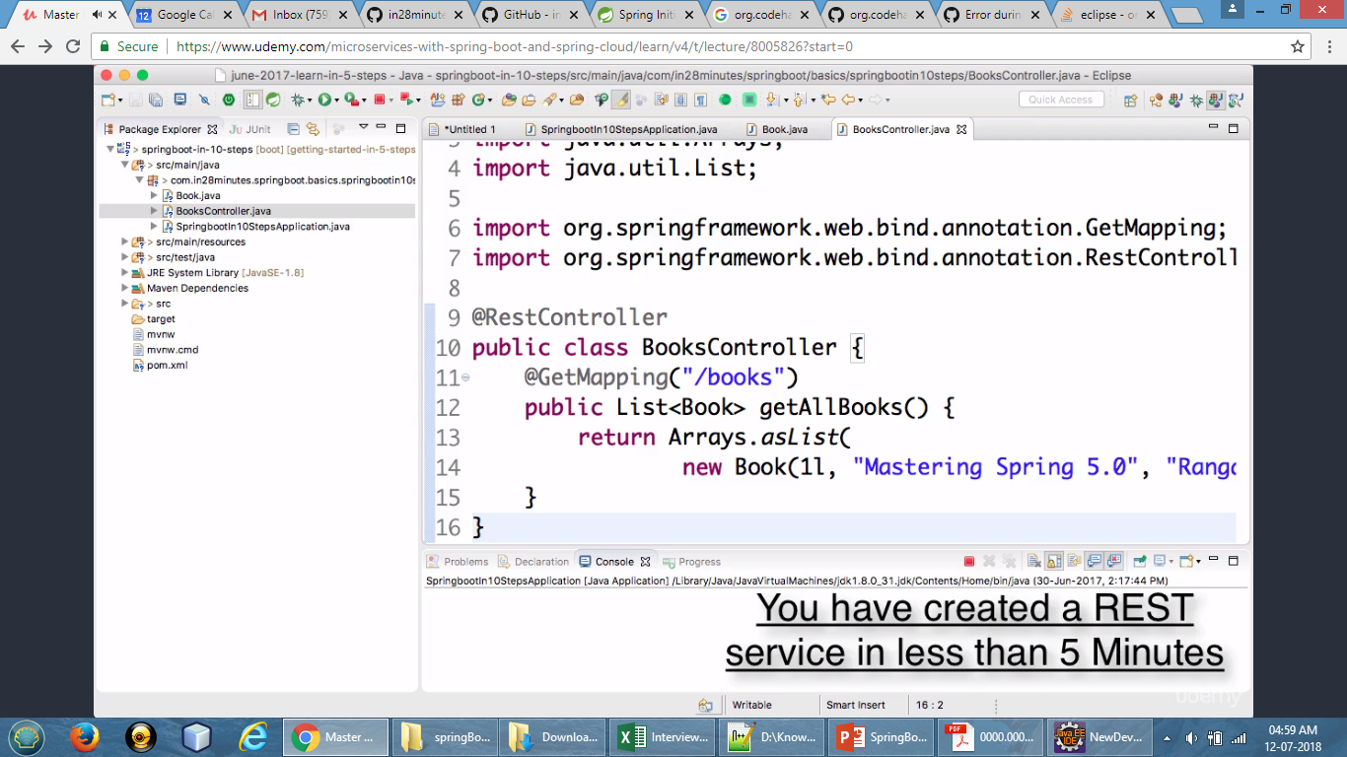

Slide 6
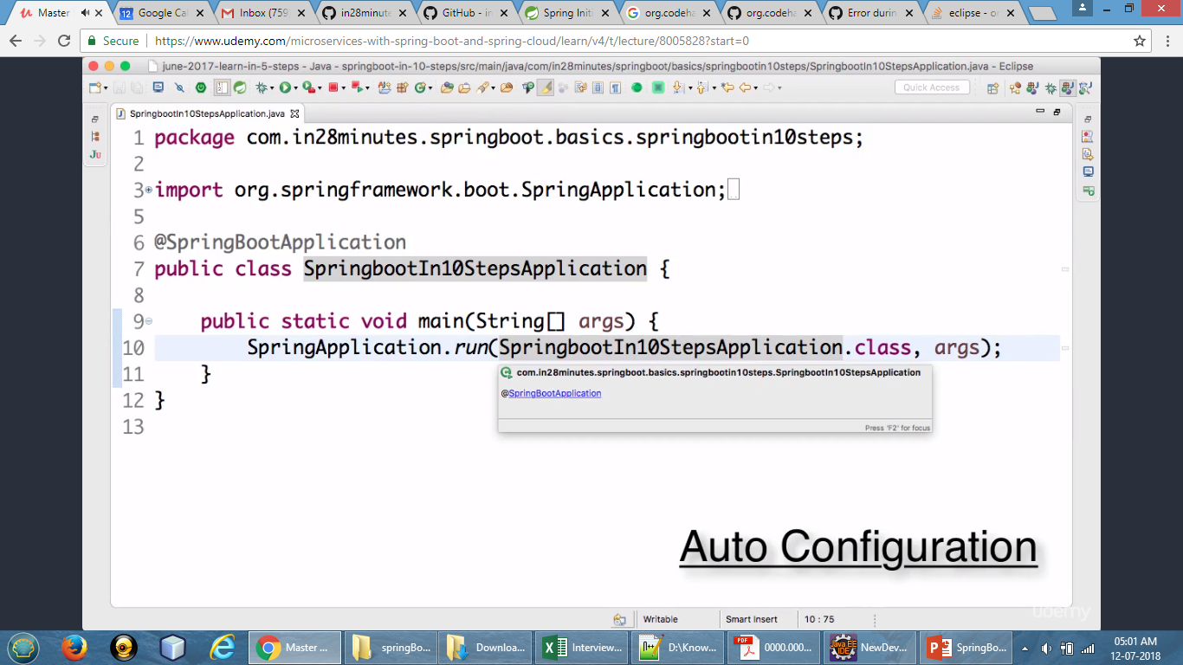

Slide 7
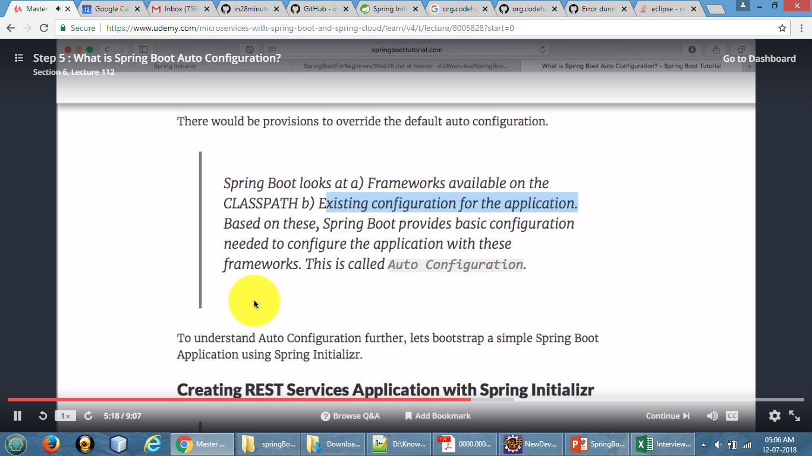
Notes:
www.springboottutorial.com

