Slide 1


Twilio Connector

Slide 2
Introduction
Twilio is a cloud communications platform which allows software developers to programmatically make and receive phone calls and send and receive text messages using its APIs.
More than 40,000 companies including Salesforce, Netflix, Coca-Cola Enterprise, Airbnb, Intuit, and Uber integrate Twilio in their products or business processes.
MuleSoft customers also use Twilio in various use cases.
For example, To send internal notifications based on the contact information in Salesforce.
To send personalized messages to its website visitors, and also to send promotional coupons to their users based on their locations.

Slide 3
Prerequisites
Twilio Account
Twilio Account SID, Auth Token, From Number, To Number, Body Message
Mule Anypoint Twilio Connector

Slide 4
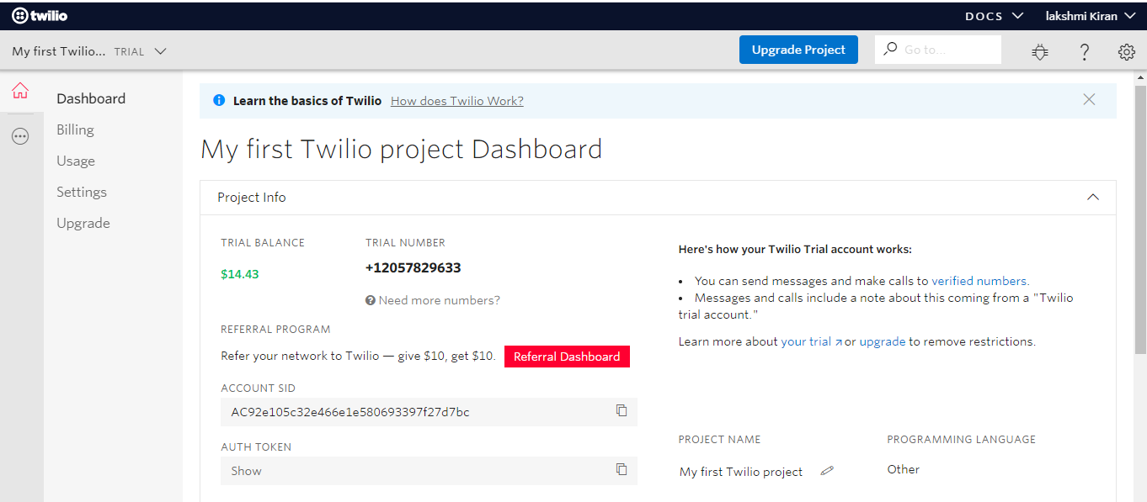
Dashboard

Slide 5
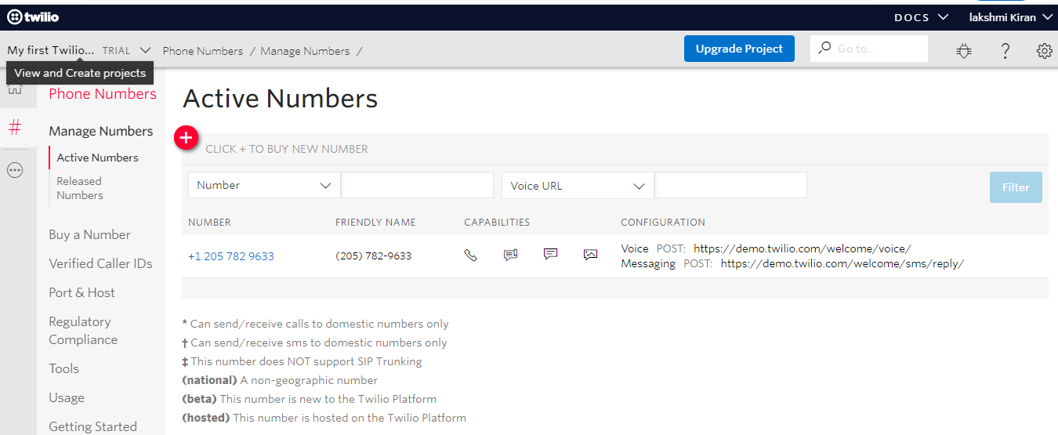
Active Numbers

Slide 6
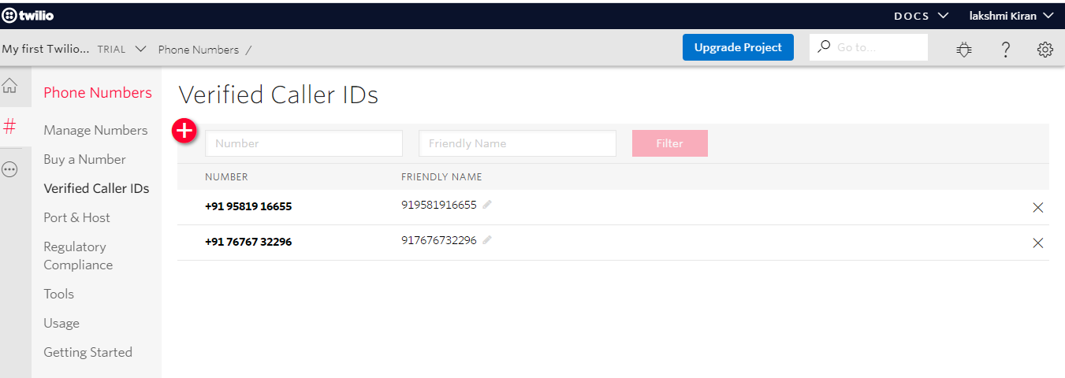
Verified Caller Ids

Slide 7
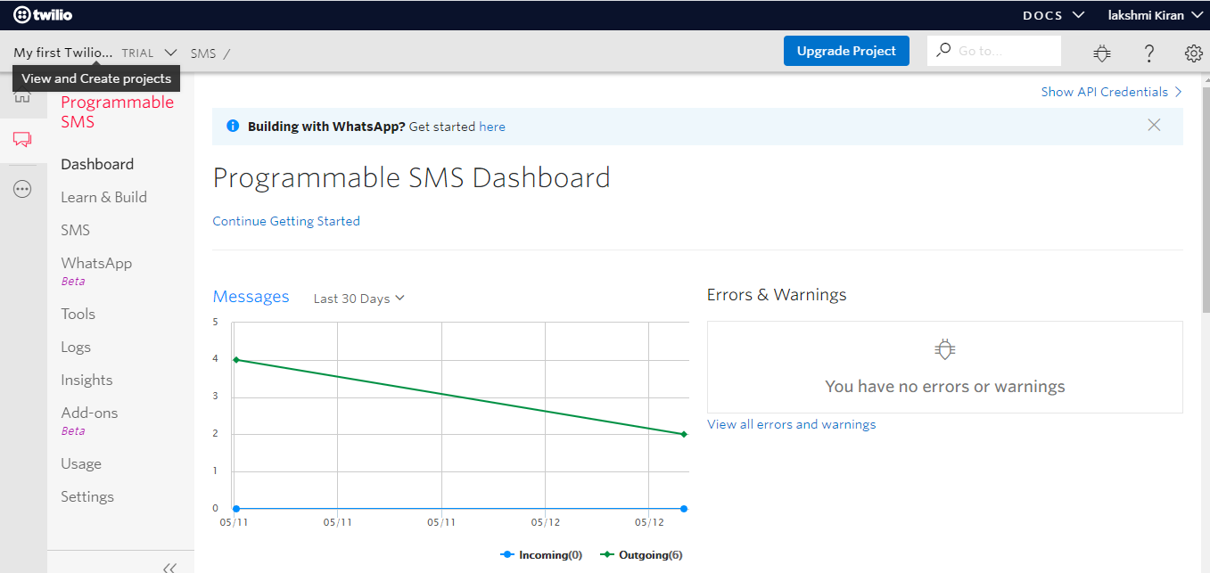
SMS Dash boards

Slide 8
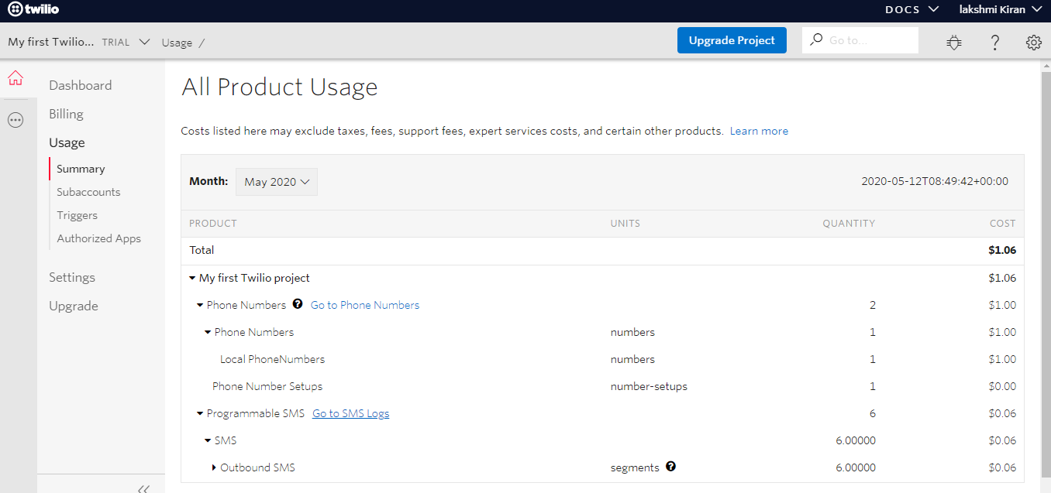
Product Usage

Slide 9
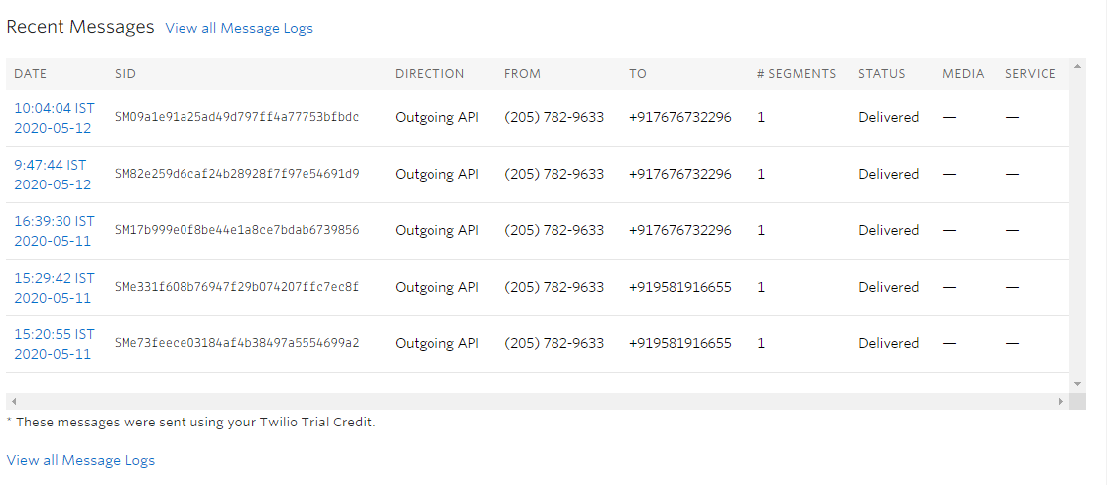
Message Logs

Slide 10
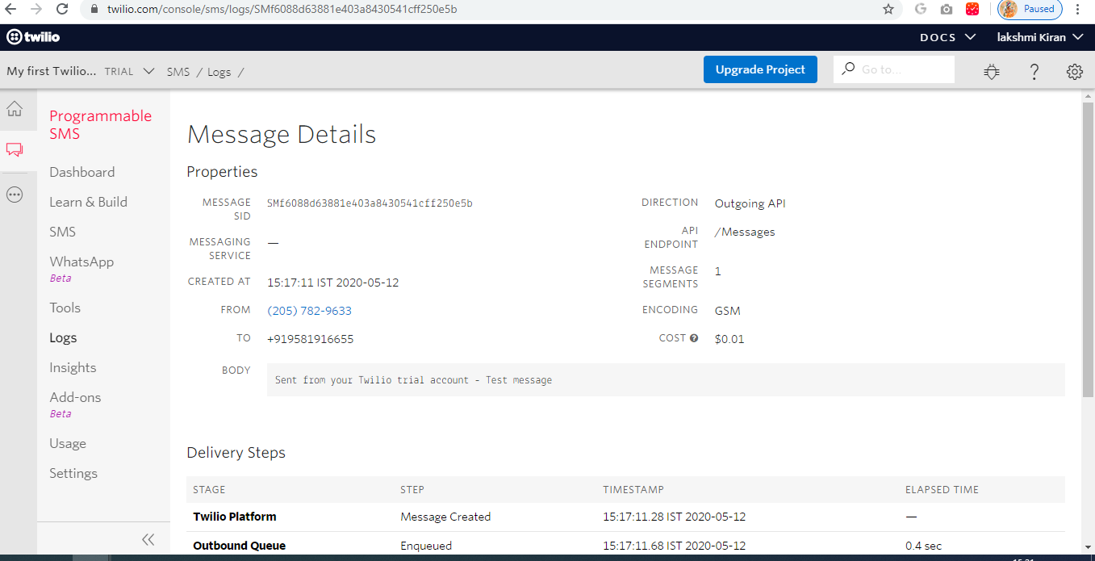
Message Details

Slide 11
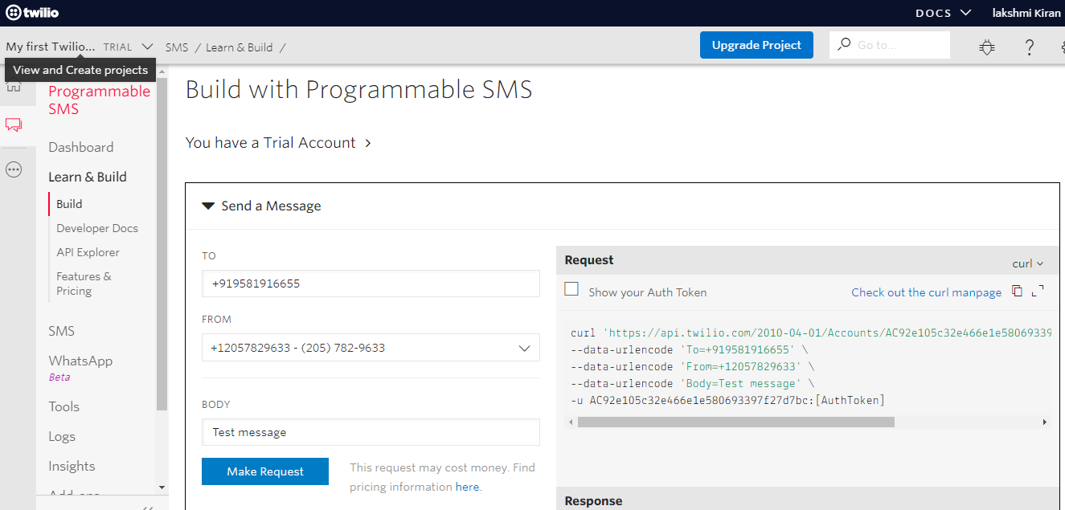
Make a Request from Twilio

Slide 12
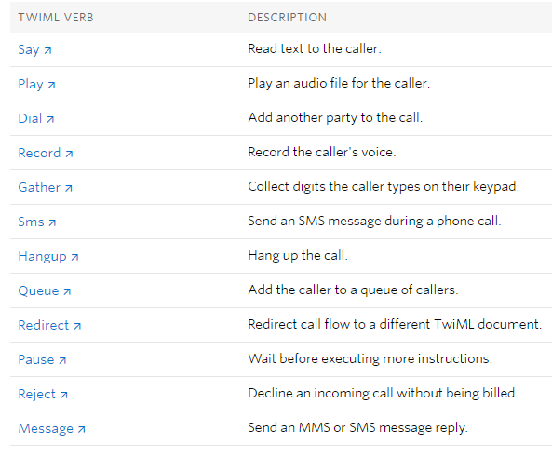
TwiML Overview

Slide 13
Thank You

