Slide 1
Extend communication between applications and services by creating connectivity between Twilio and third party SaaS applications, CRM solutions, and more with the Anypoint Twilio connector from MuleSoft.
The Anypoint Twilio connector offers instant Twilio API connectivity, providing users with a simple way to interface with the Twilio API. With API connectivity to the Twilio’s REST API, users can send SMS messages through Twilio. For example, the Twilio connector enables Zendesk connectivity, streamlining, and simplifying integration between the two commonly linked services.
Twilio is a cloud-based service that enables powerful communication between mobile devices, applications, services, and systems throughout the business to bridge the gap between conventional communication.
With Twilio, sales, marketing, and services teams can be more mobile and easily connect to customers at any time, through various mobile platforms. Moreover, with the MuleSoft Twilio connector, integration between Twilio and other popular business applications within the organization such as Salesforce, Marketo, Twitter and more - can be implemented quickly and easily from within the MuleSoft Anypoint™ Platform.

Slide 2
Top 3 Open Source Libraries
Frontline SMS
Jasmin Gateway
Kannel

Slide 3
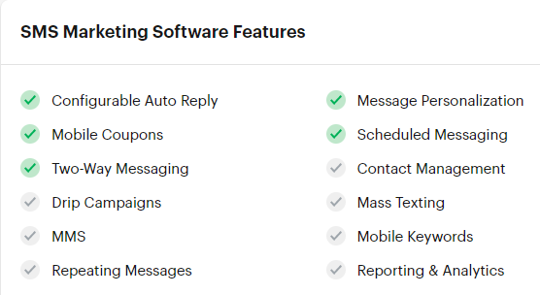
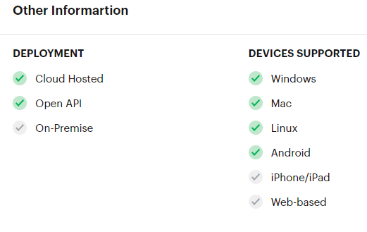
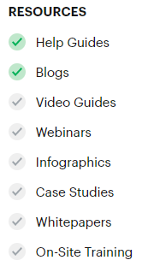
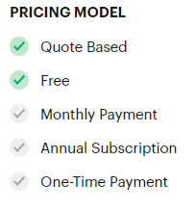
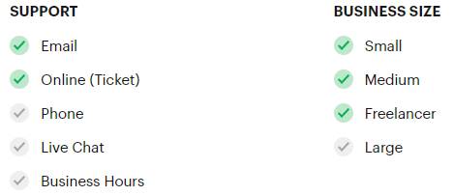
Frontline SMS: Frontline puts the power of SMS to use for smart, interactive, impactful communication with groups who need it. Whether it’s 100 people or 100,000, FrontlineSMS allows you to interact with the communities you want to reach – anywhere, any time.

Slide 4
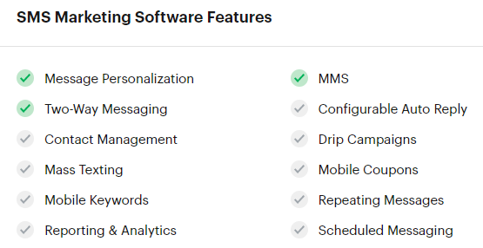
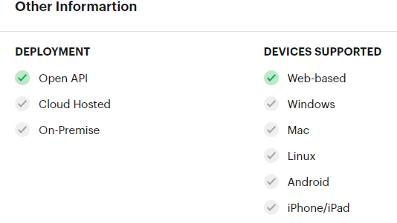
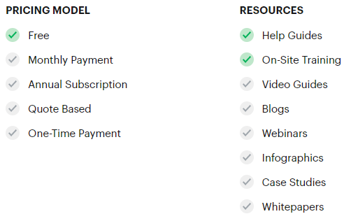
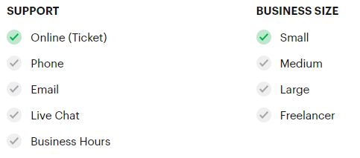
Jasmin Gateway: Jasmin is an open-source SMS Gateway with many enterprise-class features, Jasmin is built to be easily customized to meet the specific needs of messaging exchange growing business.

Slide 5
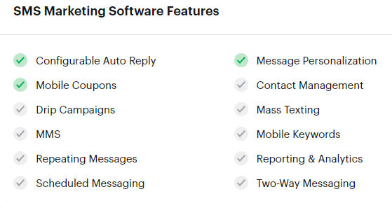
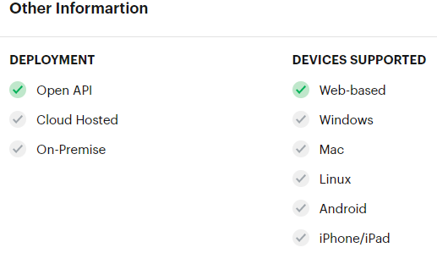
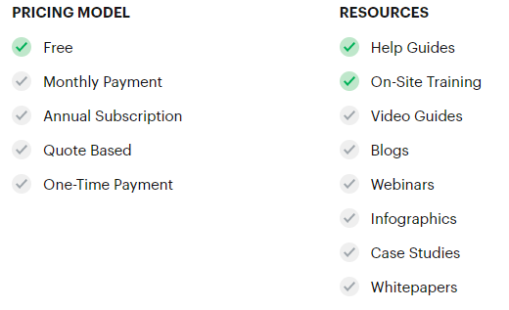
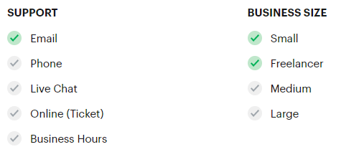
Kannel
Kannel is a compact and very powerful open source WAP and SMS gateway used widely across the globe both for serving trillions of short messages (SMS), WAP Push service indications and mobile internet connectivity.

Slide 6
Licensed Competitors
Bandwidth
Nexmo
Plivo

Slide 7
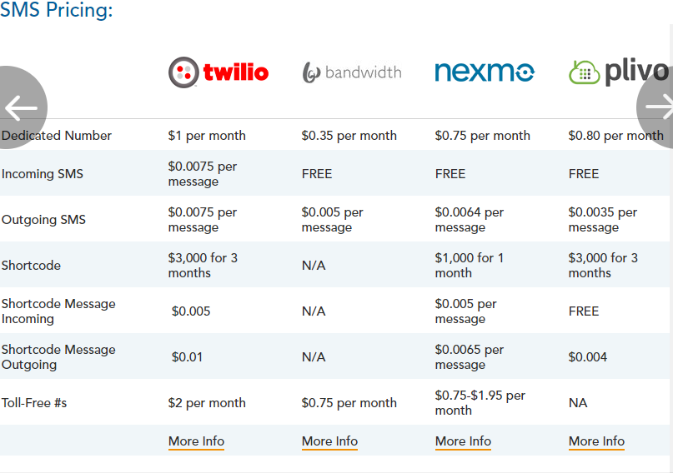
Notes:
Reference: https://getvoip.com/blog/2016/06/01/twilio-alternatives/

Slide 8
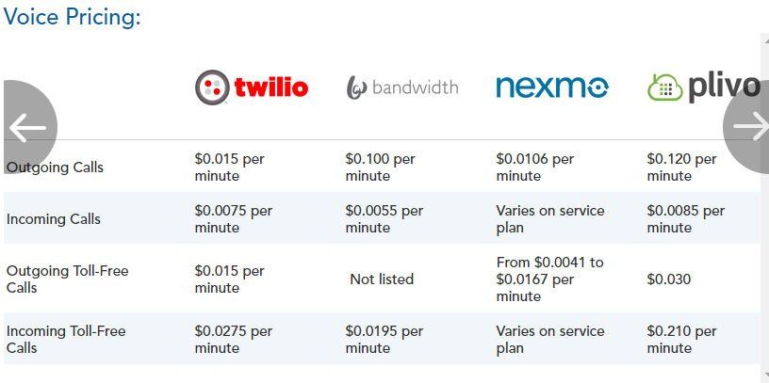
Notes:
Reference: https://getvoip.com/blog/2016/06/01/twilio-alternatives/

Slide 9
Twilio
Voice
API and SDKs to build calling capabilities within web and mobile apps. Connect to landlines, mobile devices or even WebRTC clients to make calls from apps or power multinational call centers.
Video
Real-time video infrastructure and SDKs to embed video collaboration and context-sharing into your web or mobile app. A global infrastructure that handles signaling, registration, and media relay.
Messaging
API and SDKs to send and receive SMS, MMS, and IP messages globally from your web and mobile app, and use intelligent delivery features to ensure messages get through.
Authentication
Two-factor authentication service to strengthen—and even replace—traditional username and password login for websites, SaaS products, and mobile apps.
Connectivity
Global carrier connectivity services made simple and available instantly with no upfront contracts. Local and toll-free phone numbers around the globe along with SIP connectivity made available as APIs.
Monitoring and Support
Console to see every operational detail of your Twilio accounts and applications. Expert help when you need it.

Slide 10
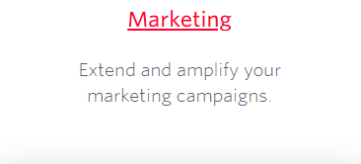
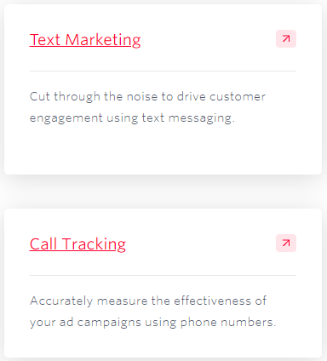
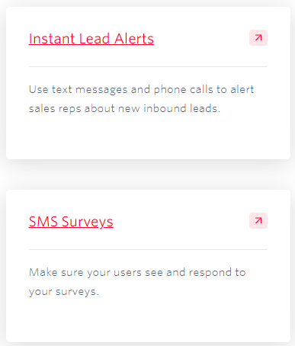
Twilio solutions

Slide 11
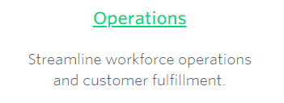
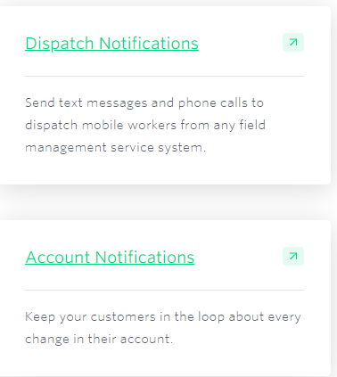
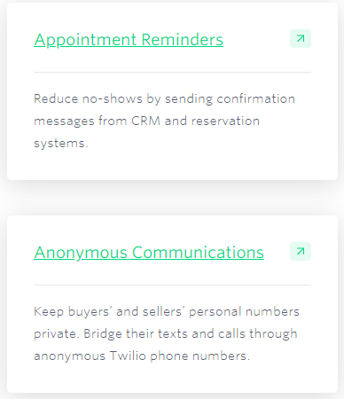

Slide 12
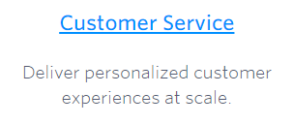
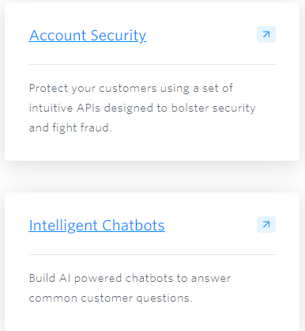
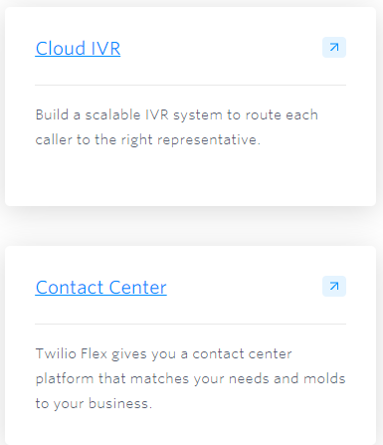
Notes:
Reference: https://www.twilio.com/solutions

Slide 13
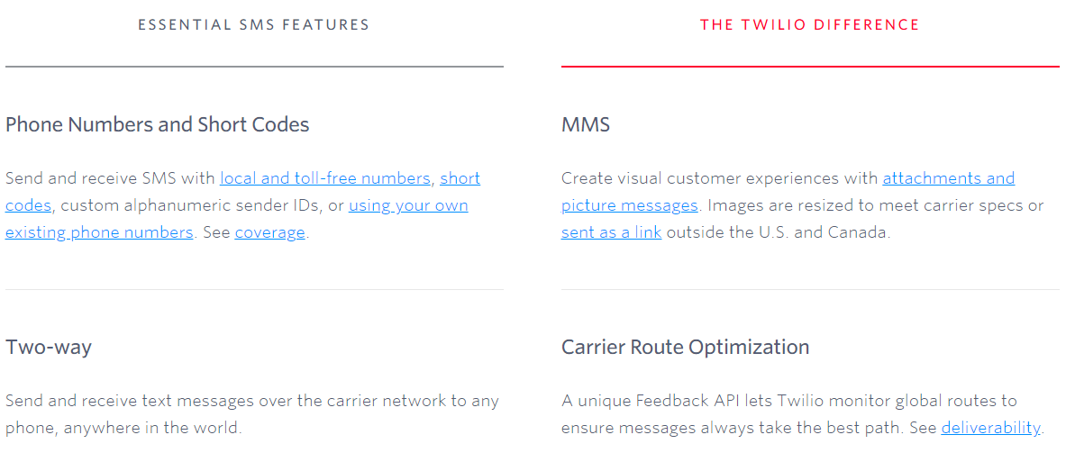
IMPROVE DELIVERY
Notes:
Reference: https://www.twilio.com/sms/features

Slide 14
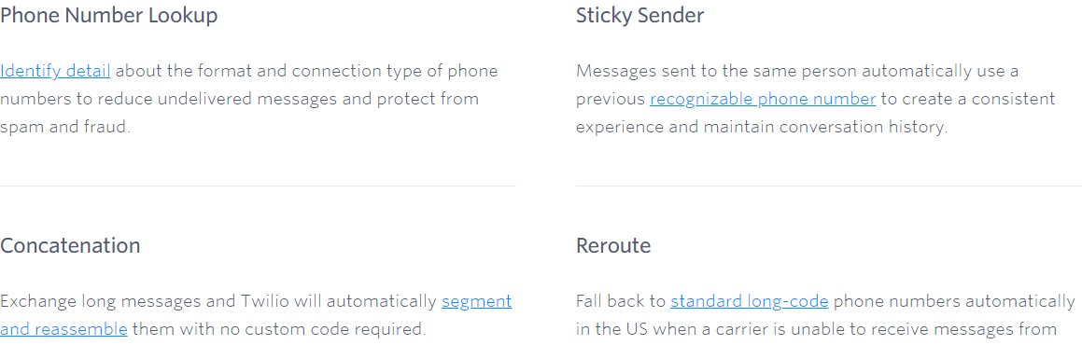
Notes:
Reference: https://www.twilio.com/sms/features

Slide 15
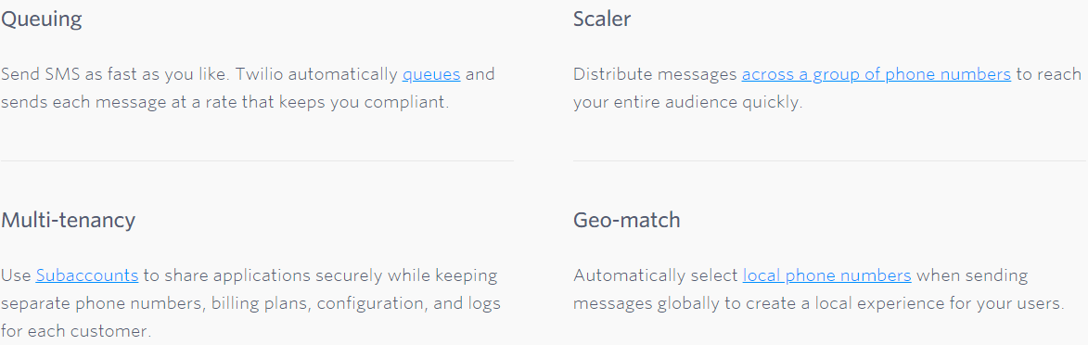
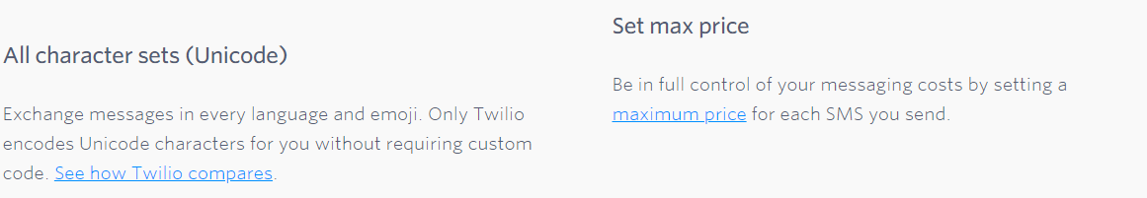
Notes:
Reference: https://www.twilio.com/sms/features

Slide 16
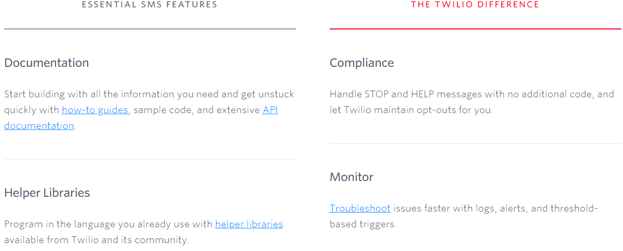
Notes:
Reference: https://www.twilio.com/sms/features

Slide 17
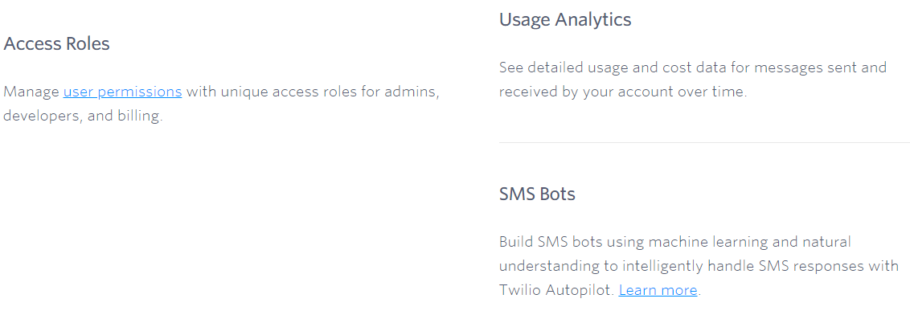
Notes:
Reference: https://www.twilio.com/sms/features

Slide 18
Business Use case
Take an example of Logistics domain.
A customer want to send his cargo from one place to another place through water ways.
Source: Shanghai
Destination: Antwerp
Here in this business it involves the customer and the service provider has to be notifies where the cargo is located and when the goods will arrive.
To track this services provider has their own systems to track, but for the customer we need to notify this by using the email notifications or to his contact number.
What information customer needs.
PTD: planned time of Departure ETD: Estimated time of Departure ATD: Actual Time of Departure
PTA: Planned Time of arrival ETA: Estimated Time of arrival ATA: Actual Time of arrival
What service provider needs:
current location details, What operations completed
Transport service operations: loading, discharge
Terminal service operations: Documents handling, insurance.

Slide 19
Who are using
More than 40k companies using Twilio.
Salesforce, Netflix, Coca-Cola Enterprise, Airbnb, Intuit, Uber etc.,
https://www.featuredcustomers.com/vendor/twilio/customers

