Slide 1
Concurrency
A star feature of Go due to ease of use and data sharing model
Uses communicating sequential process (CSP)
Threads typically share memory
Deadlocks/Race conditions can result without diligence
Hard to troubleshoot
Etc.
Processes do not share memory
Communication between processes is how data is shared
Ex: Think about an event based architecture using a queue topic
Two exes are listening to a topic and get their own event (message)
Now imagine this within a single exe
Pretty close conceptually to what Go does

Slide 2
Concurrency
Goroutines – A light-weight process allowing functions to execute in parallel/asynchronously
Easily spin up thousands in a single program

Slide 3
Gorountine Demo

Slide 4
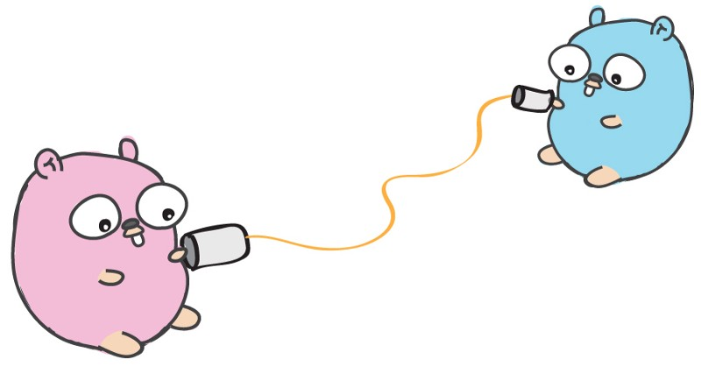
Concurrency
Channels – Mechanism by which goroutines communicate/share data
Only one goroutine has access to the value at a time
Races cannot occur as a result
Buffered and Unbuffered types
Simple Mantra
“Do not communicate by sharing memory; instead, share memory by communicating.” – Golangbootcamp.com

Slide 5
Channel Demo

Slide 6
Concurrency
Select – Used to wait on multiple channel operations
Blocks until a case statement can be ran
If multiple cases are ready it selects one at random
Default case runs if no other case is runnable/ready to run

Slide 7
Select Demo

Slide 8
https://en.wikipedia.org/wiki/Communicating_sequential_processes
https://medium.com/@trevor4e/learning-gos-concurrency-through-illustrations-8c4aff603b3
http://www.golangbootcamp.com/book/concurrency
http://divan.github.io/posts/go_concurrency_visualize/

