Slide 1
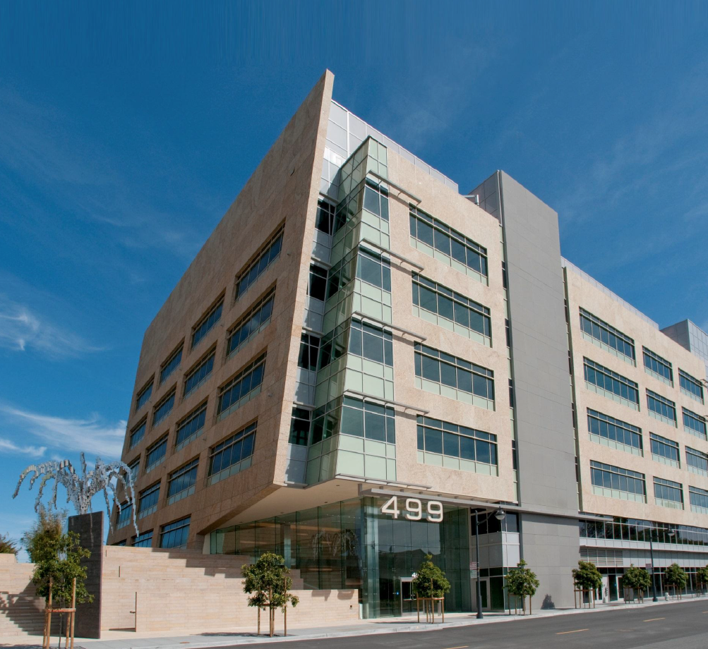
What is the Chan-Zuckerberg Biohub?
A new independent non-profit bio-medical research institute in San Francisco
Support: $600 million over 10 years
Collaborative center affiliated with UCSF, Stanford and UC-Berkeley
Notes:
The Biohub will focus on understanding underlying mechanisms of disease and developing new technologies which will lead to actionable diagnostics and effective therapies.

