Slide 1
TECHNICAL TEST SUBMISSION
Greenhouse IoT
Backend
HTTP
sensor input
MQTT
Reliable sensor ingestion and acknowledged device control through one production-oriented backend.
device command
SQL
FastAPI
PostgreSQL
Mosquitto
durable readings
Docker Compose + Pytest
September 2026
Notes:
Sources: README.md and API_CONTRACT.md. This opening frames the implementation problem and selected stack.

Slide 2
01
Three behaviors define success
The scope stays deliberately small and reviewable.
01
POST /sensor-data
Validate the payload, preserve recorded_at, and persist the reading in PostgreSQL.
02
POST /device-control
Accept device_id plus ON/OFF and publish a structured command through MQTT QoS 1.
03
GET /status
Probe the backend, SELECT 1 against PostgreSQL, and report the live MQTT connection state.
Deliverables
Source code · README · Design explanation · Presentation PDF
GREENHOUSE IOT BACKEND / 02
Notes:
Sources: the provided technical-test requirements, README.md, and API_CONTRACT.md.

Slide 3
02
One backend, two transport responsibilities
HTTP handles sensor ingestion. MQTT handles device control.
SQLAlchemy
PostgreSQL
HTTP JSON
FastAPI
IoT / Client
validation · services
repositories · lifecycle
Mosquitto
Device
MQTT QoS 1
Requirement interpretation
The implementation contract explicitly makes /sensor-data an HTTP endpoint, while MQTT is reserved for outbound device commands.
GREENHOUSE IOT BACKEND / 03
Notes:
Sources: README.md architecture section and DESIGN_DECISIONS.md. All architecture nodes and connectors are editable slide objects.

Slide 4
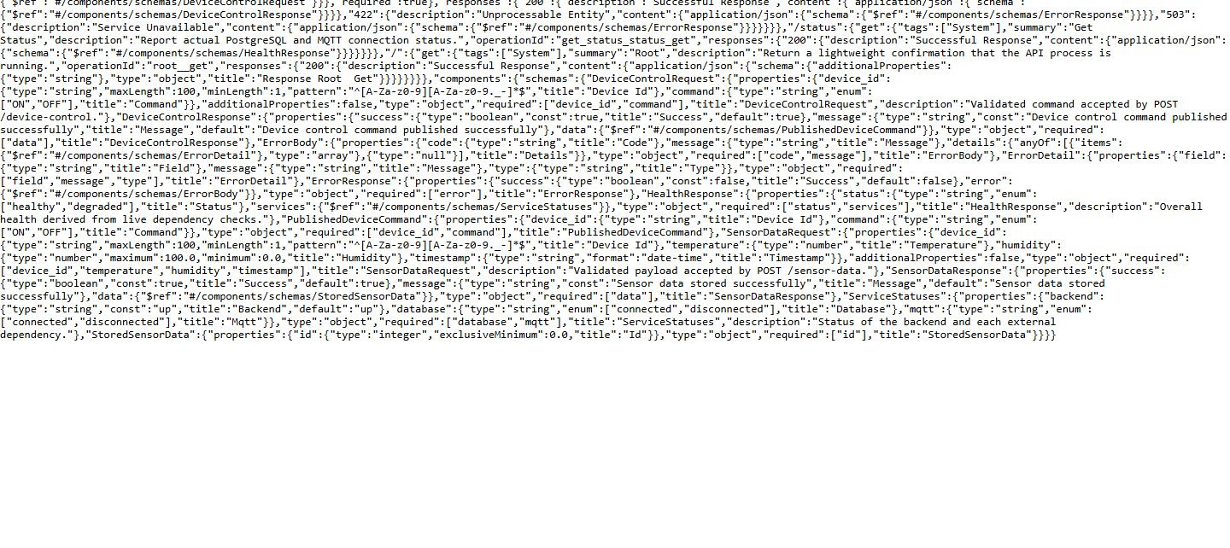
03
The contract is explicit before implementation
OpenAPI reflects the same request, response, and validation rules.
POST
/sensor-data
Live /openapi.json
Validate and persist a reading
POST
/device-control
Validate and publish a command
GET
/status
Probe live dependencies
sensor_readings
id
device_id
temperature
humidity
recorded_at
created_at
PK
text
numeric
0–100
sensor time
backend time
Separating recorded_at from created_at preserves network-delay context.
GREENHOUSE IOT BACKEND / 04
Notes:
Sources: live FastAPI /openapi.json, API_CONTRACT.md, database/models.py, and the Alembic migration.

Slide 5
04
Persistent MQTT keeps commands reliable
The HTTP request returns only after publish acceptance is confirmed.
HTTP request
DeviceService
MQTT client
Mosquitto
Device
device_id + ON/OFF
builds command
lifecycle-owned
broker ACK
subscribed topic
Topic
Why QoS 1
greenhouse/control/{device_id}
Broker acknowledgement matters more for control commands than for best-effort telemetry. QoS 1 gives at-least-once delivery, so devices should treat commands idempotently.
Payload
{ "device_id": "fan-001", "command": "ON",
"timestamp": "2026-09-19T10:35:00Z" }
GREENHOUSE IOT BACKEND / 05
Notes:
Sources: mqtt/client.py, services/device_service.py, schemas/device_sch.py, and DESIGN_DECISIONS.md.

Slide 6
05
Health is derived from real dependency checks
Failures are visible without exposing credentials or stack traces.
HEALTHY
Consistent error envelope
backend up
database connected
{
"success": false,
"error": {
"code": "MQTT_UNAVAILABLE",
"message": "MQTT broker is unavailable"
}
}
mqtt connected
DEGRADED
Any failed DB query or disconnected MQTT client changes the aggregate status.
Malformed JSON, validation failures, database outages, and broker outages follow the same external structure. Internal detail stays in logs.
SELECT 1
+ live client state
GREENHOUSE IOT BACKEND / 06
Notes:
Sources: services/health_service.py, core/exceptions.py, schemas/error_sch.py, and API_CONTRACT.md.

Slide 7
06
Testing proves the critical paths
Automated tests are paired with manual reviewer-style verification.
21
MQTT subscriber evidence
/ 21 tests passing
$ mosquitto_sub -t greenhouse/control/# -v
greenhouse/control/fan-001
{"device_id":"fan-001","command":"ON",...}
Sensor validation · command validation · MQTT failure · healthy/degraded status
Database persistence evidence
id
device_id
temperature
humidity
stored through
2
reviewer-sensor
29.4
62.8
POST /sensor-data
Manual integration run retained separate recorded_at and created_at values.
GREENHOUSE IOT BACKEND / 07
Notes:
Sources: local pytest output and the manual Docker Compose integration run documented in README.md. Database values shown were persisted during the reviewer-style flow.

Slide 8
07
Design choices keep the submission focused
Production expansion is possible without hiding today’s failure modes.
Current decisions
Future improvements
FastAPI
Security
Typed validation and automatic OpenAPI with a small code surface.
TLS, authentication, secret management, and per-device authorization.
PostgreSQL + Alembic
Observability
Durable relational storage with explicit schema evolution.
Metrics, tracing, structured log aggregation, and alert thresholds.
Persistent MQTT + QoS 1
Scale
Lower request overhead and broker acknowledgement for commands.
Connection tuning, idempotency keys, and horizontal backend replicas.
Dependency-aware health
Telemetry evolution
Partial failure is surfaced as degraded instead of masked.
Add inbound MQTT consumption only when product requirements demand it.
Submission outcome: one command starts the stack, the API contract stays stable, and failures remain observable.
GREENHOUSE IOT BACKEND / 08
Notes:
Sources: DESIGN_DECISIONS.md and README.md. Future improvements are explicitly out of the current test scope.

