Slide 1

TECHNICAL TEST SUBMISSION BADARUZZAMAN NAFIZ
Greenhouse IoT
Backend
Reliable sensor ingestion and acknowledged device control through one production-oriented backend.
FastAPI
PostgreSQL
Mosquitto
Docker Compose + Pytest

Slide 2

Three behaviors define success
The scope stays deliberately small and reviewable.
1
POST /sensor-data
Validate the payload, preserve recorded_at, and persist the reading in PostgreSQL.
2
POST /device-control
Accept device_id plus ON/OFF and publish a structured command through MQTT QoS 1.
3
GET /status
Probe the backend, SELECT 1 against PostgreSQL, and report the live MQTT connection state.
Deliverables
Source code · README · Design explanation · Presentation PDF

Slide 3

One backend,
IOT / Clients
two transport
responsibilities
HTTP JSON
FastAPI
SQLAlchemy
MQTT QoS 1
PostgreSQL
Mosquitto
Requirement interpretation
The implementation contract explicitly makes /sensor-data an HTTP endpoint, while MQTT is reserved for outbound device commands.
Devices

Slide 4
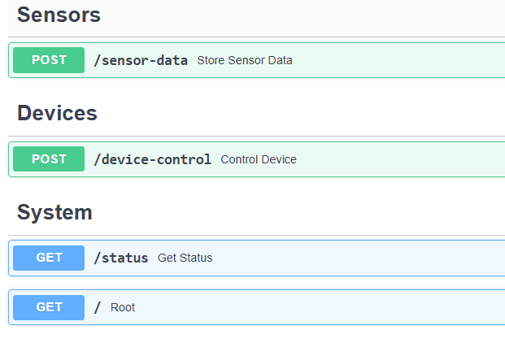
The contract is explicit before implementation
1
POST /sensor-data
Validate and persist a reading
2
POST /device-control
sensor_readings | sensor_readings | sensor_readings | sensor_readings | sensor_readings | sensor_readings
id | device_id | created_at | temprature | recorded_at | humidity
PK | text | backend time | numeric | sensor time | 0-100
Validate and publish a command
3
GET /status
Probe live dependencies

Slide 5

Persistent MQTT
keeps commands reliable
The HTTP request returns only after publish acceptance is confirmed.
HTTP request
HTTP request
HTTP request
HTTP request
HTTP request
HTTP request
DeviceService
MQTT client
Mosquitto
Device
device_id + ON/OFF
builds command
lifecycle-owned
broker ACK
subscribed topic
Topic
Why QoS 1
greenhouse/control/{device_id}
Broker acknowledgement matters more for control commands than for best-effort telemetry. QoS 1 gives at-least-once delivery, so devices should treat commands idempotently.
Payload
{ "device_id": "fan-001", "command": "ON",
"timestamp": "2026-09-19T10:35:00Z" }

Slide 6

Health is derived from real dependency checks
Failures are visible without exposing credentials or stack traces.
Healthy
HTTP request
Consistent error envelope
Backend - Up
Database - Connected
MQTT - Conncected
{
"success": false,
"error": {
"code": "MQTT_UNAVAILABLE",
"message": "MQTT broker is unavailable"
}
}
Degraded
Any failed DB query or disconnected MQTT client changes the aggregate status.
Malformed JSON, validation failures, database outages, and broker outages follow the same external structure. Internal detail stays in logs.

Slide 7

Testing proves
the critical paths
Automated tests are paired with manual reviewer-style verification.
21
MQTT subscriber evidence
/ 21 tests passing
$ mosquitto_sub -t greenhouse/control/# -v
greenhouse/control/fan-001
{"device_id":"fan-001","command":"ON",...}
Sensor validation · command validation · MQTT failure · healthy/degraded status
Database persistence evidence | Database persistence evidence | Database persistence evidence | Database persistence evidence | Database persistence evidence
id | humidity | stored through | temperature | device_id
2 | 62.8 | POST /sensor-data | 29.4 | reviewer-sensor
Manual integration run retained separate recorded_at and created_at values.

Slide 8
Design choices keep the submission focused
Production expansion is possible without hiding today’s failure modes.
Current decisions
Future improvements
FastAPI
Security
Typed validation and automatic OpenAPI with a small code surface.
TLS, authentication, secret management, and per-device authorization.
PostgreSQL + Alembic
Observability
Durable relational storage with explicit schema evolution.
Metrics, tracing, structured log aggregation, and alert thresholds.
Persistent MQTT + QoS 1
Lower request overhead and broker acknowledgement for commands.
Scale
Connection tuning, idempotency keys, and horizontal backend replicas.
Dependency-aware health
Partial failure is surfaced as degraded instead of masked.
Telemetry evolution
Add inbound MQTT consumption only when product requirements demand it.

