Slide 1
Deep Gen/3D Survey&try
人工智能 2501 许哲诚

Slide 2
关于Diffusion
DDPM
Score-based
CFG(Classifier-Free Guidence)
GLIDE
DALL-E2
SDE/ODE
Stable Diffusion
SD1.5
SDXL
SD3.0
DiT
Flow

Slide 3
关于CLIP/Multimodal
CLIPasso
CLIP4clip
pointCLIP
depthCLIP
ViLT

Slide 4
Agent/Toolkits
Codex(cli)
GPT plus
ubuntu22.04
Nvidia RTX5070
Meshlab
Blender

Slide 5
有关3D&Graphics
Point Cloud/Mesh/Voxel/SDF/Neural Fields/Camera Geometry
Deep-learning-freindly 3D Representation Learning
COLMAP/SfM(Structure from Motion)/MVS(Multi-View Stereo)
NeRF-Nerfstudio
3DGS
Games101
Games102
Pytorch3D/Open3D

Slide 6
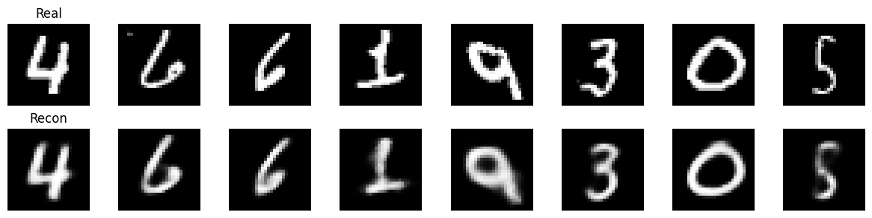
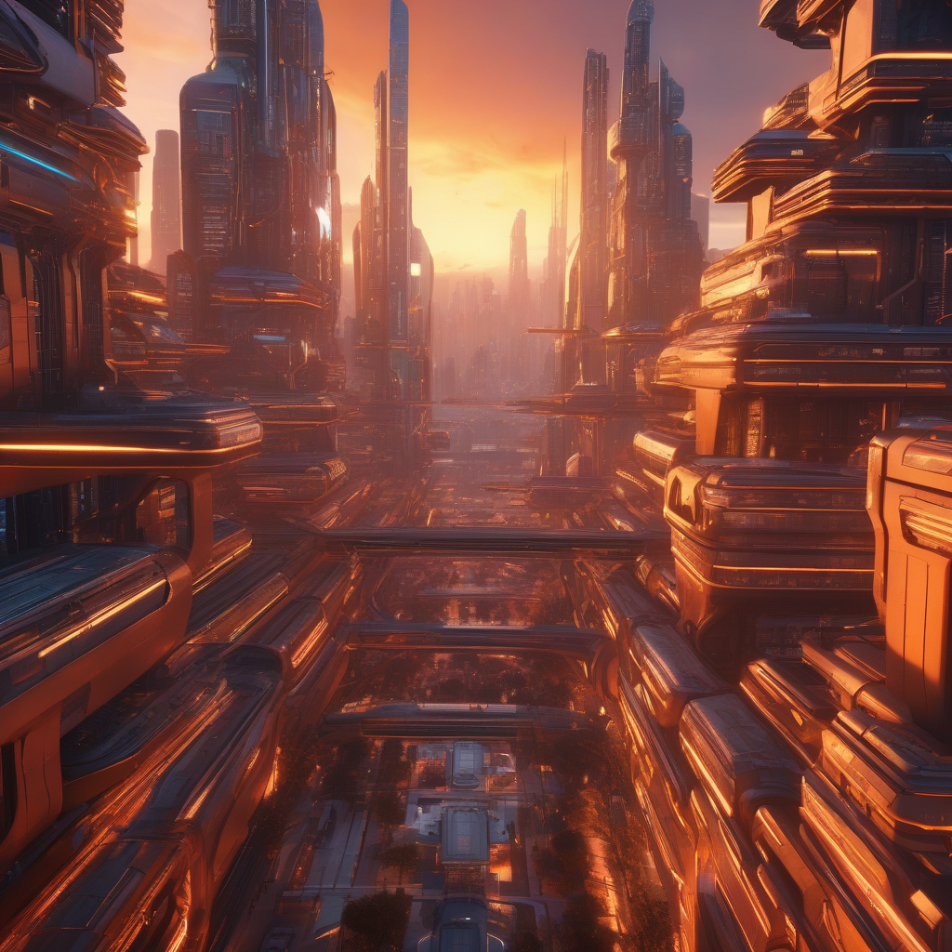
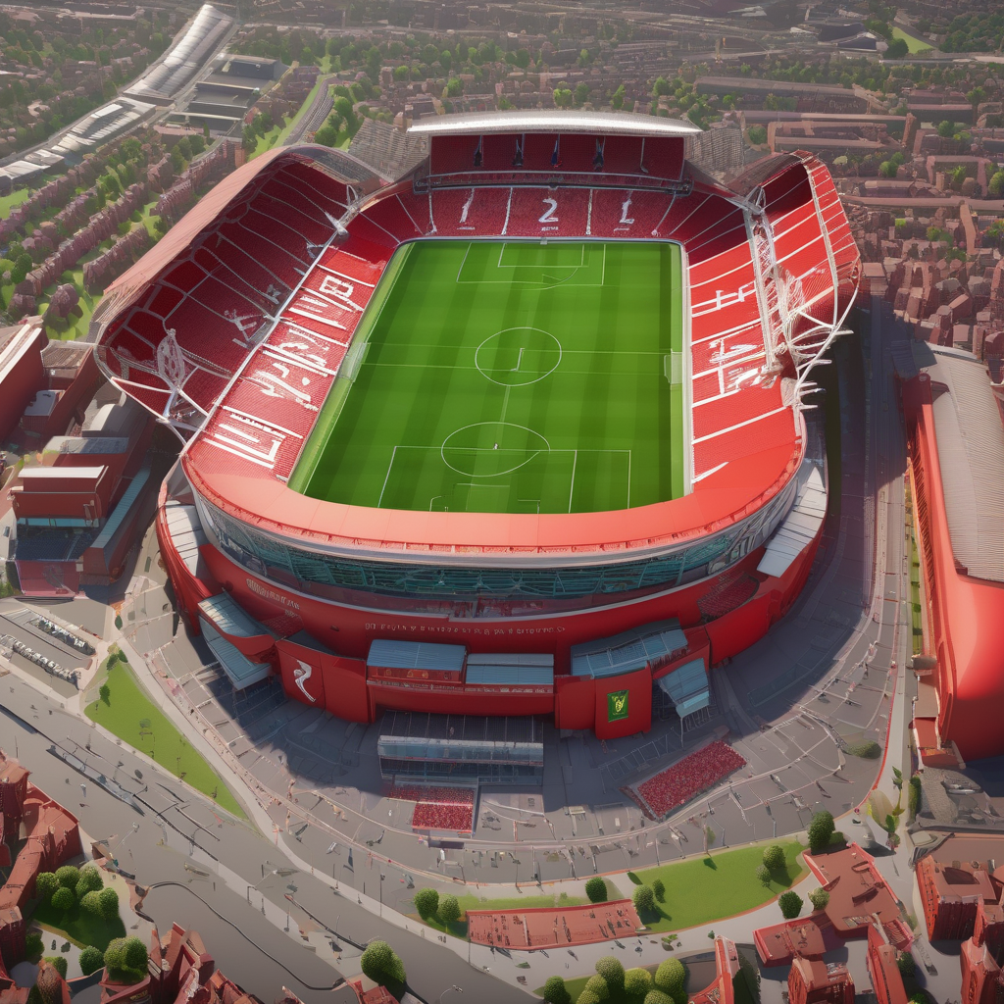
My Attempts
VAE/Diffusion from scratch for Mnist
Huggingface SDXL pipeline

Slide 7
More?
Math
Graphics—Games Series Courses(Optional)
Deep Generation Model
More paper reading accompanies the study of the above basics.

Slide 8
谢谢大家

