Slide 1
Mini-Project: Heart
Attack Risk
Team 2 ACDA1
Names: Avanish, Naquiya, Richard

Slide 2
01
31.4% of all deaths in Singapore → Cardiovascular Diseases (27,000 in 2022).
78,000 out of 614,000 elderly are living alone.

Slide 3
Problem Statement
To what extent do various physical attributes affect the target variable HeartDisease?

Slide 4
Dataset
(918 entries, 12 attributes)
01
02
Numerical Attributes
Categorical Attributes
Age, RestingBP, Cholesterol, MaxHR and Oldspeak
Sex, ChestPainType, FastingBS, RestingECG, ExerciseAngina, ST_Slope and HeartDisease

Slide 5
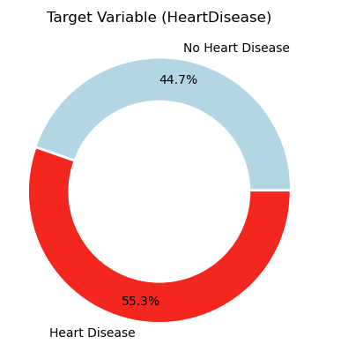
Target Variable

Slide 6
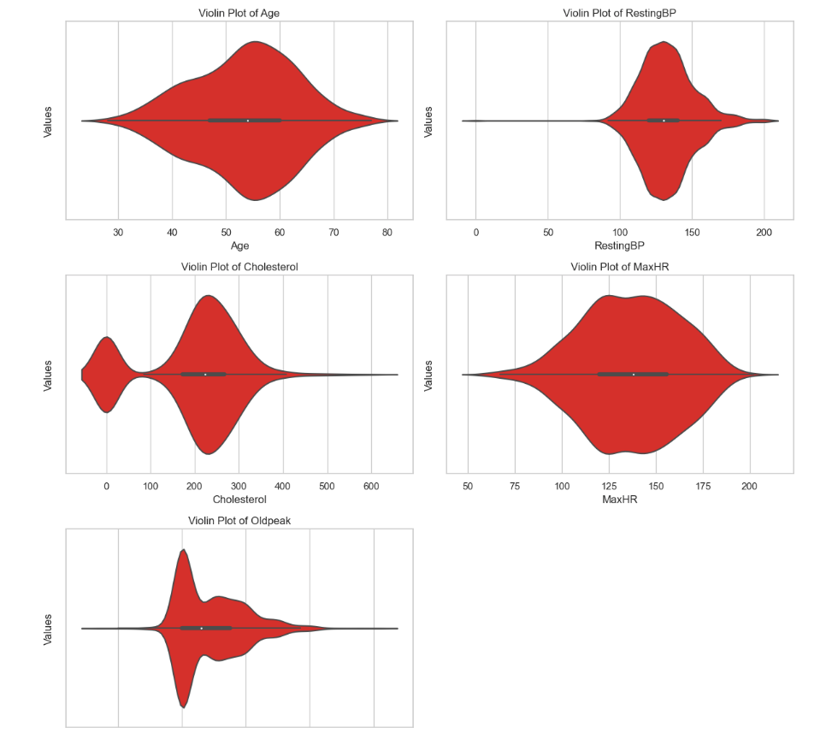
Numerical Attributes

Slide 7
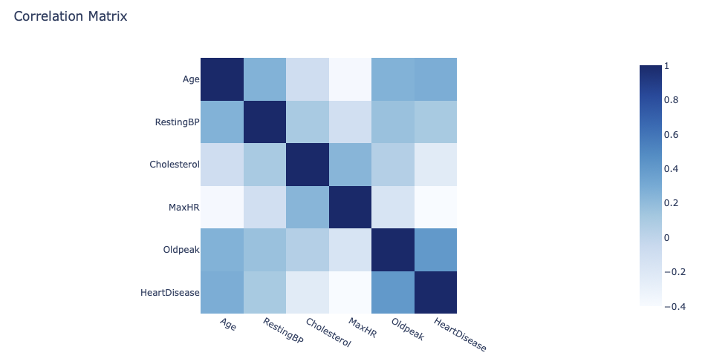
Correlation Matrix

Slide 8
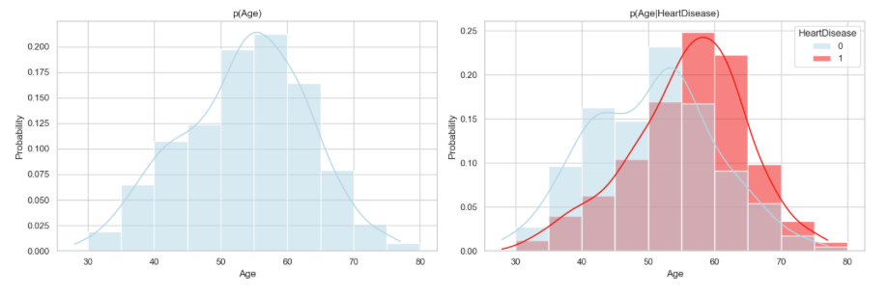
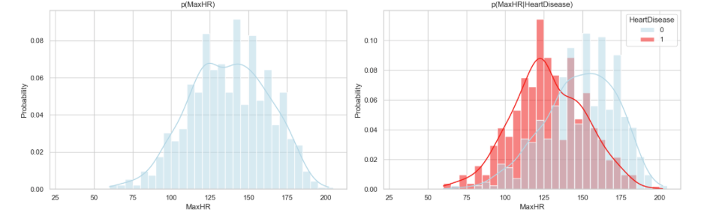
Age
MaxHR

Slide 9
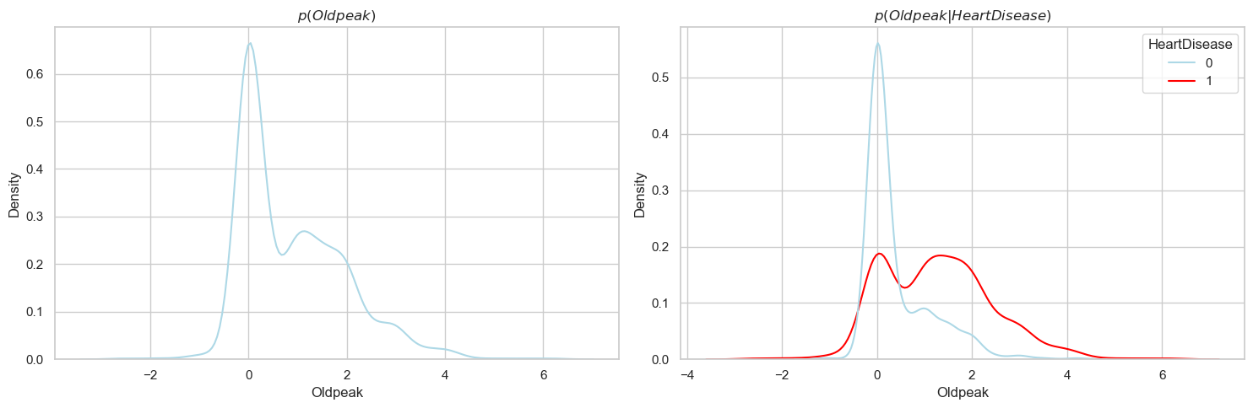
OldPeak

Slide 10
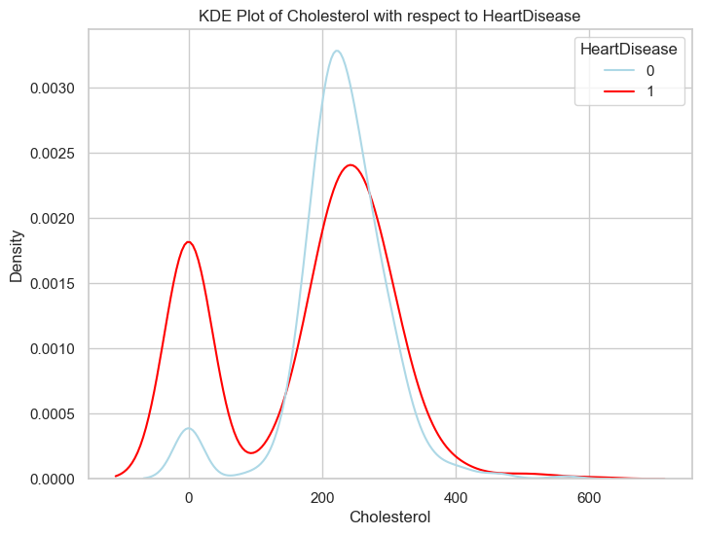
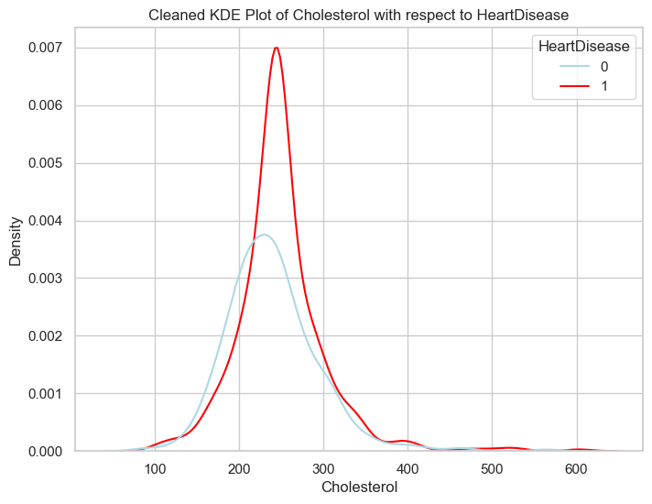
Cholesterol

Slide 11
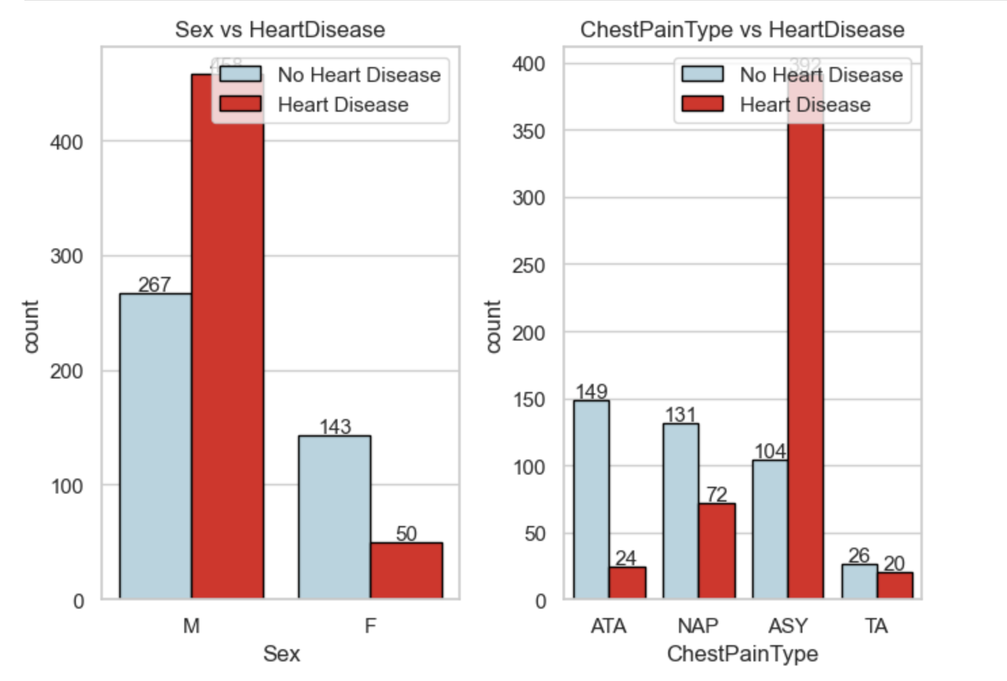
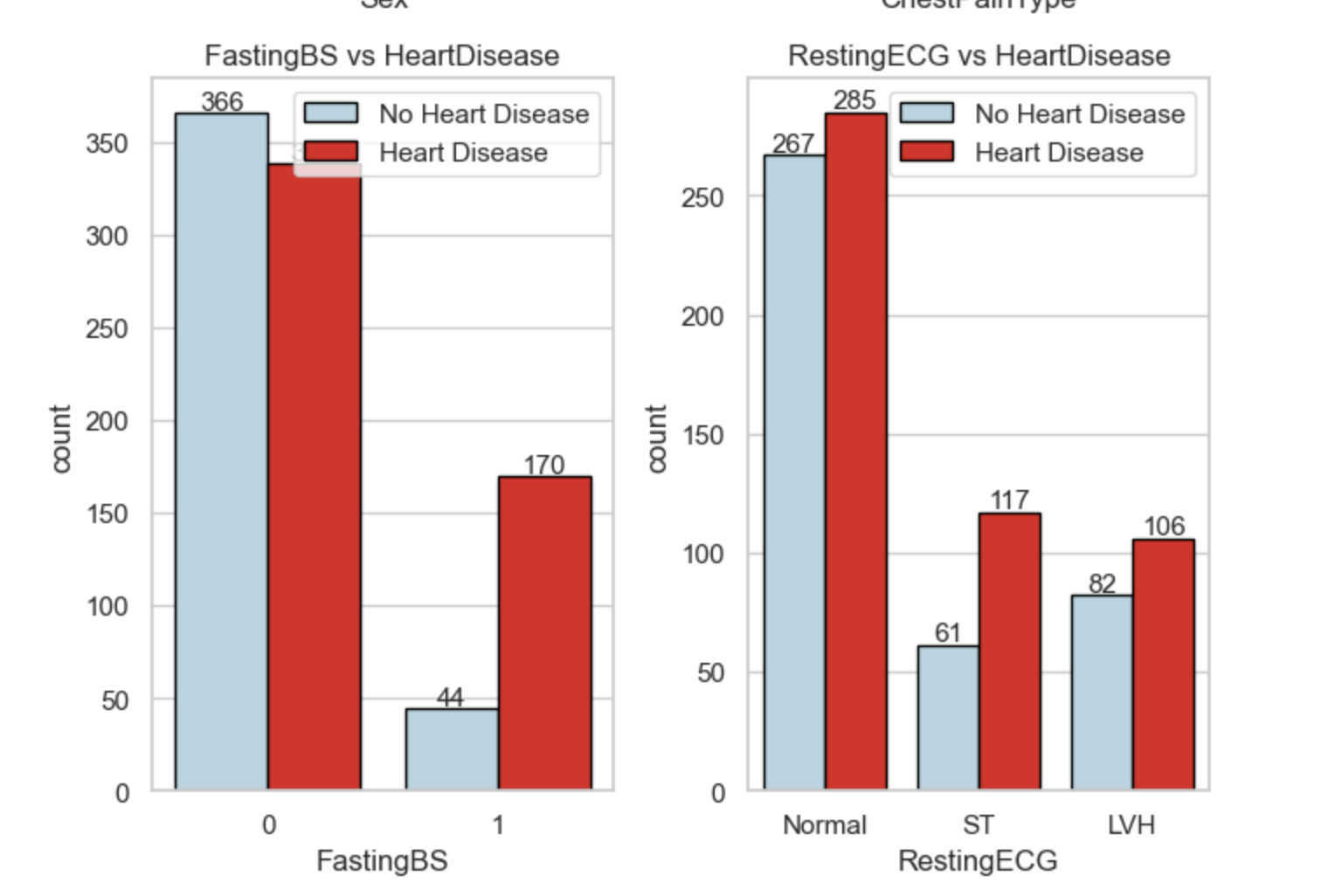
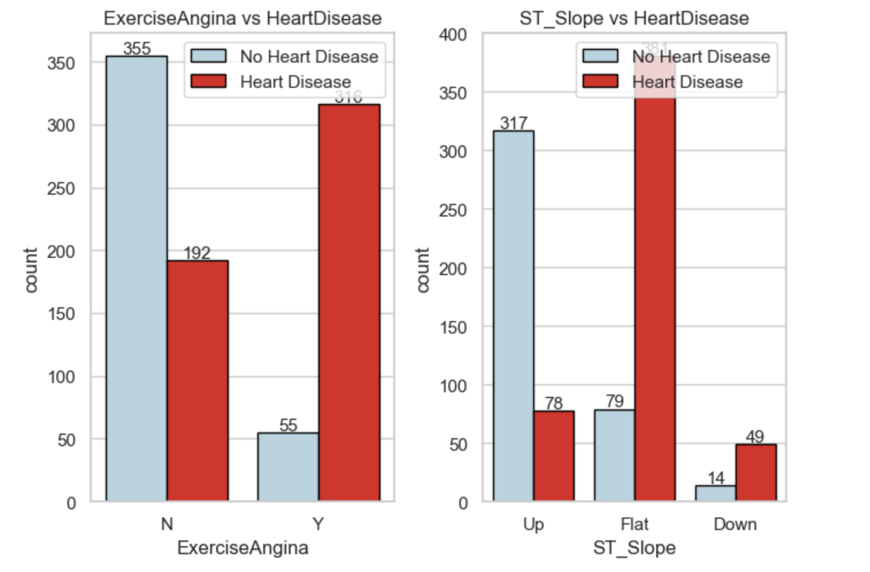
Categorical Attributes

Slide 12
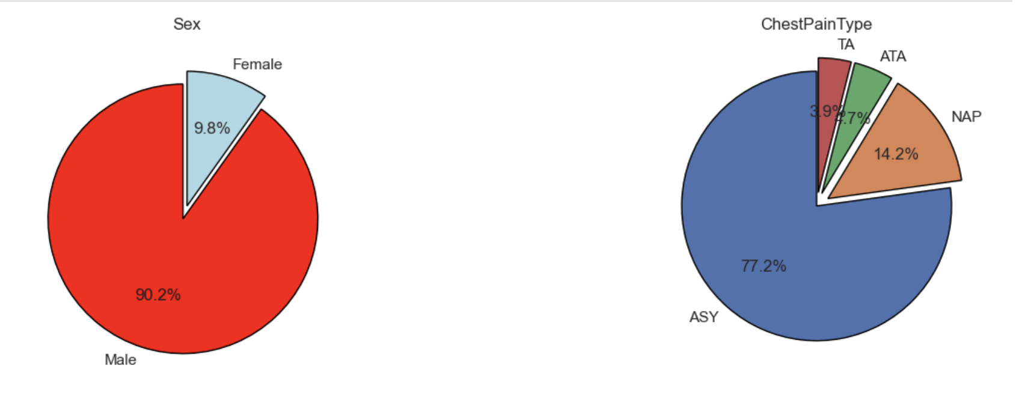
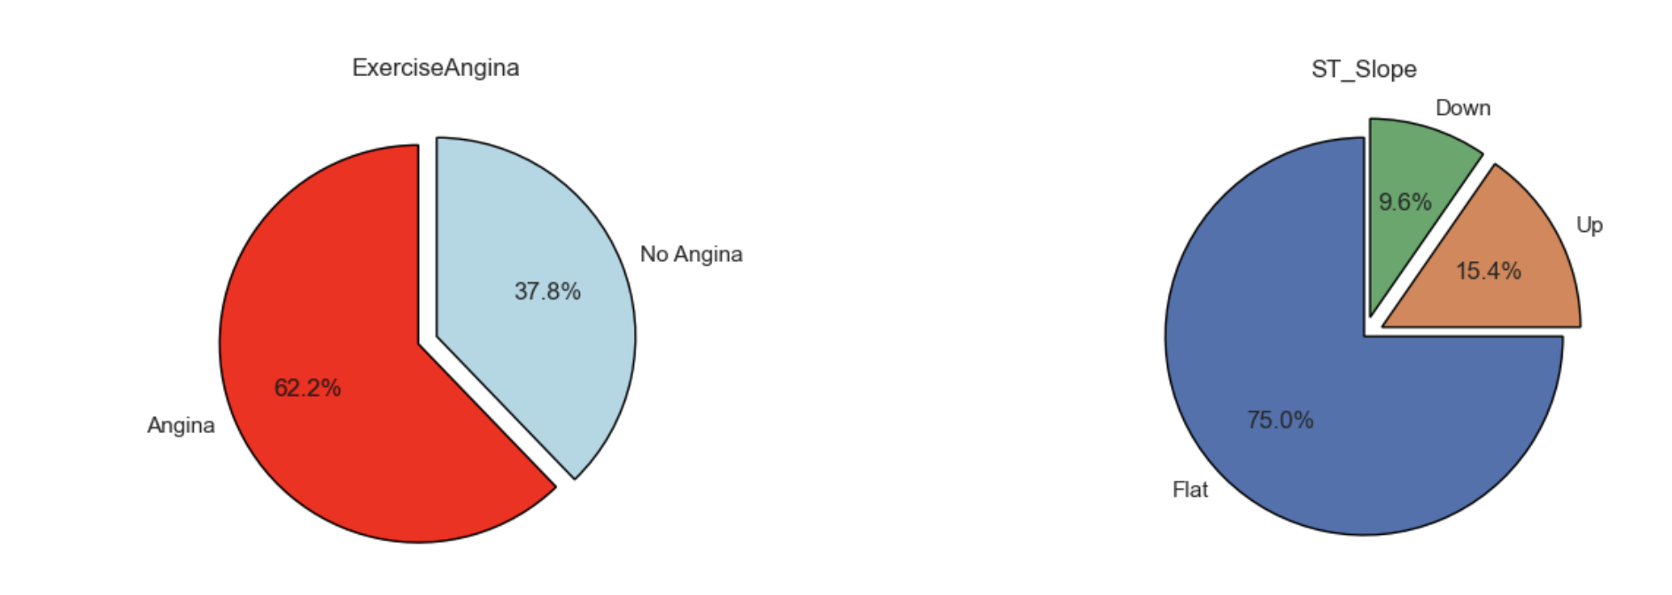

Slide 13
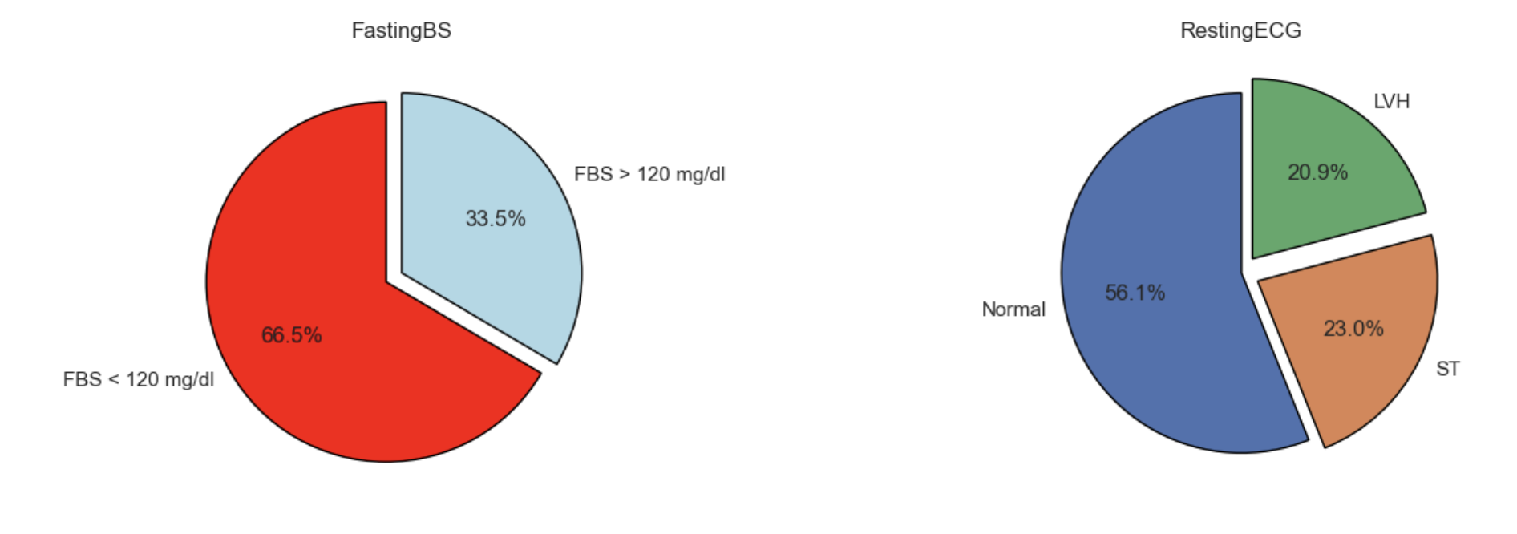

Slide 14
02
Logistic Regression

Slide 15
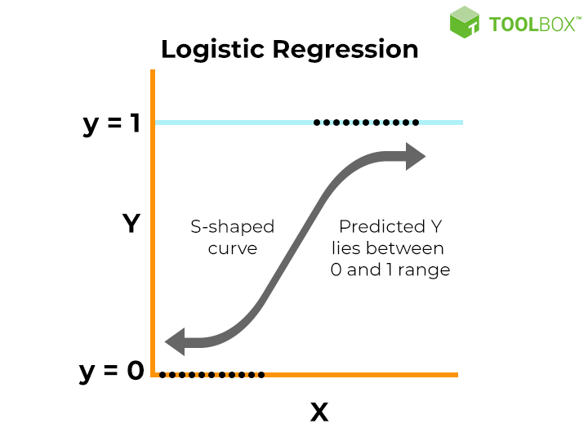
What is logistic regression?
Binary classification algorithm
Outputs probability of an instance belonging to a class
Logistic function maps input to probability
Learns feature weights to make predictions
Applicable across diverse domains
Notes:
To tackle this problem, the first model we used is a logistic regression model.Classification algorithm for predicting binary outcomes
Models probability of an event based on input features by using a logistic function to map input to probability between 0 and 1
It learns optimal feature weights to make predictions
Widely used in various domains such as healthcare and finance

Slide 16
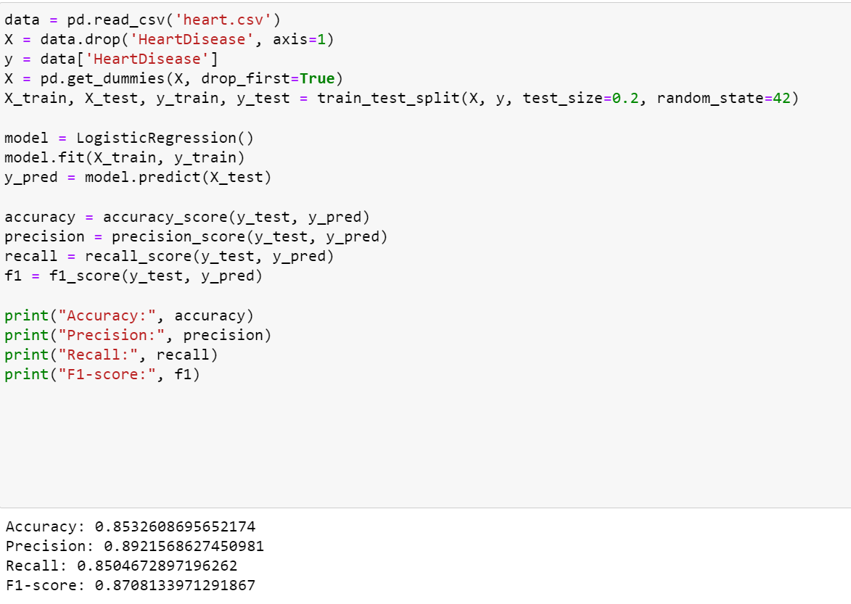
Training and testing the model
80:20 train test split
Accuracy: measures the overall correctness of the model's predictions.
Precision: focuses on the proportion of true positive predictions among all instances predicted as positive.
Recall: measures the model's ability to find all the positive instances.
F1-score: provides a balanced measure of the model's performance, considering both precision and recall
All measured 85-90%
Notes:
We used an 80:20 train test split to train and test this model. To assess the model’s performance, we used various metrics. (Read slide). Since they all measured at 85-90%, we can conclude that the model performed very well.

Slide 17
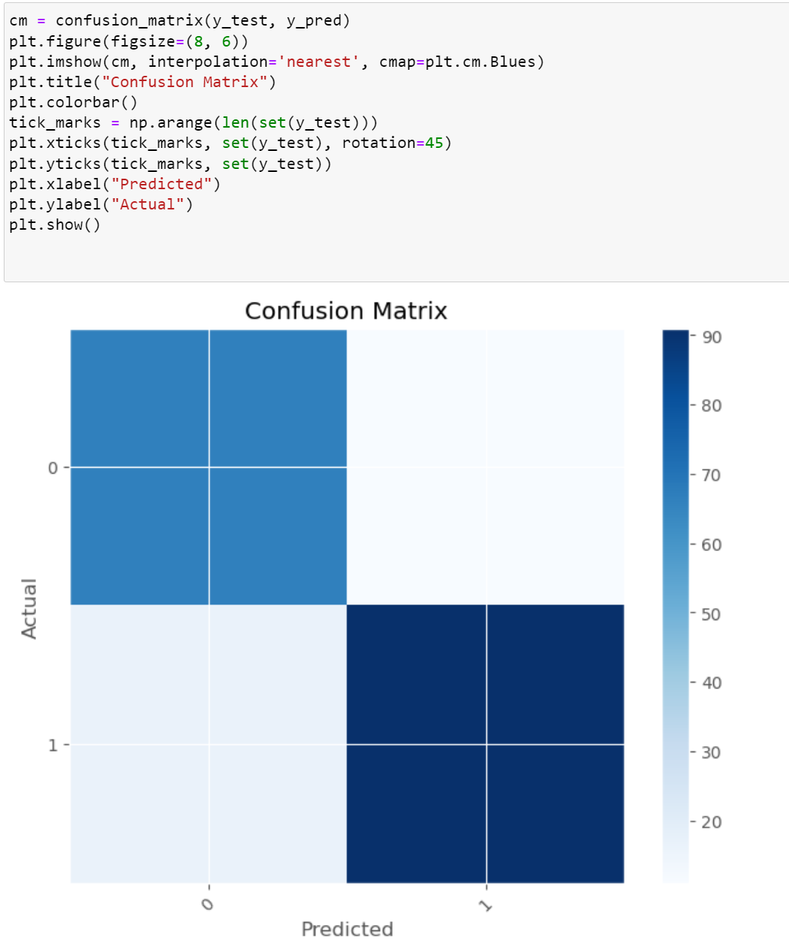
Confusion Matrix
Summarises model's classification performance
Compares predicted vs. actual class labels
The color intensity represents the count in each cell of the confusion matrix.
Helps identify types of errors and assess model's strengths and weaknesses
Low number of false positives and false negatives compared to the true positives and true negatives; model performed well
Notes:
To evaluate and visualise the model’s performance, we also used a confusion matrix as well as ROC curve. The confusion matrix summarises the model’s classification performance by comparing predicted vs actual class labels. This helps to identify the types of errors and assess the model’s strengths and weaknesses. Since the model has a Low number of false positives and false negatives compared to the true positives and true negatives; we can see the the model performed well

Slide 18
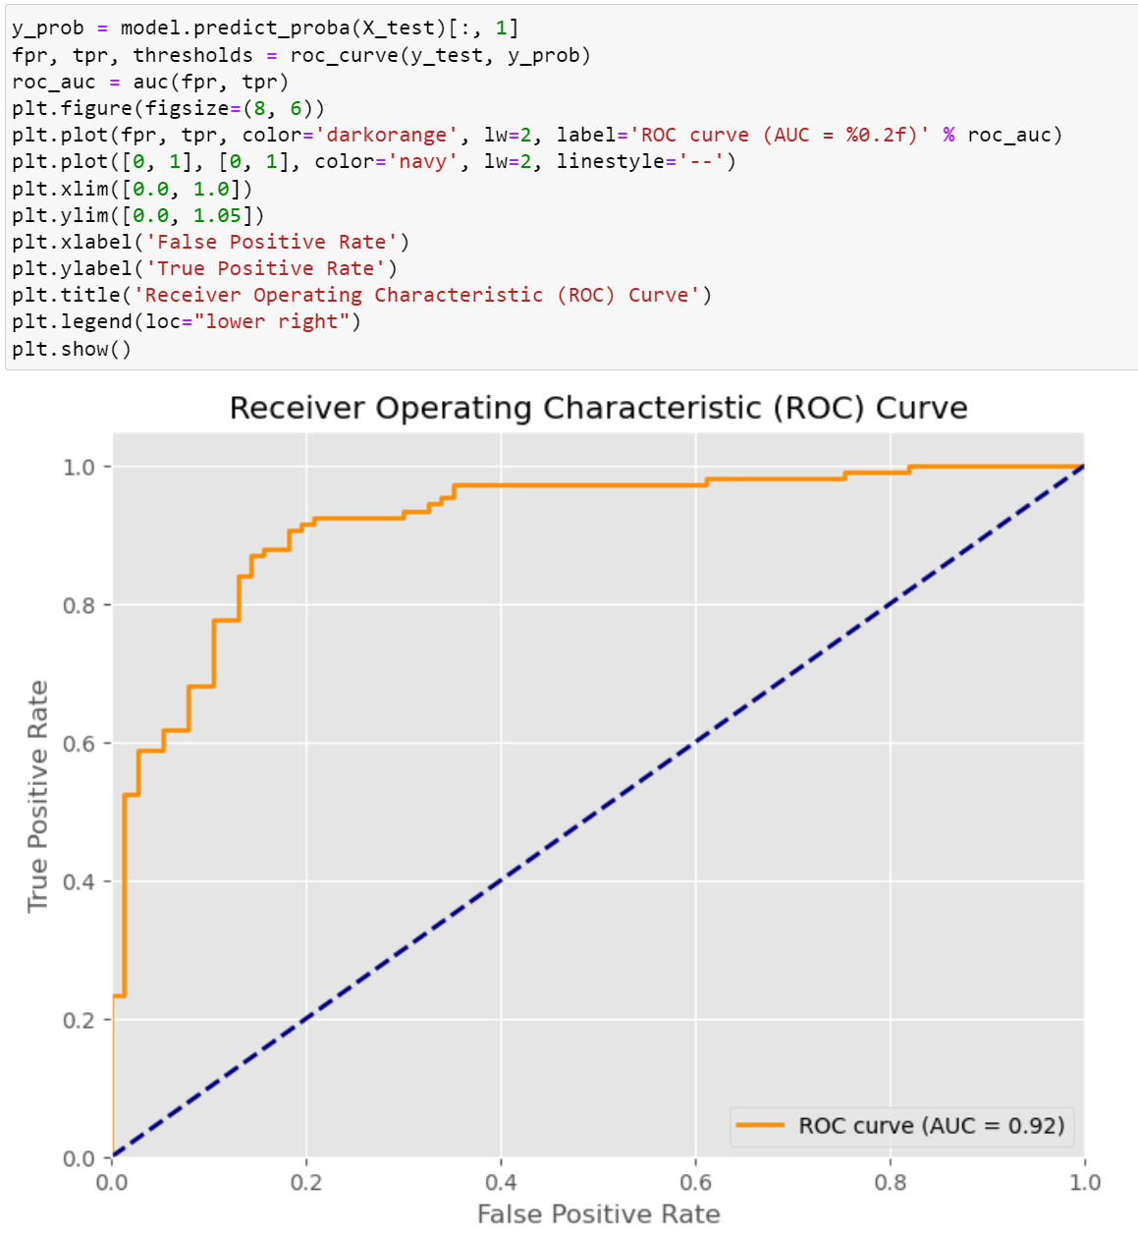
ROC Curve
Graphical representation of binary classification model's performance
Plots True Positive Rate (TPR) vs. False Positive Rate (FPR) at various thresholds
Area Under the Curve (AUC): Summary metric of model's performance
AUC of 1: Perfect classifier
AUC of 0.5: Random classifier
AUC of 0.92: Excellent classifier
Notes:
The Receiver Operating Characteristic curve, also known as ROC curve is a graphical representation of the model’s performance. It plots the true positive rate against the false positive rate at various thresholds. The area under curve shows the model’s performance. An auc of 1 means it is a perfect classifier, whereas an auc of 0.5 means it is as good as random guessing. Since our model has an auc of 0.92, it is considered an excellent classifier. Now, naquiya will talk about the next model we used.

Slide 19
03
Random Forest Regression
Notes:
Thank you Richard.

Slide 20
Random Forest Regression
Combine individual decision trees to make predictions
Each decision tree is trained separately which reduces the risk of overfitting
Notes:
Random forest regression is a model that combines individual decision trees to make predictions. Each tree is trained separately with a subset of training data and input features. This mitigates the risk of overfitting as it ensure that the decision trees do not rely on a single feature heavily.

Slide 21
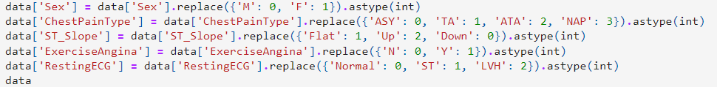
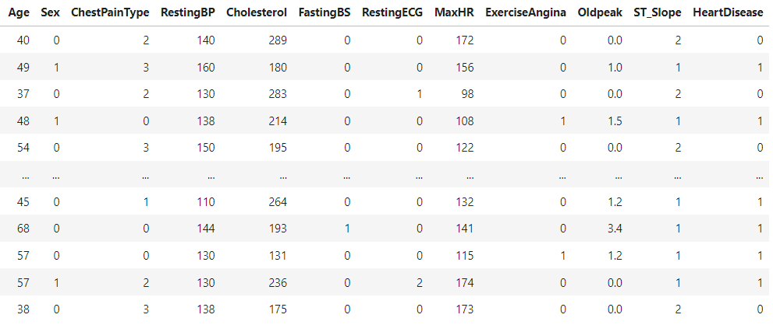
Convert all string data into integer
Notes:
Since this regression model is unable to compute data in string format, the string data was first translated into integers such that all the data in the dataframe became either float or integers.

Slide 22
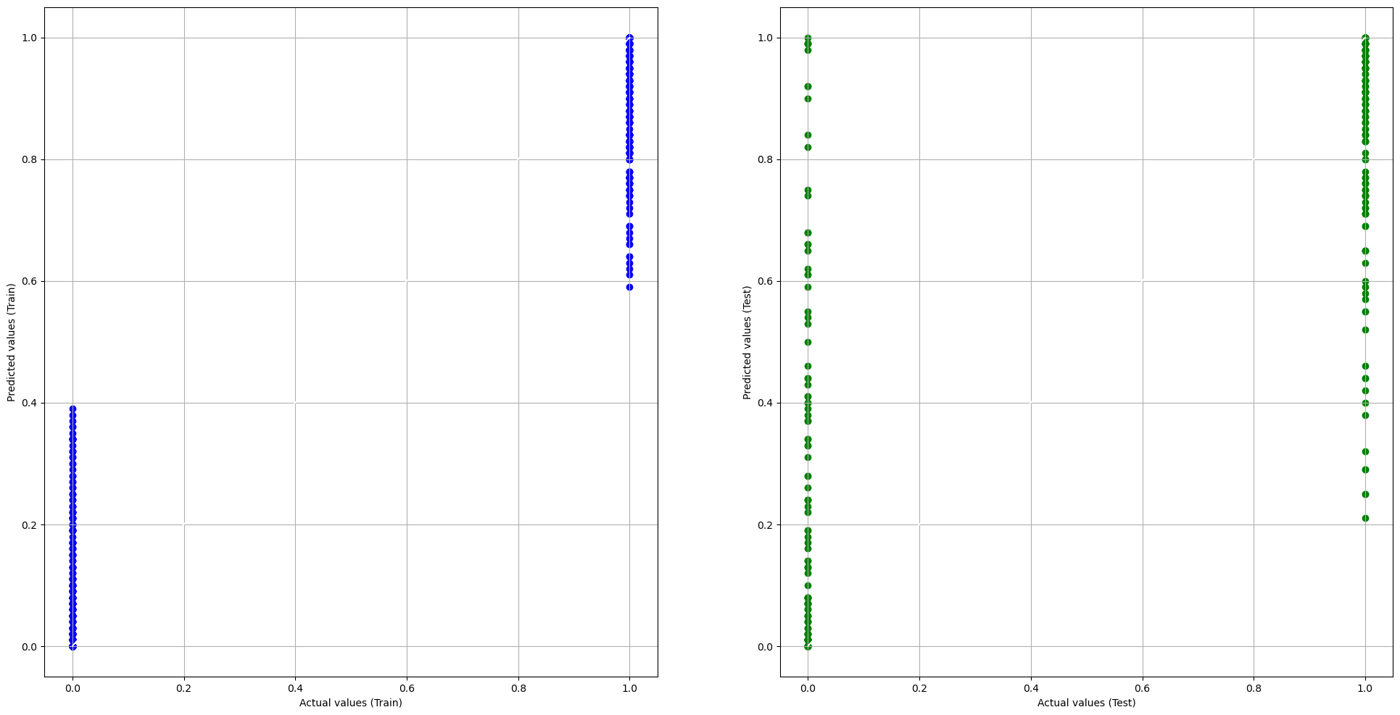
Split data into train and test set
Notes:
Next, the data was then split into train and test sets with train being 70% of data and test being 30%. These are the graphs that were generated after the regression model was ran. The reason why the data is clustered on two ends is because heart disease only has the values 0 and 1 so predicted and actual values would also be modelled as 0 and 1.

Slide 23
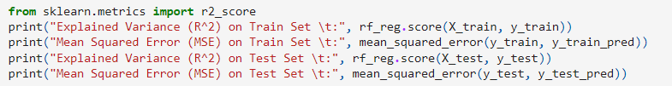

Calculate Model Performance
Notes:
To evaluate the performance of the model, explained variance and mean squared error is used. Since explained variance decreases from training to test set and MSE increases, this shows that the random forest regression model does not perform well given this dataset.

Slide 24
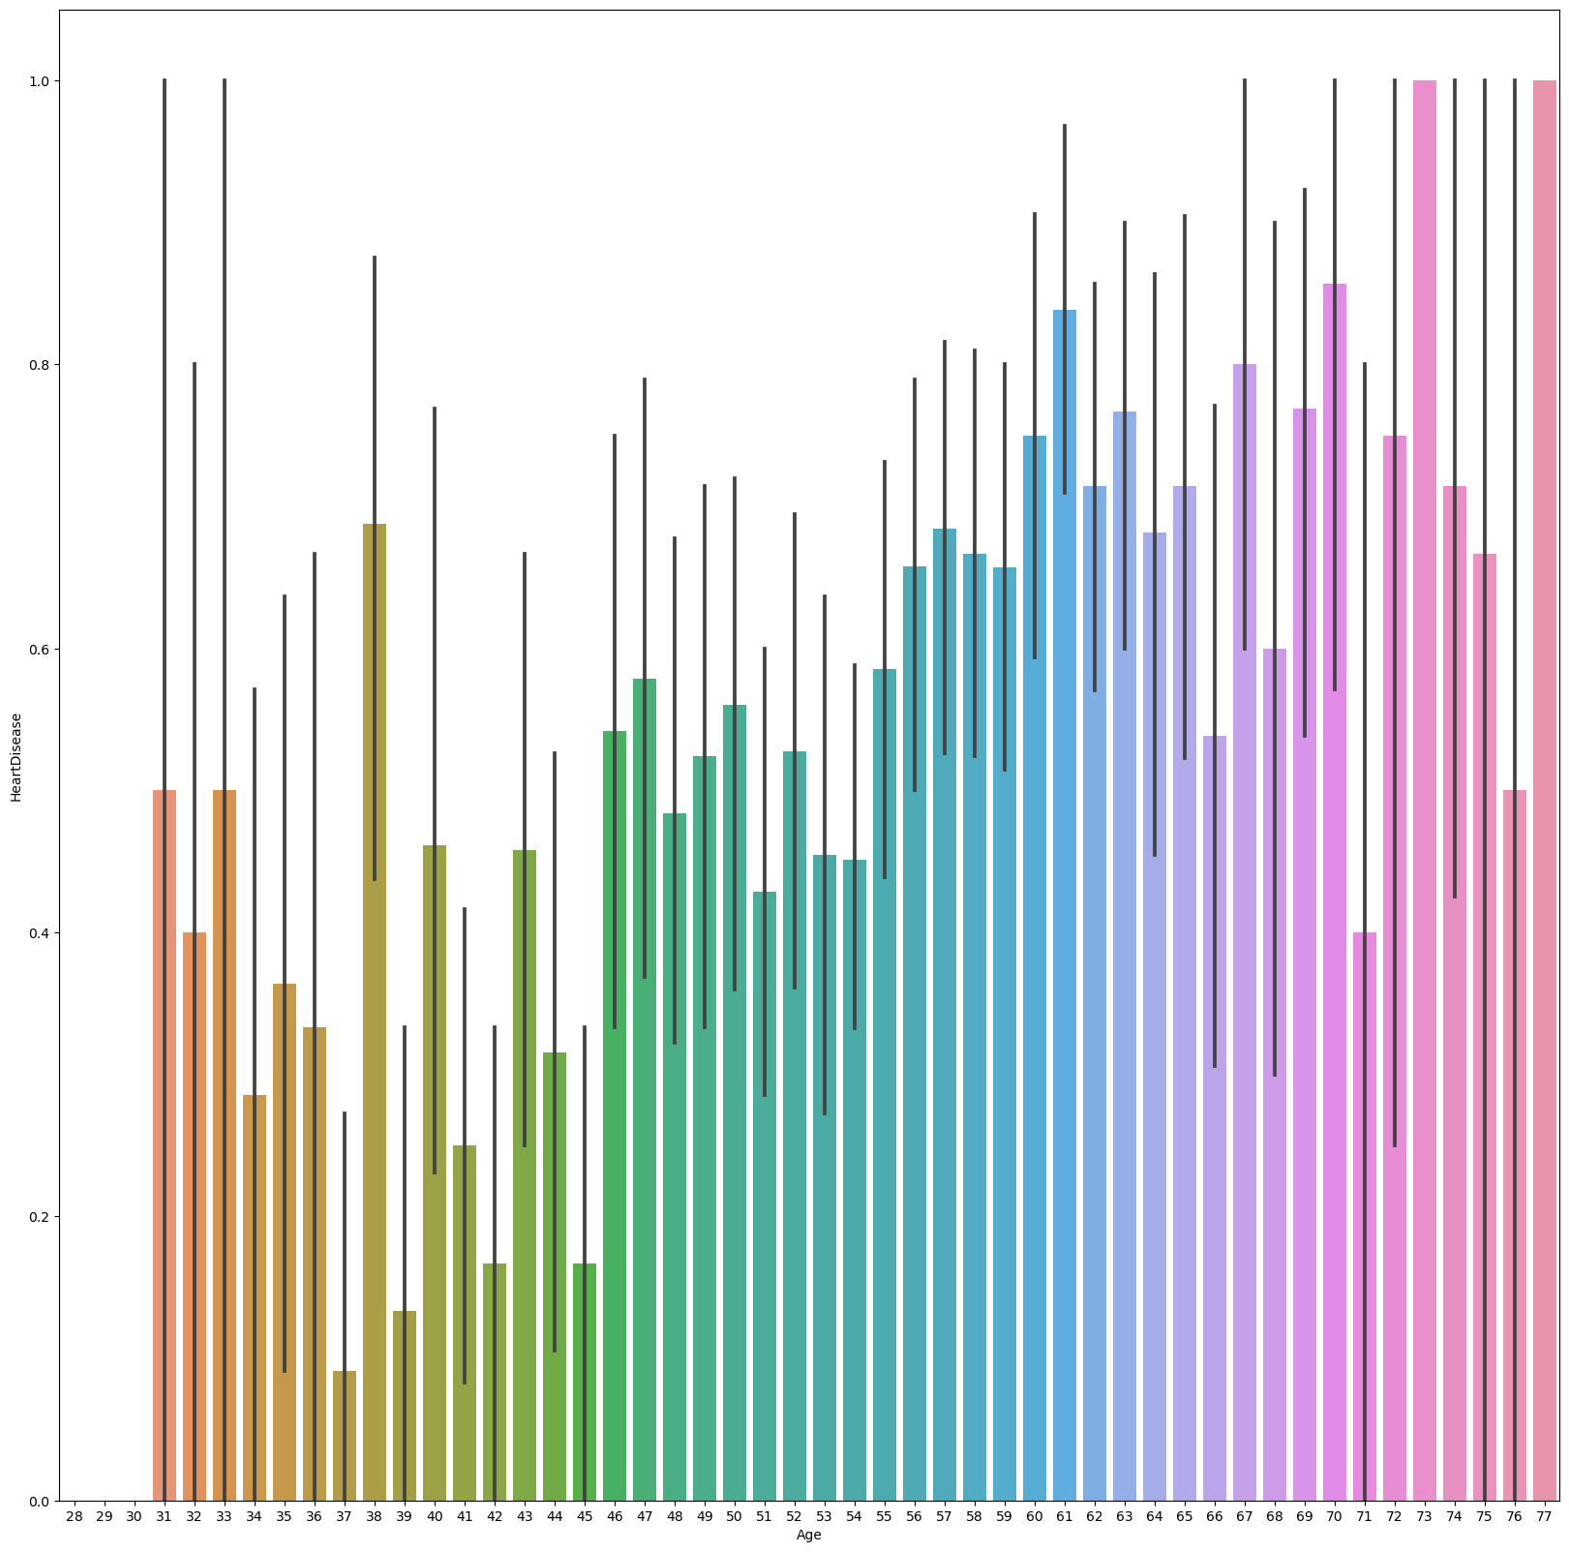
Finding Top 10 Ages
Notes:
Next, we used the seaborn plot to plot age versus heart disease to find the top 10 age values that suffer from heart disease.

Slide 25
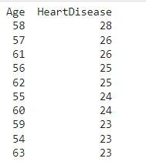
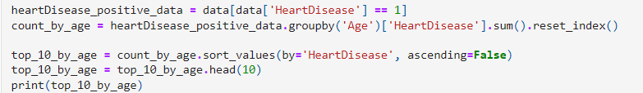
Finding Top 10 Ages
Notes:
It is apparent from the results that people above the age of 54 tend to have the highest count of heart disease

Slide 26
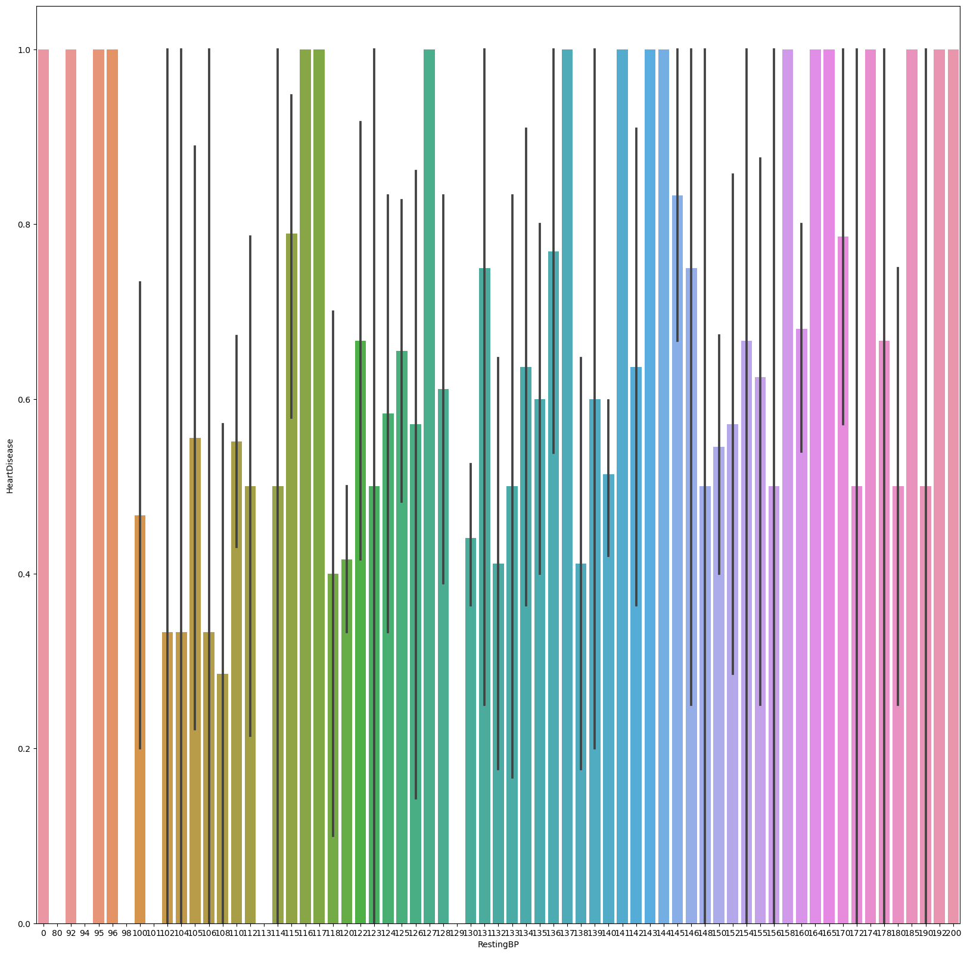
Finding Top 10 Resting BP
Notes:
In terms of the top 10 resting blood pressure, this is the plot generated

Slide 27
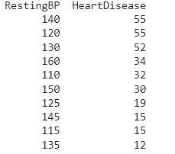
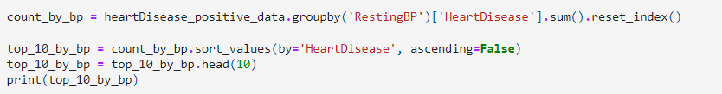
Finding Top 10 Resting BP
Notes:
In the results outputted, having resting blood pressure above 110 also indicates higher risk of heart disease

Slide 28
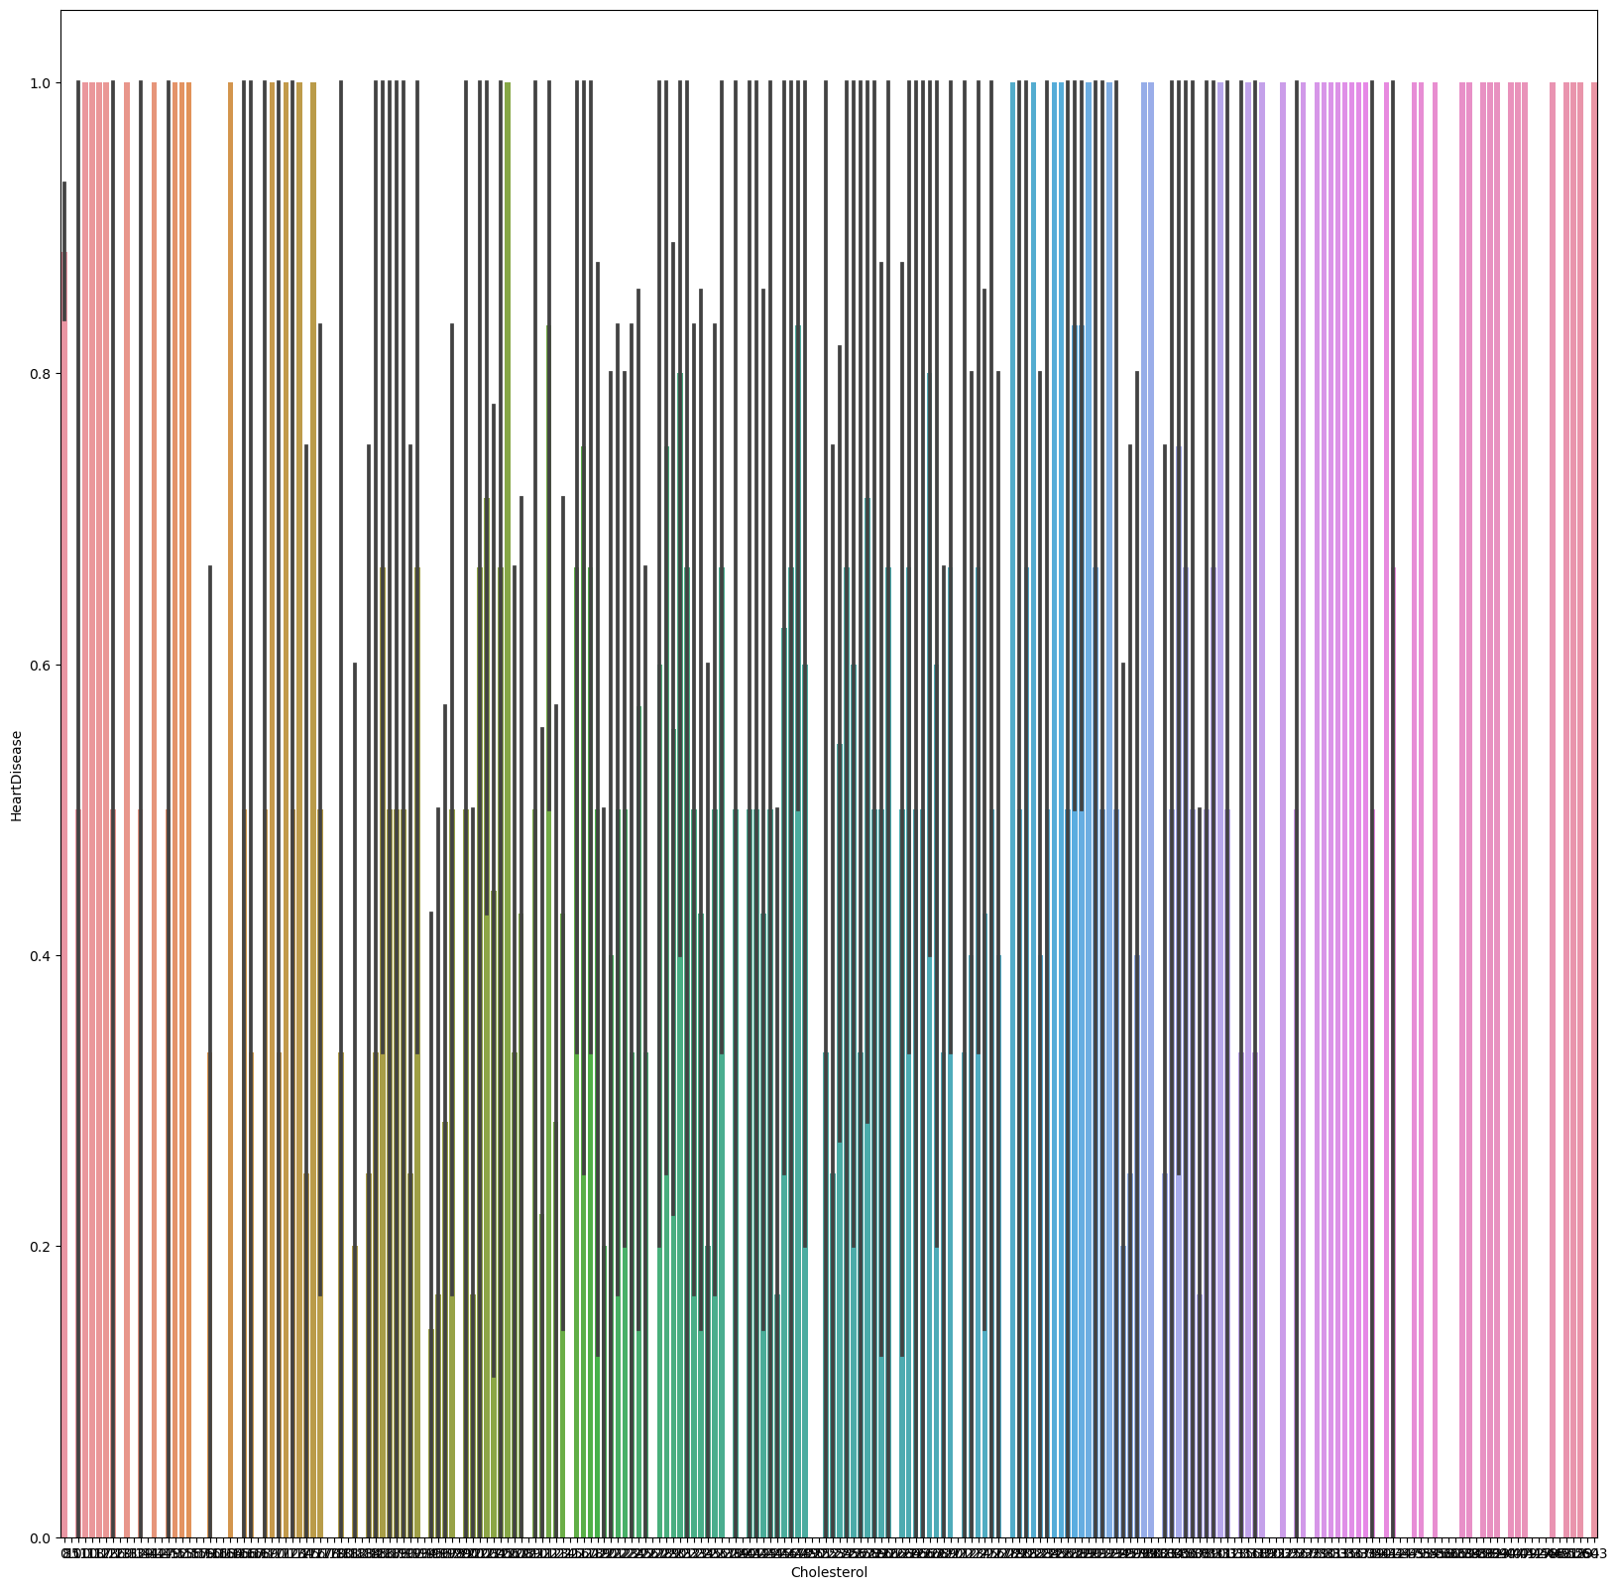
Finding Top 10 Cholesterol Levels
Notes:
The graph plotted for cholesterol levels is very detailed but according to the results

Slide 29
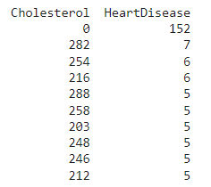

Finding Top 10 Cholesterol Levels
Notes:
Cholesterol levels above 200 tend to result in higher risk of heart disease

Slide 30
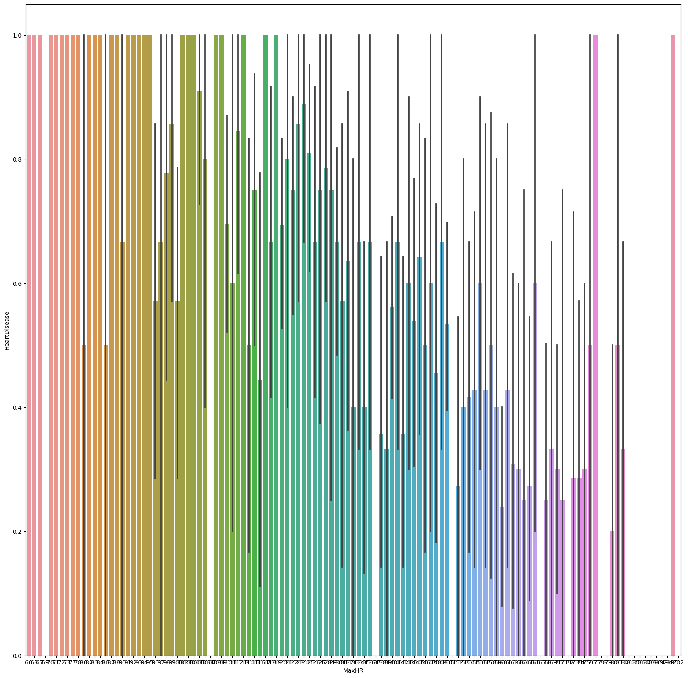
Finding Top 10 Max Heart Rate
Notes:
Lastly in terms of max heart rate,

Slide 31
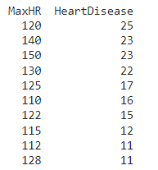
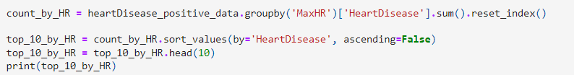
Finding Top 10 Max Heart Rate
Notes:
The results indicate that having max heart rate above 110 can increase risk of heart disease.

Slide 32
Conclusion
Carrying out Logistic Regression and Random Forest Regression
Logistic Regression Model has better performance with this dataset
RestingECG and RestingBP have lowest correlation with HeartDisease
ST_Slope and Exercise Angina tend to have highest correlation
Impact of Age on risk of Heart Disease
Notes:
In conclusion, in this project we carried out logistic regression and random forest regression models to evaluate the dataset. Comparing the two models, logistic regression model has better performance with this heart dataset. In terms of correlation with our target variable, HeartDisease, restingECG and restingBP have lowest correlation while ST_slope and exercise angine had highest correlation. Lastly, to link back to the introduction, we realised that an aging population has higher probability of heart disease as seen from the top 10 age values, so this is a topic that we should definitely concern ourselves with. That is all from us. Thank you.

Slide 33
References
Registry of Births and Deaths, Singapore. (n.d.). Heart disease statistics. Singapore Heart Foundation. https://www.myheart.org.sg/health/heart-disease-statistics/
Singapore Department of Statistics. (n.d.). Demographic profile of seniors in Singapore. https://www.singstat.gov.sg/-/media/files/publications/population/ssn122-pg6-9.ashx
Smith P., Siva Ganesh S. & Liu P., (2013) A comparison of random forest regression and multiple linear regression for prediction in neuroscience. Journal of Neuroscience Methods, Volume 220, Issue 1, 85-91. https://doi.org/10.1016/j.jneumeth.2013.08.024.
Kanade, V. (2022). Key Assumptions for Implementing Logistic Regression [Graph]. Spiceworks. https://www.spiceworks.com/tech/artificial-intelligence/articles/what-is-logistic-regression/

