Slide 1

Marketing Data and Technology
Draw Insights from Marketing Data

Slide 2

Part One:
Setting Goals

Slide 3
Identify Key Business Objectives
Key Business Objective: A defined goal or outcome used to plan the desired direction of your company. Write at least 3 but no more than 5 business objectives that support your business model. Each objective should be SMART.
1 | Increasing sales by 25% in 2023.
2 | Increasing social media users of the company by 1 million in the first 6 months of 2023.
3 | Decreasing employees working hours by 1 hour for 2 months in 2023 to boost the employees motivation to work hard.
4
5

Slide 4
Identify Key Performance Indicators
Key Performance Indicator (KPI): A quantifiable metric used to determine how effectively your key business objectives are being met. Ensure that the specific metric is clearly identified.
1 | To measure this objective we will use sales revenue rate
2 | We will use followers growth rate to measure the objective
3 | Employee satisfaction rate can be used to measure the objective
4
5

Slide 5
Part Two:
A/B Testing Proposal

Slide 6
A/B Testing Proposal: KPI, Variable, and Hypothesis
KPI used as the basis for an A/B Test:
Running a YouTube AD to increase click through rate
Identify a variable that will have an impact on the KPI and metric
AD 1) this ad should include the discount rate of 50 % and call to action box.
AD 2) the same ad with no discount rate but call to action box is present.
Determine a hypothesis for your A/B Test. Your hypothesis should include the variable you are testing and your predicted outcome.
Including the discount option on the ad will have more click through rate then the other one which has no discount mentions.

Slide 7
A/B Testing Proposal: Testing Process
Describe the steps you would take to perform the A/B test.
Step 1) click through rate is being tested
Step 2) only females are being targeted
Step 3) the test will run for 1 month
Step 4) I will use Google analytics to collect the data and analyze the results
Describe how you would determine the results of the A/B test.
I will use the Google analytics to collect and evaluate the data from the test. If the click through rate is high then we can assume that the test was successful.

Slide 8
Part Three:
Data Exploration

Slide 9
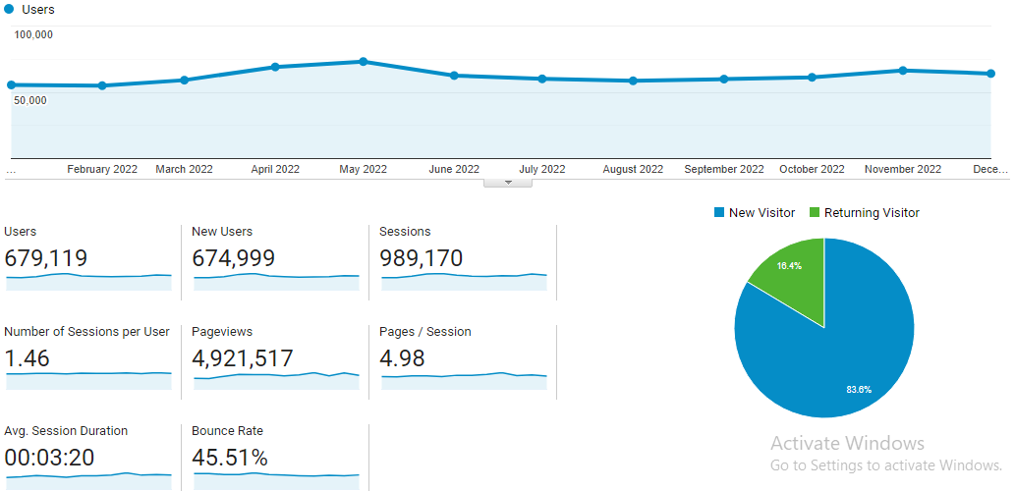
Standard Display - Audience
From the Audience Overview Report, select a twelve month time period you would like to explore.
Ensure that the following are visible in the screenshot:
Timeframe
Segment
Metric
Axis values
Replace this box with screenshot from report

Slide 10
Standard Display - Audience
Which month had the most visitors, and which month had the fewest visitors to your site?
May had the most visitors and febuary had the fewest visitors.
Do you have any ideas why certain trends are associated with these specific months?
No
Insert your notes about the screenshot on the previous page here.

Slide 11
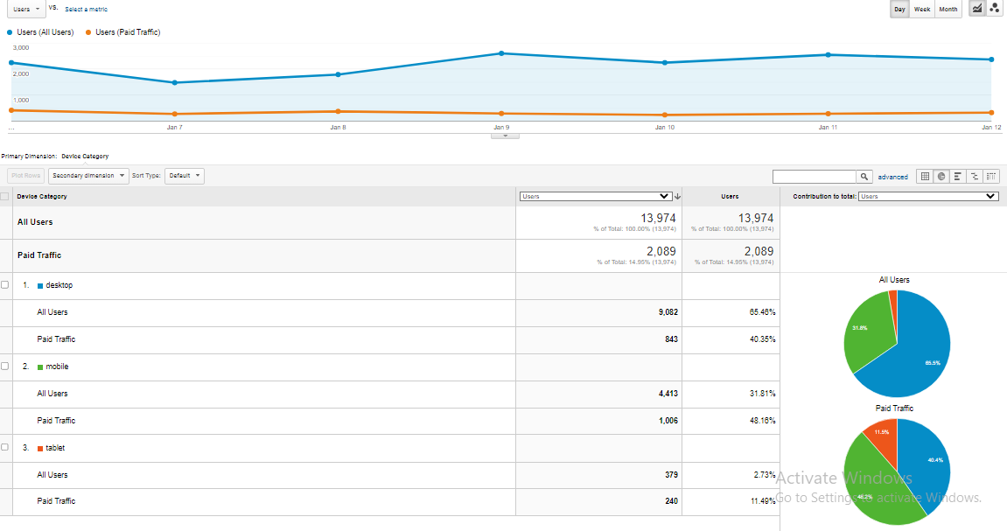
Percentage Display: Audience
Please go into the Audience → Mobile → Overview report for the following:
For the twelve month period you’ve chosen, provide a screenshot showing percentage charts (pie charts) of All Users that came from mobile, desktop, and tablet devices and the percentage of Paid Traffic Users came from mobile, desktop, and tablet devices.
Ensure that the following are visible in the screenshot:
Device Category
Total number of All Users and Paid Users
Two pie charts showing % breakdown by device
Note that the time frame selected does not need to be visible in the screenshot, but will be reflected by the number of users.
Replace this box with screenshot from report

Slide 12
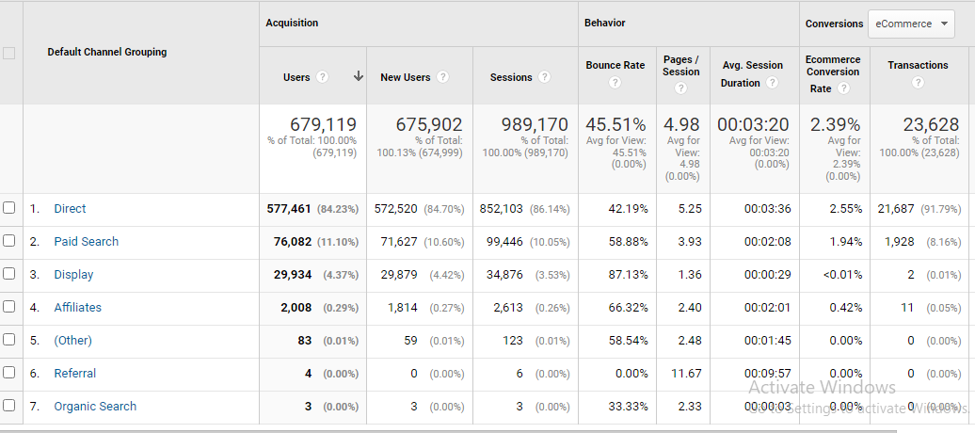
Standard Display: Acquisition
For this section, if you are using your own business’s Google Analytics data but do not have eCommerce capabilities established, please use the Google Analytics demo data provided from the Google Merchandise store.
Take a screenshot that shows the bounce rate of the different acquisition channels over a 12 month period.
Ensure that the following are visible in the screenshot:
Channel
Users
Bounce Rate
Note that the time frame selected does not need to be visible in the screenshot, but will be reflected by the number of users.

Slide 13
Standard Display: Acquisition
During the twelve month period you’ve selected, excluding Direct and (Other), which channels had the highest and lowest bounce rates and the highest and lowest eCommerce conversion rates?
over the period of twelve months display channel had the highest bounce rate and referral had the lowest.
Direct channel had the highest ecommerce conversion rate referral and organic search had the lowest.
What do these metrics mean, based on your experience?
These metics helps us to analyse the customers data and improve the sites which are weak.
Insert your notes about the screenshot on the previous page here.

Slide 14
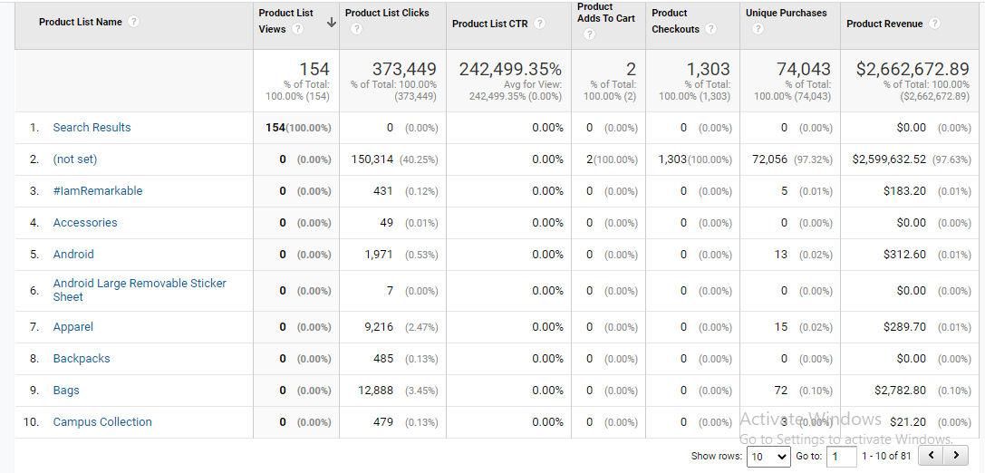
Percentage Display: Conversion
During the twelve month period you’ve selected, provide a screenshot that shows the Product Category that contributed the highest number of unique purchases for New Users and the Product Category that was responsible for the largest percentage of revenue for New Users? (Screenshot(s) only; no annotation required.)
Ensure that the following are visible in the screenshot:
New User segment
Product Categories
Unique Purchases
Revenue

Slide 15
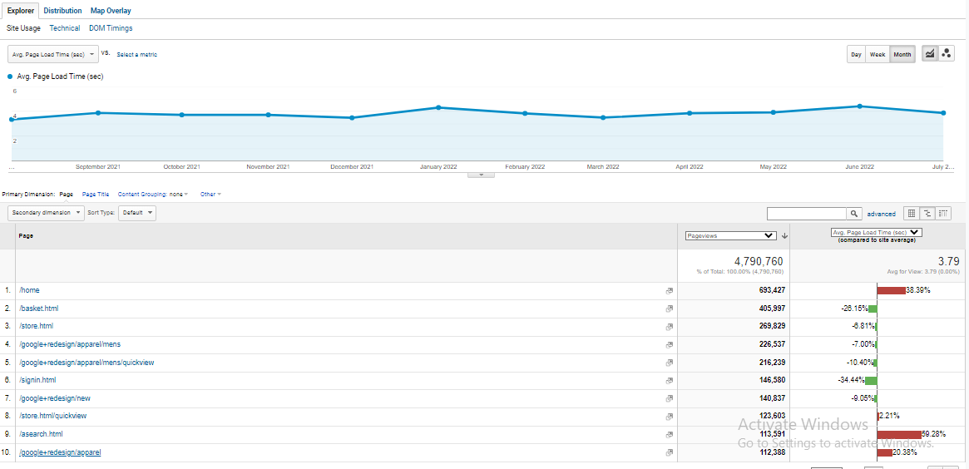
Comparison Display: Behavior
For traffic from All Users between the start and end of your twelve month period, please provide a comparison report showing Site Speed Page timings for the top ten pages (based on pageviews).
Ensure that the following are visible in the screenshot:
Top 10 Pages
Pageviews
Average page load time
Note that the time frame selected does not need to be visible in the screenshot, but will be reflected by the number of pageviews.
Replace this box with screenshot from report

Slide 16
Comparison Display: Behavior
Based on the screenshot, home page, redesign appereals, and html search have the highest trouble spot.
Insert your notes about the screenshot on the previous page here.
Replace this box with screenshot from report

Slide 17
Part Four:
Segmentation

Slide 18
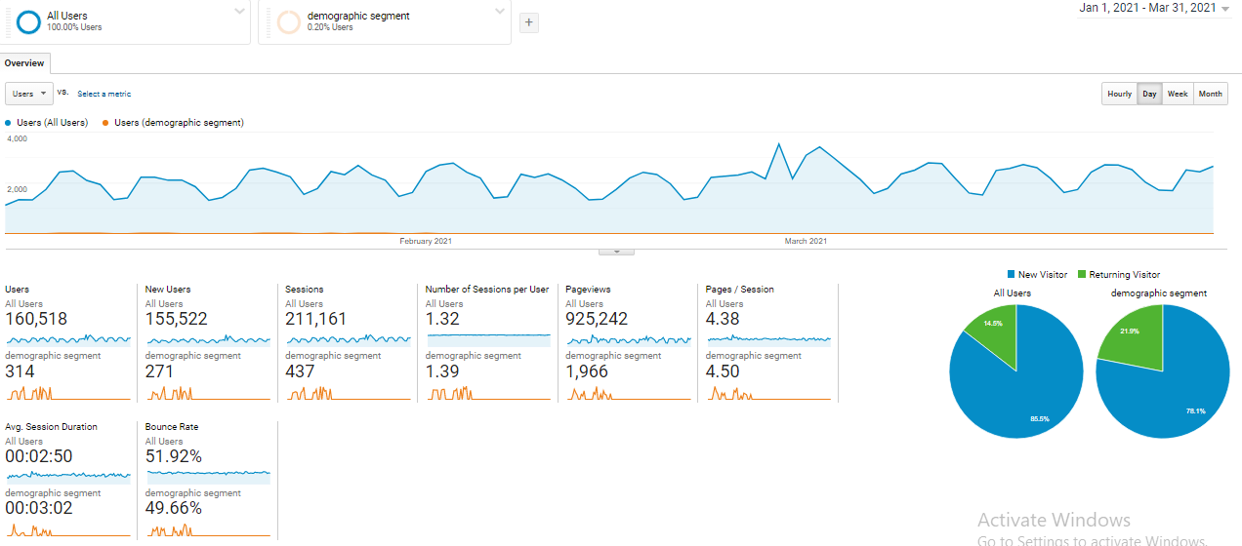
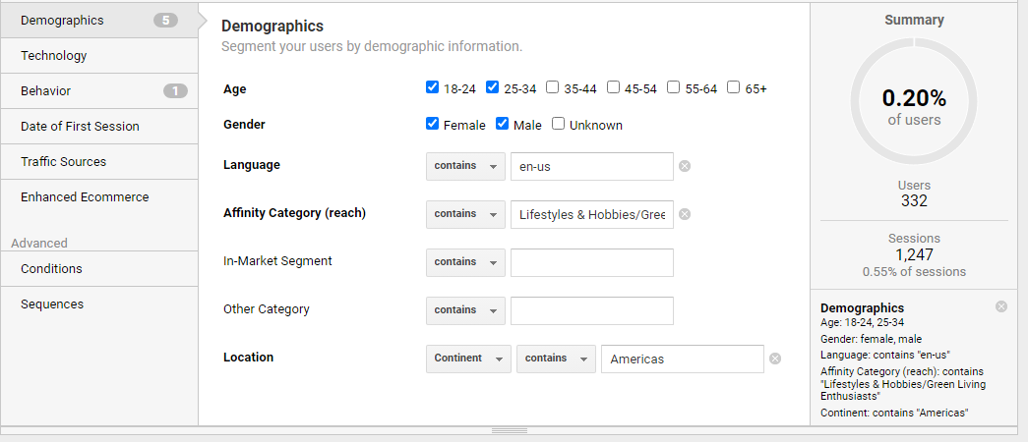
Audience Segment: Demographics
Insert the screenshot of a view (such as the Audience Overview) that includes both your Audience Demographic segment as well as “All Users.” Write down or include a screenshot of the values used to create the segment.

Slide 19
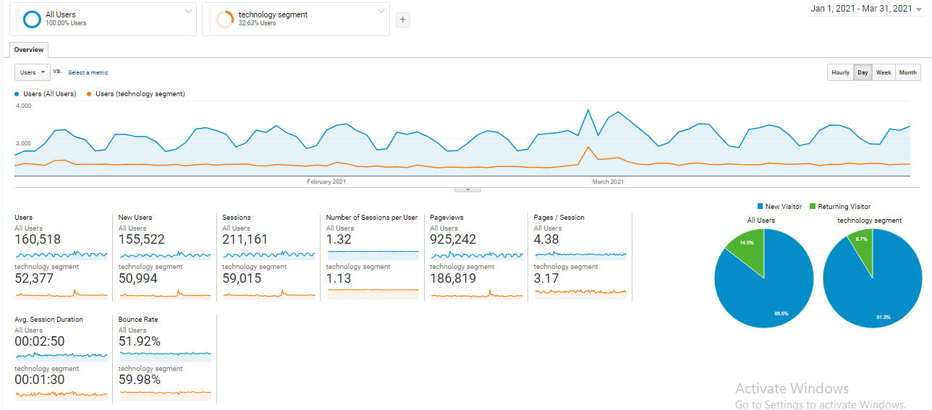
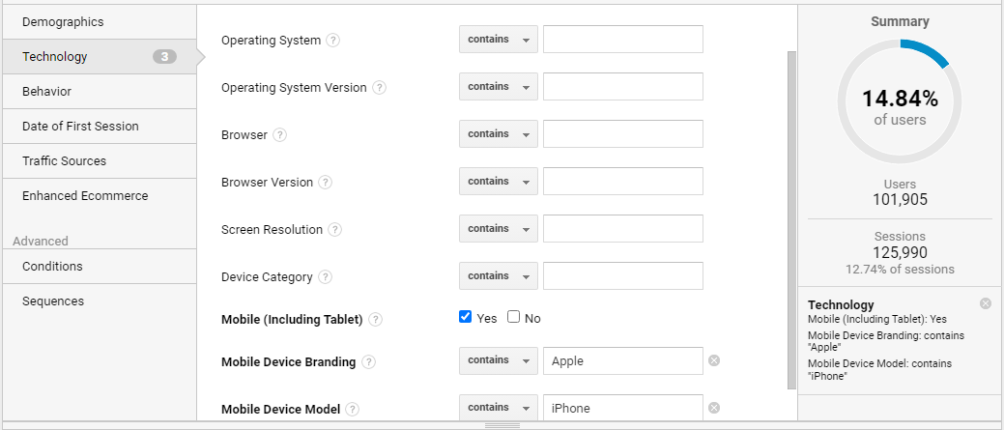
Audience Segment: Technology
Insert the screenshot of a view (such as the Audience Overview) that includes both your Technology segment as well as “All Users.” Write down or include a screenshot of the values used to create the segment.

Slide 20
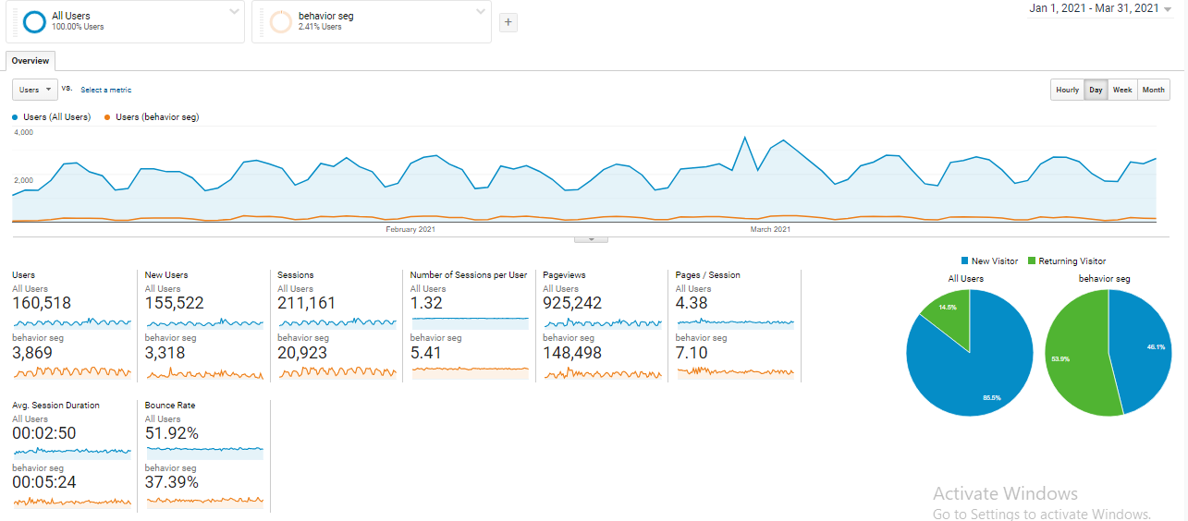
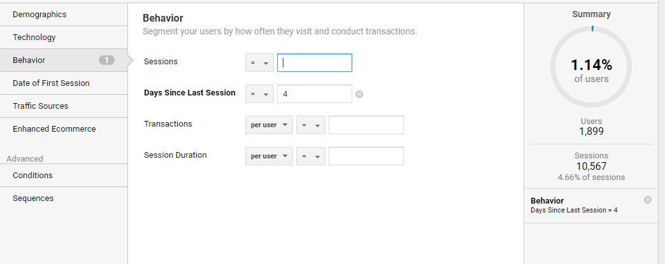
Audience Segment: User Behavior
Insert the screenshot of a view (such as the Audience Overview) that includes both your user behavior segment as well as “All Users.” Write down or include a screenshot of the values used to create the segment.

Slide 21
Part Five:
Analysis and Suggestions

Slide 22
Analysis and Suggestions: Business Sales Growth
Analyze your existing marketing campaigns to grow your business. In order to complete this section using your own data, you must have the required data (Campaign, Cost, Revenue, ROAS) for a minimum of two campaigns. If you do not have at least two campaigns or are missing some of the necessary data, you can use the 2021 GSMM Solar YouTube Ad Sales Funnel Campaigns Pitch Deck to answer this question. You are also welcome to add additional data beyond what is specified.
Intercon a well known marketing company have run a YouTube
campaign for a solar company that campaign generated
estimated $25,000 in revenue by investing only 34,00 in YouTube
Ads and they were able to generate ROAS return on ad spend 7x.
Campaign | Investment | Revenue | ROAS
Solar sales | $34,00 | $25,000 | 7 times more

Slide 23
Analysis and Suggestions: Business Sales Growth
Based on the data and other information provided, how might the campaigns be realigned and improved to potentially achieve a 20% YOY sales growth? You can assume that the c\data will remain consistent over the projected time frame. Please reference specific data to support your answer like metrics and campaigns.
To achive the 20% growth we need to re invest in the lead generation campaign. By investing $1500 in lead generation campaign the revenue should increase by 20% that would be $30000.
.
CAMPAIGNS | COST | REVENUE | LEADS | ROAS
LEAD GENERATION | $3400 | $25000 | 300 | 7
SOCIAL MEDIA VIEWS | $1500 | $1000 | 15 | 1

Slide 24
Analysis and Suggestions: eCommerce
Now you will evaluate the current state of eCommerce for your business and how it might be improved.
Looking at your website pages or the Google Merchandise store website and current eCommerce experience, identify one change to the eCommerce UX and one additional eCommerce option you would recommend implementing.
Example: One way to improve eCommerce capabilities would be to add the option of a digital wallet with the option to securely store and manage cards that have been used for payment, along with the option of using PayPal or ApplePay.
UX change:
If a new users visit a ecommerce store the website give the sign in option in the beginning many users exit the page at that time. The sign in option should be at the check out time after the customer spend some time in the store.
Other eCommerce change or addition: Many stores give irrelevant options when a customer is surffing like some one from x place bought this item that should be change.

Slide 25
Analysis and Suggestions: Technology
Now you will look at your existing technology stack and make recommendations for the future. This should include at least two additional technologies that are not currently utilized, one of which is a new emerging technology.
Emerging Marketing technology stack/tools
Mature Marketing technology stack/tools
BUFFER FOR CONTANT MANAGEMENT | GENERATIVE AI CREATES ARTIFICIAL CONTANT
SLACK TO COMMUNICATE | CANVA FOR GRAPHIC DESIGNING | GOOGLE ANALYTICS TO EVALUATE DATA | PHOTOSHOP TO MAKE CONTANT | GOOGLE DRIVE TO STORE DATA
GIT HUB TO SHARE DATA AMONG TEAM MEMBERS | HOOT SUIT FOR CRM AND CONTANT MANAGEMENT | UNSPLASH FOR FREE PHOTOS | GRAMMERLY FOR AUTO CORRECTION | OPTEMIZELY FOR SEO

