Slide 1

G2M Case Study
Virtual Internship
Ignacio Solórzano
11-March-2021

Slide 2
Background –G2M(cab industry) case study
XYZ is a private equity firm in US. Due to remarkable growth in the Cab Industry in last few years and multiple key players in the market, it is planning for an investment in Cab industry.
Objective : Provide actionable insights to help XYZ firm in identifying the right company for making investment.
The analysis has been divided into four parts:
Exploratory Data Analysis
Market Research
Profit Analysis
Demand Analysis
Customers Analysis
Finding the most profitable Cab company
Recommendations for investment

Slide 3
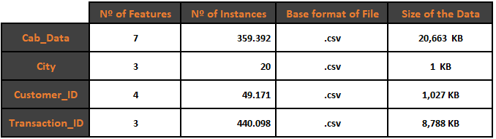
Data Intake & Hypothesis
Four Datasets
Hypothesis :
1. Is there any seasonality ? 2. The percentage of profitable trips change by city.? 3. How the demand varies according to agewise? 4. Loyalty Rates. 5. Does the payment method fluctuate yearwise? Agewise? Citywise?

Slide 4
Exploratory Data Analysis
Master Database
14 Features
Timeframe of the data: 2016-01-01 to 2018-12-31
Total data points :359.392
Assumptions:
Outliers are present in Price_Charged feature but due to
unavailability of trip duration details ,we are not treating this as outlier.
Profit of rides are calculated keeping other factors constant and only
Price_Charged and Cost_of_Trip features used to calculate profit.
Users feature of city dataset is treated as number of cab users in the city.
we have assumed that this can be other cab users as well(including Yellow and
Pink cab)

Slide 5
Profit Analysis

Slide 6
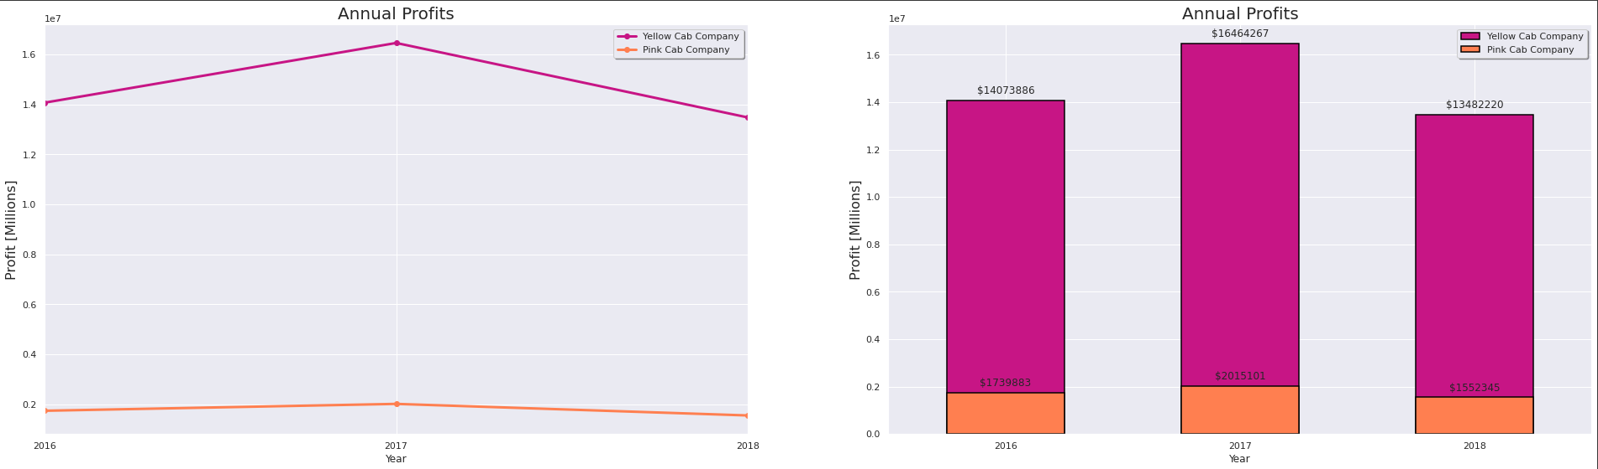
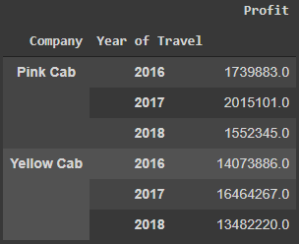
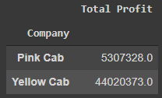
Yearly Profit
$16.464.267
$14.073.886
$13.482.220
$1.739.883
$2.015.101
$1.552.345
YellowCab’s profits over the last 3 years are eight (8) times greater than PinkCab’s company.
Let's look at this in more detail and in different perspectives…

Slide 7
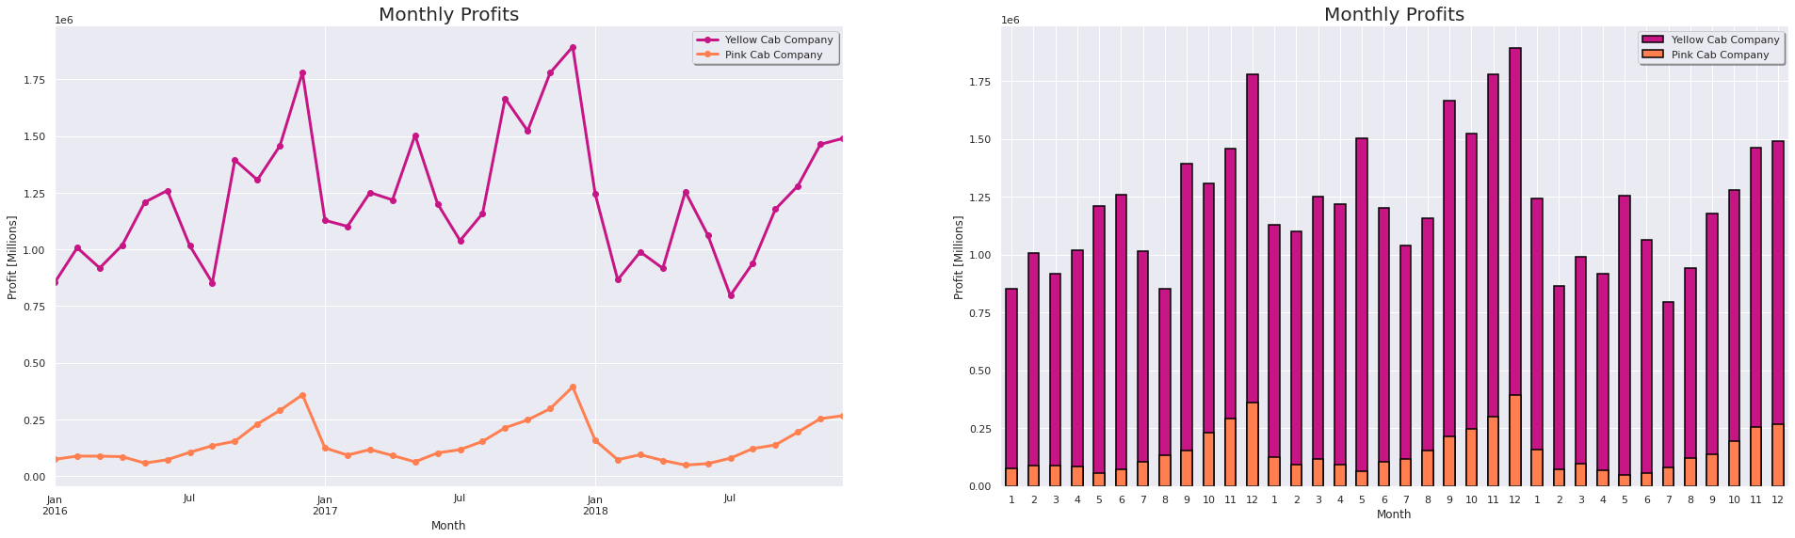
Monthly Profit
$1.222.788
$147.425
We can see that over the months, the Yellowcab company's earnings are more stable, with fluctuations of 23,08%, while those of the Pinkcab company vary in the order of 61,22%

Slide 8
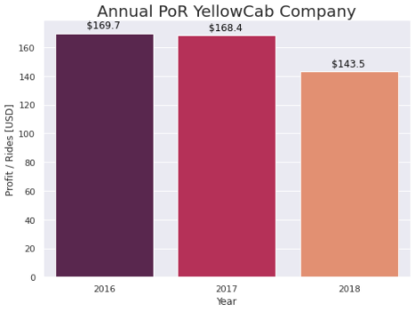
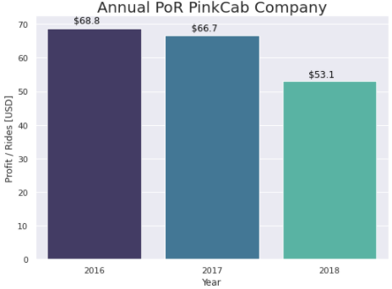
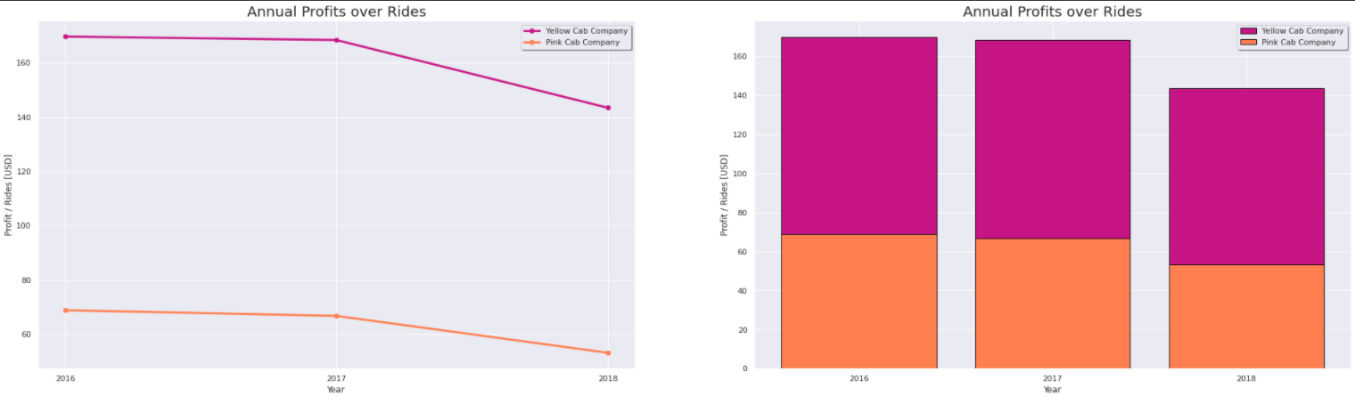
Yearly Profit per Ride
Profit per Ride is an indicator that measures how efficient the company is, in terms of operational costs
YellowCab is doing far better in profits per rides.
Both companies shows the same behaviour; decrease over time… tends to decrease this efficiency

Slide 9
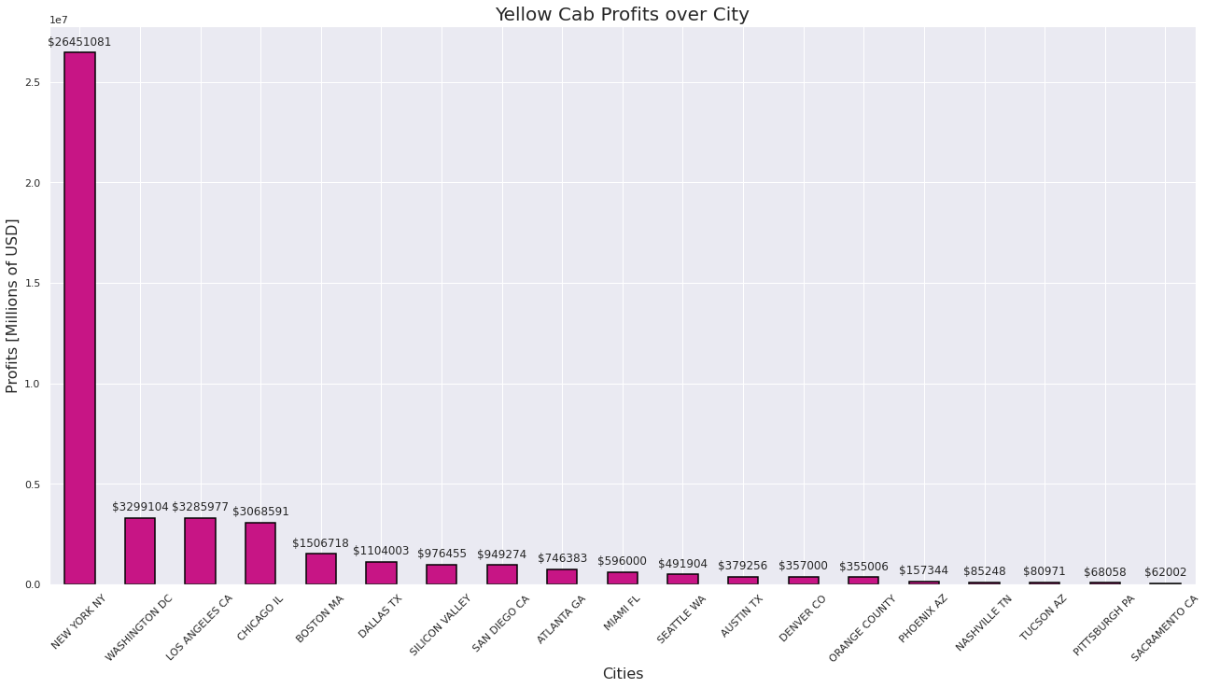
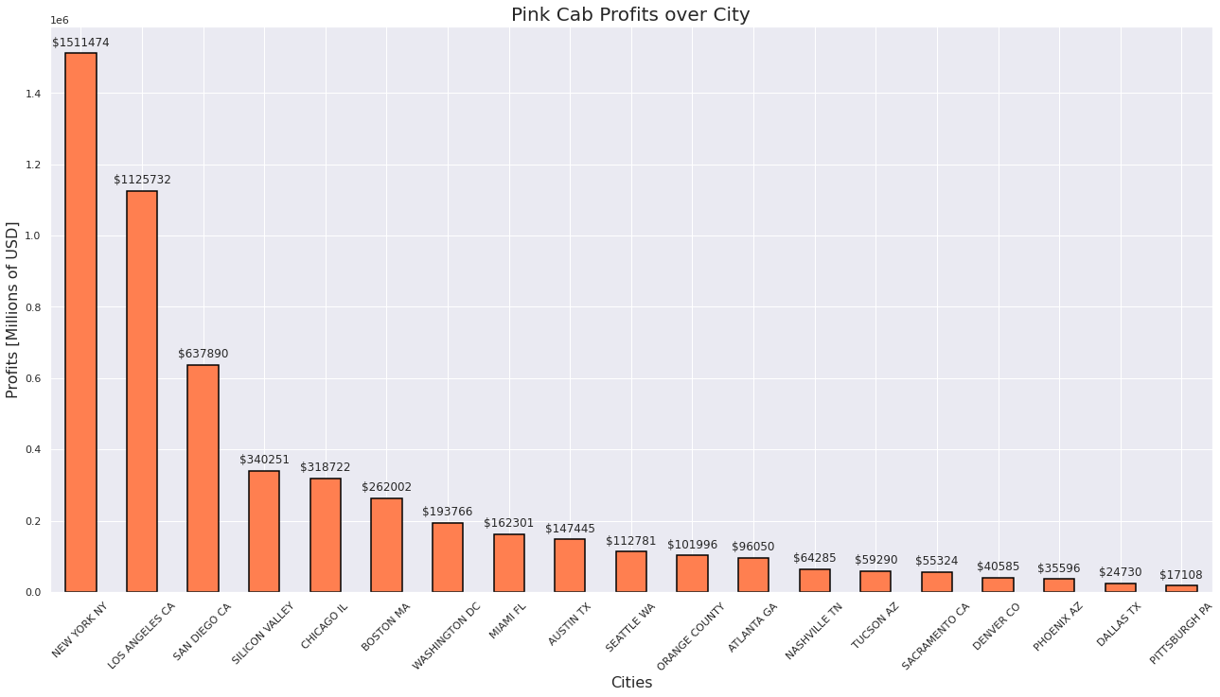
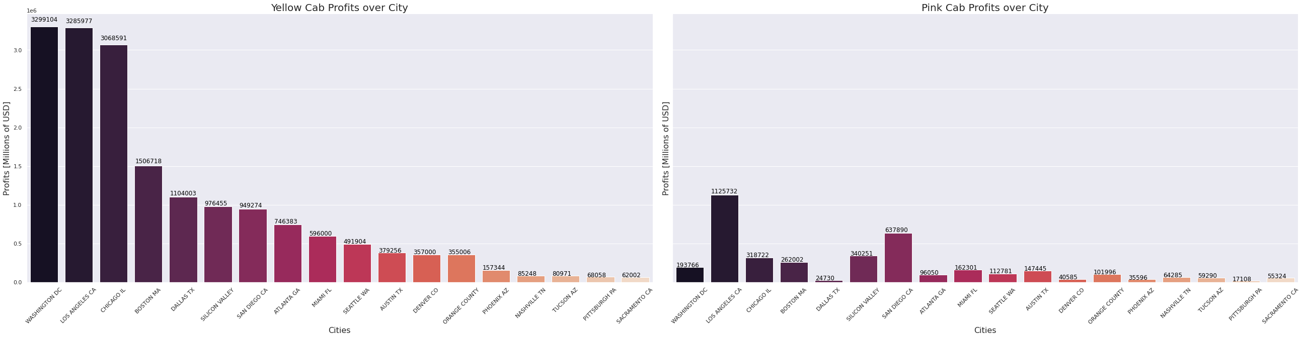
Profit Analysis
Profit Citywise
We can conclude that Yellow Cab has greater marketshare in every City.
In this picture New York has been removed from both companies to get a better sight of the other cities

Slide 10
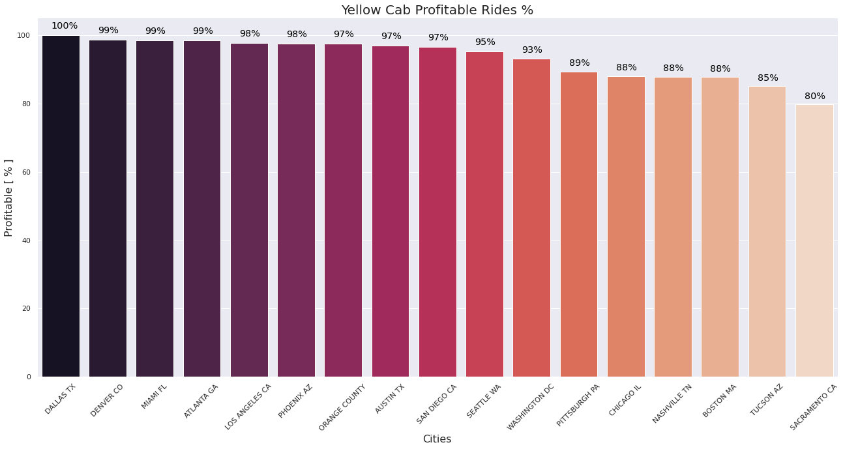
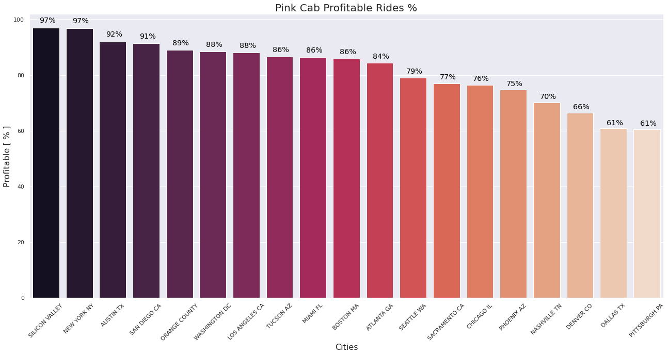
Profitable Rides Citywise
Now, we can answer the third hypothesis. Profitable Rides change by cities, and of course, according to the Company we can see some differences. Assuming that at a profitable drive rate of 80% the operation performs well; we can see that ...
YellowCab has a high performance acording to it’s operations, mantaining a high level of Profitable Rides in every City.
Pink Cab has a great too, except in Seattle to Pittsburgh.
Moreover, Pittsburgh and Dallas performance are not Good at all, with a percentage of 61%. This means that in those cities, every 10 rides, almost 4 rides are not profitables…

Slide 11
Demand Analysis

Slide 12
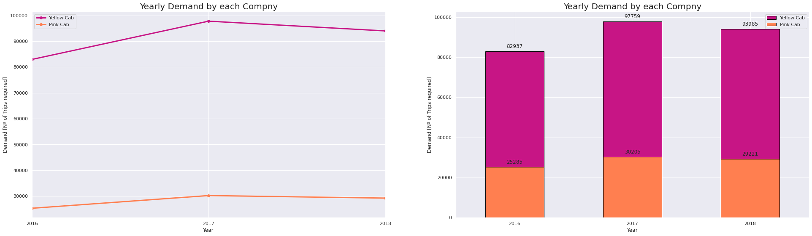
Yearly Demand
97.759
93.985
82.937
30.205
29.221
25.285
As expected, YellowCab Company has a little more than triple the demand of PinkCab Company

Slide 13
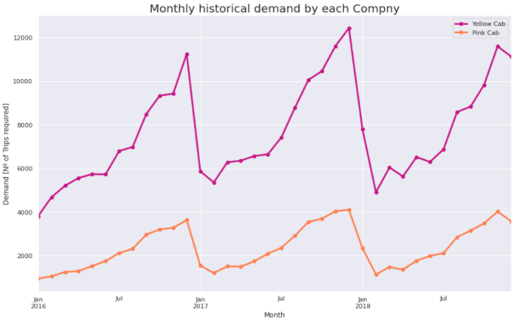
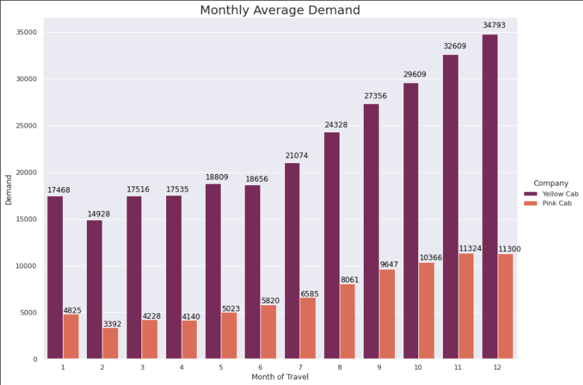
Monthly Demand
We can answer the first hypothesis here.
Both Companys presents a seasonality between the last four months of the year. With a marked drop in the first month of the year
Yellow Cab Company present almost 3 times higher demand over every month

Slide 14
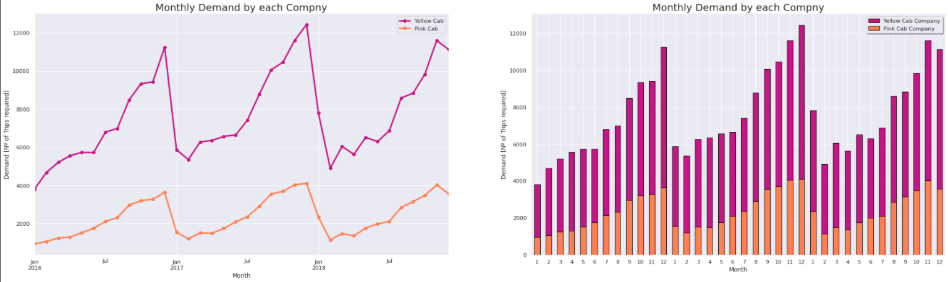
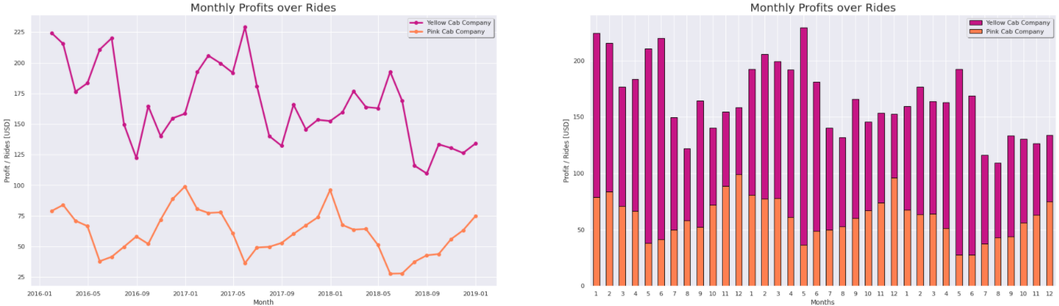
Monthly Demand vs Monthly Profits per Ride
Comparing Monthly demand beahviour against Monthly PoR, we can see that the lower the demand, the more efficient the company in terms of PoR.

Slide 15
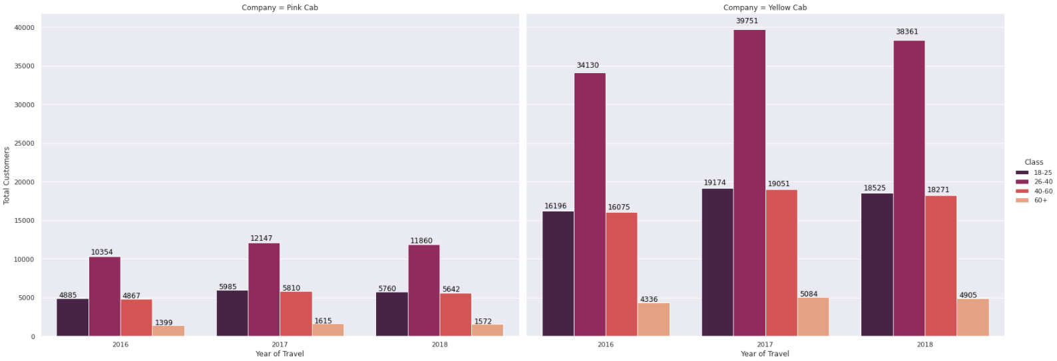
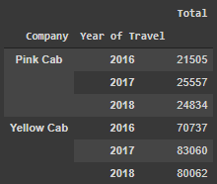
Demand Agewise
47,9 %
48,24 %
23,14 %
22.82 %
22,89 %
22,72 %
48,14 %
22,71 %
6,13 %
61,12 %
Answering the third hypothesis, the demand according the age group, is steady over the time, and over the company .

Slide 16
Customer Analysis

Slide 17
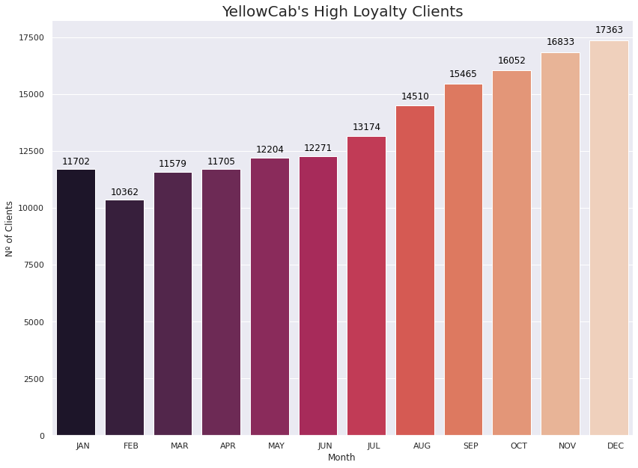
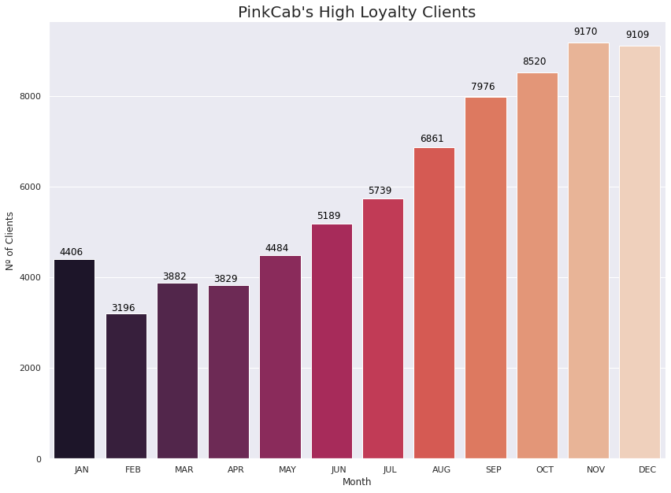
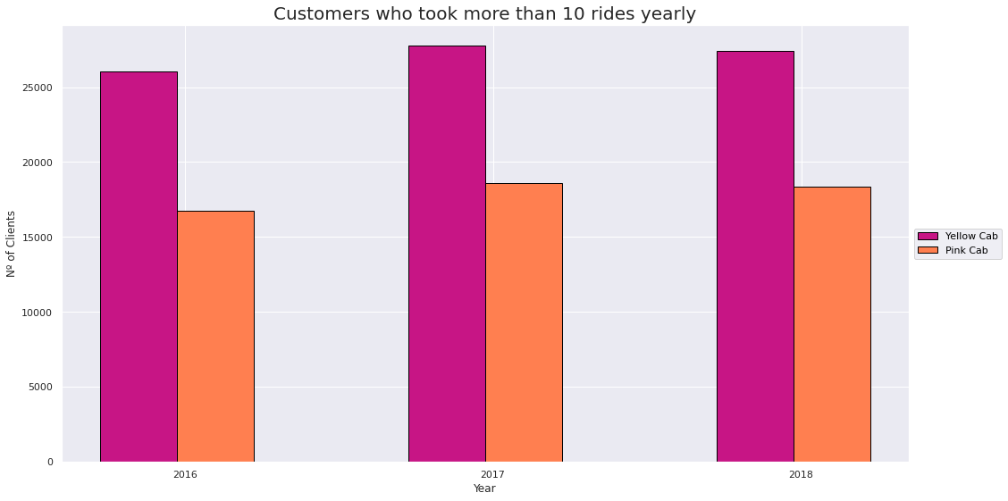
Loyalty Rates
To analyze the Loyalty rates, I define 2 classes:
Medium Loyalty Customers: Customers who took more than 10 rides yearly
High Loyalty Customers: Customers who took more than 10 rides monthly
YellowCab Company has better Loyalty Rates over both classes.

Slide 18
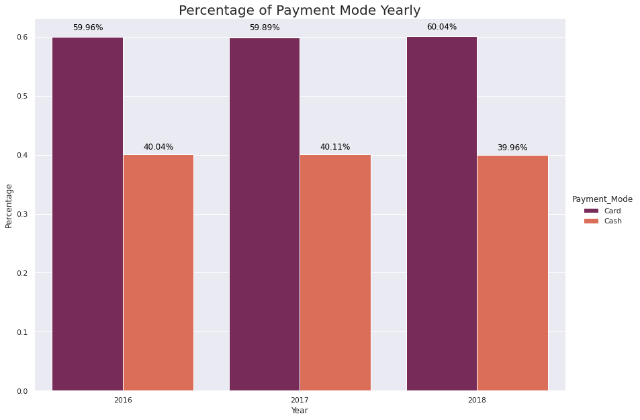
Payment Mode Distributions – Over Time
Minimal deviations over time.
60% Card
40% Cash

Slide 19
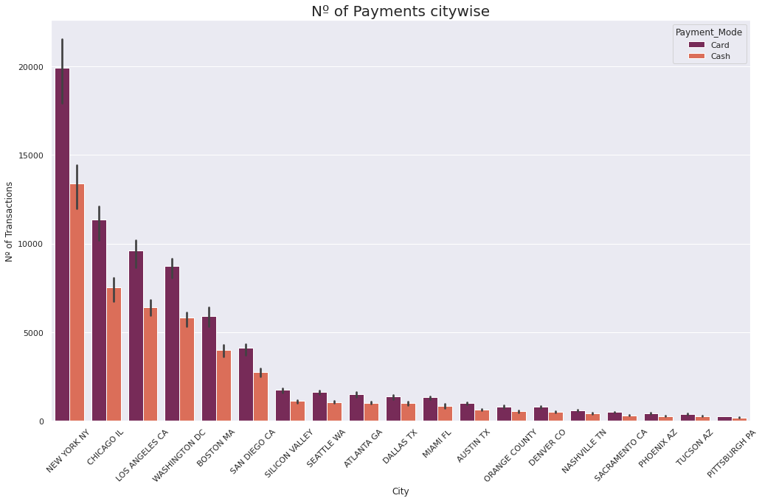
Payment Mode Distributions – Citywise
Minimal deviations citywise…
60% Card
40% Cash

Slide 20
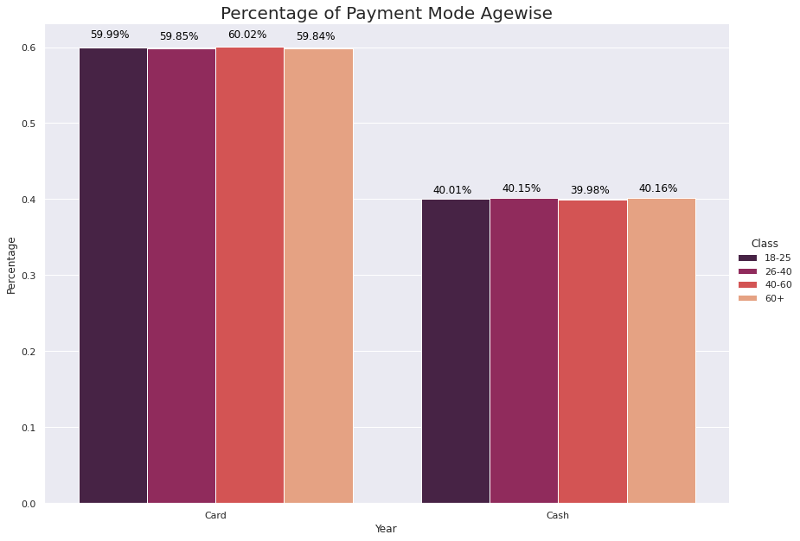
Payment Mode Distributions – Agewise
Finally, minimal deviations agewise…
60% Card
40% Cash

Slide 21
Recommendations
I have evaluated both the cab companies on following points and found Yellow cab better than Pink cab:
Profit Analysis
Profits: Higher Profits over the time and less fluctuations monthly
Profits over Rides: Better PoR rate among time. Yellow Cab has 2.5 more Profits over Ride
Profits Citywise: Yellow Cab has greater market share in every City.
Profitable Rides: Assuming that over a rate of 80% PR, the company performs well. Yellow Cab has a high performance among every city. In contrast, Pink Cab does not perform well in 8 cities.
Demand Analysis
Demand: Yellow Cab has more than triple the demand of Pink Cab Company
Demand Agewise: Both companies present the same distribution of Demand Agewise
Customer Analysis
Loyalty Rates: Assuming both classes, Yellow Cab has a higher High Loyalty Rate and Medium Loyalty Rate
Payment Mode Distributions: Both companies present the same distribution of Payment Mode over time, citywise and agewise.
On the basis of above point , I will recommend Yellow cab for investment.

Slide 22
Thank You

