Slide 1
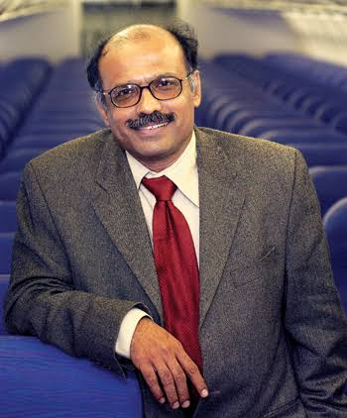
CASE STUDY Captain G. R. Gopinath
Presented By:
Devashish (1AT17IS025)
Taha (1AT17IS050)
Ankit (1AT17IS011)
Neha (1AT17IS057)

Slide 2
INTRODUCTION
Born In: 13 November 1951 , Gorur Karnataka .
Nationality: Indian.
Known As: Entrepreneur, Founder of Air Deccan.
Education: Indian Military Academy, Sainik School, Bijapur, National Defence Academy.

Slide 3
Captain Gorur Ramaswamy Iyengar Gopinath is a multi-faceted personality. He comfortably shifted into different guises:
An Army Officer
An independent political candidate
An eco- friendly farmer
A well known author
India's leading business man.

Slide 4
He is well known as a pioneer of low-cost airlines, a venture capitalist who revolutionized the face of Indian aviation in the country.
His book "Simply Fly" sheds light on the remarkable journey of turning his ambitious vision into a successful business story.

Slide 5
EARLY LIFE
Captain Gopinath hails from a small town known as Gorur located in the Hassan district in Karnataka state.
He finished his early schooling at the Sainik Military School that was situated in Bijapur before he joined the famed National Defence Academy and then passed out from the Indian Military Academy.
Once he was done with his graduation he was appointed as an Officer of the Indian Army.

Slide 6
CAREER
Once he joined the Army, Captain Gopinath served for eight years before he retired from the 'Armed Forces'. Thereafter he became interested in farming and later started a hotel in Hassan.
It was not until the year 1995 when the government took measures to improve the aviation sector in India, several rules where relaxed in order to encourage entrepreneurs to invest and explore air transportation.
The reforms initiated by the management did see positive results as many new players started to show a keen interest in this sector, Captain Gopinath was also one among them.

Slide 7
It was him and a close friend from the armed services who came together with the idea to start a private commercial helicopter service known as Deccan Aviation.
In 1997, the service became operational, while Bangalore became its headquarters. The helicopter service extended to cities like Ahmedabad, Cochin, Delhi, Indore, Mumbai, Chennai, Kolkata, Bangalore, Hyderabad, Bhubaneswar, Jamshedpur and Coochbehar.
This aviation company began with just a single helicopter, but currently boasts of a fleet that commutes across several destinations in the country.

Slide 8
In 2003, Captain Gopinath began his first air-craft service known as Air Deccan, this air service was a low-cost brand, the main aim was to fulfill the comman man's dream to fly.
Air Deccan was one of the first low-cost services in India and was an instant success but due to the excessive competiton from other similar airline carriers, Air Deccan soon started to lose out to the competition.

Slide 9
DOWNFALL
The company's overwhelming growth also saw the entry of several other low cost airbuses such as Indigo Airlines, Go Air, Spice Jet and Jet Lite.
In 2007, Captain Gopinath was left with no other altenative but to consolidate with the Kingfisher Airlines, the merger earned him substanial profits.
Currently Air Deccan is known as Kingfisher Red with Vijay Mallya being the CEO and Chairman. Meanwhile, the helicopter services exteneted to Sri Lanka in 2004 promoting itself as a major private charter services.

Slide 10
The year 2009 saw Captain Gopinath get into the role of a politician when he stood as an independent candidate in the Lok Sabha elections, but failed to gather sufficent support from the general public.
In 2009 he also started Deccan 360 also known as Deccan Cargo & Express Logistics was a cargo airline based in Bangalore, India which ceased to exist in 2011.

Slide 11
AWARDS AND HONOURS
1996 - Rolex Awards for Enterprise
2005 - Rajyotsava Award (Karnataka)
2007 - Chevalier de la legion d’Honneur (France)
Personality of the Decade Award (K.G. Foundation)
Sir M Visvesvaraya Memorial Award (Federation of Karnataka Chambers of Commerce & Industry)

Slide 12
TIMELINE
1997: He started Deccan Aviation operations.
2003: He commenced Air Deccan operations.
2004: Deccan Aviation extended to Sri Lanka.
2007: Air Deccan merged with Kingfisher Airlines.
2009: He commenced Deccan 360 and ran for the Lok Sabha elections as an independent candidate.
2014: Ran for Lok Sabha elections on the ticket of Aam Aadmi Party.

Slide 13
CONCLUSION
“I as an entrepreneur am an optimist. Optimism is the essence of entrepreneurship” – G. R. Gopinath.
Don’t give up, be optimistic.

Slide 14


