Slide 1

Importance of Electronic Records and Digital Signature
Presented By:
Ankit Bharat - 1AT17IS011
Devashish - 1AT17IS025
Jaffer Naveed - 1AT17IS032
Mohd Taha - 1AT17IS050
Owais Ahmed - 1AT17IS059

Slide 2



Slide 3
What are electronic Records?

Slide 4
Record
“Any combination of text, graphics, data, audio, pictorial or other information
representation in digital form that is created, modified, maintained, archived, retrieved
or distributed by a computer system is called electronic record.”

Slide 5
Benefits of electronic records
Reliable Backups.
Electronic records are easily amended and updated.
Better Searching Capabilities.
Electronic records use space much more efficiently than paper records.

Slide 6
Benefits of electronic records continue.
Improved Timeliness.
Electronic devices are modern, efficient, streamlined and attractive to users.
Computer-generated records, for example, those stored in a database format may generally be retrieved very rapidly.

Slide 7
What is Digital Signature?

Slide 8
A digital signature is a technique that binds a person/entity to the digital data. This binding can be independently verified by receiver as well as any third party.
Digital signatures are the public-key primitives of message authentication.
Digital signature is a cryptographic value that is calculated from the data and a secret key known only by the signer.

Slide 9
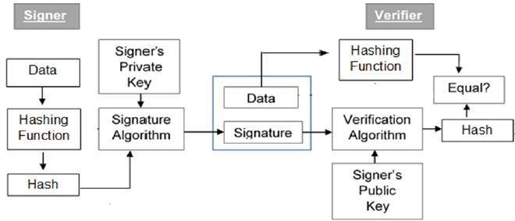
Model of Digital Signature

Slide 10
The following points explain the entire process in detail:-
Each person adopting this scheme has a public-private key pair.
Generally, the key pairs used for encryption/decryption and signing/verifying are different. The private key used for signing is referred to as the signature key and the public key as the verification key.
Signer feeds data to the hash function and generates hash of data.
Hash value and signature key are then fed to the signature algorithm which produces the digital signature on given hash. Signature is appended to the data and then both are sent to the verifier.

Slide 11
Verifier feeds the digital signature and the verification key into the verification algorithm. The verification algorithm gives some value as output.
Verifier also runs same hash function on received data to generate hash value.
For verification, this hash value and output of verification algorithm are compared. Based on the comparison result, verifier decides whether the digital signature is valid.
Since digital signature is created by ‘private’ key of signer and no one else can have this key; the signer cannot repudiate signing the data in future.

Slide 12
Importance of Digital Signature
Digital Signature Provide the non-repudiation of message, message authentication and data integrity. Let us briefly see how this is achieved by the digital signature:-

Slide 13
Message authentication − When the verifier validates the digital signature using public key of a sender, he is assured that signature has been created only by sender who possess the corresponding secret private key and no one else.
Data Integrity − In case an attacker has access to the data and modifies it, the digital signature verification at receiver end fails. The hash of modified data and the output provided by the verification algorithm will not match. Hence, receiver can safely deny the message assuming that data integrity has been breached.

Slide 14
Non-repudiation − Since it is assumed that only the signer has the knowledge of the signature key, he can only create unique signature on a given data. Thus the receiver can present data and the digital signature to a third party as evidence if any dispute arises in the future.

Slide 15
THANK YOU

