Slide 1

Group No. - 11
Aman Kumar - 1AT17IS008
Ashish Shukralia – 1AT17IS014
Mohd Taha – 1AT17IS050
File Structure Project Presentation
Notes:
ATRIA INSTITUTE OF TECHNOLOGY

Slide 2
Abstract
The purpose of the “Cyber Cafe Management System” is to automate the exisiting manual system.
This project is to manage a Cyber Cafe to reduce the burdon of Admin by automating several task. CCMS is user friendly.
It minimises the redundant entry of the data as well as errors.
It can assist the user to concentrate on the other activities rather concentrate on record keeping.
File Structure Project Presentation
Notes:
ATRIA INSTITUTE OF TECHNOLOGY

Slide 3
Introduction
“Cyber Cafe Management System” is a stand alone Application that proviedes the online help to the user and is designed so that clients/users can easily do their work online.
This project is to manage a Cyber Cafe to reduce the burdon of Admin and making it user friendly by automating the modules using algorithms. CCMS consists of 4 module.
File Structure Project Presentation

Slide 4
Introduction Cont...
User: This module is used by the anyone who wants to do the browsing & surfing.
Admin: To maintain the day to day data of the users.
Login: Can be used by both admin as well as users. This is more useful for Admin.
Reports: Admin can generate several reports such as number of users did the browsing, Receipt generation and data filters such as searching, sorting and deleting. It keeps the data of users for security and government mandate.
File Structure Project Presentation

Slide 5
Introduction Cont...
Each field of data is seperated by Pipe (“|”) and each record is seperated by new line.
Front End:
    Java, J2EE, html.
    BackEnd:
    Flat (Ordinary file).
File Structure Project Presentation

Slide 6
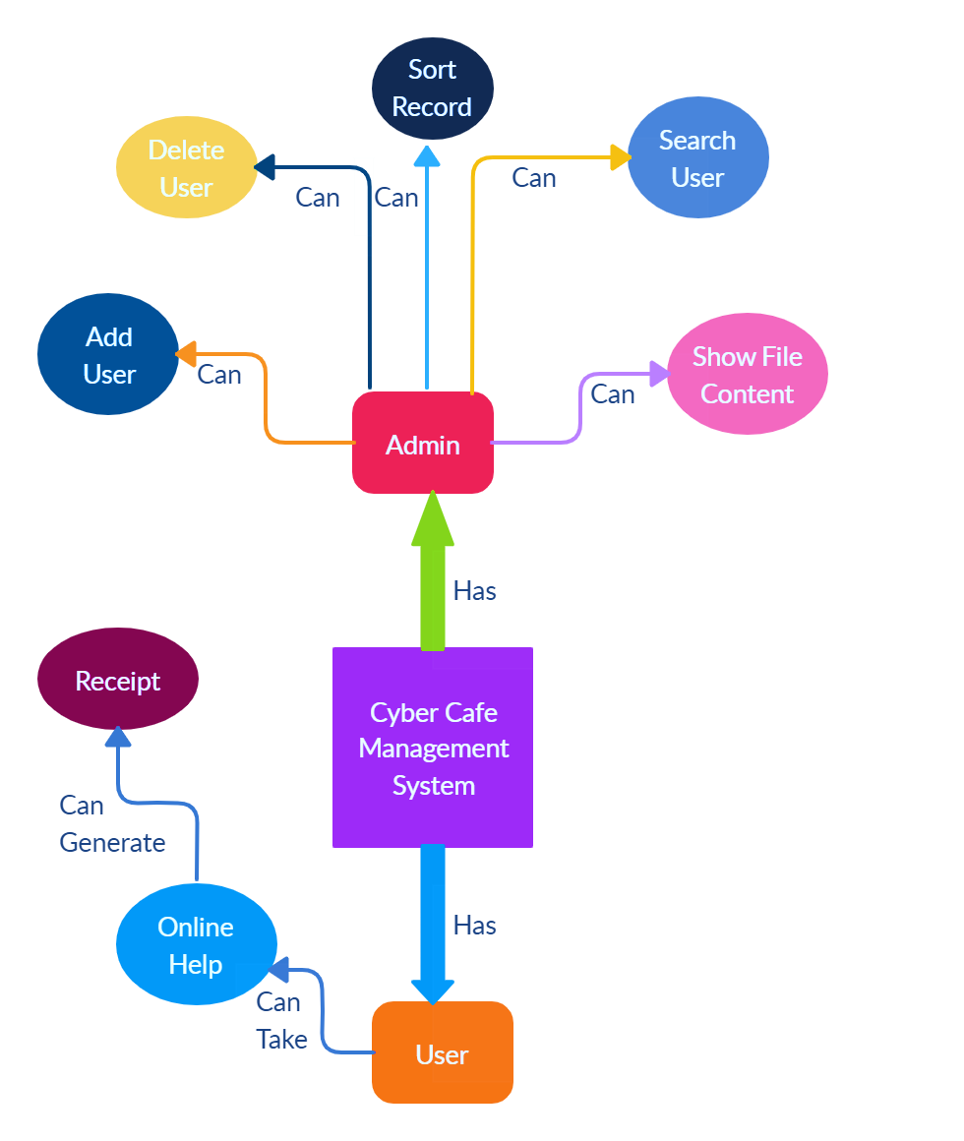
Architecture Design
File Structure Project Presentation
Notes:
ATRIA INSTITUTE OF TECHNOLOGY

Slide 7

Methodology Used
File Structure Project Presentation

Slide 8
Algorithm Used
Boyer–Moore (BM) string-search algorithm for pattern searching:
Boyer–Moore string-search algorithm is an efficient string-searching algorithm.
It was developed by Robert S. Boyer and J Strother Moore in 1977.
Boyer Moore algorithm uses the following steps :-
1) Construct Bad Match Table, and
2) Start Comparing the pattern with the given text.
File Structure Project Presentation

Slide 9
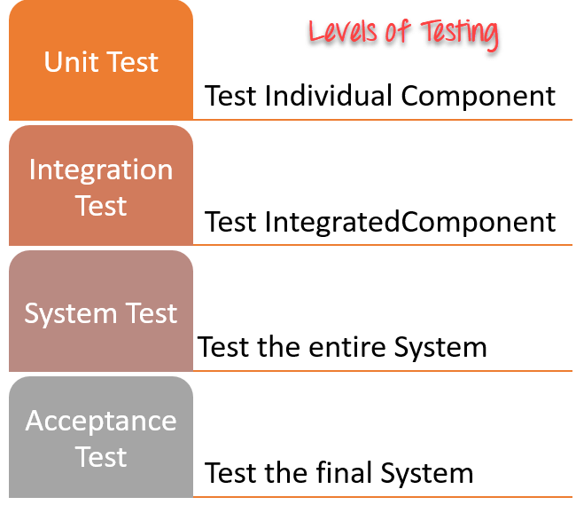
Testing
File Structure Project Presentation

Slide 10
Demo
File Structure Project Presentation

Slide 11
Conclusion
CCMS automates the existing manual system to reduce the Admin’s burdon with the help of computerized equipment & it’s softwares.
The required software and hardware are easily available and easy to work with.
Future Enhancement:
  Systems availability.
  Online Payment.
File Structure Project Presentation

Slide 12
References
https://www.w3schools.com
http://eclipse.org
https://www.geeksforgeeks.org/java/
https://www.tutorialspoint.com/java/
http://www.telusko.com
http://www.formyscholars
Java the complete reference.
File Structure Project Presentation

Slide 13
Questionnaire Time.!!!
File Structure Project Presentation

Slide 14
Thank You!!
File Structure Project Presentation

