Slide 1
eGuard – Fall Detector
project MILESTONE 2
- Narahari Sundaragopalan

Slide 2
Project Goals
Android application, focused for elderly people, for fall detection and raise emergency alerts
Use Metawear device’s 3-axis accelerometer to detect and monitor user activity
Determine and differentiate various user movement patterns
Continuously monitor transition of user movements from one type to another
Calculate a threshold value for scenarios to differentiate a fall from normal movements.
Calculate the change in acceleration for each transition and compare with a threshold value
Raise an alert in case a fall is detected.

Slide 3
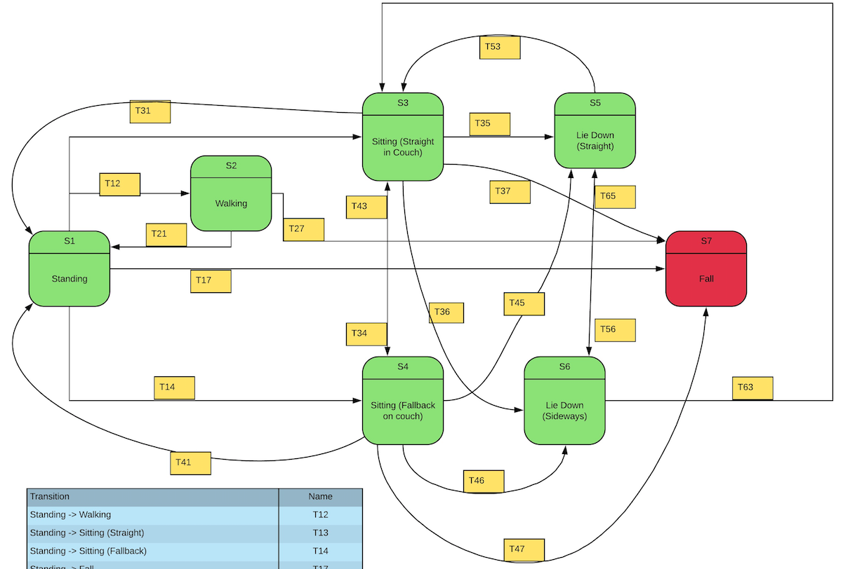
State Diagram

Slide 4
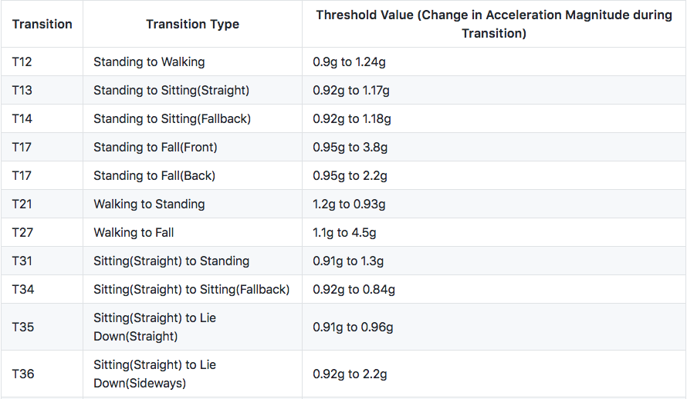
Transitions in User Movement

Slide 5
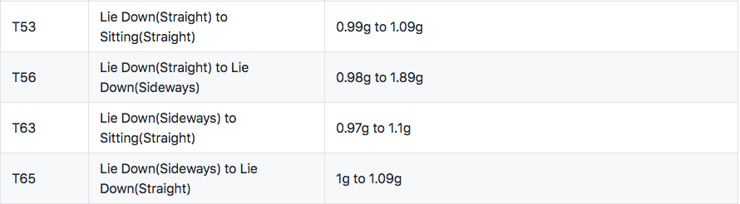
Transitions in User Movement

Slide 6
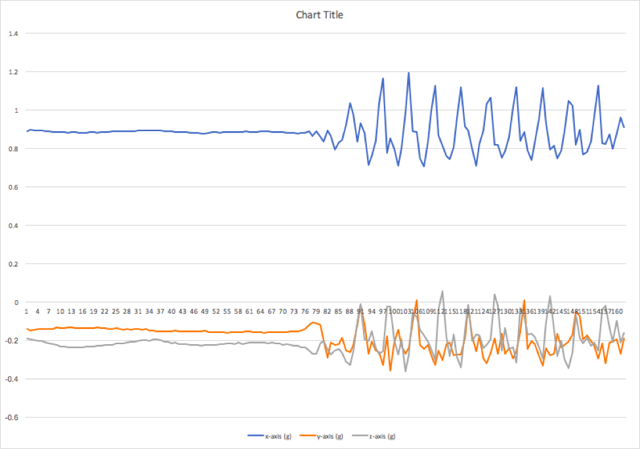
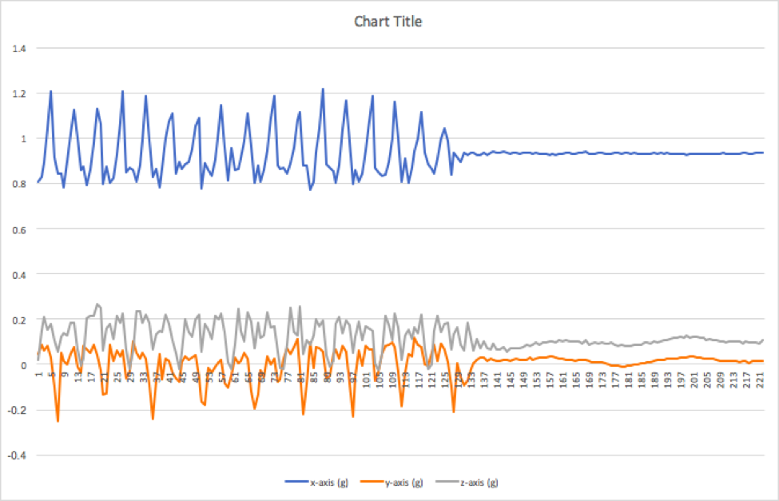
Graphs to indicate Transitions
T12 – Standing to Walking
T21 – Walking to Standing

Slide 7
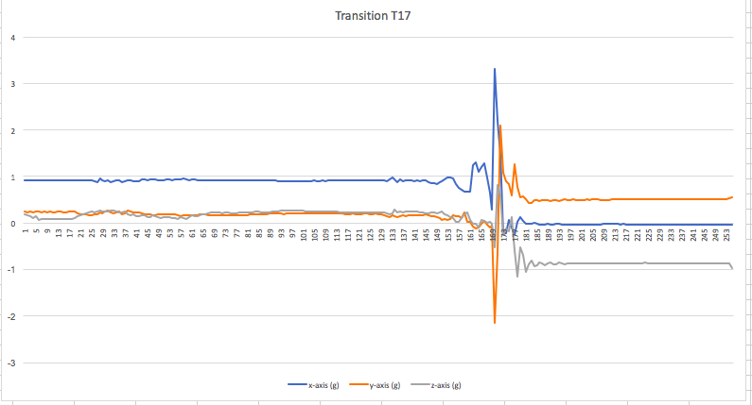
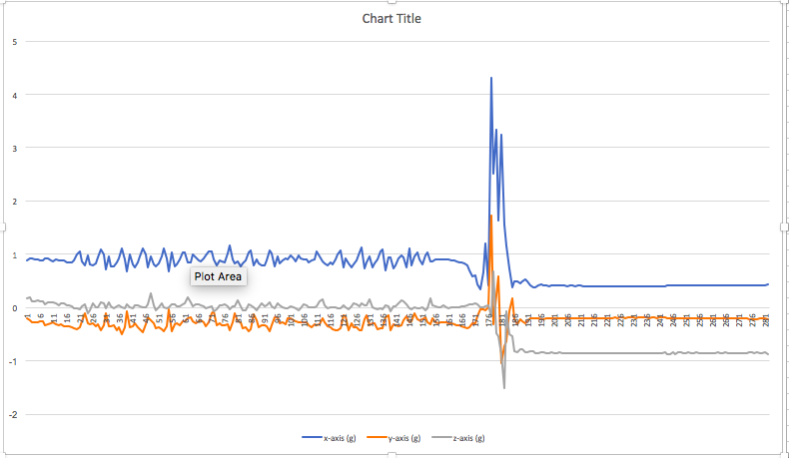
Graphs to indicate Transitions
T17 – Standing to Falling
T27 – Walking to Falling

Slide 8
User Story 1
User Story 1
As a user, I want to identify the different user movements of a user, such as Sitting (Straight & Fallback), Standing, Sleeping (Straight & Sideways) and continuously stream accelerometer data
Acceptance Criteria
When a person is walking, standing or sleeping, the application should monitor these normal movements continuously

Slide 9
User Story 2
User Story 2
As a user, I want to be able detect transitions in movement patterns of a user such as from Sitting to Standing; Standing to Walking; Sitting to Sleeping; etc. to reduce false positives
Acceptance Criteria
When a person makes a transition from type of movement to another, the application should monitor and check for the change in acceleration of the user continuously, and differentiate between normal transitions and fall transitions

Slide 10
User Story 3
User Story 3
As a user, I want to know if the user's transition indicates a fall and the application should send an emergency alert SMS
Acceptance Criteria
Application should monitor the user acceleration and correctly indicate, if the user has fallen, based on sudden increase in acceleration by checking a threshold value, and send an SMS to emergency contact

Slide 11
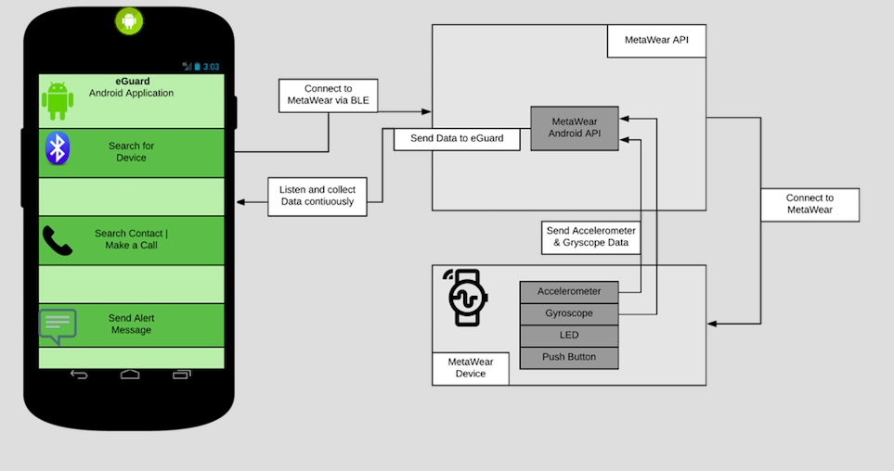
Architecture

Slide 12
Threshold Value Calculation
Magnitude of Acceleration (in terms of “g”) =
Square Root of the Sum of the Squares of the values in each of the axes of the accelerometer.
Acceleration = { Square Root of ( X² + Y² + Z² ) } * g
X – Reading in X-Axis of Accelerometer
Y – Reading in Y-Axis of Accelerometer
Z – Reading in Z-Axis of Accelerometer
g – Acceleration due to gravity (9.81 m/s²)
Threshold Values for all cases are specified in the Table in terms of ”g”

Slide 13
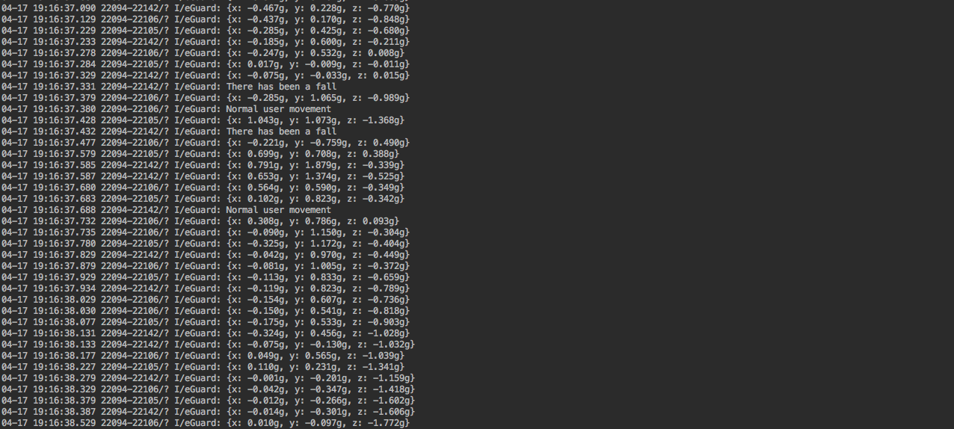
Streaming Acceleration Data to detect Fall

Slide 14
To Be Done
Need to ensure connection to the device every time and test for false positives with actual fall case.
Improve the Layout of the front-end of the application
Send an alert SMS when threshold is reached

Slide 15
Issues Faced
Losing connection with Metawear device intermittently, while testing has hampered testing the transitions with my app
Due to Loss in connection, application is not connecting every time and collecting the data for a proper demo

Slide 16
Questions

