Slide 1

eGuard – Fall Detector
MILESTONE 3
- Narahari Sundaragopalan

Slide 2
Project Goals
Android application, focused for elderly people, for fall detection and raise emergency alerts
Use Metawear device’s 3-axis accelerometer to detect and monitor user activity
Determine and differentiate various user movement patterns
Continuously monitor transition of user movements from one type to another
Calculate a threshold value for scenarios to differentiate a fall from normal movements.
Calculate the change in acceleration for each transition and compare with a threshold value
Raise an alert in case a fall is detected.

Slide 3

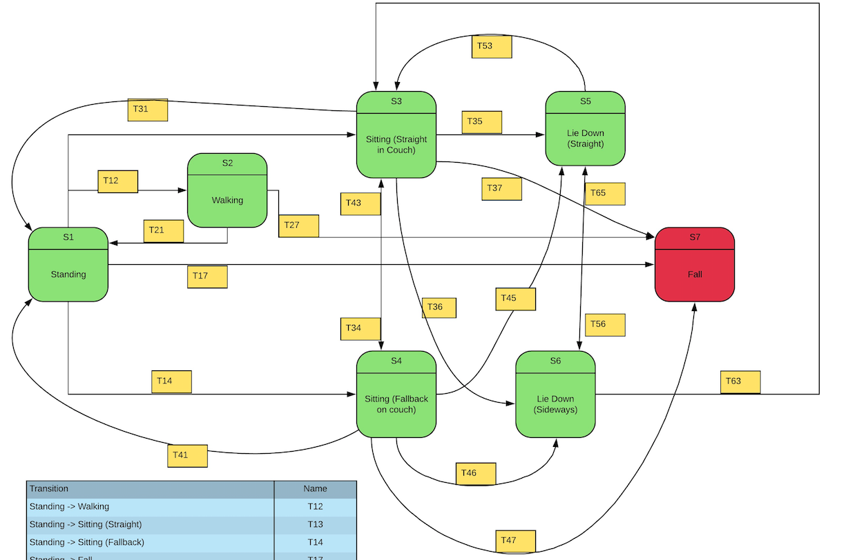



State Diagram

Slide 4

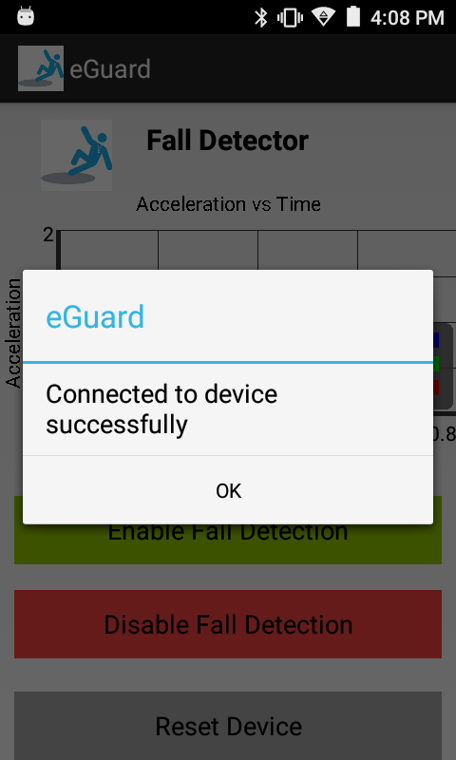
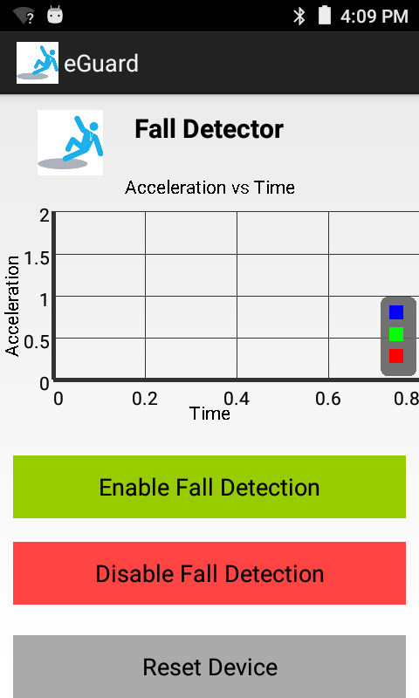
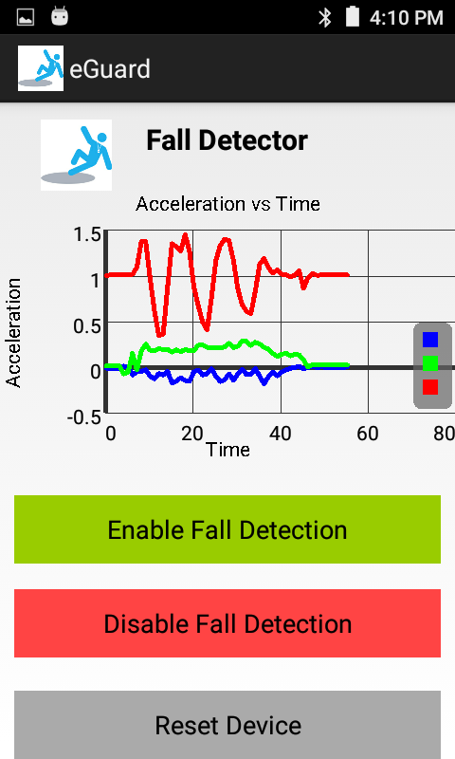
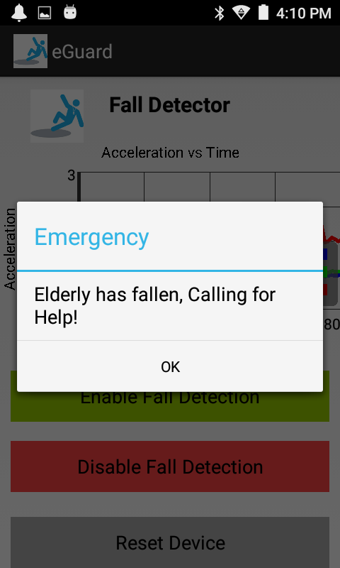
App Demo

Slide 5
Future Improvements
Stream the acceleration to a backend server and create a graph for continuous visualization
Search for Emergency Contact from Phone Book and make a call

Slide 6
Link to Releases/APK
https://github.com/Narahari-Sundaragopalan/eGuard/releases

Slide 7
Questions? THANK YOU

