Slide 1

eGuard – Fall Detector
MILESTONE 3
- Narahari Sundaragopalan

Slide 2
Project Overview
Android application, focused for elderly people, for fall detection and raise emergency alerts
Use Metawear device’s 3-axis accelerometer to detect and monitor user activity
Determine and differentiate various user movement patterns
Continuously monitor transition of user movements from one type to another
Calculate the change in acceleration for each transition and compare with a threshold value
Raise an alert in case a fall is detected.

Slide 3

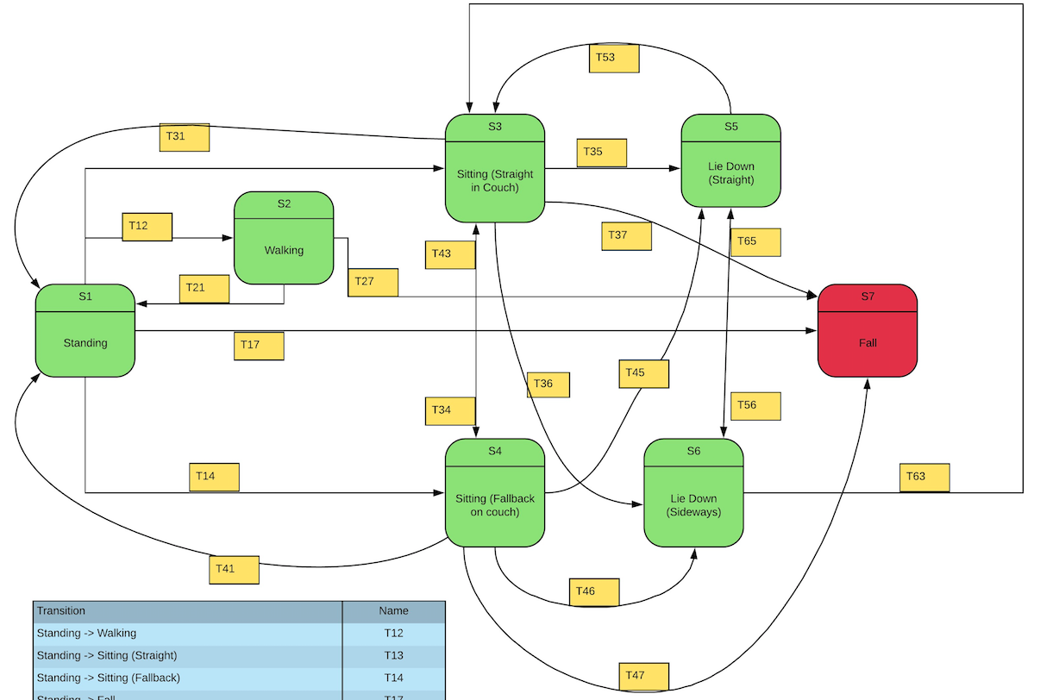



State Diagram

Slide 4
Accomplishments
Raising Alerts
Creating Notification
Streaming Real time Acceleration data to app
Working Demo and MetaWear

Slide 5

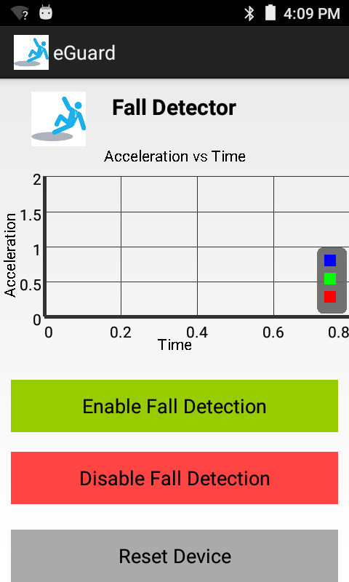
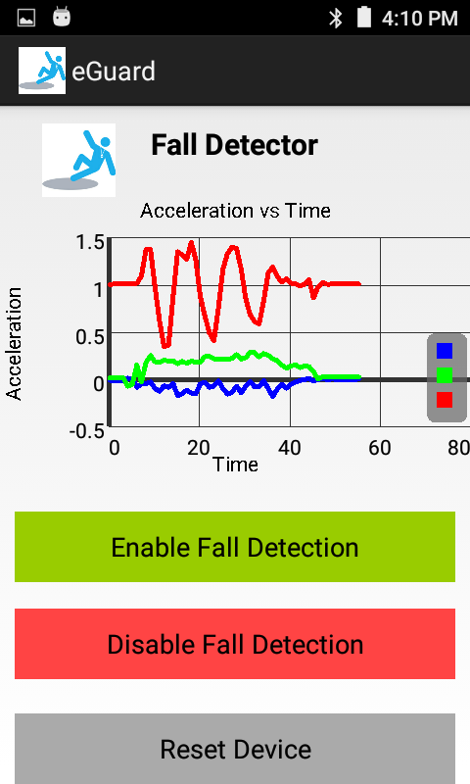
App Demo

Slide 6
Future Improvements
Improve mechanism to calculate threshold by considering all pattern movements, by learning over a period of time
Stream the acceleration to a web server and create a real-time visualization over a web application
Search for Emergency Contact and make a call or send an SMS using a Web Service
Make Front-end responsive

Slide 7
Link to Releases/APK
https://github.com/Narahari-Sundaragopalan/eGuard/releases

Slide 8
Questions? THANK YOU

