Slide 1
CYBR 8080 -eGuard
project MILESTONE 2

Slide 2
Project Goals
Android application, which uses Metawear device for fall detection and emergency alerts
Use Metawear device’s 3-axis accelerometer to detect and monitor user activity
Determine and differentiate various user movement patterns
Continuously monitor transition of user movements from type to another
Calculate a threshold value for scenarios involving a fall
Calculate the change in acceleration for each transition and compare with a threshold value
Raise an alert in case a fall is detected

Slide 3
User Stories - Recap
User Story 1
As a user, I want to detect the different user movements of a user during the course of a day, such as Sitting (Straight & Fallback), Standing, Sleeping (Straight & Sideways)
Acceptance Criteria
When a person is walking, standing or sleeping, the application should monitor these normal movements continuously
User Story 2
As a user, I want to be able detect transitions in movement patterns of a user such as from Sitting to Standing; Standing to Walking; Sitting to Sleeping; etc.
Acceptance Criteria
When a person makes a transition from type of movement to another, the application should monitor and check for the change in acceleration of the user continuously, and differentiate between normal transitions and fall transitions
User Story 3
As a user, I want to know if the user's transition indicates a fall and the application should make an emergency alert.
Acceptance Criteria
Application should monitor the user acceleration and correctly indicate, if the user has fallen, based on sudden increase in acceleration by checking a threshold value

Slide 4
Architecture Design
Application opens and connects to Metawear device via BLE
Continuously track user acceleration and changes in user acceleration
Compare acceleration with threshold value and monitor transitions in user movements
In case the threshold value is reached or exceeded, identify the user has suffered a fall, and raise an alert
Send an alert message

Slide 5
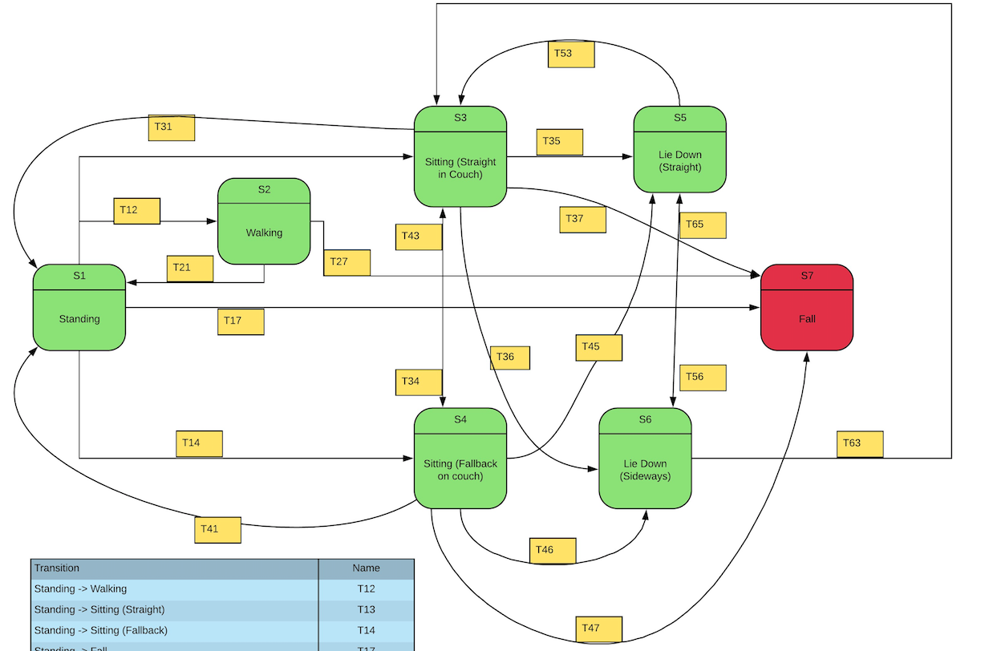
State Diagram

Slide 6
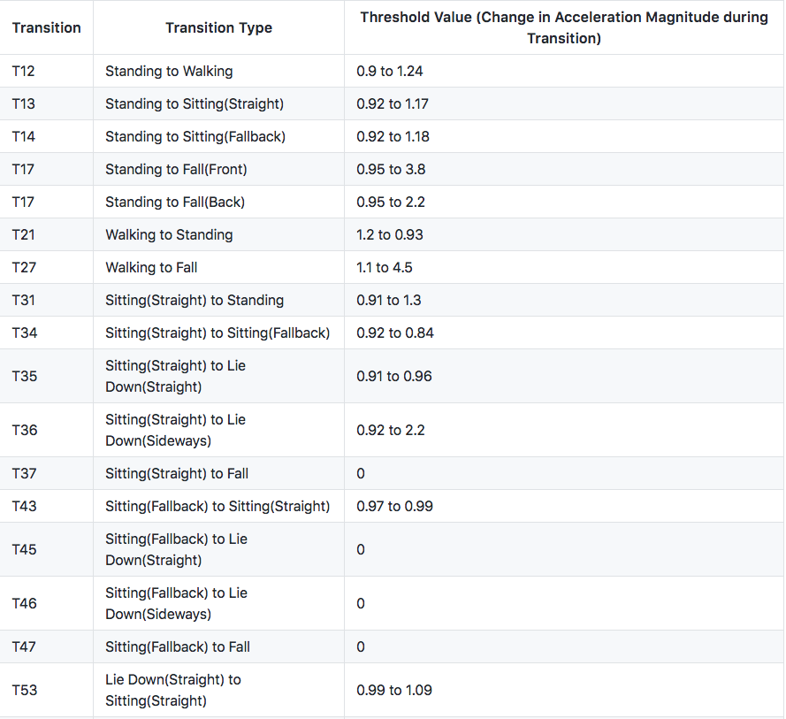
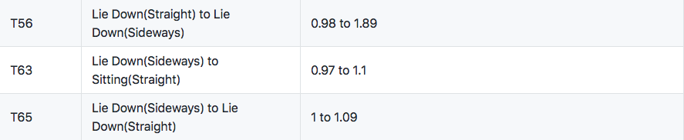
Transitions in User Movement

Slide 7
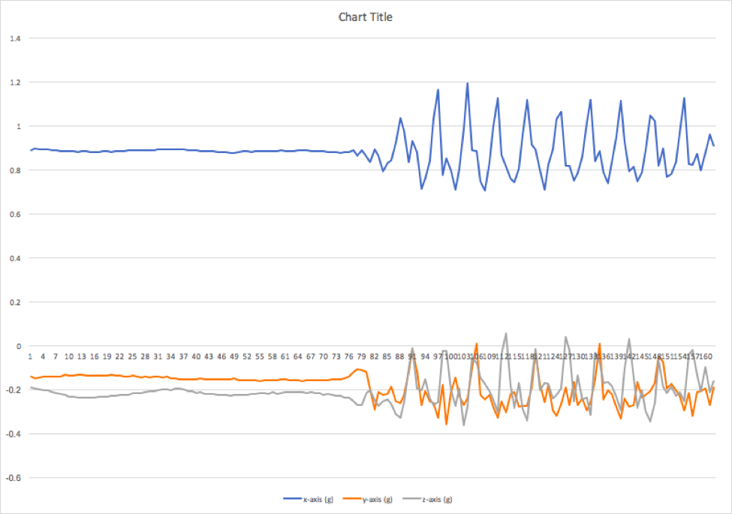
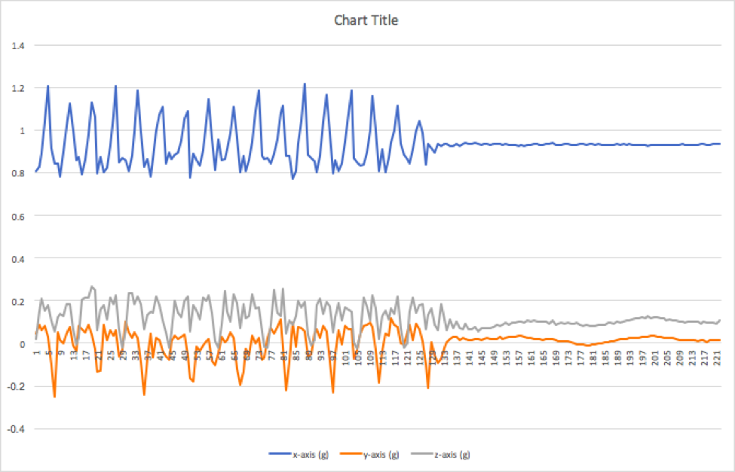
Graphs to indicate Transitions
T12 – Standing to Walking
T21 – Walking to Standing

Slide 8
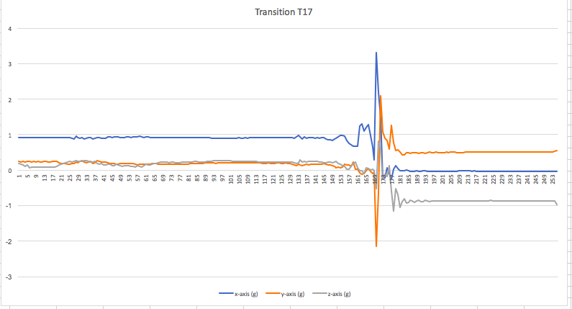
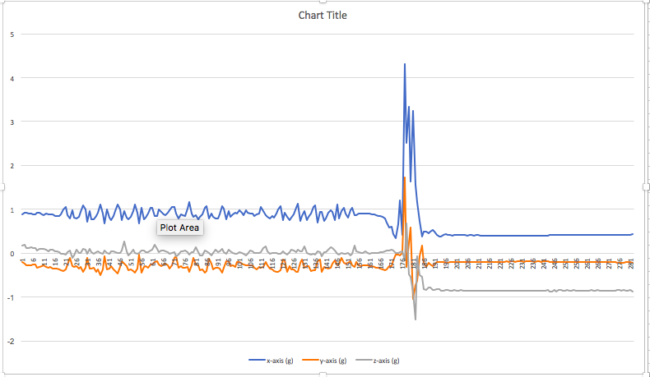
Graphs to indicate Transitions
T17 – Standing to Falling
T27 – Walking to Falling

Slide 9
All graphs in Link below: https://github.com/Narahari-Sundaragopalan/eGuard/tree/master/data-source

Slide 10
Threshold Value Calculation
Magnitude of Acceleration =
Square Root of the Sum of the Squares of the values in each of the axes of the accelerometer.
Acceleration = { Square Root of ( X² + Y² + Z² ) }
X – Reading in X-Axis of Accelerometer
Y – Reading in Y-Axis of Accelerometer
Z – Reading in Z-Axis of Accelerometer
Threshold Values for all cases are specified in the Table

Slide 11
As part of Milestone 2
As specified in User Story 1, I tracked different user movements and corresponding patterns, such as Sitting (Straight & Fallback), Lie Down(Straight & Sideways), Falling, Standing, Walking.
As specified in User Story 2, I detected the transitions from one type of movement to another, and calculated the change in acceleration.
As specified in User Story 3, I calculated a threshold value, for a fall scenario, for the application to compare and raise an alert in such a case.

Slide 12
Issues Faced
Losing connection with Metawear device intermittently, while testing
Unable to connect to the Metawear device on a consistent basis

