Slide 1
Tank Wars
Guandong Liu
Gefei Tian

Slide 2
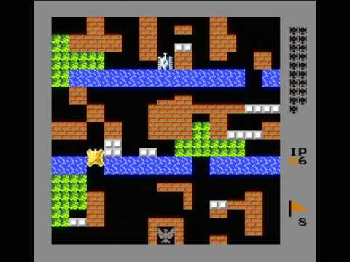
Introductions
The goal for this project is to recreate the classic NES game Battle War from Nintendo.
The original game can be played by
one player in different mode and
different map.

Slide 3
Introductions
Tank wars project is a multiplayer tank battle game. Each player can control a tank to fight against other player.
The game has two different modes
Competitive and death match. In the competitive mode, the player who destroys other player's tank wins the game;
In the death match mode, one player earns one point by killing other player, and the player who scores more points in the limited time wins the game.

Slide 4
Requirements
There are six use cases for this project.
Mode: User can pick from two different game modes, and the application will generate the game by the mode that the user choose.
Tank: There are two types of tank. Each user will be able to choose one type of tank, and the application will star the game by the tank that the user choose.

Slide 5
Requirement
Movement: User can press the key to move the tank. The system will first check if user is able to move towards to this direction, then react.
Fire: User can fire the tank by press the key. The system will first keep track the movement of the bullet, and remove the bullet after it hit anything.

Slide 6
Requirement
Ultimate: Each player can use an ultimate by pressing the key when his energy is 100%. The system will first check if this player be able to use ultimate at this moment, then react.
Winning Condition: After an user fires a bullet or uses the ultimate, the system will check if an user meets the winning condition. If so, then end the game.

Slide 7
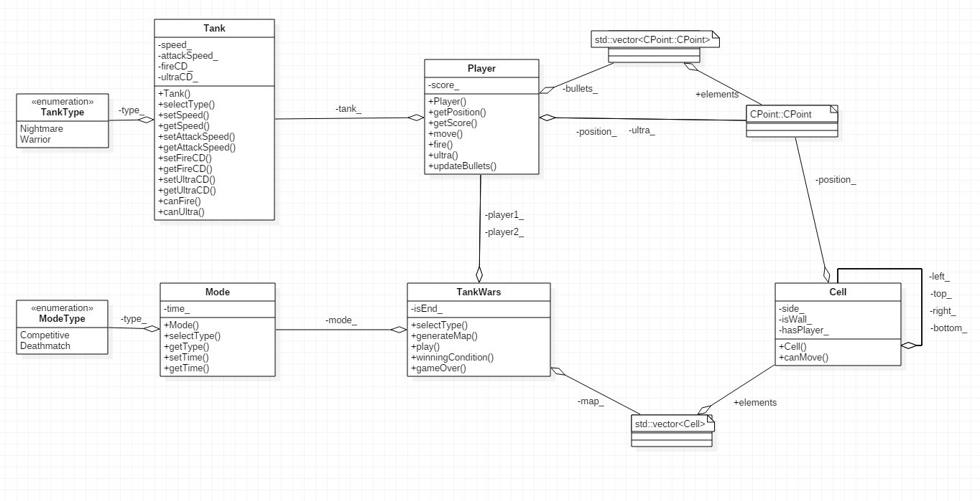
Design
Diagrams

Slide 8
Design: Map
Map is created by list of cells. Each cell has a position, and a Boolean shows if this cell represent a wall or ground.

Slide 9
Design: Game Mode & Tank Type
GameType.h is used to generate two different game mode.
Model will check the GameType first, then set a time limit for the game.
TankType.h generate two different tank type.
Tank will check the TankType first, then set different speed and muzzleVelocity on this Tank, based on the TankType.

Slide 10
Design: Player
A player contain a chose tank type, a score, a position, a direction, an energy that represent the cold down time for the ultimate, and a list off all the bullets this player fired that still shows on the screen. It basically contains all the information that the system need to identify different player.

Slide 11
Design: Display
Display handles everything about display the image on the screen. It will collect information from Tank and Player, then draw it on the screen. All the player’s actions will not directly modify anything contains in this class. Display will refresh on each tick, and collect updated information from player, and re-draw the image.

Slide 12
Discussion
Demonstrate: use of Code::Blocks

Slide 13
Conclusion
This is a basic version of the classic Tank War game from Nintendo. It allows two players to compete with each other in two game modes.
The game could be improved by add another mode, which allows single player compete with AI. Also allows player to play in different map by create a random map generator, or let players create their own map.

Slide 14
References
Apple. "Old Games Are Still In - GamesSaga.com." GamesSaga.com. N.p., 15 Aug. 2014. Web. 15 Dec. 2016.
"Battle City." Pukmo. N.p., n.d. Web. 15 Dec. 2016.
Getjar.com. "Battle City Tank." Free Battle City Tank APK Download For Android | GetJar. N.p., n.d. Web. 15 Dec. 2016.
"Tank 1990 APK Download Free." Bulledi Pc | Download Free Software and Games. N.p., n.d. Web. 15 Dec. 2016.
Baclawski, Ken. "NU CCIS Ontology Web Site." College of Computer and Information Science. N.p., n.d. Web. 15 Dec. 2016.

