Slide 1
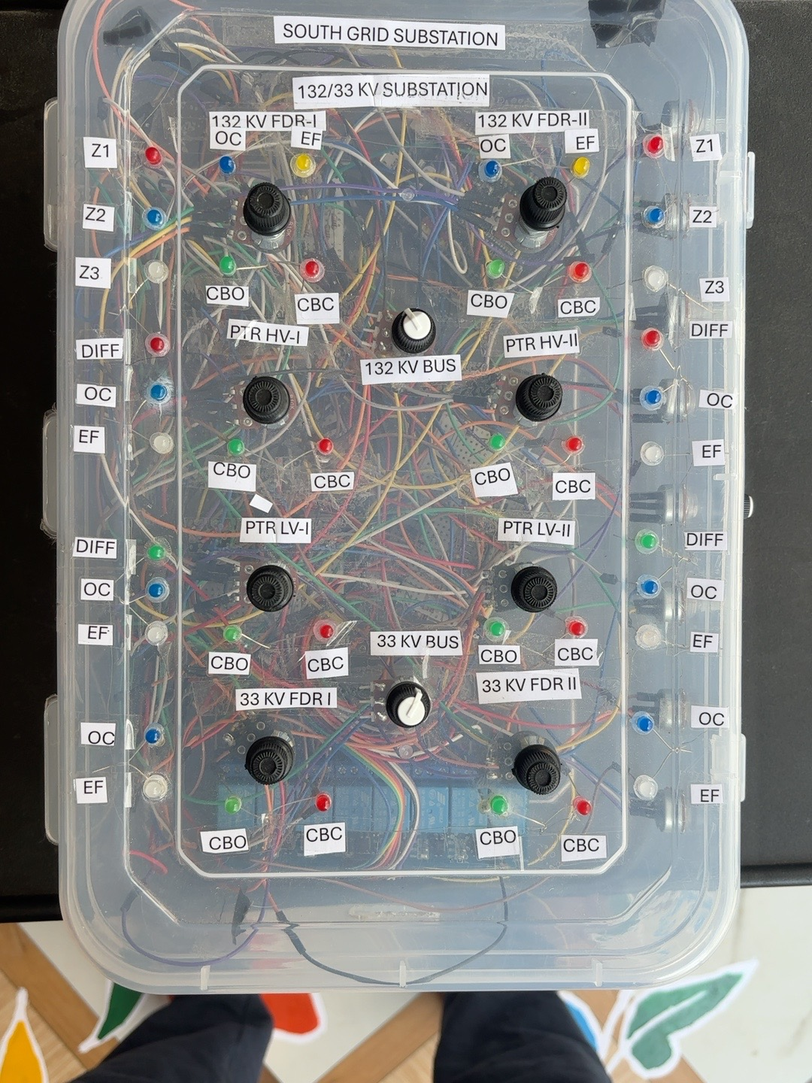
132/33 kV
DIGITAL SUBSTATION
Automation Prototype
ESP32 • Protection • Breaker Control • UART • MQTT • Blynk
Developed by Narala Heshma Sree
B.Tech – Electrical & Electronics Engineering

Slide 2
Project Overview
A physical low-voltage prototype that combines substation mimic, protection logic and IoT supervision.
Measurement
Protection
Automation
132 kV / 33 kV bus voltage, feeder current, transformer HV/LV current and 33 kV feeder current.
Distance Zones 1–3, feeder overcurrent, transformer differential, transformer HV/LV OC and earth fault.
Eight relay outputs for prototype breaker operation plus breaker/mimic status indications.
Communication
Supervision
UART event exchange between ESP32 controllers and MQTT event communication through HiveMQ Cloud.
Blynk IoT dashboard displays measurements, power, breaker status and protection indications.
• Designed as an educational/prototype automation platform
• Hardware is isolated low-voltage demonstration circuitry
• Firmware contains explicit prototype safety notes
132/33 kV Digital Substation Automation Prototype | Narala Heshma Sree
2

Slide 3
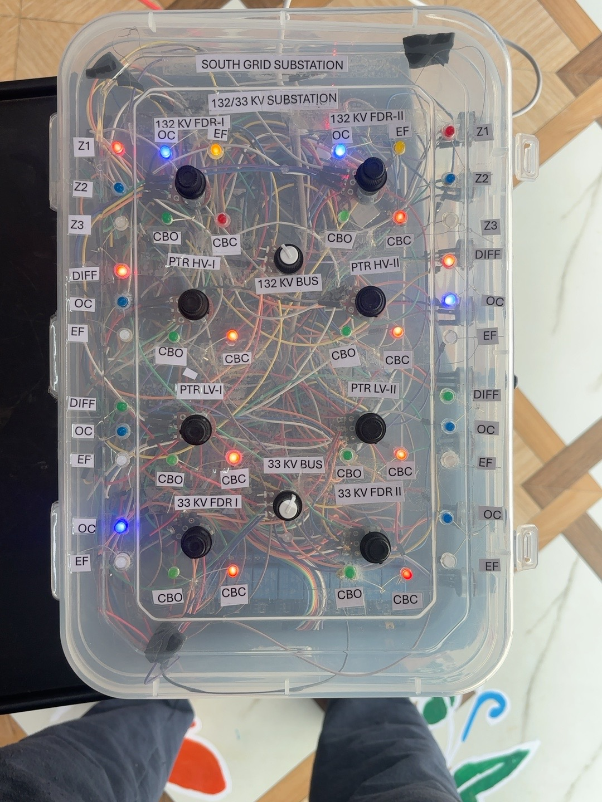
Physical Digital-Substation Prototype
Front-panel mimic and internal controller/relay wiring
• 132/33 kV mimic representation
• 132 kV and 33 kV buses
• Two transformer paths
• Feeder breaker CBO/CBC indications
• Zone 1/2/3 and OC/EF/DIFF annunciation
132/33 kV Digital Substation Automation Prototype | Narala Heshma Sree
3

Slide 4
Substation Model Represented in the Prototype
132 kV FDR-1
132 kV FDR-2
PTR-1
Feeder + distance + OC
Feeder + distance + OC
HV/LV + differential + OC/EF
132 kV / 33 kV bus representation
PTR-2
33 kV FDR-1
33 kV FDR-2
HV/LV + differential + OC/EF
Feeder + OC/EF
Feeder + OC/EF
132/33 kV Digital Substation Automation Prototype | Narala Heshma Sree
4

Slide 5
Controller & Communication Architecture
Distributed prototype control with local UART events and cloud MQTT supervision
• UART carries protection event strings between controllers
• ESP32-S3 drives relay outputs and Blynk measurement/status widgets
• ESP32-DEV handles earth-fault inputs, annunciation and MQTT messaging
ESP32-S3
Measurement + Protection
ESP32-DEV
EF + Annunciation
MQTT / HiveMQ
Event Layer
Electrical
Inputs / Sensors
Blynk IoT
Supervision
132/33 kV Digital Substation Automation Prototype | Narala Heshma Sree
5

Slide 6
Measurement & Telemetry
Analog inputs are converted to prototype engineering values and published to Blynk.
132 kV Bus
33 kV Bus
132 kV FDR-1 / FDR-2
Voltage
Voltage
Current
PTR-1 / PTR-2 HV
PTR-1 / PTR-2 LV
33 kV FDR-1 / FDR-2
Current
Current
Current
Approximate power calculation
The source calculates demonstration power values from the measured voltage and current. The firmware comments explicitly identify this as a simplified demonstration calculation.
132/33 kV Digital Substation Automation Prototype | Narala Heshma Sree
6

Slide 7
Protection Functions Implemented in the Prototype
Distance
Zone 1 • Zone 2 • Zone 3 | 132 kV feeders
Overcurrent
Feeder OC | 132 kV + 33 kV
Differential
Transformer DIFF | PTR-1 + PTR-2
Transformer OC
HV OC + LV OC | PTR-1 + PTR-2
Earth Fault
Dedicated EF channels | Feeders + transformer HV/LV
132/33 kV Digital Substation Automation Prototype | Narala Heshma Sree
7

Slide 8
Distance Protection
Prototype three-zone logic using approximate apparent impedance Z = V / I
Zone 1
Zone 2
Zone 3
Instantaneous
Z ≤ 0.264
1 s delay
Z ≤ 0.330
2 s delay
Z ≤ 0.377
Measured V + I
Z = V / I
Zone decision
Trip + Annunciation
+ UART event
• The supplied firmware includes separate distance handling for both 132 kV feeder paths.
• Zone thresholds and delays are prototype values from the supplied source.
132/33 kV Digital Substation Automation Prototype | Narala Heshma Sree
8

Slide 9
Overcurrent & Transformer Protection
Feeder OC
33 kV Feeder OC
PTR-1
132 kV feeder-1 and feeder-2 overcurrent pickup logic.
33 kV feeder-1 and feeder-2 overcurrent pickup logic.
Differential + HV OC + LV OC + earth-fault event path.
PTR-2
Event handling
Differential + HV OC + LV OC + earth-fault event path.
Protection flags prevent repeated event messages while an active condition remains asserted; reset events are sent when the condition clears.
132/33 kV Digital Substation Automation Prototype | Narala Heshma Sree
9

Slide 10
Earth-Fault Detection & MQTT Event Gateway
Eight EF input paths
Protection action
MQTT layer
2 × 132 kV feeders
2 × PTR HV/LV paths for each transformer
2 × 33 kV feeders
Analog pickup → annunciation → UART event → MQTT publication.
Wi-Fi + WiFiClientSecure + PubSubClient
HiveMQ Cloud
MQTT port 8883
EF Analog Input
EF Pickup
Annunciation
UART / MQTT
Event
Monitoring
132/33 kV Digital Substation Automation Prototype | Narala Heshma Sree
10

Slide 11
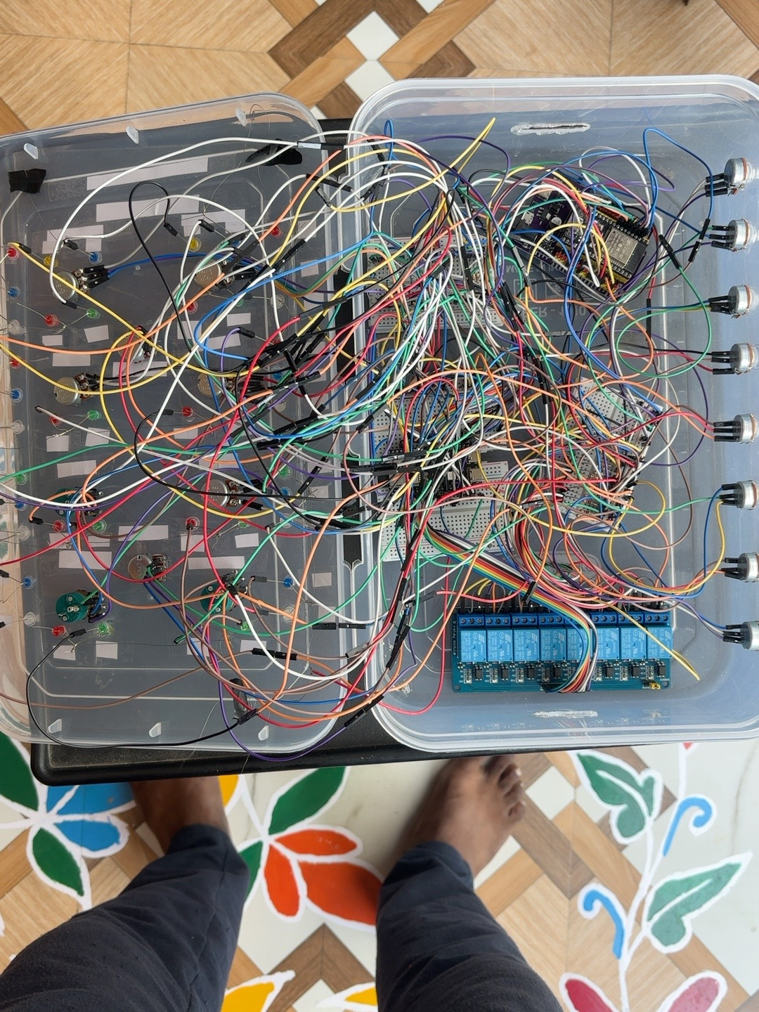
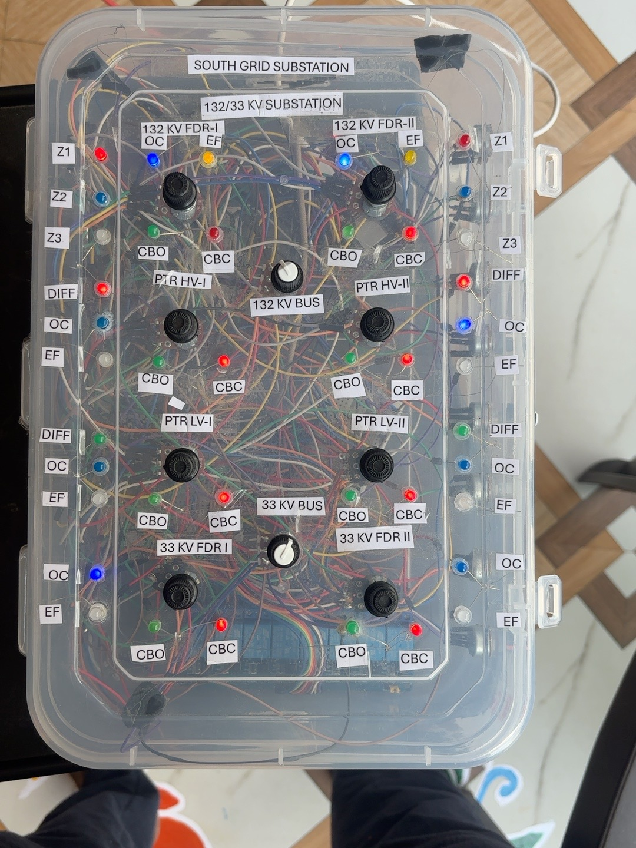
Blynk Supervisory Dashboard
Prototype HMI view for measurements, breaker controls and protection status
132/33 kV Digital Substation Automation Prototype | Narala Heshma Sree
11

Slide 12
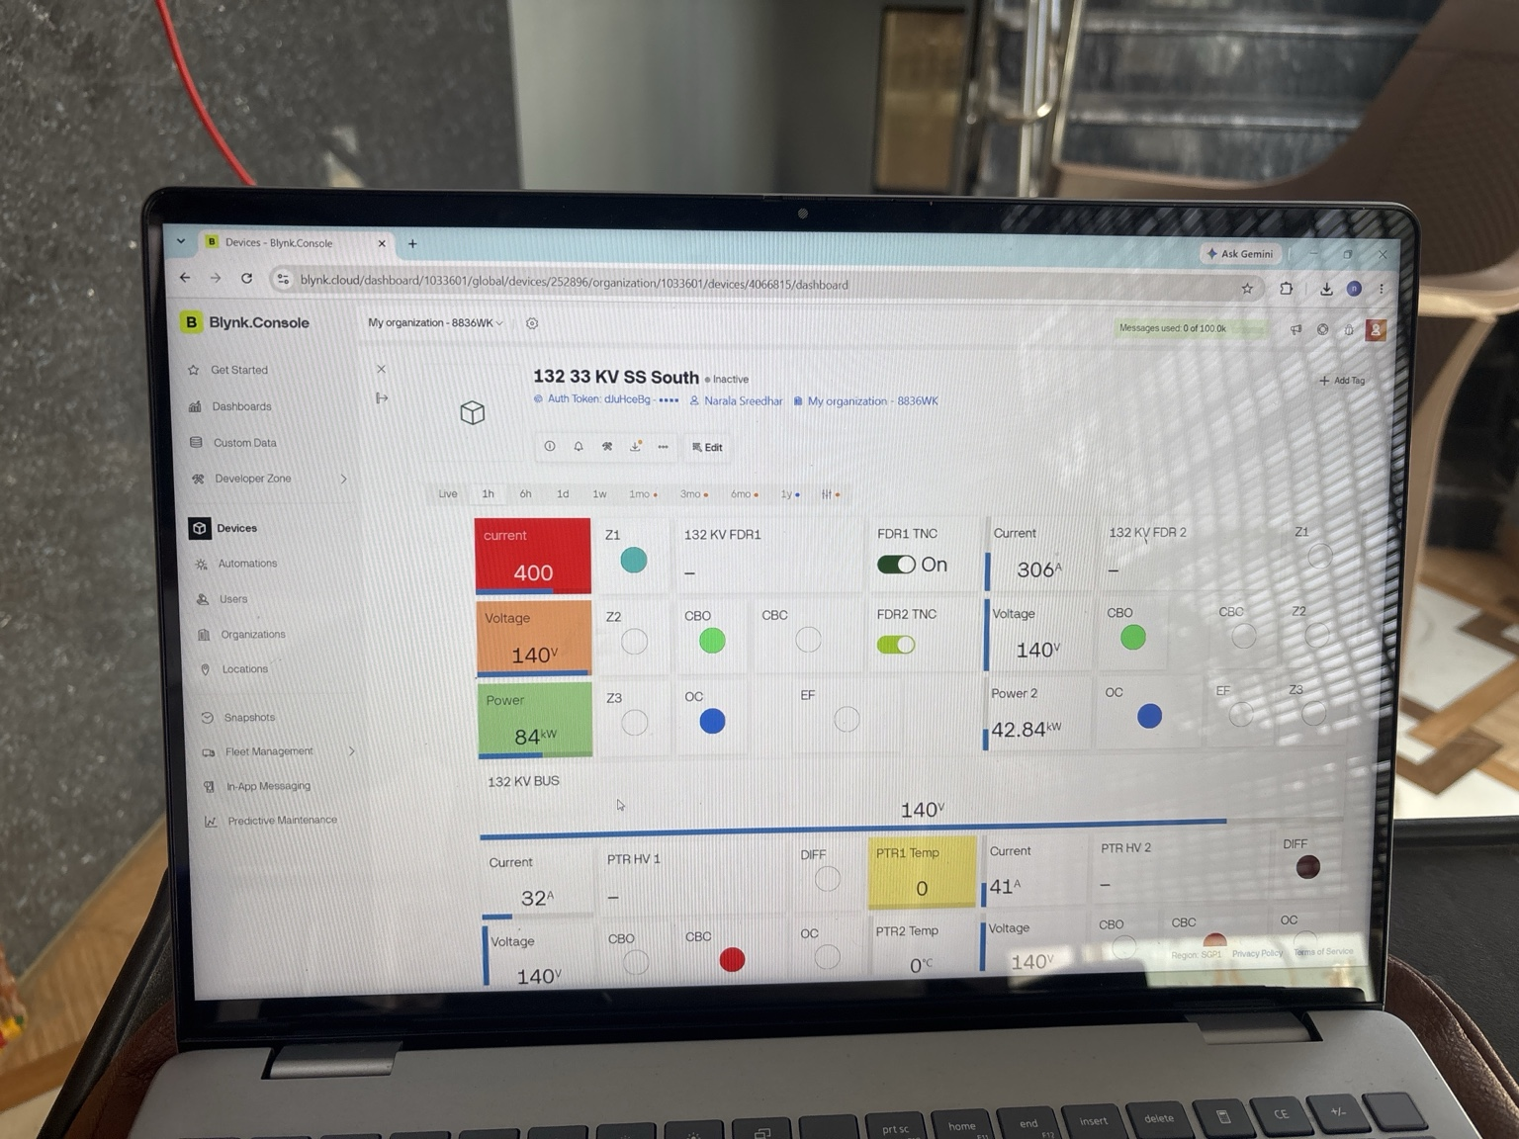
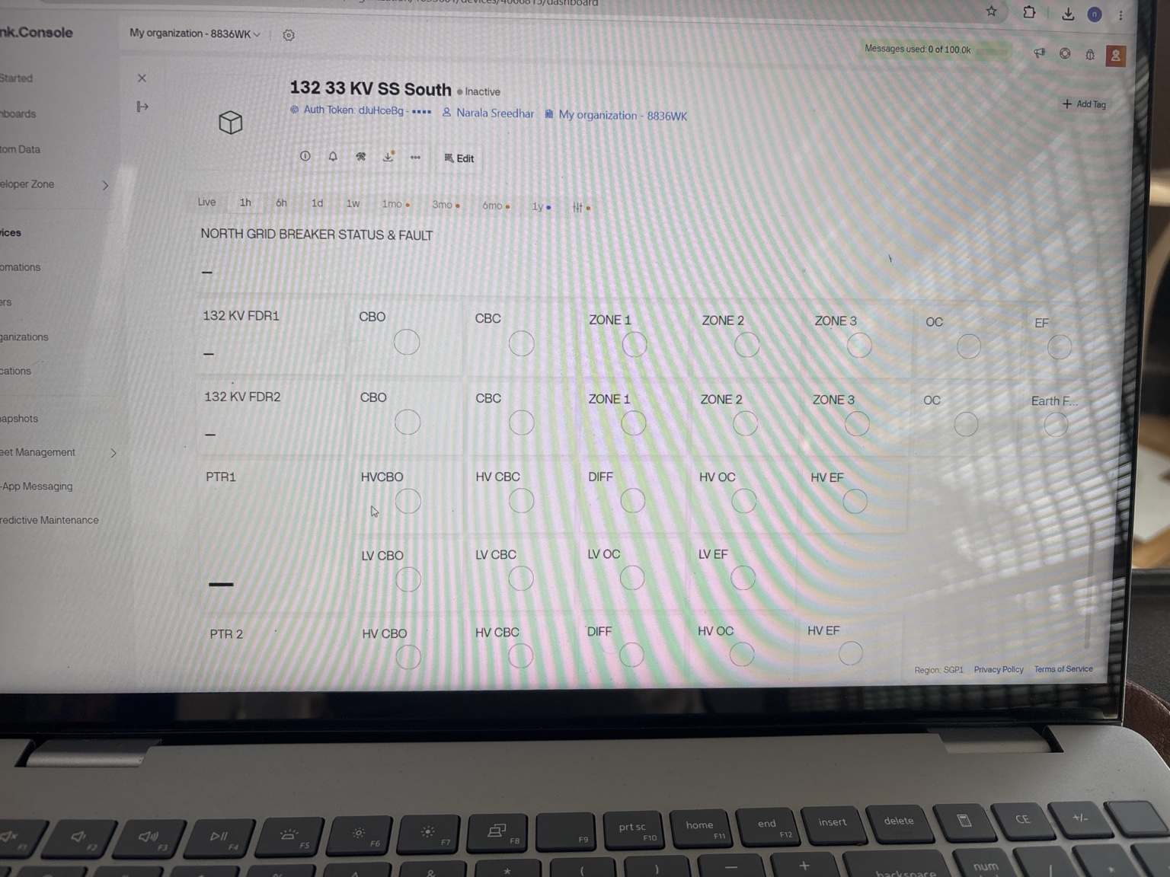
Protection & Breaker Status Demonstration
132/33 kV Digital Substation Automation Prototype | Narala Heshma Sree
12

Slide 13
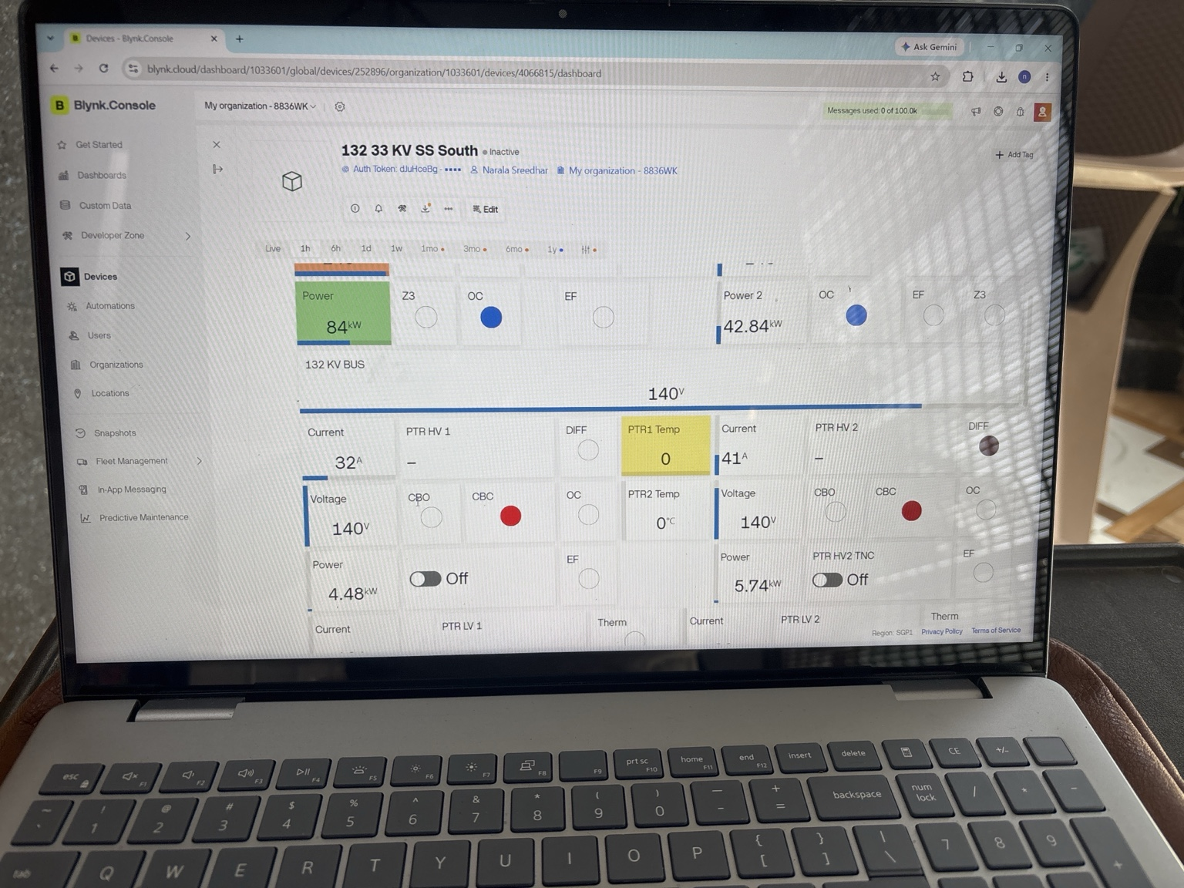
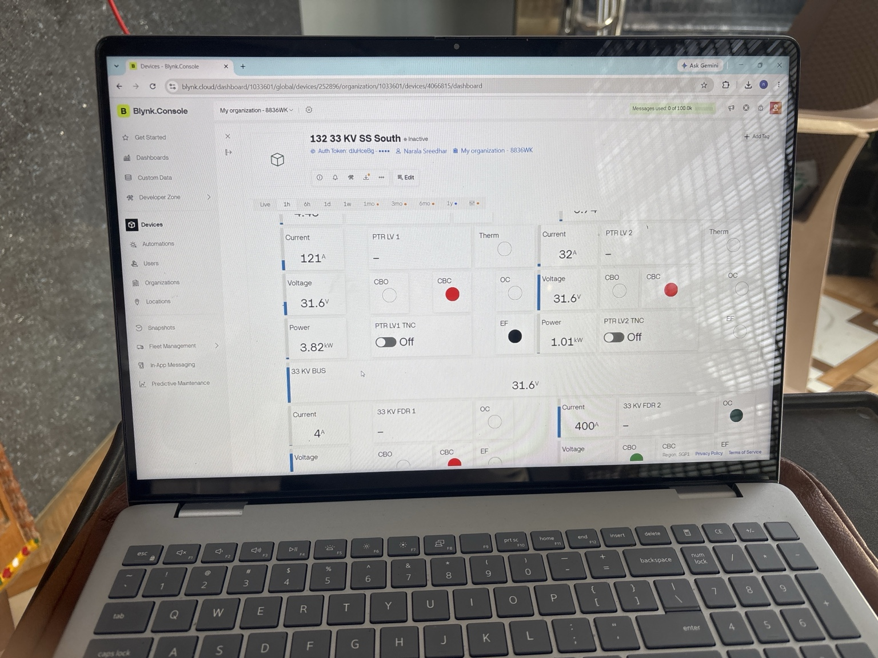
Physical Indications & Simulated Protection States
132/33 kV Digital Substation Automation Prototype | Narala Heshma Sree
13

Slide 14
Software Execution Flow
From acquisition to protection, annunciation and supervisory communication
1
2
3
4
5
6
ADC acquisition
Engineering-unit conversion
Protection logic
Relay / annunciation
UART event
Blynk / MQTT update
Control path
Blynk virtual-pin commands can operate the prototype relay outputs. The source includes safety comments that this is for demonstration and should be interlocked in a practical system.
132/33 kV Digital Substation Automation Prototype | Narala Heshma Sree
14

Slide 15
Engineering Scope & Safety Notes
Important when presenting the project in an interview
Prototype only
Isolation
Protection validation
The repository is an educational low-voltage prototype and is not an operational substation control system.
Test only with isolated low-voltage hardware. Do not connect prototype relay outputs to live APTRANSCO equipment.
Thresholds, scaling, timing, CT/VT representation and coordination require engineering validation before any field application.
Cybersecurity
Control interlocking
The supplied MQTT code uses `setInsecure()` for prototype TLS. Production systems require certificate validation and secure credential handling.
Remote breaker control needs appropriate local/remote selection, permissives, interlocks and protection coordination in a real system.
132/33 kV Digital Substation Automation Prototype | Narala Heshma Sree
15

Slide 16
GitHub Project Package
README.md
firmware/
2 Arduino files
docs/
5 engineering docs
images/
prototype photos
presentation/
PPTX + PDF
LICENSE
• Standalone 132/33 kV Digital Substation Automation prototype
• Source-based documentation with no live credentials
• Interview-ready presentation and GitHub-viewable PDF
Narala Heshma Sree • B.Tech EEE

