Slide 1
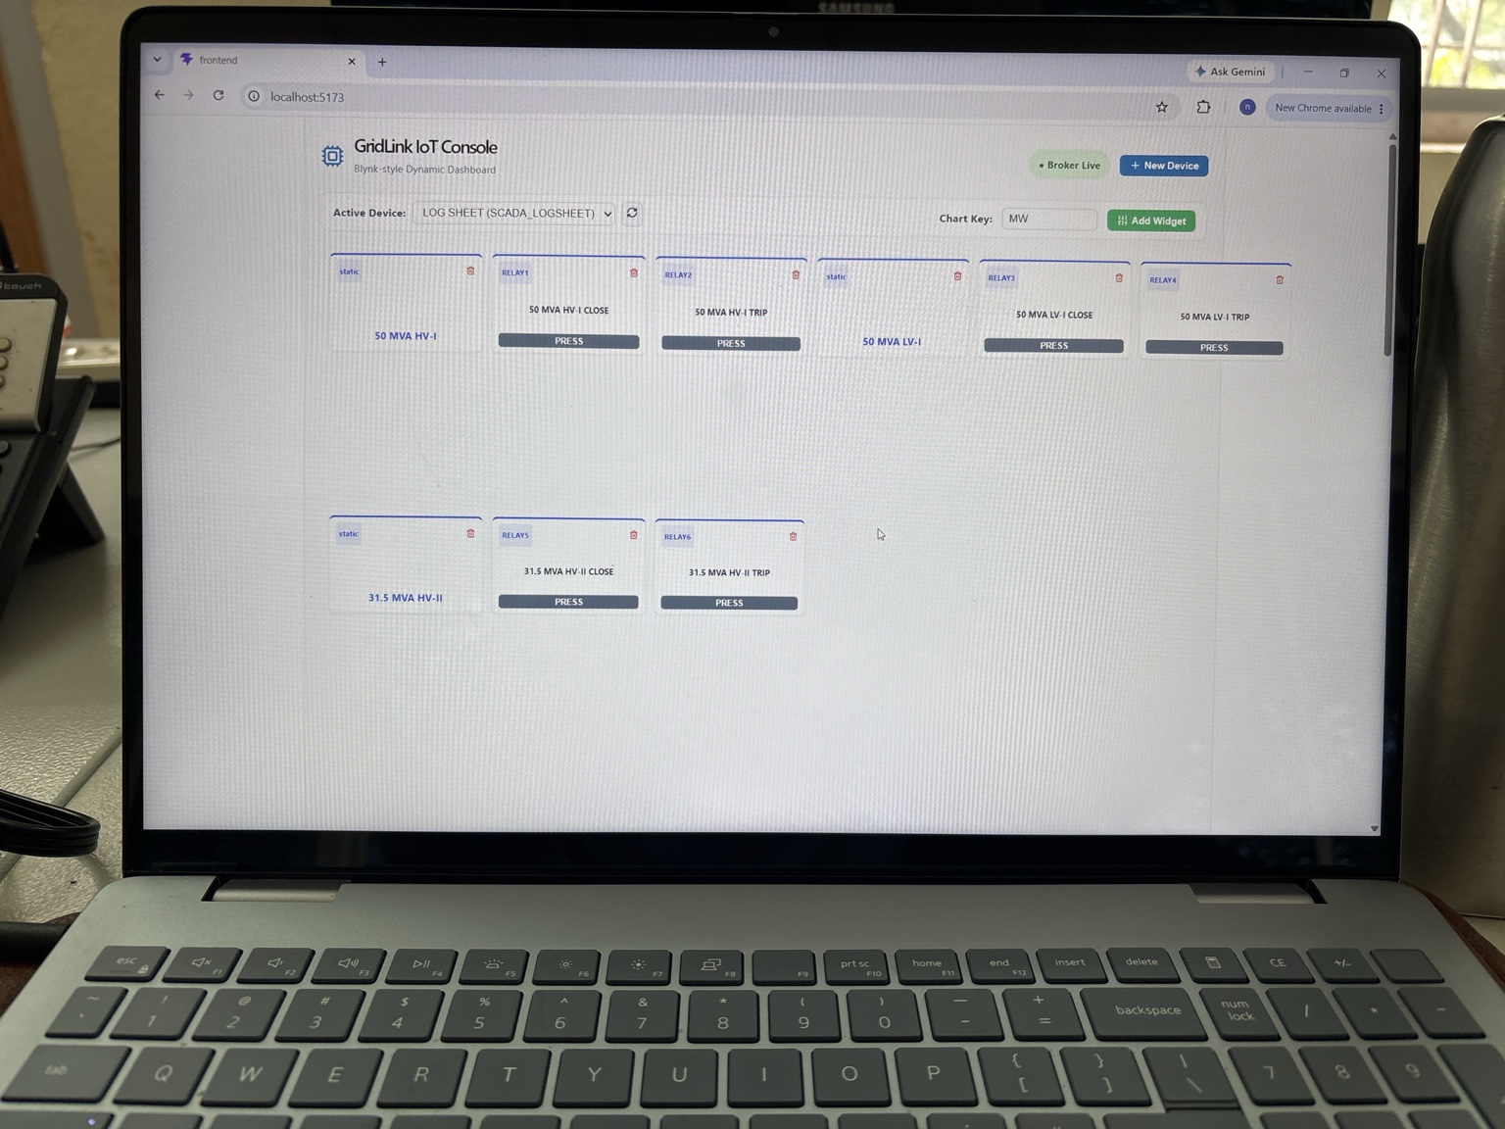
GridLink IoT Console
Self-Hosted IoT & SCADA Platform
Industrial IoT • Telemetry • Control
ESP32 | MQTT/EMQX | FastAPI | PostgreSQL | React | Docker
A self-hosted platform for device monitoring, feeder automation and SCADA-style substation visualization.
GridLink IoT Console • 1

Slide 2
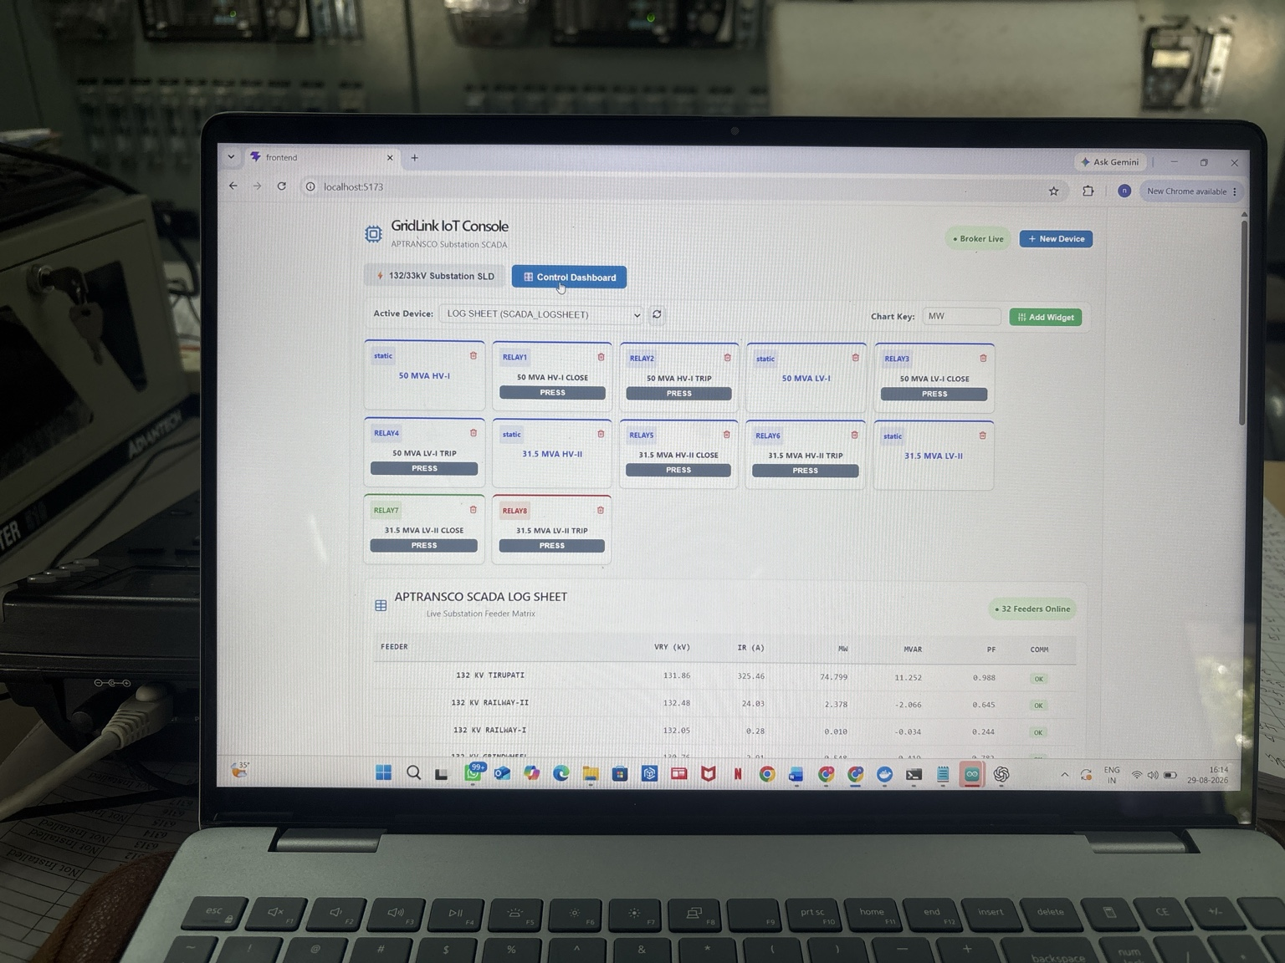
GridLink Control Console
GridLink IoT Console — actual project interface / integration
Key features
• Live visualization
• ESP32 / MQTT integration
• Industrial monitoring & control
GridLink IoT Console • 2

Slide 3
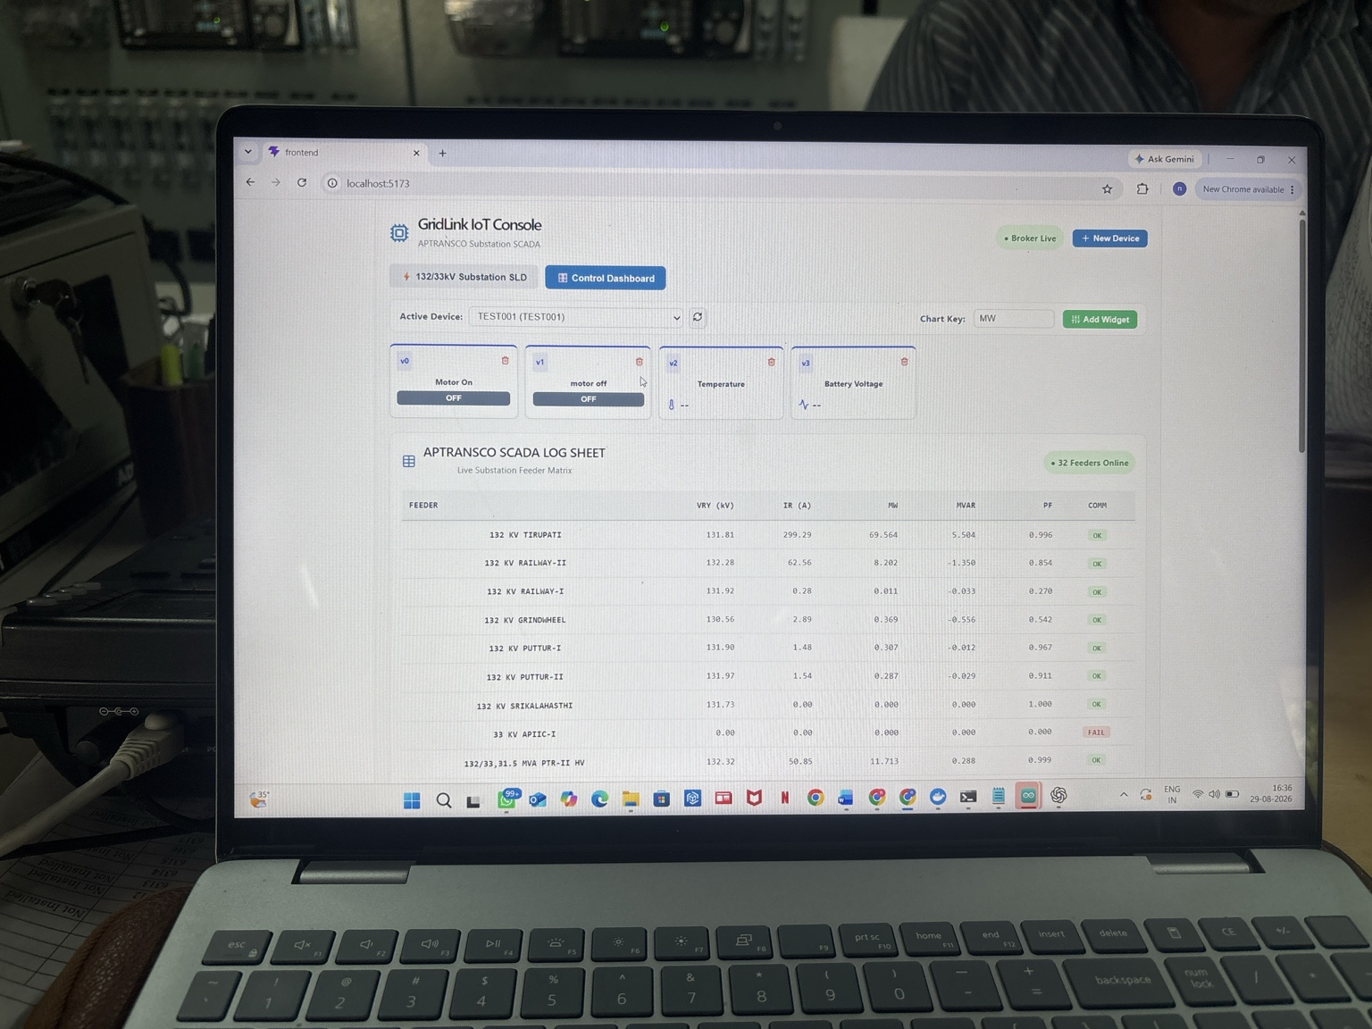
132/33 kV SCADA / SLD
GridLink IoT Console — actual project interface / integration
Key features
• Live visualization
• ESP32 / MQTT integration
• Industrial monitoring & control
GridLink IoT Console • 3

Slide 4
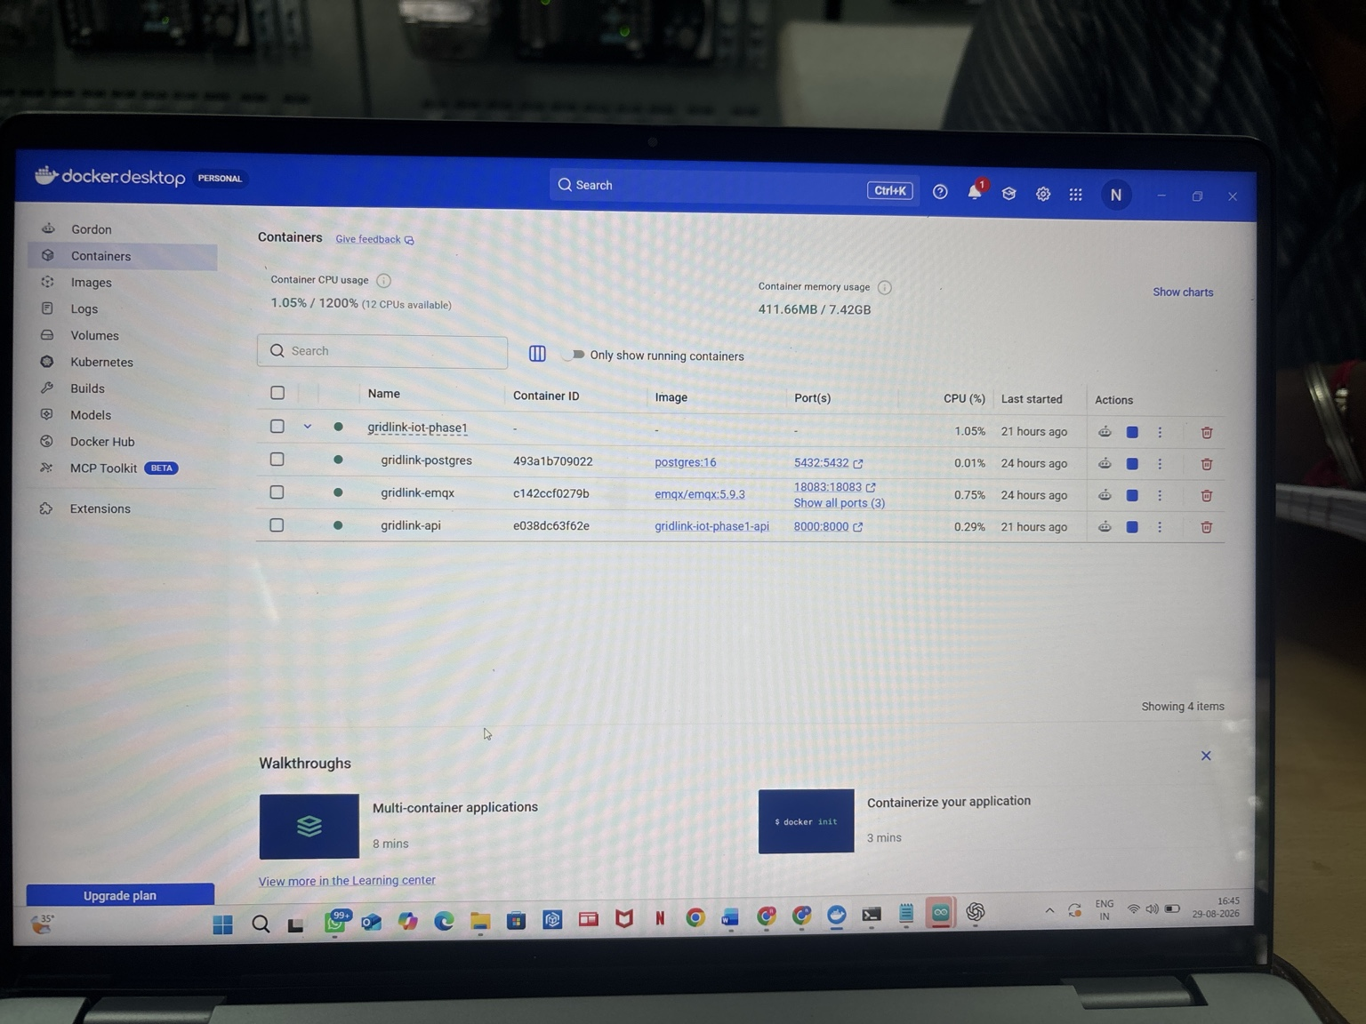
Live Feeder Monitoring
GridLink IoT Console — actual project interface / integration
Key features
• Live visualization
• ESP32 / MQTT integration
• Industrial monitoring & control
GridLink IoT Console • 4

Slide 5
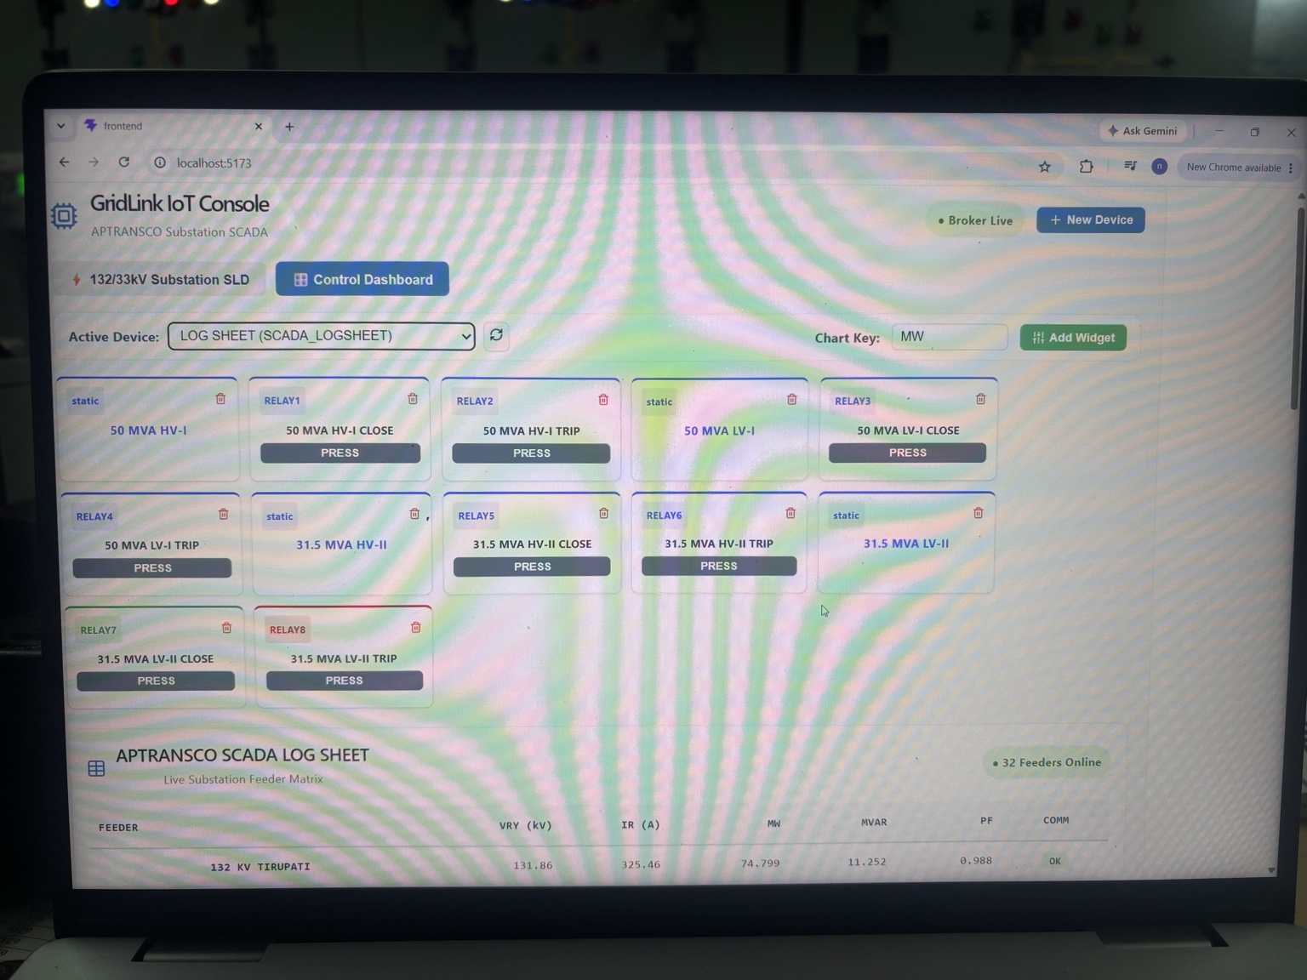
GridLink Widgets
GridLink IoT Console — actual project interface / integration
Key features
• Live visualization
• ESP32 / MQTT integration
• Industrial monitoring & control
GridLink IoT Console • 5

Slide 6
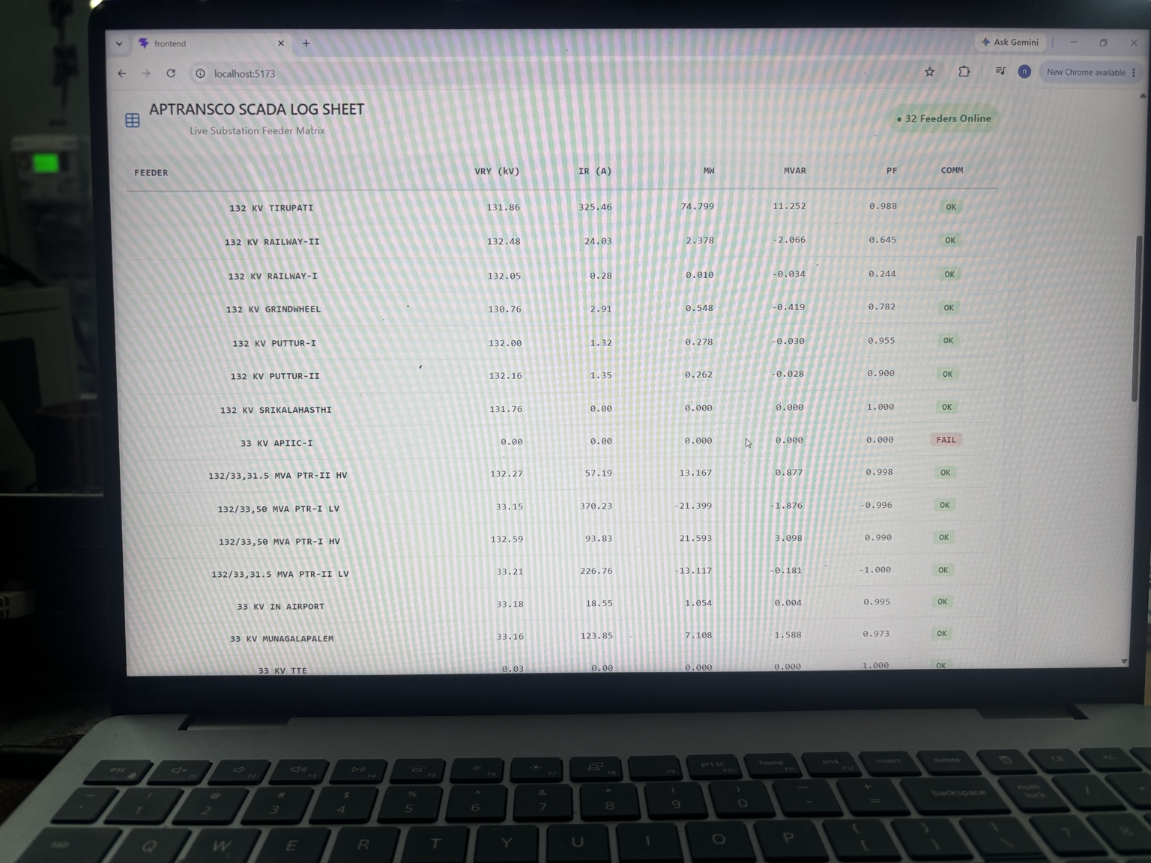
Field Device Integration
GridLink IoT Console — actual project interface / integration
Key features
• Live visualization
• ESP32 / MQTT integration
• Industrial monitoring & control
GridLink IoT Console • 6

Slide 7
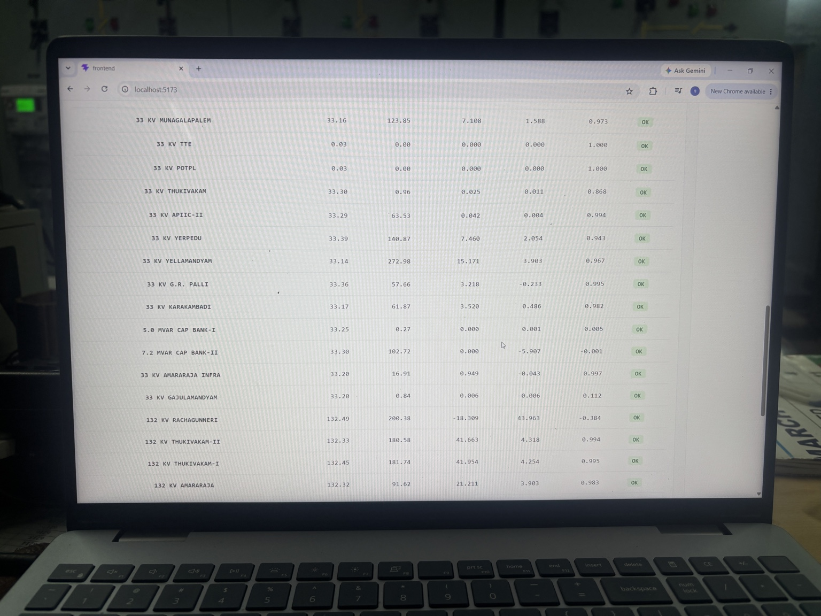
SCADA Telemetry
GridLink IoT Console — actual project interface / integration
Key features
• Live visualization
• ESP32 / MQTT integration
• Industrial monitoring & control
GridLink IoT Console • 7

Slide 8
System Architecture
End-to-end self-hosted IoT / SCADA data flow
ESP32 / Field Devices
Sensors • relays • meters
RS485 / Modbus
Industrial field communication
MQTT / EMQX
Telemetry + command messaging
FastAPI + PostgreSQL
API, device services + data
React GridLink Console
Dashboards, widgets, SLD + controls
GridLink IoT Console • 8

Slide 9
Technology Stack
Frontend: React + Vite
Backend: FastAPI / Python
Database: PostgreSQL
Messaging: MQTT / EMQX
Edge: ESP32
Field protocol: RS485 / Modbus RTU
Deployment: Docker / Docker Compose
GridLink IoT Console • 9

Slide 10
GitHub Repository
GridLink-IoT-Console/
frontend/ • backend/ • firmware/ • docs/
docker-compose.yml • .env.example • .gitignore • README.md
Firmware includes ESP32 phase-1, SCADA telemetry and motor automation.
GridLink IoT Console • 10

Slide 11
Project Summary
GridLink IoT Console brings embedded systems, industrial communication, MQTT, backend APIs, database services and a modern web dashboard into one self-hosted platform.
GridLink IoT Console • 11

