Slide 1
SMART WATER PUMP
AUTOMATION SYSTEM
ESP32 + Blynk IoT | Automated 2 HP & 6 HP Pump Control
Narala Heshma Sree
B.Tech – Electrical & Electronics Engineering | SRM Institute of Science and Technology
ESP32
IoT
Protection
Automation

Slide 2
1. Project Overview
An ESP32-based controller combining water-level sensing, current monitoring, protection and cloud supervision.
What it does
Core controller
IoT layer
Automates and remotely monitors two water pumps: 2 HP and 6 HP.
ESP32 DevKit V1 executes motor-control, sensor-processing and protection logic.
Blynk provides live status, current, runtime, mode and fault information.
Automatic and Manual operating modes
Tank and sump level supervision
Current-based over-current and dry-run protection
Maximum runtime, startup and restart delays
Remote monitoring and event notifications
2

Slide 3
2. Objectives
Remote Control
Automatic Operation
Protection
Start/stop motors through the IoT dashboard.
Use tank and sump conditions to make motor decisions.
Detect over-current, dry-run and unsafe water-level conditions.
Monitoring
Connected System
Service Flexibility
Display motor current, status, runtime and last fault.
Maintain Wi-Fi/Blynk communication for remote supervision.
Provide controlled protection-bypass options for testing/service.
3

Slide 4
3. System Architecture
Data flows from sensors to the ESP32, while commands and status are exchanged through Blynk Cloud.
Blynk Cloud / App
Wi-Fi / Blynk communication
ESP32 DevKit V1
Tank / Sump
Float Inputs
SCT Current
Sensors
Relay / Contactor
Interface
2 HP / 6 HP
Water Pumps
4

Slide 5
4. Hardware & Software Stack
Hardware
Software / Firmware
• ESP32 DevKit V1
• SCT current sensors ×2
• Float switches ×4
• Relay interface
• Motor contactors
• Wi-Fi router
• 2 HP & 6 HP pumps
• Isolated low-voltage control supply
• Arduino IDE
• Embedded C++
• ESP32 Arduino core
• Blynk IoT
• EmonLib for RMS current calculation
• BlynkTimer for periodic tasks
• Virtual pins for dashboard control/status
5

Slide 6
5. Motor Automation Logic
2 HP Pump — Automatic Mode
6 HP Pump — Automatic Mode
Tank LOW
↓
Start 2 HP
↓
Monitor current & protection
↓
Tank FULL → Stop
Additional trips:
• Over Current
• Dry Run Current
• Sump Dry
• Maximum Runtime
Sump DRY + Sump not FULL
↓
Start 6 HP
↓
Monitor current & protection
↓
Sump FULL → Stop
Additional trips:
• Over Current
• Dry Run Current
• Maximum Runtime
6

Slide 7
6. Protection & Timing
Configured firmware values — to be verified against the actual motor, sensor calibration and protection requirements before field deployment.
Over-current limit
13.0 A
2 HP / 6 HP
Dry-run threshold
1.0 A
Current based
Startup protection delay
10 s
Protection inhibited during startup
Over-current confirmation
3 s
Condition must persist
Dry-run confirmation
10 s
Condition must persist
Restart delay
5 s
Prevents immediate restart
Normal maximum runtime
15 min
Compile-time setting
Test-mode maximum runtime
50 s
Controlled bench testing
7

Slide 8
7. Current Monitoring & Signal Processing
Sensing
Processing
Dashboard
SCT current sensors are connected to ESP32 input-only ADC pins:
GPIO 34 → 2 HP current
GPIO 35 → 6 HP current
EmonLib calculates RMS current.
The firmware then applies:
• Low-level noise suppression
• Low-pass filtering
• Threshold comparison
• Time confirmation before trip
Live current values are sent to Blynk.
The dashboard can display:
• 2 HP current
• 6 HP current
• Motor status
• Last fault/status
8

Slide 9
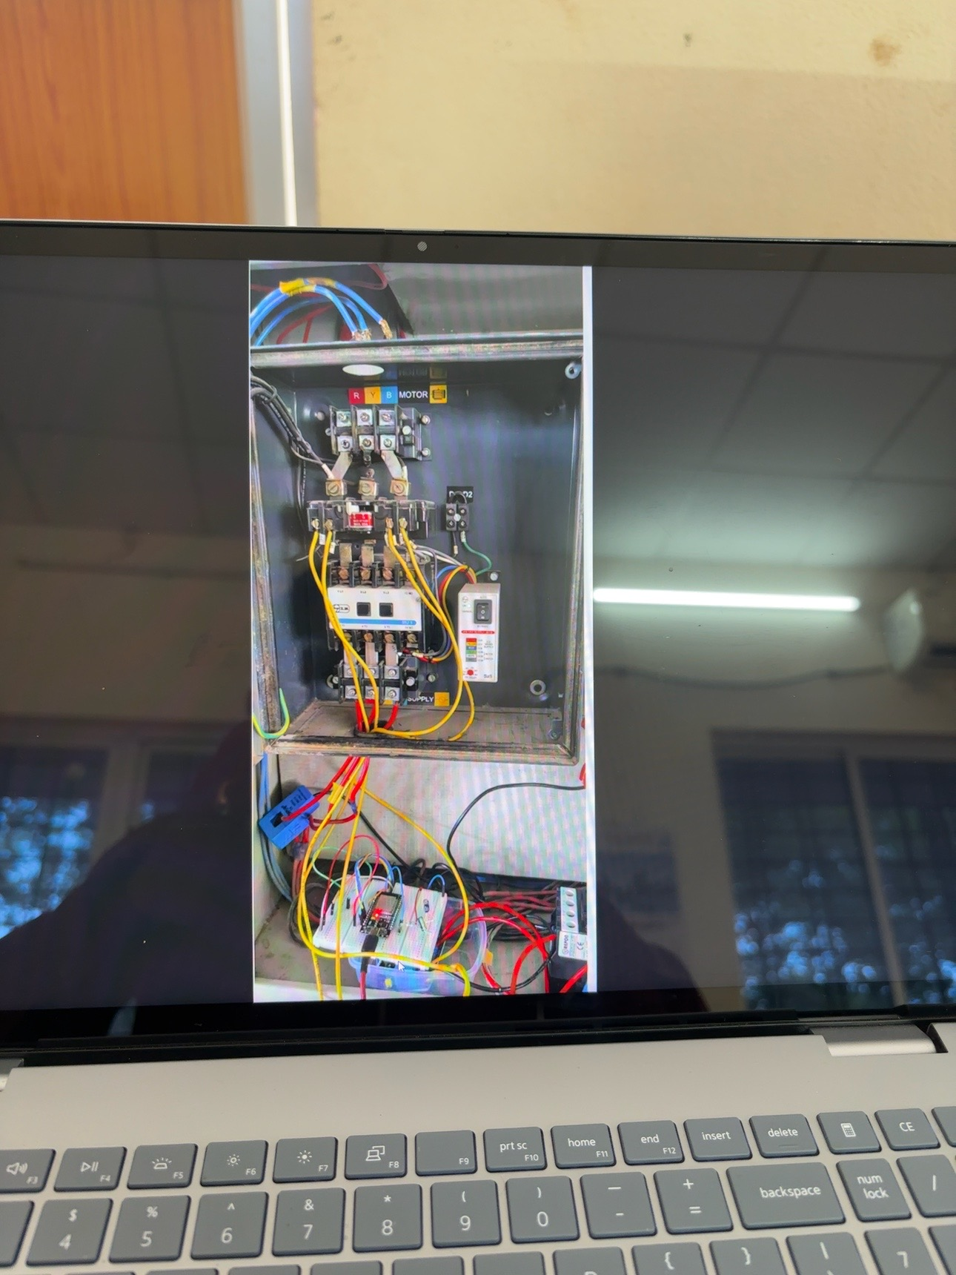
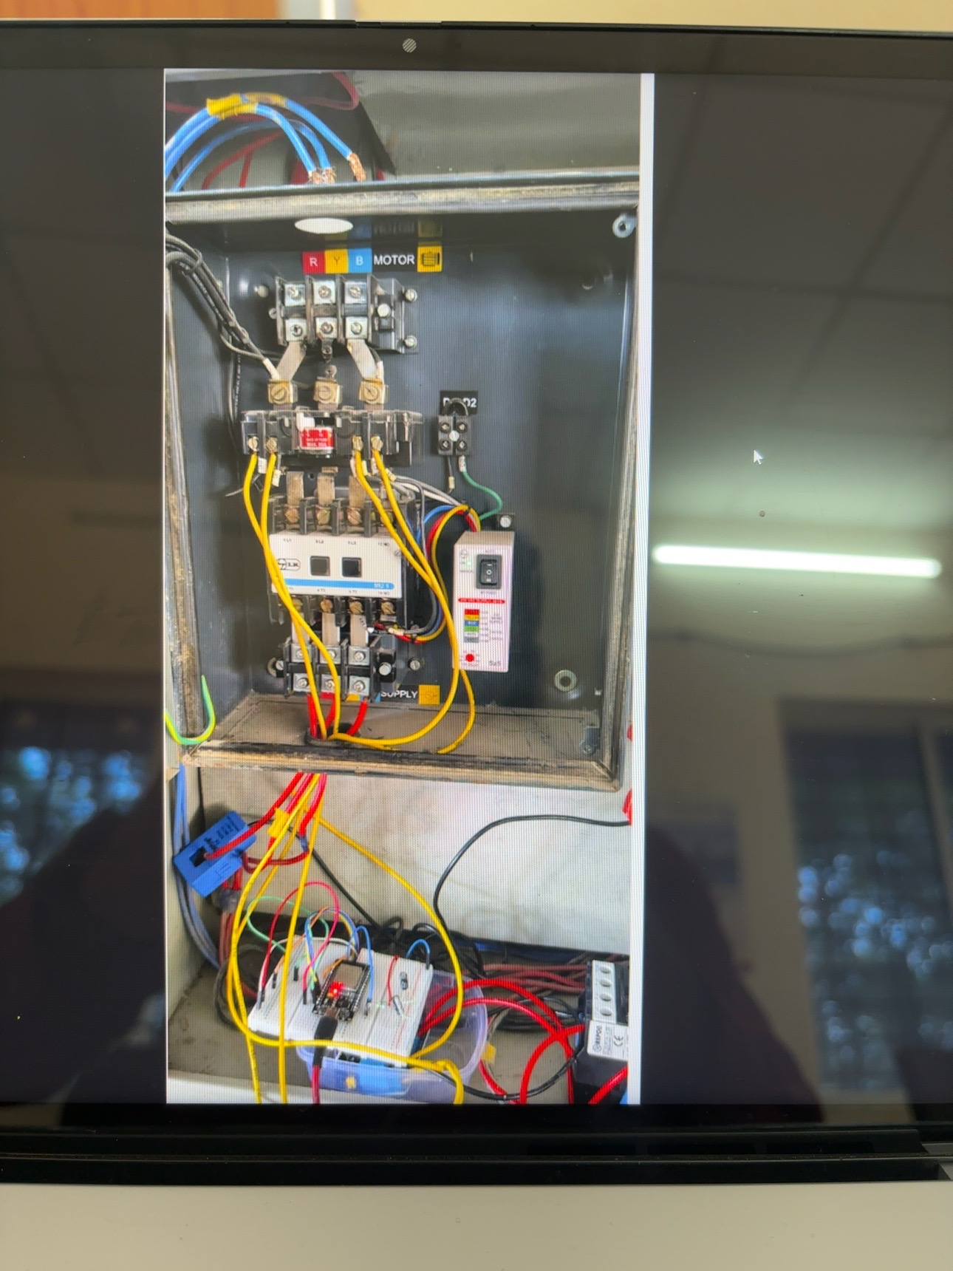
8. Hardware Implementation & Prototype
Actual motor control panel and ESP32 prototype used for the project
Prototype Hardware
• ESP32-based control electronics
• Motor contactor and control interface
• Current-sensing CT/SCT interface
• Low-voltage relay/control wiring
• Three-phase motor connection section
• Prototype wiring used for functional testing
The ESP32/relay section is used as the control layer; motor power circuits require correctly rated contactors, overload/short-circuit protection, isolation and proper earthing.

Slide 10
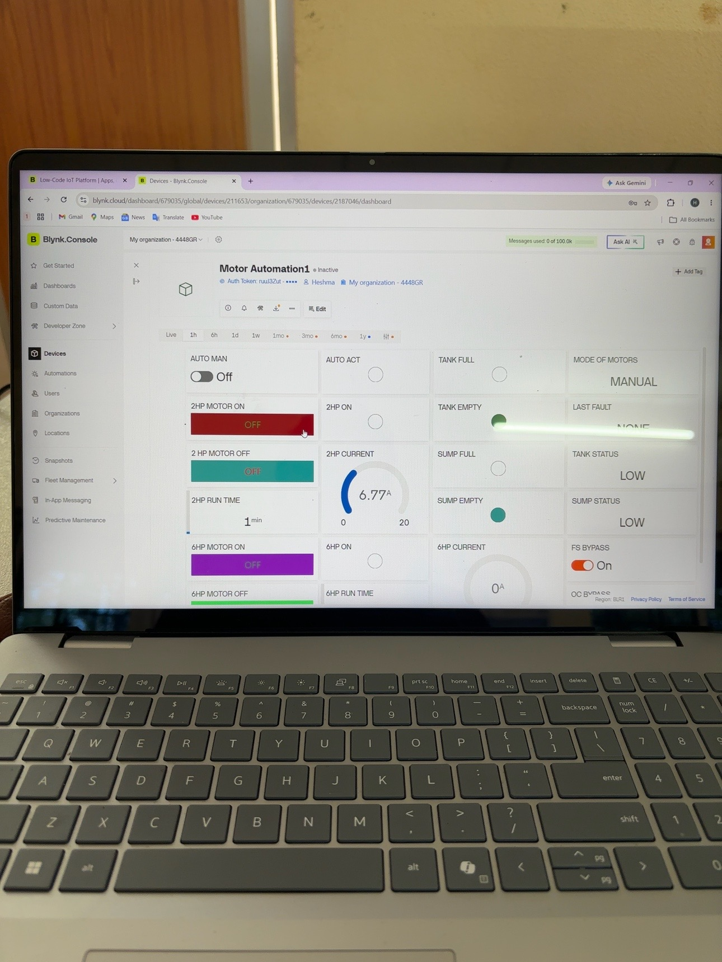
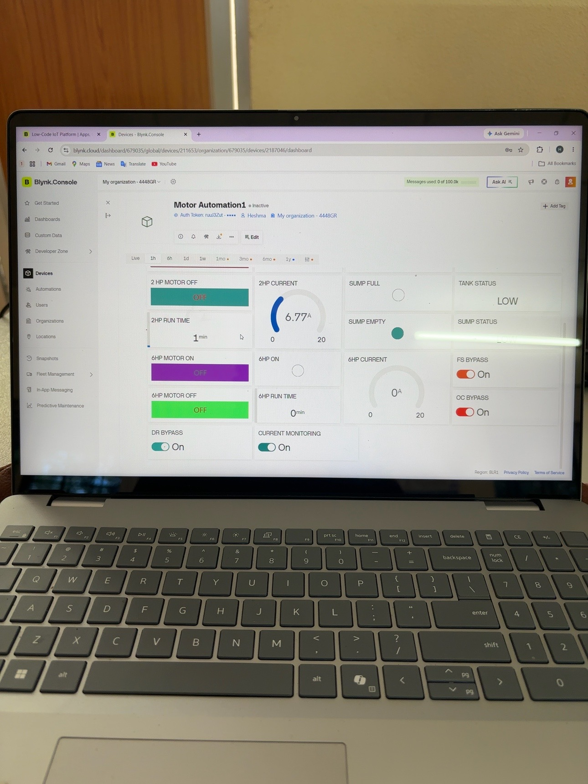
8. Blynk IoT Dashboard
Actual project dashboard screenshots
10

Slide 11
9. Dashboard Functions Visible in the Prototype
AUTO / MANUAL
2 HP / 6 HP CONTROL
Operating mode selection and indication.
Separate motor start/stop controls and running indicators.
CURRENT
TANK / SUMP STATUS
Live current gauges for both motors.
Level-condition indicators for automation decisions.
RUNTIME
FAULT / STATUS
Motor runtime tracking in minutes.
Last fault/status and protection-related information.
BYPASS CONTROLS
CLOUD MONITORING
Float, over-current and dry-run bypass for controlled service/testing.
Blynk-based remote dashboard and event notifications.
11

Slide 12
10. Implementation & Demonstrated Result
ESP32 firmware integrates motor control, water-level sensing, current measurement and protection logic.
Blynk dashboard provides a single interface for control and real-time status.
The project supports both automatic and manual operation.
The firmware records motor runtime and maintains a last-fault/status indication.
Current sensing uses RMS calculation with filtering to reduce low-level noise.
The repository is structured for documentation, source code, hardware details and future development.
2 HP
Pump control
6 HP
Pump control
4
Float inputs
2
SCT inputs
Blynk
Cloud dashboard
12

Slide 13
11. Future Scope & Developer Profile
Future Development
Developer
• Energy measurement
• Power factor monitoring
• Flow sensor integration
• Water consumption logging
• Dedicated web dashboard
• MQTT support
• OTA firmware updates
• GSM/4G backup communication
• Historical cloud data
• Advanced alarm management
• Improved PCB protection and isolation
Narala Heshma Sree
B.Tech – Electrical & Electronics Engineering
SRM Institute of Science and Technology
Skills demonstrated:
• Embedded C++
• ESP32
• IoT / Blynk
• Electrical automation
• Motor protection
• Sensor interfacing
• Relay control
• Industrial control concepts
13

Slide 14
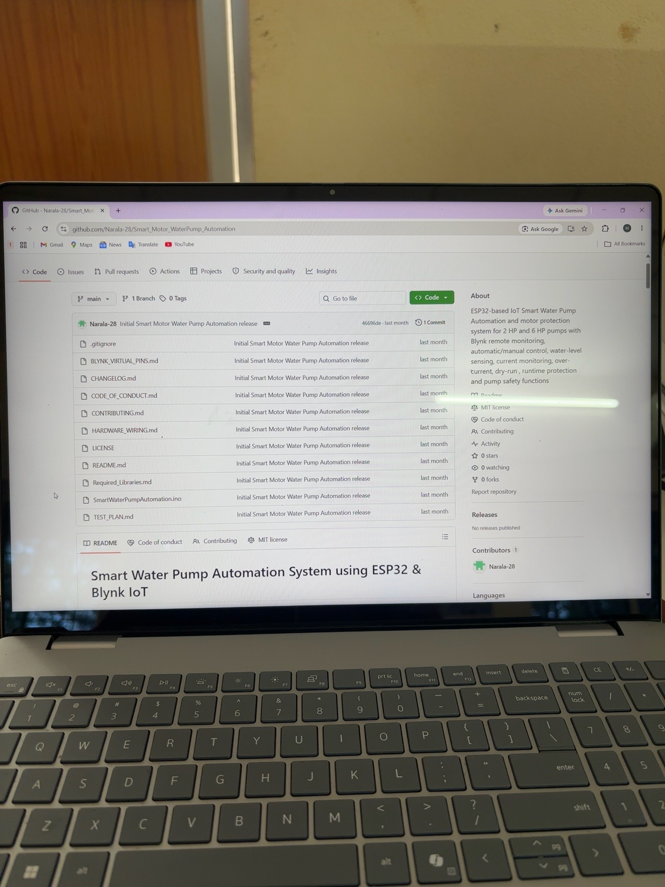
12. GitHub Project Repository
The project is documented and organized as a complete engineering repository.
Repository Contents
• README.md
• ESP32 firmware (.ino)
• Hardware wiring documentation
• Blynk virtual-pin documentation
• Test plan
• Required libraries
• Changelog & contribution files
• MIT License
GitHub repository: Smart_Motor_WaterPump_Automation

Slide 15
PROJECT PORTFOLIO
Smart Water Pump Automation System
ESP32 • Embedded C++ • Blynk IoT • Motor Protection • Automation
README.md
Project explanation
Source Code
ESP32 / Arduino firmware
Images
Hardware & dashboard evidence
PPT / PDF
Interview-ready presentation
Educational / engineering-development project. Final field installation requires correctly rated protection, isolation and professional electrical design.

