Slide 1
SMART WATER PUMP
AUTOMATION SYSTEM
ESP32 + Blynk IoT
Automated 2 HP & 6 HP Pump Control • Monitoring • Protection
SENSE
PROCESS
PROTECT
ESP32
IoT
Automation
Protection
SC Monitoring
CONTROL
Narala Heshma Sree
B.Tech – Electrical & Electronics Engineering | SRM Institute of Science and Technology

Slide 2
01 | PROJECT OVERVIEW
From sensor inputs to cloud-based motor supervision.
SMART CONTROL
ESP32 CORE
BLYNK IoT
Automates and remotely monitors 2 HP and 6 HP water pumps.
Executes motor-control, sensing, timing and protection logic.
Provides live status, current, runtime, mode and fault information.
SENSORS
ESP32
PROTECTION
RELAYS
MOTORS
CLOUD
• Automatic / Manual operation
• Tank and sump level supervision
• Current-based over-current and dry-run protection
• Runtime, startup and restart management
• Remote monitoring and event notifications
2

Slide 3
02 | PROJECT OBJECTIVES
Engineering goals addressed by the prototype.
REMOTE CONTROL
AUTO OPERATION
PROTECTION
Start/stop motors through the IoT dashboard.
Use tank and sump conditions for motor decisions.
Detect over-current, dry-run and unsafe conditions.
MONITORING
CONNECTED SYSTEM
SERVICE FLEXIBILITY
Display current, status, runtime and last fault.
Maintain Wi-Fi/Blynk communication.
Controlled bypass options for testing/service.
3

Slide 4
03 | SYSTEM ARCHITECTURE
A connected control loop between sensors, ESP32, protection and the Blynk cloud.
BLYNK CLOUD / APP
Wi-Fi / IoT
ESP32 DEVKIT V1
TANK / SUMP
FLOATS
SCT CURRENT
SENSORS
RELAY /
CONTACTOR
2 HP + 6 HP
PUMPS
4

Slide 5
04 | HARDWARE & SOFTWARE
Technology stack used in the prototype.
HARDWARE
SOFTWARE / FIRMWARE
ESP32 DevKit V1
SCT current sensors ×2
Float switches ×4
Relay interface
Motor contactors
Wi-Fi router
2 HP & 6 HP pumps
Isolated low-voltage control supply
Arduino IDE
Embedded C++
ESP32 Arduino core
Blynk IoT
EmonLib for RMS current
BlynkTimer
Virtual pins for dashboard control/status
5

Slide 6
05 | MOTOR AUTOMATION LOGIC
Automatic operating sequence for both pumps.
2 HP PUMP — AUTO
6 HP PUMP — AUTO
TANK LOW
↓
START 2 HP
↓
MONITOR CURRENT + PROTECTION
↓
TANK FULL
↓
STOP
Trips: Over Current • Dry Run • Sump Dry • Maximum Runtime
SUMP DRY + NOT FULL
↓
START 6 HP
↓
MONITOR CURRENT + PROTECTION
↓
SUMP FULL
↓
STOP
Trips: Over Current • Dry Run • Maximum Runtime
6

Slide 7
06 | PROTECTION & TIMING
Configured firmware values — verify against actual motor, sensor calibration and field protection requirements.
OVER-CURRENT
13.0 A | Configured threshold
DRY-RUN
1.0 A | Current-based detection
STARTUP DELAY
10 s | Protection delay after start
OC CONFIRMATION
3 s | Condition must persist
DRY-RUN CONFIRMATION
10 s | Condition must persist
RESTART DELAY
5 s | Prevents immediate restart
NORMAL MAX RUNTIME
15 min | Normal firmware setting
TEST MAX RUNTIME
50 s | Controlled bench testing
7

Slide 8
07 | CURRENT MONITORING
RMS current measurement with filtering and protection confirmation.
SENSING
PROCESSING
DASHBOARD
GPIO 34 → 2 HP current
GPIO 35 → 6 HP current
SCT current sensors feed ESP32 ADC inputs.
EmonLib RMS calculation
↓
Noise suppression
↓
Low-pass filtering
↓
Threshold comparison
↓
Time confirmation
Live current values
Motor status
Runtime
Last fault/status
All presented through the Blynk IoT interface.
8

Slide 9
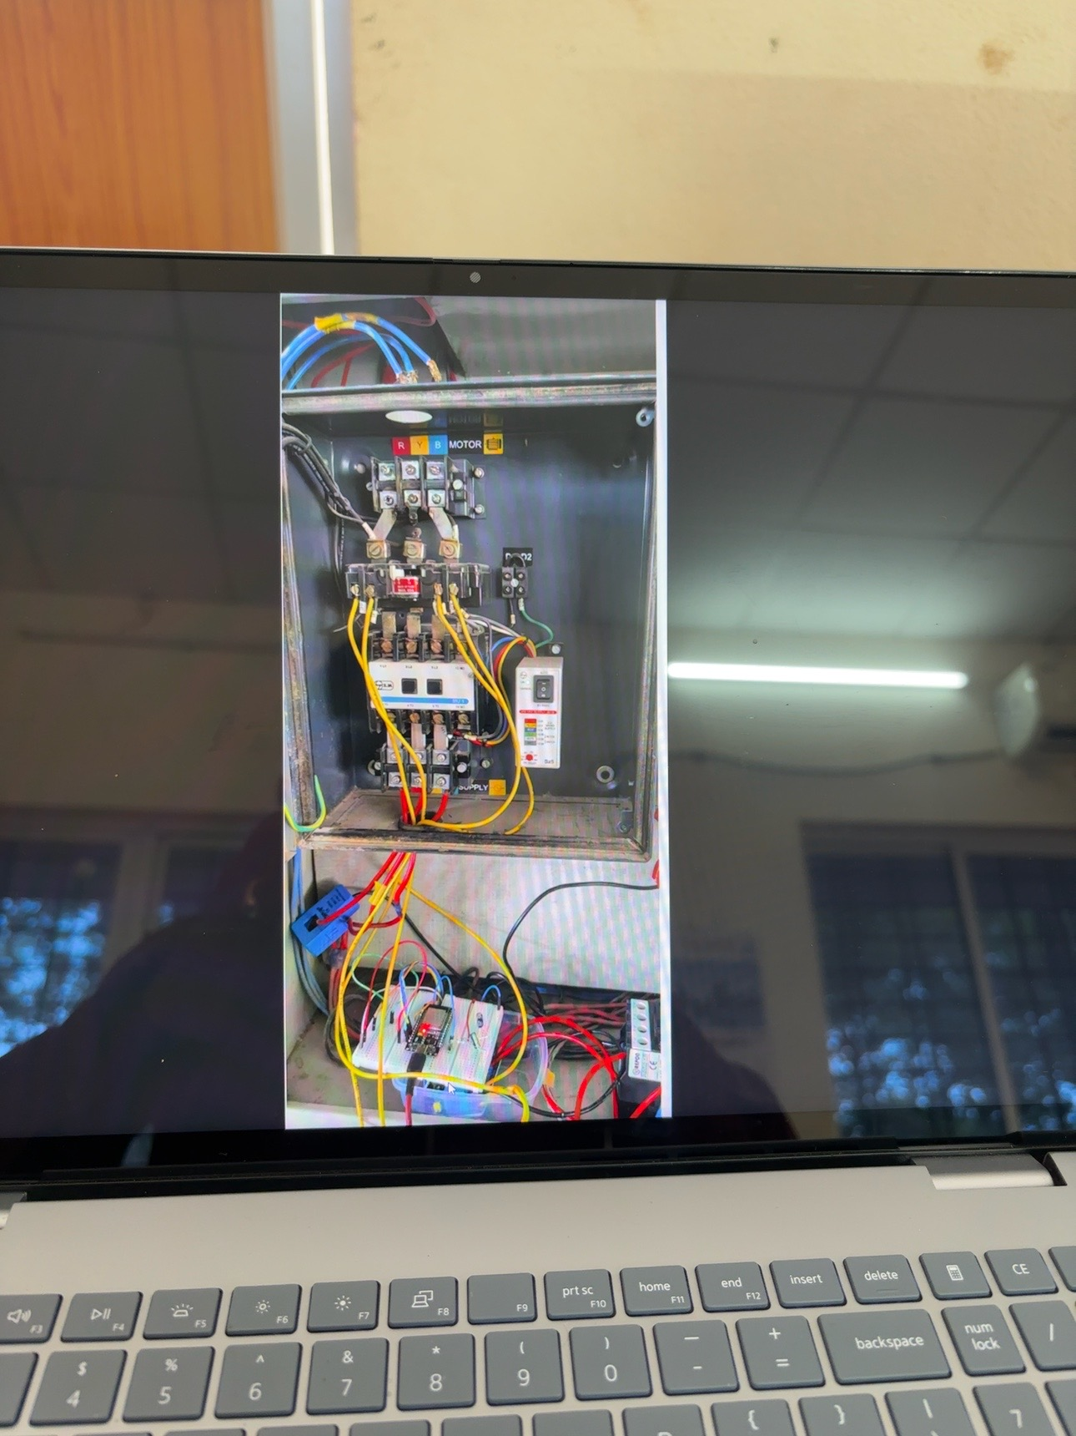
08 | HARDWARE IMPLEMENTATION
Actual motor control panel and ESP32 prototype.
MOTOR CONTROL PANEL
Three-phase motor/control section, contactor, control wiring and supply section.
ESP32 PROTOTYPE
Low-voltage relay/control wiring and current-sensing interface used for functional testing.
REAL HARDWARE
FUNCTIONAL TEST
9

Slide 10
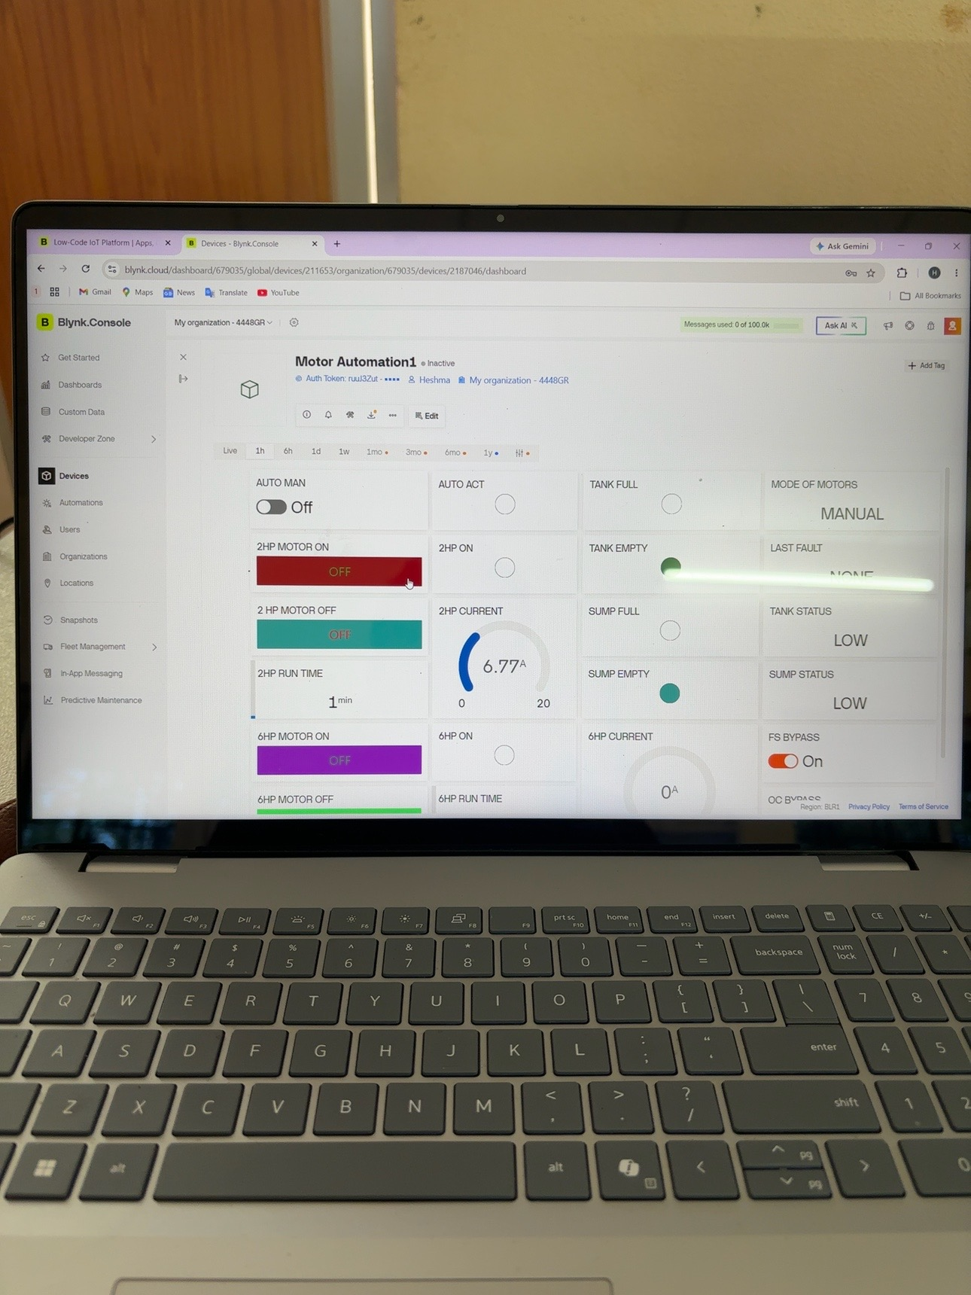
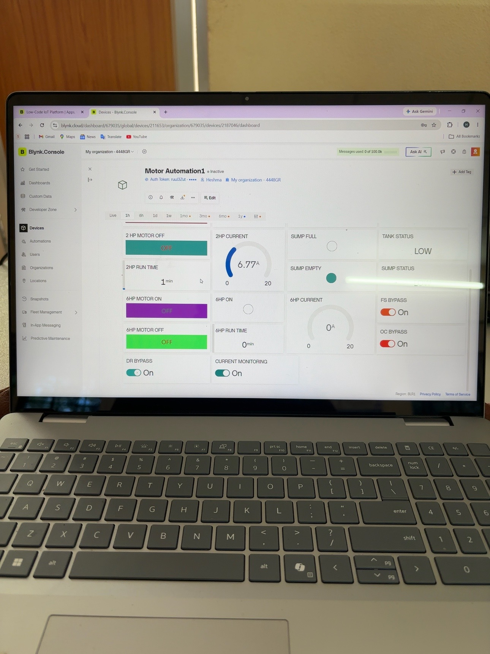
09 | BLYNK IoT DASHBOARD
Actual project dashboard screenshots.
Dashboard — upper controls
Dashboard — monitoring
10

Slide 11
10 | DASHBOARD FUNCTIONS & RESULT
What the working prototype demonstrates.
AUTO / MANUAL
2 HP / 6 HP
CURRENT
TANK / SUMP
Operating mode selection
Separate start/stop control
Live current gauges
Level-condition indication
RUNTIME
FAULT / STATUS
BYPASS
CLOUD
Motor runtime tracking
Last fault/status information
Controlled service bypasses
Blynk event monitoring
11

Slide 12
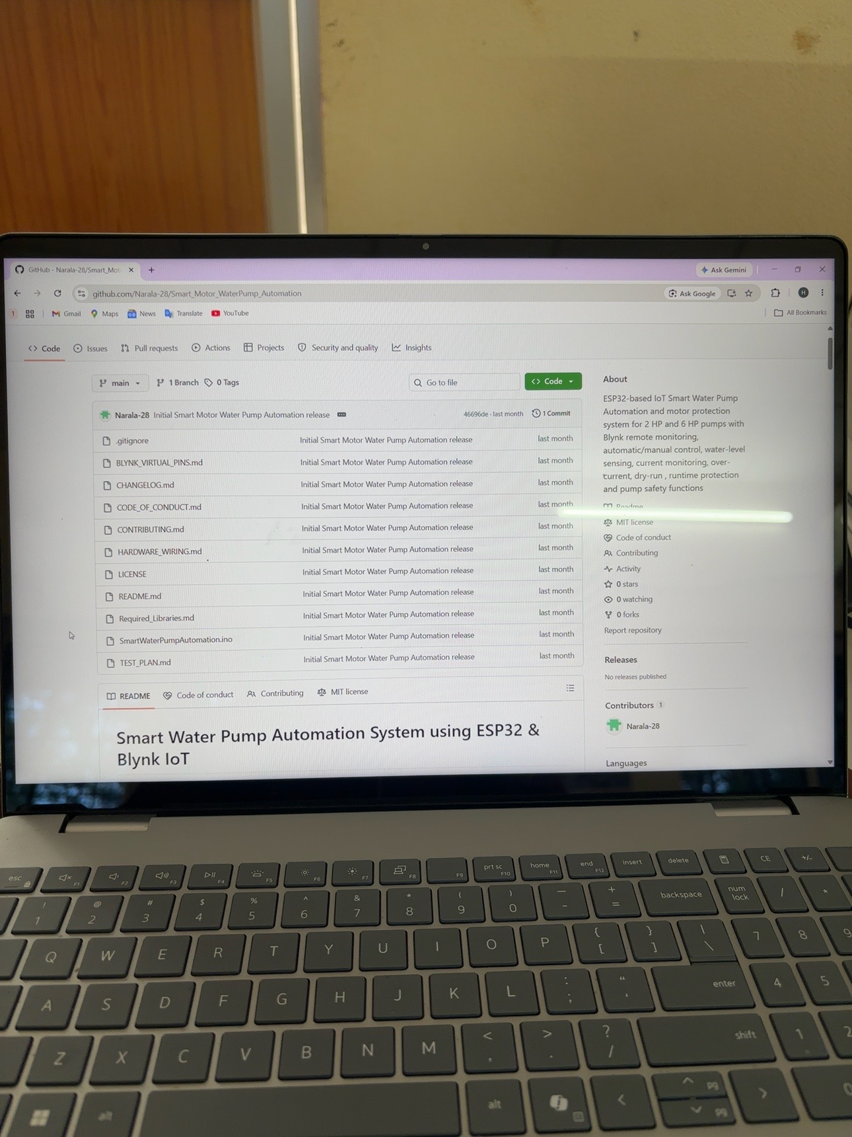
11 | DEVELOPER & GITHUB
Project documentation and portfolio readiness.
DEVELOPER
Narala Heshma Sree
B.Tech – Electrical & Electronics Engineering
SRM Institute of Science and Technology
Embedded C++
ESP32
IoT / Blynk
Electrical automation
Motor protection
Sensor interfacing
Relay control
GITHUB REPOSITORY
12

Slide 13
12 | FUTURE SCOPE
NEXT DEVELOPMENT
PROJECT PORTFOLIO
Smart Water Pump
Automation System
ESP32 • Embedded C++ • Blynk IoT • Protection • Automation
Energy measurement • Power factor monitoring • Flow sensor integration
Water consumption logging • Dedicated web dashboard • MQTT
OTA firmware updates • GSM/4G backup • Historical cloud data
Advanced alarm management • Improved PCB protection and isolation
ESP32
IoT
Protection
Automation
Educational / engineering-development project.
Final field installation requires correctly rated protection, isolation and professional electrical design.
13

