Slide 1

SeatSense
SeatSense
Free seats right now
Central Library
10
Silent
UB Canteen
10
An app that shows where you can sit on campus, right now.
Group study
Tech Park Lobby
46
Charging
Library full again? Check before you walk over.
ECE Dept. Lounge
18
Quiet
Book seats
Notes:
Speaker 1: The problem
Good morning. We’re a team of five from ECE, and we want to fix something every student here deals with. SeatSense is an app that shows where you can sit on campus, right now. Let me show you the problem first.

Slide 2
A free period, as it is today
Walk to the library
Walk to UB canteen
Find any spot
Finally studying
0 min
Full
Full
50 min
26 min
of a 50-minute free period, gone before we even sit down.
A typical example. We’ll confirm the numbers with a student survey.
Notes:
Speaker 1: The problem
You’ve all done this. Free period starts, you walk to the library. It’s full. You try UB canteen. Also full. You end up on a staircase. By the time you open your laptop, half the period is gone. Quick show of hands: how many of you have done this this week?

Slide 3
Why this keeps happening
We can’t see what’s free
We all go to the same places
There’s no way to check before walking over.
The library and canteens fill up. Other spaces stay empty.
No Wi-Fi in the library
Bags hold seats
Online work pushes us out of the library.
A bag on a chair can keep a seat for hours.
Notes:
Speaker 1: The problem
Why does this keep happening? Four simple reasons. We can’t see what’s free. Everyone heads to the same few places. The library has no Wi-Fi, so anyone doing online work has to leave. And a bag on a chair can hold a seat for hours.

Slide 4
The problem, in one line
Students can’t see where the free seats are, so free periods go into walking between full places.
Our goal
Any student finds a free seat in under 30 seconds.
Notes:
Speaker 1: The problem
So here’s the whole problem in one line. [Read the line.] Our goal is simple: any student should find a free seat in under 30 seconds. I’ll hand over to [Speaker 2] to show you the idea.

Slide 5
There are seats. We just can’t see them
Central Library
100% Full
UB Canteen
92% Full
Food courts
85% Busy
Tech Park lobbies
40% Lots free
Dept. lounges
30% Lots free
Empty classrooms
15% Lots free
How full each place gets at peak hours. Example values; we’ll count real seats first.
Notes:
Speaker 2: The idea
Thanks. Here’s the thing that surprised us. The campus isn’t out of seats. The library and UB canteen are packed, but Tech Park lobbies, department lounges and empty classrooms have plenty of room at the same time. It’s not a seat problem. It’s an information problem.

Slide 6
Meet SeatSense
One app that shows how many seats are free in every study space on campus, live.
Central Library, 1st floor
10 seats free
Live seat counts
Book up to 3 seats before you go
Free for every student
Book 3 seats
Notes:
Speaker 2: The idea
So we built SeatSense. One app that shows how many seats are free in every study space on campus, live. On the phone you can see a seat map: green seats are free, and the yellow ones are the seats this student just picked for herself and two friends.

Slide 7
What students can do with it
1
2
3
Find
Book
Get in
See free seats in every study space, with Wi-Fi and charging points marked.
Hold up to 3 seats, for you and two friends, before you walk over.
Show your QR pass to the guard at the entrance.
Notes:
Speaker 2: The idea
A student can do three things. Find a place with free seats. Book up to three seats, so you can sit with your friends. And get in by showing a QR pass to the guard. [Speaker 3] will walk you through exactly how that works.

Slide 8
Where it works
Central Library
Silent study
UB Canteen
Group work
Tech Park lobbies
Charging points
Department lounges
Quiet corners
Empty classrooms
Free between lectures
Food courts
Quick sit-down
We start with three of these in the pilot: Central Library, UB Canteen and Tech Park lobby.
Notes:
Speaker 2: The idea
Any space with seats can go on the app. Libraries, canteens, lobbies, lounges, empty classrooms. For the pilot we’ll start with just three: Central Library, UB Canteen and Tech Park lobby. Now over to [Speaker 3].

Slide 9
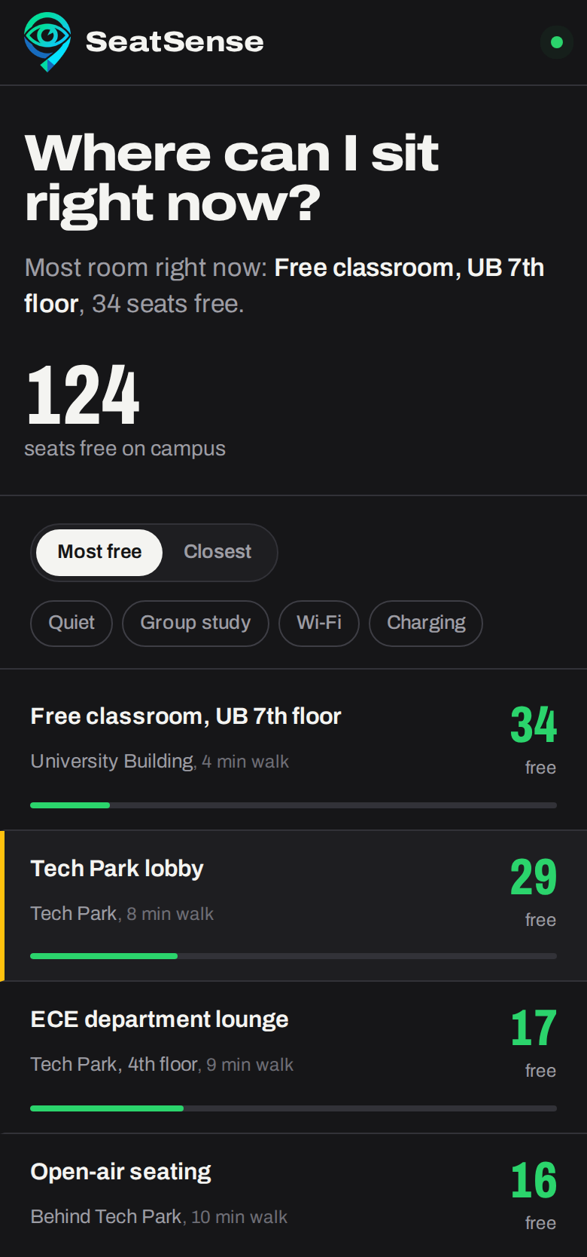
Step 1: find a place with free seats
How it works, 1 of 4
Open SeatSense
Log in with your SRM NetID. No new password to remember.
See every place at a glance
Each study space shows how many seats are free right now. Green has room, red is full.
Filter for what you need
Quiet, Wi-Fi, charging points or group study.
Notes:
Speaker 3: How it works
Thanks. I’m going to walk you through exactly how SeatSense works, from opening the app to sitting down. This is our working prototype.
Step one: you open the app and log in with your SRM NetID, the same login you already use. The first thing you see is every study space on campus and how many seats are free in each, right now. Green means there’s room, red means it’s full. If you need something specific, like a quiet place or a charging point, you filter for it.

Slide 10
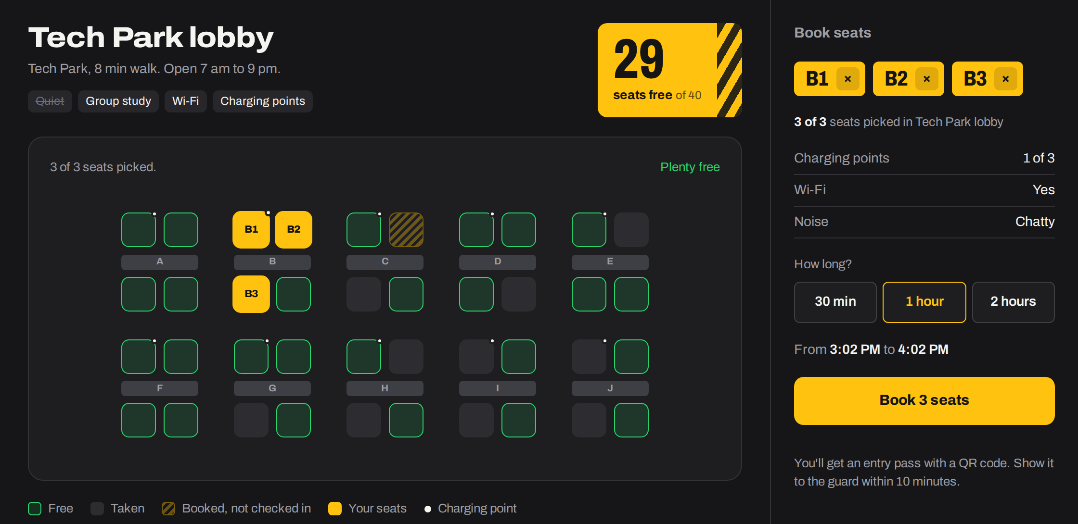
Step 2: pick up to 3 seats and book
How it works, 2 of 4
Tap the seats you want
Up to 3, so you can sit with friends.
Choose how long
30 minutes, 1 hour or 2 hours.
Tap Book
The seats turn yellow and are held for you.
Notes:
Speaker 3: How it works
Step two. You open a place and see its actual seat map. Each square is a seat. Green ones are free, grey ones are taken. You tap the seats you want. You can pick up to three, so you and two friends can sit together; here we’ve picked B1, B2 and B3 at the same table. Then you choose how long you need, up to two hours, and tap Book. Those seats are now held for you, and nobody else can book them.

Slide 11
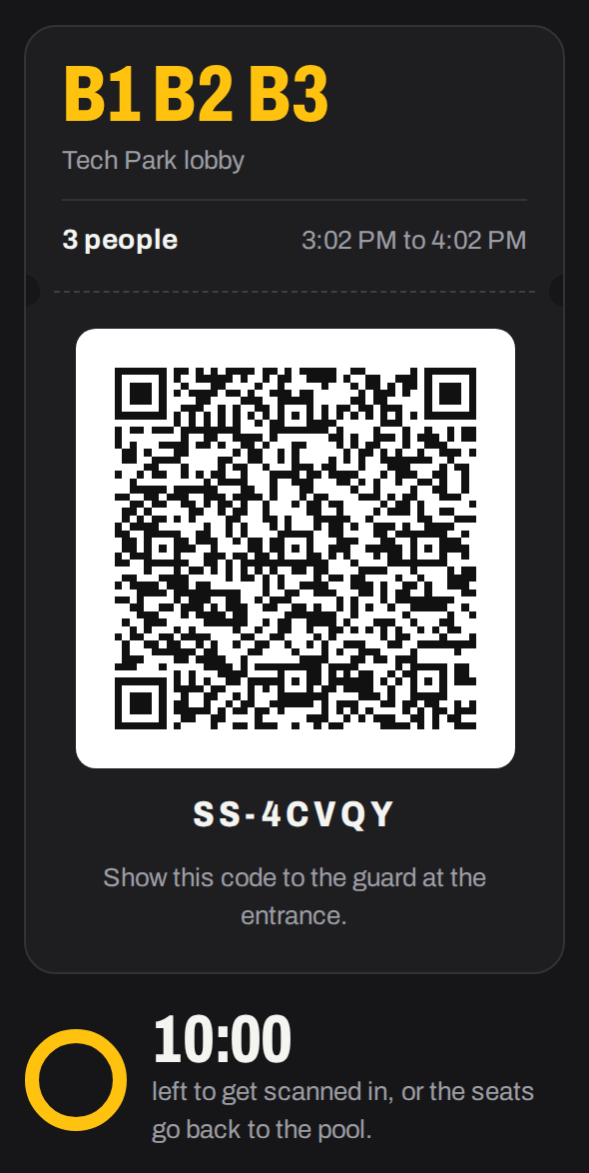
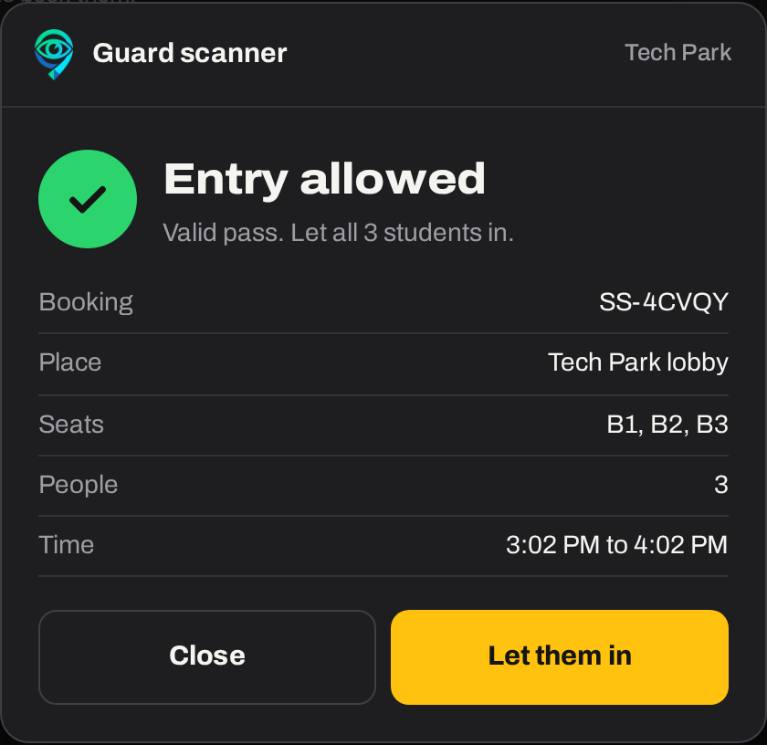
Step 3: show your pass at the entrance
How it works, 3 of 4
You get a QR pass
It shows your seats, the place and a booking code.
The guard scans it
Their screen says “Entry allowed”, with the seats and number of people.
You have 10 minutes
If the pass isn’t scanned in time, the seats go back for others.
Notes:
Speaker 3: How it works
Step three. As soon as you book, the app gives you an entry pass with a QR code. It has your seats, the place and a booking code. You walk over and show it to the guard at the entrance. The guard scans it, and their screen says Entry allowed, with the seat numbers and how many people are on the pass. They tap Let them in, and you’re checked in.
One rule matters here: you have ten minutes. If your pass isn’t scanned in ten minutes, the seats are released for someone else. That stops people booking seats and never turning up.

Slide 12
What happens behind the screen
How it works, 4 of 4
you book
guard scans
you scan out
Free
Held
In use
Free again
Not scanned in 10 minutes? The seats go straight back to Free.
Walk-ins get scanned too
AI on the existing CCTV
No booking? The guard scans your student ID and gives you a free seat. Nobody gets in uncounted.
Cameras already on campus spot which seats are free, so the count stays right even if someone forgets to scan out.
Notes:
Speaker 3: How it works
Finally, what's happening behind the screen. Every seat is in one of a few states. It starts free. When you book, it's held for you. When the guard scans your pass, it's in use. When you scan out or your time is up, it's free again. If nobody scans the pass within ten minutes, it goes straight back to free.
Nobody gets in without a scan, so the app always knows who's inside. If you don't have a booking, the guard scans your student ID and gives you a free seat, so walk-ins are counted too. And to keep the count right, we add AI to the CCTV cameras that are already on campus. They spot which seats are actually free, so even if someone forgets to scan out, the app still shows the right number. Over to [Speaker 4].

Slide 13
What students get
More study time
No more spending free periods walking around.
Less stress
You know where to go before you leave class.
Sit with your friends
Book up to 3 seats together.
Fair seats
No more bags holding seats for hours.
Notes:
Speaker 4: Why it matters
Thanks. So why does this matter? For students, it’s simple. More time actually studying. Less stress, because you know where you’re going before you leave class. You can sit with your friends. And seats are fair, because a bag can’t hold one any more.

Slide 14
What SRM gets
Library staff
Guards
Fewer arguments over seats.
A quick scan at the door instead of back-and-forth.
Administration
The university
Real data on which spaces are used, and when, to plan better.
A smart-campus project built by its own students. Useful for NAAC too.
Notes:
Speaker 4: Why it matters
And it’s not just students who benefit. Library staff deal with fewer arguments over seats. Guards get a quick scan at the door instead of a debate. The administration gets real data on which spaces are used and when, which it doesn’t have today. And the university gets a smart-campus project built by its own students, which also helps for NAAC.

Slide 15
Fair to everyone, private by default
Fair
Private
Some seats always stay walk-in
AI only counts seats. No new recording.
Up to 3 seats, one booking at a time
Only bookings and head counts are stored
10 minutes to get your pass scanned
Login through SRM’s own NetID
2 hours max per booking
Repeated no-shows pause booking for 2 days
Notes:
Speaker 4: Why it matters
You might be wondering: won't people just hog seats through the app instead? We thought about that. Some seats always stay walk-in, so nobody is locked out for not having the app. You can book up to three seats, one booking at a time, for at most two hours. If your pass isn't scanned in ten minutes, the seats are released, and repeated no-shows pause your booking for two days.
And on privacy: the AI only counts which seats are taken. It doesn't add any new recording, we only store bookings and head counts, and login goes through SRM's own NetID.

Slide 16
Before and after
Today
With SeatSense
Walk to the library. Full.
Open the app. Tech Park lobby: 46 free.
Walk to the canteen. Full.
Book 3 seats for you and your friends.
End up on the stairs.
Show the pass, walk in, sit down.
Half the free period gone.
Studying within minutes.
Notes:
Speaker 4: Why it matters
Here’s the same free period, twice. [Read the left side slowly.] Now with SeatSense. [Read the right side.] Same student, same fifty minutes, very different result. Over to [Speaker 5] for the plan.

Slide 17
Our plan for one semester
Weeks 1–2
Weeks 3–8
After that
Ask students
Launch
Grow
Run a survey and count seats in each place.
Start in Central Library, UB Canteen and Tech Park lobby.
Add more spaces across campus, based on what we learn.
How we’ll know it works
30 s
or less to find and book
40%
of library users on the app
15%
or fewer no-shows
Notes:
Speaker 5: Plan and ask
Thanks. Here’s how we’d run it. In the first two weeks we survey students and count the seats in each place, so we’re working with real numbers. By week eight we launch in three places. After that we add more spaces based on what we learn.
And we’ll hold ourselves to three numbers: finding and booking a seat in thirty seconds or less, forty percent of library users on the app, and fifteen percent or fewer no-shows.

Slide 18
Built on what campus already has
Existing CCTV cameras
What we add
AI added to spot which seats are free.
Software
Guards’ phones
Scan passes with the phone camera.
Everything else is already on campus.
SRM NetID login
No new accounts for students.
Campus network
Nothing new to wire up.
Notes:
Speaker 5: Plan and ask
The nice thing is that SeatSense is built on what the campus already has. The only thing we add is software. It uses the CCTV cameras that are already installed, with AI added to spot free seats. Guards scan passes with their phones. Students log in with their SRM NetID, and it all runs on the campus network. There's nothing new to install.

Slide 19

Requirements to Implement
1
Approval to run a pilot in 3 places
2
Seat counts and timings for those places
3
Help from IT with SRM login and CCTV access
4
Guards to scan passes at each entrance
Notes:
Speaker 5: Plan and ask
So what would it take to make this happen? Approval to run a pilot in three places. Seat counts and timings for those places. Help from IT to connect SRM login and give access to the CCTV feeds. And guards at each entrance to scan passes. We already have a working prototype, so we could get the pilot running quickly.

Slide 20
Thank you
Happy to take your questions.
AN IDEATION BY :
Narashimmaa R K
S Sujan
Hariharan
Alban Josh
E Sujeeth
Notes:
Speaker 5: Plan and ask
Thank you for listening. We’re happy to take your questions, and if you’d like, we can show the prototype live right now. [Speaker 3 can open SeatSense_prototype.html for a live demo.]

