Slide 1
Test Case Iterations
Personal Investing
Parallel Execution
By
Narasimhulu U

Slide 2




Multi Tasking

Slide 3


Test Case Structure & Problem Statement
Automation Script
MM
….
UI
API
Mainframe
Test Case 1
Test Case 2
Test Case 3
Test Case 1
Iteration 1
Iteration 2
Iteration 3
Iteration 4
Iteration N

Slide 4
Existing Flow
Sequential Execution
Sequential Execution
Sequential Execution
TC 1
2 PM
TC 2
2 PM
TC 3
2 PM
Iteration 1
Iteration 2
Iteration 3
Iteration 4
Iteration 1
Iteration 2
Iteration 3
Iteration 4
Iteration 1
Iteration 2
Iteration 3
Iteration 4
10 Min
10 Min
40 Min
10 Min
10 Min

Slide 5
New Solution
Parallel Execution
Parallel Execution
Parallel Execution
TC 1
2 PM
TC 2
2 PM
TC 3
2 PM
10 min
10 min
10 min
Total Time
Parent Thread
Thread
Thread
Thread
Parent Thread
Thread
Thread
Thread
Parent Thread
Thread
Thread
Thread
1
2
3
1
2
3
1
2
3
10 Min

Slide 6
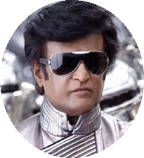


Kutty Version 3.0
Automation Script
MM
….
UI
API
Mainframe
Test Case 1
Test Case 2
Test Case 3
V 1.0
Test Case 1
Iteration 1
Iteration 2
Iteration 3
Iteration 4
Iteration N
V 2.0
V 3.0

Slide 7
Comparison and Benefits
Execution Metrics
Total Test cases : ~1100
Total Iteration : ~8000
Automation
Execution Time : ~30 days
Number of Employees : 6
TC Parallel
Execution Time : ~15 days
Number of Employees : 4
Iteration Parallel
Execution Time : ~2 days
Number of Employees : 1
2
Easily Integrate with RestAssured API framework
Applicable on UI, API & Mainframe Testing
3
1
90% Execution time reduction

Slide 8
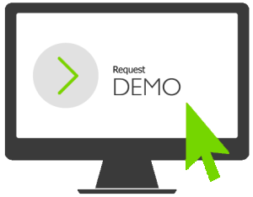
Demo

Slide 9
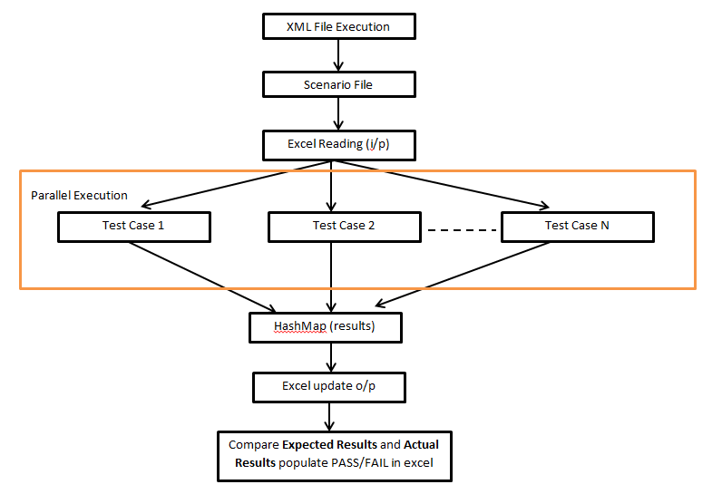
Execution Flow

