Slide 1
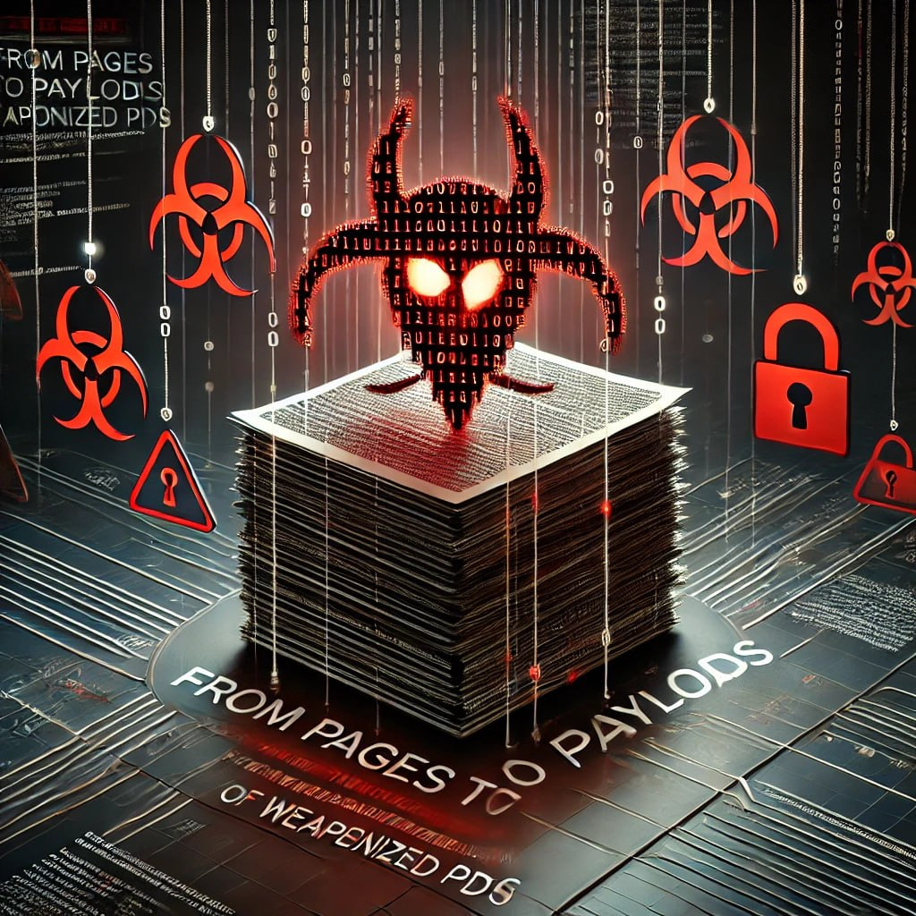
From Pages to Payloads: Unmasking the Hidden Threat of Weaponized PDFs
Mentor: Mr. LAVUDIYA NARASIMHA SWAMY
Team Members:
A. Pavan (2200031028)
B. Harika (2200030901)
Jaswanth (2200031576)
S. Narasimha Raju (2200032563)

Slide 2
Abstract
In this research, we delve into how everyday PDF files can be manipulated to serve as conduits for host-based attacks. Our experiments reveal that a file, which appears completely ordinary, can be engineered to harbor a reverse shell payload using widely accessible tools like the Metasploit Framework. By injecting malicious code into a PDF and then hosting it on a convincingly authentic-looking document portal, we show how an unsuspecting user might inadvertently trigger an exploit, leading to unauthorized system access via a Meterpreter session. Although contemporary endpoint protections have become more robust, our findings indicate that sophisticated attackers can still bypass these defenses through careful social engineering and payload obfuscation techniques. This study underscores the pressing need for enhanced user awareness, stricter source verification, and continual evolution of security practices to combat emerging threats.

