Slide 1
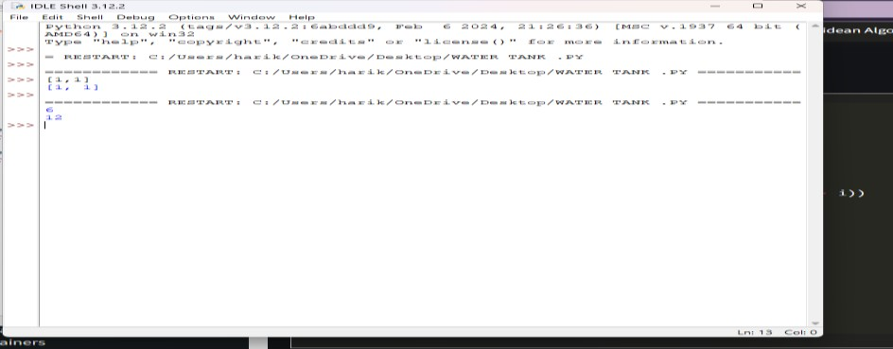
DATE:4-6-24 NAME: T.NARASIMHA REDDY
ASSIGNMENT – 2 RED NO: 192311170
11. Container With Most Water
You are given an integer array height of length n. There are n vertical lines drawn such that the
two endpoints of the ith line are (i, 0) and (i, height[i]).
Find two lines that together with the x-axis form a container, such that the container contains the
most water.
Return the maximum amount of water a container can store. Notice that you may not slant the container.
CODE:
def maxArea(A, Len) :
area = 0
for i in range(Len) :
for j in range(i + 1, Len) :
# Calculating the max area
area = max(area, min(A[j], A[i]) * (j - i)) return area
# Driver code
a = [ 1, 5, 4, 3 ]
b = [ 3, 1, 2, 4, 5 ]
len1 = len(a) print(maxArea(a, len1))
len2 = len(b) print(maxArea(b, len2))
OUTPUT:

Slide 2
12. Roman numerals are represented by seven different symbols: I, V, X, L, C, D and M.
Symbol Value I 1
V 5
X 10
L 50
C 100
D 500
M 1000
For example, 2 is written as II in Roman numeral, just two one's added together. 12 is written as
XII, which is simply X + II. The number 27 is written as XXVII, which is XX + V + II. Roman numerals are usually written largest to smallest from left to right. However, the numeral
for four is not IIII. Instead, the number four is written as IV. Because the one is before the five
we subtract it making four. The same principle applies to the number nine, which is written as
IX. There are six instances where subtraction is used:
I can be placed before V (5) and X (10) to make 4 and 9.
X can be placed before L (50) and C (100) to make 40 and 90.
C can be placed before D (500) and M (1000) to make 400 and 900. Given an integer, convert it to a roman numeral.
CODE:
def value(r): if (r == 'I'):
return 1
if (r == 'V'):
return 5
if (r == 'X'):
return 10
if (r == 'L'):
return 50
if (r == 'C'):
return 100 if (r == 'D'):

Slide 3
return 500
if (r == 'M'):
return 1000
return -1
def romanToDecimal(str):
res = 0
i = 0
while (i < len(str)):
# Getting value of symbol s[i] s1 = value(str[i])
if (i + 1 < len(str)):
# Getting value of symbol s[i + 1] s2 = value(str[i + 1])
# Comparing both values if (s1 >= s2):
# Value of current symbol is greater # or equal to the next symbol
res = res + s1
i = i + 1 else:
# Value of current symbol is greater # or equal to the next symbol
res = res + s2 - s1 i = i + 2
else:
res = res + s1 i = i + 1 return res
# Driver code
print("Integer form of Roman Numeral is"), print(romanToDecimal("MCMIV")) OUTPUT:

Slide 4
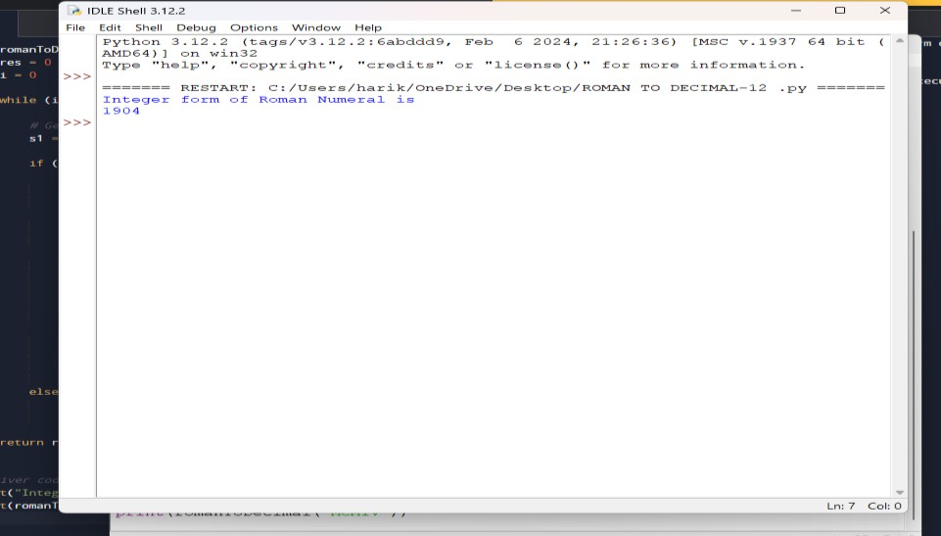
13. Roman to Integer
Roman numerals are represented by seven different symbols: I, V, X, L, C, D and M. Symbol Value
I 1
V 5
X 10
L 50
C 100
D 500
M 1000
For example, 2 is written as II in Roman numeral, just two ones added together. 12 is written as
XII, which is simply X + II. The number 27 is written as XXVII, which is XX + V + II. Roman numerals are usually written largest to smallest from left to right. However, the numeral
for four is not IIII. Instead, the number four is written as IV. Because the one is before the five
we subtract it making four. The same principle applies to the number nine, which is written as
IX. There are six instances where subtraction is used:
I can be placed before V (5) and X (10) to make 4 and 9.
X can be placed before L (50) and C (100) to make 40 and 90.
C can be placed before D (500) and M (1000) to make 400 and 900.
Code:
roman = {'I':1,'V':5,'X':10,'L':50,'C':100,'D':500,'M':1000}
class Solution:
def romanToInt(self, S: str) -> int: summ= 0

Slide 5
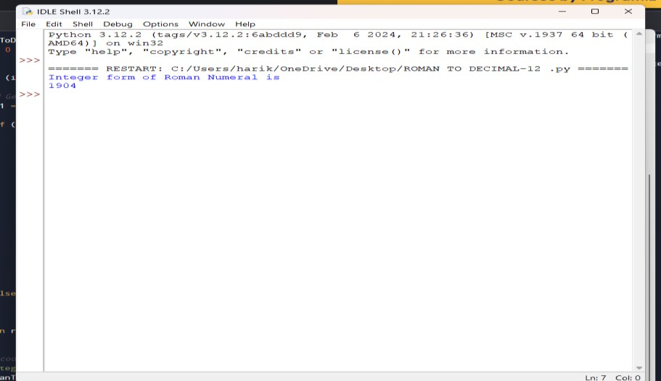
for i in range(len(S)-1,-1,-1): num = roman[S[i]]
if 3*num < summ: summ = summ-num else:
summ = summ+num return sum OUTPUT:
14. Longest Common Prefix
Write a function to find the longest common prefix string amongst an array of strings. If there is no common prefix, return an empty string ""
CODE:
def longestCommonPrefix( a): size = len(a)
# if size is 0, return empty string if (size == 0):
return ""
if (size == 1):
return a[0]
# sort the array of strings a.sort()
# find the minimum length from # first and last string
end = min(len(a[0]), len(a[size - 1]))
# find the common prefix between

Slide 6
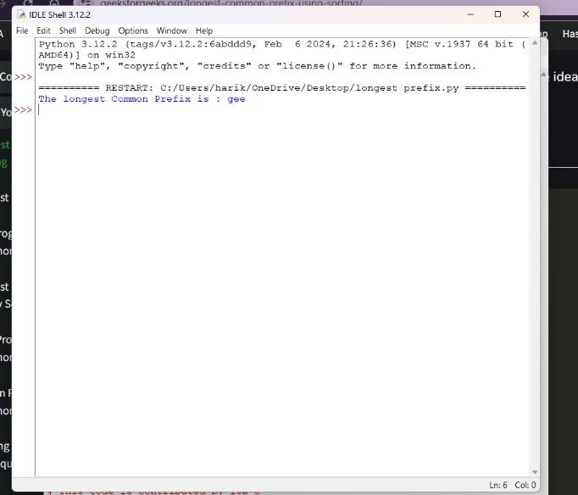
# the first and last string i = 0
while (i < end and a[0][i] == a[size - 1][i]):
i += 1
pre = a[0][0: i] return pre
# Driver Code
if name == " main ":
input = ["geeksforgeeks", "geeks", "geek", "geezer"]
print("The longest Common Prefix is :" , longestCommonPrefix(inp)
OUTPUT:
15. 3Sum
Given an integer array nums, return all the triplets [nums[i], nums[j], nums[k]] such that i != j, i
!= k, and j != k, and nums[i] + nums[j] + nums[k] == 0.
Notice that the solution set must not contain duplicate triplets. Example 1:
Input: nums = [-1,0,1,2,-1,-4]
Output: [[-1,-1,2],[-1,0,1]]
Explanation:
nums[0] + nums[1] + nums[2] = (-1) + 0 + 1 = 0.
nums[1] + nums[2] + nums[4] = 0 + 1 + (-1) = 0.
nums[0] + nums[3] + nums[4] = (-1) + 2 + (-1) = 0. The distinct triplets are [-1,0,1] and [-1,-1,2].
Notice that the order of the output and the order of the triplets does not matter.

Slide 7
CODE:
def findTriplets(nums, n, Sum):
i = 0
j = 0
k = 0
# list to store all unique triplets. triplet = []
# list to store already found triplets # to avoid duplication.
uniqTriplets = []
# Variable used to hold triplet # converted to string form. temp = ""
# Variable used to store current # triplet which is stored in vector # if it is unique.
newTriplet = [0, 0, 0] # Sort the input array. nums.sort()
# Iterate over the array from the # start and consider it as the
# first element.
for i in range(n - 2):
# index of the first element in # the remaining elements.
j = i + 1
# index of the last element. k = n - 1
while(j < k):
# If sum of triplet is equal to

Slide 8
# given value, then check if # this triplet is unique or not.
# To check uniqueness, convert # triplet to string form and
# then check if this string is # present in set or not. If
# triplet is unique, then store # it in list.
if(nums[i] + nums[j] + nums[k] == Sum):
temp = str(nums[i]) + ":" + str(nums[j]) + ":" + str(nums[k]) if temp not in uniqTriplets:
uniqTriplets.append(temp) newTriplet[0] = nums[i]
newTriplet[1] = nums[j] newTriplet[2] = nums[k]
triplet.append(newTriplet) newTriplet = [0, 0, 0]
# Increment the first index # and decrement the last
# index of remaining elements.
j += 1
k -= 1
# If sum is greater than given # value then to reduce sum
# decrement the last index.
elif(nums[i] + nums[j] + nums[k] > Sum): k -= 1
# If sum is less than given value # then to increase sum increment

Slide 9
# the first index of remaining # elements.
else:
j += 1
# If no unique triplet is found, then # return 0.
if(len(triplet) == 0):
return 0
# Print all unique triplets stored in # list.
for i in range(len(triplet)): print(triplet[i], end = ", ") return 1
# Driver Code
nums = [12, 3, 6, 1, 6, 9]
n = len(nums)
Sum = 24
# Function call
if(not findTriplets(nums, n, Sum)): print("No triplets can be formed.") output:

Slide 10
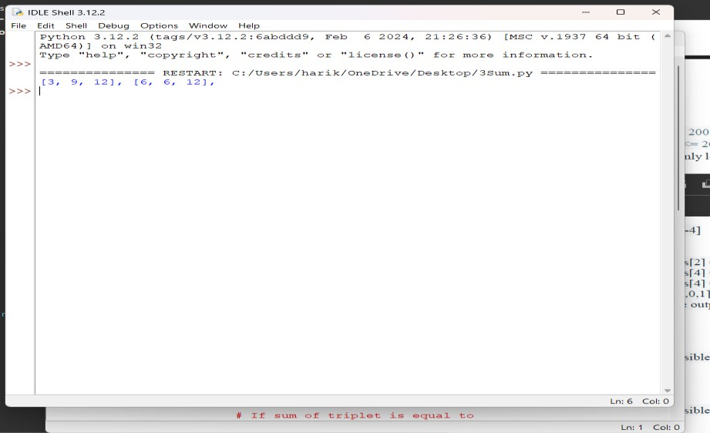
16. 3Sum Closest
Given an integer array nums of length n and an integer target, find three integers in nums such
that the sum is closest to target. Return the sum of the three integers.
You may assume that each input would have exactly one solution.
CODE:
import sys
# Function to return the sum of a # triplet which is closest to x
def solution(arr, x):
# To store the closest sum closestSum = sys.maxsize
# Run three nested loops each loop # for each element of triplet
for i in range (len(arr)) :
for j in range(i + 1, len(arr)): for k in range(j + 1, len( arr)):
# Update the closestSum

Slide 11
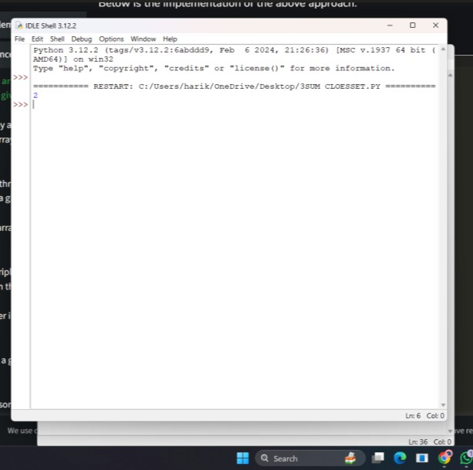
if(abs(x - closestSum) > abs(x - (arr[i] +
arr[j] + arr[k]))): closestSum = (arr[i] + arr[j] + arr[k])
# Return the closest sum found return closestSum
# Driver code
if name == " main ":
arr = [ -1, 2, 1, -4 ]
x = 1
print(solution(arr, x))
output:
17. Letter Combinations of a Phone Number
Given a string containing digits from 2-9 inclusive, return all possible letter combinations that
the number could represent. Return the answer in any order.

Slide 12
A mapping of digits to letters (just like on the telephone buttons) is given below. Note that 1
does not map to any letters.
CODE:
# Python3 implementation of the approach from collections import deque
# Function to return a list that contains # all the generated letter combinations
def letterCombinationsUtil(number, n, table):
list = []
q = deque() q.append("")
while len(q) != 0:
s = q.pop()
# If complete word is generated # push it in the list
if len(s) == n:
list.append(s)
else:
# Try all possible letters for current digit # in number[]
for letter in table[number[len(s)]]: q.append(s + letter)
# Return the generated list return list

Slide 13
# Function that creates the mapping and # calls letterCombinationsUtil
def letterCombinations(number, n):
# table[i] stores all characters that # corresponds to ith digit in phone
table = ["0", "1", "abc", "def", "ghi", "jkl",
"mno", "pqrs", "tuv", "wxyz"]
list = letterCombinationsUtil(number, n, table) s = ""
for word in list:
s += word + " "
print(s) return
# Driver code number = [2, 3] n = len(number)
# Function call letterCombinations(number, n)
OUTPUT:

Slide 14
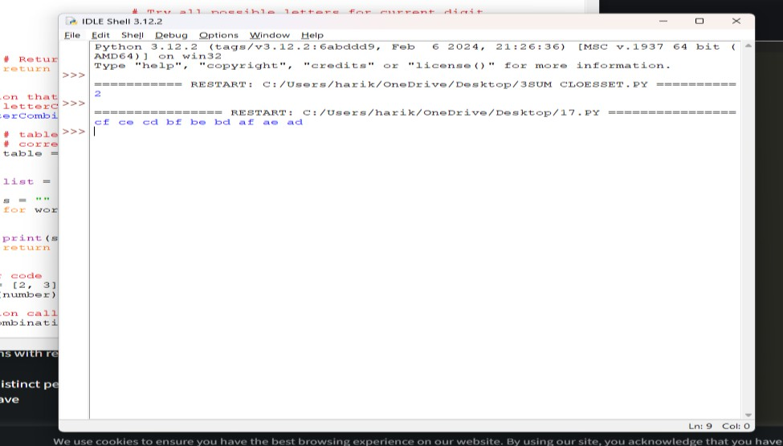
4Sum
Given an array nums of n integers, return an array of all the unique quadruplets
[nums[a],
nums[b], nums[c], nums[d]] such that:
0 <= a, b, c, d < n
a, b, c, and d are distinct.
nums[a] + nums[b] + nums[c] + nums[d] == target
CODE:
# Store the pair of indices class Pair:
def init (self, x, y):
self.index1 = x self.index2 = y
# Function to find the all the unique quadruplets # with the elements at different indices
def GetQuadruplets(nums, target):
# Store the sum mapped to a list of pair indices map = {}
# Generate all possible pairs for the map for i in range(len(nums) - 1):

Slide 15
for j in range(i + 1, len(nums)):
# Find the sum of pairs of elements sum = nums[i] + nums[j]
# If the sum doesn't exist then update with the new pairs if sum not in map:
map[sum] = [Pair(i, j)]
# Otherwise, add the new pair of indices to the current sum else:
map[sum].append(Pair(i, j))
# Store all the Quadruplets ans = set()
for i in range(len(nums) - 1):
for j in range(i + 1, len(nums)):
lookUp = target - (nums[i] + nums[j])
# If the sum with value (K - sum) exists if lookUp in map:
# Get the pair of indices of sum temp = map[lookUp]
for pair in temp:
# Check if i, j, k and l are distinct or not
if pair.index1 != i and pair.index1 != j and pair.index2 != i and pair.index2 != j: l1 = [nums[pair.index1], nums[pair.index2], nums[i], nums[j]]
# Sort the list to avoid duplicacy l1.sort()
# Update the set

Slide 16
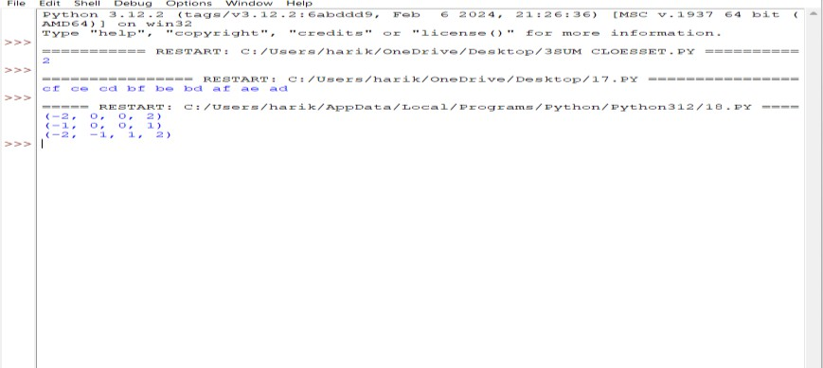
ans.add(tuple(l1))
# Print all the Quadruplets print(*reversed(list(ans)), sep = '\n')
# Driver Code
arr = [1, 0, -1, 0, -2, 2]
K = 0
GetQuadruplets(arr, K)
OUTPUT:
19. Remove Nth Node From End of List
Given the head of a linked list, remove the nth node from the end of the list and return its head.
CODE:
# Python code for the deleting a node from end # in two traversal
class Node:
def init (self, value): self.data = value self.next = None

Slide 17
def length(head):
temp = head count = 0
while(temp != None):
count += 1
temp = temp.next return count
def printList(head):
ptr = head while(ptr != None):
print (ptr.data, end =" ") ptr = ptr.next
print()
def deleteNthNodeFromEnd(head, n): Length = length(head) nodeFromBeginning = Length - n + 1 prev = None
temp = head
for i in range(1, nodeFromBeginning): prev = temp
temp = temp.next if(prev == None):
head = head.next return head
else:
prev.next = prev.next.next return head
if name == ' main ':

Slide 18
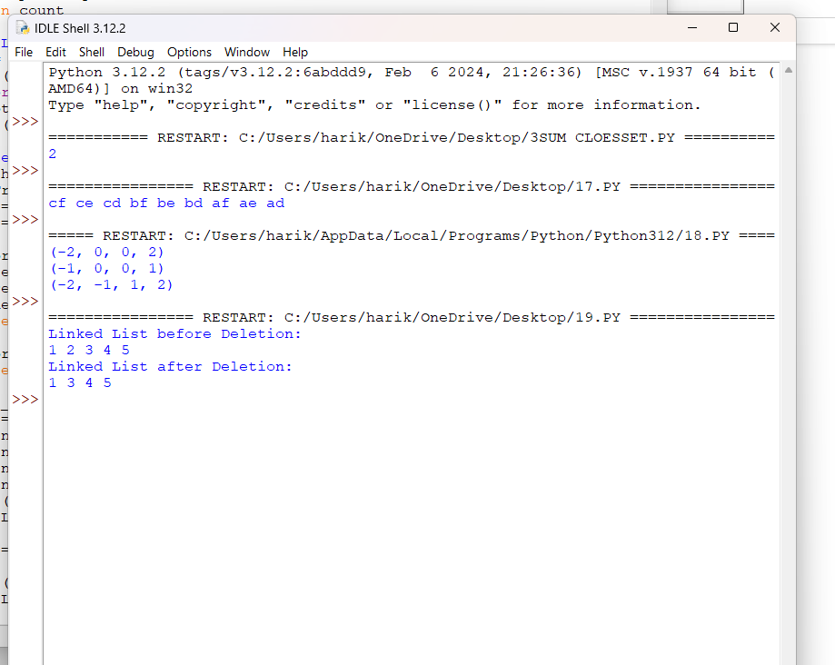
head = Node(1) head.next = Node(2) head.next.next = Node(3)
head.next.next.next = Node(4) head.next.next.next.next = Node(5) print("Linked List before Deletion:") printList(head)
head = deleteNthNodeFromEnd(head, 4)
print("Linked List after Deletion:") printList(head)
OUTPUT:
Valid Parentheses
Given a string s containing just the characters '(', ')', '{', '}', '[' and ']', determine if the input string
is valid.
An input string is valid if:
Open brackets must be closed by the same type of brackets.

Slide 19
Open brackets must be closed in the correct order.
Every close bracket has a corresponding open bracket of the same type.
CODE:
def areBracketsBalanced(expr): stack = []
# Traversing the Expression
for char in expr:
if char in ["(", "{", "["]:
# Push the element in the stack stack.append(char)
else:
# IF current character is not opening # bracket, then it must be closing.
# So stack cannot be empty at this point. if not stack:
return False
current_char = stack.pop() if current_char == '(':
if char != ")": return False
if current_char == '{': if char != "}":
return False
if current_char == '[': if char != "]":
return False
# Check Empty Stack if stack:
return False return True
# Driver Code

Slide 20
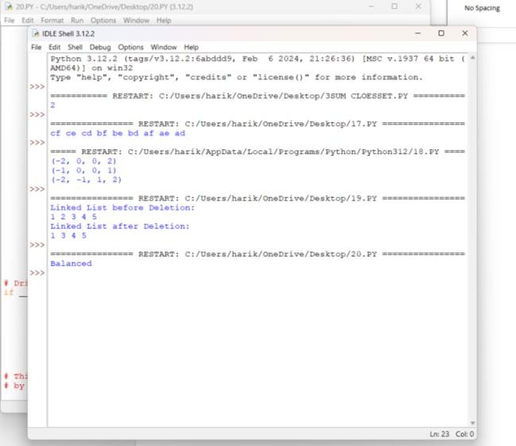
if name == " main ": expr = "{()}[]"
# Function call
if areBracketsBalanced(expr): print("Balanced")
else:
print("Not Balanced")
OUTPUT:

