Slide 1

MINI PROJECT
ON
ONLINE QUIZ
Department of Information Technology
Presented by Batch number:- 16
Batch members:
K.NARASIMHA SAI (17121A1246)
K.SUSHMA (17121A1247)
K.CHANDANA (17121A1248)

Slide 2
Content table
✓Abstract...............................
✓Introduction.........................
✓project Details.....................
✓Required components.........
✓Design of project.................
✓Result...................................
✓Conclusion...........................
✓Future reference..................
✓Member's roles in project....
✓Status of project..................
✓Reference to project............

Slide 3
ABSTRACT
Main objective:
•To efficiently evaluate the candidate thoroughly through a fully automated system that not only saves lot of time but also gives fast results.
•By using the concepts of Functions,Files,Structures,File Handlings...this will be done..
•This results in getting the
-Easy results
-No use of pen and paper
-Fully automated system

Slide 4
Introduction
In this project, we store the questions, choices and correct answer into a file.
System asks the user to enter name and also asks the user whether they want to participate in the quiz or not.
If user want to participate it display the questions followed by choice and asks user to enter they choice..

Slide 5
Introduction
If the entered choice matches the correct answer..then score incremented by 10 or else it's displays choice entered is wrong.. and displays correct answer..
At the end, Displays the student total score..

Slide 6
Project Details
There are three modules:
1.Registration
2.Participate in QUIZ
3.Display Records

Slide 7
Registration
•To register their (his/her) details to participate in the quiz.
•concepts used in it is looping statements, structures
•Details are
--Participant name.
--Participant ID no.
--Participant password.

Slide 8
Participate in QUIZ
•To take part to play the Quiz game.
•Concepts used is Looping statements,Files, structures,File handling...
•Operations
--Registration
--GetQuetions
--StartExam
--WriteExam

Slide 9
Display records
•To display stored records of participants.
•concepts are structures and files
•Operations are
--WatchScore

Slide 10
Hardware and Software Requirements
•Minimum software Requirements:
->Ubuntu 14.04.5 LTS
->Linux operating system
•Minimum Hardware Requirements:
->4GB RAM,1TB Hard disk
->64-bit processor

Slide 11
DESIGN OF PROJECT
Main menu
1
Registration
2
Participate in the QUIZ
3
Display records
Output

Slide 12
Registration
REGISTRATION
Read
NAME
Read
ID No.
Set
Pswd

Slide 13
Participation
PARTICIPATION
New user
Existing user
Registration
Questions display
Read CHOICE

Slide 14
Display records
DISPLAY RECORDS
Display participants names
Display participants
ID no.
Display participants
Score

Slide 15
Simple description on design
Main menu
1.registration
2.display records
3.participate in quiz
4.exit
INPUT read
If input is 1-->registration
If input is 2-->display old participants results
If input is 3-->questions will display..participate in quiz
If input is 4-->exit from Quiz
Output we get is the Total marks

Slide 16
Result
* Participant NAME
* ID No.
* Score obtained

Slide 17
Conclusion
•Final conclusion i.e., OUTPUT is
The total score obtained by the
Participants, their Names including
their ID numbers.

Slide 18
FUTURE REFERENCE
For students they give papers according to their convenience and time and there is no need of using extra thing like paper, pen etc.

Slide 19
Member's roles in project
NAME | ROLE
K.Narasimha Sai | Designer
K.Chandana | Developer
K.Sushma | Analyser

Slide 20
Status of project
Analysis | 100%
Design | 100%
Coding | 100%

Slide 21
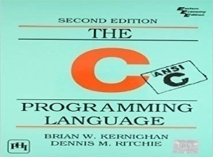
Reference to project
THE C PROGRAMMING LANGUAGE
*Neil Matthew and Richard Stones,
Beginning Linux
Programming, Wiley Dreamtech, Fourth Edition, 2008.
✓Software downloaded Website is
https://www.ubuntu.com/#download.
Drafted on: [02/10/2018]

Slide 22
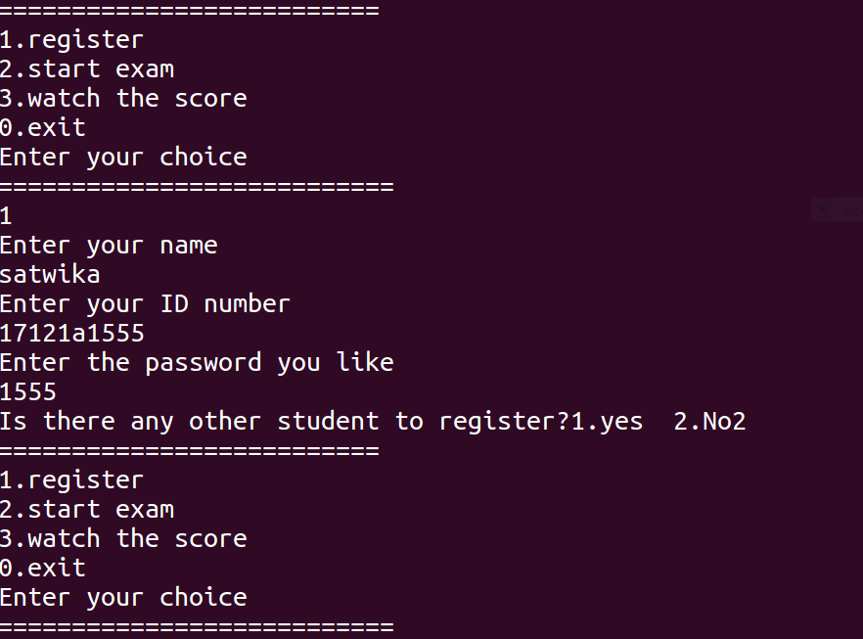
Output For Registration

Slide 23
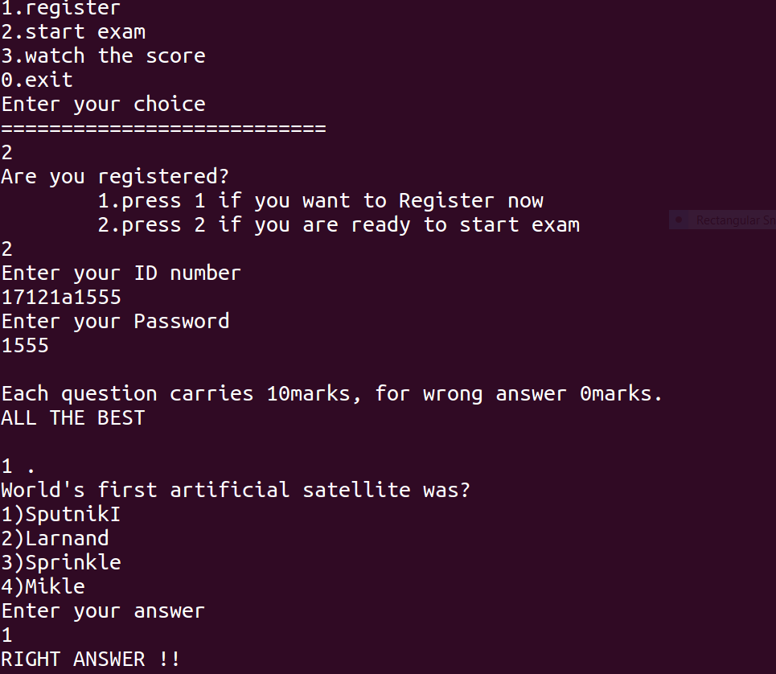
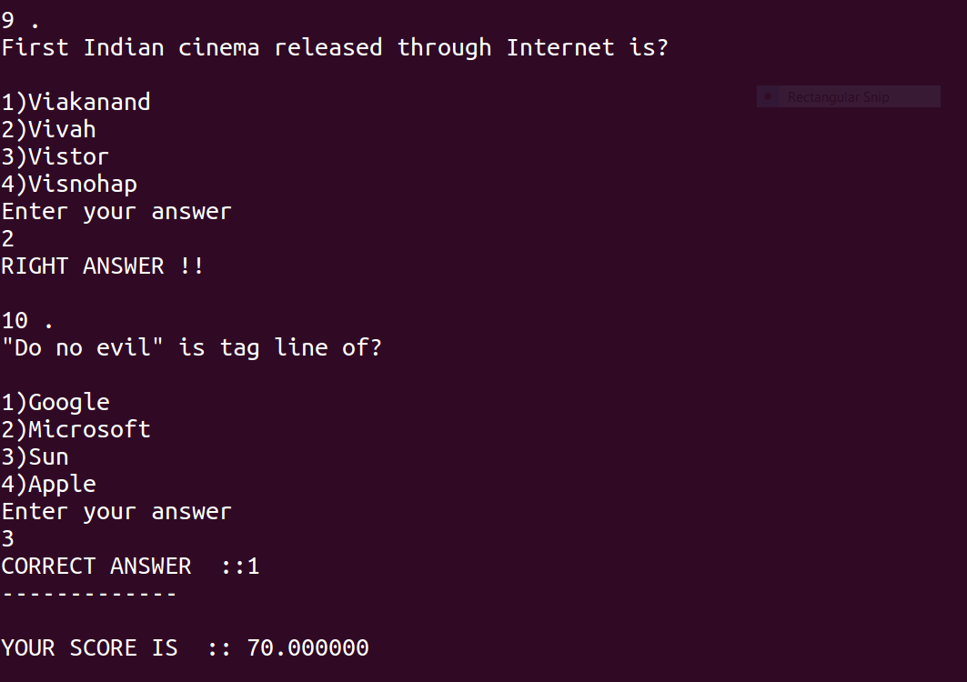
Output For Participation

Slide 24
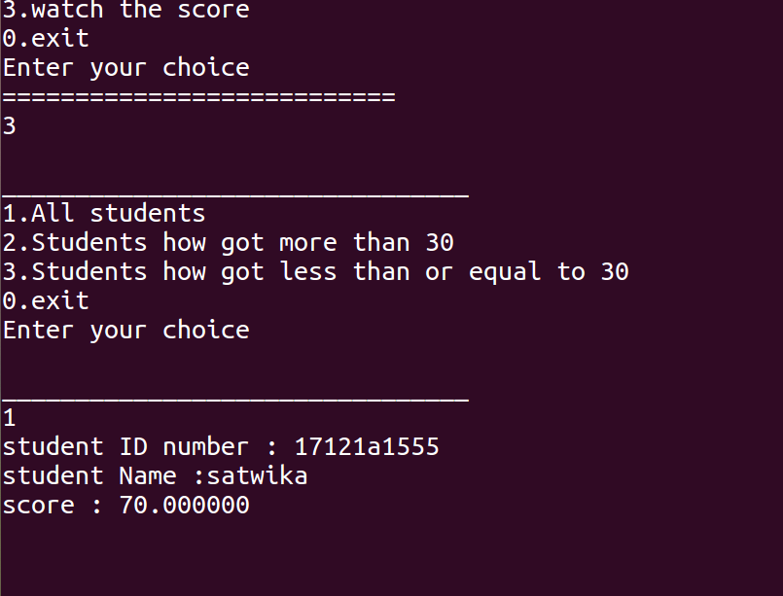
Output For Display Records

Slide 25


