Slide 1
Workday - HCM Fundamentals
Jobs and Positions

Slide 2
Session Objectives
At the end of this session participants will be familiar
With
Job Profiles
Differentiating Job profiles, Job Families and Job Family Groups
Creating positions and Headcount groups
Hiring Restrictions
Managing Filled and Unfilled positions & Headcount groups

Slide 3
Agenda
Job Profiles
Differentiating Job profiles, Job Families and Job Family Groups
Creating positions and Headcount groups
Managing Filled & Unfilled Positions and Headcount groups

Slide 4
Job Profiles
Positions, Headcount group and Jobs use job profile as their foundation.
Job profiles enable you to describe general characteristics of a position and identify special skills, training or other qualifications.
Job profiles can be used to create multiple positions.
Job profile
Position 1
Position 2
IT Helpdesk Specialist
IT Helpdesk Specialist -1
IT Helpdesk Specialist 2

Slide 5
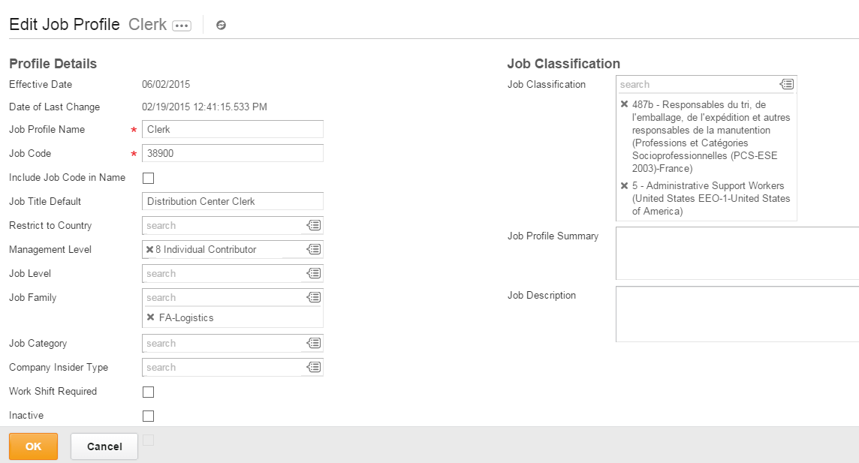
Job Profile

Slide 6
Job Profiles and Localizations
When you staff a job or a position using a job profile with country
specific values, Workday determines the default country to apply to
employee based on the primary business address and country of
the location entered during the staffing change.
The field that allow localization are
Job classification
Pay rate type
Certifications

Slide 7
Job Profiles and Compensation Rules
When a new job profile is created it is necessary to update the compensation rules to include the new instance. To ensure that compensation components will default correctly into a worker’s compensation , bonus or merit target amounts are applied as configured.

Slide 8
Job Families & Job Family Groups
Job families are used to organize and group Job profiles.
Job family Groups are used to communicate the opening externally.
Job Family Group
Job Family
Job profile
Job profile
Job Family
Job profile
Notes:
The use of Job Families and Job family groups is optional
But they can help to organization and group Job profiles and allow these groupings as criteria in a condition rule or compensation eligibility rule
Job Families and Job family groups can be used as filters for locating a specific job profile in prompt as well as to use when writing reports related to job profiles.
If using Job Families and Job family groups in an eligibility rule when a new job profile is created it is important that it gets added to appropriate Job family

Slide 9
Job profiles, Job Families & Job Family Groups
Job profile
Can be used as eligibility condition
New job profiles need to be added to eligibility rule as a comparison value
Job Family
Can be used as eligibility condition
New job profiles - add to job family
Job Family Group
Can be used as eligibility condition
New job profiles must be added to Job family
New job Family – add to eligibility rule as comparison value
New job Family - add to job family group
New job Family group – add to eligibility rule as comparison value

Slide 10
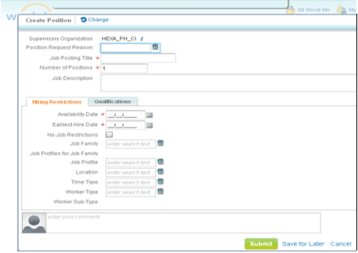
Creating Positions and Headcount Groups
To staff a supervisory organization there must be a open position or available
position in a headcount group.
Field | Description
Position request reason | Custom defined
Job posting title | This is how you are communicating this open position externally
Academic Tenure Eligible | Identifies position that will allow tenured status for higher education
Availability date | The date the position will be seen in the system and can be worked on by recruiting
Earliest Hire date | The position will not be available for hire prior to this date
No Job Restrictions | If no restrictions turn on the check box, otherwise at least one restrictions must be entered
Notes:
1.The only required fields in crating position or headcount are – Posting title, Number of Headcount allocations, availability date & earlier hire date.
2. If no Hiring restrictions selected the No Job Restriction check box must be turned on.
3.When a position is filled if there is information like qualifications entered on the position and qualification are entered on Job profile as well, the qualification on the position will be used since they are considered specific to this unique position.
4. Academic Tenure Eligible must be turned in at the tenant level to be available

Slide 11
Creating Positions and Headcount Groups
Default Compensation:
After creating a position setup default compensation.
All the compensation components can be used as default regardless of eligibility.
Notes:
1.Compensation component includes : compensation package, grade, grade profile, step, salary, unit salary, allowance, unit allowance, bonus, merit commission and stock.
2. If compensation rule have been set up as well as default compensation , the compensation rule will be ignored and default compensation will be populated at time of hire.

Slide 12
Creating Positions and Headcount Groups
Hiring Restrictions
Are used to set controls on how a position, headcount group or Job Management of a Supervisory Organization can be filled during hire.
* The restrictions are used during the hire and ignored for job changes such as transfers or when editing a position
Position management
Hiring restrictions are established for each position
Headcount Management
Hiring restrictions are established for all positions in a headcount group
Job Management
Hiring restrictions are established for entire supervisory organization

Slide 13
Creating Positions and Headcount Groups
Hiring Restrictions
Job Restrictions
Fields | Description
Job Family | All job profiles in the family are available to select from when hiring .
Job profile | Limits what job profiles can be selected. If one value is selected , it cannot be changed when hiring.
Location | Limits what location can be selected. If one value is selected no other business site can be entered during hire.
Worker type | Limits what worker type can be selected; Employee or Contingent worker
Time type | Limits what time type can be selected ; either full or part time

Slide 14
Creating Positions and Headcount Groups
Job Requisitions
You may require a Job Requisition be created before a worker can be moved into a open position
When Job requisition functionality is enabled then
Use the Position Management Staffing
Have a job requisition for all staffing changes(hire, promote , transfer..)
Have an open job requisition when you plan on moving a worker into a unfilled or filled position so you can recruit or hire for the position.
Set hiring restrictions in the job requisition, not the position.

Slide 15
Managing Filled & Unfilled Positions & Headcount Groups
Filled position
Edit position
Filled Headcount Group
Edit position
Edit position restrictions
Manage position restrictions
View Position History
View position History
Unfilled Position
Edit position restrictions
Unfilled Headcount Group
Edit headcount restrictions
Manage position freeze
Close headcount
Close position
Manage headcount freeze

Slide 16
Managing Filled & Unfilled Positions & Headcount Groups
Edit position & Edit position Restrictions
An unfilled position can be edited because a restriction is being added or removed
A filled position can be edited when the change to the employee position data is not considered a promotion, demotion or transfer.
If you use the edit position task the system will let you change anything the restrictions will allow to change
If you use Edit position restrictions it changes the restrictions but not the employee data

Slide 17
Managing Filled & Unfilled Positions & Headcount Groups
Close position Vs Managing A Hiring Freeze
Closing a position is considered as a permanent status, the position will no longer available to hire into. The ability to close requires the position or headcount group is unfilled.
Hiring Freeze task is used to temporarily freeze hiring position or headcount group , one or more supervisory organization or entire supervisory organization.
Tasks
Manage Position Hiring freeze or Manage Position Freeze – Freeze individual position with in a single supervisory organization.
Manage Organization Hiring Freeze – Freeze an Organization and all selected subordinates

Slide 18
Thank you

