Slide 1


























Introduction To Python – Day 1

Slide 2
What is python ???
Python is often misunderstood to be a statistical language used for data analysis / data science because of its growing popularity in that field.
One of those rare languages which is Simple yet powerful

Slide 3
It is an interpreted , object oriented programming language which emphasizes on code readability .
“Interpreted” – Because there is no compilation step like other languages

Slide 4
It has big Libraries for almost everything and a huge community who constantly work on its improvement and support
History ……
Designed by Guido Van Rossum [known as BDFL - Benevolent Dictator For Life]
Python is 26 years old
One of the reasons to name it python - he was a fan of British sketch comedy series, “Monty Python”
Major releases :
Python 2.0 - Oct 2000
Python 3.0 - Dec 2008

Slide 5
Wide Range Of Applications :
Web Development - Python web development frameworks - Pyramid/Django/Flask
Data Analysis - Libraries like Numpy and Pandas
Machine learning - Scikit-Learn / NLTK / TensorFlow
Computer vision - color and face detection using opencv and python
Raspberry Pi - Most popular and efficient language for programming in raspberry pi
Game Development - Game logics can be written using module Pygame
Web Scraping - Fetching data from a website

Slide 6
Python Interpreter :
Python is known for its execution speed and the main reason for faster processing is the omission of the compilation step
The interpreter combines the process of
byte code conversion and compilation
PYTHON PROGRAM
PYTHON INTERPRETER
OUTPUT

Slide 7
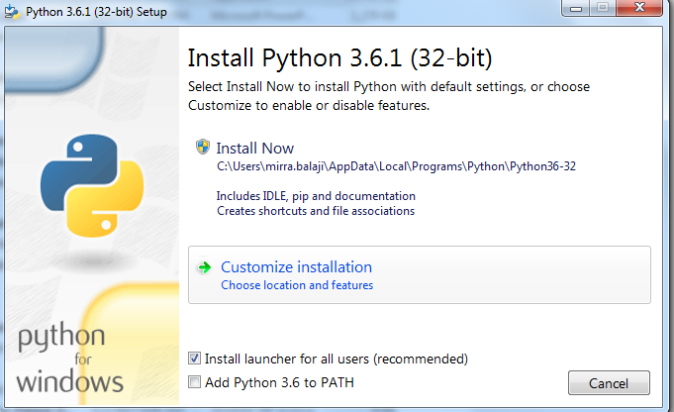
Installation :
Download the latest version of python from the below link,
https://www.python.org/downloads/
The installation process
is quite simple and you
can choose a custom
installation for simpler
access path.
Step 1->

Slide 8
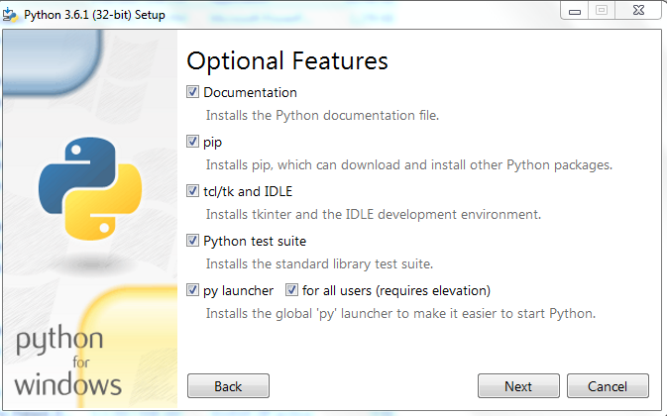
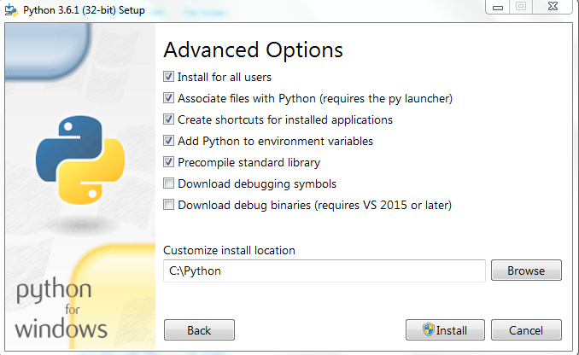
Step 2 ->
<- Step 3

Slide 9
The customary “hello world” program :
Open notepad and type
print(“hello there”)
Save the file as first.py
Open command prompt and change directory to the file where you have saved
first.py
Now,
python first.py
will run the file and display the output

Slide 10
Python program Execution from python shell:
Python shell is a Live Interpreter
It executes line by line code
Python shell through command prompt :
Change directory to the python installation path
Type “python” and the python shell is ready to use

Slide 11


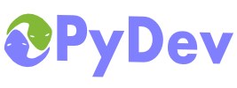

Some of the Python IDE’s
Python IDLE [ comes in-built with python 3.x ]
PyCharm
Spyder
PyDev
Eclipse

Slide 12
Lines and Indents :
Python does not use braces to indicate blocks of code , functions or any control flow.
It differentiates the start and end a code block using indent.
A line indicates the termination of a multi line code block.
Single and Multi line Comments :
# - Single line comments
’’’ – Multi line comments

Slide 13
Data Types:
There are 4 major categories in python. A detailed explanation of each type will be given in the later sessions.
Categories | Sub Types
Numbers | Int Long Float Complex
Sequences | String Byte Byte array List tuple
Sets | Set Frozen set
Mapping | Dictionary

Slide 14
Variables :
There is no necessity to mention the data type before a variable as done in most languages.
The scope of a variable is identified based on indents.
name=“Mirra” #String
num = 5 #Integer
flt = 101.1 #float
Multiple Assignments :
a,b,c=0,”name”,10.5
Here the values are assigned as a=0 , b= “name” and c = 10.5

Slide 15
Strings :
Reverse Indexing :
name = “mirra amritha”
name[1] , name[-1] , name[:] , name[2:6] , name[:3], name[2:] ,name[1:7:-1] , name[:: -2]
Incase we use escape sequence or a quote within a string, use a \ before the symbol
Example: Input "\"" –> Output "

Slide 16
Function Definition
Example of function definition -
def sample_function():
print(“Have a python day”)
sample_function()
def is the keyword to define a function and the colon denotes the start of the function
The indentation plays an important part here. Within the function definition , everything comes after a TAB.
Using a TAB is more preferred than spaces as their interpretation is different while execution

Slide 17
Our First Function : [with turtle package]
import turtle
turt = turtle.Turtle()
def square():
turt.forward(100)
turt.right(90)
turt.forward(100)
turt.right(90)
turt.forward(100)
turt.right(90)
turt.forward(100)
square()

Slide 18
Python Style Guide :
Python provides a style guide where in it defines a common pattern to code in python. It isn’t necessary to follow the guide but an important principle is to follow a consistent pattern throughout
Style Guide : https://www.python.org/dev/peps/pep-0008/

Slide 19
Return Statement :
Python has no requirement for a return type
Example:
def word():
return “biryani”
Arguments :
Arguments that are passed to a function can be flexible and have default values.
def temp(x=“food”, y=“water”, z=“shelter”):
print(x+” ”+y+” ” +z)
temp()
temp(”don't”,”hold”,”back”)
temp(z=”work”)

Slide 20
Unpacking arguments :
def cal(year,month,date):
ans=(100-year)+(month*2)-(5+date)
temp = [10,20,30] #this is a list
cal(*temp)
cal(temp[0],temp[1],temp[2])

Slide 21
Range () :
This function is used to specify range of values
range(10)
range(2,10)
range(10,3,20)
Break and continue keyword :
if n == 5:
break
elif n == 3:
continue

Slide 22
Pass : Pass is a keyword used to make a loop or function wait until you terminate it manually. It functionally does nothing but waits for the process to terminate.
while x is 1:
pass
Input() :
This function gets a single line input from the user
We get a letter from the user every time he/she takes a guess
def guess():
print(“enter a letter : ”)
return input()

Slide 23
Control Flow :
For loop :
Basic Syntax:
for instance in variable/limit/condition :
#task to be performed
Example:
Consider the square() function we wrote earlier. Now we will print number of squares using a for loop.
for i in range(0,4):
square()

Slide 24
While loop:
Basic syntax :
While condition:
#Task
The same thing that we performed previously using the for loop can be performed with a while loop,
x=0
while x<4:
square()
x += 1

Slide 25
If / Elif / Else Statement :
Example
if name is “mirra”:
print(“hello mirra”)
elif name is “amritha”:
print(“hello amritha”)
else:
print(“hello there !!”)
“is” keyword is used to equate / compare strings
“in” keyword is used to iterate through sequences

Slide 26
Try These :
Define a string and print it in the reverse order [Use for and while loop to do the same functionality]
Use multiple assignments and generate fibonacci series
Check for a number is odd or even using if / else statements
Notes:
Using for loop;
for i in name[::-1]:
print(i)
using while loop;
i=-1
while i <len(name):
print(name[i])
i=i+1
Fibonacci series using multiple assignment:
a,b=0,1
for I in range(0,10)
print(a)
a,b=b,a+b
3. Odd/even :
if i%2 == 0:
print(i,"is even")
else:
print(I,”is odd”)

