Slide 1


























Data Structures in Python – Day 2

Slide 2
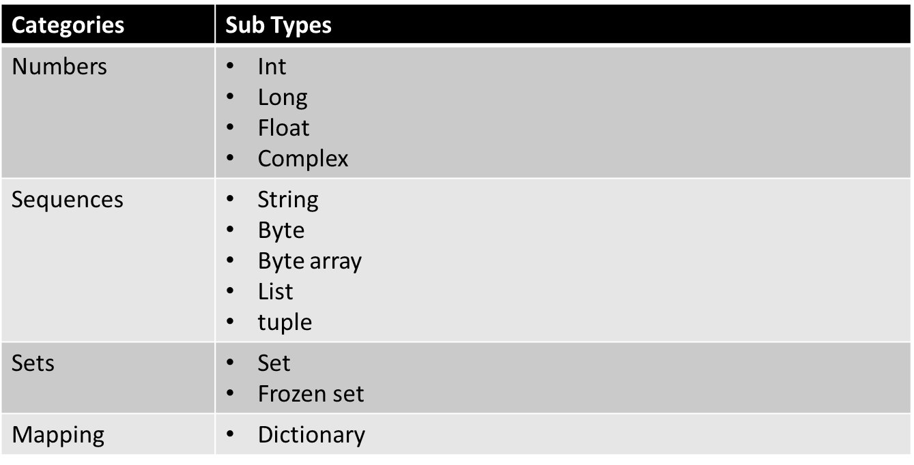
Overview Of Data Types in Python
We will learn each of these types and their usage in detail.

Slide 3
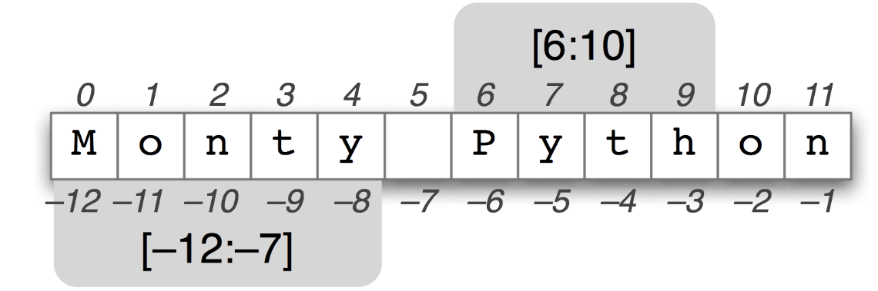
List :
List is an mutable ordered data structure in python which is represented using []
Example:
  my_list = [1,3,”name”,10.7,2,4]
It is heterogeneous which means that it can store numbers, strings and floating points
Slicing Lists:
Slicing functionalities are similar to how we slice a string in python.
my_list[2]
-> name
my_list[2:5]
-> name , 10.7 , 2
my_list[:] #returns entire list
-> 1,3,name,10.7,2,4

Slide 4
my_list[::-1] #returns reverse of list
-> 4,2, 10.7, name, 3, 1
Common List Methods :
Consider a list ,
mylist= [32,11,10.0, "python", "data"]
append() : adds a value to the end of the list
mylist.append(21)
- 32, 11, 10.0, "python", "data" , 21
insert() : inserts a value at a specific index
mylist.insert(3,"name")
- 32, 11, 10.0, "name", "python", "data" , 21

Slide 5
c. extend() : adds an other list to the end of a list
newlist= [10,20,30]
mylist.extend(newlist)
mylist
- 32, 11, 10.0, "name", "python", "data" , 21, 10, 20, 30
d. sort() : sorts the list in the order specified
mylist.sort()
- This will give an error since there are string values which can not be sorted . We now take a substring from “mylist” and then sort it
list = mylist[7:11]
list.sort()
- 10,20,21,30

Slide 6
remove() : removes the specified instance from the list
mylist.remove("name")
-32, 11, 10.0, "python", "data" , 21, 10, 20, 30
reverse() : reverses the order of the list and can not be applied to string values in the list
list.reverse()
-30,21,20,10
g. Deleting a list :
del mylist

Slide 7
List Comprehension :
It is a elegant way to create a list from a loop / iterable.
When a function / loop has to return a new list with a new set of values, this can be done using comprehension
Example :
sample = [2 ** x for x in range(10)]
- [1, 2, 4, 8, 16, 32, 64, 128, 256, 512]
Break down of the comprehension :
The loop:
for x in range(10):
2*x

Slide 8
2. Entering values into the loop
temp = []
for x in range(10):
temp.append(2 ** x)
List comprehension in detail :
Example :
odd_num = [x for x in range(20) if x % 2 == 1]
Here we include another condition within the for loop to check the entries made into the list
Notes:
When we use if and else , odd = ["ha" if i%2==0 else "ho" for i in range(3)]

Slide 9
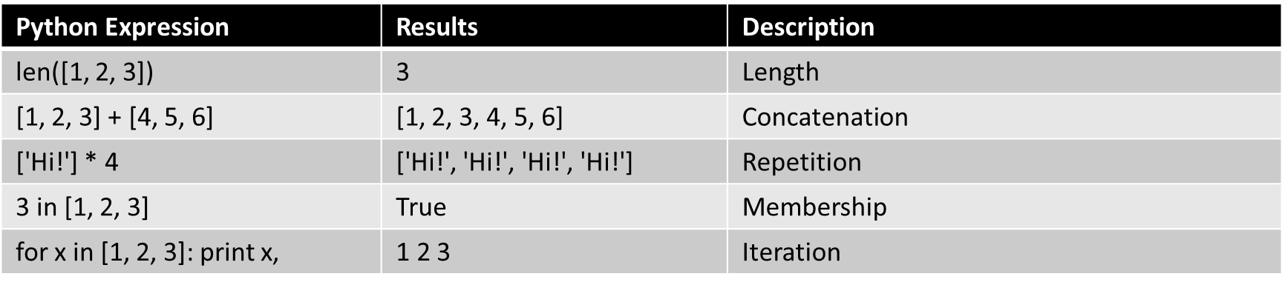
Basic List Operations:

Slide 10
Tuple :
Tuple is a immutable sequence object . In other words , it is known as ‘read-only’ structure where you cannot append , modify or delete values
They have similar functionality as a list other than being immutable.
Comparing tuple with list, tuple increases performance since it cannot be changed and can be used as key to dictionary while it is not possible with a list
Example :
x= 1,2,3, "python", "data“
y = (3,5,6)
Test of Immutability :
tuple1 = 1,2,3,4,5
tuple1[0]= 6
- TypeError: 'tuple' object does not support item assignment

Slide 11
Concatenation of tuples :
Modifying values within a tuple is not possible but we can combine two different tuple without changing them.
tuple2 = 45,56,67
tuple1+tuple2
- (1, 2, 3, 4, 5, 45, 56, 67)
Assigning single value as a tuple:
when we have to use a single value which should not be changed within methods or loops, we can define it as tuple.
tuple3 = (1,)

Slide 12
Repeating tuples:
tuple3*4
1,1,1,1
Deleting a tuple: This is to delete a tuple
del tuple3

Slide 13
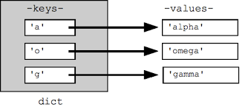
Dictionary :
A dictionary is the “key , value” structure of python. It is a most common and important structure which helps in mapping values to implicit keys.
A dictionary can have heterogeneous data and allows mixed keys (i.e) the keys can be numbers and integers
Creating a dictionary :
dict = {‘key’:’value’}
Example:
my_dict = {'first':'mirra', 'last': 'amritha', 'age' : 22 }
my_dict
{'first': 'mirra', 'last': 'amritha', 'age': 22}

Slide 14
Accessing values
my_dict['first']
- 'mirra'
b. Inserting values :
my_dict['new'] = 'value'
- {'first': 'mirra', 'last': 'amritha', 'age': 22}
c. Updating values : updating and inserting work in the same way.
my_dict['last']= 'balaji'
- {'first': 'mirra', 'last': 'balaji', 'age': 22}
d. Removing element :
my_dict.pop('age')
{'first': 'mirra', 'last': 'balaji', 'new': 'value'}
(or)
del my_dict['new']
{'first': 'mirra', 'last': 'balaji'}

Slide 15
Most Common Methods :
clear() : removes all the elements in the dictionary but the dictionary remains as an empty dictionary
my_dict.clear()
- {}
b. items() : returns entire list of dictionary items
my_dict.items()
dict_items([('first', 'mirra'), ('last', 'amritha'), ('age', 22)])
keys() : returns list of keys in the dictionary
my_dict.keys()
dict_keys(['first', 'last', 'age'])
values() : returns the list of values
my_dict.values()
dict_values(['mirra', 'amritha', 22])

Slide 16
Dictionary Comprehension :
Similar to list comprehension , it is a elegant way to create a dictionary from a loop / iterable.
This is often used when a function / loop has to return a new dictionary with a new set of values
Example :
multiples = {x: x*x for x in range(6)}
- {0: 0, 1: 1, 2: 4, 3: 9, 4: 16, 5: 25}
Breakdown of the comprehension :
Loop:
for x in range(6):
x*x

Slide 17
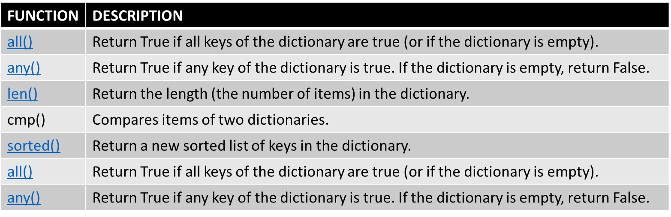
2. Entering values to the dictionary :
multiples= {}
for x in range(6):
multiples[x] = x*x
Other Functions :

Slide 18
Sets :
Sets is a mutable , unordered data structure which does not allow duplicate values.
It allows heterogeneous data and set operations differ from the other data types.
It does not support indexing.
Creating a new set :
Empty set :
sample = set()
With values :
sample = {1,2,3,3} ##from integers
sample = set((1,2,3,3)) ##from tuple
sample = set([1,2,3,3]) ## from list
- 1,2,3

Slide 19
Adding values :
sample.add(1) ##adding single value
sample.update([2,3,4]) ##adding multiple values
Removing values :
The only difference between remove and discard is that remove() will throw error if the value doesn't exist but discard() remains unchanged.
sample.remove(2)
sample.discard(2)
Clear all values:
sample.clear()

Slide 20
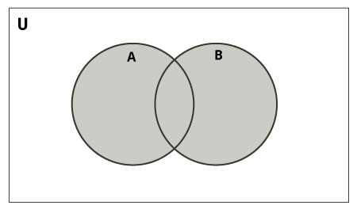
Set Operations :
Union:
Union of A and B is a set of all
elements from both sets. Union is
performed using ‘|’ operator. Same
can be accomplished using the method
union()
  x={12,34,45,65}
  y={56,78,89,56}
  x|y (or) x.union(y)
  - > {65, 34, 12, 45, 78, 56, 89}

Slide 21
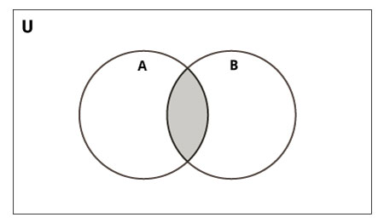
Set Intersection :
Intersection of A and B is a set of elements that are common in both sets.
It is performed using ‘&’ operator. Same can be accomplished using the method intersection().
x={12,34,45,65}
y= {65,45,00}
x.intersection(y) (or) x&y
- {65, 45}

Slide 22
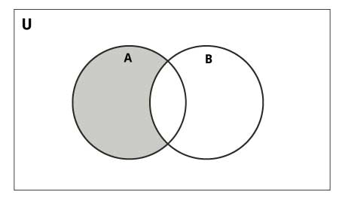
Set Difference:
Difference of A and B (A - B) is a set of elements that are only in A but not in B. Similarly, B - A is a set of element in B but not in A.
x= {23,34,45,56}
y={56,45,00,67}
x-y (or) x.difference(y)
- {34, 23}
Symmetric Difference of A and B is a
set of elements in both A and B except those that are common in both.
x^y
- {0, 34, 67, 23}

Slide 23
Frozen set :
This is a immutable form of sets where all the functionalities are similar to sets except add or remove
Being immutable, the frozen sets can be used as keys to a dictionary.
x= frozenset([1,2,3,4,5])
x = frozenset((1,2,3,4,4,5,5))
- 1,2,3,4,5

Slide 24
Try These : (With or without comprehension)
1.) Write a program which will find all such numbers which are divisible by 7 but are not a multiple of 5, between 2000 and 3200 (both included).
The numbers obtained should be printed in a comma-separated sequence on a single line.
2.) With a given integral number n, write a program to generate a dictionary that contains (i, i*i) such that is an integral number between 1 and n (both included) and then the program should print the dictionary.
Suppose the following input is supplied to the program: 8
Then, the output should be:{1: 1, 2: 4, 3: 9, 4: 16, 5: 25, 6: 36, 7: 49, 8: 64}

