Slide 1


























Object Oriented Programming in Python – Day 3

Slide 2
Concept Of Class and Object :
CLASS
HUMAN
METHODS PROPERTIES
SPEAKS NAME
GENDER DOES WORK
OCCUPATION EATS

Slide 3
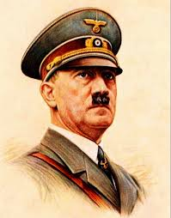

Objects :
Object 1
Object 2 :
Name: Hitler
Gender: Male
Occupation:
Leader
Name:Mariappan
Gender: Male
Occupation: Olympics player

Slide 4
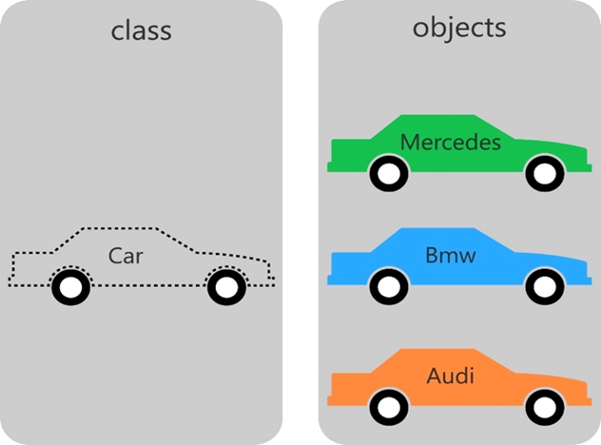
Class :
A class is like a container which consists of similar functions and members.
In order to use a function/member from the class , we create an object to access the required instance.
An object doesn’t give you the class
instead is using the class as a blue print
for building a copy of that type of thing.

Slide 5
Class Demo :

Slide 6
The Special Methods : Constructor , Initiator and Destructor
Static Methods : @staticmethod
@staticmethod is a decorator which changes a method to static method.
Static methods can be called using the class name directly
Constructor method : __new__()
This method creates the object
The return value of this method should be the new object instance

Slide 7
Initiator : __init__()
This is a instance method which is called after the instance has been created by __new__() [i.e] the __init__() doesn't create the instance, it receives the created instance as the first argument.
The arguments are those passed to the class constructor expression.
These methods work together in constructing objects.
Destructor : __del__()
This method is called when the instance is about to be destroyed.
You normally will not notice when the garbage collector destroys an orphaned instance and reclaims its space. By calling this method implicitly, we manually clear instances of a class.

Slide 8
Sample Code Demo:

Slide 9
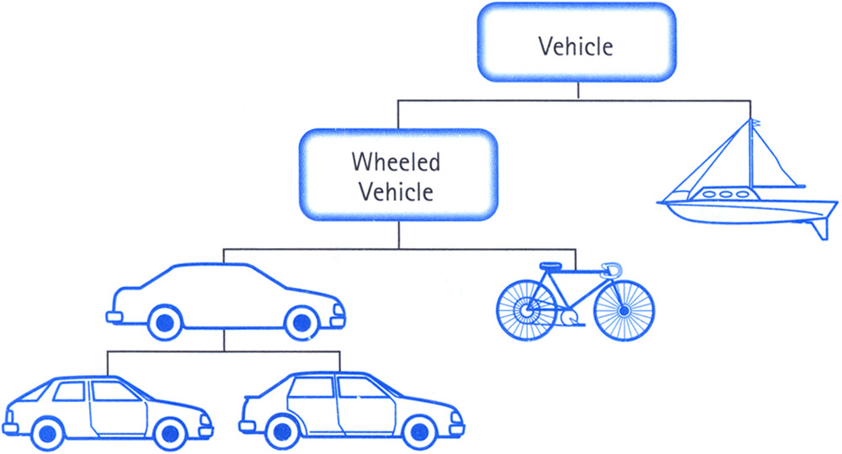
Inheritance :
Just like the concept of inheritance in real life, we inherit properties and methods from a base class.
A class from which we
derive another class is
known as Base Class
The class which has
obtained properties from
a base class is called a
Derived Class

Slide 10
Multiple Inheritance:
Multiple inheritance is when a derived class inherits from n number of base classes.
All classes inherit from object, so any case of multiple inheritance provides more than one path to reach object.
To keep the base classes from being accessed more than once, the dynamic algorithm linearizes the search order in a way that preserves the left-to-right ordering specified in each class, that calls each parent only once

Slide 11
Inheritance Demo

Slide 12
Exception Handling:
It is possible to write programs that handle selected exceptions in python.
The try statement works as follows:
First, the try clause (the statement(s) between the try and except keywords) is executed.
If no exception occurs, the except clause is skipped and execution of the try statement is finished.
If an exception occurs during execution of the try clause, the rest of the clause is skipped. Then if its type matches the exception named after the except keyword, the except clause is executed, and then execution continues after the try statement.
If an exception occurs which does not match the exception named in the except clause, it is passed on to outer try statements; if no handler is found, it is an unhandled exception and execution stops with a message as shown above.

Slide 13
Exception Demo:

Slide 14
Try These :
1.)Define a class which has at least two methods:
getString: to get a string from console input
printString: to print the string in upper case.

