Slide 1


Slide 2

1

Slide 3
2

Slide 4
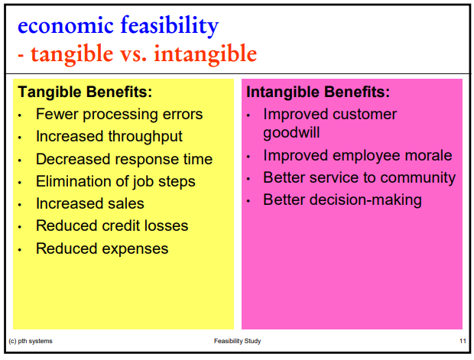

Slide 5
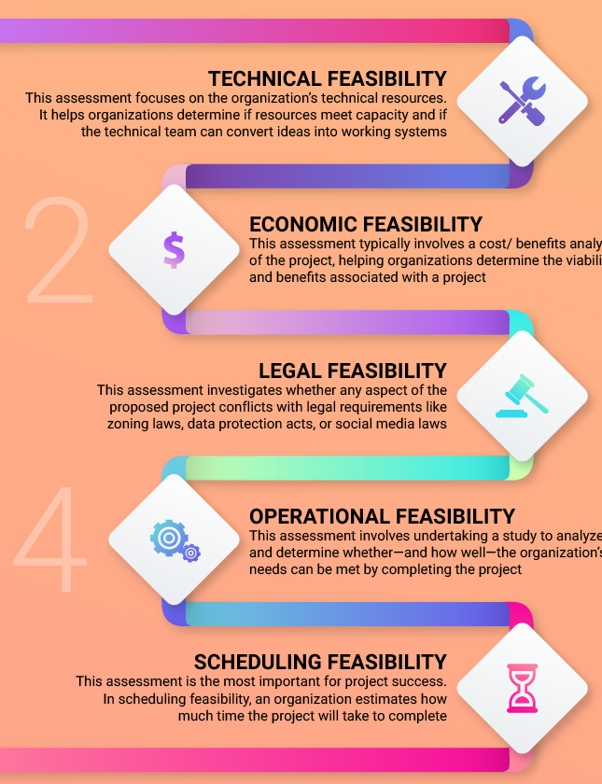

Slide 6
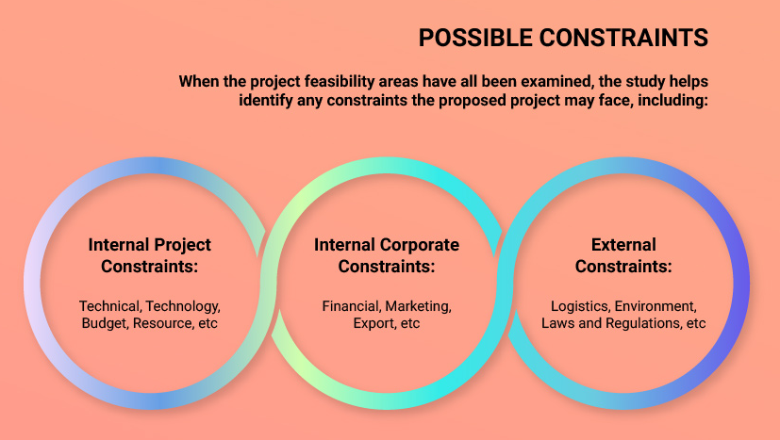

Slide 7
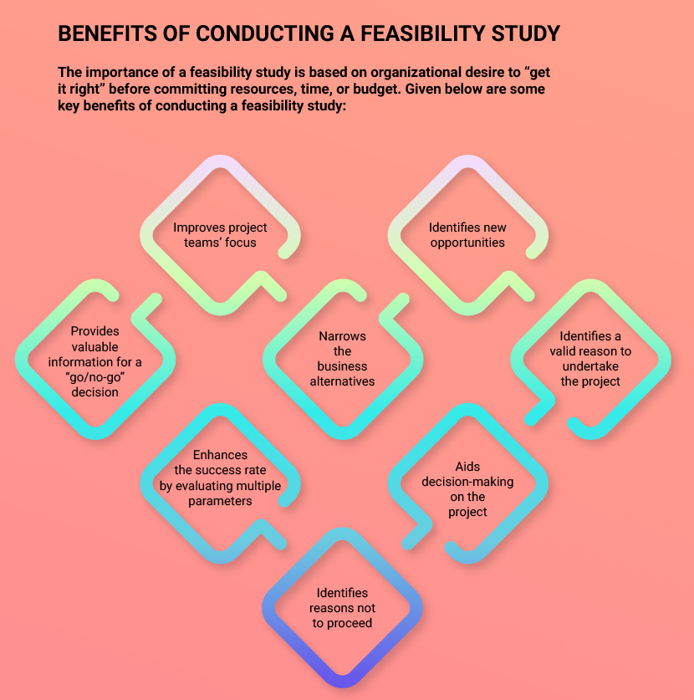

Slide 8

Group
Aline Fernandes 2962245
Amandio Pinto 2938072
Darwin Machado 2948811
Paula Oehme 2957903
Sarah Silva 2960992
Thanks for your attention!
Questions?

