Slide 1

MakeTechEz
BridgeGap Finishing School

Slide 2

Engineers, Are They Employable?
In 2011-12 India produced more than 500,000 engineers, only 3.51% are appropriately trained to be directly deployed on projects and 2.68% are employable in IT product companies
Source - National Employability Report (NER)

Slide 3
Engineers, Are They Employable?
In 2013-14 about 1.5 million engineers will graduate in India across various disciplines. Of this 60-75% opt for IT which is 1 million engineers, only 150,000 will be hired down from 400,000 in year 2007.
Source – A Private Study

Slide 4
Engineers, Are They Employable?
By 2015, India needs at least 500,000 cyber professionals. Yet 99% Indian IT students incapable of secure coding and 87% do not understand concepts or have requisite skills.
Source – US-based EC-Council (International Council for E-Commerce Consultants)

Slide 5
Engineers, Are They Employable?
NASSCOM has launched a Pilot Programme across 15 Engineering Colleges for Students called the Foundation Skills. An Integrated Product Development Programme to make students Industry Ready along with train-the-trainer initiatives to train professors. As Nasscom estimates employment rate will spur from 3 million currently to 10 million Jobs by 2020.

Slide 6

Experts Opinion
Dr. Sameer Prabhu director of Industry Marketing, MathWorks,
Engineering education in India has considerable Skill Gap in computer science, algorithms, industry-standard tools and software to match the industry requirements.

Slide 7
Experts Opinion
Raghu Panicker, country sales director, Mentor Graphics,
Fresh engineering graduates who get hired by leading companies have to go through In-house Training Programmes that run for over four to six months. These programmes involve a lot of effort, time and costs for any corporate. This is where finishing schools come in

Slide 8
Experts Opinion
Col. N.C. Pande from EFY Tech Center
While the colleges make a theoretical background for the students, finishing schools teach them the practical aspects of things and make them ‘Job Ready’. Hence cut down the time required by companies to make the fresh hires productive

Slide 9


What is Finishing School?
Finishing school is a supplementary training school that compensates for the deficiencies of colleges by providing specialized technology training (hard skills) or personality development programmes (soft skills).

Slide 10
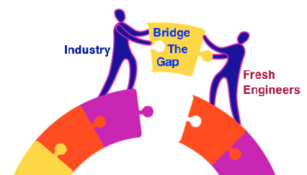
What Role do Finishing Schools play?
Increase Job Readiness and Productivity
Bridge The Gap based on requisite needs
Ensure Industry Know-how for better employment
Create pool of Industry Ready Engineers

Slide 11
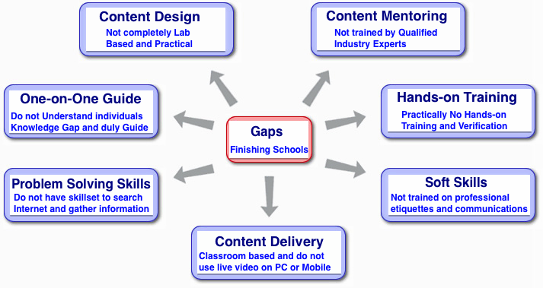
Gaps in Finishing Schools

Slide 12


BridgeGap Finishing School Fills the Gap
Content Design Not completely Lab Based and Practical | Content Design Lab based with students writing compiling and executing 150-200 live programs
Content Mentoring Not trained by Qualified Industry Experts | Content Mentoring Senior Industry Professionals working on latest technologies will be mentors
BridgeGap Finishing School

Slide 13
BridgeGap Finishing School Fills the Gap
Content Delivery Classroom based and do not use live video on PC or Mobile | Content Delivery Online Training Content, Self Paced Study and One-on-One Mentoring using Live Video
One-on-One Guide Do not Understand individuals Knowledge Gap and Guide accordingly | One-on-One Guide One Skill - One Mentor - One Student Mentoring Process due to limited intake of students
BridgeGap Finishing School

Slide 14
BridgeGap Finishing School Fills the Gap
Hands-on Training Practically No Hands-on Training and Verification | Hands-on Training After Every Step students write Practice Programs verified by the Industry Experts
Problem Solving Skills Do not have skillset to search Internet and gather information | Problem Solving Skills Ongoing Mentoring to reach out to internet to solve Practice Programs given during training
BridgeGap Finishing School

Slide 15
What is BridgeGap Finishing School?
BridgeGap Finishing School
BridgeGap Training Solution is a Skill Gap Enhancement Programme for Fresh Engineers opting for IT Jobs.
BridgeGap provides Training Programme on Latest Technologies ranging from Core Programming Languages to Mobile Programming to Web and Server Programming.

Slide 16
What is BridgeGap Finishing School?
BridgeGap Finishing School
Each Technology Series consists of up to 18 Steps with 100s of Sample Codes and Practice Programs to make Engineers hands-on with technology.
Mentoring Process is based on the philosophy of One Skill - One Mentor - One Student. This helps to identify skill gaps in the engineers and guide them appropriately

Slide 17

How BridgeGap Finishing School Works?
Content Design –
Introduces Concepts mainly by writing and compiling lot of programs than reading lot of theory. Its Learning by being Hands-on
Its a 18 Step Process which can be completed in flat 2 - 4 weeks time
Every Step introduces 5 - 10 Concepts and each concepts is demonstrated with a sample code which are built, compiled and executed by engineers
At the end of each step students write Practice Programs verified by Technology Experts in India and Globally.
At the End of the Training Programme, Engineers would have written any-where between 150 - 200 Programs

Slide 18

How BridgeGap Finishing School Works?
Content Mentoring –
Mentoring Process is based on the philosophy of One Skill - One Mentor - One Student. This helps to identify skill gaps in the engineers and guide them appropriately
After Every Step mentor cross examines the engineer one-on-one to check the level of understanding and give them practice programs accordingly.
Internally our Mentors are called
Dronaacharya

Slide 19


How BridgeGap Finishing School Works?
Content Delivery –
Online Training Content and Self Paced Study by Engineer
Mentor and Engineer connect using Google Hangout or Skype One-on-One where-in Mentor can see the shared desktop of engineer, ask questions on concepts and give Practice Programs from the pre-defined list
Real People - Real Help - Real Time

Slide 20

Recap BridgeGap Finishing School
BridgeGap enrolls Limited Students and goes through pre-screening evaluation process.
It is a One Skill - One Mentor - One Student Training Programme
Online Training Platform, Self Paced Study and One-on-One Mentoring using Live Video
150 – 200 Programs written, compiled and executed by Engineers and verified by Industry Experts
Mentoring by Senior Industry Professionals working on latest technology

Slide 21


BridgeGap Finishing School Grading Process
Grading done by Mentor at the end of Every Step
Graded on top 100 Concepts and Practice Programs using 5 point scale
Students are Graded using A, B, C, and D Grades with
A Grade – 90 and above
B Grade – 80 – 90
C Grade – 70 – 80
D Grade – Below 70
Students are encouraged to get better grades for
better

Slide 22


Benefit to Corporates
Corporate Hiring – HIRE – AND – TRAIN
BridgeGap Solution – TRAIN – AND – HIRE
Corporate Avg. Spend – 60,000 to 80,000
Work Ready Time – 3 – 6 months
BridgeGap Students get trained – 4 – 6 Weeks
Work Ready Time Reduced – 1 – 2 Months
Corporate Save on Training Cost, Hiring Cost and Salary Cost.
In HIRE – AND – TRAIN – Engineers are less motivated during training as they have Job.
In BridgeGap Solution – Engineers EXCEL for better Job.
Companies will have a constant Pool of fresh engineering which earlier they have to seek out by visiting campuses

Slide 23
Benefit to Fresh Engineers
Fresh Engineers who have taken the Training Programme will have a competitive edge over others who have just a college degree to rely upon
BridgeGap Training Solution will connect the Engineers with the Companies
Fresh Engineers will have high level of confidence to get into programming and understand the real-time systems of the industry

Slide 24


Core Team
Narayan Mahadevan
Narayan Mahadevan is a Strong Technologist and an Entrepreneur with nearly 2 decades of experience in USA and India. He has strong Product Engineering background and has been successful to build engineering out of India firstly for EFI Inc. (Nasdaq: efii) as Engineering Director and then for his own start-ups in the last 10 years.
He has hands-on experience in developing Front End Technologies (Mobile, Web and Desktop), Middleware and Server Side Technologies that includes Internet Systems, e-Commerce Systems, Workflow Systems, MIS Systems, Mobile Apps, SOA, SaaS Service, Imaging and Content Composition Technologies.

Slide 25


Partner
Srimanto Bhattacharya
Srimanto is currently a Co Founder of a International Senior Management Executive Search company called Spearhead InterSearch. He has been associated with the industry since 18 years, advising and hiring CXO’s and Independent Directors on the Board.
Srimanto is based in Bangalore. His passion is to transform the Engineering talent in the country and make them more focused with a thorough personality improvement and development initiative.

Slide 26

About MakeTechEz
MakeTechEz (www.maketechez.wordpress.com) , is a single place “To Know, To Learn and To Use” Technology. The sole motto being make Technology Easy to Understand and Use.
MakeTechEz caters to fresh engineers, techies as well as technology leaders through training solutions (BridgeGap Finishing School), blogs, one minute videos and open source software's on
Programming - C/C++, Java, Mobile, Web and Server Side Programming,
Enterprise Technologies – BigData, CRM, ERP, etc.,
Enterprise Architecture - Architecture Patterns, Designs Patterns, Performance, Security, Delivery, etc.

Slide 27
MakeTechEz
Thank you
BridgeGap Finishing School

