Slide 1


SIR M. VISVESVARAYA INSTITUTE OF TECHNOLOGY DEPARTMENT OF COMPUTER SCIENCE AND ENGINEERING
The Project Review
On
“Predictive Modelling of Urban Water Quality”
PRESENTED BY
Siddhi Narayan 1MV20CS108
Dharmitha V 1MV20CS122
Y. Yasaswini 1MV20CS128
UNDER THE GUIDANCE OF
Dr. Suma Swamy ` Dr. Anitha T. N.
Professor, Dept. of CSE Professor & HOD
Sir MVIT Dept. of CSE, SMVIT

Slide 2

CONTENTS
ABSTRACT
INTRODUCTION
LITERATURE SURVEY
PROBLEM STATEMENT
METHODOLOGY
EXISTING SYSTEM AND PROPOSED SYSTEM
SOFTWARE REQUIREMENT SPECIFICATION
ANALYSIS AND DESIGN
CONCLUSION
REFERENCES

Slide 3
ABSTRACT
This study employs machine learning techniques to predict water quality parameters in urban areas. The focus is on forecasting pH levels, organic carbon, turbidity, and pollutant concentrations.
The developed machine learning algorithms enable early detection of contamination events. Integration of predictive analytics into water quality management systems supports proactive decision-making for sustainable urban water resource preservation.
The research has implications for environmental monitoring, policy development, and the establishment of smart city infrastructures to safeguard water quality amid urbanization and environmental challenges.

Slide 4
INTRODUCTION
Water quality is a critical aspect of environmental health and human well-being, as it directly impacts ecosystems, agriculture, and human consumption. With the increasing pressures on water resources due to population growth, industrialization, and climate change, ensuring water quality has become a paramount concern. Traditional methods of water quality monitoring involve manual sampling and laboratory analysis, which are often time-consuming and costly.
In recent years, there has been a growing interest in leveraging machine learning (ML) techniques to predict and monitor water quality more efficiently. ML algorithms can analyze large datasets containing diverse water quality parameters, environmental variables, and historical records to make accurate predictions about water quality conditions.
The utilization of machine learning (ML) for water quality prediction offers a plethora of benefits that address the challenges inherent in traditional monitoring methods.

Slide 5
LITERATURE SURVEY
Sl No. | Paper Title | Journal Name | Year | Methodology/Algorithm | Accuracy/Efficiency
1 | Proposition of new Ensemble Data Intelligence Models for Surface Water Quality Prediction | IEEE Volume: 9 | 2021 | Quantile Regression Forest(QRF), Random Forest(RF), Radial Support Vector Machine(SVM), Gradient Boosting Machine(GBM_H2O) | 80%
2 | Towards design of IoT and Machine Learning Embedded Frameworks for analysis and prediction of water quality | IEEE Volume: 11 | 2023 | Support Vector Machine(SVM), XGBoost(eXtreme Gradient Boosting), Decision Tree and Random Forest | 83%
3 | Water Quality Management using Hybrid Machine Learning and Data Mining Algorithms: an indexing approach | IEEE Volume: 10 | 2022 | Random Trees, Random Forest, M5P and Reduced Error Pruning Tree | 70%

Slide 6
Sl No. | Paper Title | Journal Name | Year | Methodology/Algorithm | Accuracy/Efficiency
4 | Water Quality Prediction using machine learning models based on Grid Search Method | Multimedia Tools and Applications Journal | 2023 | Random Forest Model, eXtreme Gradient Boosting Model and Adaptive Boosting | 72%
5 | A Novel Hybrid Model to Predict Dissolved Oxygen for Efficient Water Quality in Intensive Aquaculture | IEEE Access Volume: 11 | 2023 | Light Gradient Boosting Machine (LightGBM) and the Bidirectional Simple Recurrent Unit (BiSRU) | 68%
6 | Prediction of Water Quality Using SoftMax-ELM Optimized Using Adaptive Crow-Search Algorithm | IEEE Access Volume: 11 | 2022 | Adaptive Crow Search Optimized SoftMax-Extreme Learning Machine (AdCSO-sELM) | 65%
7 | Dual Kidney-Inspired Algorithm for Water Quality Prediction and Cancer Detection | IEEE Access Volume: 8 | 2020 | Dual-population Kidney-inspired Algorithm (Dual-KA) | N/A
8 | A Complete Proposed Framework for Coastal Water Quality Monitoring System With Algae Predictive Model | IEEE Access Volume: 9 | 2021 | Long Short-term Memory (LSTM) | 70%

Slide 7
Sl No. | Paper Title | Journal Name | Year | Methodology/Algorithm | Accuracy/Efficiency
9 | Machine learning algorithms for efficient water quality prediction | Modelling Earth Systems and Environments algorithm | 2021 | Multiple Regression Algorithm | 75%
10 | Towards design of IoT and Machine Learning Embedded Frameworks for analysis and prediction of water quality | IEEE Volume: 11 | 2023 | Support Vector Machine(SVM), XGBoost(eXtreme Gradient Boosting), Decision Tree and Random Forest | 84%
7

Slide 8
PROBLEM STATEMENT
Develop a system to predict water quality, addressing challenges in data collection, preprocessing, visualization, and classification based on environmental factors like pH, hardness, solids, chloramines, sulphates, conductivity, organic carbon, trihalomethanes, turbidity and portability. The primary focus aims to provide accurate assessments for effective water resource management and environmental monitoring with the objective of enhancing accuracy and efficiency in water quality assessment. Through the utilization of ML techniques, the outcome of the model classifies the input data set in to potable or not-potable class.

Slide 9















The Dataset
pH
pH
Turbidity
Hardness
Turbidity
Hardness
9 Parameters
Trihalomethanes
Solids
Trihalomethanes
Solids
Potability
3276 Records
Organic Carbon
Chloramines
Binary Target Variable
Organic Carbon
Chloramines
Conductivity
Sulfates
Conductivity
Sulfates

Slide 10
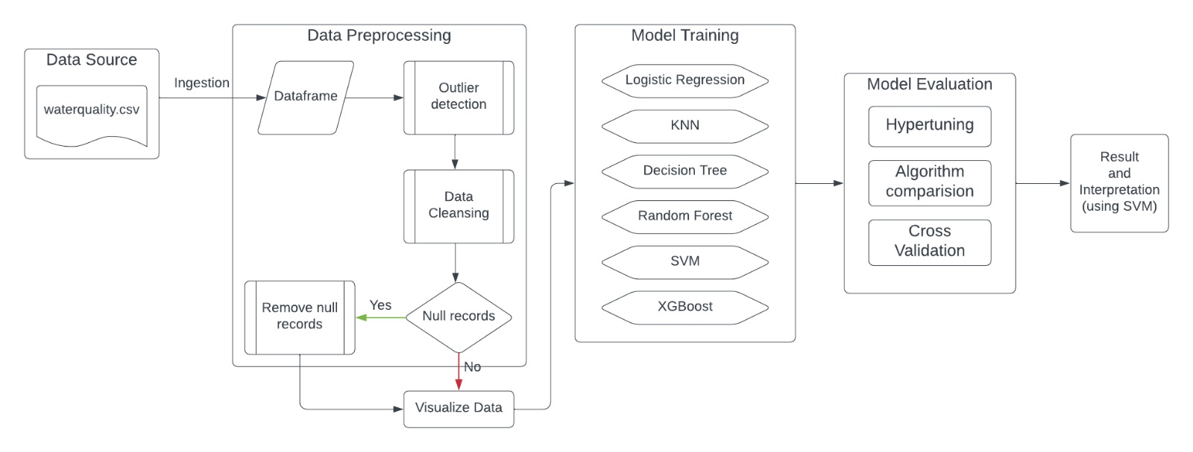
METHODOLOGY

Slide 11
OBJECTIVES
Design a Comprehensive ML Model: Develop a machine learning model that integrates multiple algorithms to predict water quality accurately.
Implement a Classification System: Input dataset will be classified to a particular class based on their characteristics and also different environmental factors and attributes.
Implement Data Visualization Modules: Develop visualization modules to present water quality data in an insightful and comprehensible manner, aiding in better understanding and decision-making.

Slide 12
EXISTING SYSTEM
Machine learning models, trained on historical data, classify the water as potable or not-potable based on the input parameters. Any one among the classification algorithm has used to classify the input data.
Existing systems preprocessing procedures are not much effective while removing outliers and handling the missing values. Also the accuracy achieved in existing systems was less.
Limitations
No comparison has been considered among different ml models
The accuracy achieved was less
Most of the systems does not provide user interface

Slide 13
PROPOSED SYSTEM
The proposed system for water quality prediction integrates advanced technologies to ensure accurate and efficient water resource management and environmental monitoring.
Various classification algorithms are considered to best fit the data. Continuous model retraining and system monitoring ensure the system adapts to changing conditions and maintains high performance.
Advantages
Considered multiple classification algorithms
Better training and testing accuracy
Cross validation has used
Dept. of CSE, Sir MVIT 2023-24

Slide 14
SOFTWARE REQUIREMENT SPECIFICATION
Programming Language: Python (preferred due to its extensive libraries for data analysis and machine learning).
Integrated Development Environment (IDE): - Jupyter Notebook or JupyterLab for interactive development and data exploration.
Machine Learning Libraries: - scikit-learn for implementing machine learning models and evaluation. - TensorFlow or PyTorch for neural network-based models (if applicable).
Data Handling and Analysis Libraries: - pandas for data manipulation and preprocessing. - numpy for numerical operations.
Visualization Libraries: - matplotlib and seaborn for data visualization.

Slide 15
CONCLUSION
Using ML it is possible to predict water potability
Support Vector Machine Classifier best performance 87.98% accuracy
Hyper-tunning did increased accuracy in modeling for most of the algorithms
The parameters within the dataset were affective in prediction although had low correlation
Confident in our findings but room for improvement
for improvement
17

Slide 16
REFERENCES
Breiman, L. (2001). Random Forests. Machine Learning, 45(1), 5-32. https://doi.org/10.1023/A:1010933404324
Chen, T., & Guestrin, C. (2016). XGBoost: A Scalable Tree Boosting System. In Proceedings of the 22nd ACM SIGKDD International Conference on Knowledge Discovery and Data Mining (pp. 785-794). https://doi.org/10.1145/2939672.2939785
Journal of Emerging Technologies and Innovative Research [ISSN: 2349-5162] jetir.org
Vapnik, V. (1995). The Nature of Statistical Learning Theory. Springer-Verlag. https://doi.org/10.1007/978-1-4757-2440-0
Rumelhart, D. E., Hinton, G. E., & Williams, R. J. (1986). Learning representations by back-propagating errors. Nature, 323(6088), 533-536. https://doi.org/10.1038/323533a0
Quinlan, J. R. (1986). Induction of Decision Trees. Machine Learning, 1(1), 81-106. https://doi.org/10.1023/A:1022643204877
Haykin, S. (1998). Neural Networks: A Comprehensive Foundation. Prentice Hall.
Pedregosa, F., Varoquaux, G., Gramfort, A., Michel, V., Thirion, B., Grisel, O., ... & Duchesnay, E. (2011). Scikit-learn: Machine Learning in Python. Journal of Machine Learning Research, 12, 2825-2830. http://jmlr.org/papers/v12/pedregosa11a.html
Jolliffe, I. T. (2002). Principal Component Analysis. Springer Series in Statistics. https://doi.org/10.1007/b98835
Witten, I. H., Frank, E., Hall, M. A., & Pal, C. J. (2016). Data Mining: Practical Machine Learning Tools and Techniques. Morgan Kaufmann.

Slide 17


