Slide 1

SMART INDIA HACKATHON 2026
TITLE PAGE
Problem Statement ID –
Problem Statement Title-
Theme-
PS Category- Software/Hardware
Team ID-
Team Name (Registered on portal)

Slide 2
PyroSat: AI-Powered Satellite Thermal Anomaly & Sub-Pixel Inversion
Platform for Industrial Fire and Disaster Mitigation
Thinkers
Problem:
NASA FIRMS satellites detect heat, but cannot tell what is burning. Coarse 375m pixels mix routine refinery flares with runaway chemical explosions and wildfires. In industrial corridors, this causes heavy false alarms, putting critical infrastructure and lives at risk.
Our Idea :
PyroSat is an AI-powered platform with a three-pillar approach ensuring automated disaster intelligence when orbital feeds are ambiguous. It combines infrared flame physics, hierarchical ML, and 3D GIS maps to deliver instant emergency alerts and toxic plume evacuation modeling.
Proposed Solution :
• When satellite telemetry arrives, the system applies Dual-Band Planck Pyrometry to calculate true flame temperature (Tf > 1200 K) and exact fire area from sub-pixel clutter.
• A 2-Stage Hierarchical ML Classifier automatically segregates routine refinery flares from industrial explosions and forest wildfires.
• An integrated 3D GIS WebGL Command Dashboard drapes thermal hotspots and real-time Gaussian toxic plume evacuation zones onto a live virtual globe.
Innovation/Uniqueness:
• India's first sub-pixel pyrometry platform to detect industrial fires.
• Converts raw heat pixels into physical flame data (temperature & burning area) with zero AI hallucination.
• Dual-satellite land grounding uses 10m ESA land-cover and Sentinel-2 data to eliminate false alarms at industrial plants.
• Live Toxic Plume Dispersion Engine combines real-time wind and chemical data to map evacuation zones for first responders.

Slide 3
TECHNICAL APPROACH
Thinkers
Hardware & Software
• NASA FIRMS Telemetry: VIIRS (375m) & MODIS (1km) dual-band NRT infrared radiance.
• Sentinel-2 & ESA LULC: 10m land-cover & Level-2A surface reflectance (NDVI/SWIR).
• SciPy (Planck Pyrometry): Dual-band Dozier inversion solving flame temp & area.
• LightGBM & TreeSHAP: 2-stage hierarchical ML classifier with exact local Shapley XAI.
• CesiumJS (WebGL 3D): Virtual 3D globe rendering terrain, 3D tiles & hazard layers.
• Open-Meteo & Plume Model: Pasquill-Gifford dispersion with live wind vectors.
• FastAPI & Node.js Gateway: Sub-second REST inference API & SSE real-time alerting.
• PostGIS Spatial Database: Industrial infrastructure & boundary threat engine.
FLOW CHART
[ INSERT SYSTEM ARCHITECTURE / INGESTION-TO-DISPATCH FLOWCHART IMAGE HERE ]
(NASA FIRMS ➔ Dozier Planck Inversion ➔ 2-Stage ML Classifier ➔ TreeSHAP ➔ Gaussian Plume ➔ IAP Dispatch)
3 LAYER APPROACH
GitHub link: https://github.com/Narayana1729/SIH2026.git
Live Dashboard: http://localhost:8080 (Cesium 3D WebGL HUD)
Above 80% of the prototype is completed
[ INSERT 3-LAYER ARCHITECTURE MOCKUP ]
L1: Sensing ➔ L2: Physics/ML ➔ L3: Dispatch

Slide 4
FEASIBILITY AND VIABILITY
Thinkers
Feasibility Analysis:
• Open-Data Architecture: Zero dependence on costly commercial tasking; runs entirely on free, open NASA FIRMS, ESA Copernicus, and Open-Meteo feeds.
• Tested Operational Prototype: Full-stack system already implemented with 130 passing automated tests covering pyrometry, ML inference, and 3D UI rendering.
• Low Hardware Footprint: Efficient TreeSHAP DP and Dozier solvers run in sub-second inference on standard edge or cloud servers.
Strategies for Overcoming Challenges:
• Multi-Constellation Satellite Fusion: Combines VIIRS NOAA-20, NOAA-21, Suomi-NPP, and MODIS Aqua/Terra across complementary orbital nodes, reducing revisit latency.
• Sentinel-2 Scene Classification (SCL): Integrates cloud probability and cirrus masks to quarantine obstructed pixels without generating false-negative alerts.
• 90-Day Spatio-Temporal Persistence Memory: Maintains historical heat baselines at known facilities, filtering out static solar glint while instantly flagging genuine flaring surges.
• Multi-Band Invariant Ratio Verification: Uses MWIR/LWIR radiance ratios and night-pass observations to reject non-combustion thermal reflections.
Potential Challenges & Risks:
• Cloud & Monsoon Obscuration: Dense cloud cover attenuates thermal infrared emissions from orbit.
• Orbital Revisit Latencies: Sun-synchronous satellite passes leave gaps of 3-6 hours between revisits.
• Reflective Solar Glint: Highly reflective metal industrial roofs can mimic daytime thermal hotspots.

Slide 5
IMPACT AND BENEFITS
Thinkers
Target Audience & Stakeholders:
• Disaster Management Authorities: National & State Disaster Authorities (NDMA, SDMA, NDRF battalions).
• Environmental & Safety Regulators: Central & State Pollution Control Boards (CPCB, SPCB, PESO).
• Industrial Facility Operators: Safety Operations Centers at refineries, chemical hubs, and steel plants.
• Forest & Wilderness Services: Forest Protection Divisions guarding national parks and biosphere reserves.
Environmental & Governance Benefits:
• Industrial Emissions Compliance Auditing: Provides empirical, continuous satellite monitoring of permitted vs. illegal flaring and fugitive emissions across India's industrial belts.
• Forest Boundary Encroachment Warning: Geodesic buffer engine computes real-time threat distance to protected wilderness reserves, stopping wildfires before boundary penetration.
• Data-Driven Emergency Governance: Standardizes emergency response with automated Incident Action Plans (IAPs), HazMat UN placards, and immediate responder coordination.
• Climate & Methane Mitigation: Quantifies high-temperature industrial combustion volumes to support national carbon accounting and fugitive methane reduction targets.
Social & Economic Benefits:
• Life Safety in Toxic Corridors: Proactive evacuation isopleths protect civilian settlements downwind of chemical disasters.
• Asset & Infrastructure Protection: Detects abnormal flare blowouts before uncontained catastrophic refinery explosions occur.
• Slashes False Alarm Overhead: Eliminates wasteful emergency mobilization caused by routine flaring misidentifications.

Slide 6
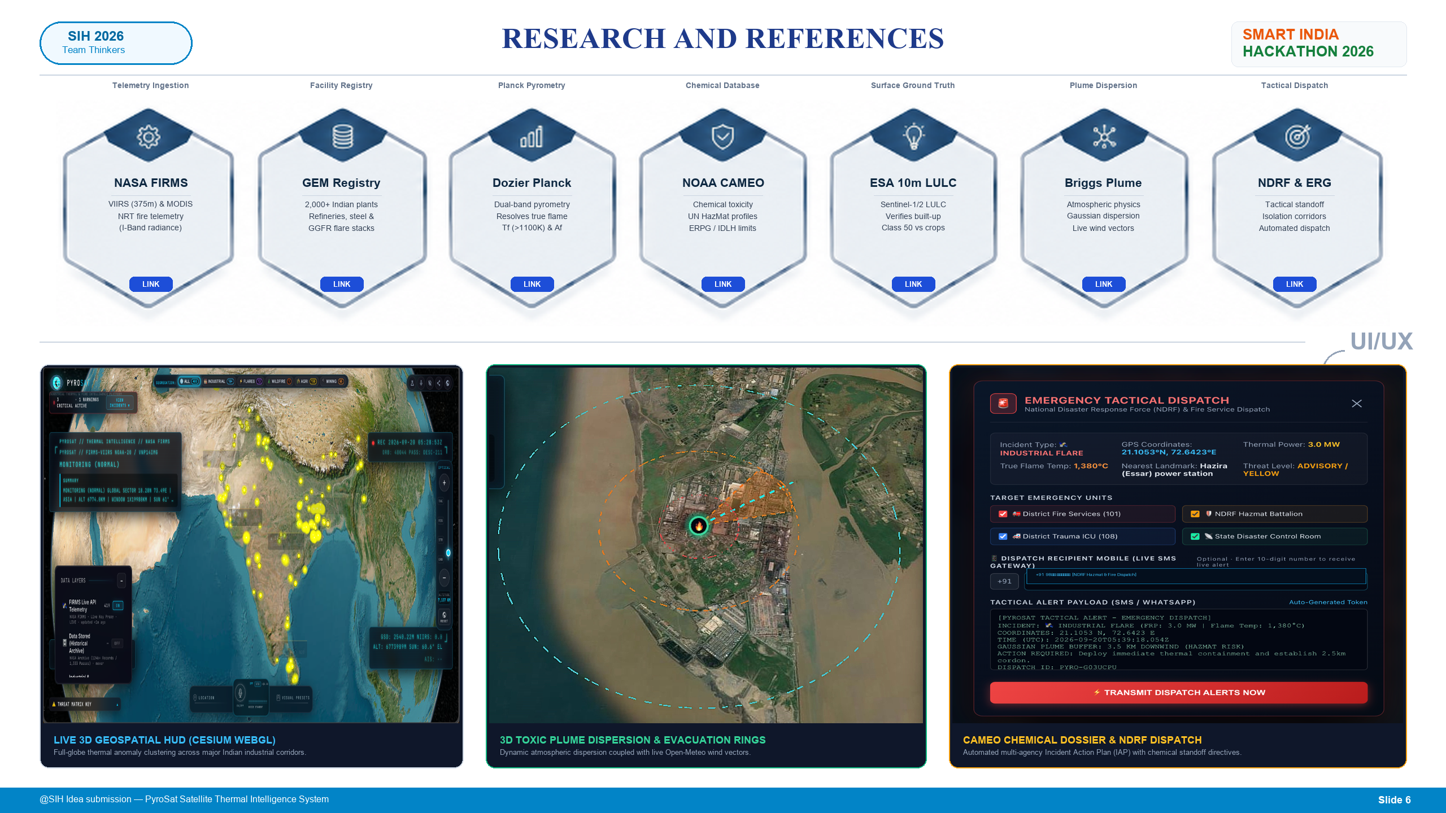

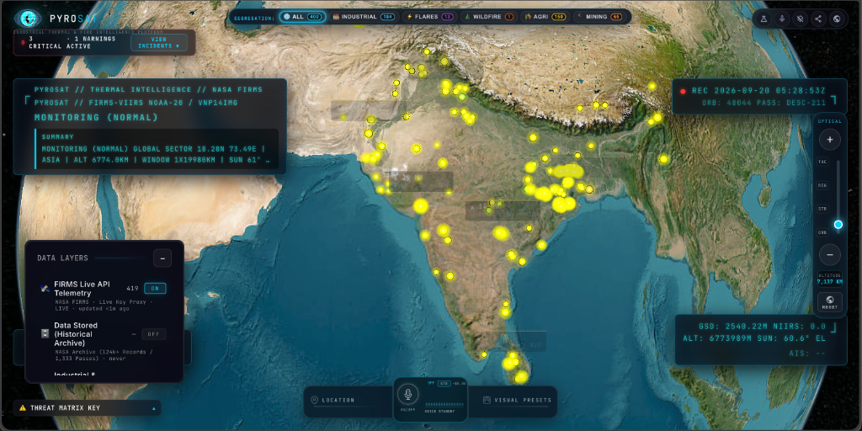
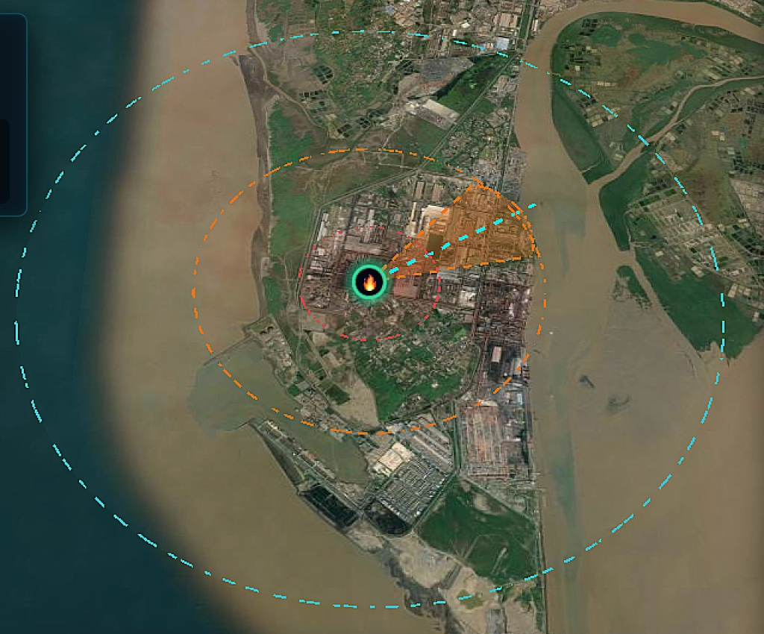
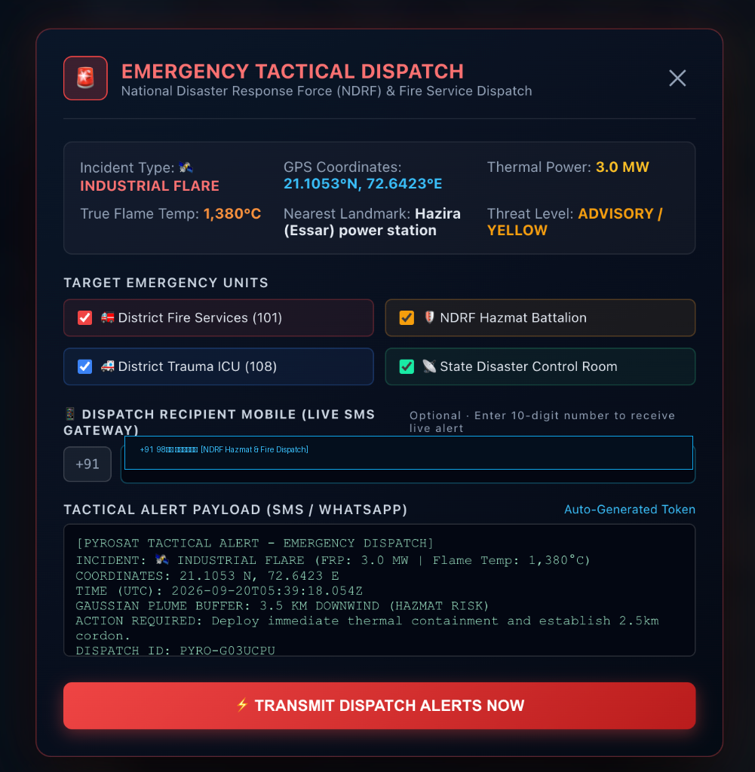
RESEARCH AND REFERENCES
NASA FIRMS
Telemetry
NRT Thermal Hotspot Ingestion — VIIRS 375m & MODIS 1km active fire feeds.
Dozier Pyrometry
(1981)
Sub-Pixel Planck Inversion — Resolves flame temp (Tf > 1100 K) & sub-pixel area (Af).
ESA WorldCover
10m
10m Surface Ground Truth — Sentinel-1/2 LULC classifying Built-up (Class 50) vs Cropland.
GEM & World Bank
GGFR
2,000+ Facility Registry — Catalog of Indian refineries, petrochemical hubs & flaring stacks.
NOAA CAMEO &
NIOSH
Chemical & HazMat Profiles — Reactivity data, UN placards & toxic thresholds.
EPA / Briggs
Plume Rise
Atmospheric Dispersion — Buoyant plume rise & Pasquill-Gifford Gaussian dispersion.
NDRF & HazMat
ERG
Tactical Standoff & Routing — Emergency chemical standoff, isolation corridors & automated dispatch.
UI/UX
3D Geospatial HUD (Cesium WebGL)
Real-time thermal clustering across Indian industrial corridors.
3D Toxic Plume & Evacuation Rings
Atmospheric dispersion driven by live Open-Meteo wind vectors.
CAMEO HazMat Dossier & NDRF Dispatch
Automated Incident Action Plan with SMS/WhatsApp responder routing.

Slide 7
IMPORTANT INSTRUCTIONS
Please ensure below pointers are met while submitting the Idea PPT:
Kindly keep the maximum slides limit up to six (6). ( Including the title slide)
Try to avoid paragraphs and post your idea in points /diagrams / Infographics /pictures
Keep your explanation precise and easy to understand
Idea should be unique and novel.
You can only use provided template for making the PPT without changing the idea details pointers (mentioned in previous slides).
You need to save the file in PDF and upload the same on portal. No PPT, Word Doc or any other format will be supported.
Note - You can delete this slide (Important Pointers) when you upload the details of your idea on SIH portal.

