Slide 1
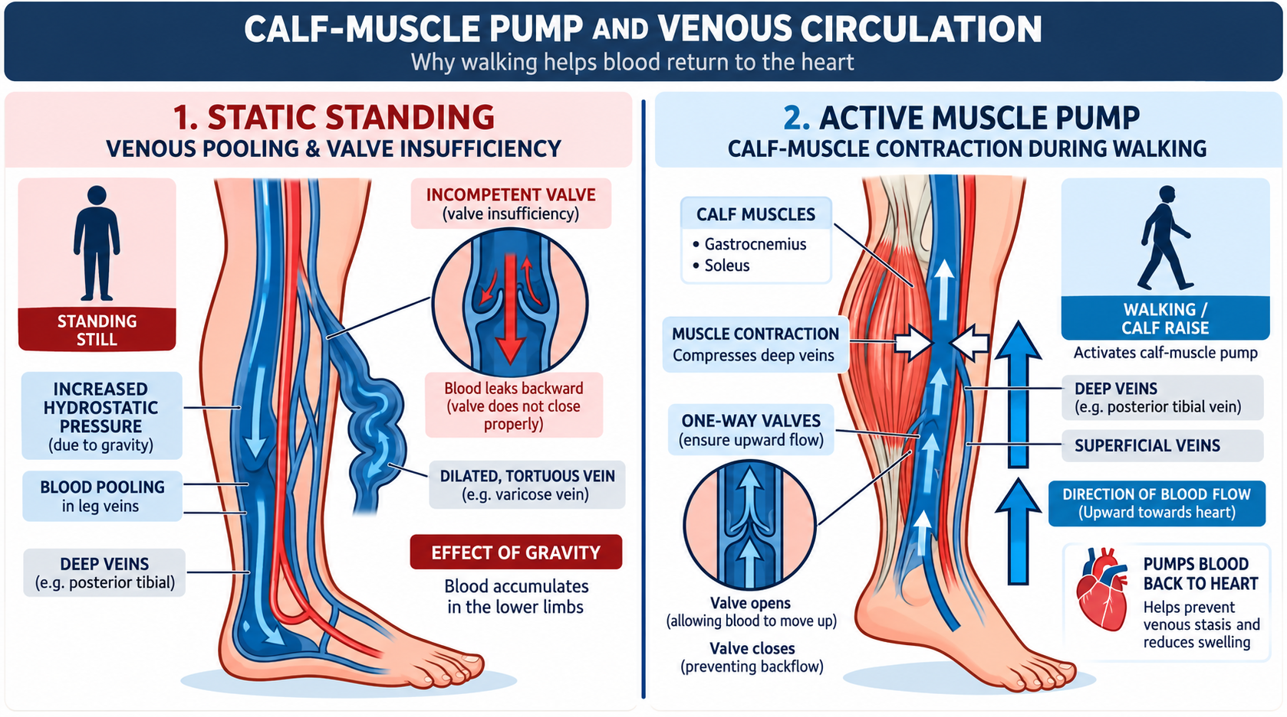
01
Occupational Vascular Disease & Personal Safety Crisis
Two critical real-world problems addressed by one wearable platform
• The occupational vascular burden: Prolonged standing is associated with elevated risk of venous symptoms, CVI and varicose veins in standing-intensive occupations.
• Biomechanical cause: Static standing maintains high hydrostatic venous pressure in the lower limb, promoting venous pooling and progressive valve stress.
• Personal safety gap: Physical panic buttons and phone-based SOS workflows require overt manual access and may be difficult to activate during restraint.
• Project objective: Design a dual-domain smart anklet for postural vascular monitoring + hands-free covert emergency signaling within a ₹2,500 prototype target.
Calf-muscle pump: static venous pooling vs active upward blood return
Technical review note: epidemiological prevalence and pressure values should be cited to the specific literature used in the final report.
VEINGUARD • TECHNICAL REVIEW
01

Slide 2
02
Why the Ankle?
Biomechanical justification for ankle-mounted kinematics
• Posture ambiguity: Wrist orientation can remain similar during sitting and standing; ankle orientation provides a more direct lower-limb posture signal.
• Calf-pump physics: An ankle IMU can observe plantarflexion and repeated calf-raise motion associated with activation of the calf-muscle pump.
• Hemodynamic relevance: The ankle is close to the lower-limb venous region where gravitational pooling effects are most pronounced.
• Covert ergonomics: Foot-to-foot tapping can be performed without reaching for a visible device.
Criterion
Smartwatch
Smart Anklet
Static standing discrimination
Indirect / ambiguous
Direct ankle orientation
Calf-pump / plantarflexion
Limited
Directly observable
Covert foot-tap SOS
No
Native interaction
Near lower-limb pooling region
No
Yes
Engineering Decision
Sensor placement is selected to maximize lower-limb kinematic observability and enable a discreet interaction gesture.
VEINGUARD • TECHNICAL REVIEW
02

Slide 3
03
Proposed Solution — VeinGuard Smart Anklet
Fashion-disguised vascular health monitoring and emergency dispatch
FORM FACTOR
COMPANION MOBILE ARCHITECTURE
Embedded electronics inside a discrete PETG charm pod attached to an anklet chain.
VEINGUARD
Native Android background/foreground service • BLE telemetry • silent emergency dispatch
SMART ANKLET
VASCULAR PILLAR
• Static-standing tracking
• Calf-raise validation
• Relative NIR/PPG trend logging
BLE LINK
ESP32-C3
+ Sensors
Anklet → Android
GPS
SAFETY PILLAR
Acquire coordinates
• Covert multi-tap SOS
• Haptic confirmation
• High-g fall + immobility pipeline
SMS
BLE 5.0 telemetry
Send Maps link to contacts
PPG output is treated as a relative optical trend signal; it is not presented as a diagnostic measurement of venous disease.
VEINGUARD • TECHNICAL REVIEW
03

Slide 4
04
Hardware Architecture & Sensor Interfacing
High-efficiency, low-power embedded system topology
MPU-6050
2 × 10K NTC
6-axis IMU • I²C • 0x68
Posture + tap detection
ESP32 ADC
Medial–lateral ΔT
ESP32-C3 SUPERMini
160 MHz 32-bit RISC-V • ~400 KB SRAM • BLE 5.0 • low-power modes
MAX30102
HAPTIC DRIVER
Red/IR optical sensing • I²C • 0x57
Motion-gated PPG trend logging
BC547 + vibration motor
1N4148 flyback clamp
SHARED BUS
SDA/SCL shared by MPU-6050 + MAX30102 • analog channels reserved for NTC thermistors
VEINGUARD • TECHNICAL REVIEW
04

Slide 5
05
Circuit Schematic, Filtering & Power Management
Analog conditioning and power rail stabilization
I²C BUS HEALTH
SIMPLIFIED POWER + SIGNAL SCHEMATIC
GPIO 4 = SDA • GPIO 5 = SCL • 4.7 kΩ pull-ups to logic rail
ESP32-C3
I²C
Sensors
Li-ion
3.7V
3.3V
Regulator
RC LOW-PASS FILTER
R = 10 kΩ, C = 100 nF
f_c = 1 / (2πRC) ≈ 159 Hz
ADC +
RC Filter
NTC ×2
MOTOR TRANSIENT CLAMPING
Reverse-biased 1N4148 across motor terminals to suppress inductive back-EMF
BC547
Driver
Vibration
Motor
POWER DELIVERY
3.7 V Li battery → regulator → 3.3 V rail
10 µF input/output decoupling
Power-regulator choice and real battery runtime should be validated with measured current and regulator quiescent current under the final load profile.
VEINGUARD • TECHNICAL REVIEW
05

Slide 6
06
Kinematic Posture & Calf-Pump Validation Algorithm
Firmware-level signal processing and false-repetition rejection
Pitch estimate: θ = arccos(a_z / g) • Posture + variance thresholds determine state
IMU SAMPLE
POSTURE CLASSIFIER
30 min STATIC TIMER
CALF-RAISE GATE
HOLD VALIDATION
REP ACCEPT / REJECT
50 Hz motion stream
Standing / walking / sitting
Reminder threshold
>15° plantarflexion
1.0–3.0 s
Half-reps discarded
STATE THRESHOLDS
MOTION-GATED OPTICAL SAMPLING
OUTPUTS
Static standing: |a_z| ≈ 1 g + low variance
Walking: cyclic motion ~1.5–2.5 Hz
Sitting/elevation: gravity vector tilted
MAX30102 optical samples accepted only during confirmed low-motion states to reduce motion artifact.
• Static-standing duration
• Valid calf-raise count
• Rest-state optical trend samples
Thresholds shown are engineering design parameters and must be calibrated on representative users and validated experimentally.
VEINGUARD • TECHNICAL REVIEW
06

Slide 7
07
Covert Safety Protocol & Emergency Dispatch Pipeline
Multi-stage false-positive rejection and autonomous fall alert
A. COVERT TAP CONFIRMATION
B. AUTONOMOUS FALL PIPELINE
1
2
3
4
HIGH-g
ORIENTATION
IMMOBILITY
DISPATCH
3 taps
Haptic prompt
4th tap
Abort window
Impact > 3.5 g
Horizontal ankle
> 10 s
GPS + SMS
1.5–3.0 Hz
single pulse
within 1.0 s
3 s vibration
ANDROID EMERGENCY DISPATCH EXECUTION
BLE EVENT
FOREGROUND SERVICE
GPS FIX
SMS DISPATCH
Anklet alert received
Wake persistent emergency workflow
Acquire high-accuracy location
Maps link → 5 preset contacts
Android SMS/location behavior depends on OS version, permissions, default SMS restrictions, and foreground-service policy; implementation must be tested on the target device.
VEINGUARD • TECHNICAL REVIEW
07

Slide 8
08
Power Budget & Real-World Battery Derivation
Analytical current profile demonstrating expected runtime
Subsystem / mode
Average current
Duty assumption
TOTAL ESTIMATE
ESP32-C3 light sleep + BLE advertising
1.055 mA
5% active duty
ΣI ≈ 1.62 mA average
MPU-6050 motion sampling
0.390 mA
50 Hz / 10%
400 mAh CELL
MAX30102 motion-gated PPG
0.024 mA
2%
Runtime ≈ 400 / 1.62
≈ 246 h ≈ 10.2 days
NTC differential sampling
0.0003 mA
0.1%
Haptic trigger pulses
0.150 mA
0.2%
4000 mAh DEV PACK
Battery model:
Runtime ≈ Battery capacity (mAh) / Average system current (mA)
Runtime ≈ 4000 / 1.62
≈ 2,469 h ≈ 103 days
These are idealized estimates. Final runtime must include regulator quiescent current, BLE connection duty, battery derating, self-discharge, and real sensor/motor current.
VEINGUARD • TECHNICAL REVIEW
08

Slide 9
09
Bill of Materials (BOM) & Cost Feasibility
Low-cost prototype target within ₹2,500 INR
Item
Qty
Category
Cost (₹)
TOTAL PROTOTYPE EXPENDITURE
ESP32-C3 SuperMini RISC-V Board
2
Core controller
700
₹1,846
Target ceiling: ₹2,500
MPU-6050 6-axis IMU
1
Motion tracking
300
MAX30102 optical module
1
PPG / optical
150
[INSERT IMAGE]
10K bead NTC thermistors
2
Thermal sensing
30
Battery + TP4056 USB-C + regulator
1 set
Power
481
Procurement Bill / Invoice Photo
Motor + driver + passives
1 set
Actuation
65
Insert itemized invoice or component purchase proof
Perfboard, headers, switch
1 set
Prototype hardware
120
Final BOM should distinguish purchased quantities from per-device cost and identify non-recurring development hardware.
VEINGUARD • TECHNICAL REVIEW
09

Slide 10
10
Current Project Status & Milestone Roadmap
Review-1 completion and Review-2 delivery targets
COMPLETED — REVIEW 1
NEXT — REVIEW 2 & FINAL DEMO
• Biomechanical and clinical feasibility research completed.
• Core electronic modules and passive components procured and bench-verified.
• Breadboard assembly completed; I²C communication verified at 0x68 and 0x57.
• Firmware state-machine for posture detection developed and tested.
M1
BLE GATT + Android service
Finalize telemetry and emergency workflow.
M2
28 mm hardware integration
Solder circuit with integrated power switch.
M3
PETG enclosure + strap
3D-print charm pod and integrate anklet.
M4
Human validation
Measure posture-transition accuracy and rep counting.
Review-2 success criterion: integrated wearable prototype + validated posture pipeline + demonstrable emergency dispatch workflow
Human testing should follow institutional approval/consent requirements and the device should not be represented as a medical diagnostic product without appropriate validation.
VEINGUARD • TECHNICAL REVIEW
10

