Slide 1
Digital Prescription Record Analysis
Presented By:
K.Y.S.L.Narayana Reddy

Slide 2


Abstract
This project focuses on analyzing digital prescription records using Python and MySQL. It processes raw prescription CSV files, cleans the data, stores it in a MySQL database, and generates actionable insights in the form of reports. The goal is to identify patterns in prescribing trends, drug utilization, anomalies, and demographic/geographic insights.

Slide 3
CSV File Used
The input CSV file should contain the following columns:
patient_name, age, gender, doctor_name, diagnosis, medicines, dosage, date, location
Sample Data:
John Doe, 30, Male, Dr. Smith, Fever, Paracetamol, 500mg, 2024-04-01, New York

Slide 4
System Workflow
1. Load CSV file
2. Clean and preprocess data (remove nulls, duplicates)
3. Store into MySQL database
4. Run SQL queries to generate insights
5. Save insights as CSV reports
6. Display results in console and reports

Slide 5

Insights
1. Prescribing Trends: Top prescribed medicines
2. Drug Dosage Utilization: Dosage count by age & gender
3. Anomalies: Doctors with the highest prescription count
4. Geographic Analysis: Medicines by location
5. Demographic Analysis: Diagnosis by age group

Slide 6
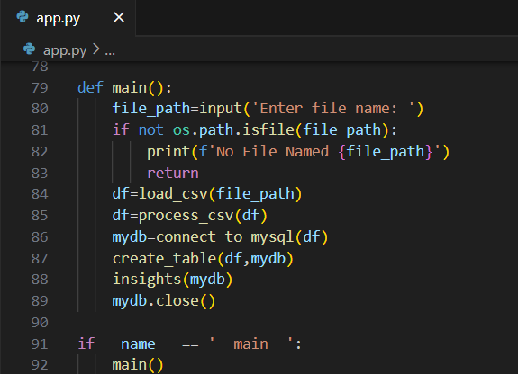
Main Python Code
app.py

Slide 7
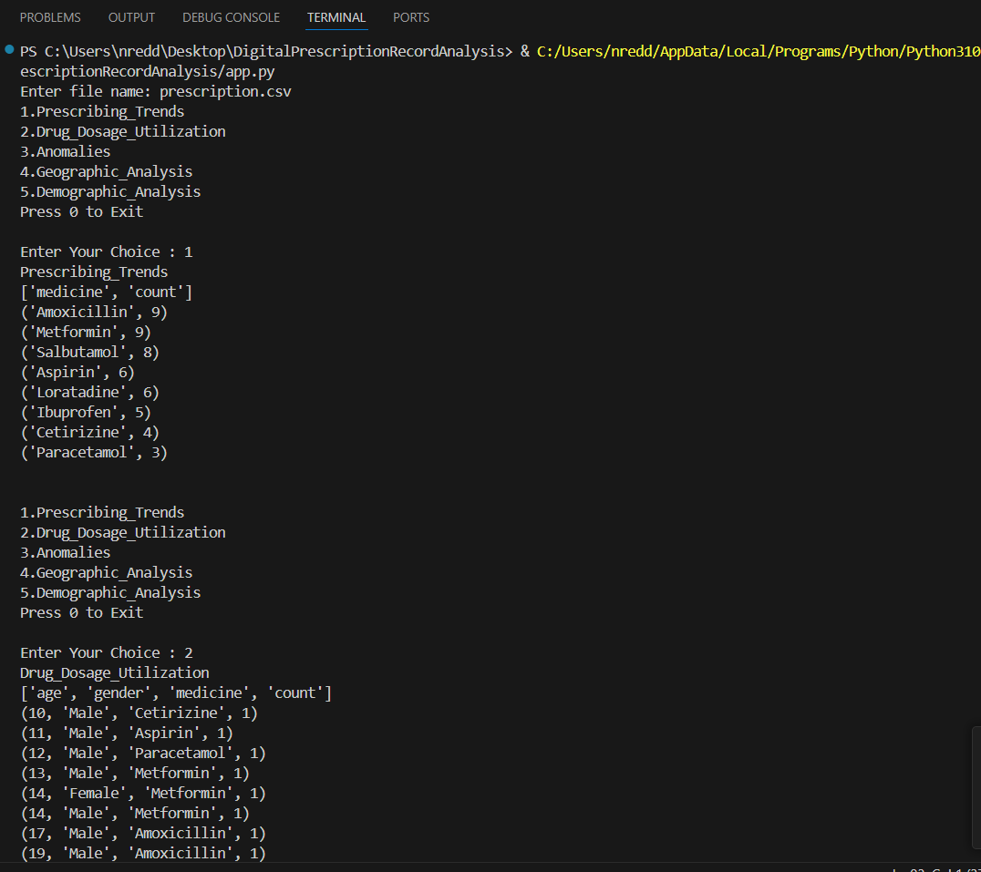
Output Reports
CSV reports are saved in the 'reports/' directory.

Slide 8
Conclusion
Uncovered prescription trends to observe changes over time and peak illness periods.
Mapped medicine usage across various age groups and genders.
Detected suspicious prescription behavior through anomaly detection techniques.
Integrated location-based insights to understand regional drug demands.

